Slide 1


DOMYOS
Campaign Impact
Alma-Duc
Elie-Eswar

Slide 2


OUR
ACHIEVEMENT
Net Profit
15.62 K €
From budget= 30K €
Total sales
  361.46 K €
Profitability
Target population
New GenZ population
  635

Slide 3

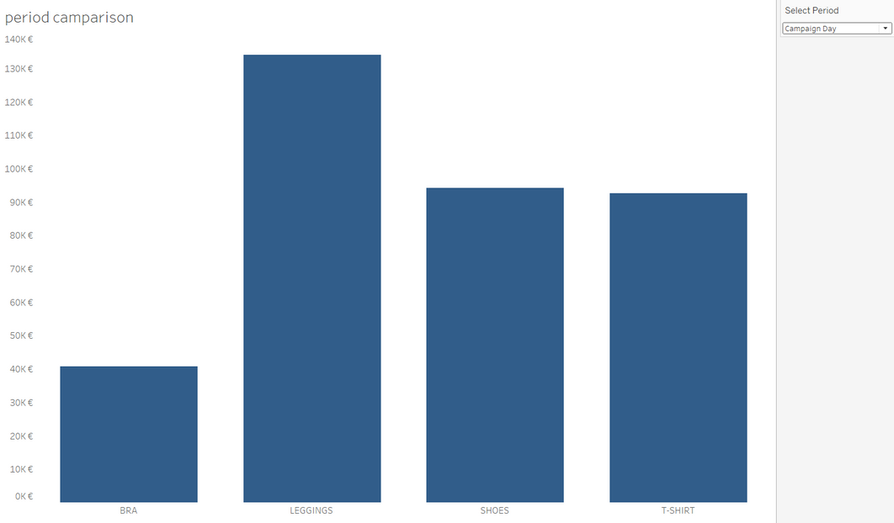
ABOUT
CAMPAIGN DAY
September 4th, 2020
Fitness influencer: Sissy.M
(1.3M followers)
Instagram live
4 products: t-shirt, bra, leggings, shoes
TOTAL SALES
  361.46 K €
TOTAL QUANTITY
  7.70 K

Slide 4
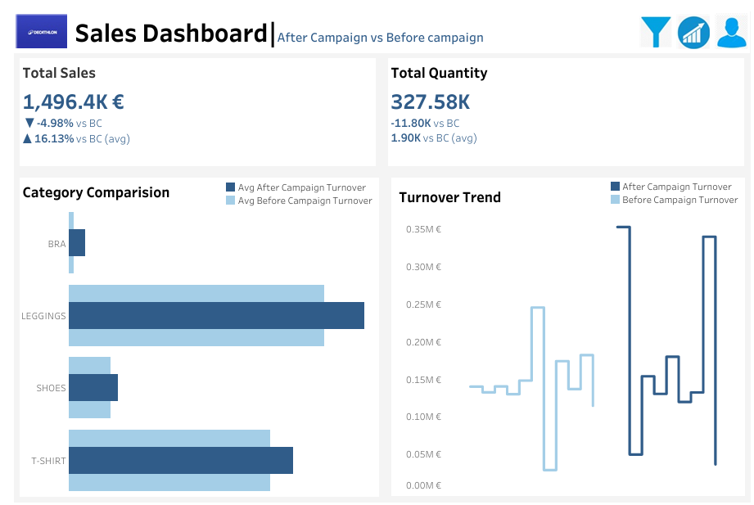
FINANCIAL KPI

Slide 5
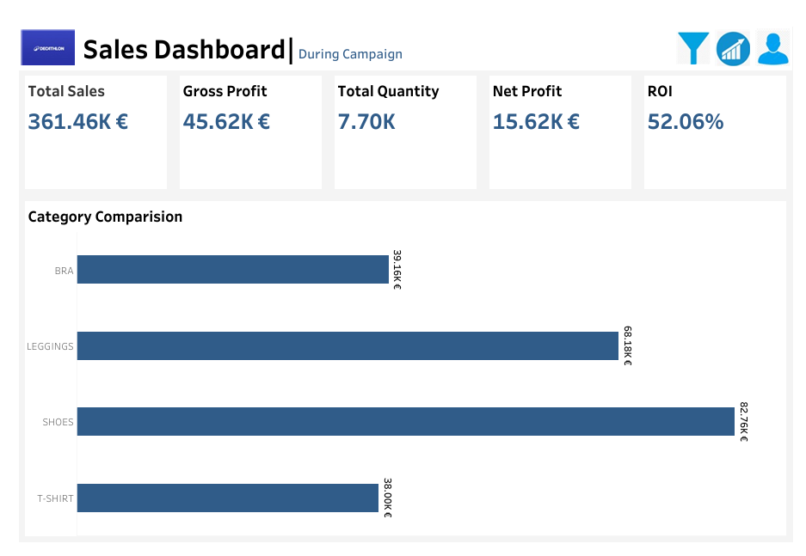
DURING CAMPAIGN DAY

Slide 6
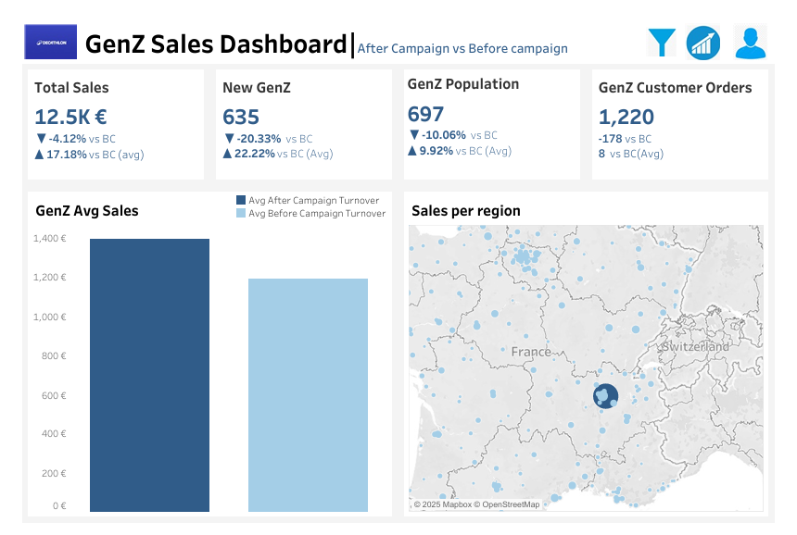
TARGET POPULATION

Slide 7

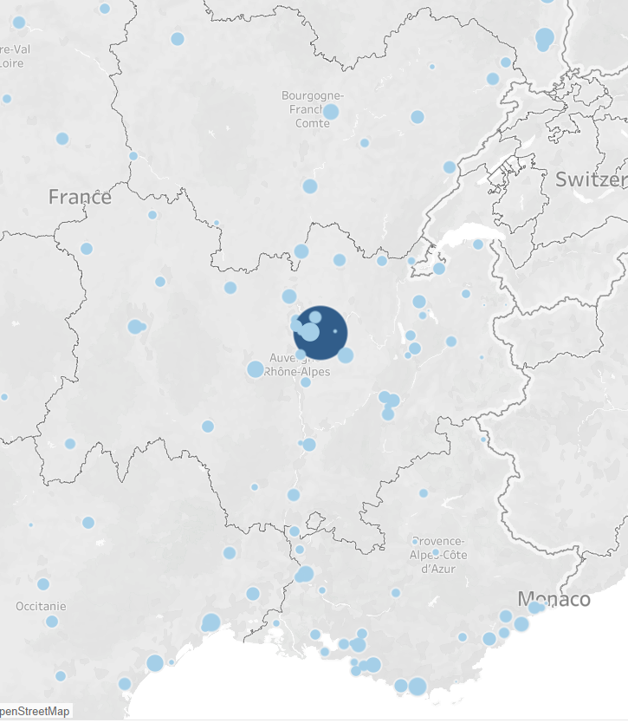

REGIONAL
INSIGHT
Top Performing Commune
Genas
Auvergne-Rhône-Alpes
The data highlights a major sales hotspot in Genas, east of Lyon.
Insight
This increase in demand may help Decathlon identify a few locations where we can run localized campaigns for the 4 products in the future.

Slide 8
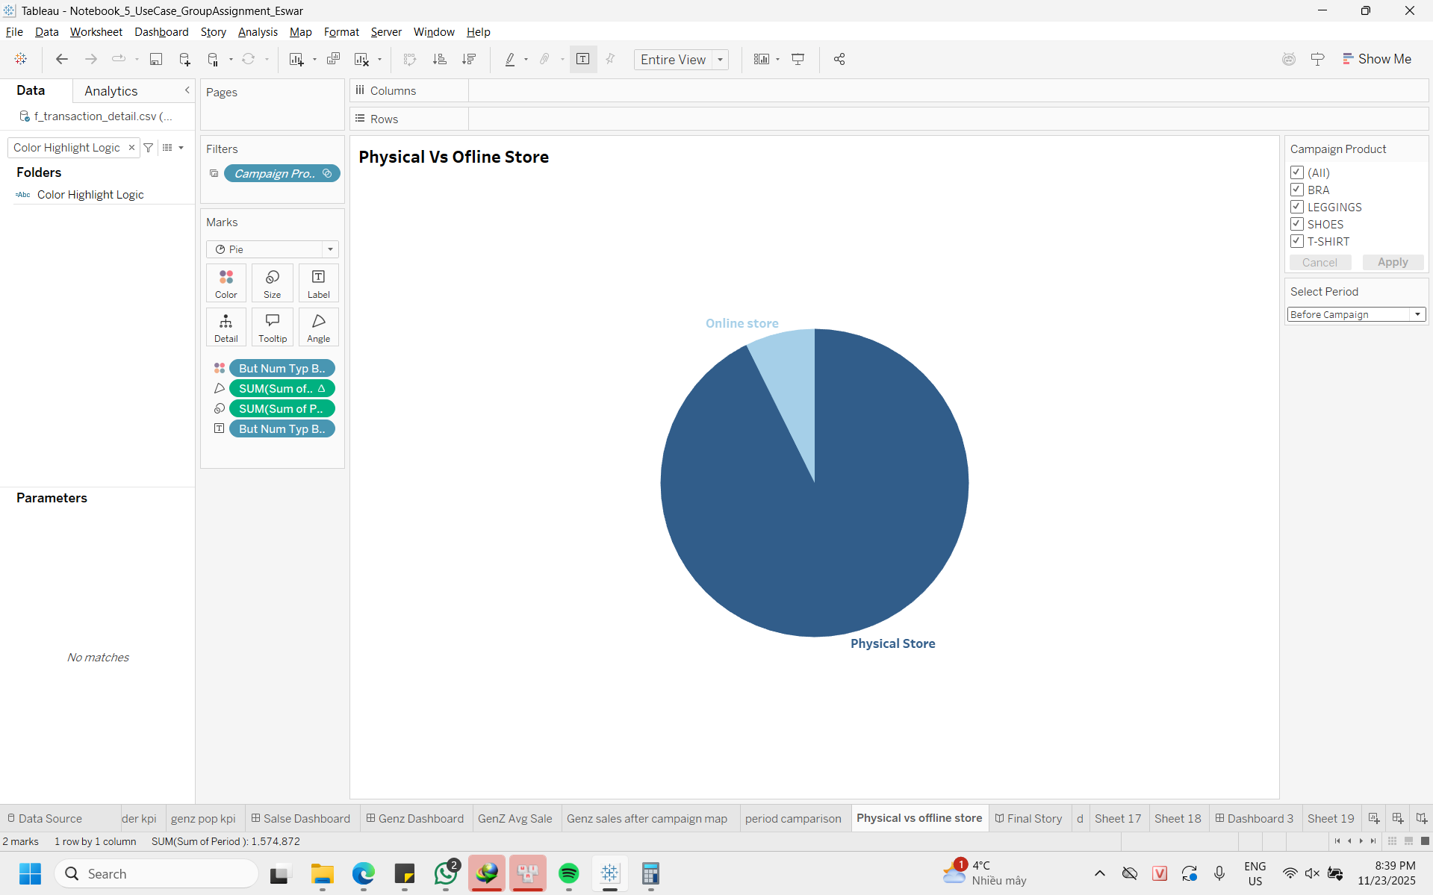
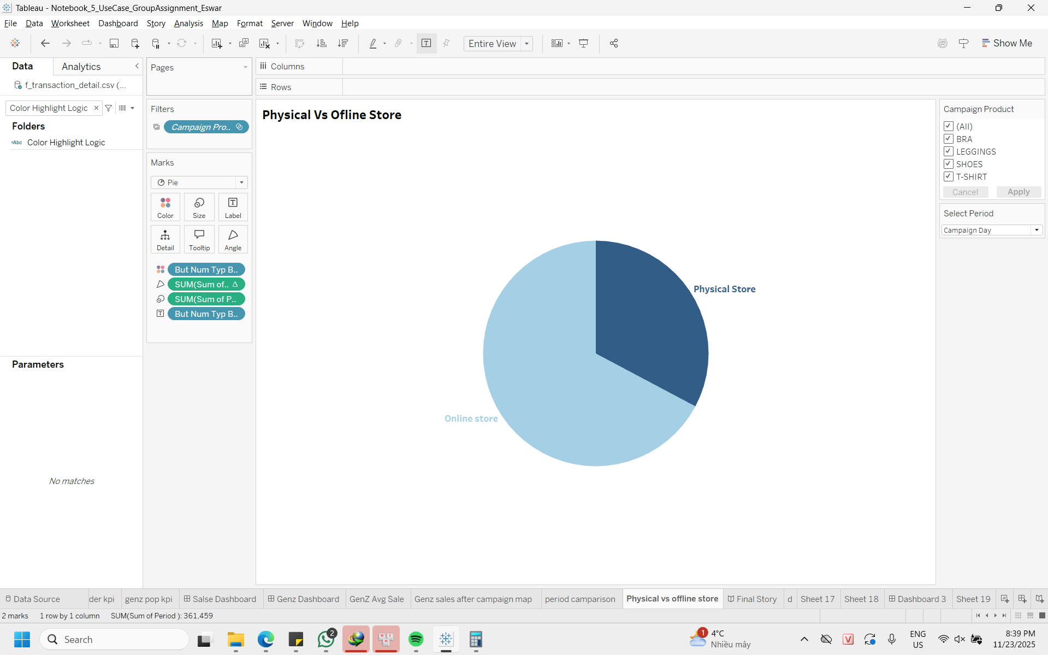
SALE CHANNEL
INSIGHT
From Offline to Online
Before the campaign, sales were overwhelmingly dominated by physical stores.
During the event, the Online Store share grew to ~40% of the total mix.
Before
Insight
This validates the strategy of using livestream influencers to drive immediate, direct-to-web traffic.
During

Slide 9
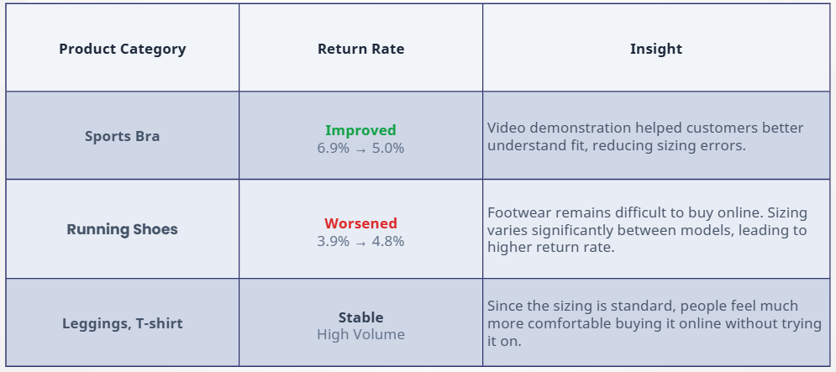
PRODUCTS
INSIGHT

Slide 10

  Performance remained above average
  Campaign improved purchase value per customer (GenZ average spending increased)
  Need more time to measure full impact
CONCLUSION
&
RECOMMENDATIONS
Consider more measures to:
  Focus more on GenZ clients
  Increase sales in other regions in France
  Increase sales for the 3 other product categories

Slide 11


THANK YOU !
ANY QUESTIONS?

