Slide 1




PREDICTIVE MODEL
FOR
DSC DONOR’S
RE-ACTIVATION CAMPAIGN
Aarsi Poddar
Eswar Karthikeyan
Selima Medhioub

Slide 2

INTRODUCTION
Non-profits often struggle to re-engage inactive donors.
DSC aims to improve its reactivation campaign by focusing only on donors most likely to respond.
A predictive model can help target the right people, reduce costs, and increase campaign impact.

Slide 3





TARGET DEFINITION
Goal: Re-activate inactive donors through targeted mail campaigns
Campaign Economics: €0.80 per letter cost
Focus: Donors contributing ≥€30 for meaningful impact
Approach: Random selection with 1.8% baseline response rate

Slide 4
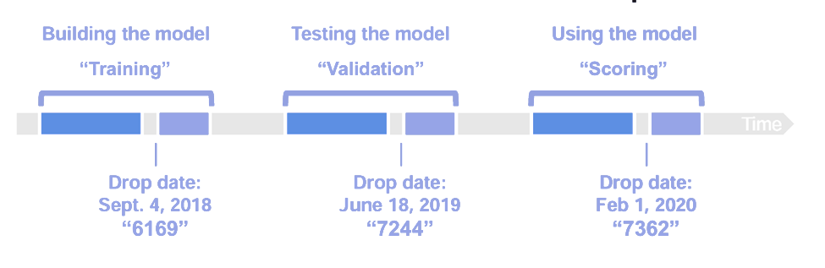
TIMELINE
⟶ 1900 days back = 5+ years of donor history (recency, frequency, amounts
⟶ 1 day gap = Campaign date (decision point)
⟶ 250 days forward = Prediction window (did they donate ≥€30?)

Slide 5
XGBOOST: OUR CHOSEN MODEL
XGBoost ✓
0.80
AUC Score
23% Better Performance
Gradient Boosting
0.65
AUC Score

Slide 6
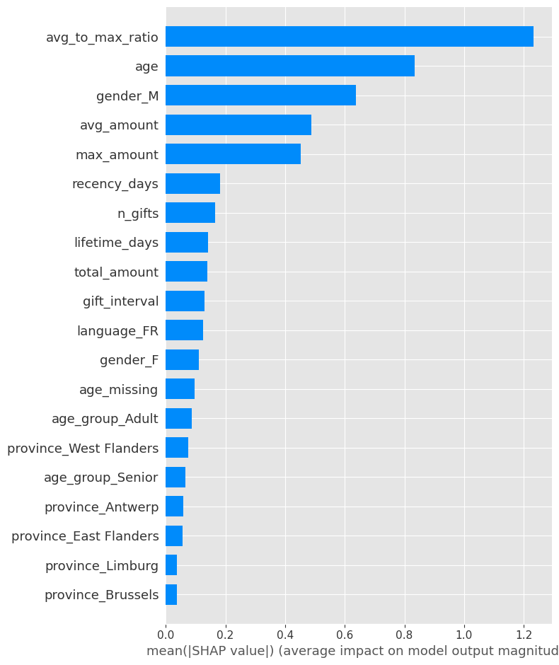
KEY PREDICTION DRIVERS
Donation consistency
Age
Gender
Average donation amount by donor
Maximum donation by donor

Slide 7

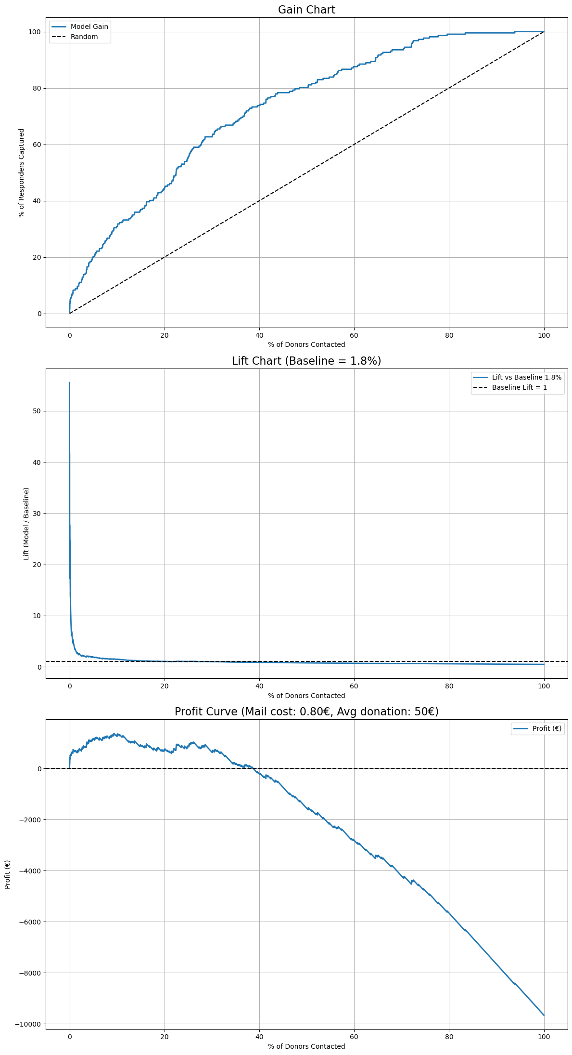
CUMULATIVE GAIN ANALYSIS
Top 10% captures - 35–40% of responders
Much higher than random (10%)

Slide 8

LIFT OVER BASELINE
Top 10% donors
1.46×
more likely to respond than
baseline response rate

Slide 9
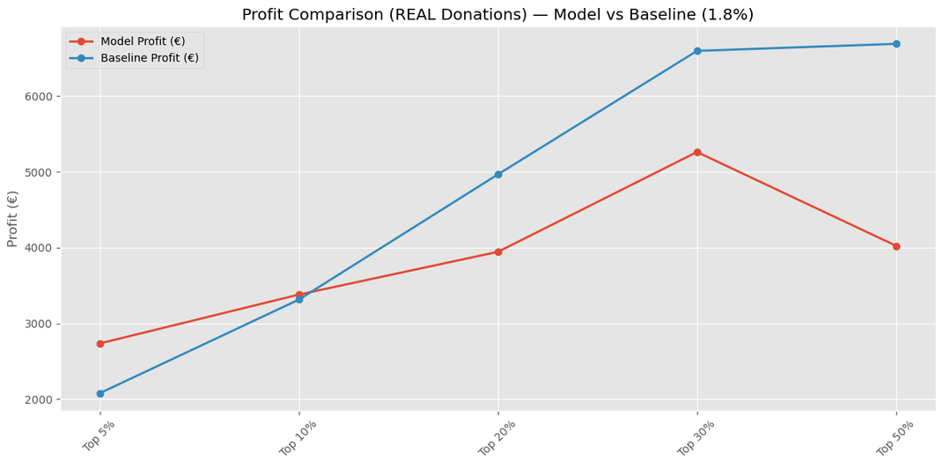
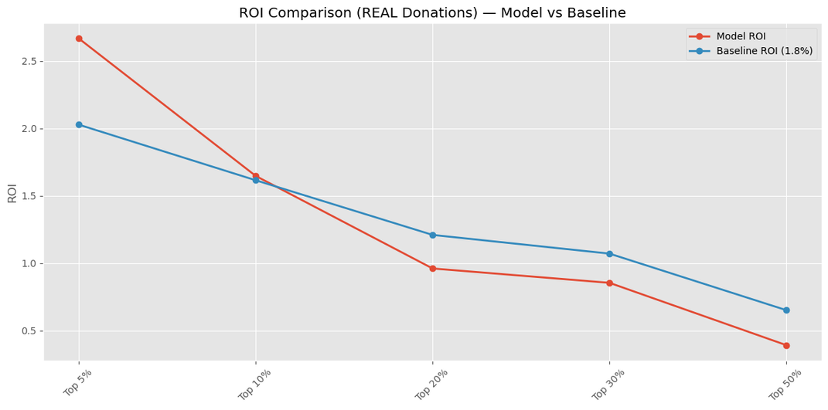
PROFIT & ROI ANALYSIS
€3380.8
Peak Profit at Top 10%
2.65
ROI at Top 10%

Slide 10
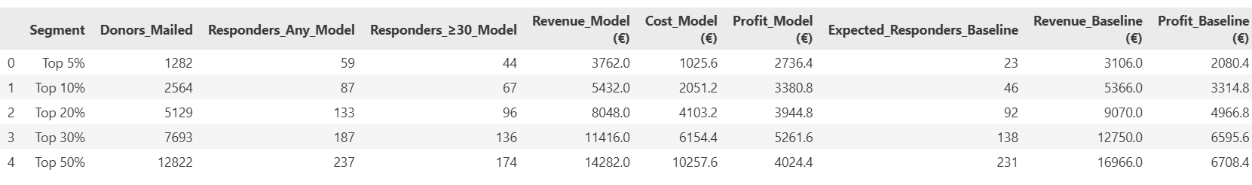
WHY TARGET TOP 10%?
– The model predicts more responders than the 1.8% baseline.
– Even though the baseline appears to generate more revenue in a hypothetical scenario.
– It relies on knowing future donations - which is impossible.

Slide 11
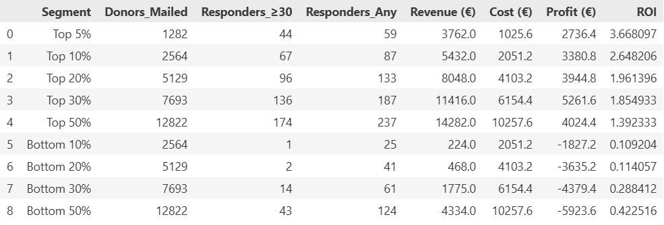
WHY TARGET TOP 10%?
Highest ROI (2.65)
Strong profit (€3,381)
67 responders captured

Slide 12
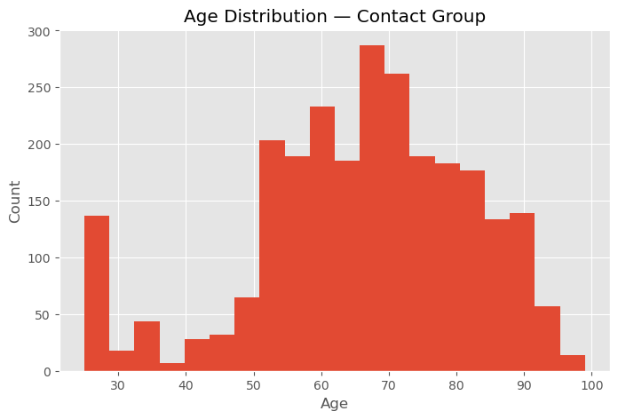
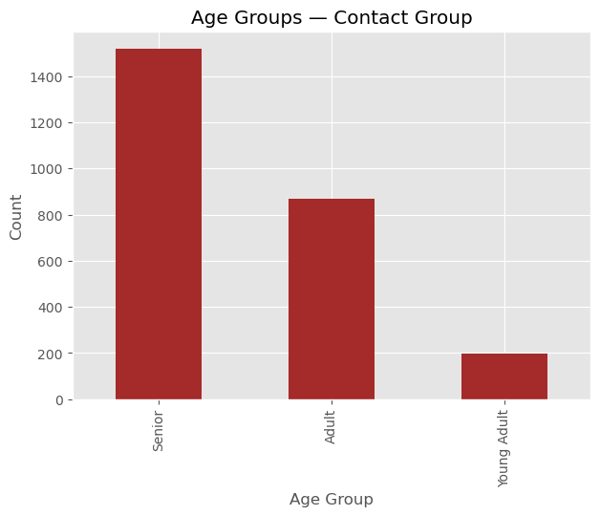
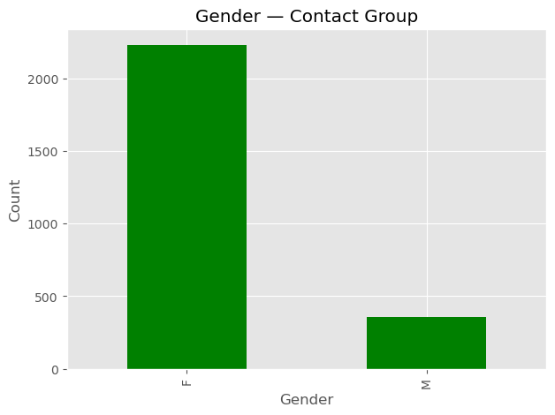
WHO ARE OUR TARGETED DONORS?
Seniors and Adults have higher probability to donate
Female donors → Higher donation likelihood than male donors

Slide 13
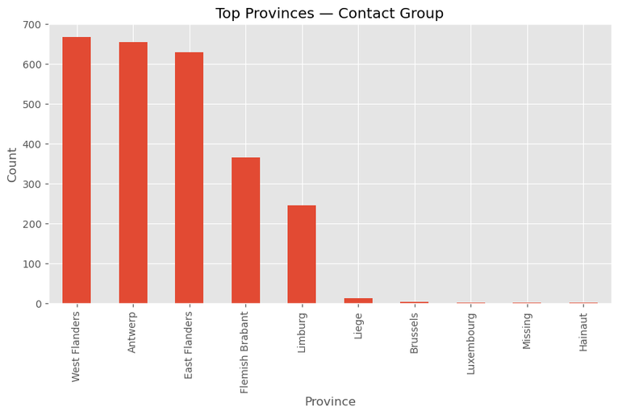
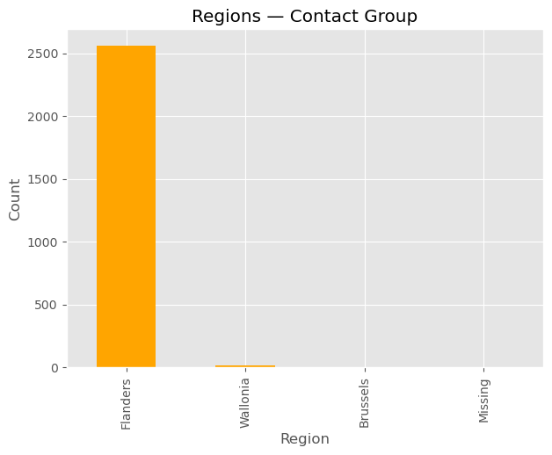
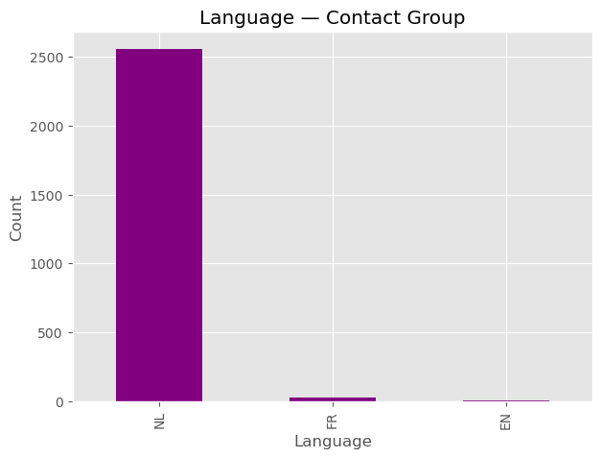
GEOGRAPHIC DISTRIBUTION
West Flanders ,Antwerp ,East Flanders show the highest number of potential responders
Dutch NL speakers → Higher predicted donation probability

Slide 14
KEY FINDINGS
The model clearly outperforms random targeting.
High predictive accuracy with a Test AUC in the high 0.80s.
Behavioral donation patterns are the strongest predictors.
The Top 10% of donors captures 35–40% of all responders.
Only the Top 5–10% segments generate higher profit than the baseline.
Mailing more than 20% becomes unprofitable when compared to baseline.

Slide 15
RECOMMENDATION
Focus mailings on the Top 10%
best ROI and highest response rate
Avoid mailing beyond 20%
as additional letters do not generate enough revenue compared to baseline
Adopt this model
as the targeting engine for top 10% population for all future re-activation campaigns
Retrain periodically
to maintain performance as donor behaviour evolves

Slide 16
Thank You

