Slide 1
COMP 8700 : INTRODUCTION TO ARTIFICIAL INTELLIGENCE
PROJECT PRESENTATION
CORRELATIONAL ANALYSIS OF WEATHER AND POPULATION ON CROP PRODUCTION
ESWARAN BADRINARAYANAN VENKATESWARAN
JANANI SURESH KUMAR
ZANNATUL FERDOUSH
Date : 04/13/2022 Term: Winter 2022

Slide 2
INTRODUCTION
Nature has seen a dramatic change in weather conditions and population in recent years and the field of agriculture has been drastically impacted as a result.
Agriculture is critical to every country's economic development. With the current population's growth, frequent fluctuations in climatic conditions, and limited resources, meeting the current population's food needs has become a difficult issue.[2]
By the end of 2050, the world's population will have increased by nearly 34% to 9.1 billion.[6]

Slide 3
PROBLEM STATEMENT
Although cutting-edge technologies and modern developments in precision agriculture show a positive trend there has always been a degree of uncertainty in understanding behavioral patterns of crop produce.
Our project involves a correlational analysis of environmental factors and the trend in which affect crop production (food production industry) in Canada.
We focus on particular category under food industry and observe the data across a period span of 20 years eg; 2002-2021 to understand the pattern growth of the selected crops - fruits and vegetables

Slide 4
IMPORTANCE AND OBJECTIVES
Determine prevalence and relationships among variables, and to forecast events from current data and knowledge.
Correlational analysis can be applied in agricultural research where researchers can effectively establish dependencies and identify potential mismatches between supply and demand [3].
The goal of our project is to evaluate importance of key metrics in each of considered correlational variables that can affect crop production, thereby providing valuable insights for future analytical study.[4]

Slide 5
LITERATURE REVIEW
[1] Monteith, J. L. (1977). Climate and the efficiency of crop production in Britain. Philosophical Transactions of the Royal Society of London. B, Biological Sciences, 281(980), 277-294.
The efficiency of crop production is defined in thermodynamic terms as the ratio of energy output (carbohydrate) to energy input (solar radiation).
Temperature and water supply are the main climatic constraints on efficiency.
[2] Evangelista, J. C., Escalona, J. A. S., & Pigao, K. (2022). The Correlational Analysis between the Industrial Sector and Agriculture Sector towards Economic Development. Journal of Economics, Finance and Accounting Studies, 4(2), 44-54.
- Pearson coefficient and multiple regression model were used to identify relationship between Manufacturing-Agriculture and Construction-Agriculture Industry.

Slide 6
CHALLENGES
Dataset identification and cleansing
Selection and comparison between regression models was time consuming
Precision in framing correlational relationships between variables

Slide 7
METHODOLOGY
Our model works in three stages
In the first phase
- Collects different crop production, weather and population data of Ontario between 2002 - 2019
- Preprocesses and cleans data
In the second phase
- Performs correlational analysis to better understand the statistical relationships between the input variables and the output variable
- This will help to identify which variables may or may not be relevant as input for developing a model
7

Slide 8
METHODOLOGY
In the third phase
Employs four popular regression models
Linear Regression​
Decision Tree Regressor​
K Neighbor Regressor​
Support Vector Regressor
to predict the production of Apple and Asparagus based on weather and population variables
- Identifies most important input variables by calculating feature importance
8

Slide 9
EVALUATION
All the collected data is open-source and available at Statistics Canada [6]
All experiments were conducted on a machine with
- 64-bit Windows 10
- Intel Core i7 CPU
- 16 GB RAM
- Python programming language
9

Slide 10
CORRELATIONAL ANALYSIS
Correlational analysis is a numerical measure to calculate a statistical relationship between two variables
Can be useful in data analysis and modeling to better understand the relationships between variables
Three types of correlations are found
Positive correlation indicates that two variables will move in the same direction
Negative correlation is a relationship between two variables in which the increase in one variable leads to a decrease in the other
No correlation shows that the data plots are completely random and do not show any sign of correlation
10

Slide 11
CORRELATIONAL ANALYSIS
Correlation coefficient is a statistical measure that quantifies the relationship between two variables
Popular method to calculate coefficient is
Pearson’s correlation coefficient: a test to measure the strength of a linear relation between two normally distributed variables
Size of Correlation | Interpretation
.90 - 1.00 | Very high positive correlation
.70 - .90 | High positive correlation
.50 - .70 | Moderate positive correlation
.30 - .50 | Low positive correlation
.00 - .30 | Negligible correlation
11

Slide 12
CORRELATION COEFFICIENT VALUES
Apple Production
Pearson correlational coefficient (Population) | 0.875
Pearson correlational coefficient (Annual Rainfall) | 0.923
Pearson correlational coefficient (Annual Snowfall) | 0.320
Pearson correlational coefficient (Mean temperature) | 0.413
Asparagus Production
Pearson correlational coefficient (Population) | 0.855
Pearson correlational coefficient (Annual Rainfall) | 0.830
Pearson correlational coefficient (Annual Snowfall) | 0.255
Pearson correlational coefficient (Mean temperature) | 0.369
12

Slide 13
DATA PREPROCESSING
Data cleaning is the process of identifying and correcting errors in a dataset that may have a negative impact on the model. Data cleaning involves cleaning the null values and outliers from the dataset. The following steps are performed in cleaning the dataset. ​
Replace null values by mean​
Removed outliers​
Checked Skewness

Slide 14
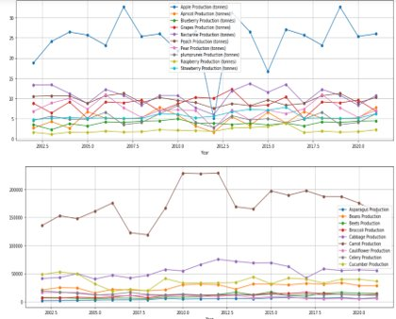
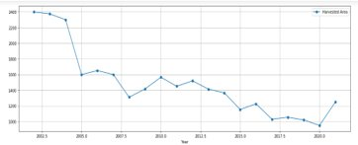
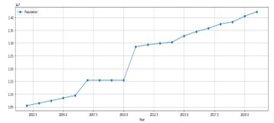
DATA VISUALIZATION
Fig 2. Crop harvest area over years
Fig 1. Fruits and Vegetables production over years​
Fig 3. Population over years

Slide 15
TRAINING AND TESTING DATA
The dataset is divided into two groups for training and testing data​
70% - Training Data​
30% - Testing Data​
Input factors: Weather and Population​
Output: Apple and carrot production​
Model Used - Regression​

Slide 16
REGRESSION ALGORITHMS
Linear Regression​
Decision Tree Regressor​
K Neighbor Regressor​
Support Vector Regressor​

Slide 17
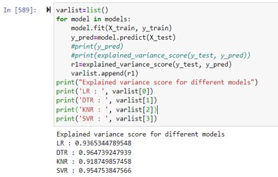
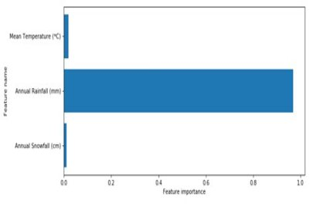
FEATURE IMPORTANCE
Fig 4. Variance Score Calculation
Fig 5. Feature Importance

Slide 18
CONCLUSION & FUTURE WORK
In conclusion,
- Regression models were trained and tested and correlational analysis was performed on crop production.
Important features of weather and population impacting crop production were identified.
In future,
- Correlation between multiple variables on multiple metrics can be studied effectively and meaningful relationships can be derived.

Slide 19
REFERENCES
[1] Sharma, A. Jain, P. Gupta and V. Chowdary, "Machine Learning Applications for Precision Agriculture: A Comprehensive Review," in IEEE Access, vol. 9, pp. 4843-4873, 2021, doi: 10.1109/ACCESS.2020.3048415.
[2] Climate change impacts on agriculture - agriculture.canada.ca. (2020, January 31). Agriculture Canada. https://agriculture.canada.ca/en/agriculture-and-environment/climate-change-and-air-quality/climate-scenarios-agriculture
[3] Prematunga, R. K. (2012). Correlational analysis. Australian Critical Care, 25(3), 195-199.
[4] Curtis, E. A., Comiskey, C., & Dempsey, O. (2016). Importance and use of correlational research. Nurse researcher, 23(6).
[5] Krishna Kumar, K., Rupa Kumar, K., Ashrit, R. G., Deshpande, N. R., & Hansen, J. W. (2004). Climate impacts on Indian agriculture. International Journal of Climatology: A Journal of the Royal Meteorological Society, 24(11), 1375-1393.
[6] https://www.statcan.gc.ca/en/

