Slide 1

Assignment 3
Game Playing
CS24M109 - Pashaula Eswar Sai
CS24M123 - Gooty Bharadwaj

Slide 2

Minimax and AlphaBeta Pruning on Chess
Mini-Max
Alpha-Beta

Slide 3
Evaluation Function
The evaluation function is a heuristic scoring system that assigns a numerical value to a given chess board position. The evaluation is from White’s perspective: a positive score favors White, a negative one favors Black.
Key Components of Evaluation Function | Description
Checkmate & Game Over Handling | - Returns ±∞ if the board is in checkmate (positive for White win, negative for Black win). - Returns 0 if the game is drawn or otherwise over.
Material Score | Each Piece has a base value. White pieces add to the score and Black’s subtract
Piece-Square Tables | Each piece type uses a 64-square positional table to reflect optimal placement. Scaled by 0.1 to balance with material score.
Mobility | White get +0.01 per legal move; black gets -0.01.

Slide 4
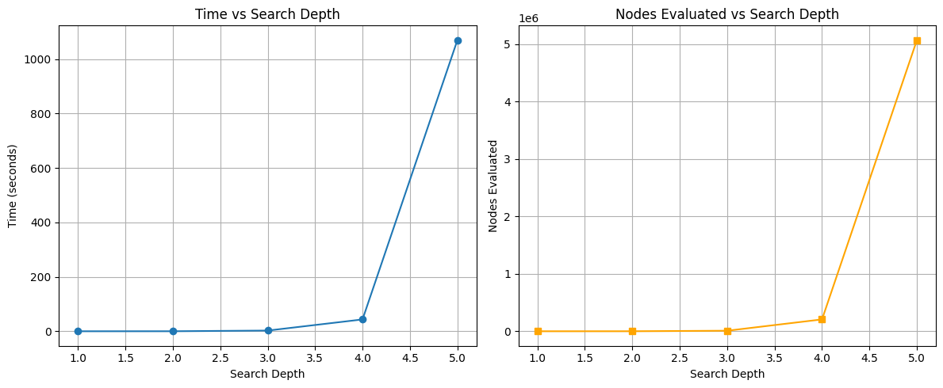
Plots for MiniMax

Slide 5
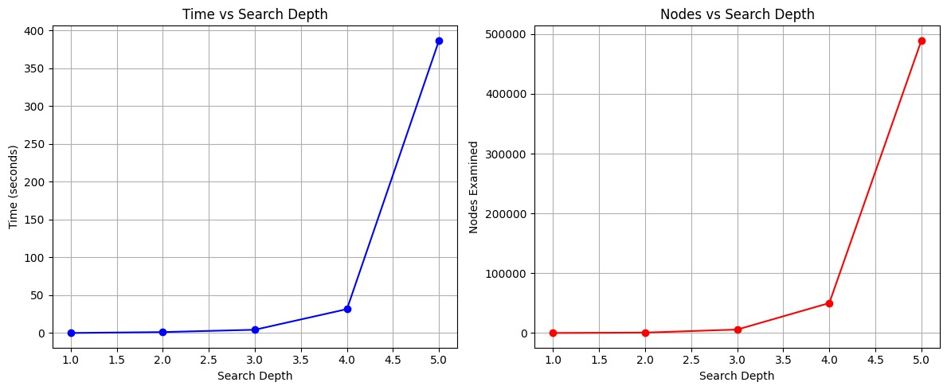
Plots for AlphaBeta Pruning

Slide 6
Results Analysis
Key Observations:
Minimax evaluates all possible nodes → leads to exponential growth in time and nodes.
Alpha-Beta Pruning skips irrelevant branches, drastically reducing node evaluations and runtime at deeper levels.
Why Alpha-Beta Outperforms:
Pruning: Alpha-Beta reduces effective branching factor from O(b^d) to O(b^(d/2)) in best cases.
Lower Nodes: At depth 5, Alpha-Beta evaluates ~10× fewer nodes than Minimax.
Faster at Deeper Levels: Despite higher overhead at shallow depths, pruning benefits dominate from depth 3 onward.
Conclusion:
Alpha-Beta Pruning is significantly more efficient for deeper searches in complex games like chess.
Move ordering can further improve pruning effectiveness.

