Slide 1
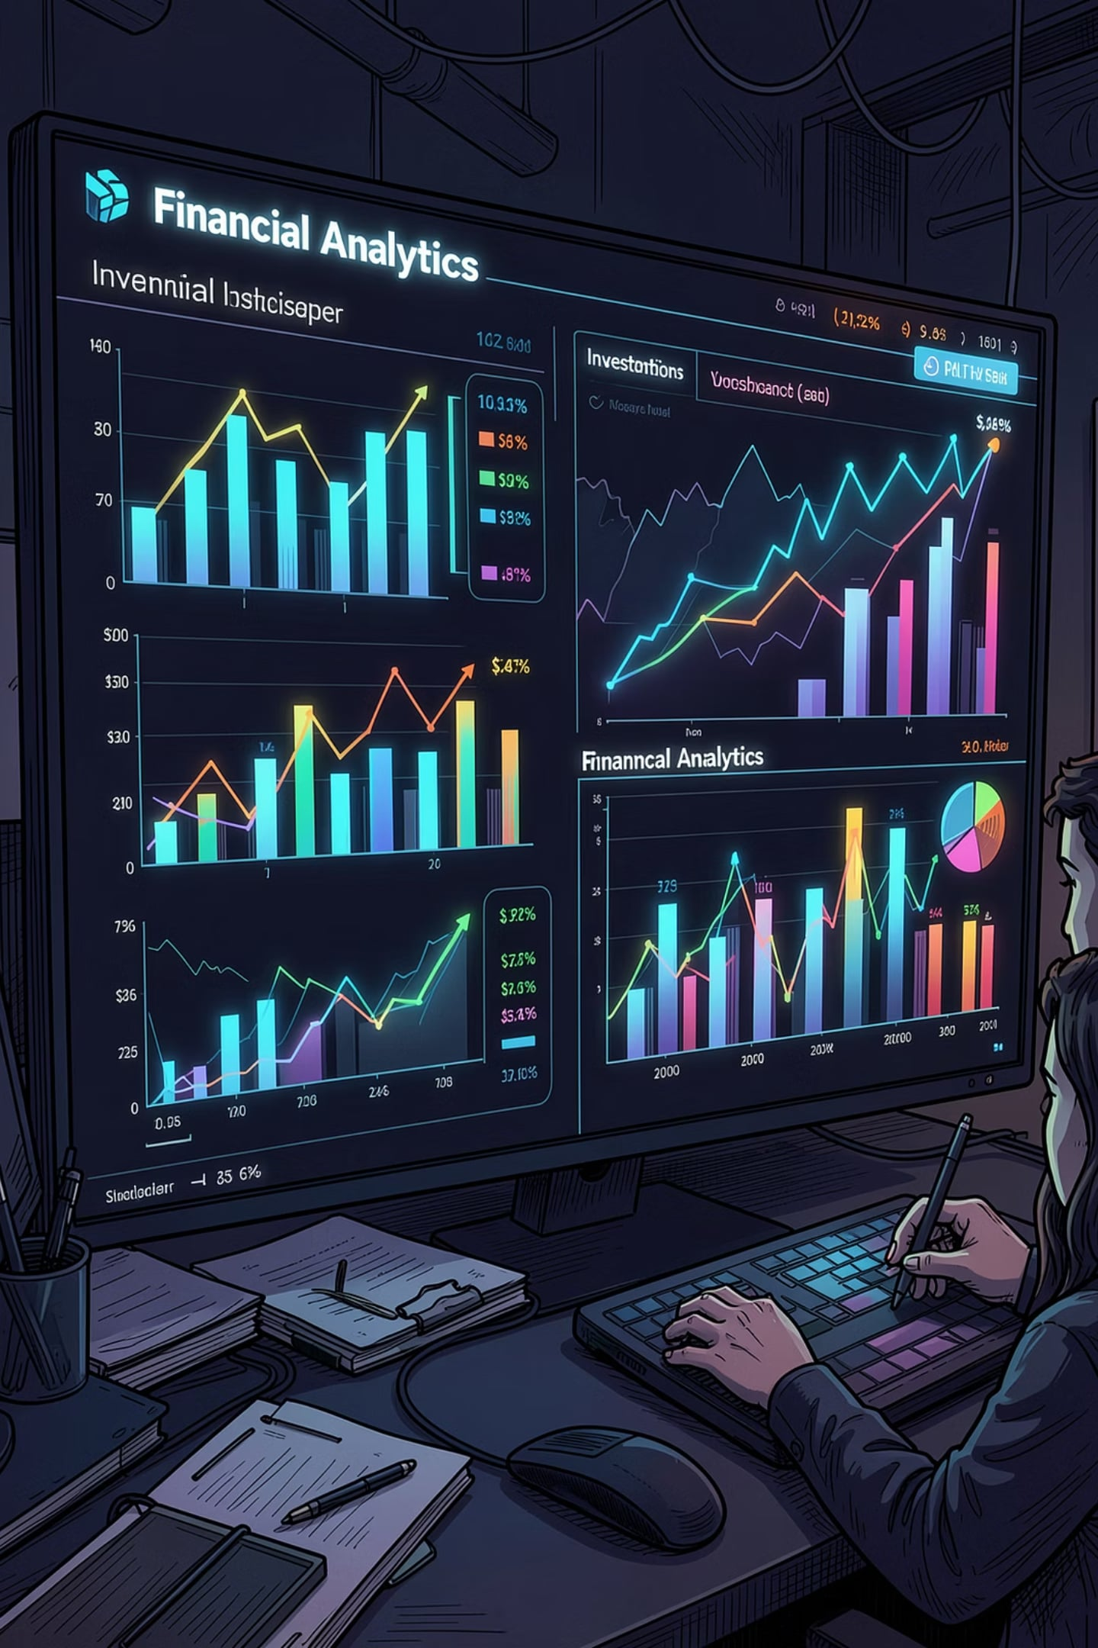
Mutual Fund Performance Analytics and Risk Assessment
Using Python & SQLite
Eswar Vardhan

Slide 2
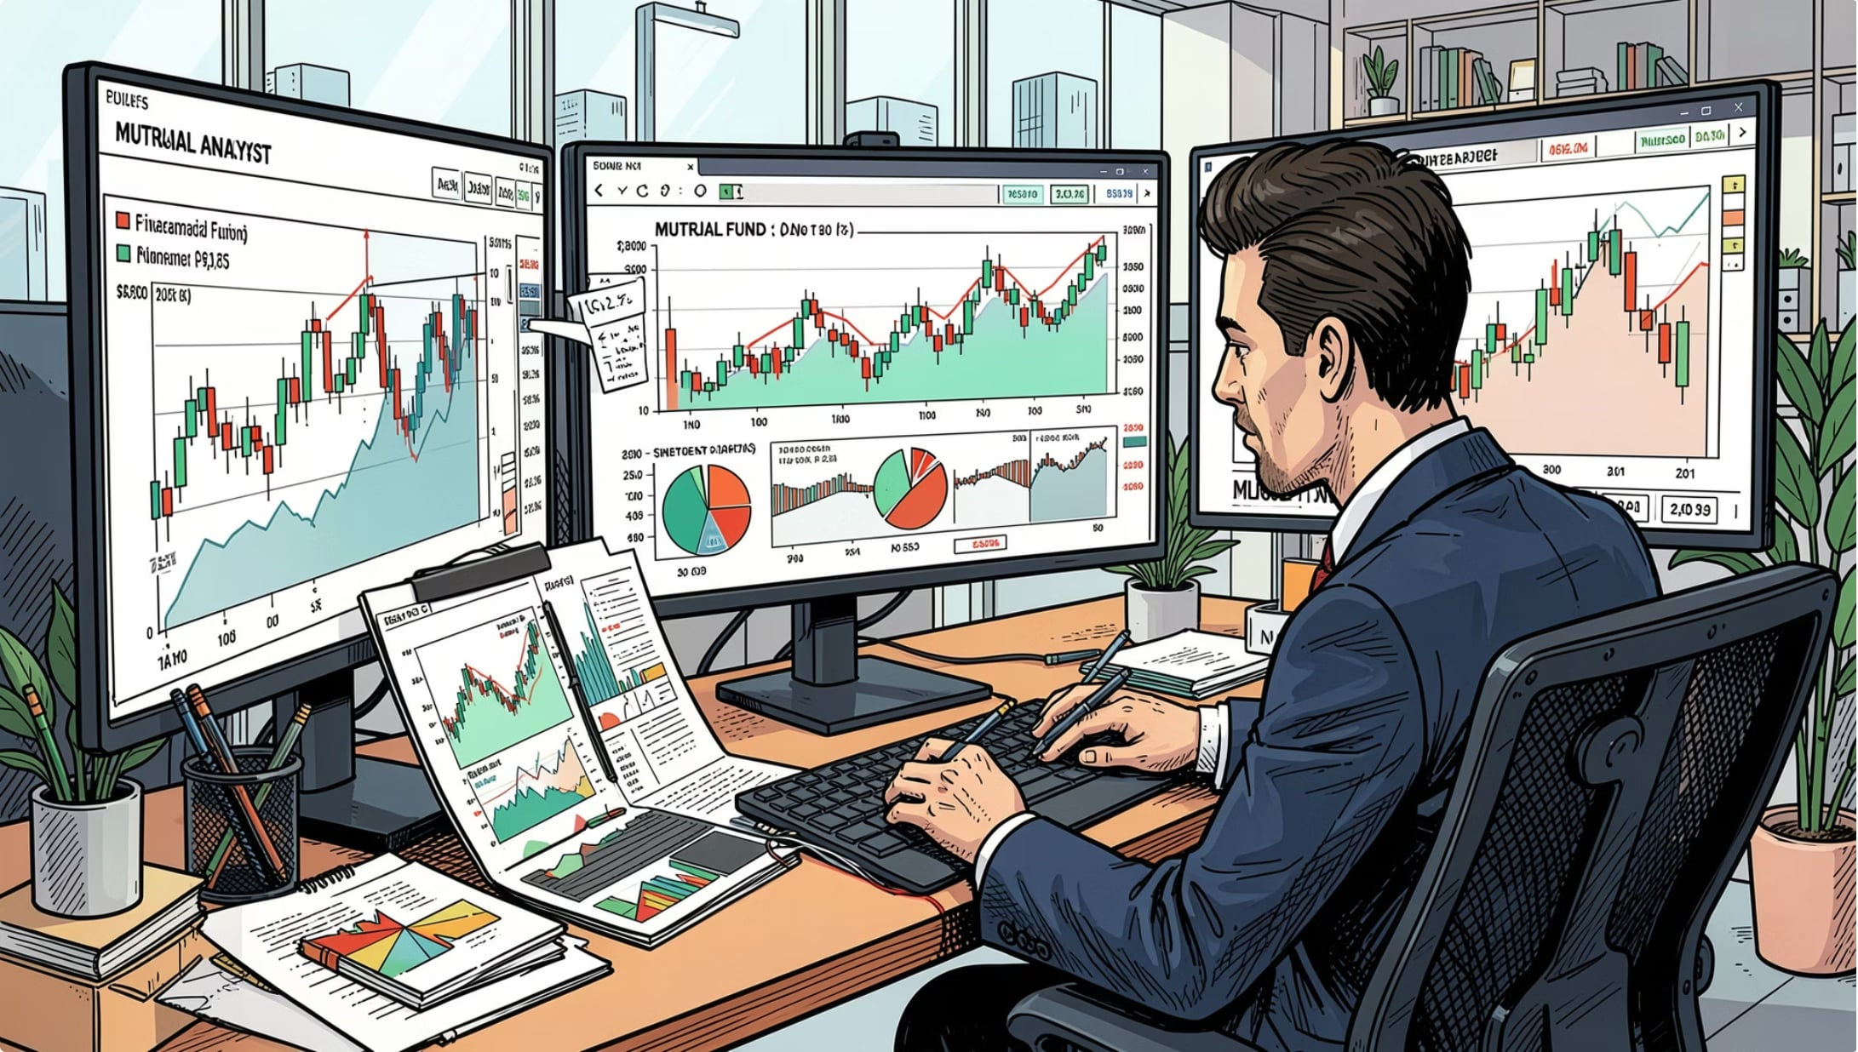
PROJECT OVERVIEW
What This Project Does
Objectives
Analyze mutual fund performance using historical NAV data
Evaluate risk through Sharpe, Sortino, Alpha, and Maximum Drawdown
Build a cleaned, structured analytical database
Generate actionable investment insights via Python
Dataset at a Glance
40 mutual fund schemes across categories
46,000 NAV records
32,778 investor transactions
Portfolio holdings, benchmark indices, and AUM data

Slide 3
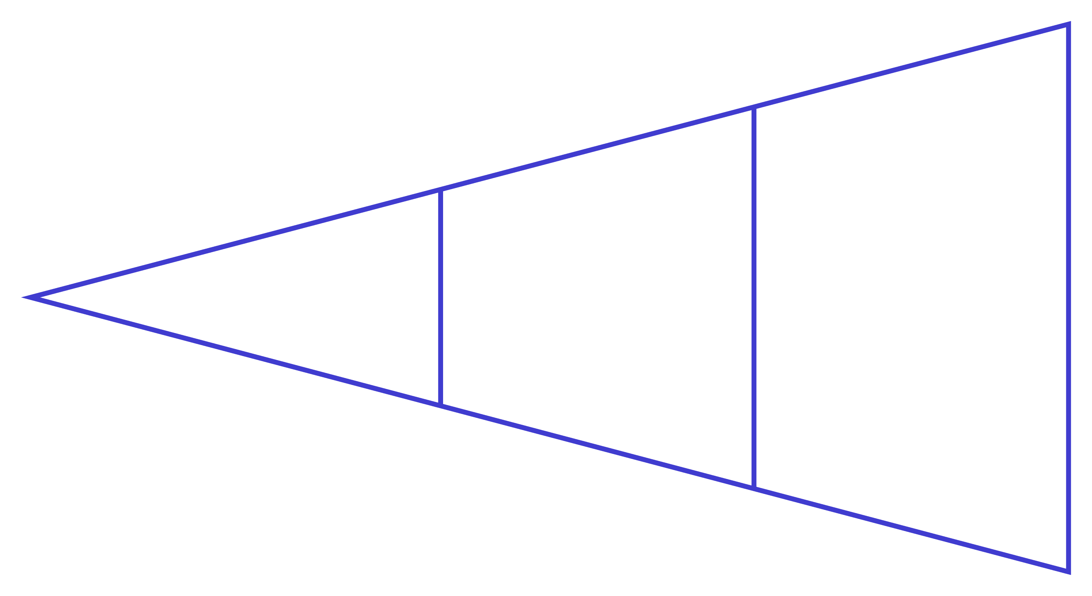
ARCHITECTURE
Project Architecture
Raw CSV
Risk Reports
Processed CSV
A structured end-to-end pipeline transforms raw fund data into validated, queryable datasets and ultimately into risk metrics and investment reports.

Slide 4
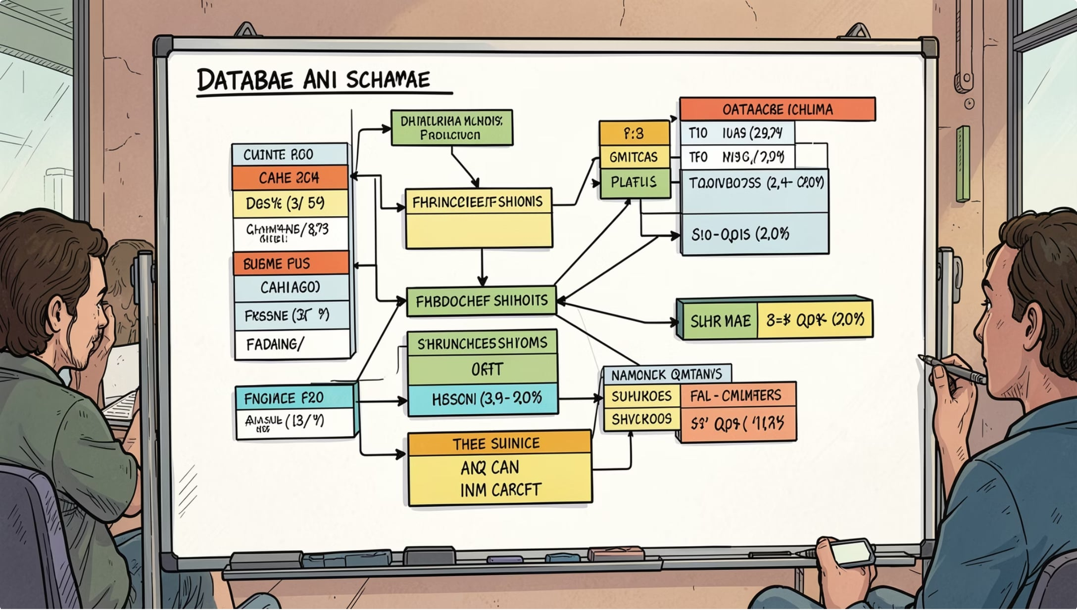
DATA PREPARATION
Data Cleaning & Database Design
Data Cleaning
Removed duplicate records
Standardized transaction types
Formatted dates consistently
Validated missing values, expense ratios, and NAV entries
SQLite Schema
Fact Tables: fact_nav, fact_transactions, fact_performance, fact_aum
Dimension Tables: dim_fund, dim_date

Slide 5
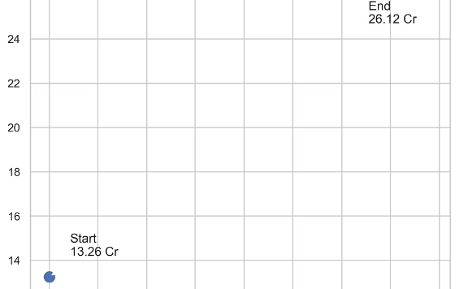

EXPLORATORY DATA ANALYSIS
Industry Growth Overview
These charts provide an overview of industry growth before advanced analytics.
Portfolio Growth
Age Group Distribution
Gender Distribution
State SIP Distribution

Slide 6
RISK ANALYTICS
Risk Metrics Computed
Daily Returns
CAGR
Day-over-day NAV change
Compounded annual growth rate
Sharpe Ratio
Sortino Ratio
Risk-adjusted return vs. risk-free rate
Downside deviation-adjusted returns
Alpha & Beta
Maximum Drawdown
Benchmark outperformance & market sensitivity
Largest peak-to-trough decline

Slide 7
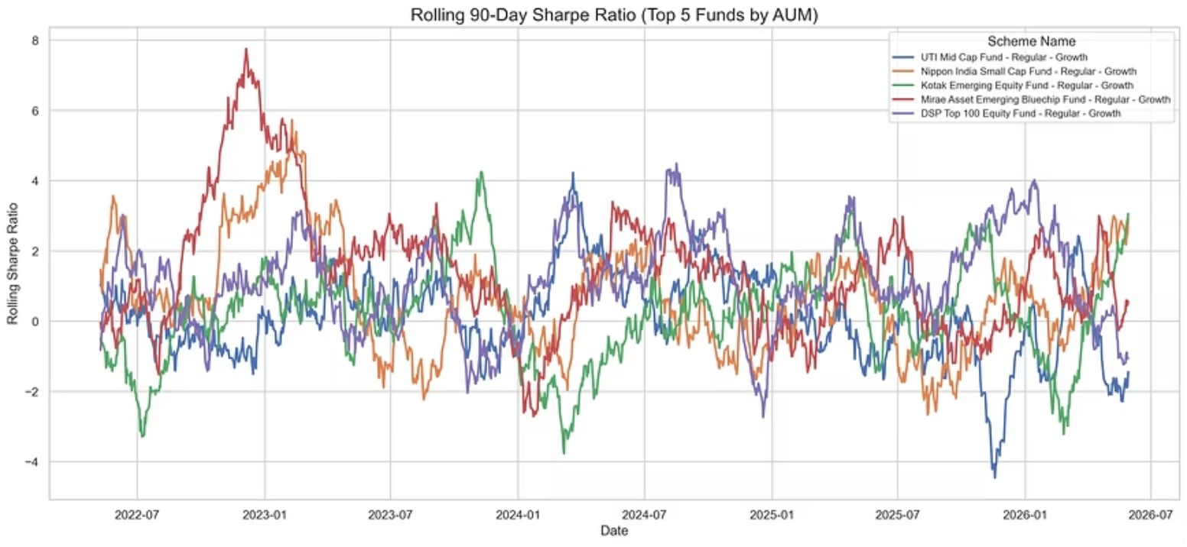
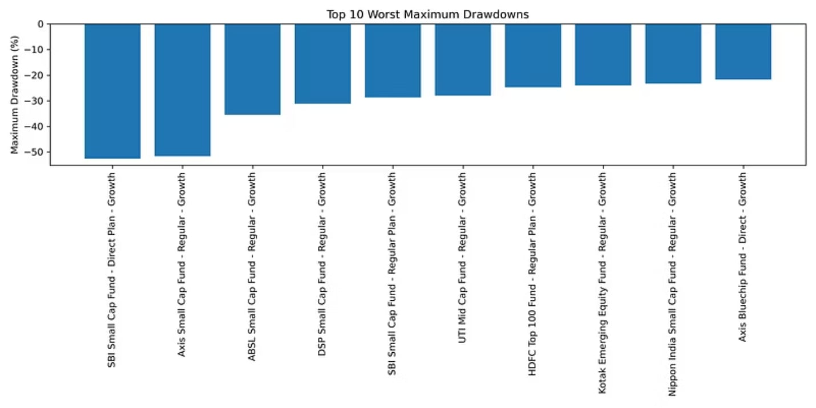
RISK ANALYSIS RESULTS
Risk Metrics: Top Performers
The rolling Sharpe chart highlights funds with the strongest risk-adjusted returns over time, while the maximum drawdown chart identifies which schemes experienced the smallest peak-to-trough losses — both critical for evaluating downside protection and consistency.

Slide 8
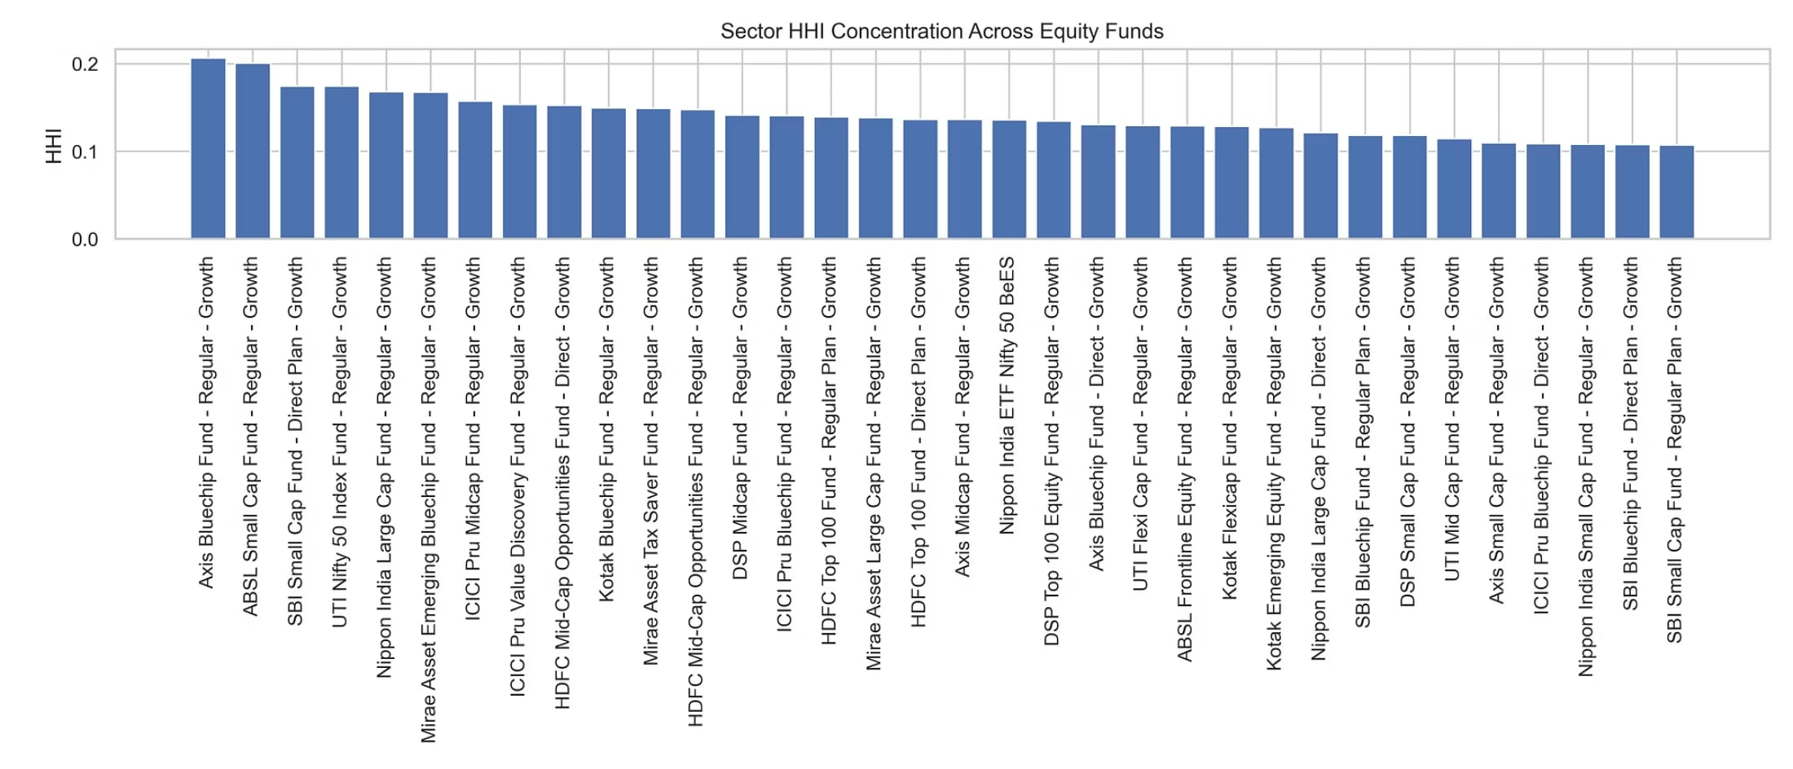
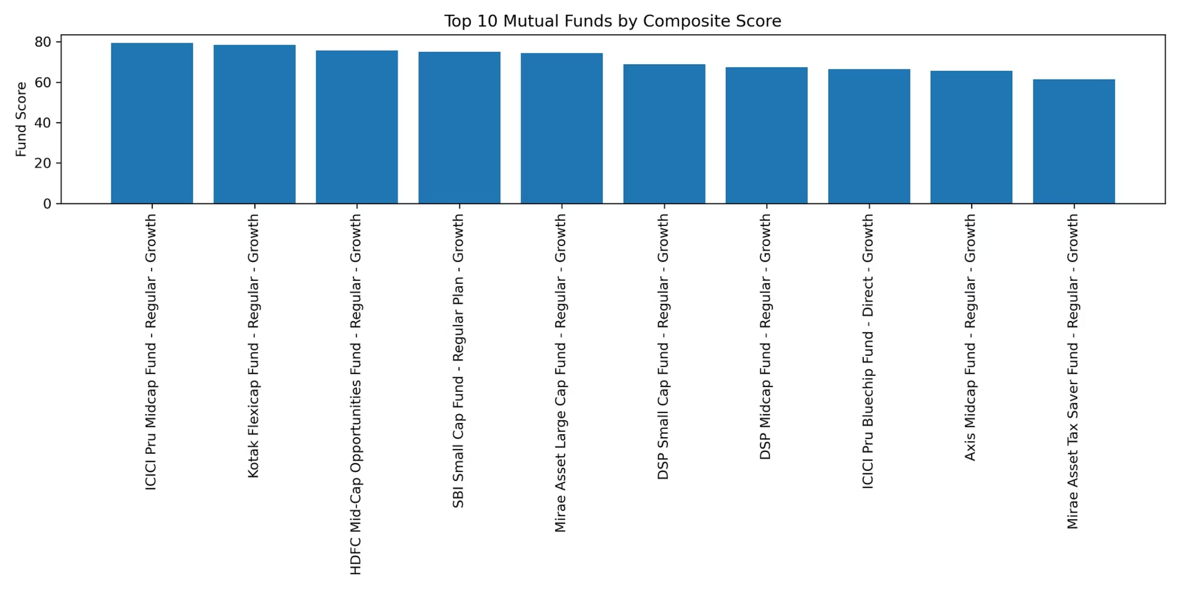
PORTFOLIO ANALYTICS
Sector Concentration & Fund Scorecard
Sector HHI Analysis
The Herfindahl-Hirschman Index measures portfolio concentration. High HHI funds are concentrated in fewer sectors; low HHI funds are well-diversified, reducing idiosyncratic risk.
Fund Scorecard
A composite ranking combines 3-year return, Sharpe ratio, Alpha, expense ratio, and maximum drawdown into a single comparable score across all 40 schemes.

Slide 9
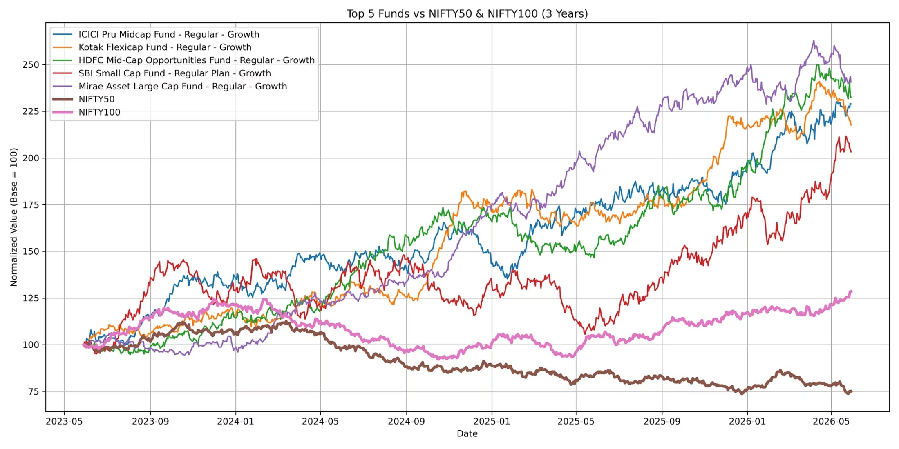
BENCHMARK COMPARISON
Funds vs. NIFTY50 & NIFTY100
Benchmark Comparison
Top 5 funds are benchmarked against NIFTY50 and NIFTY100 to evaluate relative outperformance, tracking error, and consistency across market cycles.
Tracking Error
Fund
Tracking Error
Top Fund 1
Low
Top Fund 2
Moderate
Top Fund 3
Low
Top Fund 4
Moderate
Top Fund 5
Low
Lower tracking error indicates closer alignment with the benchmark index.

Slide 10

KEY INSIGHTS
What the Data Reveals
Best Risk-Adjusted Returns
Highest CAGR
One fund led in Sharpe and Sortino ratios with strong downside protection.
A concentrated equity fund delivered the strongest compounded growth over the period.
Strongest Investor Cohort
Diversified vs. Concentrated
Mid-career investors showed the highest SIP continuity and portfolio growth rates.
Diversified funds showed lower drawdowns; concentrated funds delivered higher alpha.

