Slide 1
Medical AI Wizards Milestone 1
Ethan Sandoval, Kevin Chen, Jonah Levine
Notes:
Kevin

Slide 2
Topic: Identifying and Classifying Skin Cancer

Slide 3
Identifying and Classifying Skin Cancers
To classify images of skin cancers as benign or malignant

Slide 4
Previous Solutions
DeepSkin
DenseNet169 and ResNet50
Attempts to address class imbalance in training data
U-Net and MobileNetV3
Combines a standard U-Net and an Improved MobileNetV3
Melanoma Skin Cancer Detection
Identification of melanoma, the most deadly type of skin cancer
Notes:
kevin

Slide 5
Data Exploration/Cleaning

Slide 6
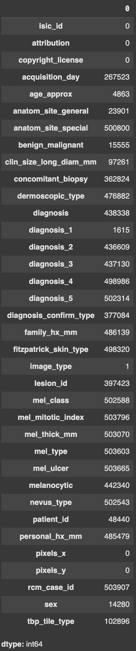
Initial exploration of metadata
Used ISIC Archive API to download all of the images and metadata from the ISIC (international skin imaging collaboration) archive
https://api.isic-archive.com/api/docs/swagger/#/images/isic_core_api_image_retrieve_image
503955 rows, 36 columns
Many columns were missing the majority of their data, and some were not useful, so we filtered the columns
Notes:
Jonah

Slide 7
Features (X)
We will use the images as well as the associated metadata as features
Found 11 usable features in our metadata dataset
Isic_id (use to match with photos)
Age_approx (patient age to nearest multiple of 5)
Anatom_site_general (Where the photo was taken on the body),
Clin_size_long_diam_mm (size of lesion)
Diagnosis_1 (malignant, intermediate, benign
Image_type (how the image was taken),
Lesion_id (To compare with other photos of same lesion),
Patient_id, (To compare with other lesions on the same patient)
pixels_x, pixels_y (size of image)
Sex
Tbp_tile_type (Modality of body imaging)
All others had either too many missing values or were useless
Notes:
Ethan

Slide 8
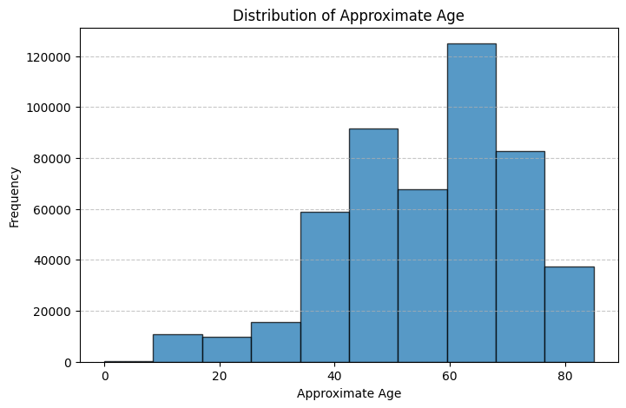
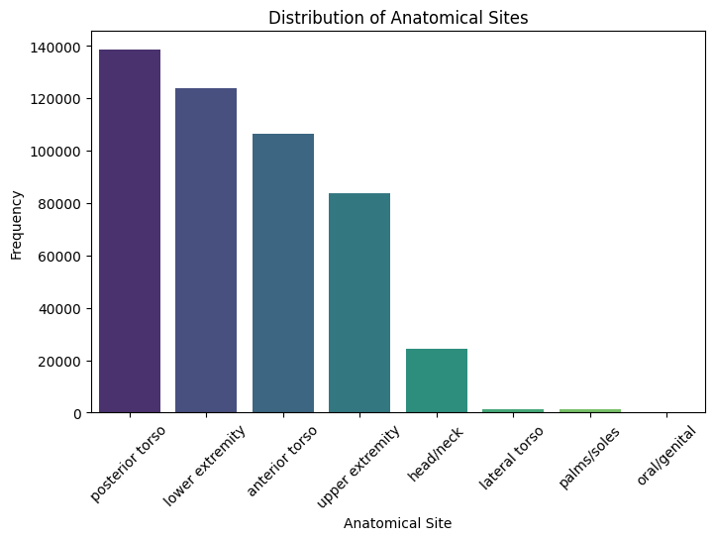
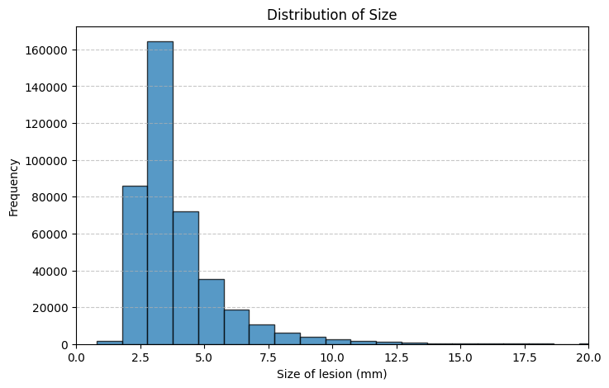
Feature Exploration
Notes:
Jonah

Slide 9
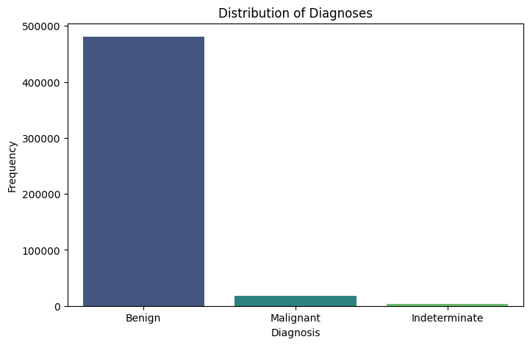
Target variable (Y)
Column “Diagnosis_1” gives each lesion a malignancy classification diagnosis: either benign, indeterminant, or malignant
We are considering adding “Diagnosis_2” which would give us more specific diagnoses, but it is missing in 85% of cases
Notes:
Ethan

Slide 10
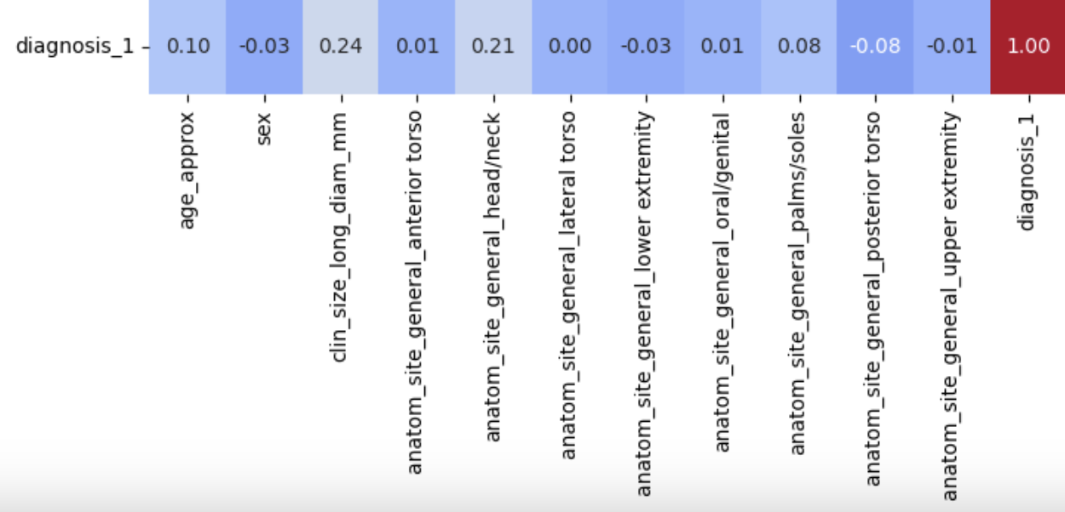
Correlation Matrix
Notes:
Jonah

Slide 11



Challenges
Handling Large Image Dataset
Incomplete metadata
ISIC API permission issues
Lack of sample size for the more detailed diagnosis
Lack of malignant lesion representation in data set
Notes:
Kevin

