Slide 1
Study of simultaneous markers
July 7, 2023
S. Scott (CFS) and H. Zhang (Caltech)
This file: 20230706_simultaneous_markers_03_sds.pptx

Slide 2
Study: how many markers are followed simultaneously on a core?
# | group | runID | Nmrk | Cpus-per-task | ntasks | OMP_NUM_THREAD | CPU-time | Sim-time |  | CPU-secs | efficiency
 |  |  |  |  |  |  |  | max | all
1 | 2537 | 11142670 | 128 | 128 | 1 | 128 | Failed (8m)
2 | 2549 | 11208620 | 4 | 128 | 1 | 128 | 6:37 | 0.108 | 0.251 | 337 | 0.74
3 | 2548 | 11208606 | 8 | 128 | 1 | 128 | 6:51 | 0.099 | 0.171 | 351 | 0.49
4 | 2547 | 11208573 | 16 | 128 | 1 | 128 | 6:51 | 0.089 | 0.623 | 351 | 1.86
5 | 2542 | 11146754 | 32 | 128 | 1 | 128 | 7:01 | 0.090 | 1.40 | 421 | 3.32
6 | 2538 | 11143915 | 64 | 128 | 1 | 128 | 6:58 | 0.085 | 1.86 | 418 | 4.45
7 | 2539 | 11144909 | 126 | 128 | 1 | 128 | 7:21 | 0.039 | 2.23 | 441 | 5.06
8 | 2540 | 11145949 | 127 | 128 | 1 | 128 | failed
9 | 2541 | 11146475 | 128 | 128 | 1 | 256 | 7:12 | 0.038 | 1.85 | 432 | 4.28
10 | 2543 | 11147092 | 252 | 128 | 1 | 256 | 6:53 | 0.025 | 2.52 | 413 | 6.10
11 | 2544 | 11148128 | 504 | 128 | 1 | 512 | Failed (8m)
12 | 2545 | 11148731 | 504 | 128 | 1 | 512 | Failed (12m)
13 | 2545(a) | 11188627 | 504 | 128 | 2 | 512 | 8:48 | 0.036 | 3.96 | 528 | 7.50
14 | 2545(b) | - | 504 | 128 | 3 | 512 | Not allowed

Slide 3
Common attributes of those runs
taken from group_go_2539:
collisional simulation
ripple is ON
MHD is OFF
my_fixedstep_gyrodefined = 10
my_max_simtime = 0.15 (essentially irrelevant)
my_max_simtime = 360 seconds = 6 minutes
define_prt_markers_03, marker_set = 7 → random marker positions
birth_rhomin = 07, birth_rhomax = 1.0 -> markers are born in edge region

Slide 4
Observations
Line 1 (2537): 128 markers with OMP_NUM_THREADS=128 fails. I think this means that a core cannot
process 128 markers simultaneously with OMP_NUM_THREADS=128.
Line 7 (2539): 126 markers with OMP_NUM_THREADS=128 succeeds. I think this means that a core
can process 126 simultaneous markers with OMP_NUM_THREADS=128.
Line 8 (2540): 127 markers with OMP_NUM_THREADS=128 fails. I think this means that a core cannot
process 127 markers simultaneously with OMP_NUM_THREADS=128.
Line 10 (2543): 252 markers with OMP_NUM_THREADS=256 succeeds. I think this means that a core
can process 252 simultaneous markers with OMP_NUM_THREADS=256.
Lines 11,12 (2544, 2545): 504 markers with OMP_NUM_THREADS=512 fails, with ntasks=1.
I think this means that a core cannot process 504 simultaneous markers with OMP_NUM_THREADS=512
so long as ntasks=1.
Line 13 (2545a). If we increase ntasks to 2, then 504 markers can be processed simultaneously when
OMP_NUM_THREADS=512.
Line 14 (2545b). The system does not allow us to set ntasks=3.

Slide 5
Summary of switch settings that ‘work’
CPUs-per-task | ntasks | OMP_NUM_THREADS | Simultaneous markers allowed | efficiency | Max sim time
128 | 1 | 128 | 126 | 5.06 | .039
128 | 1 | 256 | 252 | 6.10 | .025
128 | 2 | 512 | 504 | 7.50 | .036
… so we gain about 50% in efficiency ( i.e. 5.06 → 7.50) by increasing ntasks from 1 to 2 and by increasing
OMP_NUM_THREADS from 128 to 512.

Slide 6
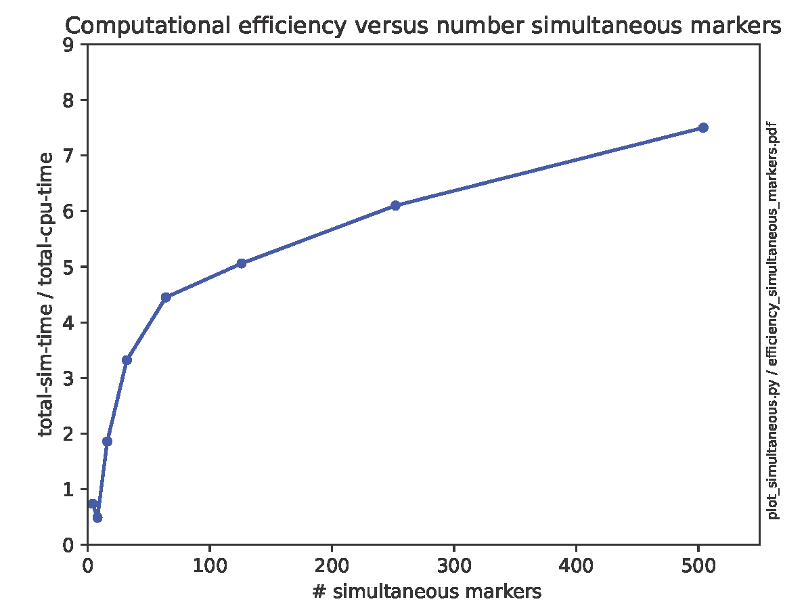
Do not understand why computational efficiency does not increase ~linearly with number of simultaneous markers up to number of cores in a node (128). It ‘rolls over’ much sooner
2545a
2543
2539
2538
2542
2547
2549
2548
My expectation was that if there are 128 cores available, and you ask to follow only 64 markers,
then the other 64 markers would essentially go ‘idle’ during the simulation.

Slide 7
Effect of including MHD on CPU requirements
MHD on? | group | runID | Wall time | Max orbtime | Summed orbtime | efficiency
no | 2542 | 11146754 | 7:01 (421) | 0.090 | 1.403 | 3.33
No* | 2546 | 11190045 | 7:10 (430) | 0.099 | 1.34 | 3.12
yes | 2550 | 11246845 | 9:52 (592) | 0.059 | 0.510 | 0.86
* off by mistake. I had intended it to be on.
Conclusion: turning on MHD reduces the efficiency (orbit time / CPU time) of the orbit calculation by
a factor of ~ 3.75.
The observation that the simulation with MHD on took substantially more wall clock time is surprising:
all 3 runs were intended to terminate after 360 seconds. Is it possible that the time to compute
the MHD fields is somehow not included in the ‘cputime’ determination by ASCOT?

Slide 8
We see enormous variations in run time for nominally identical runs
Pitch lim | group | runID | Nmrk/ntasks/OMP | Wall time | aborted | Max orbtime | Summed orbtime | efficiency | Charged node hours
0.99999999 | 2554 | 11256513 | 120/1/128 | 47:04 | 5 | 0.00100 | 0.115 |  | 0.78
0.99999999 | 2554(repeat) | 11297209 | 120/1/128 | 1:07 ?? | 5 | 0.00100 | 0.115 |  | 0.01
0.99999999 | 2554(repeat) | 11338619 | 120/1/128 | 0:58
0.9999 | 2557 | 11293219 | 120/1/128 | 3:24 | 4 | 0.00100 | 0.115
0.9999 | 2557(repeat) | 11297541 | 120/1/128 | 3:40
0.999 | 2555 | 11257326 | 120/1/128 | 31:41 | 5 | 0.00100 | 0.115 |  | 0.53
0.999 | 2555(repeat) | 11297721 | 120/1/128 | 2:21 ?? |  |  |  |  | 0.02
0.999 | 2555(repeat) | 11338368 | 120/1/128 | 1:14??
0.999 | 2555(repeat) | 11338542 | 120/1/128 | 0:58
0.99 | 2556 | 11293210 | 120/1/128 | 2:42 | 4 | 0.00100 | 0.115
All have 120 markers with ntasks=128 and OMP_NUM_THREADS=128

Slide 9
Identical rerun with pitch lim = 0.999
(myenv) sscott@perlmutter:login38:/global/cfs/cdirs/m3195/ascot/ascot5/runs> mycputime 11257326
JobID JobName Partition AllocCPUS State CPUTimeRAW Elapsed
------------ ---------- ---------- ---------- ---------- ---------- ----------
11257326 perlmutte+ regular_m+ 256 COMPLETED 486656 00:31:41
11257326.ba+ batch 256 COMPLETED 486656 00:31:41
11257326.ex+ extern 256 COMPLETED 486656 00:31:41
11257326.0 hydra_bst+ 128 COMPLETED 24448 00:03:11
(myenv) sscott@perlmutter:login38:/global/cfs/cdirs/m3195/ascot/ascot5/runs> mycputime 11297721
JobID JobName Partition AllocCPUS State CPUTimeRAW Elapsed
------------ ---------- ---------- ---------- ---------- ---------- ----------
11297721 perlmutte+ regular_m+ 256 COMPLETED 14080 00:00:55
11297721.ba+ batch 256 COMPLETED 14080 00:00:55
11297721.ex+ extern 256 COMPLETED 36096 00:02:21
11297721.0 hydra_bst+ 128 COMPLETED 5888 00:00:46
… but from pnp_losses.py, the maximum simulation time for individual markers was in the neighborhood of 26 sec

Slide 10
Identical re-runs with pitch lim = 0.99999999
mycputime 11256513
JobID JobName Partition AllocCPUS State CPUTimeRAW Elapsed
------------ ---------- ---------- ---------- ---------- ---------- ----------
11256513 perlmutte+ regular_m+ 256 COMPLETED 722944 00:47:04
11256513.ba+ batch 256 COMPLETED 722944 00:47:04
11256513.ex+ extern 256 COMPLETED 722944 00:47:04
11256513.0 hydra_bst+ 128 COMPLETED 7808 00:01:01
mycputime 11297209
JobID JobName Partition AllocCPUS State CPUTimeRAW Elapsed
------------ ---------- ---------- ---------- ---------- ---------- ----------
11297209 perlmutte+ regular_m+ 256 COMPLETED 13056 00:00:51
11297209.ba+ batch 256 COMPLETED 13056 00:00:51
11297209.ex+ extern 256 COMPLETED 17152 00:01:07
11297209.0 hydra_bst+ 128 COMPLETED 6400 00:00:50
… but from the output of pnp_losses.py, the maximum cputime per marker was in the neighborhood
of 21 sec for both simultions.

Slide 11
‘Candidate workflow’ simulations
line | group | runID | MHD | Bfld | Nmrk | ntasks/OMP | Wall time | aborted | rhomax | emin | Max orbtime | Max simtime | Summed orbtime | efficiency | node hours
1 | 2560 | 11300695 | y | 3D | 490 | 2/512 | 1:59:58 | 65 | 0 | 419 | 0.242 | 7161 | 54.6 | 7.58
2 | 2561 | 11410057 | y | 2D | 490 | 2/512 | 1:37:07 | 0 | 82 | 408 | 0.229 | 5795 | 52.7 | 9.04
3 | 2561a | 11430013 | y | 2D | 490 | 1/128
4
5
All runs: to thermalization, using marker_sets_hongyu.py with set=3, marker_option=2
‘efficiency = 1000 * ‘summed orbtime’ / “wall-time” … with wall-time expressed in seconds
Efficiency is reduced 16% when we turn on a 3D (‘ripple’) magnetic field
Note that when we go from a 3D to a 2D magnetic field, the aborted markers go to zero but the number of
markers that terminate due to rhomax increases from 0 → 82.
Going forward, assume an efficiency of 9.0 for simulations that include MHD but no ripple. Will get some
boost in efficiency by ‘stacking’

Slide 12
Scaling for production runs
From 2561/11410057) (=MHD on, ripple off, collisions on, to-thermalization): 490 markers were
processed in 97 minutes on one node. my_max_simtime = 0.300, my_max_cputime = 14000.
From the pnp_losses.py analysis, the maximum CPU time for any marker was about 5800 sec.
Suppose we want to simulate 5000 markers.
Assume that we want each node to process 3 orbits, one after another. Then each
node would handle 3 x 490 = 1470 markers.
Without taking advantage of ‘stacking’, this might take 3 x 97 = 291 minutes = 5 hours.
We would need just a little more than 3 nodes, since 3 x 1470 = 4410.
So I think that asking for 4 nodes, 5 hours, with ntasks=2, OMP_NUM_THREADS=512 and cpus-per-task=128
is both reasonably efficient and should complete well within the allowed 5 hours. The only price you pay
for asking for a long run time (5 hours) is that you will wait a little longer for the job to start.
Suppose the job actually takes 2.5 hours. Then the ‘charge’ for the job would be 4 nodes x 2.5 hours
= 10 node hours. We have about 3000 node hours to use from now until mid-January 2024. So
this is a small, but not insignificant simulation.
Once you write your group_go_xxxx.py and perlmutter_xxxx.sh files with the final, production values of
all parameters, I would propose first making a copy for a ‘test case’ with: my_max_cputime = 30 with a total
allowed run time in the perlmutter_xxxx.sh of 5 minutes (but still keep the 4 nodes). Run this case in the ‘regular’
queue and briefly examine the output before submitting the production run.

Slide 13
Things to check in the test case
In the group_go_xxxx.py file, check that
settings["bfield_make_3D"] = False
[options_settings["my_enable_mhd"] = 1
From the pdf ‘marker file’ that is generated by group_go_xxxx.py: does the
distribution of markers in [R,Z] space look OK? Does the other output look OK?
Examine the output from the pnp_losses.py postprocessor
Most markers should terminate due to cpu time
A small percentage of the markers should terminate due to rhomax
Very few markers should abort
If possible, check the output to see if the markers are actually slowing down during the
30-sec cputime limit, i.e. that you have turned on collisions.
Then if all looks OK, hold you breath and submit the production run!

Slide 14
Another study regarding number simultaneous markers
line | group | runID | MHD | Bfld | Nmrk | ntasks/OMP | Wall time | aborted | rhomax | emin | Max orbtime | Max Cpu time | Summed orbtime | efficiency | node hours
1 | 2562 | 11423907 | y | 2D | 490 | 2/512 | 9:03 | 0 | 82 | 408 | 0.0100 | 422 | 4.083 | 7.52
2 | 2563 | 11423909 | y | 2D | 224 | 2/512 | 4:58 | 0 | 22 | 202 | 0.0100 | 258 | 2.020 | 6.78
3 | 2564 | 11425640 | y | 2D | 520 | 2/512 | 8:48 | 0 | 68 | 452 | 0.0100 | 507.8 | 4.534 | 8.59
4 | 2565 | 11428828 | y | 2D | 576 | 2/512 | 9:45 | 1 | 68 | 507 | 0.0100 | 559.9 | 5.091 | 8.70
5

