Slide 1



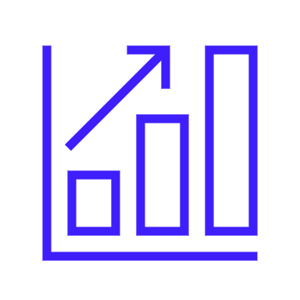


GNN

Slide 2
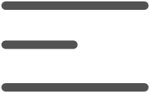
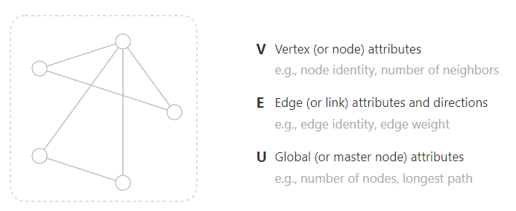


Grafos

Slide 3
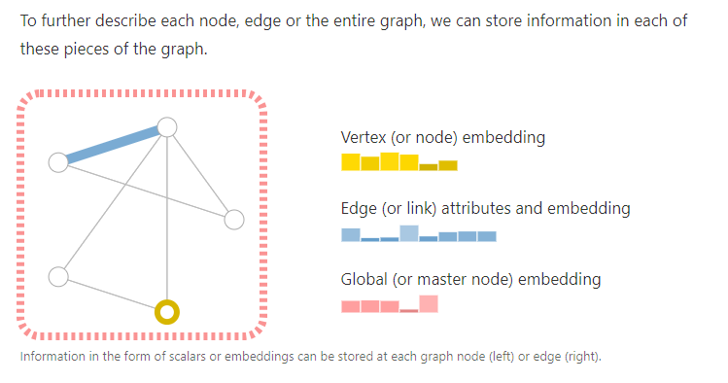
Representación con escalares o embeddings

Slide 4
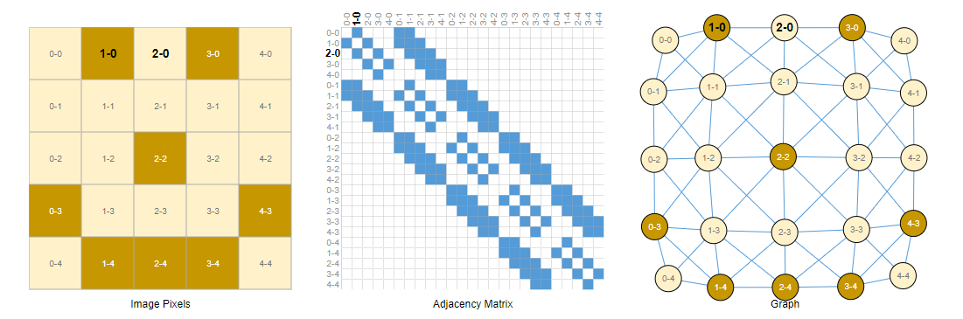
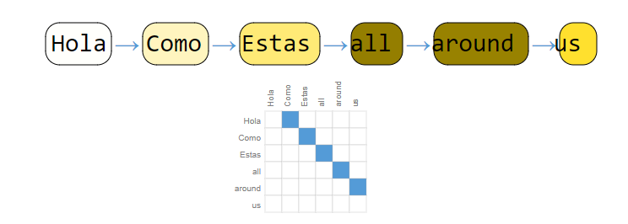
Imágenes and text as graphs

Slide 5
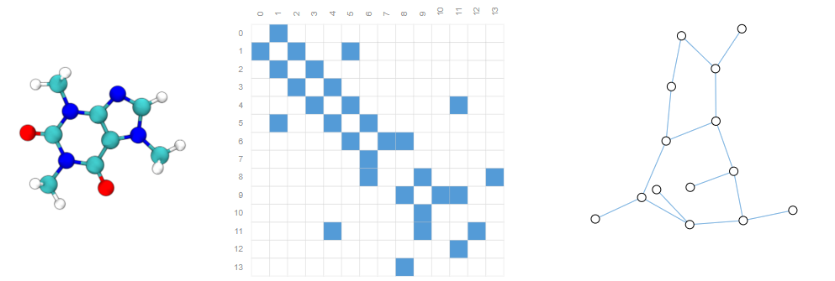
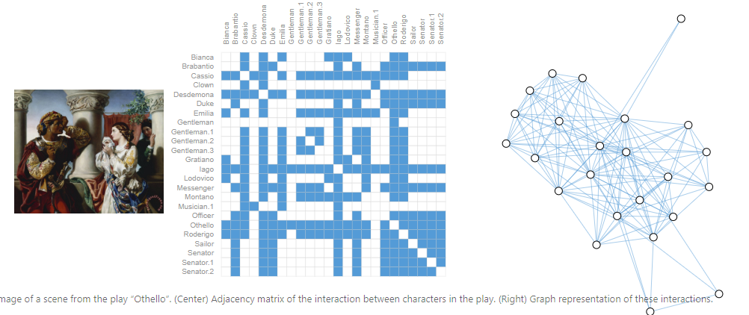
Otros ejemplos

Slide 6
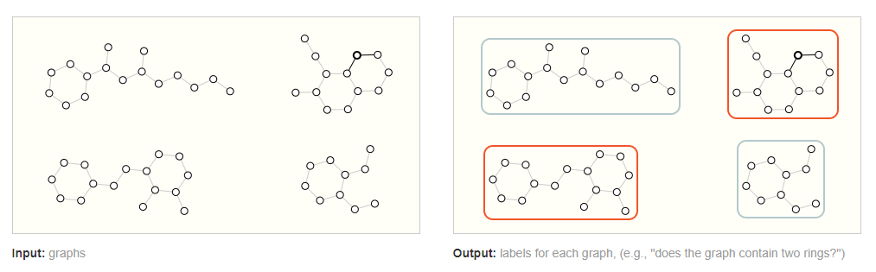
Tipos de problemas con graph structured data
Graph-level task
Predecir el olor de una molécula
Predecir la etiqueta de una imagen
Predecir el sentimiento de un pedazo de texto

Slide 7
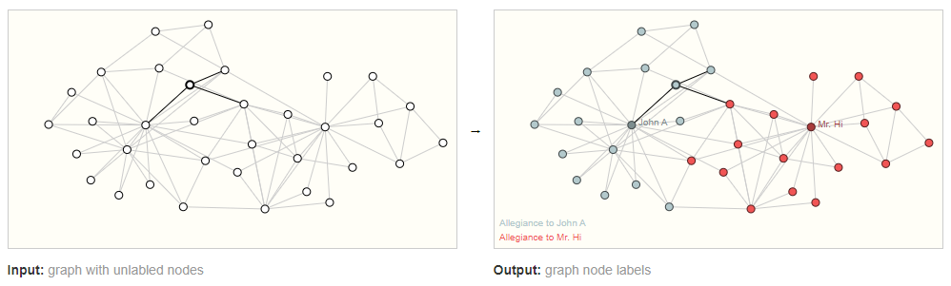
Tipos de problemas con graph structured data
Node-level task
Predecir una alianza en una red social
Segmentar una imagen, o sea predecir la categoría de pixeles particulares
Predecir el tipo de palabra en una oración (verbo, adverbio, sustantivo, etc.)

Slide 8
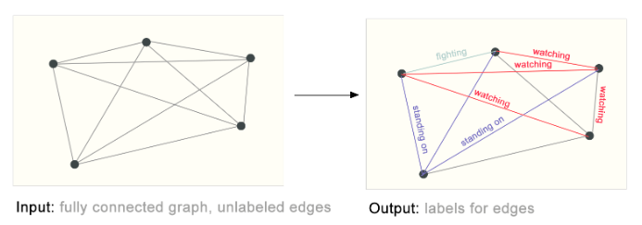
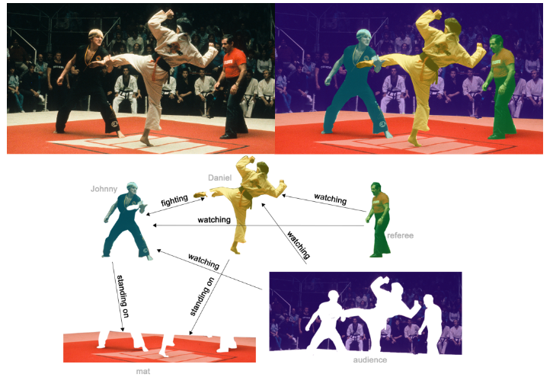
Tipos de problemas con graph structured data
Edge-level task
Predecir el tipo de interacción en una imágen

Slide 9
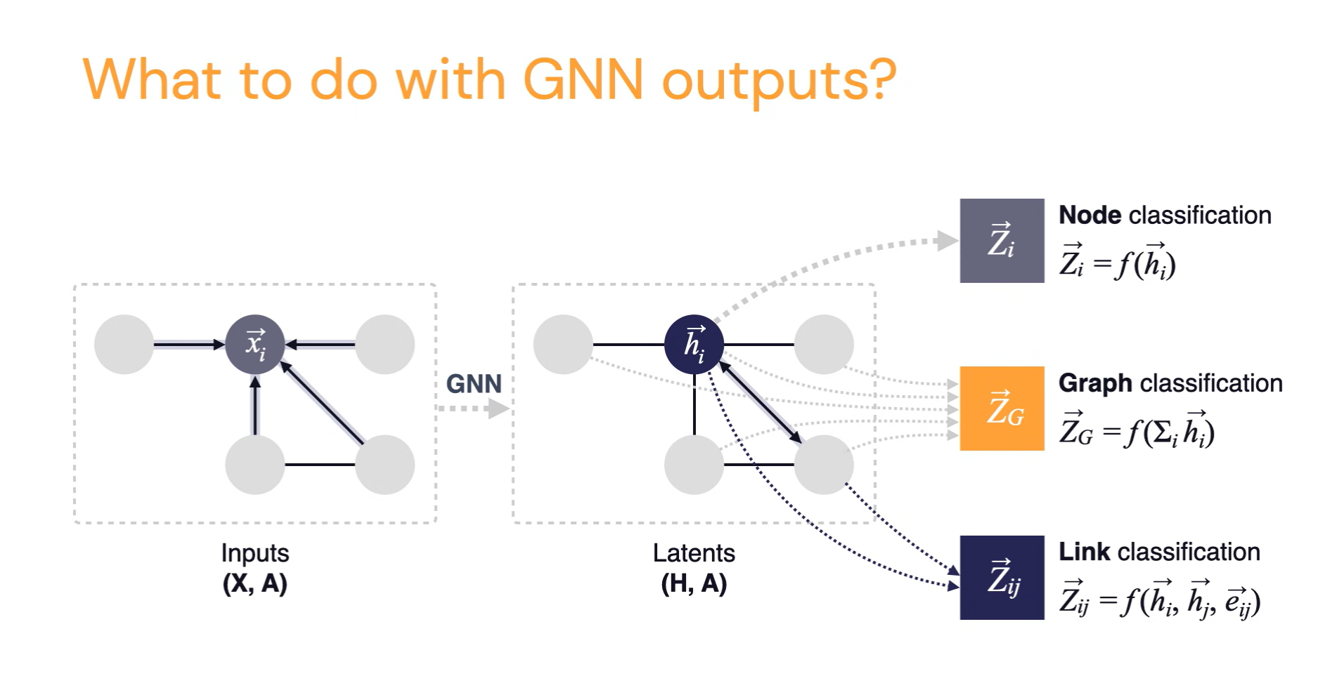
Tipos de problemas con graph structured data

Slide 10
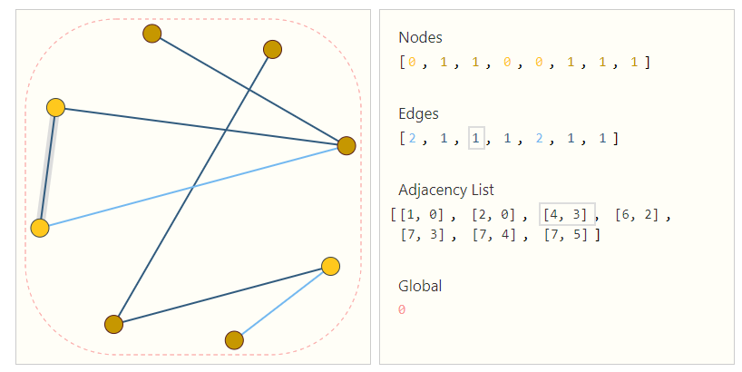
¿Cómo representamos graphs para ser compatibles con neural networks?
Nodes
Edges
Global-context
Connectivity

Slide 11
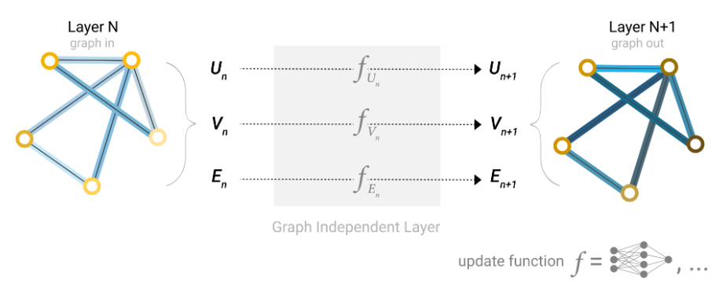
GNNs, a simple architecture
A GNN is an
Optimizable transformation on all attributes of the graph (nodes, edges, global-context)
Preserves graph symmetries (permutation invariances).
Components
Embeddings
Message passing
Aggregation
Update
Notes:
Optimizable Transformation:
A process or function that can be adjusted (optimized) during training to minimize a loss function. In the context of GNNs, this means that the network learns to transform graph attributes in a way that improves performance on a given task (e.g., node classification, link prediction)
Graph Symmetries (Permutation Invariances):
A property of graphs where the order of nodes and edges does not affect the overall structure or the result of graph operations. For instance, renaming nodes or rearranging their order should not change the outcome of computations on the graph.

Slide 12
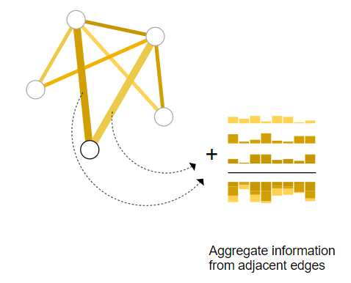
¿Que pasa cuando queremos usar información entre components del grapho? -> The message passing framework
Pooling
Concatenar embeddings de lo que se quiera considerar
Usar una función de agregación
Notes:
Optimizable Transformation:
A process or function that can be adjusted (optimized) during training to minimize a loss function. In the context of GNNs, this means that the network learns to transform graph attributes in a way that improves performance on a given task (e.g., node classification, link prediction)
Graph Symmetries (Permutation Invariances):
A property of graphs where the order of nodes and edges does not affect the overall structure or the result of graph operations. For instance, renaming nodes or rearranging their order should not change the outcome of computations on the graph.

Slide 13
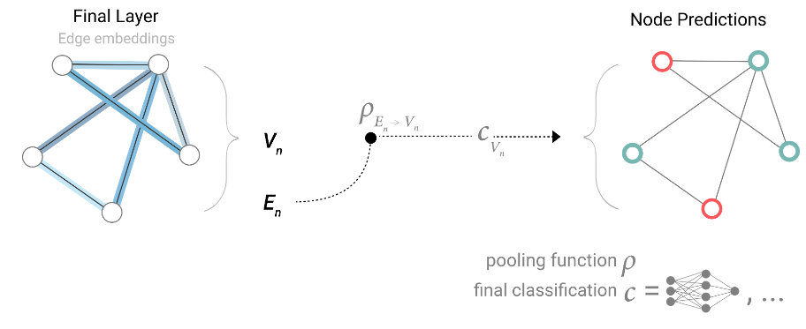
¿Que pasa cuando queremos usar información entre components del grapho? -> The message passing framework
Notes:
Optimizable Transformation:
A process or function that can be adjusted (optimized) during training to minimize a loss function. In the context of GNNs, this means that the network learns to transform graph attributes in a way that improves performance on a given task (e.g., node classification, link prediction)
Graph Symmetries (Permutation Invariances):
A property of graphs where the order of nodes and edges does not affect the overall structure or the result of graph operations. For instance, renaming nodes or rearranging their order should not change the outcome of computations on the graph.

Slide 14
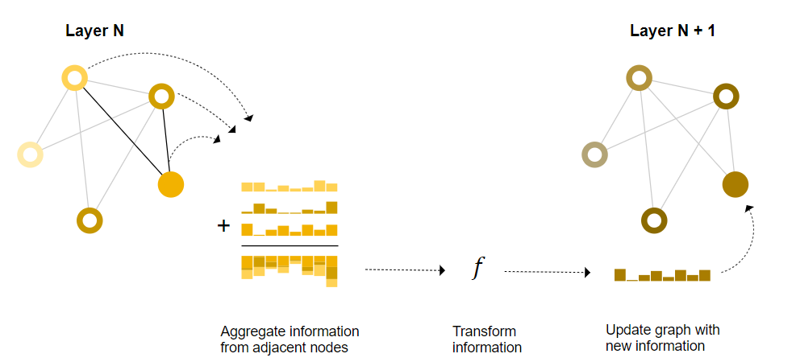
¿Que pasa cuando queremos usar información entre components del grapho? -> The message passing framework
Notes:
Optimizable Transformation:
A process or function that can be adjusted (optimized) during training to minimize a loss function. In the context of GNNs, this means that the network learns to transform graph attributes in a way that improves performance on a given task (e.g., node classification, link prediction)
Graph Symmetries (Permutation Invariances):
A property of graphs where the order of nodes and edges does not affect the overall structure or the result of graph operations. For instance, renaming nodes or rearranging their order should not change the outcome of computations on the graph.

Slide 15
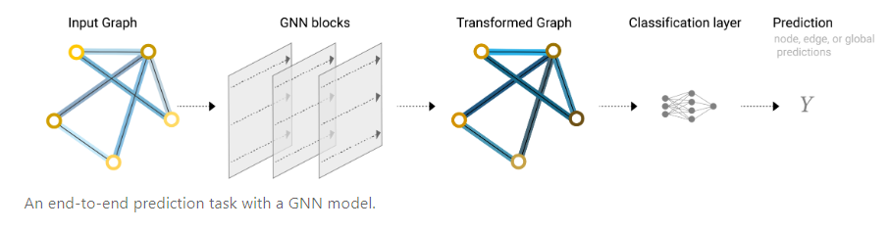
¿Que pasa cuando queremos usar información entre components del grapho? -> The message passing framework
In essence, message passing and convolution are operations to aggregate and process the information of an element’s neighbors in order to update the element’s value. In graphs, the element is a node, and in images, the element is a pixel.
Notes:
Optimizable Transformation:
A process or function that can be adjusted (optimized) during training to minimize a loss function. In the context of GNNs, this means that the network learns to transform graph attributes in a way that improves performance on a given task (e.g., node classification, link prediction)
Graph Symmetries (Permutation Invariances):
A property of graphs where the order of nodes and edges does not affect the overall structure or the result of graph operations. For instance, renaming nodes or rearranging their order should not change the outcome of computations on the graph.

Slide 16
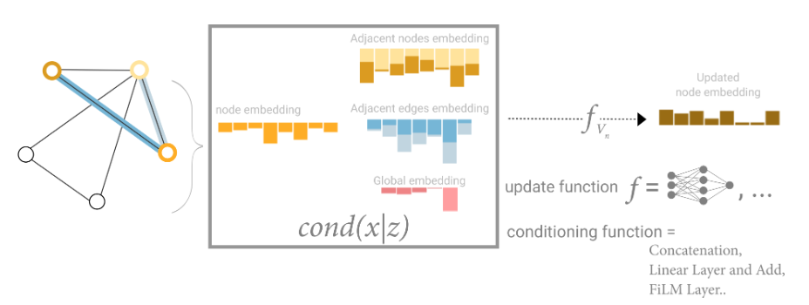
¿Que pasa cuando queremos usar información entre components del grapho? -> The message passing framework
Notes:
Optimizable Transformation:
A process or function that can be adjusted (optimized) during training to minimize a loss function. In the context of GNNs, this means that the network learns to transform graph attributes in a way that improves performance on a given task (e.g., node classification, link prediction)
Graph Symmetries (Permutation Invariances):
A property of graphs where the order of nodes and edges does not affect the overall structure or the result of graph operations. For instance, renaming nodes or rearranging their order should not change the outcome of computations on the graph.

Slide 17
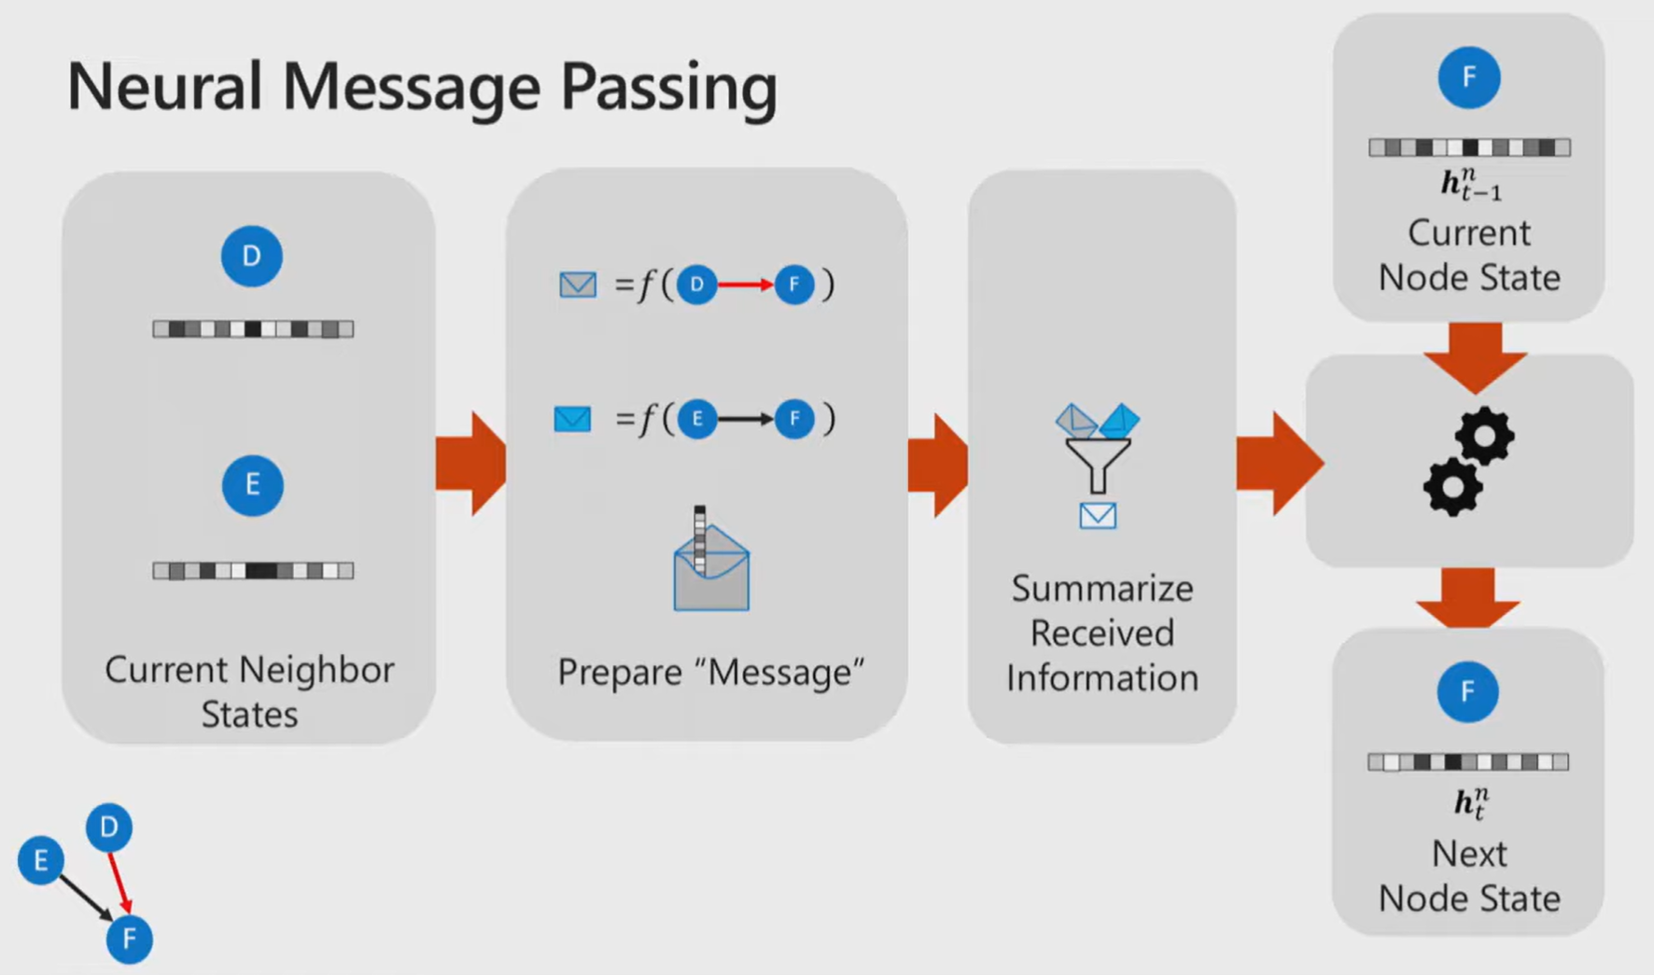
¿Que pasa cuando queremos usar información entre components del grapho? -> The message passing framework
Notes:
Optimizable Transformation:
A process or function that can be adjusted (optimized) during training to minimize a loss function. In the context of GNNs, this means that the network learns to transform graph attributes in a way that improves performance on a given task (e.g., node classification, link prediction)
Graph Symmetries (Permutation Invariances):
A property of graphs where the order of nodes and edges does not affect the overall structure or the result of graph operations. For instance, renaming nodes or rearranging their order should not change the outcome of computations on the graph.

Slide 18
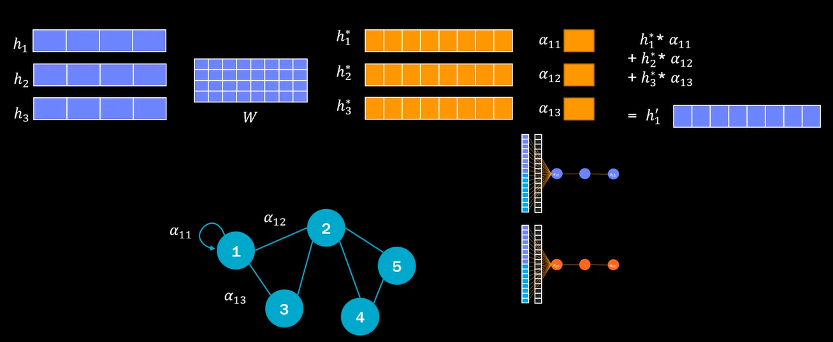
¿Que pasa cuando queremos usar información entre components del grapho? -> The message passing framework
Notes:
Optimizable Transformation:
A process or function that can be adjusted (optimized) during training to minimize a loss function. In the context of GNNs, this means that the network learns to transform graph attributes in a way that improves performance on a given task (e.g., node classification, link prediction)
Graph Symmetries (Permutation Invariances):
A property of graphs where the order of nodes and edges does not affect the overall structure or the result of graph operations. For instance, renaming nodes or rearranging their order should not change the outcome of computations on the graph.

