Slide 1


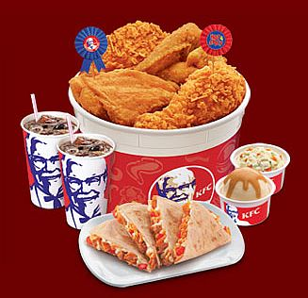
PROBLEM of the WEEK -- #2
Alice’s guess:
Bob’s guess:
Alice’s flip
==
Bob’s flip
Alice’s flip
!=
Bob’s flip
CHICKEN DINER

