Slide 1
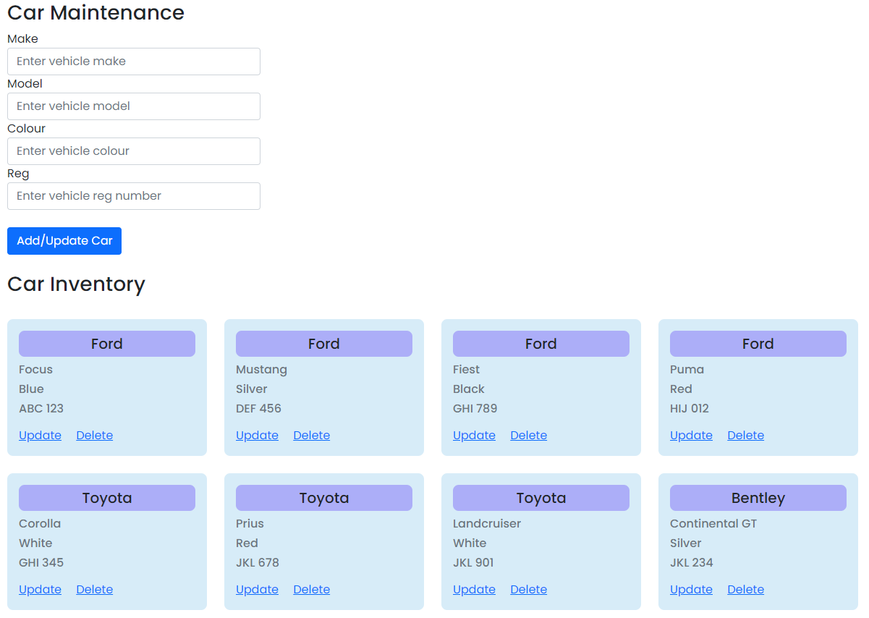
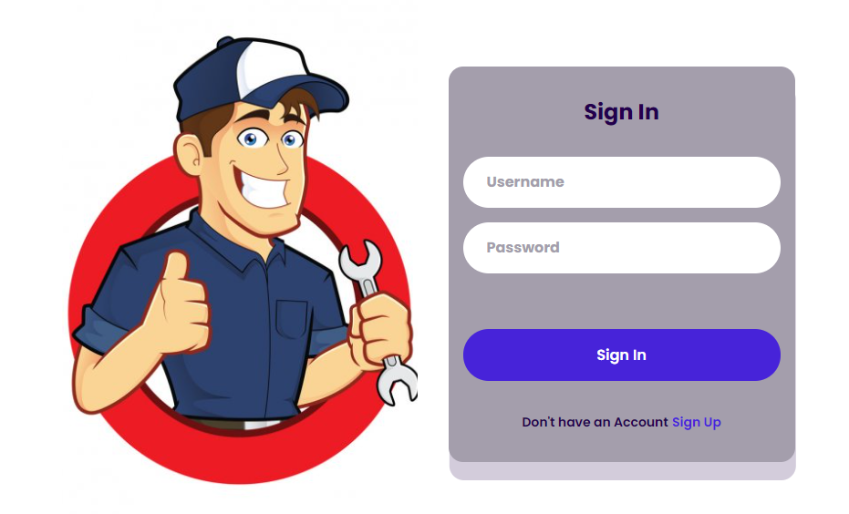
Frontend
Backend
Backend
Database
Browser
Cars
Controller
Cars
Service
Cars
Repository
MySQL
(Garage)

