Slide 1
7/6/17
EternaBrain – Rohan Koodli

Slide 2
Trying
Validate EternaBrain on actual Eterna puzzles, not player movesets
Improve accuracy on solving single-state puzzles

Slide 3
Methods
Trained on 3 Microfluidic Chip Puzzles and 1 RNA Polymerase Puzzle
~530,000 moves total
Validated on RNA Polymerase 6/9
Deep neural net, 700 epochs, 5 fully-connected layers, 250 nodes each
https://github.com/RK900/EternaBrain/blob/master/rna-prediction/baseDNN.py
https://github.com/RK900/EternaBrain/blob/master/rna-prediction/locationDNN.py

Slide 4
Results
baseDNN (predicts only base)
Train Accuracy: 0.56
Test Accuracy: 0.25
locationDNN (predicts only location)
Train Accuracy: 0.25
Test Accuracy: 0.1
Tends to overpredict G
Base G makes up 32% of labels, whereas A, U, C make up ~22% each

Slide 5
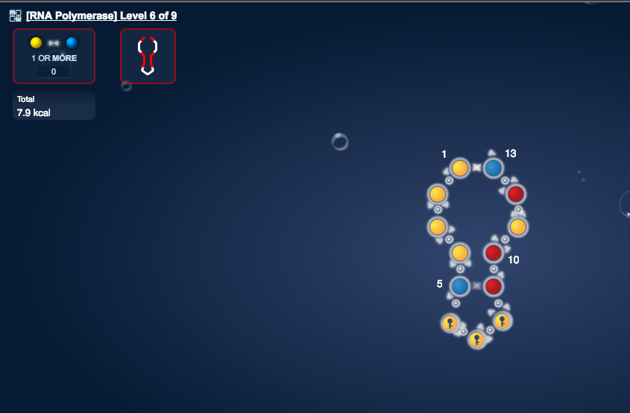
Results
Made AU pair at top
Made 2 more AU pairs, then predicted G everywhere and got stuck

Slide 6
Conclusions
Overpredicting G due to imbalanced data
Most likely needs more data

Slide 7
Next Steps
Prep & train more data
Check if bases are imbalanced before training on larger dataset
Start encoding multi-state puzzle information (oligos, reporters)?

