Slide 1
7/13/17
EternaBrain – Rohan Koodli

Slide 2
Trying
Parallelizing code so that it runs faster and can use multiple CPUs/GPUs
Training model on 1.8M moves on 12 progression puzzles (Gene Synthesizer, Thermocycler, RNA Polymerase, Microfluidic Chip)
Exploring reinforcement learning

Slide 3
Methods
12 puzzles, 1.8M moves
Validate on Gene Synthesizer 4/14 and Nucleotide Mixer 7/11
Deep neural net, 300 epochs, 5 fully-connected layers, 250 nodes per layer
Parallelized across 4 GPUs
https://github.com/RK900/EternaBrain/blob/master/rna-prediction/baseDNN_gpu.py
https://github.com/RK900/EternaBrain/blob/master/rna-prediction/locationDNN_gpu.py

Slide 4
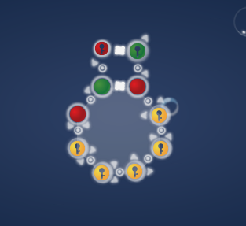
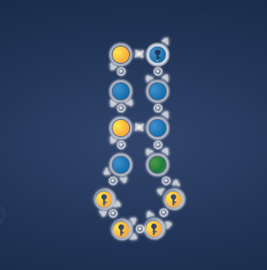
Results
Gene Synthesizer 4/14 (solved)
Nucleotide Mixer 7/11

Slide 5
Results
Overpredicting U
Can solve the puzzle up to some extent, but eventually gets stuck and predicts most used base in training data (last week: G; this week: U)
Overall, performing similarly to how old model performed (deep neural net, 500K moves, 700 epochs, 250 nodes, 5 fully-connected layers)
Simply adding more puzzles won’t help anymore– will have to be more selective

Slide 6
Next Steps
Select only expert player data to train on
Use NumPy arrays when saving data (much faster than using lists and pickling)
Balance data
Use reinforcement learning to improve prediction after DNN (explained more on next slides), or use RL separately altogether

Slide 7
Reinforcement Learning
Algorithm initially will mutate random bases in a base sequence
As a result, the natural structure will change
Then compare the natural structure and target structure, and check how the structures compare
Bases on how many bases are paired/unpaired correctly, the algorithm receives a score (the reward)
Reinforcement learner tries to maximize reward by doing similar actions in the future

Slide 8
Reinforcement Learning (continued)
Could either be implemented independently or be called in after deep neural network has attempted to solve the puzzle
E.g.: if the deep neural net cannot solve the puzzle after 100 moves, the reinforcement learner is called in and tries to complete the puzzle

