Slide 1
7/20/17
EternaBrain – Rohan Koodli

Slide 2
Trying
Convolutional Neural Networks
Reinforcement Learning

Slide 3
Methods
92 puzzles, 30K moves, 40 experts (solved over 3000 puzzles each)
Validate on Next Gen Sequencer 11/11
Convolutional neural net, 7 convolutional layers (with pooling), 3 fully-connected, 150 epochs
2D convolutions (height 7 to match number of features, 7 nearest neighbors)
But essentially 1D convolutions with 7 nearest neighbors
https://github.com/RK900/EternaBrain/blob/master/rna-prediction/baseCNN.py
https://github.com/RK900/EternaBrain/blob/master/rna-prediction/locationCNN.py

Slide 4
Results
baseCNN
Train Accuracy: 0.96
Test Accuracy: 0.46
locationCNN
Train Accuracy: 0.76
Test Accuracy: 0.2

Slide 5
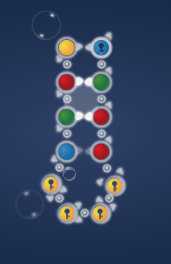
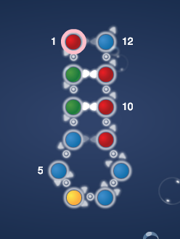
Results
Next Gen Sequencer 11/11

Slide 6
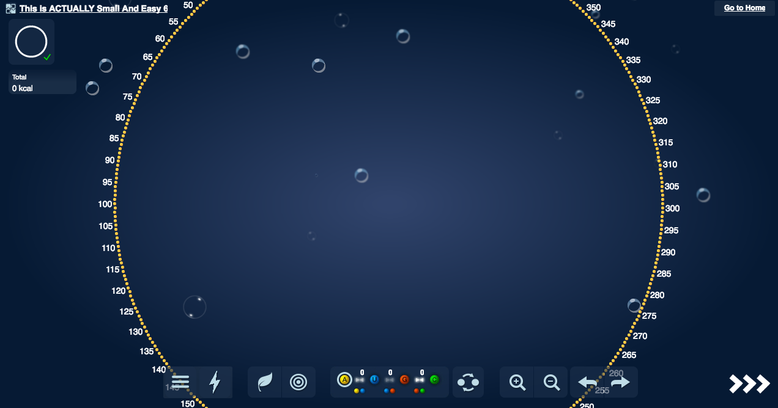
Results
This is ACTUALLY small and easy 6

Slide 7
Conclusions
Training on only experts definitely helped
Reduced overall variance
Convolutions helped it look at nearest neighbors
Performs well on puzzles with stacks
Can solve up to 85% of any puzzle (85% of the natural structure matches the target structure)
Still cannot solve relatively complex puzzles
Increase number of layers
Increase dataset (more experts/more puzzles)
Add reinforcement learning

Slide 8
Conclusions
I am fairly certain adding more layers/improving the CNN will not help it solve the remaining 15% of a puzzle; reinforcement learning is needed
RL will help the model “clean up” it’s silly mistakes, such as incorrect pairings
Often, the only thing hindering the model is incorrect pairings (such as turning a U-U pair to an A-U pair or breaking up a G-C pair
This could be done even without RL, but I believe adding RL will improve it even more
The CNN does most of the heavy lifting, RL will help it solve the remaining 15%

Slide 9
Conclusions
Remove the stochastic predictions (SP)
The only use for the SP is that it prevents the predictions from getting stuck
However, it often predicts the wrong base, even when the probability for the correct base is higher (due to the random probability)
Therefore, instead of using the SP, I will implement a simpler function to prevent the model from getting stuck
If the predicted base already exists in that location, take the second highest base probability

Slide 10
Next Steps (in order of priority)
Remove stochastic move selector (for base at least)
Add some non-ML functions to fix small mistakes, such as incorrect pairings
Run reinforcement learning on top of convNet to fix small, dumb mistakes
Combine base and location into a 4 x (Puzzle length) vector
Train on fastest solutions

