Slide 1
7/26/17
EternaBrain – Rohan Koodli

Slide 2
Trying
Varying CNN hyperparameters
Adding domain-specific pipeline
Training on fastest movesets

Slide 3
Methods
92 puzzles, 30K moves, 70 experts (solved over 3000 puzzles each)
Validate on Eterna100
Added pairmaps to feature space
Convolutional neural net, 7 convolutional layers (with pooling), 3 fully-connected, 150 epochs, 0.9 keep prob
2D convolutions (height 7 to match number of features, 7 nearest neighbors)
But essentially 1D convolutions with 7 nearest neighbors
https://github.com/RK900/EternaBrain/blob/master/rna-prediction/baseCNN.py
https://github.com/RK900/EternaBrain/blob/master/rna-prediction/locationCNN.py

Slide 4
Methods
Add “fixer” which goes through each individual base and mutates it to A, U, G, or C and sees which brings it closer to target structure
Add domain specific pipeline
Fix incorrect base pairs
Change all loops to A’s
Change G-U pairs to G-C pairs

Slide 5
Results
baseCNN
Train Accuracy: 0.68
Test Accuracy: 0.34
locationCNN
Train Accuracy: 0.27
Test Accuracy: 0.14

Slide 6
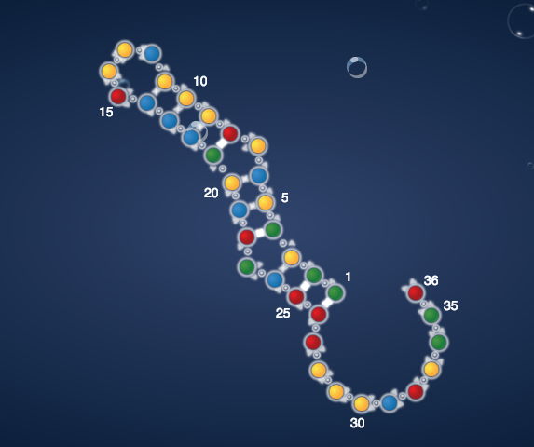
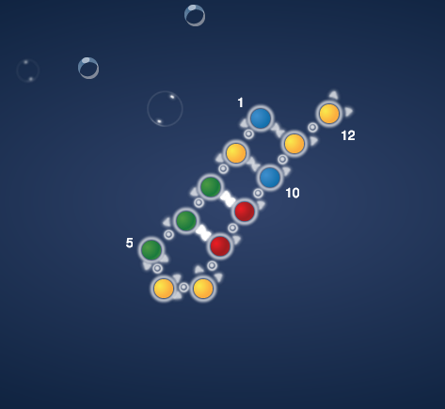
Results
Prion Pseudoknot
G-C placement

Slide 7
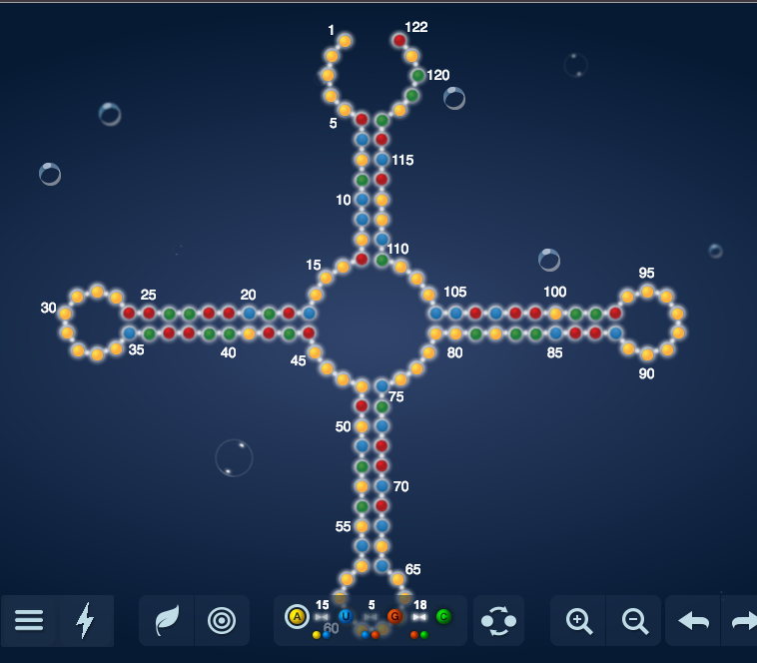
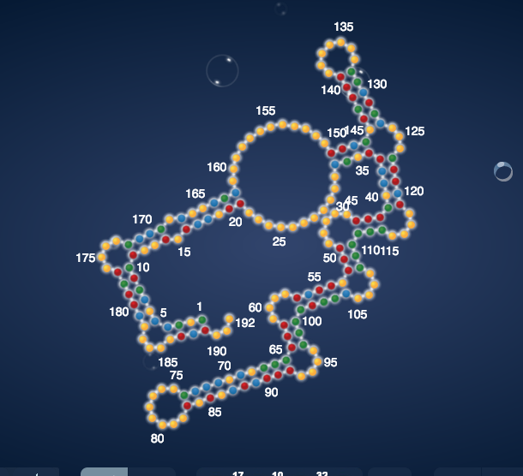
Results
Fractal
Adenovirus

Slide 8
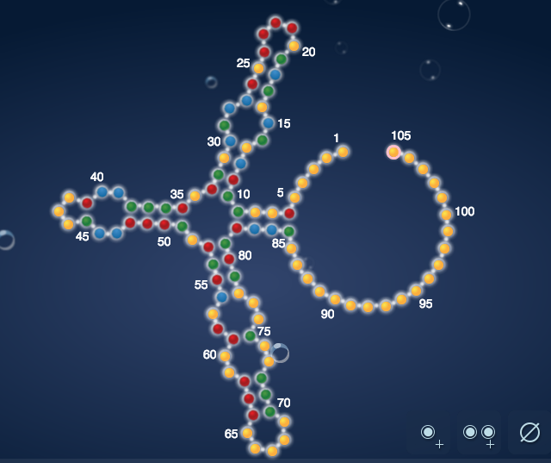
Results
Quasispecies 2-2 loop challenge
Didn’t solve

Slide 9
Conclusions
Can solve first 10 of Eterna100
Adding pairmaps helps
Solves faster
https://github.com/RK900/EternaBrain/blob/master/rna-prediction/predict_pm.py
Will need a more complex domain-specific pipeline for more complex puzzles
May need more complex CNN as well

Slide 10
Next Steps
Start working on switch puzzles?
Add more layers to CNN
Train on fastest solutions
Train on more puzzles to get more variation (perhaps all single-state puzzles, labs and progression)
Improve domain-specific pipeline
Can use Eternabot rules for this

Slide 11
Next Steps
Neuroevolution
After the net solves a puzzle, train on the same moves it made to make it better/faster
Problem: what if the net can’t solve a puzzle? Do I still train it on the moves it made?

