Slide 1


Children’s Education Society ®
The Oxford College of Engineering
Department of Computer Science & Engineering
Project Phase 2 - Review 1
TOPIC: Intelligent Cloud Resource Optimization Platform
Project Guide :
HOD
By -
Prithiviraj-1OX22CS002
Arun Kumar-1OX22CS028
Atharva Gupta-1OX22CS031
Dr E.Saravana Kumar
Dr Kanagavalli R

Slide 2
Introduction
In today's digital world, businesses face the modern cloud paradox: escalating costs with nearly 30% wasted spend, reactive management that hurts user experience, and expanding security risks.
To solve these challenges, we introduce the Intelligent Cloud Resource Optimization Platform.
Our platform is a unified, AI-driven solution that transforms multi-cloud management. It shifts operations from a manual, reactive model to a fully automated and predictive one, providing a single control plane for complete visibility. This enables organizations to proactively cut costs, guarantee application performance, and automate security across their entire cloud ecosystem.
The platform delivers on this promise through three core pillars:
Intelligent Storage Management: We leverage machine learning to analyze data access patterns, automatically tiering files to the most cost-effective storage layers and even predicting the optimal placement for new data on upload. This directly attacks the largest source of wasted spend.
Advanced Dynamic Computing: Our system moves beyond simple autoscaling. It uses predictive analytics to forecast future workload demands and proactively scales compute resources before a spike occurs, guaranteeing seamless application performance and eliminating over-provisioning.
Proactive Security and Observability: We embed security into your cloud operations by automatically detecting and encrypting sensitive data, managing access with temporary, least-privilege credentials, and logging every action in a centralized, auditable system.
In essence, the Intelligent Cloud Resource Optimization Platform empowers organizations to finally realize the full promise of the cloud—maximum efficiency, peak performance, and robust security—all managed effortlessly through a single, intelligent system.

Slide 3

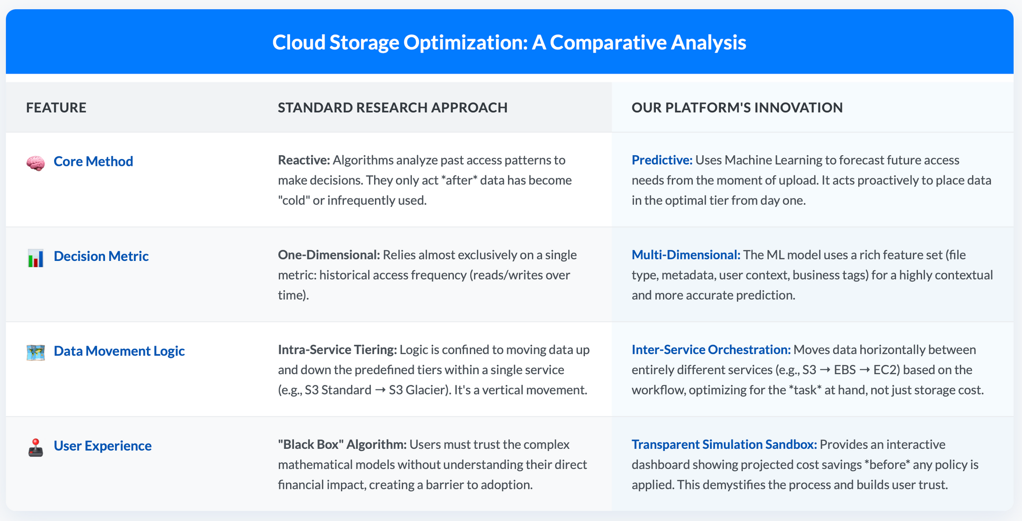
Abstract
Intelligent Storage Management
Cloud storage tier optimization through storage object classification
Published: 03 April 2024
Volume 106, pages 3389–3418, (2024)
4

Slide 4
Predictive & Automated Tiering
Step 1: Analyze the Upload
The moment a file is uploaded, an S3 Event instantly triggers an AWS Lambda function. This function acts as a quick analyst, immediately extracting key clues about the file's purpose, such as its type, size, and any project tags it might have.
Step 2: Predict the Future
These clues are immediately sent to our XGBoost Machine Learning model, which is hosted on Amazon SageMaker. The model's only job is to make a rapid, intelligent forecast, predicting the likelihood of the file being accessed frequently or rarely in the future.
Step 3: Place with Intelligence
Based on the model's prediction, the Lambda function takes immediate action. It moves the file directly to the most financially sensible storage tier—like S3 Standard for hot data or S3 Glacier for cold data. This single action eliminates the typical 30-90 day waiting period, saving money from the very first second.

Slide 5
Cross Platform Storage
Step 1: Holistic Data Ingestion
Our process begins by collecting a 360-degree view of your data's lifecycle. A scheduled job continuously gathers usage logs, access patterns, and performance metrics from all your connected cloud accounts (AWS and Google Cloud) and centralizes them in your MongoDB database.
Step 2: Two-Layered ML Analysis
Our Machine Learning model analyzes this holistic data in two distinct layers to form the perfect recommendation:
Layer 1 (Workload Analysis): The model first determines the best type of storage for the data's current job. It asks, "Does this data need high-performance Block Storage (EBS), shared File Storage (EFS), or simple Object Storage (S3)?"
Layer 2 (Cost Analysis): After determining the type of storage needed, the model then finds the cheapest providerfor it. It asks, "Is it cheaper to get this Object Storage from AWS or Google Cloud, considering all transfer and access costs?"
Step 3: User-Controlled Recommendation
The final, combined recommendation is presented to you on your dashboard in simple terms, such as: "Move archive.zip from AWS S3 to Google Cloud Storage to save $50/month." You have full control and approve the migration with a single click.
Step 4: Automated Orchestration
Once you approve, our backend takes over and executes the recommended move. This could be a simple, intra-AWS transfer using AWS DataSync or a more complex, multi-cloud migration using your own authorized account credentials.
Step 5: Update the Single Source of Truth
After a successful and verified transfer, the system's final, crucial step is to update the file's new location in your central MongoDB database. This ensures all your applications can instantly find the data in its new, optimized home without any code changes.

Slide 6
Cost Simulation Sandbox
Step 1: The User's "What-If" Click
On your dashboard, next to any recommendation (like "Archive Old Logs"), you click the "Simulate" button. This action tells our platform you want to see the financial impact before you agree to the change.
Step 2: Gathering the Data
An AWS Lambda function instantly queries your central MongoDB database. It gathers a complete list of every file that would be affected by the proposed policy, along with their size and current location.
Step 3: The Real-Time Calculation
Using live, up-to-the-minute data from the official AWS and Google Cloud Price List APIs, the system calculates three key numbers:
Your total current monthly cost for those files.
Your projected new monthly cost after the changes.
The one-time cost to perform the migration, including any expensive egress fees.
Step 4: The Clear Financial Report
The results are displayed back to you in a simple, visual report on your dashboard. You see the bottom line: the projected monthly savings, the upfront cost, and a "payback period." This gives you full financial transparency and the confidence to click the final "Approve & Execute" button.

Slide 7
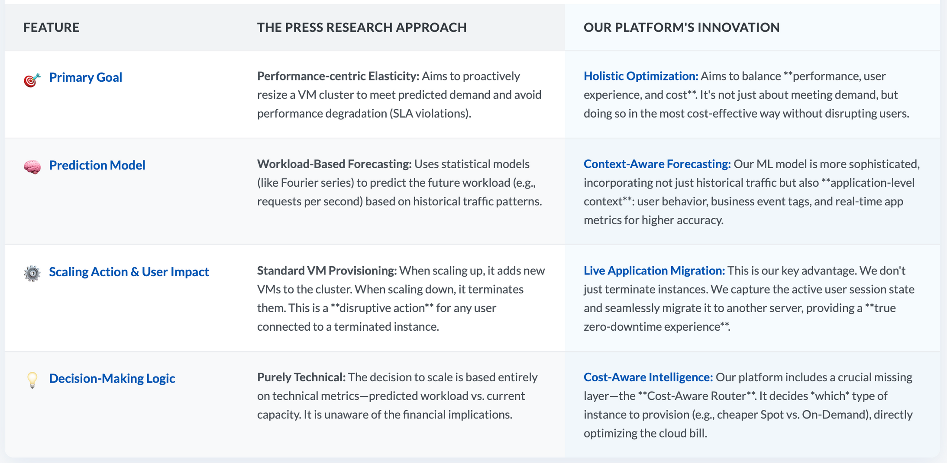
Advanced Dynamic Computing
The Research Paper: "PRESS: PRedictive Elastic ReSizing for Web Applications"
Conference: 8th International Conference on Autonomic Computing (ICAC '11)

Slide 8
Live Migration
Step 1: The Decision to Migrate
Our system first decides that a move is necessary to improve either performance, cost, or user experience.
Step 2: The Bulk Memory Copy
While the original Virtual Machine (VM) on Host A is still running and serving the user, the system begins copying its main RAM over the network to the new server, Host B. The user experiences no interruption.
Step 3: Tracking the Changes
The system then quickly copies over the small bits of memory that changed while the main copy was happening. This is an iterative "catch-up" phase to get the new VM almost perfectly in sync.
Step 4: The Millisecond Freeze & Switch
For a fraction of a second, the original VM on Host A is paused. In this tiny, imperceptible window, the final memory and CPU state are sent over, and the VM is instantly resumed on Host B, picking up exactly where it left off.
Step 5: The Network Redirect
The system instantly tells the network the VM's new physical address. All user traffic is seamlessly rerouted to Host B without dropping any connections. The original VM on Host A is then deleted.

Slide 9
Cost-Aware Routing
Step 1: Gather a 360-Degree Snapshot
A continuous monitoring loop is triggered. It instantly gathers a complete picture of the situation:
The Workload's State: Its current performance, the user's network latency, and its running cost.
The Cluster's Options: The current load, specs, and cost of every other available server in our Virtual Cluster.
Step 2: Calculate a "Suitability Score" for Every Option
The ML model analyzes the data and calculates a "Suitability Score" for every potential server. This score is a weighted combination of our three key business goals:
Performance: How much faster will the application run?
User Experience: How much will the user's latency improve?
Cost: How much money will be saved per hour?
The importance (weight) of each goal is adjusted based on the current operational policy, like "Max Performance Mode" or "Max Savings Mode."
Step 3: Execute the #1 Ranked Move
The system simply chooses the server with the single highest Suitability Score. It then initiates the Live Migrationprocess to seamlessly move the workload to this new, mathematically-proven optimal home.

Slide 10
Predictive Autoscaling
Step 1: Create a Diverse Fleet of VMs
We start by intentionally creating a mixed fleet of Virtual Machines, not a uniform one. This includes a variety of server types—like CPU-optimized, Memory-optimized, and cheap Spot Instances—to ensure we have the right tool for any job.
Step 2: Unify Them into a Virtual Pool
Our management software creates a "virtual" layer that logically groups this diverse, physically scattered fleet into a single, unified resource pool. This gives us one central "pane of glass" to see and control all our available computing power.
Step 4:Cost-Aware Routing
When our system decides to add a new server, it doesn't just grab the default option. This step acts as a smart financial advisor, automatically choosing the most cost-effective VM available that can handle the job. It intelligently prioritizes cheaper Spot Instances over expensive On-Demand ones, ensuring we meet the predicted demand at the lowest possible cost.
Step 5:Live Migration
This is our zero-downtime technology. When we need to move a user's workload to a better server (identified in the previous steps), we copy its live memory and state while the original is still running. The system then pauses the application for a fraction of a second to complete the switch. The user experiences no interruption, guaranteeing a perfectly seamless experience.
Step 3: Dynamically Adjust the Pool Size
This virtual pool isn't static. Our main Predictive Autoscaling model works at this level, automatically adding or removing VMs from the pool based on its forecasts of overall future demand. This ensures we always have the right mix and number of servers ready for the next step.

Slide 11
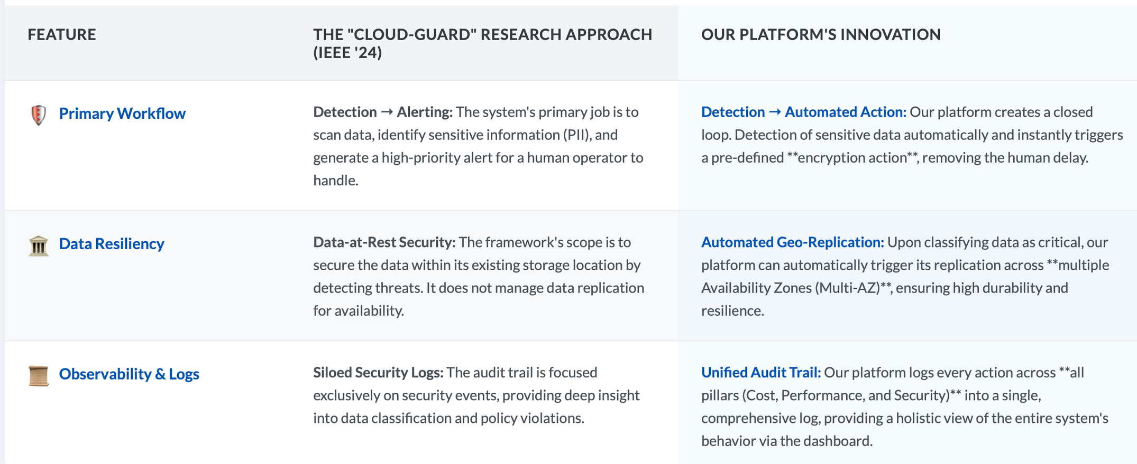
Proactive Security
Publication: IEEE Transactions on Cloud Computing
Published Date: 2024
(Volume): The specific volume number is not mentioned in the table, but the source is a 2024 edition of the IEEE journal.

Slide 12
Abstract
Automated Data Security
Step 1: The Instant Trigger The moment a file is uploaded, a free S3 Event immediately triggers our central AWS Lambda function, which operates entirely within the permanent free tier.
Step 2: The Two-Layer Open-Source Scan The Lambda function runs a self-contained, two-layer scan using free, open-source libraries packaged inside it:
First, a rapid Regex scan for simple, obvious patterns like API keys or credit card numbers.
If no match is found, it performs a deeper, contextual scan using a spaCy NER model to identify more complex PII like names and locations.
Step 3: The Free Automated Lockdown If the scan finds sensitive data, the Lambda function executes an instant, free lockdown protocol:
It applies free, default server-side encryption (SSE-S3) to make the file unreadable.
It attaches a permanent S3 Object Tag to label the file as "confidential" for all future operations.

Slide 13
Abstract
Automated Data Security
Step 1: The "Sensitive" Verdict
The process starts the moment our own free, open-source scanner finishes analyzing a newly uploaded file and concludes: "This file is sensitive."
Step 2: Tag It for a Special Journey
Our AWS Lambda function immediately attaches a specific digital "Post-it note" to the file—an S3 Object Tag that reads replication-scope=multi-region. This tag is a special instruction for the AWS system.
Step 3: AWS Takes Over the Transfer
AWS's own super-reliable, built-in feature, S3 Cross-Region Replication (CRR), is constantly watching for that specific tag. The moment it sees our tag, it automatically and securely copies the file in the background over its private global network to our pre-defined backup bucket in a different continent (e.g., from the USA to India).
Step 4: Geo-Redundancy Achieved
Within minutes, the sensitive file now exists in two physically separate locations across the globe. We have a primary copy for active use and a backup copy safe from any regional disaster, guaranteeing its security and availability.

Slide 14

Observability & Control
Cloud Mission Control Dashboard
A single-pane-of-glass for unified multi-cloud intelligence.
Financial Hub (FinOps)
Multi-Cloud Cost Tracking: View costs by service, project, or tag.
AI Anomaly Detection: Get alerts on unusual spending.
Savings Simulator: Model the impact of optimizations.
Budgeting & Forecasting: Track budgets with ML-powered forecasts.
Operations Hub (DevOps)
Global Health Map: Visualize the real-time health of all resources.
Predictive Scaling Visualizer: See proactive scaling actions before they happen.
Waste Finder: Identify and eliminate idle resources (zombie VMs, unattached disks)
Security Hub (SecOps)
Unified Alert Feed: A single, prioritized list of multi-cloud security threats.
Compliance Scorecards: Track compliance in real-time (CIS, GDPR, HIPAA).
Sensitive Data Mapping: Visually locate sensitive data across all storage.
Core Design
Role-Based Views: Customized for CTOs, Engineers, and Analysts.
Drill-Down Details: Navigate from summary views to individual resources.
Actionable UI: Resolve issues directly from the dashboard.
Centralized Dashboard

Slide 15
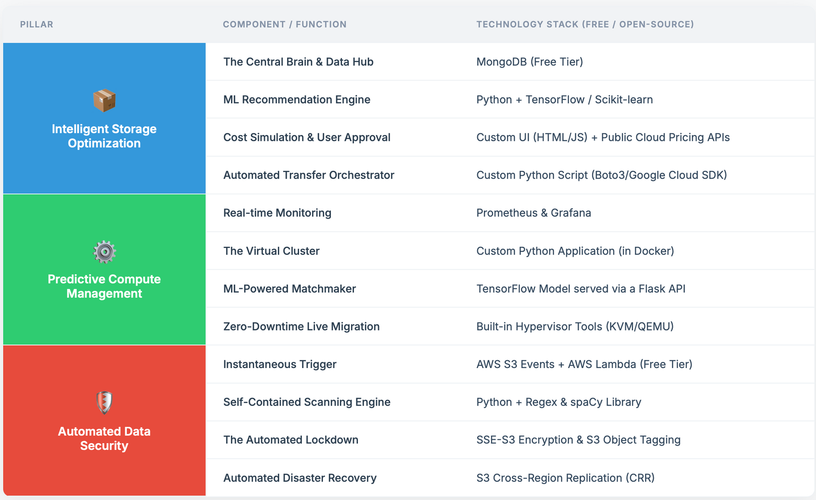
Methodology(System Design)
The components are outlined below:

Slide 16
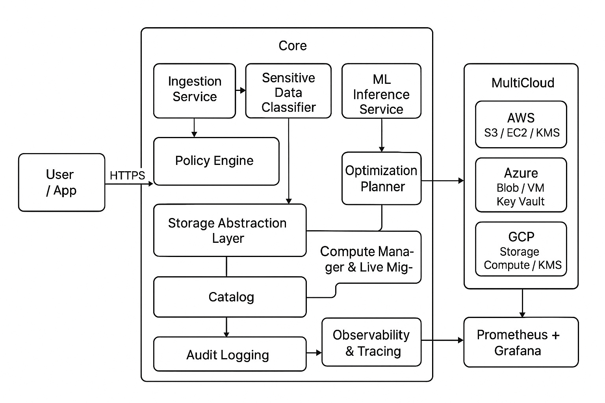
Architectural Diagram

Slide 17
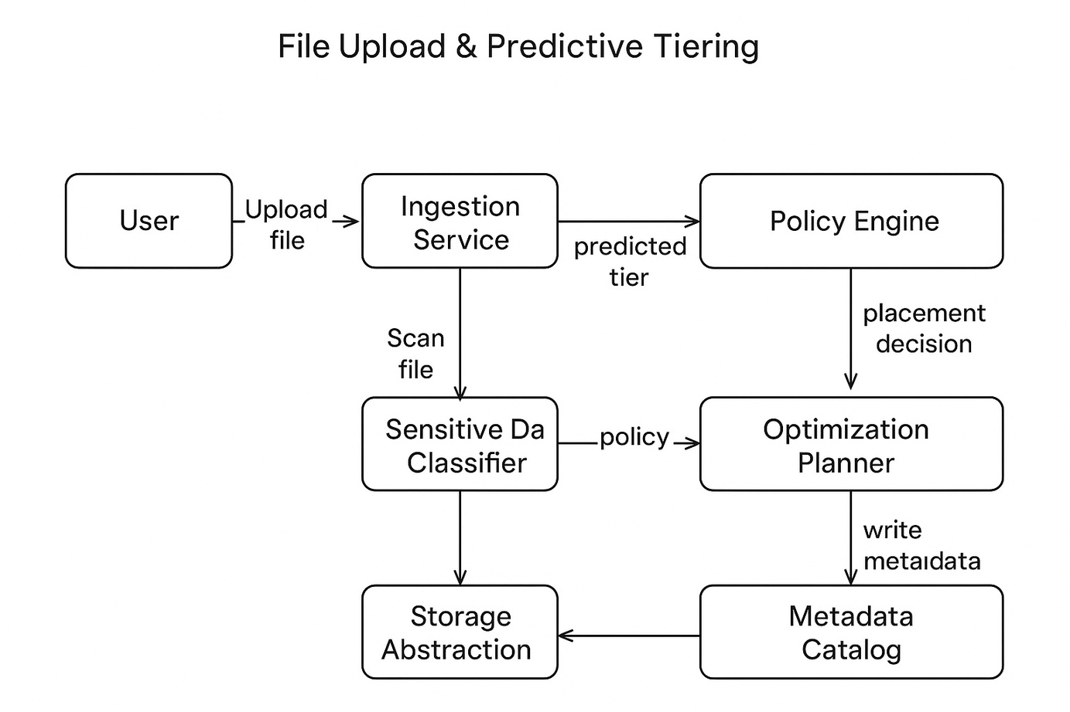
Flowchart

Slide 18
Conclusion & Next Steps
Our platform offers an intelligent, automated, and secure solution for cloud resource optimization. It empowers users to save money, boost performance, and maintain security effortlessly.
Key Takeaways:
Cost reduction through intelligent tiering and routing.
Enhanced performance via predictive autoscaling and live migration.
Robust security with automated encryption and least privilege access.
Centralized visibility for simplified cloud management.

