Slide 1


Machine learning for physics and astronomy chapter 3
Viviana Acquaviva

Slide 2
Performance Metrics

Slide 3
DT vs KNN recap
So far, we have looked at Decision Trees
and k Nearest Neighbors algorithm.
Let’s think about strengths and weaknesses.
Weaknesses:
Both: they work well only if they have seen similar examples.
Poor extrapolation properties, tend to squeeze distributions towards the mean
kNN: needs scaling otherwise one component may be dominant.
Can’t weigh different features differently
DT: can only split along features, feature engineering quite important.
Strengths:
DT: Interpretable, kNN: fast
Both: accurate if there is a well sampled learning set

Slide 4
Beyond accuracy
Until now, we have “judged” algorithms by the percentage of correct answers. This metric is called accuracy.
Now imagine building an algorithm to look for rare objects
(e.g. habitable planets).
The data contains 1,000 instances.
Of those, 10 belong to the “interesting” class.
(the data set is imbalanced: the target values
are not distributed uniformly).
You feel lazy and propose an algorithm
that says that there are no habitable planets.
What is its accuracy (% of correct predictions)?

Slide 5
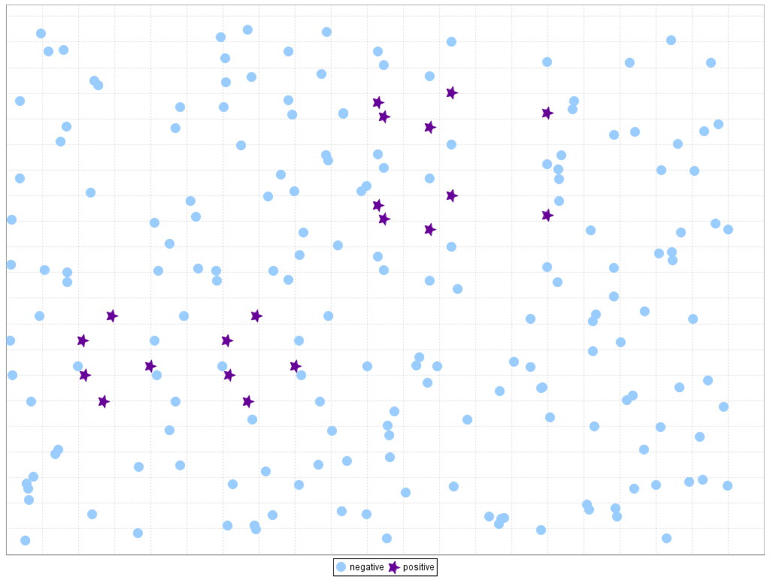
Picking a performance metric
“The accuracy paradox”
Accuracy = % of correct predictions
meaningless in
unbalanced
data set
For our dataset :
Accuracy = 990/1000 = 99.0%!

Slide 6
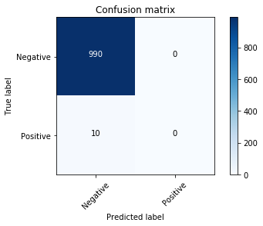
Evaluating classifiers performance: beyond accuracy
For a binary classifier where the “true”
or desired class is defined to be positive,
every metric is enclosed by four numbers:
TP = True Positives
TN = True Negatives
FP = False Positives
FN = False Negatives
0
990
0
10
Accuracy = % of correct predictions TP+TN/(TP+TN+FP+FN)

Slide 7
Alternative metrics
precision = percentage of correct positive classifications TP/(TP + FP)
recall = percentage of “caught” positive instances = TP/(TP+FN)
For our lazy classifier
TP = 0; TN = 990; FP = 0; FN = 10
Will have undefined precision and 0 recall
so we’ll be able to know that something is amiss.

Slide 8
Alternative metrics
In physics (or at least astrophysics), we often talk of precision
as purity, or 1 – precision as contamination
Recall is IMO best visualized as completeness
Another common one is F1-score = weighted avg of precision/recall
WHAT DO YOU CARE ABOUT?
The best metric can only be decided by you on the basis
of the science you want to do (can be custom!)

Slide 9
Precision vs recall
In general, there is a trade-off between precision and recall.
It’s hard to get both types of errors (FN and FP) down, but you can choose to have fewer errors of one type.
High precision: “Don’t waste my time” (few FP, more FN)
High recall: “Get them all” (few FN, more FP)
* Heard from Cassie Kozyrkov

Slide 10
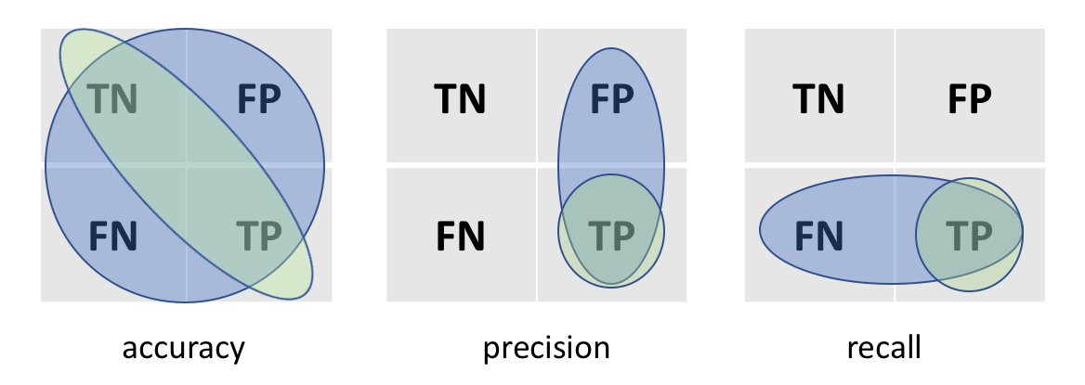
Visual Mnemonics: green over blue

Slide 11
A few words about ROC and AUC
ROC (Receiving Operator Characteristic) is
a plot of TPR (True Positive Rate) vs FPR (False Positive Rate)
TPR = TP/(TP+FN) = recall
FPR = FP/(TN+FP)
(swap F T in recall)
How can this be a plot?
The trick is to calculate it for different probability thresholds
of belonging to the positive class
(as opposed to the “standard” 0.5)

Slide 12
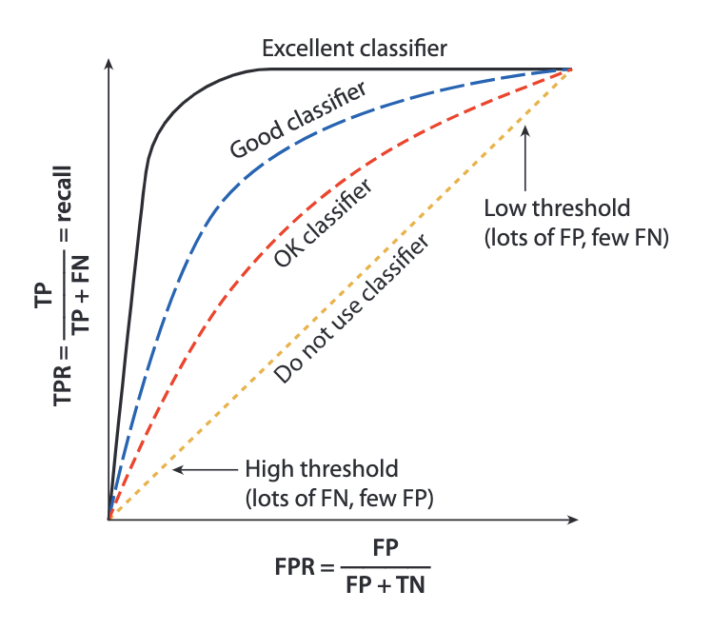
A few words about ROC and AUC
ROC (receiving operator characteristic) is
a plot of TPR (True Positive Rate) vs FPR (False Positive Rate)
FPR = FP/(TN+FP)
(swap F->T in recall)
TPR = TP/(TP+FN) = recall
AUC =
area under
the curve
Notes:
Think about what happens for the perfect classifier, a crappiest classifier

Slide 13
Metrics: Optimizing vs viewing
Important:
There is a big difference between choosing the optimal metric (e.g., precision vs accuracy) when comparing models (for example, when we choose between kNN or DT or when we select parameters) and choosing the metric that is optimized when building models.
For example, in a decision tree, would choosing accuracy or recall change the optimal splits of a given training set?
Why or why not?
Many algorithms, especially in sklearn, have a hard coded loss function.

Slide 14
Good practices: cross validation

Slide 15
The goal of the training set and test set split is to be able to evaluate performance on unseen examples.
The test set “mimics” new data.
However, it might be better to pick
more than one test split.
Why would this be a good idea?

Slide 16
1. We use all the training data
2. We avoid the risk of under/overestimating performance because of a “non-typical” pick of train/test split.
3. We get an estimate how how much scores fluctuate because of variance in data.
(think about what happened with our two train/test splits for DT/kNN)
Note: issues are particularly relevant when the learning set is small.

Slide 17

k-FOLD CROSS VALIDATION
LEARNING SET
TRAIN
TEST
5 folds (k = 5)

Slide 18
k-FOLD CROSS VALIDATION
LEARNING SET
TEST
TRAIN
5 folds (k = 5)

Slide 19
k-FOLD CROSS VALIDATION
LEARNING SET
TRAIN
TEST
5 folds (k = 5)

Slide 20
k-FOLD CROSS VALIDATION
LEARNING SET
TRAIN
TEST
5 folds (k = 5)

Slide 21
k-FOLD CROSS VALIDATION
LEARNING SET
TRAIN
TEST
5 folds (k = 5)

Slide 22
k-FOLD CROSS VALIDATION
LEARNING SET
We use all learning data
(all objects are equally represented)
The mean/standard deviation
of scores vector
gives us an idea of average performance + uncertainty
☹ It takes 5x more time to run
TRAIN
TEST
5 folds (k = 5)

Slide 23
Diagnosing and Improving
Machine Learning algorithms

Slide 24
Diagnosing a ML algorithm
BIAS
VARIANCE
Algorithm
can’t capture
complexity
of rule
connecting
input and output
Algorithm
is excessively
tailored
to training set
and generalizes
poorly
UNDERFITTING
OVERFITTING

Slide 25
BIAS vs variance
Linear model
Degree 2 polynomial
High-degree polynomial
y
y
y
x
x
x
Not enough complexity:
high bias/underfit
Good trade-off
between complexity
and performance
Excessive complexity:
high variance/overfit
Slide inspired by Andrew Ng

Slide 26
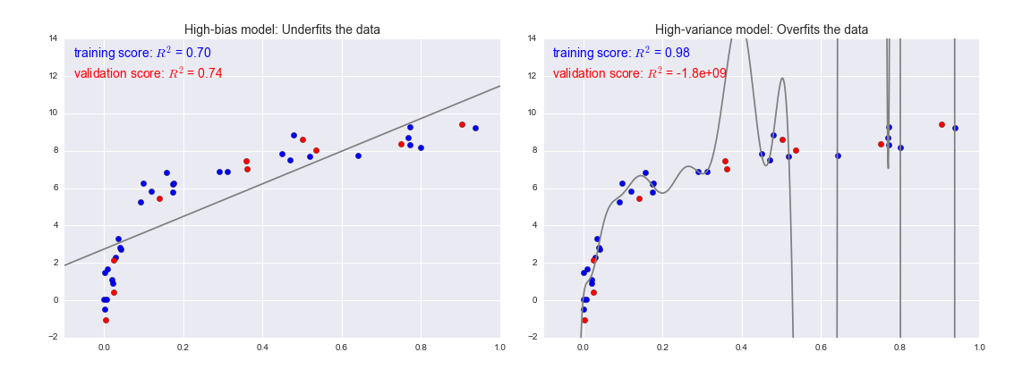
How can we diagnose high variance vs high bias?
Figure credit: Jake VanderPlas
High bias: test and train error are
similar but high
High variance: there is a gap between test and train error because algorithm does not generalize well

Slide 27
Improving high bias
Try using different features.
Try engineering new features.
Try a more complex algorithm/change parameters.
Improving high variance
Try reducing the number of features.
Try a less complex algorithm/change parameters/
Add regularization.
Also: Check if you need more training data.
Also: take all this with a huge grain of salt.
Not mutually exclusive, really meant as diagnostics.

Slide 28
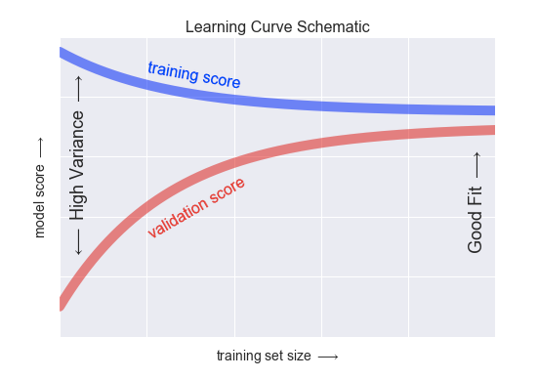
Useful diagnostic tool: learning curves
plot performance of algorithm for train and test set
as a function of size of training set
curve is flat = more
data doesn’t help
scores still changing:
more training data please
test score
Figure credit:
Jake VanderPlas

Slide 29
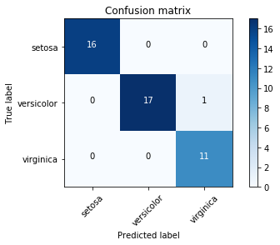
What happens for non-binary classifiers?
The confusion matrix can be built normally
class 1
class 2
class 3ss
class 1
class 2
class 3ss
Note: in this case accuracy is still the % of correct predictions, but precision and recall require you to define a “positive” class and do one-vs-all
(plus choose micro/macro averaging if you want one number)
Notes:
Micro: PR = (TP1+TP2+… )/(TP1 + TP2 + … FP1 +FP2…)
Macro: Average (PR1 + PR2 …. )/k

Slide 30
Note: which algorithm is the best?
A) High bias low variance
B) High variance low bias
C) Lowest gap between train/test scores
D) Highest test scores

Slide 31
Note: which algorithm is the best?
A) High bias low variance
B) High variance low bias
C) Lowest gap between train/test scores
D) Highest test scores

Slide 32
Updated Summary of how to build a ML model
Choose a class of model (aka a machine learning algorithm) by importing the appropriate estimator class from Scikit-Learn.
Choose model hyperparameters by instantiating this class with desired values. Alternatively: optimize hyperparameters (later).
Arrange data into a feature matrix and target vector, if necessary.
Split the learning set into training/test using k fold cross validation.
Build the model to your data by calling the ``fit()`` method.
Apply the model to new data: predict labels for unknown data using the ``predict()`` method.
Estimate the performance (averaged over the k folds) by using one of the metrics in the "metrics" method of the model instance (accuracy, precision, recall … or custom).
Figure out what is not working out: Check training vs test score, learning curves, diagnose high variance vs high bias and decide how to move forward.

Slide 33
