Slide 1


Machine learning for physics and astronomy chapter 6
Viviana Acquaviva

Slide 2
THE POWER OF ENSEMBLING:
BAGGING AND
BOOSTING METHODS

Slide 3
ENSEMBLING
The main idea of ensembling is to combine base estimators (usually, weak learners) to obtain a more powerful (e.g. accurate, or robust) estimator.
Very often, the base estimator is a Decision Tree (or stump, which is a 1-split tree).
The name “bagging” comes from Bootstrap AGGregating. Boosting is just boosting, no acronym.
Bagging methods like Random Forests, Extremely Random Trees work by building full base estimators (trees) in parallel and then averaging the predictions.
Boosting methods (like AdaBoost or XGBoost) work sequentially: a weak learner (sometimes a small tree, or stump) is created and used to make predictions, then the next step focuses on getting the problematic examples right and this procedure is applied iteratively.
The common wisdom is that bagging is used to reduce variance, boosting to reduce bias. But I really think that this depends on the base learner and the ensemble method.

Slide 4
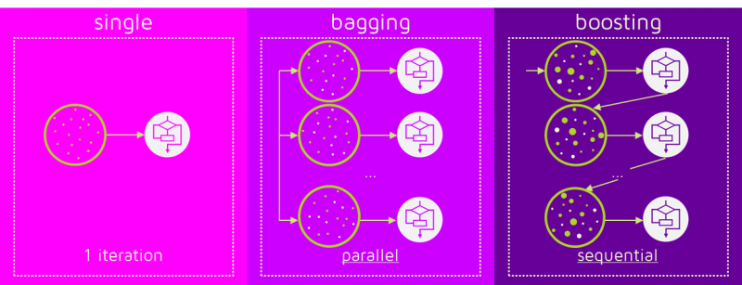
BAgging vs boosting
Bagging: learners are independent of each other.
Boosting: new learner is adjusted on the basis of previous steps.
Figure credit:
https://quantdare.com/what-is-the-difference-between-bagging-and-boosting/
(reproduced with permission)

Slide 5
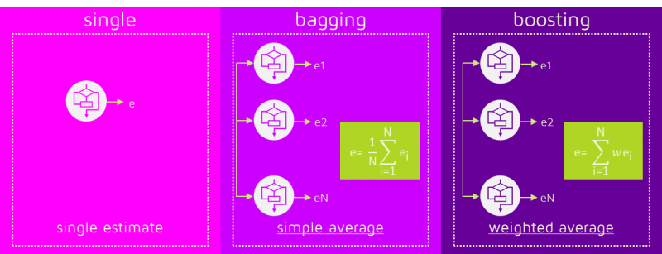
BAgging vs boosting
In Bagging algorithms, all models have equal weight.
In Boosting algorithms, the weight of different learners (weak models, e.g. stumps or shallow trees)
in the final classification depends on their performance.
Figure credit:
https://quantdare.com/what-is-the-difference-between-bagging-and-boosting/
(reproduced with permission)

Slide 6
DECISION TREES RECAP
☺
☹
INTERPRETABLE
FAST
ACCURATE (LOW BIAS)
USUALLY HIGH VARIANCE!
WHY?
It is VERY EASY to overfit (keep splitting more than necessary),
which makes for poor generalization.

Slide 7
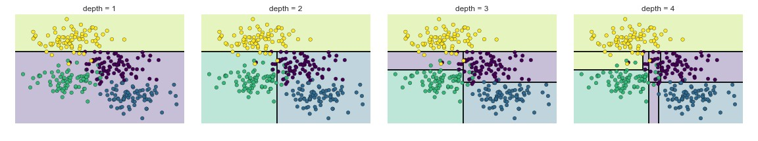
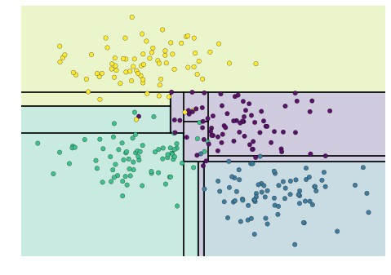
example
Figure credit: Jake Vanderplas (https://jakevdp.github.io/PythonDataScienceHandbook/06.00-figure-code.html#Decision-Tree-Levels)
depth = 5
Traditional approach: “prune” trees
(get rid of small leaves)
Notes:
Note: The notebooks are publicly available

Slide 8
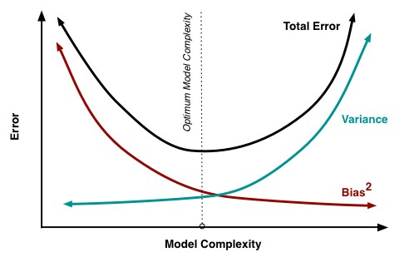
HOW CAN WE IMPROVE?
CONSIDER BIAS/VARIANCE DECOMPOSITION
For the mean squared error loss, the bias-variance decomposition of the expected generalization error at X = x is
MSE(x) =
noise(x)+bias²(x)+var(x)
P
Remember that this plot is not necessarily correct, but the idea of exploring
a different combination of bias-vs-variance error budget holds.
Idea: If we are willing to take a hit in bias, we can reduce variance by combining RANDOMIZED trees,
and still have an improved model (= lower test scores).
Figure from Fortman-Roe 2012

Slide 9
THEOREM:
WE CAN further decompose the VARIANCE AS follows.
MSE(x) = noise(x) + bias²(x) + var(x)
and
noise(x) = Err (𝒚(x)),
bias²(x) = 𝐄[𝒚(x) − y(x)]²
var(x) = ρ(x) σ ²(x) + ^{𝟏 -𝝆(𝒙)} σ ² (x)
where σ is the variance of a single tree, M is the number of trees, and ρ(x) is the Pearson correlation coefficient between the predictions of two randomized trees built on the same learning set.
𝑴
Slide adapted from Gilles Louppe; see arXiv:1407.7502 for derivation

Slide 10
notes on bias and variance for a set of randomized trees (FOREST)
Bias: Identical to the bias of a single randomized tree.
Variance: var (x) = ρ(x) σ ²(x) + ^{𝟏 -𝝆(𝒙)} σ² (x)
M
As M → ∞, var (x) → ρ(x) σ²(x)
Stronger randomization, ρ(x) → 0, var(x) → 0
Weaker randomization, ρ(x) → 1, var(x) → σ² (x)
Bias-variance trade-off take-home point: Randomization increases bias but makes it possible to reduce the variance of the corresponding ensemble model. The crux of the problem is to find the right trade-off (reducing variance does not guarantee higher test scores!)
Slide adapted from Gilles Louppe; see arXiv:1407.7502 for derivation

Slide 11
how do we build randomized trees?
Bootstrap samples (with replacement)
}Random Forests
build different learning sets using bootstrap
Random selection of K ≤ p split variables
choose best split not among all features, but among some random ones
Random selection of the threshold
} Extra
Random
Trees
threshold value for split is chosen at random
These become hyper parameters of the model, as we will see in the coding part.

Slide 12
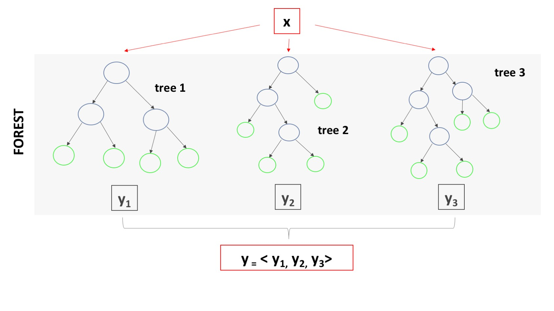
HOW TO COMBINE TREES?
The final prediction (class, or number) is the
average of all predictions
(for a regression problem),
or the majority vote
(for a classification problem)

Slide 13
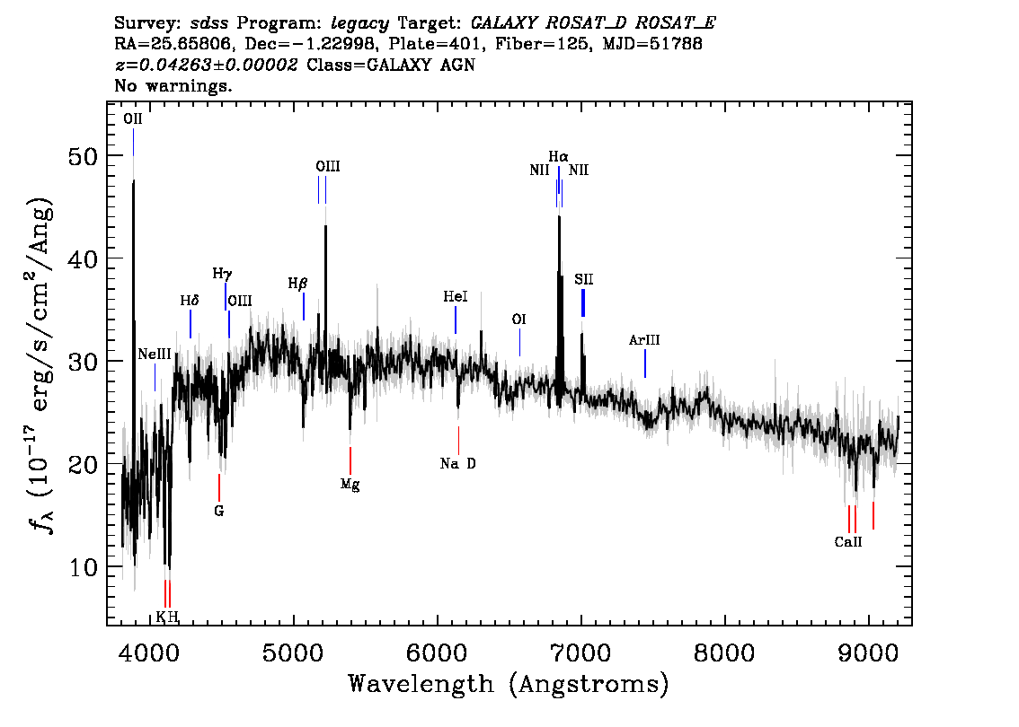
APPLICATION:
PHOTOMETRIC REDSHIFTS
A spectrum is a high-resolution chart of brightness vs wavelength.
For galaxies that are further away, the spectrum
is stretched
(all the wavelengths are longer).
Spectra contains spikes and dips, which corresponds to known transition in basic atoms (e.g., H, O).
If I can identify the emission lines I see (from the structure – one is not enough!), I can calculate the amount of stretch, which is 1 + z
(a Doppler effect, essentially!)
Example spectrum from the SDSS survey

Slide 14
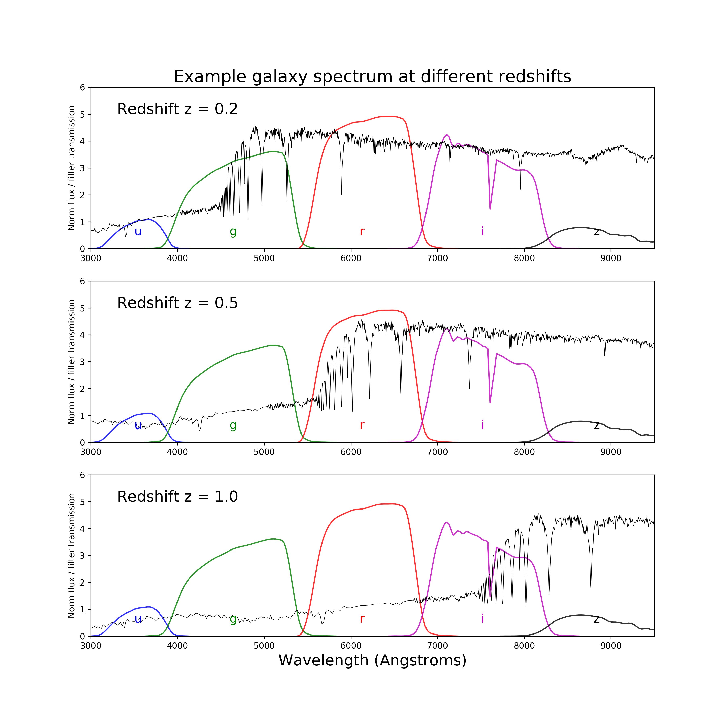
IT IS MUCH MORE CHALLENGING TO DO THE SAME THING THROUGH A DILUTED MAP
(PHOTOMETRY)
In this case, we only have the average brightness over wide range of wavelengths, called filters or bands (1000s of Angstroms).
Much more challenging/less accurate, but a lot cheaper to obtain!
Photo-z can be derived for billions of galaxies.
Spectroscopic redshifts (derived from line identification) can be used as a learning set for photometric redshifts.

Slide 15
Ensembling FTW:
BOOSTING METHODS

Slide 16
Boosted ensemble methods
(Gradient Boosted Trees, AdaBoost, XGB, LIGHTGBM…)
Tree-based boosting methods are the most common.
They work sequentially: a small tree (sometimes called a stump) is created and used to make predictions, then the next step focuses on getting the problematic examples right and this procedure is applied iteratively. They are multi-stage estimators.
There are two main schools of thought:
1. Update weights of each example (AdaBoost)
2. Update loss function (GBTs & friends)
Also, the ensembling can combine different stage-estimators with non-uniform weights.

Slide 17
My personal observations re: Boosting
It’s not true that boosting would help any weak learner.
There is a “boost-worthiness” threshold!
In classification problems with majority vote (i.e. Random Forests) where all estimators count equally, “slightly better than random” is the key to ensembling
In regression problems, it’s less clear what makes a base learner boost-worthy.
However/additionally, this is different from algorithm to algorithm.
I think one can empirically look at different stages and see if scores are improving when more stages are added, but I haven’t seen much literature on the subject.

Slide 18
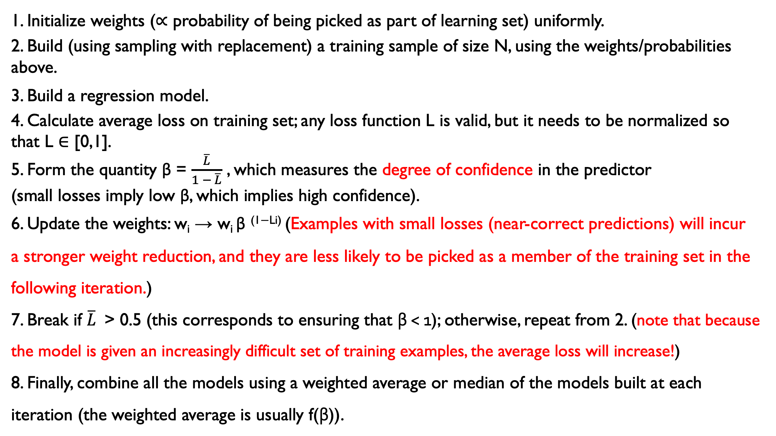
AdaBoost (Adaptive Boosting) pseudo-code
1. Initialize weights (∝ probability of being picked as part of learning set) uniformly.
2. Build (using sampling with replacement) a training sample of size N, using the weights/probabilities above.
3. Build a regression model.
4. Calculate average loss on training set; any loss function L is valid, but it needs to be normalized so that L ∈ [0,1].
5. Form the quantity β = $\frac{\overline{L}}{1 − \overline{L}}$ , which measures the degree of confidence in the predictor
(small losses imply low β, which implies high confidence).
6. Update the weights: w_{i} → w_{i} β ^{(1−Li)} (Examples with small losses (near-correct predictions) will incur
a stronger weight reduction, and they are less likely to be picked as a member of the training set in the following iteration.)
7. Break if $\overline{L}$> 0.5 (this corresponds to ensuring that β < 1); otherwise, repeat from 2. (note that because the model is given an increasingly difficult set of training examples, the average loss will increase!)
8. Finally, combine all the models using a weighted average or median of the models built at each iteration (the weighted average is usually f(β)).

Slide 19
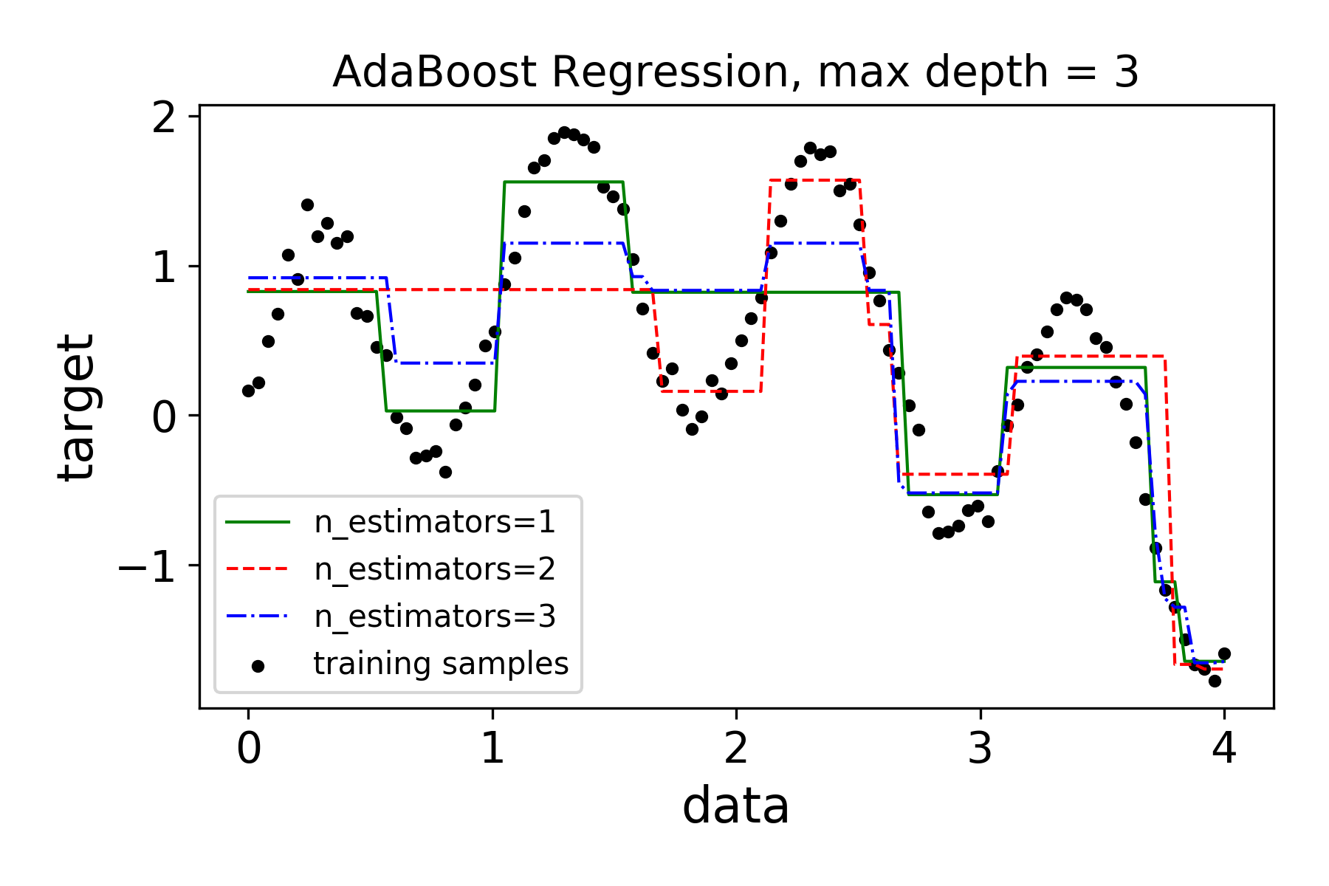
Toy model with AdaBoost
base
learner
not strong
enough

Slide 20
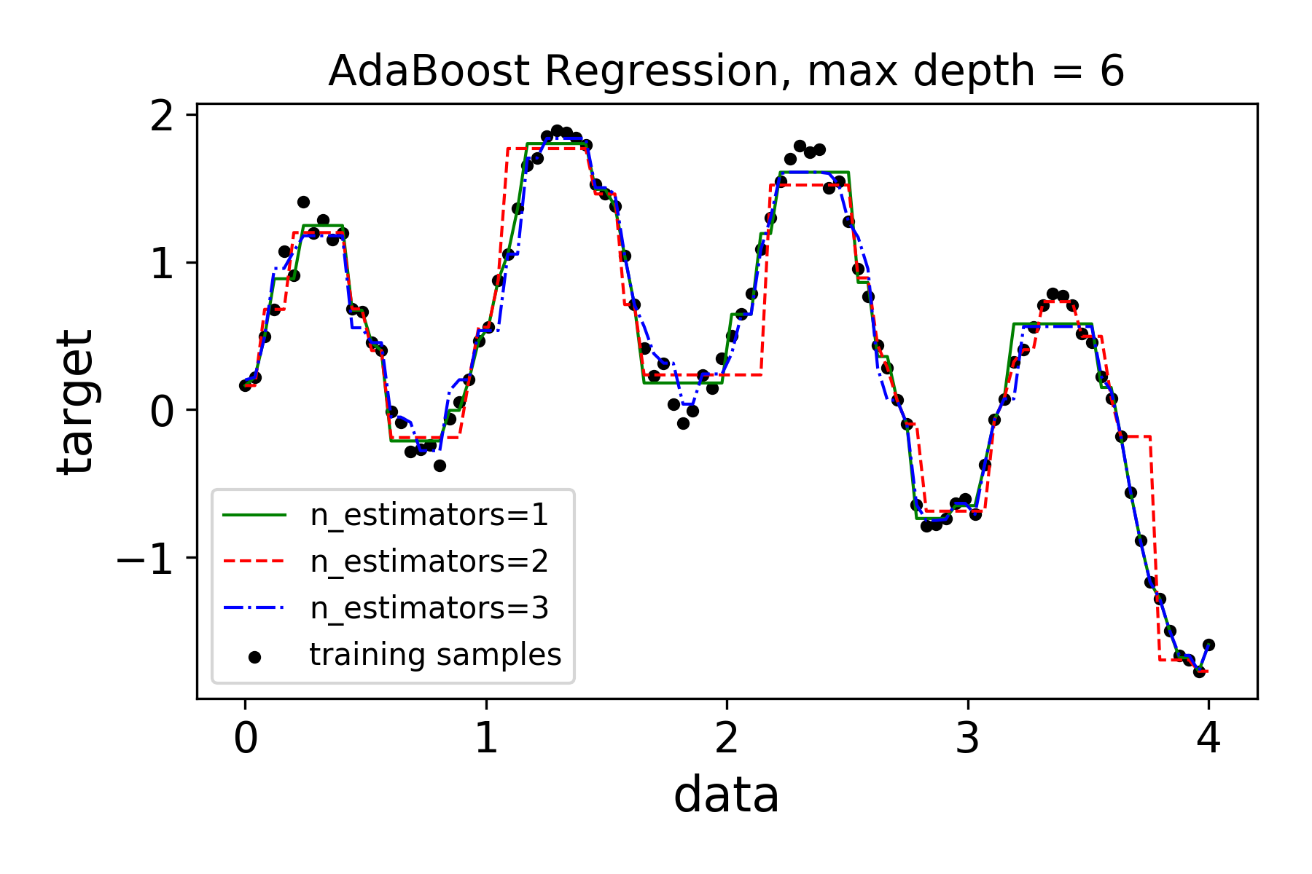
Toy model with AdaBoost
base
learner
strong
enough

Slide 21
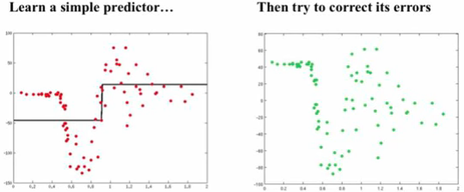
Gradient Boosted Trees
Simple idea:
1. Start with a weak learner (e.g. 1-split tree) and fit a model F to data y: F₁(x) = y
2. Calculate residuals (i.e., where model is failing) F₁(x) – y and make model h(x) that fits the residuals
3. Update model: F₂(x) = F₁(x) + h(x)
4. Repeat from 1, until convergence
Example credit: Alexander Ilher

Slide 22
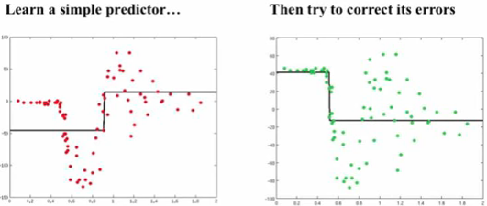
Gradient Boosted Trees
Simple idea:
1. Start with a weak learner (e.g. 1-split tree) and fit a model F to data y: F₁(x) = y
2. Calculate residuals (i.e., where model is failing) F₁(x) – y and make model h(x) that fits the residuals
3. Update model: F₂(x) = F₁(x) + h(x)
4. Repeat from 1, until convergence
Example credit: Alexander Ilher

Slide 23
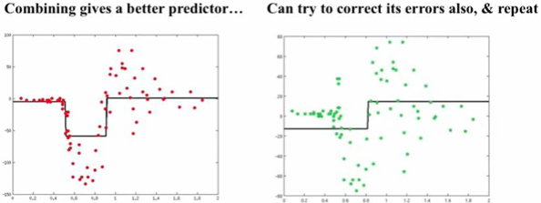
Gradient Boosted Trees
Simple idea:
1. Start with a weak learner (e.g. 1-split tree) and fit a model F to data y: F₁(x) = y
2. Calculate residuals (i.e., where model is failing) F₁(x) – y and make model h(x) that fits the residuals
3. Update model: F₂(x) = F₁(x) + h(x)
4. Repeat from 1, until convergence
Example credit: Alexander Ilher

Slide 24
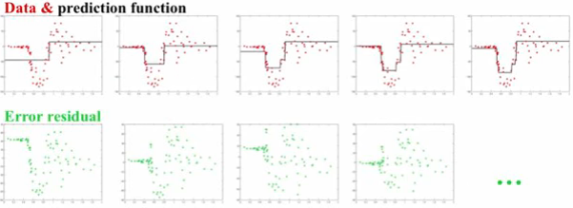
Gradient Boosted Trees
Simple idea:
1. Start with a weak learner (e.g. 1-split tree) and fit a model F to data y: F₁(x) = y
2. Calculate residuals (i.e., where model is failing) F₁(x) – y and make model h(x) that fits the residuals
3. Update model: F₂(x) = F₁(x) + h(x)
4. Repeat from 1, until convergence
Example credit: Alexander Ilher

Slide 25
Let’s put the “Gradient” in GBM
The general idea of “Gradient Descent” is that the most efficient way to minimize a function is to move in the direction of the loss function’s negative gradient.
If we want to minimize the loss function, we can fit a model iteratively to its negative gradient components.
In fact, fitting the residuals works because the residuals are the derivative of the mean square error function.

Slide 26
Let’s put the “Gradient” in GBM
Modified idea to work with any differentiable loss function L:
Initialize F to median of y
Calculate pseudo-residuals = - dL/dF
Fit model to pseudo - residuals, h(x)
Make new model: F₂(x) = F₁(x) + α* h(x) (α = learning rate)
Repeat from 2, until convergence
The learning rate is a parameter of boosted models (shrinkage).
Small α values require larger # of iterations but often gives better predictions
α can be chosen on a step-by-step basis and becomes the weight of each predictor in the final ensemble.

Slide 27
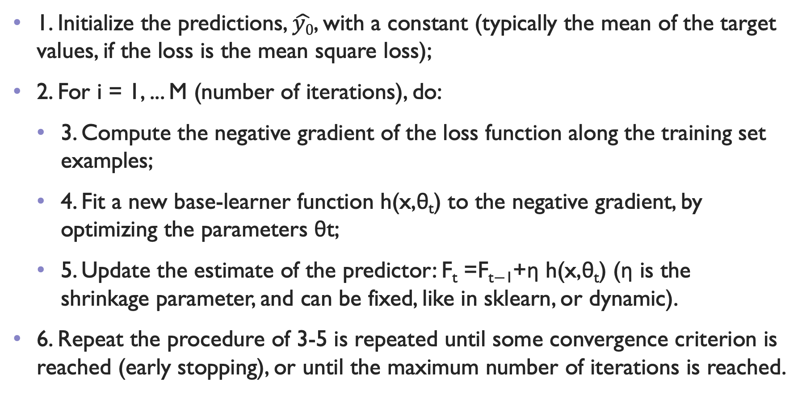
GBT pseudo code
1. Initialize the predictions, $\hat{y0}$, with a constant (typically the mean of the target values, if the loss is the mean square loss);
2. For i = 1, ... M (number of iterations), do:
  3. Compute the negative gradient of the loss function along the training set examples;
  4. Fit a new base-learner function h(x,θ_{t}) to the negative gradient, by optimizing the parameters θt;
  5. Update the estimate of the predictor: F_{t} =F_{t−1}+η h(x,θ_{t}) (η is the shrinkage parameter, and can be fixed, like in sklearn, or dynamic).
6. Repeat the procedure of 3-5 is repeated until some convergence criterion is reached (early stopping), or until the maximum number of iterations is reached.

Slide 28
Questions:
- do you think that GBT will work even with weak base learners?
- do you think that they are more likely to overfit or underfit?

Slide 29
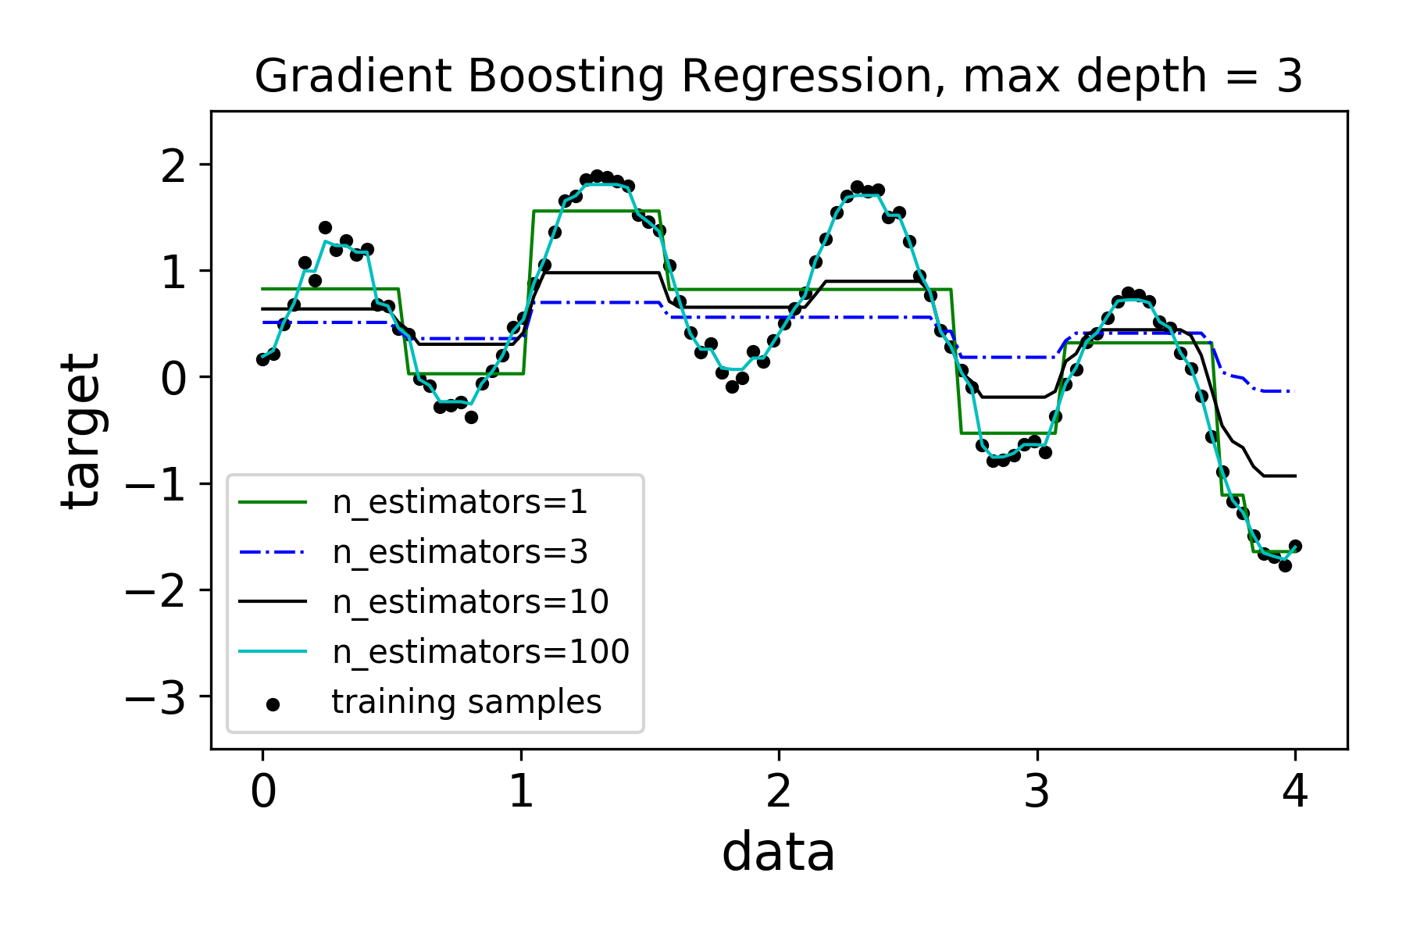
GBT on toy model

Slide 30
Issues with GBT: very easy to overfit → regularization is needed!
Regularization can be applied in various ways:
Shrinkage: We can choose a small value (< 1) for the coefficient η, also known in sklearn as learning rate, which regulates the contribution of each new correction to the current model. A GBT model with smaller values of η will take longer to achieve the same accuracy; there is a trade-off between the number of iterations and the learning rate.
Subsampling: We might select a random fraction of the data (with or without replacement) in order to fit each step. The smaller the fraction, the stronger the regularization.
Random feature selection: We might use only a random subset of features at each step. This randomization technique is “borrowed” from bagging algorithms such as Random Forests, where it is similarly used to reduce the variance of the single estimator.

Slide 31
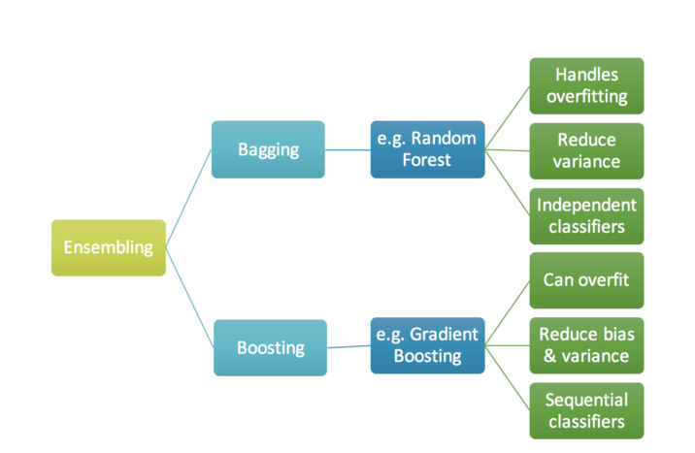
Pros and Cons Summary
*
with regularization
Source: https://nbviewer.jupyter.org/github/groverpr/Machine-Learning/blob/master/notebooks/01_Gradient_Boosting_Scratch.ipynb

Slide 32
What can you use Bagging/Boosting methods for?
Both classification and regression problems!
You can also always turn a classification problem into a regression problem by predicting a probability that on object belongs to a certain class
They are an all-purpose, generally fast and accurate sets of algorithms
For tabular data (where you don’t need to learn a representation, i.e., you are satisfied with your original feature space), often the best method out there (see this thread)

Slide 33
Variable importance
A cool feature of ensemble methods is that it is easy to build an understanding of
which features carry the majority of the relevant information.
Typically, variables are ranked according to two criteria:
The mean decrease of impurity (MDI) : summing total impurity reductions at all tree nodes where the variable appears (Breiman et al., 1984);
The mean decrease of accuracy (MDA) : measuring accuracy reduction on out-of-bag samples when the values of the variable are randomly permuted (Breiman, 2001).

Slide 34
Variable importance
A variable is most important if it leads to a large Mean Decrease of Impurity or Mean Decrease of Accuracy (in other words, it has a large impact on the performance).
Feature ranking can be used to gain understanding of the data and to reduce the size of a data set (for example, one can feature-rank the original data set and picked the first x out of y features, using information loss as a guidance).
Cool example:
Here!

Slide 35
Too good to be true?
Yes.
High cardinality features tend to be picked more often, because they have more “capacity”. It took me a while to understand this issue; reading this helped.
The feature importance is calculated using the training data. If the model overfits, we can’t trust the ranking (the model could be just picking up a lot of noise).
Highly correlated features will “split” the importance (this is the bane of my existence as an Astrophysicist!)
Solution for 1: permutation-based feature importance (the decrease in a model score when a single feature value is randomly shuffled).
Solution for 2: use not the most performant model, but a robust (low-bias) model for the FI.
Solution for 3: Do clustering on highly correlated features to pick the centroid feature and then do feature importance. I am applying it right now to SED fitting problem, will report!

Slide 36
FEATURE IMPORTANCE
WITH OTHER ALGORITHMS?
It is possible!
If computational power is not an issue, my favorite method is
Start from all features and compute cross-validated score
Do the same for all combinations of N-1 features; discard feature that makes the smallest difference
Continue iteratively
Another option (if computational power is an issue) is to start from one feature and build up the model (considering N+1 features at each step)
SHAP values work in a similar manner

Slide 37
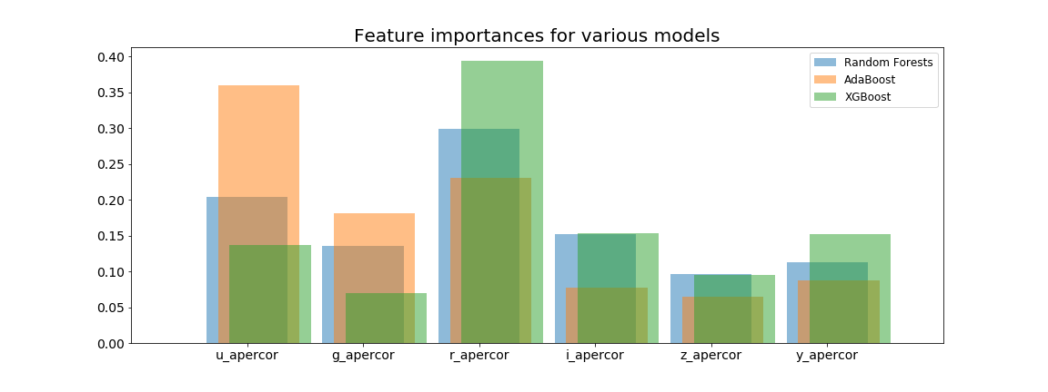
ARE feature importances algorithm-dependent?
BUT OF COURSE!
This example shows the feature importance derived for the photometric redshift problem for three ensemble methods.
Take-home point: you can use these methods to discard unimportant features quite safely, but take the ranking with a huge grain of salt.

Slide 38
References / Further Reading
On Random Forests:
Gilles Louppes Ph. D. thesis (Random Forests: from Theory to Practice)
arXiv preprint arXiv:1407.7502
Jake VanDerPlas, the Python Data Science Handbook, “In depth: Random Forests”
On Boosted Trees:
https://www.youtube.com/watch?v=sRktKszFmSk
https://www.gormanalysis.com/blog/gradient-boosting-explained/
https://medium.com/mlreview/gradient-boosting-from-scratch-1e317ae4587d
or (https://nbviewer.jupyter.org/github/groverpr/Machine-Learning/blob/master/notebooks/01_Gradient_Boosting_Scratch.ipynb) not sure of original source…
On Interpretability tools: I made a short document that may be a useful starting point.

