Slide 1

Building blockchain skeleton
Lior Gordon ,308140631
Ram Pakanayev ,313561433

Slide 2
Completed assignments:
A. BloomFilter library
B. MerkleTree library
C. Transaction confirmation
D. 30 Transaction logs
E. Blockchain building - (i-iv)
F. Burning coins code
G. Printing the balance sheet of each wallet, and required final parameters

Slide 3
Known bugs:
Connects to peer without private key. Mining will happen anyway.
Issue saving transaction logs in file
Double rewards when loading log file
Weird total coin behaviour that requires investigation
A bug exists in which mined blocks are only sent to a single SPV node. A workaround for this issue is for the SPV node to request chain history headers using the 'getHeaders' command.
It is uncertain whether the NULL signature for burn transactions is a bug or intended behavior. This occurs because burn transactions are added by the full node, which does not have access to the private key of the sender.
There was difficulty serializing and deserializing Block objects, resulting in a bug where chain history blocks are not saved. Instead, all transactions are saved.
When transaction history is loaded, the transactions are remined, resulting in double rewards for the original miner and the miner who loaded the history.
There is a bug in which an SPV node sometimes prints requests to a full node twice.

Slide 4
Dependencies:
Elliptic - elliptic curve cryptography
express - web app framework
secp256k1 - elliptic curve hash for keys
fully-connected-topology - p2p library

Slide 5
Setup instructions:
First, install dependencies with the following command in the console:
npm install elliptic express secp256k1 fully-connected-topology
Make sure you are in the right directory as the files are, if not use the command “ls” to see list of files, and “cd [directory]” to move to the right directory.”
To activate the blockchain, use the command:
Node fullNode 4000 4001 4002
To activate both the SPV Wallets, type the following commands:
Node SPV 4001 4000 4002
Node SPV 4002 4002 4000

Slide 6
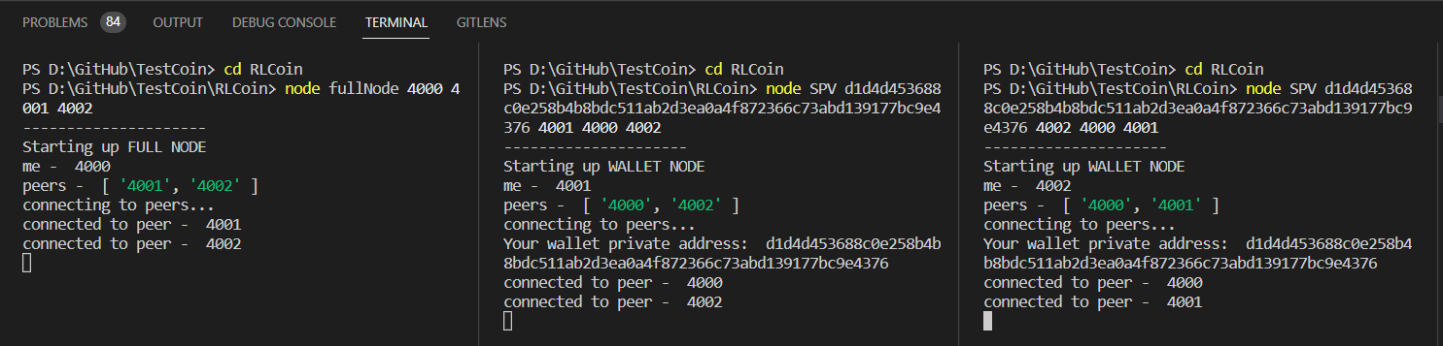
Console:
Connecting to peers between 3 nodes
Notes:
אולי למחוק את ה "Your " בWallet private adress ?

Slide 7
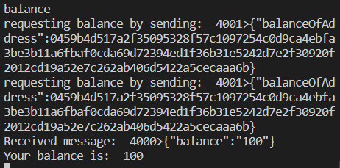
balance - returns balance in wallet

Slide 8


getTotalCoins - returns coins in chain
In SPV.js, type ‘getTotalCoins’ command:
Response in fullNode.js:

Slide 9

getTotalMinedCoins - returns the total amount of mined coins
SPV.js:
fullNode.js:

Slide 10
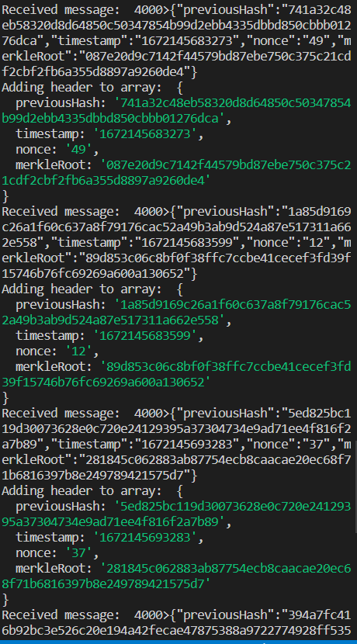
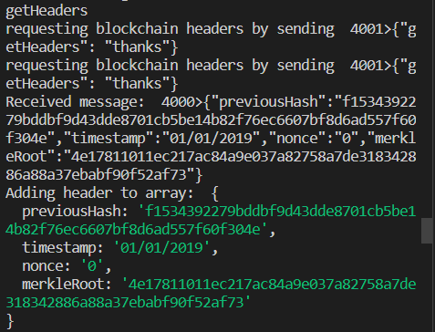
getHeaders - returns mined block header
–>

Slide 11

getTotalBurnedCoins
SPV.js:
fullNode.js:

Slide 12
Bloom Filter
We start off with an empty bloom filter using the following command in blockChain.js:
> this.filter = new bloom(transactions.length);
if it already exist, thus not the genesis block, we’ll use this command instead:
> this.filter.add(transactions[i].calculateHash());
bloomFilter.js implementation:
var BloomFilter = function (n, fpl = FALSE_POS_TOL) {
this.b = Math.ceil((-2) * n * Math.log(fpl));
this.k = Math.ceil(0.7 * (this.b / n));
this.size = (this.b > BITS_IN_BYTE) ? (Math.ceil(this.b / BITS_IN_BYTE)) : 1;
this.bitview = new BitView(new ArrayBuffer(this.size));

Slide 13
Merkle Tree
set root:
if (transactions == "Genesis block") {
this.merkleRoot = SHA256("Genesis block").toString();
} else {
this.setMerkleRoot();
}
root function:
setMerkleRoot() {
if (this.transactions.length == 0) {
return "0";
}
let hashes = [];
for (const tx of this.transactions) {
hashes.push(tx.calculateHash());
}
while (hashes.length > 1) {
if (hashes.length & 1) {
hashes.push(hashes[hashes.length-1]);
}
let nextLevel = [];
for (let i = 0; i < hashes.length; i += 2) {
let TempString = (hashes[i] + hashes[i + 1]).toString();
nextLevel.push(SHA256(TempString).toString());
}
hashes = nextLevel;
}
this.merkleRoot = hashes[0];
}

Slide 14
Transaction Verification 1-1
In SPV.js file, the following code checks for entered command “verify” + the transaction hash which they want to verify.
else if (splitMessage[0] === 'verify') {
const toSend = "{\"verify\":\"" + splitMessage[1] + "\"}"
console.log("requesting verification of: ", toSend);
socket.write(formatMessage(toSend));
The fullNode.js receives the message, and calls for findBlockContainingTX function:
findBlockContainingTX(TXHash){
console.log("Verifying: ", TXHash);
for(const block in this.chain){
if(this.chain[block].filter.test(TXHash)){ // the filter is via bloomfilter, which is used to find it
for(const tx in this.chain[block].transactions){
if(this.chain[block].transactions[tx].calculateHash() == TXHash){
console.log("returning: ", [this.chain[block], this.chain[block].transactions[tx]])
return [this.chain[block], this.chain[block].transactions[tx]];}}}}
console.log("returning: false");
return false;}

Slide 15
Transaction Verification 1-2
Once the block containing the transaction is found, a partial merkle tree is constructed in the function “recreateMerkleRoot()” as seen below
if (jsonObj.previousHash && jsonObj.timestamp && jsonObj.nonce && jsonObj.merkleRoot) {
console.log('Adding header to array: ', jsonObj)
headers.push(jsonObj)}
else if(jsonObj.PartialMerkleTree){
if(jsonObj.PartialMerkleTree == "TRANSACTION CANNOT BE VERIFIED"){
console.log("TRANSACTION CANNOT BE VERIFIED by the full node");}
else{
const trimmed = jsonObj.PartialMerkleTree.trim();
const PartialMerkleTreeArr = trimmed.split(",");
const merkleRoot = recreateMerkleRoot(PartialMerkleTreeArr)
const merkleExists = isMerkleRootInHeaders(merkleRoot);
console.log("merkle root returned by full node has found in existing headers?: ", merkleExists);}}

Slide 16
Transaction Verification 1-3
function recreateMerkleRoot(partialMerkleTree){
if (partialMerkleTree.length == 1){
return partialMerkleTree[0];}
else if (partialMerkleTree.length == 2)
{
let combineddoublehash = SHA256(partialMerkleTree[0] + partialMerkleTree[1]).toString();
return combineddoublehash;}
else if (partialMerkleTree.length == 3){
let hash01 = SHA256(partialMerkleTree[0] + partialMerkleTree[1]).toString();
let hash2 = partialMerkleTree[2];
let Temp0122hash = SHA256(hash01 + hash2).toString();
return Temp0122hash;}
return false;}
The function below compares the roots with the original.
function isMerkleRootInHeaders(root){
for(const header in headers){
if(headers[header].merkleRoot == root){
return true;}}
return false;}

Slide 17
Saving logs (mempool)
This function will log the transactions and add them to the history file.
This function saves it to file
function saveListToFile(list, file) {
const jsonified = JSON.stringify(list);
try {
fs.writeFileSync(file, jsonified);
} catch (error) {
console.error("Failed to save list due to: ", err);}}
saveTransactionHistory(){
const fileName = "./history.json"
let listToSave = [];
console.log("Saving Transaction histoy to: ", fileName)
for(const block in this.chain){
if(this.chain[block].transactions != "Genesis block"){
console.log("Block TXs: ", this.chain[block].transactions)
listToSave = listToSave.concat(this.chain[block].transactions);
}
}
console.log("final list: ", listToSave);
saveListToFile(listToSave, fileName);
}
This function loads from file
function loadTransactionFileToList(file) {
const objectList = JSON.parse(fs.readFileSync(file));
const txList = [];
for (obj in objectList) { txList.push(Transaction.class(objectList[obj]));
}
return txList;}

Slide 18
Burning Coin
const eaterAddress = '0xDEAD'; // will be used to send coins to address 0 which means the coins are forever ‘locked’
burn(fromAddress, feeAmount, transactionAmount) {
const balance = this.getBalanceOfAddress(fromAddress);
if (balance < parseInt(transactionAmount) + parseInt(feeAmount)) {
console.log('Cannot add burn transaction, sender doesn\'t have a high enough balance to cover it.\nBalance: ', balance, ". Burn amount: ", feeAmount);
return false;
}
const tx = new Transaction(fromAddress, eaterAddress, feeAmount);
this.pendingTransactions.push(tx);
return true;
}

Slide 19
Total returns
getTotalCoins() {
return this.getTotalMinedCoins() - this.getTotalBurnedCoins();
}
getTotalMinedCoins() {
return (this.chain.length - 1) * this.miningReward; // -1 to stop before genesis block
}
getTotalBurnedCoins() {
return this.getBalanceOfAddress(eaterAddress) - BEGINNING_BALANCE;
}

