Slide 1
Feature expansion
Computation Time Prediction
NN layer
Benchmark dataset
Neural network decomposition
Feature space sampling
Training
MLP model
Predicting
layer by layer
Computation-Communication Pattern Analysis
Operation queue
Computation Time
Iteration time
Critical path extraction
Communication Time
Device time
Communication Time Prediction
Real-time throughput analysis
Single-link communication time prediction model
Model combination
Communication topology analysis
Cluster communication model

Slide 2
Computation Time Prediction
Neural network layer
Benchmark dataset
Neural network decomposition
Feature space sampling
Training
MLP model
Predicting
layer by layer
Computation-Communication Overlap Analysis
Computation Time
Iteration time
Critical path extraction
Communication Time
Communication Time Prediction
Real-time throughput analysis
Single-link communication time prediction model
Model combination
Communication topology analysis
Cluster communication model

Slide 3
计算时间预测
基准测试数据集
神经网络层
训练多层感知器模型
神经网络分解
特征空间采样
逐层预测
计算通信并行性分析
计算时间
迭代时间
关键路径提取
通信时间
通信时间预测
实时吞吐量
单链路通信时间预测模型
模型结合
通信拓扑分析
集群通信模型

Slide 4
……
……
……
……
communication n-1 times
……
……
……
……

Slide 5
……
……
……
……
communication n-1 times
……
……
……
……
scatter-reduce
……
……
……
……
communication n-1 times
……
……
……
……
all-gather

Slide 6
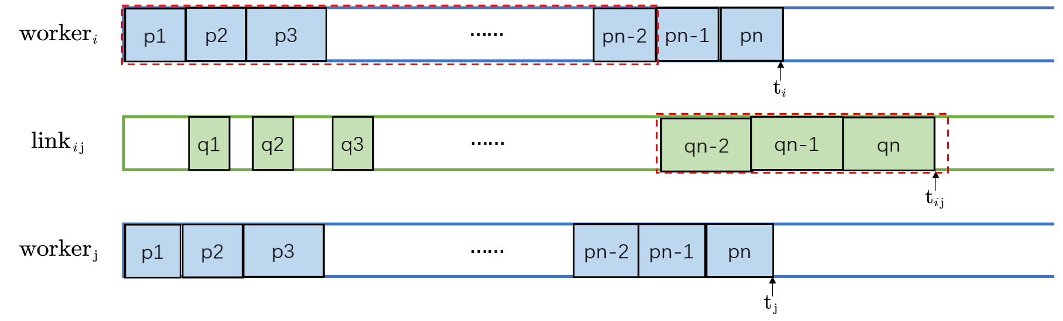
Critical Path

Slide 7
……
……
……
……
communication n-1 times
……
……
……
……

Slide 8
……
……
……
……
communication S+n-2 times
……
……
……
……

Slide 9
CPU1
QPI
CPU2
Root
Complex
Root
Complex
Memory
Memory
PCIe
Endpoint
PCIe
Endpoint
PCIe
Endpoint
PCIe
Endpoint
Switch
Switch
Switch
Switch
GPU0
GPU1
GPU2
GPU3
GPU4
GPU5
GPU6
GPU7

Slide 10
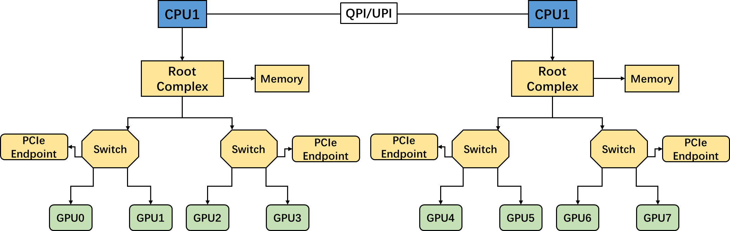

Slide 11
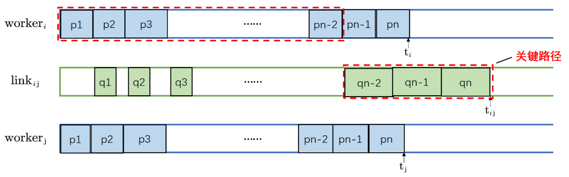
p_{i}：计算操作
q_{i}：通信操作
t_{i}：节点i的设备时间
t_{ij}：链路ij的设备时间
节点i
链路ij
节点j

Slide 12
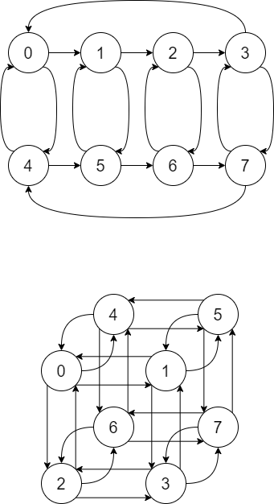
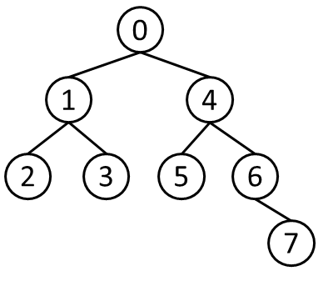
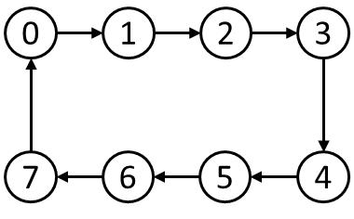
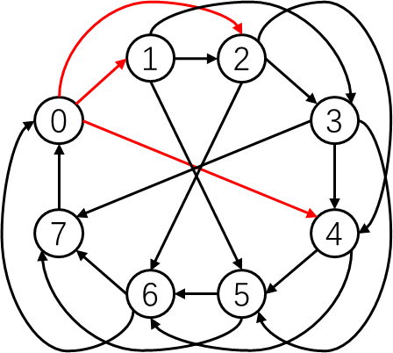
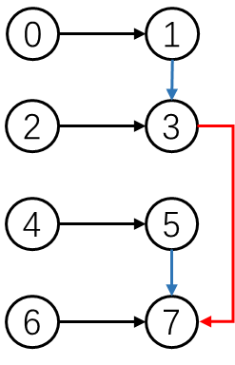
ring
tree
2D-Ring
[[1],[2],[1],[3],[1],[2],[1]]
[[1,3],[2,1],[1]]
[[1],[2],[1],[3]]
exponential
hierarchical
3D-Ring
[[1,2,3],[2,2,3],[1,3,3],[3,3,3],[1,2,3],[2,2,3],[1,3,3],[3,3,3]]
[[1],[2],[3]]
[[1],[2],[3]]

Slide 13
1
2
0
0
3
0
1
2
3
1
4
7
4
7
6
5
4
2
3
5
6
6
5
ring
tree
7
exponential
0
1
2
3
4
5
6
7
hierarchical

Slide 14
0
1
4
2
3
5
6
7

Slide 15
GPU 0
GPU 1
……
GPU n
data copy
computation of neural network
communication

Slide 16
……
critical path
……
……

Slide 17
Feature expansion
Computation Time Prediction
NN
layer
Benchmark dataset
Neural network decomposition
Feature space sampling
Training
MLP model
Predicting
layer by layer
Computation-Communication Pattern Analysis
Operation queue
Computation Time
Iteration time
Critical path extraction
Communication Time
Device time
Communication Time Prediction
Real-time throughput analysis
Single-link communication time prediction model
Model combination
Communication topology analysis
Cluster communication model

Slide 18
……
……
……
……
communication S+n-2 times
……
……
……
……

Slide 19
……
node
critical path
……
other
nodes
link
node
……

