Slide 1
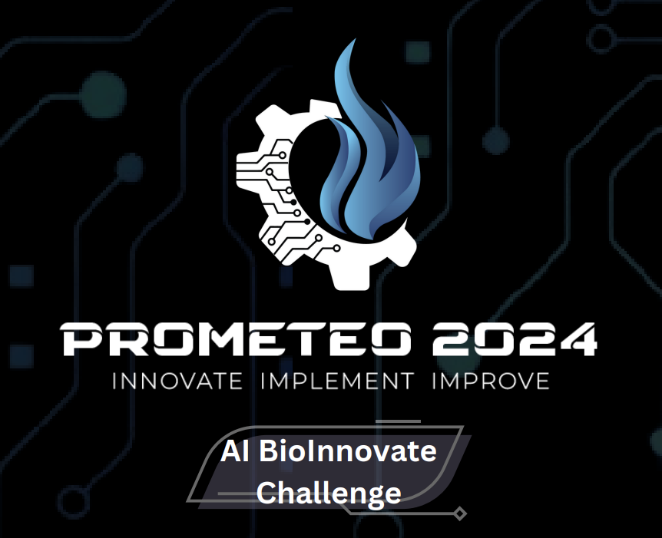
Moonlight Proteins
Presented by:
Innovisionaries
[Arushi Gupta]
[Somil Gupta]
[Anik Roy]

Slide 2
Problem Statement
PE3: A model for predicting moon light proteins based on protein language models and deep learning.
The project aims to develop a predictive model for distinguishing between moonlight and non-moonlight proteins. Moonlight proteins exhibit dual functionalities, with a primary role within a cellular context and an additional function outside of that context.

Slide 3
Table of contents
Overview
Preprocessing
01
02
Models Used
Future Scope
03
04
Describing moonlight proteins
How was the given data handled?
Approaches taken to build models
Future scope of the project

Slide 4
01
Overview

Slide 5
What are Moonlight Proteins?
Moonlight proteins, also known as multifunctional or dual-function proteins, are a class of proteins that exhibit multiple distinct functions within a biological system. These proteins defy the conventional expectation that a given protein primarily serves a singular role or function within a specific cellular context. Instead, moonlight proteins demonstrate versatility by participating in different biological processes or pathways, often exerting their influence both within and outside the cell.

Slide 6
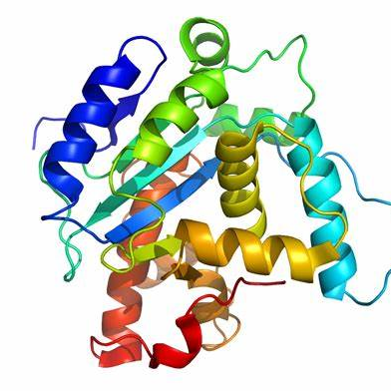
Why study moonlight proteins?
The existence of moonlight proteins highlights the complexity and adaptability of biological systems, challenging traditional notions of protein function. Studying moonlight proteins is crucial for a comprehensive understanding of cellular processes and the intricate ways in which proteins contribute to the functioning of living organisms.

Slide 7
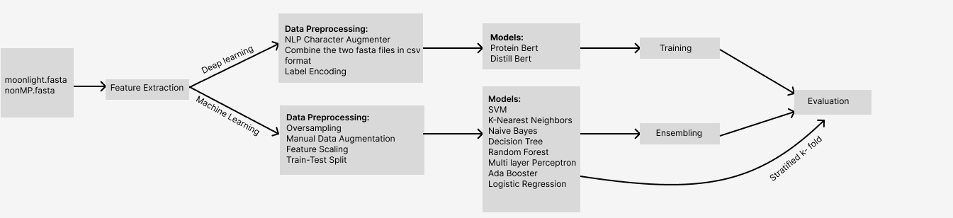
Our WorkFlow

Slide 8
02
Preprocessing

Slide 9
Pre Processing
1. Data Collection:
We were provided with 2 fasta files, namely moonlight.fasta (positive data) and nonMP.fasta (negative data).
FASTA is a widely used text-based format for representing biological sequences, such as nucleotide sequences (DNA or RNA) or protein sequences. The name "FASTA" stands for "Fast-All," indicating its efficiency in handling large-scale sequence data.

Slide 10
Pre Processing
2. Data Inspection:
Used ftrCOOL tool (a library for the R programming language) to extract features from the fasta files.
The ftrCOOL tool is useful in reading the uppercase amino acid sequence and convert it into feature vectors of numerical type that is easier to understand and work with.
Used matplotlib library to plot the extracted data to get an idea on how to handle the raw data.

Slide 11
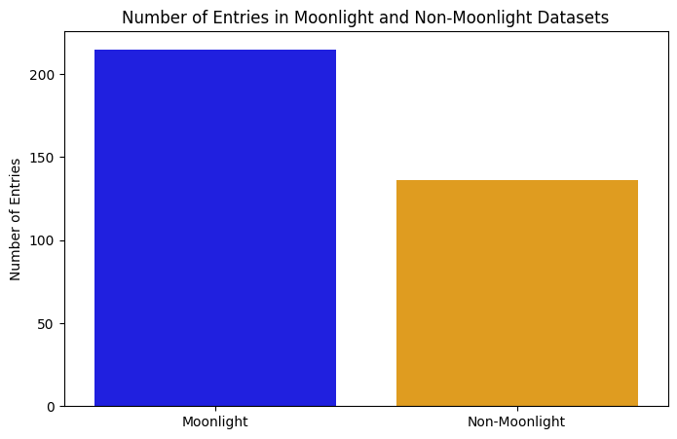
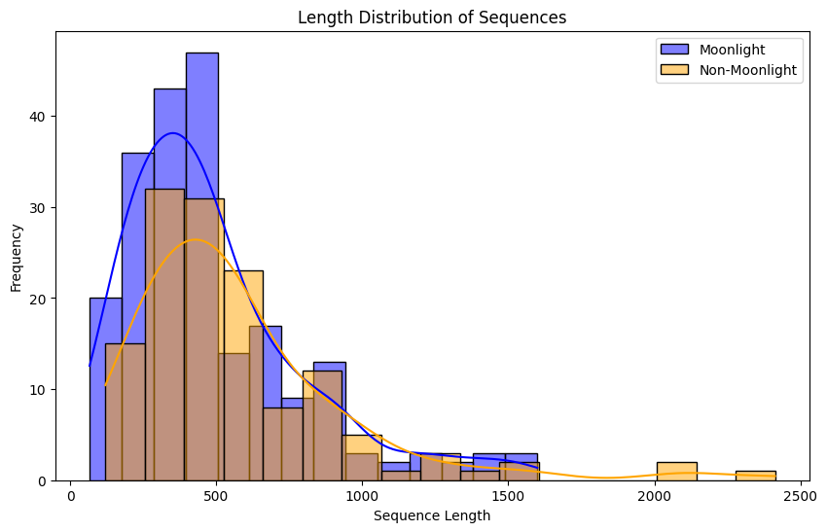
Plot
Moonlight
Non moonlight
From this graph we can observe that we have more training data for positive class. Thus, we need to use oversampling (to increase negative data) or use stratified k-fold
https://github.com/Eternatus29/aiBioInnovateChallenge/blob/main/02_ML_models_using_ensembling_and_k_fold.ipynb

Slide 12
Plot Understanding
1. The dataset is very small. We have 136 records for negative data and 215 records for positive data. Deep Learning models do not work well with small datasets as there might be problem of overfitting.
2. Hence, we must use data augmentation techniques if we wish to train our model using deep learning techniques.
3. Here, we have used ProtBERT and distilBERT models with augmented data and achieved significant accuracies.

Slide 13
03
Models Used

Slide 14
Models Used [Deep Learning]
1. ProtBERT: ProteinBERT, often abbreviated as ProtBert, is a variant of the popular BERT (Bidirectional Encoder Representations from Transformers) model designed specifically for the representation and analysis of protein sequences.
2. DistilBERT: DistilBERT is a distilled and smaller version of BERT (Bidirectional Encoder Representations from Transformers), designed to be more lightweight while preserving much of the original model's performance. It was introduced to address the computational cost associated with deploying large transformer models like BERT in real-world applications.

Slide 15
Models Used [Deep Learning]
Before data augmentation
After data augmentation

Slide 16
Models Used [Traditional ML]
Support Vector Machine (SVM)
K nearest neighbor (KNN)
Naive Bayes (NB)
Decision Tree (DT)
Random Forest (RF)
Multi-Layer perceptron (MLP)
Ada Boost (ADA)
Logistic Regression (LR)
Further k-fold cross validation and ensembling techniques were used to improve performance metrics.

Slide 17
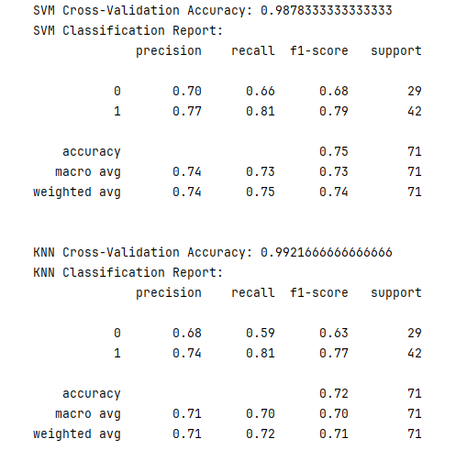
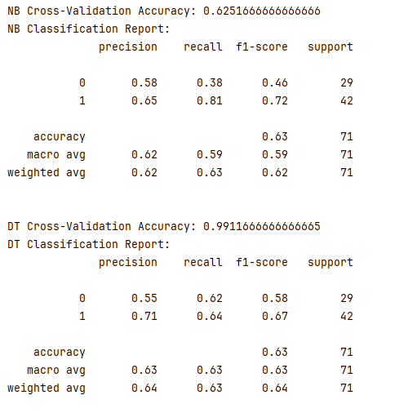
Benchmarks[Traditional ML]

Slide 18
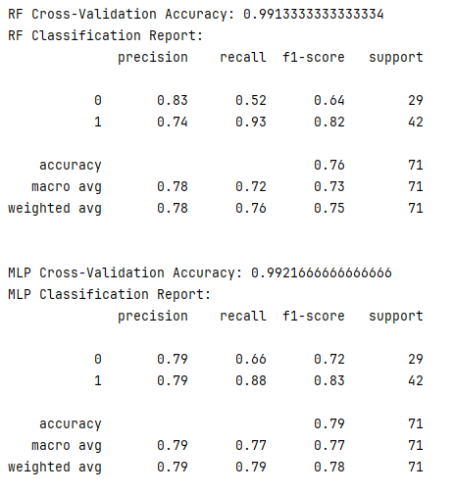
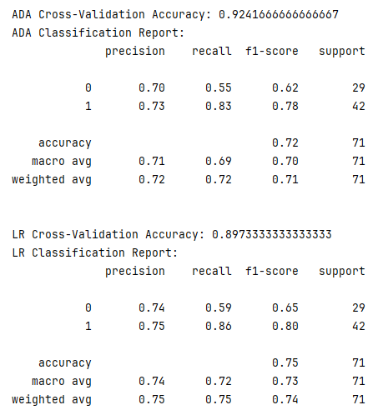
Benchmarks[Traditional ML]

Slide 19
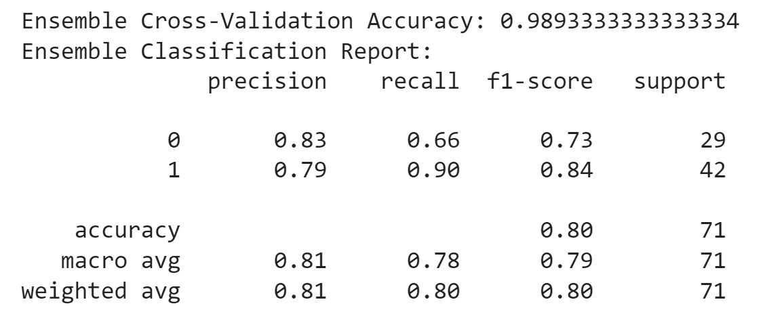
Benchmarks[Traditional ML]

Slide 20
Future Scope
Incorporation of Advanced Feature Engineering
Integration of Deep Learning Architectures
Utilization of Graph Neural Networks (GNNs)
Transfer Learning in Bioinformatics
Integration of Multi-Omics Data

Slide 21
Models Used [Traditional ML]
Support Vector Machine (SVM)
K nearest neighbor (KNN)
Naive Bayes (NB)
Decision Tree (DT)
Random Forest (RF)
Multi-Layer perceptron (MLP)
Ada Boost (ADA)
Logistic Regression (LR)
Further k-fold cross validation and ensembling techniques were used to improve performance metrics.

Slide 22
Thank You!
Do you have any questions?

