Slide 1
PROBLEM STATEMENT:
Business Contract Validation Project
The project focuses on classifying content within business contract clauses, determining deviations from templates, and highlighting these deviations. Business contracts are legal documents that need to be parsed and structured, with key details and clauses identified. The goal is to classify the contents into these clauses and sub-clauses, and compare them against associated templates to highlight any deviations.
Project Goals :
Parse contract documents
Classify content
Identify deviations
Highlight deviations
Integrate additional features

Slide 2
IDEA SOLUTION:
Trains models using the Legal Clauses Dataset to precisely classify contract text into clauses and sub-clauses.
Uses difflib for comparing documents, highlighting deviations from templates.
Uses spaCy for NER to identify entities accurately within contract texts, enhancing accuracy through contextual analysis.
Generates summaries emphasizing critical differences and key information, tailored to user preferences.
Used pytesseract library for OCR (Optical Character Recognition).
Used streamlit python framework to deliver interactive data apps.

Slide 3
FEATURES OFFERED:
Effective PDF Parsing: Extracts text from contract documents.
Accurate Text Classification: Classifies text into clauses and sub-clauses.
Named Entity Recognition (NER): Identifies key entities within the text.
Precise Text Comparison: Compares text against templates to identify deviations.
Deviation Highlighting: Highlights deviations for user review.
Concise Summarization: Provides concise summaries of contract content.
Optical Character Recognition (OCR): Processes scanned contract documents.

Slide 4
PROCESS FLOW:
Document Upload: Users upload contracts via a React.js frontend.
PDF Parsing: Extract text and structure from documents.
Classification & NER: Categorize text and identify entities.
Template Comparison: Detect deviations from standard templates.
Deviation Highlighting: Highlight differences for user review.
Summarization & OCR: Summarize content and process scanned images.
Display Results: Present results on the user-friendly interface.

Slide 5
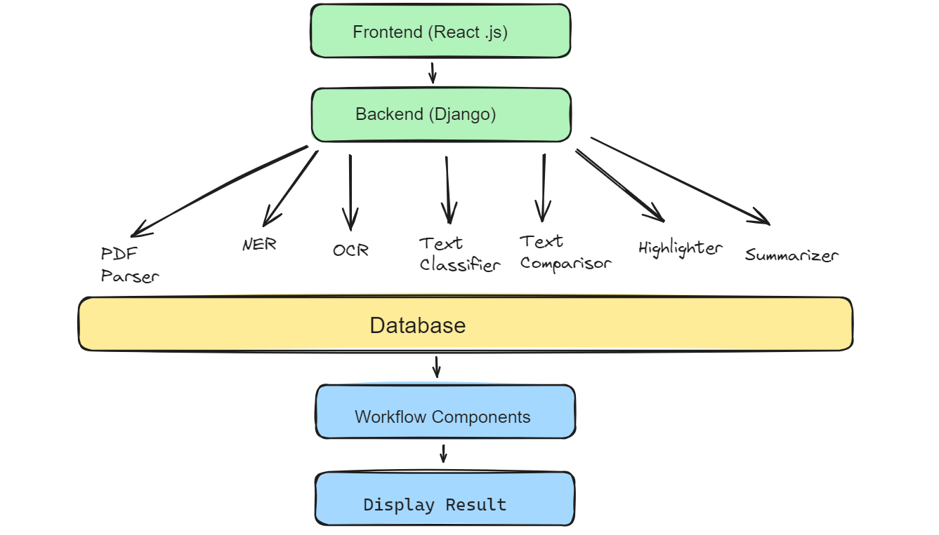

ARCHITECTURAL DIAGRAM:
Flask

Slide 6
TECHNOLOGIES USED:
Backend: Flask Framework
PDF Parser: Text and metadata extraction using PyMuPDF.
NER: Entity categorization with spaCy or Stanford NER.
OCR: Image-to-text conversion with Tesseract, OpenCV.
Text Comparison: Deviation detection using DiffMatchPatch.
Summarization: Condensed document summaries with Gensim, BERT.
Frontend: React.js Library
Interactive Document Viewer: View and interact with highlighted PDFs.
Customizable Highlighting: User-defined criteria and color settings.
Entity Recognition Display: Visualize categorized entities.
Summary View: Key deviations and information in concise summaries.

Slide 7
TEAM MEMBERS AND THEIR CONTRIBUTIONS:
Members | Contribution
Luvkush Sharma | Worked on frontend and built interactive UI with React.js.
Anik Roy | Developed backend with Flask and integrated libraries for data extraction and processing.
Muskan Garg | Implemented PDF parsing, developed NER and created text classifier.
Uday Pratap Singh | Developed PDF highlighter and implemented OCR.
Dheeraj Sharma | Created text comparison (Difflib) and developed summarization models.

Slide 8
FUTURE SCOPE:
Mobile Application: Create a mobile version of the application to allow users to review and validate contracts on-the-go.
Advanced NLP Techniques: Incorporate the latest advancements in natural language processing, such as transformers and deep learning models, to improve the accuracy and efficiency of text extraction, classification, and named entity recognition.
Future Scope:
Additional Features: Incorporate additional functionalities like personal information masking, profanity filtering, and sentiment classification.
Scalability: Enhance the scalability of the application to handle larger volumes of contracts.

