Slide 1
Prediction for hiring new staffs in a tech company
Bayesian Networks
Jiexin Chen (2130026008)
Jiayin Peng (2130031205)
Ruotong Yu (2130026185)

Slide 2
Introduction
Topic：Predict the probability that any tech company will hire a new employee.
Our work:
Parameter learning: MLE for datasets, Statistical charts, Assumptions from common sense.
Inference: VE (hand, package), CT
Visualization: UI

Slide 3
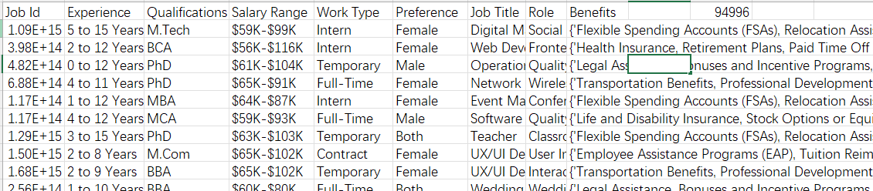
Data collection for parameter learning
Kaggle: Job dataset include factors considering when looking for jobs
E.g. Company: Work experience, Interview performance, etc.
E.g. Interviewee: Salary, Major related, etc.
100,0000 items SUBTATOL(3, X, X)
x
x
x
x
x
x

Slide 4
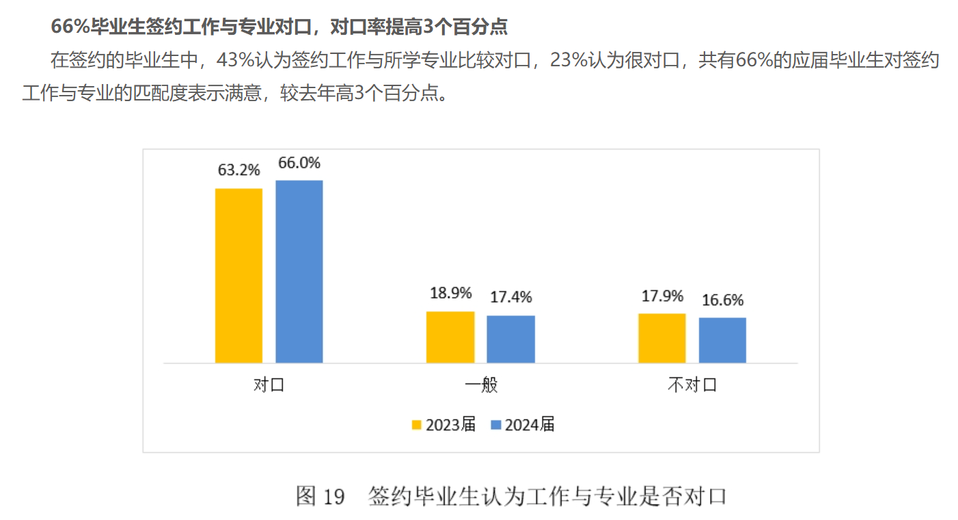
Data collection for parameter learning
Survey of 2024 graduate working situation

Slide 5
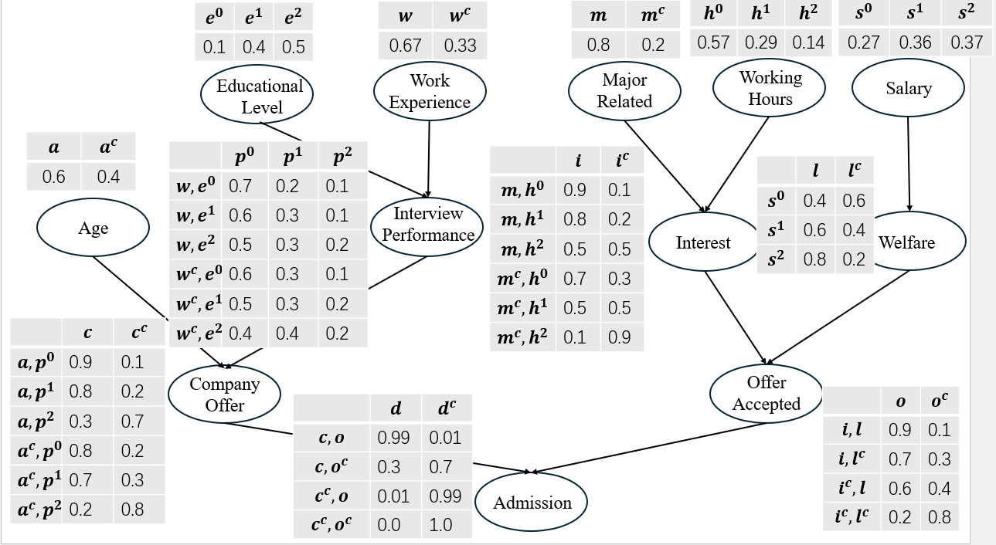
Bayesian Network Construction

