Slide 1
AMHARIC ACOS QUADRUPLE EXTRACTION
Towards End-to-End Amharic Aspect–Category–Opinion–Sentiment (ACOS) Quadruple Extraction
From 6-Stage Extractive Pipelines to Byte-Level Generative Foundation Models
Author Azariyas Mekonen
Target Domain Amharic E-Commerce & Hospitality Reviews
Current State ByT5-Base Generative (Final Test Evaluation)
Source github.com/EthAIResearch/acos-amharic
September 2026 · Technical Report

Slide 2
FOUNDATIONAL PROBLEM FORMULATION
The Amharic ACOS Quadruple Extraction Challenge
Formulating fine-grained sentiment as four-dimensional semantic tuples under low-resource Semitic morphology
Q = { (a, c, s, o) | a ∈ A ∪ {NULL}, c ∈ C, s ∈ {POS, NEG, NEU}, o ∈ O ∪ {NULL} }
a = aspect term · c = one of 29 predefined categories · s = sentiment polarity · o = opinion expression. Either a or o (or both) may be NULL when the target or sentiment is implicit — the source of most difficulty in this report.
1. Extreme Morphological Fusion
2. High Implicit Density (42.7%)
3. Open Vocabulary
Amharic is agglutinative: pronouns, prepositions and negation clitics fuse into single surface tokens.
'አልተመቺኛም' decomposes into al-(negation) + temeche(root) + -gn(object) + -m(conjunction).
Whitespace/BPE tokenizers split such tokens arbitrarily, shattering opinion modifiers.
Nearly half of all quads lack an explicit aspect, an explicit opinion, or both.
Implicit aspect: 'በጣም ውድ ነው' ("very expensive") — target never named.
Extractive impossibility: a model that only copies spans can never produce a token absent from the input.
66.2% of opinion spans in the test set never appear in training.
Slang and phonetic spelling variants ('ዋው', 'ጀመረኛ') fragment under any fixed vocabulary.
Motivates the eventual move to byte-level, vocabulary-free modeling (Phase 6).
2

Slide 3
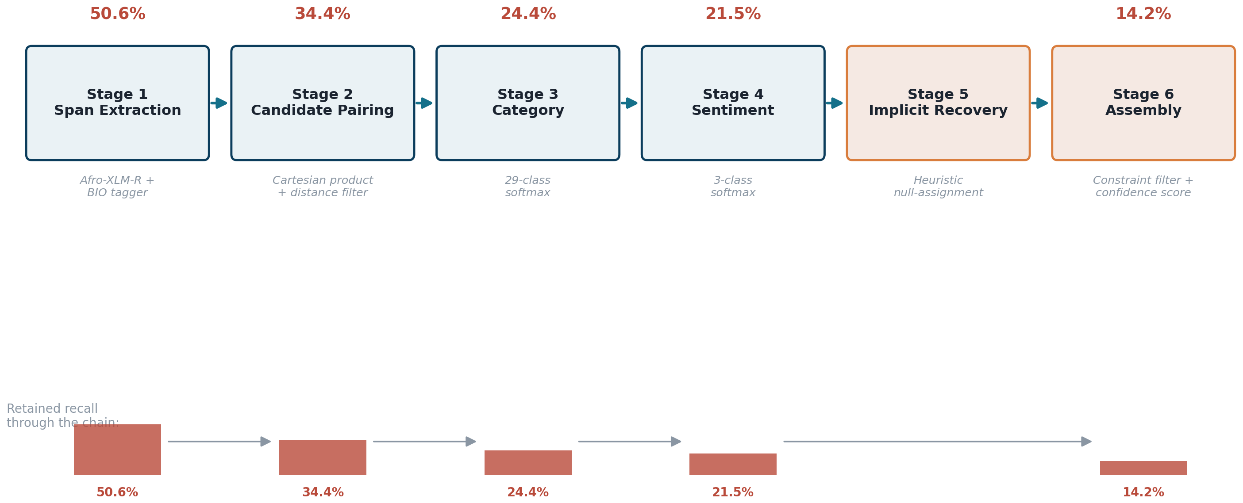
PHASE 1 · BASELINE ARCHITECTURE
The 6-Stage Modular Extractive Pipeline
Each stage is an independently trained classifier consuming only the previous stage's output — no feedback path exists
3

Slide 4
PHASE 1 AUTOPSY
The Error-Compounding Law in Cascaded Pipelines
How independently-good stage results still guarantee a bad end-to-end result
Zero-Error-Recovery Theorem
If Stage 1 misses an aspect term, that quadruple is irrevocably lost — later stages never see it.
Stage 2 pairing retains 68% of survivors: 0.506×0.680 ≈ 34.4%.
Category classification retains 71%: 0.344×0.710 ≈ 24.4%.
Sentiment classification retains 88%: 0.244×0.880 ≈ 21.5%.
Assembly & precision penalties in Stage 6 drive the final exact F1 down to 14.2%.
Methodological note: the bound is defined over recall; the per-stage figures available are F1 scores used here as a practical proxy, so this chain is an order-of-magnitude illustration rather than an exact derivation.
Only Stages 1–4 participate in this illustrative chain; Stage 5 (heuristic recovery) and Stage 6 (assembly/filtering) act afterward.
4

Slide 5
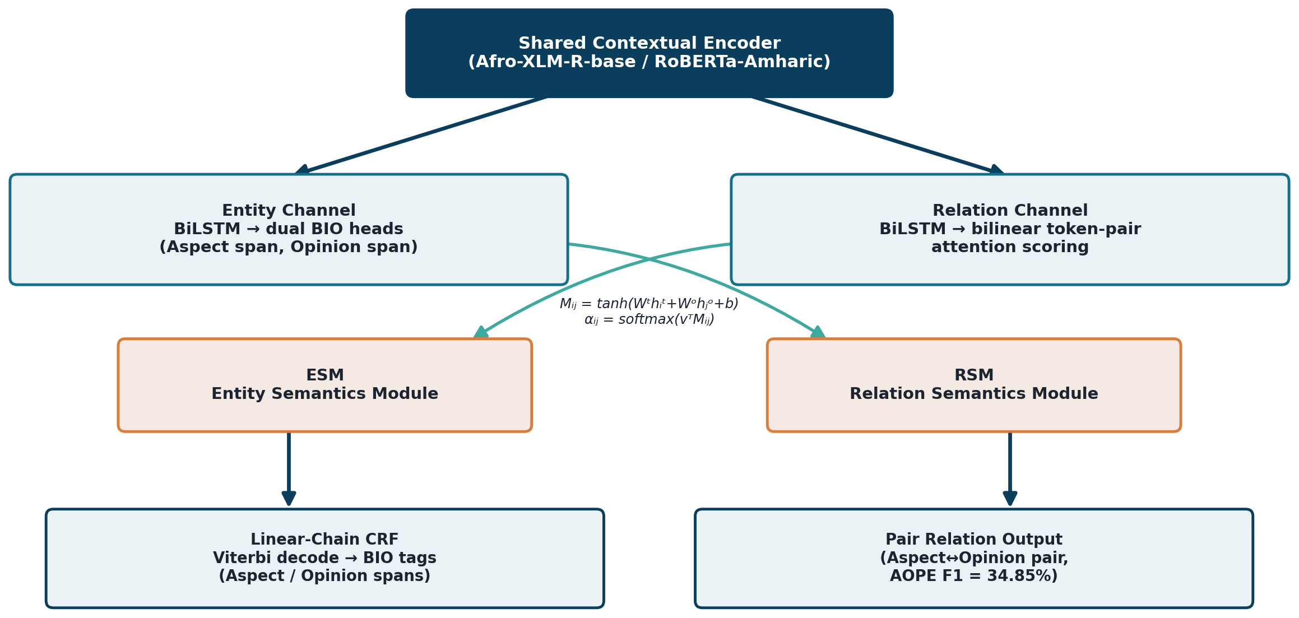
PHASE 2 · TRANSITION TO JOINT MODELING
Synchronous Dual-Channel Recurrent Network (SDRN)
Coupling aspect and opinion extraction via cross-channel interaction matrices and linear-chain CRFs
5

Slide 6
PHASE 2 AUTOPSY
The BIO Token-Fragmentation Ceiling
Why token-level sequence labeling collapses on morphologically rich, multi-word Semitic expressions
Three Fatal Failure Modes
Subword boundary jitter: agglutinative clitics split words into 2–4 subwords; one misclassified subword fractures the whole span.
Devastating candidate ceiling: only 33.04% of ground-truth aspect–opinion pairs were even co-extracted by the CRF — 66.96% discarded before pairing began.
Non-contiguous, multi-word failures: opinions average 2.4 tokens; the CRF often produced disjoint tags like [B-OPN, O, I-OPN].
Verdict: token-level BIO tagging is fundamentally incompatible with Amharic morphosyntax — forcing the shift to direct span enumeration (Phase 3).
Different runs shown at each run's own default decision threshold; Run 2's default-threshold pair recall was not separately reported.
6

Slide 7
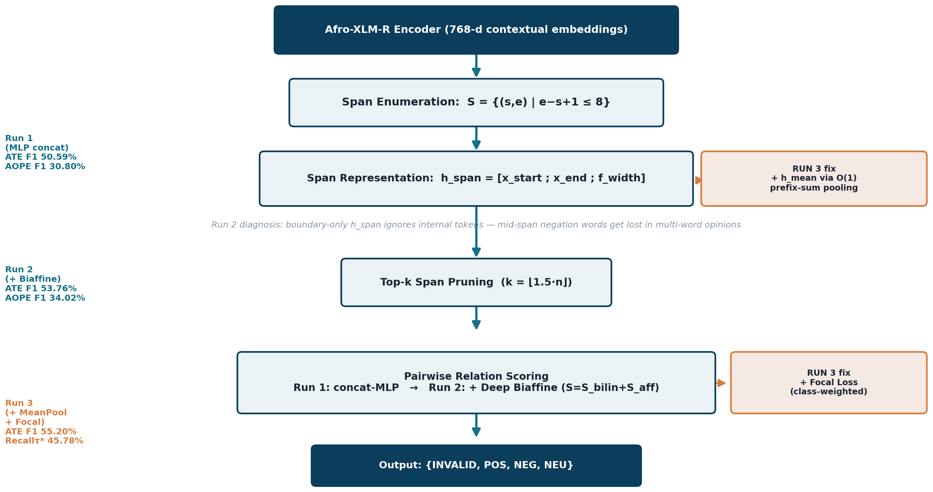
PHASE 3–5 · THE SPAN PARADIGM SHIFT
Span-ASTE: Architecture and the Three Design Decisions
Xu et al. (ACL 2021), adapted for Amharic — eliminating BIO tagging via direct span enumeration
7

Slide 8
SPAN-ASTE RUN 1 · DIAGNOSTIC & CALIBRATION
Uncovering the Extreme Class Imbalance
Diagnosing why 81.1% candidate recall still produced only 22.7% pair recall at the default decision boundary
Root Cause: 96.8% Class Skew
Threshold τ | Valid Pairs | Precision | Recall | F1
0.50 (default) | 290 | 47.93% | 22.68% | 30.80%
0.40 | 362 | 42.10% | 26.50% | 32.51%
0.30 (optimal τ*) | 422 | 37.50% | 32.06% | 34.54%
0.20 | 501 | 31.20% | 36.20% | 33.51%
0.10 | 680 | 22.10% | 41.50% | 28.84%
Aspect Detection (ATE): P 51.52% · R 49.69% · F1 50.59%
Opinion Detection (OTE): P 47.90% · R 39.81% · F1 43.48%
AOPE Pair Extraction: P 47.93% · R 22.68% · F1 30.80%
ASTE Triplet Extraction: P 42.15% · R 19.95% · F1 27.09%
In the pruned span-pair matrix, over 96.8% of candidates are the INVALID (no-relation) class. Ordinary cross-entropy training makes the model excessively conservative, so true relations often score only 0.25–0.45 — just under the 0.50 threshold.
Lowering the acceptance threshold to τ*=0.30 unlocks +132 valid pairs — without any retraining, purely by adjusting the inference-time decision boundary.
8

Slide 9
RUN 2 RESULTS · DIAGNOSTIC AUTOPSY
Biaffine Breakthrough & the Boundary-Truncation Bottleneck
Deep Biaffine attention (Dozat & Manning, 2017) surpasses Run 1 on every metric — while exposing a new flaw
Metric | Run 1 (MLP) | Run 2 (Biaffine) | Δ
Aspect Detection (ATE F1) | 50.59% | 53.76% | +3.17 pts
Opinion Detection (OTE F1) | 43.48% | 45.02% | +1.54 pts
AOPE Pair F1 (default τ=0.50) | 30.80% | 34.02% | +183 pairs
ASTE Triplet F1 (default τ=0.50) | 27.09% | 29.37% | +2.28 pts
Valid Pairs (at τ*=0.30) | 422 | 605 | +43.4%
The Boundary-Truncation Bottleneck
h_span = [x_start; x_end; f_width] encodes only the first and last tokens of a span.
For multi-word opinions like 'በጣም ጥሩ አይደለም' ("very good not"), the critical mid-span negation word 'አይደለም' is completely ignored.
This produced severe boundary mismatches: the model predicted 'ጥሩ' (good) as positive, missing the trailing negation entirely.
Conclusion: span representations must aggregate every intermediate token, not just the two endpoints — without exploding inference-time compute. This motivates Phase 5.
9

Slide 10
PHASE 5 · ARCHITECTURAL INNOVATION
Vectorized O(1) Prefix-Sum Mean-Pooling & Focal Loss
Capturing complete internal span semantics at zero added asymptotic cost, plus cost-sensitive class re-weighting
O(1) Cumulative Prefix-Sum Pooling
Cost-Sensitive Focal Loss
P[t] = Σ(k=1..t) x_k → precomputed once per sentence in O(n).
h_mean = (P[e] − P[s]) / (e − s + 1) — any span's mean in O(1) lookup.
h_span = [x_start; x_end; h_mean; f_width] ∈ ℝ²³²⁴
This directly fixes Run 2's boundary-truncation flaw: h_mean now reflects every token in the span, not just its two endpoints.
Counters the 96.8% INVALID-class skew directly during training, not only via post-hoc threshold tuning.
L_focal = −α_t(1−p_t)^γ log(p_t)
Per-class weights: w = [INVALID: 0.25, POS: 2.5, NEG: 2.5, NEU: 3.0]
Down-weights the overwhelmingly common INVALID class and up-weights the three rare, informative relation classes.
10

Slide 11
RUN 3 RESULTS · PARADIGM LIMIT
Upstream State-of-the-Art & the Inherent Extractive Ceiling
Mean-pooling reaches the project's best upstream detection scores — and exposes the theoretical boundary of any extractive model
Metric | Run 1 | Run 2 | Run 3
Aspect Term Extraction (ATE F1) | 50.59% | 53.76% | 55.20%
Opinion Term Recall (OTE Recall) | 39.81% | 41.60% | 46.70%
Candidate Ceiling Recall | 81.10% | 80.46% | 81.91%
Calibrated Pair Recall (τ*=0.30) | 32.06% | 34.02% | 45.78%
Implicit Quadruple F1 | 0.00% | 0.00% | 0.00%
The Extractive Wall
An extractive span model can only select continuous token slices from the input string X.
42.7% of all quads have an implicit target, implicit opinion, or both — and NULL has no token coordinate in X.
Even with perfect recall on every explicit quad, full-quad recall is capped at the 57.3% of quads that are fully explicit. This is a theoretical best-case ceiling, not a prediction of achieved performance.
Strategic pivot: the only viable path forward is sequence-to-sequence generation, which can emit tokens — including the literal string NULL — that never appeared in the input.
11

Slide 12
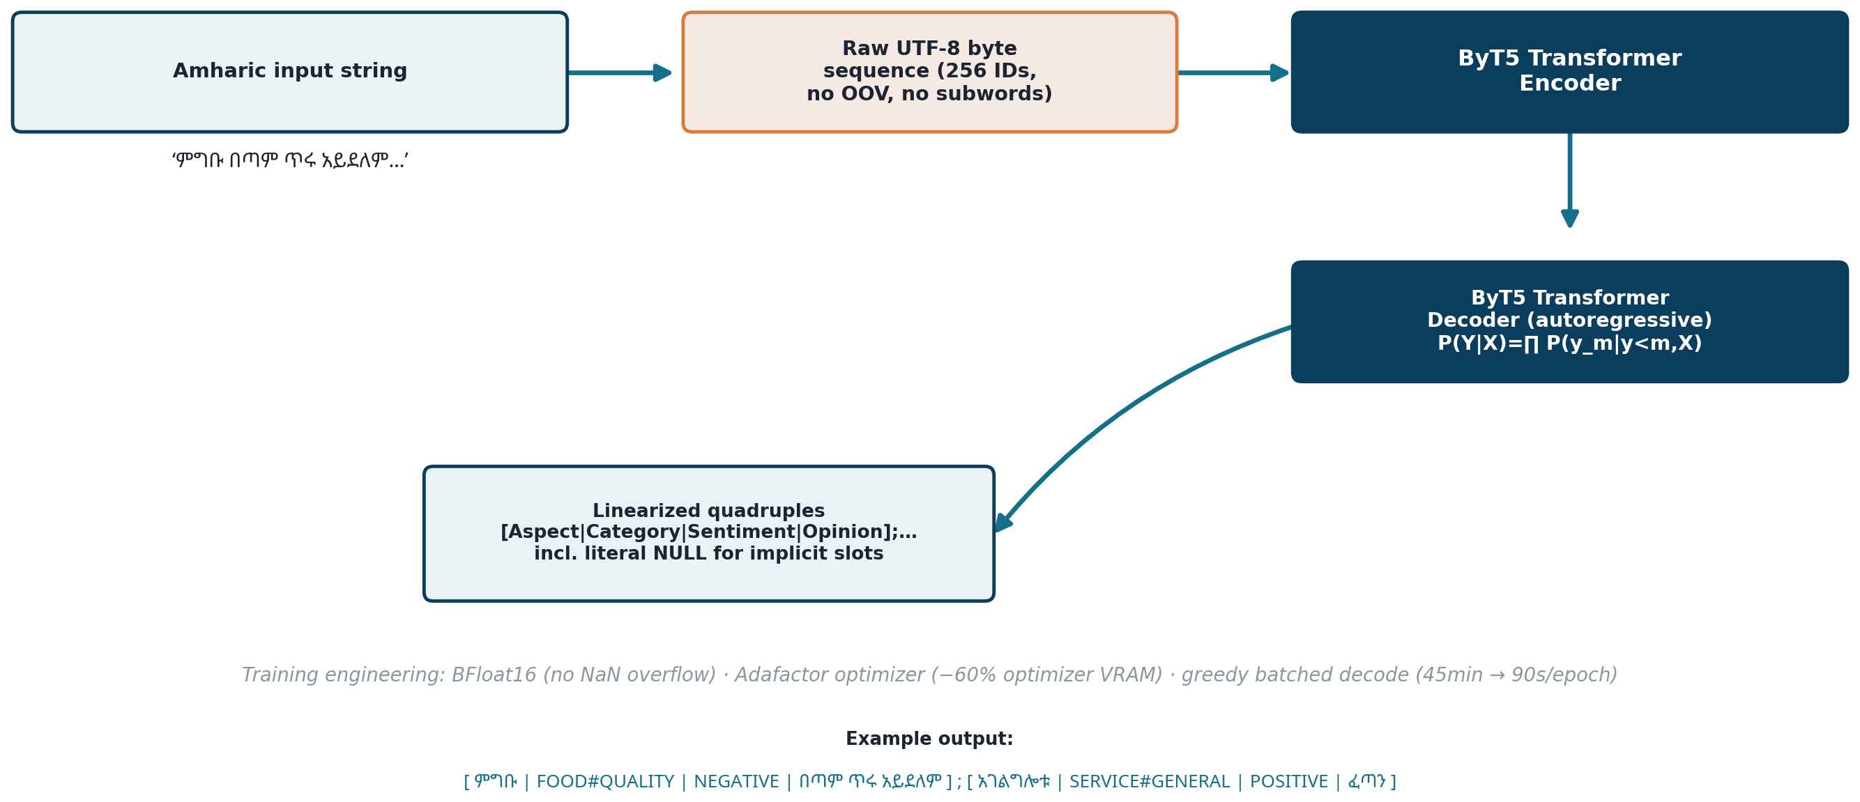
PHASE 6 · GENERATIVE FOUNDATION MODEL
The Paradigm Shift to Generative ByT5-Base
Formulating quadruple extraction as autoregressive, byte-level sequence generation (Xue et al., 2022)
12

Slide 13
BYT5 ENGINEERING & OPTIMIZATION
Overcoming the FP16 NaN Collapse
Hardware-level stabilization: BFloat16 dynamic range, Adafactor memory reduction, and fast greedy evaluation
The Epoch 1 Training Failure
Three Engineering Fixes
ByT5 byte sequences run ~3–4× longer than the equivalent subword sequences (up to 512 bytes).
Under FP16, byte-embedding gradients caused arithmetic underflow and exponent overflow beyond ±65,504.
Training loss diverged to NaN within step 350 of epoch 1.
Separately, beam-search validation took ~45 minutes per epoch, making multi-epoch training impractical.
BFloat16 (BF16): keeps FP32's 8 exponent bits, expanding dynamic range from ~10±4.8 to ~10±38 — eliminates NaN crashes entirely.
Adafactor optimizer: factorizes second moments (V ≈ R·C / mean(R)), cutting optimizer VRAM ~60% and enabling batch size 8 with gradient accumulation ×4.
Fast greedy validation: batched (bs=16) greedy decoding cuts validation time from ~45 min to ~90 sec/epoch — a ~30× speedup.
13

Slide 14
BYT5 DEV-SET MILESTONE · BEST CHECKPOINT, EPOCH 9
Breaking the Implicit Barrier
First-ever non-zero implicit-quad recovery across the entire project
Metric | P | R | F1 | TP
Full Quadruple (A,C,S,O) | 18.20% | 17.62% | 17.90% | 182
Implicit Quadruples | 23.49% | 16.36% | 19.28% | 70
Explicit Quadruples | 15.95% | 18.51% | 17.14% | 112
Joint Category–Sentiment | 49.50% | 47.90% | 48.70% | 495
Aspect–Category–Sentiment (ACSE) | 30.30% | 29.33% | 29.81% | 303
AOPE Pair (A,O) | 30.00% | 29.04% | 29.51% | 300
ASTE Triplet (A,S,O) | 27.40% | 26.52% | 26.96% | 274
Exact Match — Complex Implicit Sentence
Input: ውህደቱ ለአገራዊ ለውጡ አስተዋጽኦ ያበረክታል በሚል ብዙዎች ተስፋ ጥለውበት የነበረ ቢሆንም በተግባር የታየው ግን ተስፋ አስቆረጣቸው።
Ground truth: [ ውህደቱ | GOVERNANCE#CITIZEN_ENGAGEMENT | NEGATIVE | ተስፋ አስቆረጣቸው ]
ByT5 prediction: exact match ✓
Every extractive architecture in Phases 1–5 scored exactly 0.00% on implicit quads; ByT5 recovers 70 true-positive implicit quads at 23.49% precision.
14

Slide 15
FINAL TEST EVALUATION · 10-EPOCH BYT5-BASE
Definitive Test-Set Metrics
Complete held-out test evaluation after 10 epochs, best checkpoint selected on dev
Metric | P | R | F1 | TP
Full Quadruple (A,C,S,O) | 16.52% | 15.78% | 16.14% | 811
Explicit Quadruples | 15.90% | 18.00% | 16.88% | 537
Implicit Quadruples | 17.90% | 12.71% | 14.87% | 274
AOPE Pair (A,O) | 27.32% | 26.10% | 26.69% | 1341
ASTE Triplet (A,S,O) | 24.24% | 23.16% | 23.69% | 1190
Aspect–Category–Sentiment | 30.64% | 29.27% | 29.94% | 1504
Joint Category–Sentiment | 49.40% | 47.20% | 48.27% | 2425
Dev-Best vs. Final Test
Full Quad F1: 17.90% → 16.14% (−1.76 pts) — a modest generalization gap.
Implicit Quad F1: 19.28% → 14.87% (−4.41 pts) — the largest drop; implicit extraction remains the hardest sub-task.
Category–Sentiment F1: 48.70% → 48.27% — highly stable, generalizes robustly.
ACSE F1: 29.81% → 29.94% (+0.13 pts) — improved slightly on test.
811 true-positive full quadruples and 274 implicit true positives on the full held-out test set.
15

Slide 16
MASTER BENCHMARK
Cross-Architecture Synthesis
Consolidated performance across all six model generations
Architecture | Aspect F1 | AOPE Pair F1 | Full Quad F1 | Implicit F1
6-Stage Pipeline | 50.60% | N/A* | 14.20% | 0.00%
Joint SDRN | 48.00% | 34.85% | N/A | 0.00%
Span-ASTE Run 1 | 50.59% | 30.80% | N/A | 0.00%
Span-ASTE Run 2 | 53.76% | 34.02% | N/A | 0.00%
Span-ASTE Run 3 | 55.20% | 32.04%† | N/A | 0.00%
ByT5-Base (Dev Ep.9) | 29.81%‡ | 29.51% | 17.90% | 19.28%
ByT5-Base (Final Test) | 29.94%‡ | 26.69% | 16.14% | 14.87%
*No pair-level metric was reported for the pipeline separately from its final quad score. †Not directly traceable to Run 3's own results — the confirmed figure is 45.78% calibrated pair recall. ‡Joint Aspect–Category–Sentiment (ACSE), not directly comparable to ATE F1 in rows above.
16

Slide 17
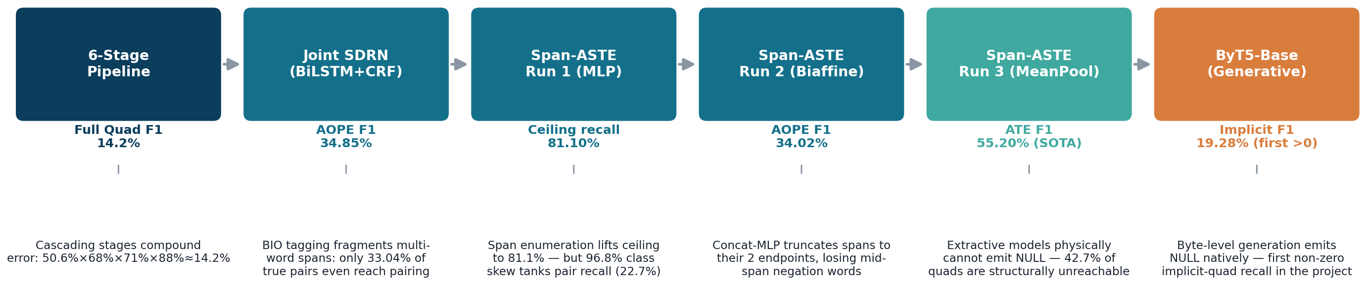
SYNTHESIS
Architecture Evolution: Six Generations, Six Decisions
Each transition was forced by a specific diagnosed failure in the previous generation
Future Strategic Horizons
Horizon 1 — Curriculum fine-tuning: pre-train the ByT5 decoder on explicit quadruples before joint fine-tuning on implicit NULL tuples.
Horizon 2 — Constrained trie/FSM decoding: enforce a finite-state machine over the 29 categories and 3 sentiment labels to eliminate hallucinations.
Horizon 3 — Foundation model scaling: scale ByT5-Base (580M) to ByT5-Large (1.2B) via LoRA to enrich contextual Semitic representations.
17

Slide 18
REFERENCES
Bibliography
1. Xu, L., Chia, Y. K., & Bing, L. (2021). Learning Span-Level Interactions for Aspect Sentiment Triplet Extraction. Proceedings of ACL-IJCNLP 2021.
2. Chen, S., Wang, Y., Liu, J., & Wang, Y. (2020). Synchronous Double-Channel Recurrent Network for Aspect-Opinion Pair Extraction. Proceedings of ACL 2020.
3. Cai, H., Xia, R., & Yu, J. (2021). Aspect-Category-Opinion-Sentiment Quadruple Extraction with Implicit Aspects and Opinions. Proceedings of ACL-IJCNLP 2021.
4. Dozat, T., & Manning, C. D. (2017). Deep Biaffine Attention for Neural Dependency Parsing. International Conference on Learning Representations (ICLR).
5. Lin, T.-Y., Goyal, P., Girshick, R., He, K., & Dollár, P. (2017). Focal Loss for Dense Object Detection. Proceedings of ICCV 2017.
6. Xue, L., Barua, A., Constant, N., Al-Rfou, R., Narang, S., Kale, M., Roberts, A., & Raffel, C. (2022). ByT5: Towards a Token-Free Future with Pre-trained Byte-to-Byte Models. Transactions of the ACL (TACL), 10.
7. Raffel, C., Shazeer, N., Roberts, A., Lee, K., Narang, S., Matena, M., Zhou, Y., Li, W., & Liu, P. J. (2020). Exploring the Limits of Transfer Learning with a Unified Text-to-Text Transformer. Journal of Machine Learning Research (JMLR), 21.
8. Shazeer, N., & Stern, M. (2018). Adafactor: Adaptive Learning Rates with Sublinear Memory Cost. Proceedings of ICML 2018.
9. Conneau, A., Khandelwal, K., Goyal, N., Chaudhary, V., Wenzek, G., Guzmán, F., Grave, E., Ott, M., Zettlemoyer, L., & Stoyanov, V. (2020). Unsupervised Cross-lingual Representation Learning at Scale (XLM-R). Proceedings of ACL 2020.
10. Alabi, J. O., Adelani, D. I., Mosbach, M., & Klakow, D. (2022). Adapting Pre-trained Language Models to African Languages via Multilingual Adaptive Fine-Tuning (AfroXLM-R). Proceedings of COLING 2022.
11. Mekonen, A. (2026). acos-amharic: End-to-End Amharic ACOS Quadruple Extraction [Source code repository]. github.com/EthAIResearch/acos-amharic
12. rasyosef/roberta-base-amharic and Davlan/afro-xlmr-base model cards. Hugging Face Model Hub.
18

