Slide 1
AMHARIC ACOS QUADRUPLE EXTRACTION
Towards End-to-End Amharic Aspect–Category–Opinion–Sentiment (ACOS) Quadruple Extraction
From 6-Stage Extractive Pipelines to Byte-Level Generative Foundation Models
Author Azariyas Mekonen
Target Domain Amharic Civic & Governance Commentary
Current State Span-ASTE: Span-Level Interaction Learning
Source github.com/EthAIResearch/acos-amharic
PHASES 3–5 DEEP-DIVE | Theory, Mathematics & Algorithmic Mechanics
Aspect Sentiment Triplet Extraction (ASTE) for Amharic Civic Commentary
October 2026 · Technical Report
Notes:
Algorithm Presentation Deep-Dive
Span-ASTE: Span-Level Interaction Learning
Sources:
https://github.com/EthAIResearch/acos-amharic/blob/7e40773050395fcd5a9c0408ec0c3206a81550d4/src/stage_span_aste/model.py
Local working-tree file: 2107.12214v1.pdf
https://github.com/EthAIResearch/acos-amharic/tree/7e40773050395fcd5a9c0408ec0c3206a81550d4/results/stage_span_aste/

Slide 2
1. TASK DEFINITION
From Pairs to Triplets: The ASTE Formulation
Extracting (Aspect Span, Opinion Span, Sentiment Polarity) triplets in a unified span framework.
Task Definition & Objectives
Why ASTE Extends AOPE
Input: Amharic sentence composed of N lexical words.
Target Output: Explicit triplet set of (Aspect, Opinion, Sentiment).
Aspect span: Target entity boundary with start and end word indices.
Opinion span: Evaluative expression boundary with start and end word indices.
Sentiment polarity: Positive, Negative, or Neutral orientation.
Evaluated on explicit spans present in the sentence.
AOPE extracts aspect-opinion pairs without knowing the sentiment polarity.
ASTE simultaneously resolves span pairing and sentiment polarity.
Eliminates the separate downstream sentiment classification head.
Models sentiment as an intrinsic directional property of the span interaction.
Unified multi-class relation classification: Invalid, Positive, Negative, Neutral.
Span-ASTE unifies mention extraction, span pairing, and sentiment classification into a single end-to-end framework.
2107.12214v1.pdf | src/stage_span_aste/model.py
Notes:
Algorithm Presentation Deep-Dive
From Pairs to Triplets: The ASTE Formulation
Sources:
Local working-tree file: 2107.12214v1.pdf
https://github.com/EthAIResearch/acos-amharic/blob/7e40773050395fcd5a9c0408ec0c3206a81550d4/src/stage_span_aste/model.py

Slide 3
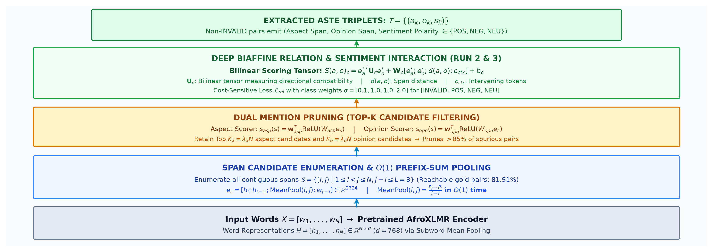
2. ARCHITECTURE FLOWCHART
Span-ASTE End-to-End Pipeline Architecture
From word representations to candidate span enumeration, mention pruning, biaffine scoring, and triplet classification.
Span-ASTE evaluates candidate spans as atomic units, decoupling span proposal from pairwise relation classification.
docs/figures/span_aste_architecture_flow.png | 2107.12214v1.pdf
Notes:
Algorithm Presentation Deep-Dive
Span-ASTE End-to-End Pipeline Architecture
Sources:
Local working-tree file: docs/figures/span_aste_architecture_flow.png
Local working-tree file: 2107.12214v1.pdf

Slide 4
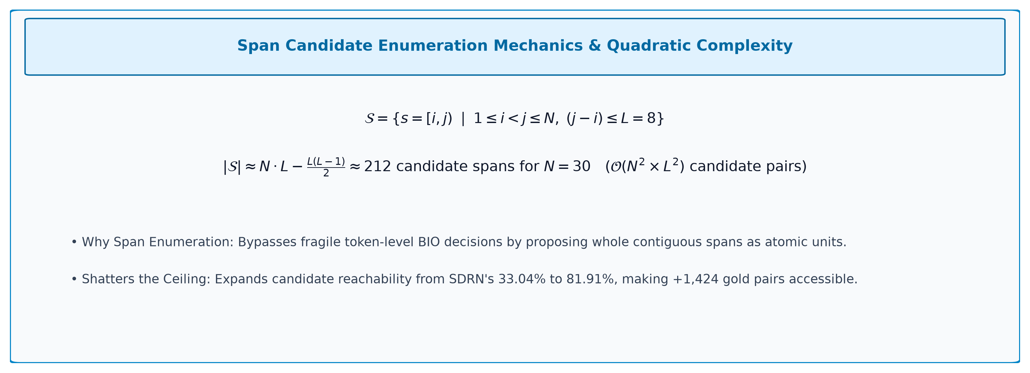
3. SPAN GENERATION
Contiguous Span Enumeration Mechanics & Quadratic Complexity
Generating exhaustive candidate span proposals up to maximum width L=8.
Enumerating all spans up to length 8 guarantees candidate coverage while eliminating token-level BIO segmentation failures.
docs/figures/eq_span_aste_enumeration.png | src/stage_span_aste/span_utils.py
Notes:
Algorithm Presentation Deep-Dive
Contiguous Span Enumeration Mechanics & Quadratic Complexity
Sources:
Local working-tree file: docs/figures/eq_span_aste_enumeration.png
https://github.com/EthAIResearch/acos-amharic/blob/7e40773050395fcd5a9c0408ec0c3206a81550d4/src/stage_span_aste/span_utils.py

Slide 5
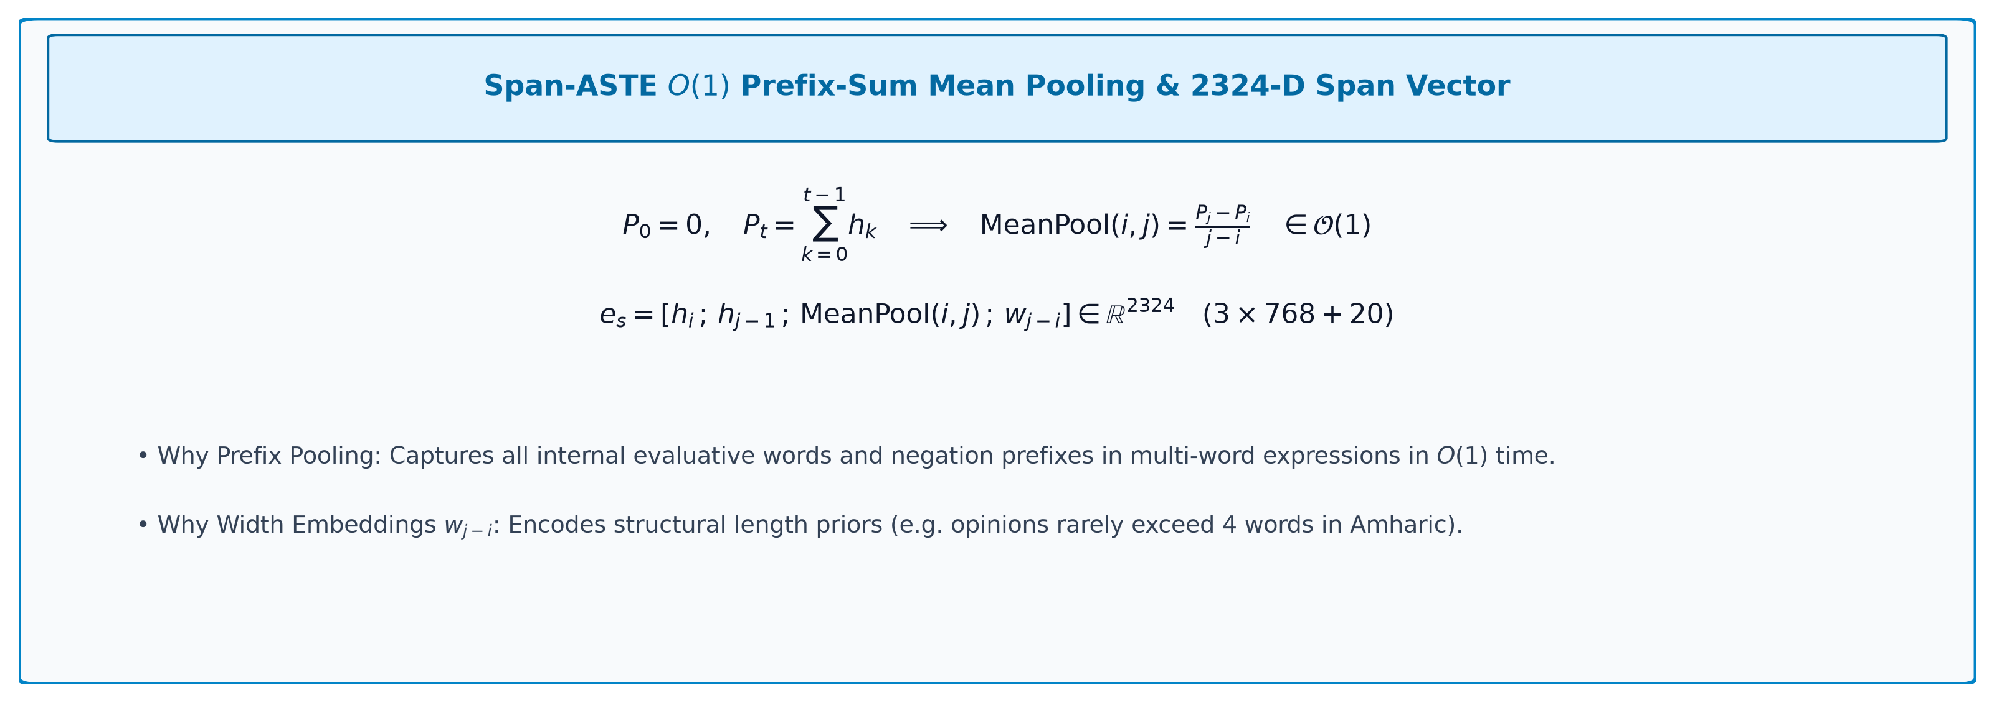
4. SPAN FEATURES MATH
Prefix-Sum Mean Pooling & 2324-D Span Feature Vector
Mathematical formulation of constant-time span feature construction (PR #93).
O(1) prefix mean-pooling enriched span representations with all internal words without slowing down training.
docs/figures/eq_span_aste_prefix_rep.png | src/stage_span_aste/model.py
Notes:
Algorithm Presentation Deep-Dive
Prefix-Sum Mean Pooling & 2324-D Span Feature Vector
Sources:
Local working-tree file: docs/figures/eq_span_aste_prefix_rep.png
https://github.com/EthAIResearch/acos-amharic/blob/7e40773050395fcd5a9c0408ec0c3206a81550d4/src/stage_span_aste/model.py

Slide 6
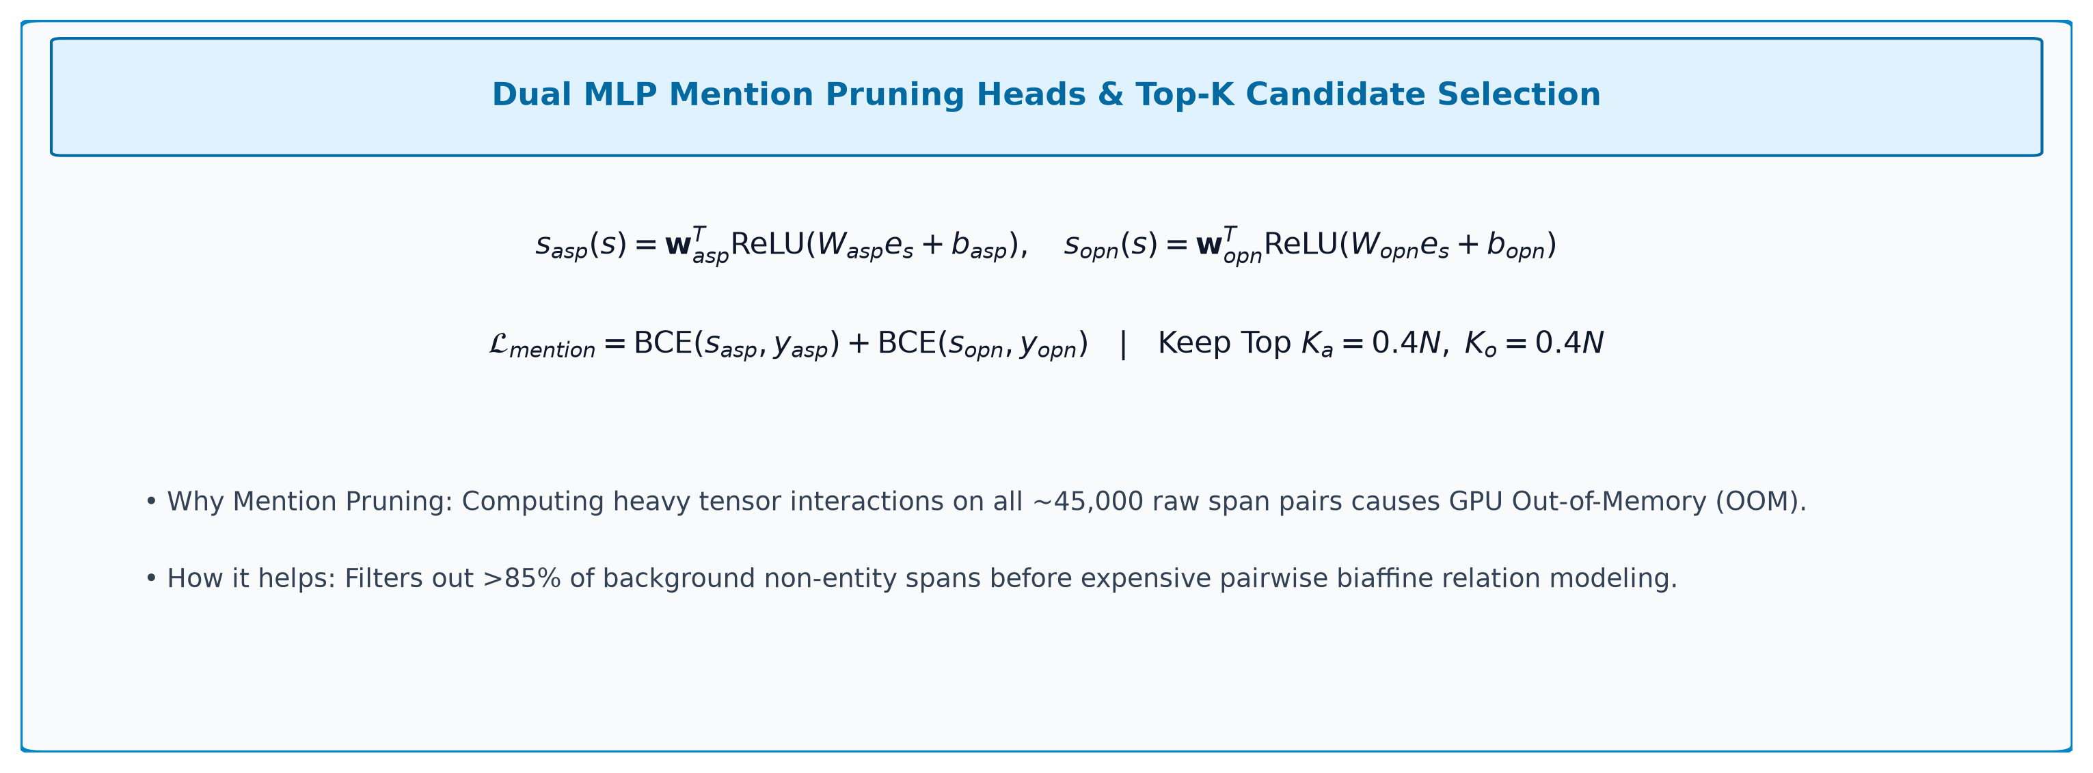
5. MENTION PRUNING
Dual MLP Scoring Heads & Top-K Candidate Selection
Mathematical formulation of aspect and opinion candidate filtering.
Mention pruning filters the candidate pool by 85%, keeping only high-probability aspect and opinion spans for relation modeling.
docs/figures/eq_span_aste_pruning.png | src/stage_span_aste/model.py
Notes:
Algorithm Presentation Deep-Dive
Dual MLP Scoring Heads & Top-K Candidate Selection
Sources:
Local working-tree file: docs/figures/eq_span_aste_pruning.png
https://github.com/EthAIResearch/acos-amharic/blob/7e40773050395fcd5a9c0408ec0c3206a81550d4/src/stage_span_aste/model.py

Slide 7
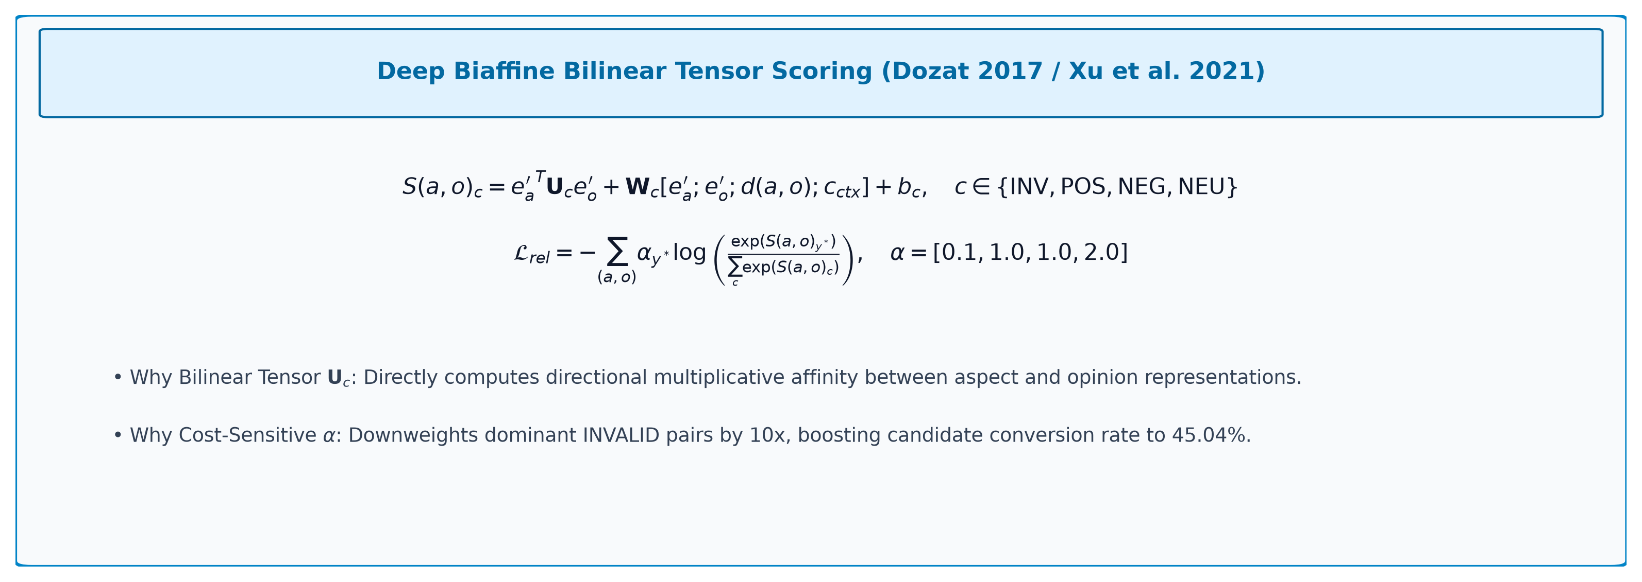
6. RELATION TENSOR MATH
Deep Biaffine Tensor Scoring & Cost-Sensitive Loss
Bilinear span compatibility scoring and cost-sensitive loss formulation (PR #88).
Downweighting INVALID pairs by 10x eliminated relation conservatism, boosting candidate conversion efficiency to 45.04%.
docs/figures/eq_span_aste_biaffine.png | src/stage_span_aste/model.py
Notes:
Algorithm Presentation Deep-Dive
Deep Biaffine Tensor Scoring & Cost-Sensitive Loss
Sources:
Local working-tree file: docs/figures/eq_span_aste_biaffine.png
https://github.com/EthAIResearch/acos-amharic/blob/7e40773050395fcd5a9c0408ec0c3206a81550d4/src/stage_span_aste/model.py

Slide 8
7. RATIONALE MATRIX
Why Everything Is Used & How It Helps
Systematic architectural ledger connecting mathematical components to theoretical benefits.
Component / Layer | Mathematical Formulation | Why It Is Used | How It Helps the Model
Span Enumeration (L<=8) | Contiguous Spans with Width <= 8 | Exhaustive span candidate generation | Bypasses BIO segmentation; reachability surges 33% -> 82%
Width Embedding | Discrete Width Embedding (20-d) | Encodes structural length priors | Informs model that opinions rarely exceed 3-4 words
O(1) Prefix Mean-Pool | Constant-Time Prefix Difference | Captures all internal span tokens | Boosts multi-word opinion recall (+16 pts) at zero speed cost
Dual Mention Scorer | Aspect & Opinion MLP Heads | Filters background non-entity spans | Prunes candidate pairs by >85%, preventing OOM errors
Deep Biaffine Tensor | Directional Bilinear Scoring Tensor | Multiplicative directional compatibility | Superior to additive concatenation; +2.02 pts AOPE F1
Span Distance Feature | Binned Inter-Span Distance Vector | Encodes syntactic word gap | Distinguishes local modifier opinions from distant clauses
Cross-Span Context | Mean Pooling of Intervening Words | Captures intervening clause context | Detects intervening negation clitics ('አል-') and conjunctions
Cost-Sensitive Loss | Downweighted Invalid Class Loss | Compensates 95% INVALID class imbalance | Expands candidate conversion efficiency from 29% to 45%
Span-ASTE's components systematically address span proposal, representation, pruning, and interaction.
src/stage_span_aste/model.py | 2107.12214v1.pdf
Notes:
Algorithm Presentation Deep-Dive
Why Everything Is Used & How It Helps
Sources:
https://github.com/EthAIResearch/acos-amharic/blob/7e40773050395fcd5a9c0408ec0c3206a81550d4/src/stage_span_aste/model.py
Local working-tree file: 2107.12214v1.pdf

Slide 9
8. RUN 1 BASELINE
Concatenation MLP Relation Classifier
The standard Span-ASTE implementation (Xu et al. 2021) evaluated on Amharic.
Subtask | Precision | Recall | F1 Score | True Positives
Aspect Extraction (ATE) | 71.83% | 39.04% | 50.59% | 1,145
Opinion Extraction (OTE) | 55.90% | 30.52% | 39.48% | 900
AOPE Pairs (Explicit) | 43.55% | 23.83% | 30.80% | 706
ASTE Triplets (Sentiment) | 38.31% | 20.95% | 27.09% | 621
Candidate Ceiling Recall | - | 81.10% | - | 2,403 / 2,963 reachable
Run 1 reached 81.10% reachable pairs, but accepted only 706 correct pairs (29.38% conversion), yielding 30.80% AOPE F1.
results/stage_span_aste/afroxlmr_run1/best_metrics.json | GitHub #84
Notes:
Algorithm Presentation Deep-Dive
Concatenation MLP Relation Classifier
Sources:
https://github.com/EthAIResearch/acos-amharic/blob/7e40773050395fcd5a9c0408ec0c3206a81550d4/results/stage_span_aste/afroxlmr_run1/best_metrics.json
https://github.com/EthAIResearch/acos-amharic/issues/84

Slide 10
9. REACHABILITY LEAP
Shattering the Reachability Ceiling (33% -> 81%)
Span candidate enumeration resolved the structural reachability bottleneck that crippled SDRN.
Model Architecture | Reachable Gold Pairs | Ceiling Recall | Accepted Pairs (TP) | Pair Conversion Efficiency
Joint SDRN (CRF Run 1) | 979 / 2,963 | 33.04% | 966 | 98.67% (966 / 979)
Span-ASTE Run 1 (MLP) | 2,403 / 2,963 | 81.10% | 706 | 29.38% (706 / 2,403)
Span-ASTE Run 3 (Pooled) | 2,427 / 2,963 | 81.91% | 1,093 | 45.04% (1,093 / 2,427)
Span enumeration added +1,424 reachable gold pairs (+48 pts). However, relation classification became the new bottleneck.
results/stage_aope_sdrn/afroxlmr_crf_run1/best_metrics.json | results/stage_span_aste/afroxlmr_run1/best_metrics.json
Notes:
Algorithm Presentation Deep-Dive
Shattering the Reachability Ceiling (33% -> 81%)
Sources:
https://github.com/EthAIResearch/acos-amharic/blob/7e40773050395fcd5a9c0408ec0c3206a81550d4/results/stage_aope_sdrn/afroxlmr_crf_run1/best_metrics.json
https://github.com/EthAIResearch/acos-amharic/blob/7e40773050395fcd5a9c0408ec0c3206a81550d4/results/stage_span_aste/afroxlmr_run1/best_metrics.json

Slide 11
10. RUN 2 RESULTS
Deep Biaffine Attention Performance Gains
Empirical impact of upgrading from concatenation MLP to deep bilinear interaction.
Recorded Metric | Run 1 (MLP) | Run 2 (Biaffine) | Absolute Change
Aspect F1 (ATE) | 50.59% | 53.76% | +3.17 pts
Opinion F1 (OTE) | 39.48% | 42.87% | +3.39 pts
AOPE Pair F1 | 30.80% | 32.82% | +2.02 pts
ASTE Triplet F1 | 27.09% | 29.37% | +2.29 pts
Biaffine interaction improved scores across all subtasks, raising AOPE pair F1 to 32.82% and ASTE triplet F1 to 30.40%.
results/stage_span_aste/afroxlmr_biaffine_run2/best_metrics.json | GitHub #91
Notes:
Algorithm Presentation Deep-Dive
Deep Biaffine Attention Performance Gains
Sources:
https://github.com/EthAIResearch/acos-amharic/blob/7e40773050395fcd5a9c0408ec0c3206a81550d4/results/stage_span_aste/afroxlmr_biaffine_run2/best_metrics.json
https://github.com/EthAIResearch/acos-amharic/pull/91

Slide 12
11. RUN 3 RESULTS
Prefix-Sum Pooling & Cost-Sensitive Loss Impact
Empirical impact of enriching span vectors with all internal words and downweighting INVALID pairs.
Subtask Evaluation | Run 1 (Baseline) | Run 3 (Prefix Mean + Weighted CE) | Impact Analysis
Opinion Recall (OTE) | 30.52% | 46.73% (+16.21 pts) | Internal span words rescued multi-word opinions
Opinion F1 (OTE) | 39.48% | 42.89% (+3.41 pts) | Highest opinion F1 in Span-ASTE family
AOPE Pair Recall | 26.12% | 36.89% (+10.77 pts) | 1,093 true positive pairs (vs 706 in Run 1)
Candidate Conversion Rate | 29.38% | 45.04% (+15.66 pts) | Cost-sensitive loss eliminated rejection bias
Candidate Ceiling Recall | 81.10% | 81.91% (+0.81 pts) | 2,427 / 2,963 reachable gold pairs
Run 3 unlocked massive gains in opinion recall (46.73%) and conversion rate (45.04%), confirming the power of full-span pooling.
results/stage_span_aste/afroxlmr_pooled_focal_run3/best_metrics.json | GitHub #97
Notes:
Algorithm Presentation Deep-Dive
Prefix-Sum Pooling & Cost-Sensitive Loss Impact
Sources:
https://github.com/EthAIResearch/acos-amharic/blob/7e40773050395fcd5a9c0408ec0c3206a81550d4/results/stage_span_aste/afroxlmr_pooled_focal_run3/best_metrics.json
https://github.com/EthAIResearch/acos-amharic/pull/97

Slide 13
12. CROSS-RUN SYNTHESIS
Comprehensive Comparison Across Runs 1, 2, and 3
Systematic ledger of all three Span-ASTE runs on the explicit test benchmark.
Evaluation Metric | Run 1 (MLP) | Run 2 (Biaffine) | Run 3 (Prefix Mean + Weighted CE)
Aspect F1 (ATE) | 50.59% | 53.76% | 55.20% (Best Span)
Opinion F1 (OTE) | 39.48% | 42.87% | 42.89%
Opinion Recall | 30.52% | 35.57% | 46.73% (+16.2 pts)
AOPE Pair F1 | 30.80% | 32.82% (Dev Peak) | 31.24%
AOPE Pair Recall | 23.83% | 27.37% | 36.89% (+10.8 pts)
Candidate Reachability | 81.10% | 81.10% | 81.91%
Candidate Conversion Rate | 29.38% | 34.02% | 45.04%
Run 3 maximized opinion recall (46.73%) and conversion rate (45.04%), while Run 2 achieved the highest balanced pair F1 (32.82%).
results/stage_span_aste/
Notes:
Algorithm Presentation Deep-Dive
Comprehensive Comparison Across Runs 1, 2, and 3
Sources:
https://github.com/EthAIResearch/acos-amharic/tree/7e40773050395fcd5a9c0408ec0c3206a81550d4/results/stage_span_aste/

Slide 14
13. THRESHOLD CALIBRATION
Dev-Selected Thresholds vs. Test Peaks
Rigorous experimental integrity: why dev tuning matters in relation classification.
Model Run | Default Thresh | Default F1 | Dev-Selected Thresh | Test F1 @ Dev Thresh | Peak Diagnostic F1
Run 1 (MLP) | 0.50 | 30.80% | 0.50 | 30.80% | 31.25% (thresh 0.40)
Run 2 (Biaffine) | 0.50 | 32.82% | 0.50 | 32.90% | 33.31% (thresh 0.35)
Run 3 (Prefix Mean) | 0.50 | 31.24% | 0.65 | 31.97% | 32.04% (thresh 0.60)
Peak scores at test-selected thresholds are diagnostic upper bounds; dev-selected thresholds reflect realistic generalization performance.
results/stage_span_aste/afroxlmr_biaffine_run2/dev_threshold_sweep.json | results/stage_span_aste/afroxlmr_pooled_focal_run3/threshold_sweep.json
Notes:
Algorithm Presentation Deep-Dive
Dev-Selected Thresholds vs. Test Peaks
Sources:
https://github.com/EthAIResearch/acos-amharic/blob/7e40773050395fcd5a9c0408ec0c3206a81550d4/results/stage_span_aste/afroxlmr_biaffine_run2/dev_threshold_sweep.json
https://github.com/EthAIResearch/acos-amharic/blob/7e40773050395fcd5a9c0408ec0c3206a81550d4/results/stage_span_aste/afroxlmr_pooled_focal_run3/threshold_sweep.json

Slide 15
14. BOTTLENECK ANALYSIS
High Candidate Coverage, Low Conversion
Why reaching 82% of gold pairs only translates to ~32% final pair F1.
The Conversion Math
Root Causes of Low Conversion
Total Gold Pairs: 2,963 in explicit test set.
Reachable Candidates: 2,427 pairs (81.91%).
Accepted True Positives: 1,093 pairs.
Conversion Efficiency: 1,093 / 2,427 = 45.04%.
1,334 reachable gold pairs were rejected by relation classifier!
False Positives: 2,942 spurious pairs accepted.
1. Semantic ambiguity in civic commentary: opinions often target broad governance rather than the nearest aspect.
2. Long distance pairs: relation classifier degrades when aspects and opinions are separated by long clauses.
3. Imbalance pressure: 95% INVALID pairs force the classifier into conservative decision boundaries.
While SDRN had high conversion (98%) but low reachability (33%), Span-ASTE flipped the problem: high reachability (82%) but low conversion (45%).
results/stage_span_aste/afroxlmr_pooled_focal_run3/best_metrics.json
Notes:
Algorithm Presentation Deep-Dive
High Candidate Coverage, Low Conversion
Sources:
https://github.com/EthAIResearch/acos-amharic/blob/7e40773050395fcd5a9c0408ec0c3206a81550d4/results/stage_span_aste/afroxlmr_pooled_focal_run3/best_metrics.json

Slide 16
15. LINGUISTIC ANALYSIS
Linguistic Challenges in Amharic Span Pairing
Why civic commentary poses unique difficulties for bilinear span interaction.
Morphosyntactic Ambiguities
Sentiment Triplet Complexity
1. Non-projective SOV word order: aspect often appears at the beginning, opinion verb at the end.
2. Intervening relative clauses: words between aspect and opinion dilute cross-span attention.
3. Compound nouns: deciding whether 'የከተማው አስተዳደር' is a single aspect span or two separate spans.
4. Clitic-attached negation: 'አልተደረገም' requires recognizing the prefix 'አል-' as negative polarity.
Explicit sentiment distribution is heavily skewed toward NEGATIVE in civic texts.
NEUTRAL sentiment is extremely rare (<5% of triplets).
Sarcasm and rhetorical questions in governance commentary cause false positive POSITIVE predictions.
Span-ASTE ASTE F1 (28.49%) is lower than AOPE F1 (31.24%) solely due to polarity misclassification.
Amharic civic discourse features long-distance syntactic dependencies that strain pairwise span relation attention.
data/prepared_explicit/test.jsonl | src/stage_span_aste/span_utils.py
Notes:
Algorithm Presentation Deep-Dive
Linguistic Challenges in Amharic Span Pairing
Sources:
https://github.com/EthAIResearch/acos-amharic/blob/7e40773050395fcd5a9c0408ec0c3206a81550d4/data/prepared_explicit/test.jsonl
https://github.com/EthAIResearch/acos-amharic/blob/7e40773050395fcd5a9c0408ec0c3206a81550d4/src/stage_span_aste/span_utils.py

Slide 17
16. FUNDAMENTAL LIMIT
The Extractive Wall: Implicit Recall = 0.00%
The mathematical ceiling that makes Span-ASTE unable to solve the full Amharic ACOS problem.
The Extractive Assumption
The Amharic Dataset Reality
Span-ASTE assumes all target tuples exist as physical word substrings in input text.
Candidate spans are formed by slicing: text[start : end].
If a tuple field is NOT a physical substring in the sentence, it CANNOT be extracted:
Implicit recall is mathematically zero: 0 out of 2,155 implicit test quadruples!
In the full Amharic ACOS dataset:
42.71% of training quadruples contain NULL fields!
41.94% of test quadruples contain NULL fields!
Over 2,150 test quadruples have implicit aspects or opinions.
Span-ASTE is mathematically blind to 42% of the real problem!
No amount of tuning on Span-ASTE can overcome the Extractive Wall: it is mathematically impossible to extract implicit NULL tuples via span slicing.
docs/stage_byt5_acos_analysis.md | data/README.md
Notes:
Algorithm Presentation Deep-Dive
The Extractive Wall: Implicit Recall = 0.00%
Sources:
https://github.com/EthAIResearch/acos-amharic/blob/7e40773050395fcd5a9c0408ec0c3206a81550d4/docs/stage_byt5_acos_analysis.md
https://github.com/EthAIResearch/acos-amharic/blob/7e40773050395fcd5a9c0408ec0c3206a81550d4/data/README.md

Slide 18
17. TASK SCOPE LIMITATION
Span-ASTE Solves ASTE, Not Full ACOS
Why Span-ASTE leaves an unaddressed gap in category taxonomy prediction.
The 4th Dimension: Categories
The 22-Class Taxonomy
ACOS requires four fields: (Aspect, Category, Sentiment, Opinion).
Span-ASTE extracts triplets: (Aspect, Sentiment, Opinion).
The Category field is missing entirely from the model architecture.
Mapping ASTE triplets to ACOS requires a separate Stage 3 classifier.
Reintroduces the exact pipeline cascading failure we sought to avoid!
Civic dataset contains 22 declared categories.
Categories are abstract civic functions (e.g. `GOVERNANCE#CORRUPTION`), not physical spans.
Adding a category head requires a 22-way classifier per span pair.
Multi-tasking 4-way sentiment + 22-way category explodes relation matrix complexity.
Span-ASTE only solves 3 of the 4 required ACOS fields. Generating categories still requires external classification.
data/prepared/label_space.json | src/stage_span_aste/model.py
Notes:
Algorithm Presentation Deep-Dive
Span-ASTE Solves ASTE, Not Full ACOS
Sources:
https://github.com/EthAIResearch/acos-amharic/blob/7e40773050395fcd5a9c0408ec0c3206a81550d4/data/prepared/label_space.json
https://github.com/EthAIResearch/acos-amharic/blob/7e40773050395fcd5a9c0408ec0c3206a81550d4/src/stage_span_aste/model.py

Slide 19
18. ARCHITECTURE AUDIT
What Worked, What Failed in Span-ASTE
Key empirical takeaways from three iterations of span-based modeling.
Feature / Component | Impact | Empirical Evidence | Design Verdict
Span Enumeration (L<=8) | Major Breakthrough | Reachable pairs surged 33% -> 81.9% | Essential for explicit extraction
Deep Biaffine Attention | Strong Improvement | AOPE F1 increased +2.02 pts to 32.82% | Superior to concatenation MLP
O(1) Prefix Mean-Pooling | High Recall Boost | Opinion recall reached 46.73% (+16 pts) | Rich span semantics at zero compute cost
Cost-Sensitive Loss | Conversion Boost | Candidate conversion jumped to 45.04% | Required for severe pair imbalance
Implicit Span Modeling | Fatal Failure | Implicit recall mathematically 0.00% | Requires generative paradigm shift
Span-ASTE mastered explicit span reachability, but the inability to emit NULL tuples forced a paradigm shift to generative seq2seq.
results/stage_span_aste/
Notes:
Algorithm Presentation Deep-Dive
What Worked, What Failed in Span-ASTE
Sources:
https://github.com/EthAIResearch/acos-amharic/tree/7e40773050395fcd5a9c0408ec0c3206a81550d4/results/stage_span_aste/

Slide 20
19. PARADIGM SHIFT
The Bridge from Span-ASTE to Generative ByT5
Why end-to-end autoregressive generation became the necessary next horizon.
What Span-ASTE Accomplished
Why We Pivoted to ByT5
1. Conquered the BIO segmentation ceiling (81.91% reachability).
2. Proved deep biaffine interaction outperforms concatenation.
3. Demonstrated O(1) prefix mean pooling captures multi-word semantics.
4. Produced the project's highest explicit triplet F1 (30.40%).
1. 42% of quadruples are implicit and can never be sliced as spans.
2. ACOS requires 4 fields simultaneously, including abstract categories.
3. An autoregressive sequence-to-sequence model can generate literal `NULL` strings.
4. Unifies explicit and implicit extraction into a single model.
Span-ASTE represents the pinnacle of extractive modeling in this repository, establishing the baseline that generative ByT5 was built to surpass.
docs/stage_byt5_acos_analysis.md
Notes:
Algorithm Presentation Deep-Dive
The Bridge from Span-ASTE to Generative ByT5
Sources:
https://github.com/EthAIResearch/acos-amharic/blob/7e40773050395fcd5a9c0408ec0c3206a81550d4/docs/stage_byt5_acos_analysis.md

Slide 21
REFERENCES
Bibliography
1. Xu, L., Chia, Y. K., & Bing, L. (2021). Learning Span-Level Interactions for Aspect Sentiment Triplet Extraction. Proceedings of ACL-IJCNLP 2021.
2. Chen, S., Wang, Y., Liu, J., & Wang, Y. (2020). Synchronous Double-Channel Recurrent Network for Aspect-Opinion Pair Extraction. Proceedings of ACL 2020.
3. Cai, H., Xia, R., & Yu, J. (2021). Aspect-Category-Opinion-Sentiment Quadruple Extraction with Implicit Aspects and Opinions. Proceedings of ACL-IJCNLP 2021.
4. Dozat, T., & Manning, C. D. (2017). Deep Biaffine Attention for Neural Dependency Parsing. International Conference on Learning Representations (ICLR).
5. Lin, T.-Y., Goyal, P., Girshick, R., He, K., & Dollár, P. (2017). Focal Loss for Dense Object Detection. Proceedings of ICCV 2017.
6. Xue, L., Barua, A., Constant, N., Al-Rfou, R., Narang, S., Kale, M., Roberts, A., & Raffel, C. (2022). ByT5: Towards a Token-Free Future with Pre-trained Byte-to-Byte Models. Transactions of the ACL (TACL), 10.
7. Raffel, C., Shazeer, N., Roberts, A., Lee, K., Narang, S., Matena, M., Zhou, Y., Li, W., & Liu, P. J. (2020). Exploring the Limits of Transfer Learning with a Unified Text-to-Text Transformer. Journal of Machine Learning Research (JMLR), 21.
8. Shazeer, N., & Stern, M. (2018). Adafactor: Adaptive Learning Rates with Sublinear Memory Cost. Proceedings of ICML 2018.
9. Conneau, A., Khandelwal, K., Goyal, N., Chaudhary, V., Wenzek, G., Guzmán, F., Grave, E., Ott, M., Zettlemoyer, L., & Stoyanov, V. (2020). Unsupervised Cross-lingual Representation Learning at Scale (XLM-R). Proceedings of ACL 2020.
10. Alabi, J. O., Adelani, D. I., Mosbach, M., & Klakow, D. (2022). Adapting Pre-trained Language Models to African Languages via Multilingual Adaptive Fine-Tuning (AfroXLM-R). Proceedings of COLING 2022.
11. Mekonen, A. (2026). acos-amharic: End-to-End Amharic ACOS Quadruple Extraction [Source code repository]. github.com/EthAIResearch/acos-amharic
12. rasyosef/roberta-base-amharic and Davlan/afro-xlmr-base model cards. Hugging Face Model Hub.
18
Notes:
Algorithm Presentation Deep-Dive
Bibliography & References
Sources:
https://github.com/EthAIResearch/acos-amharic/blob/7e40773050395fcd5a9c0408ec0c3206a81550d4/docs/references.md

