Slide 1
AMHARIC ACOS QUADRUPLE EXTRACTION
Towards End-to-End Amharic Aspect–Category–Opinion–Sentiment (ACOS) Quadruple Extraction
From 6-Stage Extractive Pipelines to Byte-Level Generative Foundation Models
Author Azariyas Mekonen
Target Domain Amharic Civic & Governance Commentary
Current State SDRN: Synchronous Double-Channel Recurrent Network
Source github.com/EthAIResearch/acos-amharic
PHASE 2 DEEP-DIVE | Theory, Mathematics & Algorithmic Mechanics
Joint Aspect-Opinion Pair Extraction (AOPE) in Amharic Civic Commentary
October 2026 · Technical Report
Notes:
Algorithm Presentation Deep-Dive
SDRN: Synchronous Double-Channel Recurrent Network
Sources:
https://github.com/EthAIResearch/acos-amharic/blob/7e40773050395fcd5a9c0408ec0c3206a81550d4/src/stage_aope_sdrn/model.py
https://github.com/EthAIResearch/acos-amharic/blob/7e40773050395fcd5a9c0408ec0c3206a81550d4/docs/stage_aope_sdrn_analysis.md
Local working-tree file: 2020.acl-main.582.pdf

Slide 2
1. PROBLEM FORMULATION
The Aspect-Opinion Pair Extraction (AOPE) Task
Formulation of the joint pair extraction problem and why pipelining fails.
Task Definition & Objectives
Why Pipelining Fails (The 14% Collapse)
Input: Amharic sentence composed of N lexical words or tokens.
Target Output: Set of explicit aspect-opinion pairs (Aspect, Opinion).
Aspect span: Target governance entity, service, or policy mentioned in text.
Opinion span: Evaluative predicate or sentiment expression targeting the aspect.
Example: [ የከተማው አስተዳደር (Aspect) | ጥሩ ስራ ሰርቷል (Opinion) ].
Coupled semantics: An opinion is only meaningful relative to its aspect target.
Stage 1 (Span Extraction): Detects aspects and opinions in isolated passes.
Stage 2 (Heuristic Pairing): Applies nearest-token word distance rules.
Failure: Nearest-distance achieves 99.3% F1 ONLY on perfect gold spans.
Against noisy Stage 1 spans, Stage 2 has zero recovery mechanism.
Upstream false negatives and boundary shifts cascade irreversibly.
End-to-end full quadruple F1 collapses to approximately 14.2%.
AOPE requires joint modeling: an opinion cannot be reliably extracted without simultaneously identifying its aspect target.
2020.acl-main.582.pdf | src/stage_aope_sdrn/model.py
Notes:
Algorithm Presentation Deep-Dive
The Aspect-Opinion Pair Extraction (AOPE) Task
Sources:
Local working-tree file: 2020.acl-main.582.pdf
https://github.com/EthAIResearch/acos-amharic/blob/7e40773050395fcd5a9c0408ec0c3206a81550d4/src/stage_aope_sdrn/model.py

Slide 3
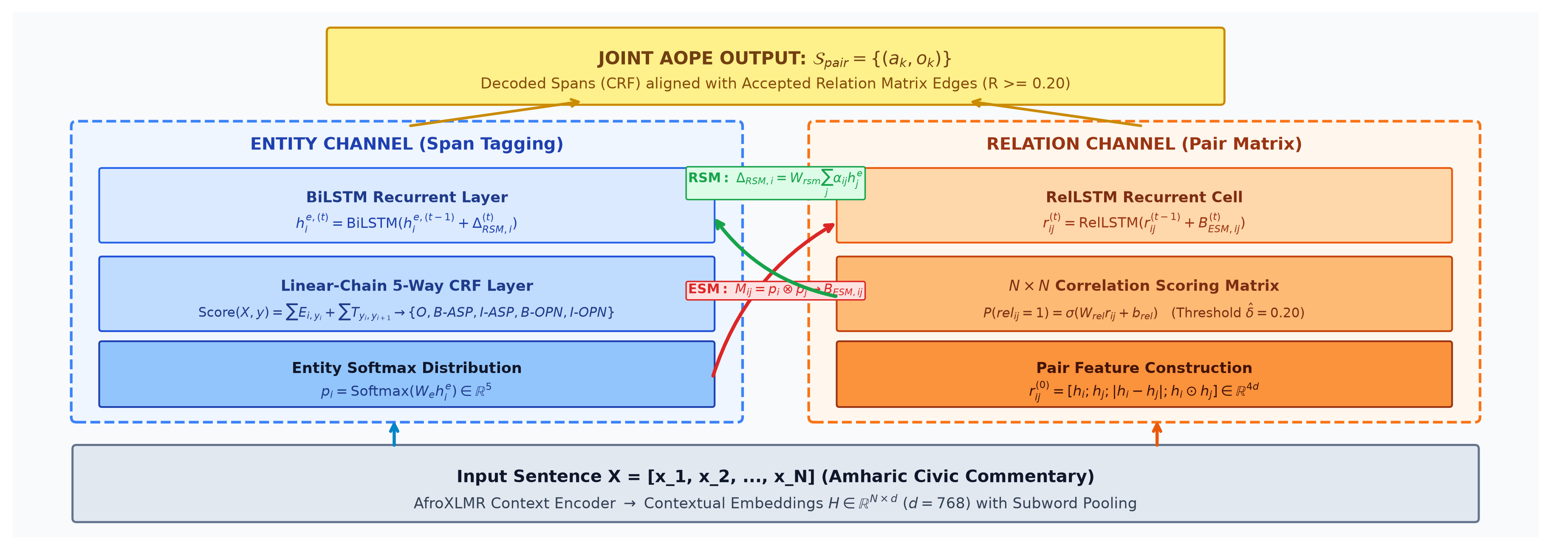
2. ARCHITECTURE FLOWCHART
Dual-Channel Recurrent Interaction with ESM & RSM Loops
Complete architecture diagram illustrating synchronous feedback between Entity and Relation channels.
Non-synchronized models fail; only bidirectional synchronization between entity and relation channels outperforms pipelines.
docs/figures/sdrn_architecture_flow.png | 2020.acl-main.582.pdf
Notes:
Algorithm Presentation Deep-Dive
Dual-Channel Recurrent Interaction with ESM & RSM Loops
Sources:
Local working-tree file: docs/figures/sdrn_architecture_flow.png
Local working-tree file: 2020.acl-main.582.pdf

Slide 4
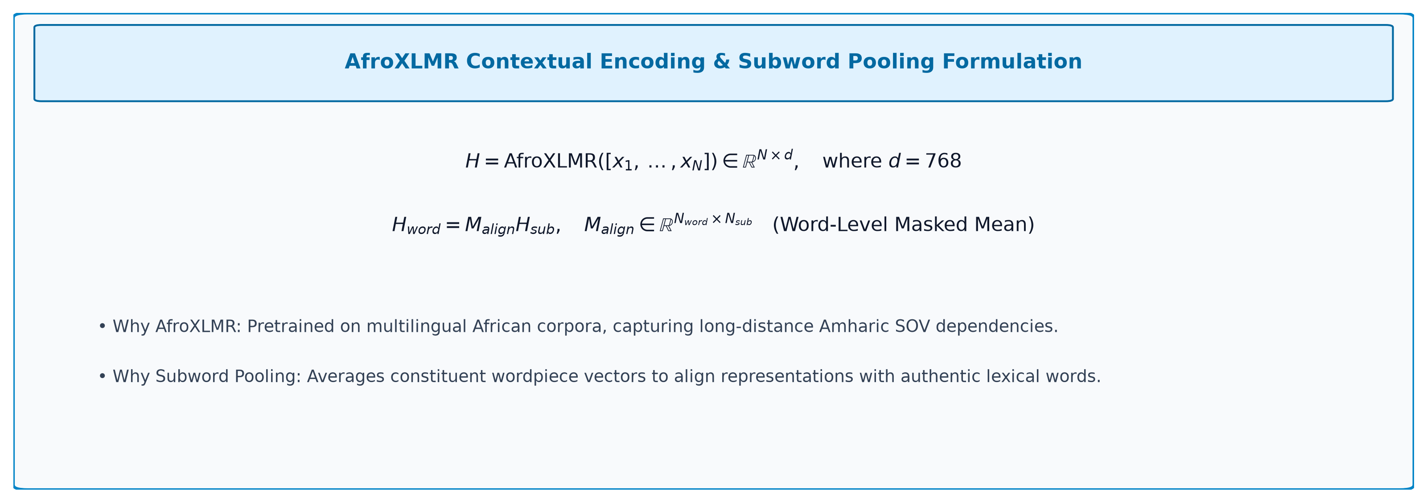
3. ENCODER LAYER
Contextual Sequence Representation & Subword Pooling
Mathematical formulation of the contextual text encoder layer.
Contextual encoding establishes continuous 768-dimensional semantic vectors for both downstream recurrent channels.
docs/figures/eq_sdrn_encoder.png | src/stage_aope_sdrn/model.py
Notes:
Algorithm Presentation Deep-Dive
Contextual Sequence Representation & Subword Pooling
Sources:
Local working-tree file: docs/figures/eq_sdrn_encoder.png
https://github.com/EthAIResearch/acos-amharic/blob/7e40773050395fcd5a9c0408ec0c3206a81550d4/src/stage_aope_sdrn/model.py

Slide 5
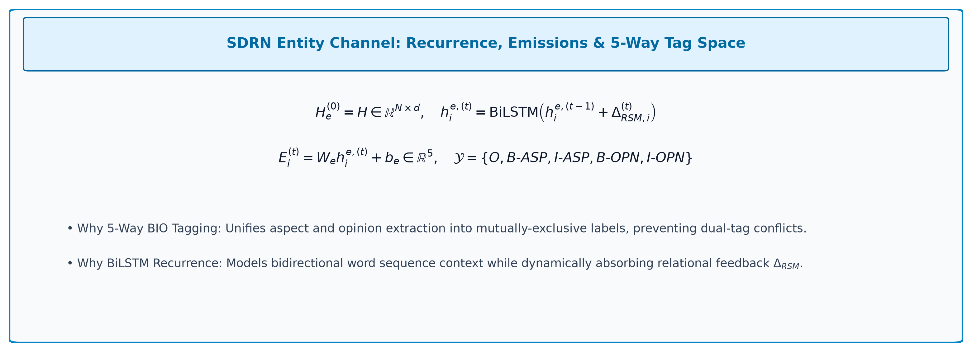
4. ENTITY CHANNEL MATH
5-Way BIO Sequence Tagging Formulation
Mathematical formulation of the Entity Channel's hidden states and emission scores.
The entity channel models sequential boundary tags while continuously accepting relational feedback from the relation channel.
docs/figures/eq_sdrn_entity_channel.png | src/stage_aope_sdrn/crf.py
Notes:
Algorithm Presentation Deep-Dive
5-Way BIO Sequence Tagging Formulation
Sources:
Local working-tree file: docs/figures/eq_sdrn_entity_channel.png
https://github.com/EthAIResearch/acos-amharic/blob/7e40773050395fcd5a9c0408ec0c3206a81550d4/src/stage_aope_sdrn/crf.py

Slide 6
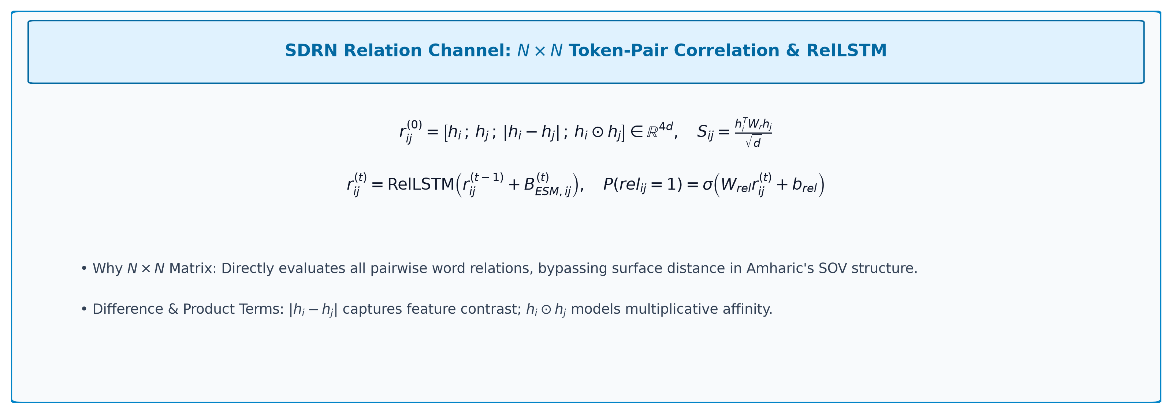
5. RELATION CHANNEL MATH
N × N Token-Pair Correlation Matrix Formulation
Mathematical formulation of pairwise token affinity representations.
The relation channel explicitly scores whether token pairs are semantically connected, bypassing linear word distance.
docs/figures/eq_sdrn_relation_channel.png | src/stage_aope_sdrn/model.py
Notes:
Algorithm Presentation Deep-Dive
N × N Token-Pair Correlation Matrix Formulation
Sources:
Local working-tree file: docs/figures/eq_sdrn_relation_channel.png
https://github.com/EthAIResearch/acos-amharic/blob/7e40773050395fcd5a9c0408ec0c3206a81550d4/src/stage_aope_sdrn/model.py

Slide 7
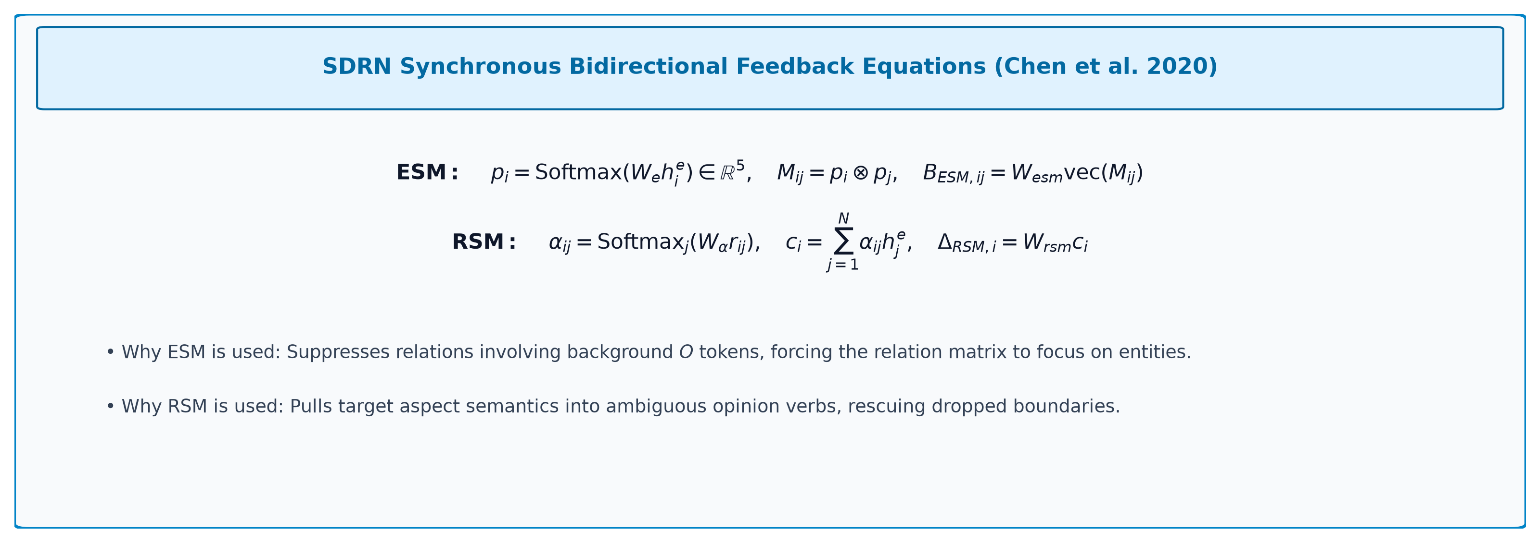
6. SYNCHRONIZATION MATH
Entity-to-Relation (ESM) & Relation-to-Entity (RSM) Feedback
Mathematical formulas governing bidirectional cross-channel feedback loops.
ESM filters spurious non-entity relations, while RSM pulls aspect evidence into ambiguous opinion predicates.
docs/figures/eq_sdrn_esm_rsm.png | 2020.acl-main.582.pdf
Notes:
Algorithm Presentation Deep-Dive
Entity-to-Relation (ESM) & Relation-to-Entity (RSM) Feedback
Sources:
Local working-tree file: docs/figures/eq_sdrn_esm_rsm.png
Local working-tree file: 2020.acl-main.582.pdf

Slide 8
7. RECURRENCE ALGORITHM
The Synchronous Recurrent Execution Schedule
Algorithmic execution trace across recurrent iterations t = 1, ..., T.
Step | Module / Tensor Operation | Input Representations | Output Representations | Theoretical Purpose
1. Init | Context Projection | AfroXLMR Token Embeddings | Baseline States H(0) and R(0) | Initialize baseline contextual representations
2. ESM (t) | Entity Outer Product | Entity Probability Distribution | ESM Bias Tensor | Generate entity-guided relational constraints
3. Rel Update | Relation Recurrent Cell | Prior Relation State + ESM Bias | Updated Pair Matrix R(t) | Refine token-pair correlation representations
4. RSM (t) | Relational Attention | Pair Matrix R(t) & Entity State | RSM Feedback Vector | Aggregate relational context for each token
5. Ent Update | Entity BiLSTM Layer | Prior Entity State + RSM Feedback | Updated Entity State H_e(t) | Refine token sequence boundary representations
6. Final (T) | CRF & Threshold Decode | Final States H_e(T) and R(T) | Decoded Pairs Set | Jointly emit constrained spans and accepted pairs
Iterating ESM and RSM over T=2 steps allows entity and relation representations to iteratively calibrate each other.
2020.acl-main.582.pdf | src/stage_aope_sdrn/model.py
Notes:
Algorithm Presentation Deep-Dive
The Synchronous Recurrent Execution Schedule
Sources:
Local working-tree file: 2020.acl-main.582.pdf
https://github.com/EthAIResearch/acos-amharic/blob/7e40773050395fcd5a9c0408ec0c3206a81550d4/src/stage_aope_sdrn/model.py

Slide 9
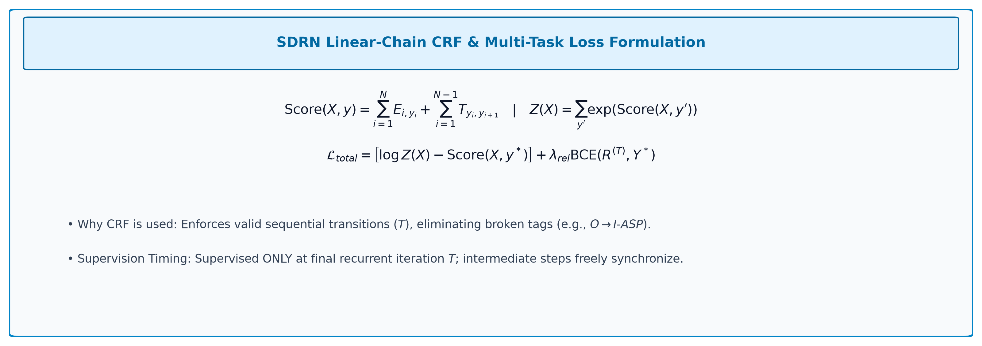
8. STRUCTURED LOSS MATH
Linear-Chain CRF Score & Multi-Task Objective
Global sequence scoring and supervision timing formulation.
Supervising only at step T allows intermediate representations to synchronize freely without premature loss penalties.
docs/figures/eq_sdrn_crf_loss.png | src/stage_aope_sdrn/crf.py
Notes:
Algorithm Presentation Deep-Dive
Linear-Chain CRF Score & Multi-Task Objective
Sources:
Local working-tree file: docs/figures/eq_sdrn_crf_loss.png
https://github.com/EthAIResearch/acos-amharic/blob/7e40773050395fcd5a9c0408ec0c3206a81550d4/src/stage_aope_sdrn/crf.py

Slide 10
9. RATIONALE MATRIX
Why Everything Is Used & How It Helps
Systematic architectural ledger connecting mathematical components to theoretical benefits.
Component / Layer | Mathematical Formulation | Why It Is Used | How It Helps the Model
AfroXLMR Context | Contextual Sequence Encoder (768-d) | Pretrained Amharic contextualization | Captures long-distance syntactic dependencies
5-Way Entity BiLSTM | Recurrent State with RSM Feedback | Sequential token boundary state | Models left-to-right & right-to-left word context
N × N Relation Matrix | Pair Feature Vector (4d Concat) | Direct token pair modeling | Bypasses word distance; connects separated pairs
ESM Outer Product | Outer Product of Tag Distributions | Injects entity class into relation | Suppresses false relations involving background words
RSM Attention Feedback | Relational Attention Weighted Sum | Injects relation affinity into entity | Rescues ambiguous opinion verbs targeting aspects
Linear-Chain CRF | Global Viterbi Sequence Scoring | Globally normalized sequence decoding | Prevents broken BIO sequences (e.g. O -> I-ASP)
T-Step Supervision | Loss Penalized Exclusively at t = T | Unconstrained intermediate recurrence | Prevents premature convergence on initial noisy states
Every mathematical module in SDRN directly addresses a failure mode of independent cascaded extraction.
src/stage_aope_sdrn/model.py | docs/stage_aope_sdrn_analysis.md
Notes:
Algorithm Presentation Deep-Dive
Why Everything Is Used & How It Helps
Sources:
https://github.com/EthAIResearch/acos-amharic/blob/7e40773050395fcd5a9c0408ec0c3206a81550d4/src/stage_aope_sdrn/model.py
https://github.com/EthAIResearch/acos-amharic/blob/7e40773050395fcd5a9c0408ec0c3206a81550d4/docs/stage_aope_sdrn_analysis.md

Slide 11
10. AMHARIC ENGINEERING
Subword Projection & FP16 Stabilization
Engineering solutions implemented to make SDRN train reliably on Amharic text.
Challenge | Engineering Solution | Implementation Details | Impact on Amharic ABSA
Subword Fragmentation | Entity-first subword decoding | decode_subword_predictions_5way() | Rescues prefix B-tags (PR #68)
FP16 NaN Overflow | Attention scaling clamp | Clamp relation logits before exp() | Eliminated training crashes (PR #66)
Scale Mismatch | Uniform decode bio_weights | Scaled Viterbi emissions identically | Matched train & eval objectives (PR #67)
Memory Exhaustion | Gradient checkpointing | AfroXLMR checkpointing enabled | Batch size 8 fit comfortably in VRAM
Subword fragmentation in AfroXLMR was a major root cause of broken spans; entity-first decoding rescued suppressed root tokens.
src/stage_aope_sdrn/model.py | GitHub #66 | GitHub #67
Notes:
Algorithm Presentation Deep-Dive
Subword Projection & FP16 Stabilization
Sources:
https://github.com/EthAIResearch/acos-amharic/blob/7e40773050395fcd5a9c0408ec0c3206a81550d4/src/stage_aope_sdrn/model.py
https://github.com/EthAIResearch/acos-amharic/pull/66
https://github.com/EthAIResearch/acos-amharic/pull/67

Slide 12
11. EMPIRICAL PROGRESS
SDRN Ablation History Across 5 Recorded Runs
Systematic evolution of SDRN configurations evaluated on the held-out test benchmark.
Model Variant | Aspect F1 | Opinion Recall | Pair Reachability | Pair F1
AfroXLMR Baseline (Dual BIO) | 58.42% | 48.32% | 35.88% | 32.75%
Exact SDRN + 5-Way CRF (Run 1) | 60.41% | 44.69% | 33.04% | 34.16%
Asymmetric BIO Weights (Run 2) | 59.76% | 46.90% | 33.51% | 33.93%
+ Multi-Class Dice Loss (Run 3) | 59.78% | 44.66% | 33.01% | 32.88%
Word-Level SDRN + Pooling | 59.96% | 44.76% | 32.16% | 34.07%
CRF Run 1 reached the project peak Aspect F1 (60.41%) and Pair F1 (34.16% @ delta=0.20). Dice loss and asymmetric weights did not surpass it.
results/stage_aope_sdrn/ | GitHub #70 | GitHub #78 | GitHub #80
Notes:
Algorithm Presentation Deep-Dive
SDRN Ablation History Across 5 Recorded Runs
Sources:
https://github.com/EthAIResearch/acos-amharic/tree/7e40773050395fcd5a9c0408ec0c3206a81550d4/results/stage_aope_sdrn/
https://github.com/EthAIResearch/acos-amharic/pull/70
https://github.com/EthAIResearch/acos-amharic/pull/78
https://github.com/EthAIResearch/acos-amharic/pull/80

Slide 13
12. RUN 1 BENCHMARK
AfroXLMR CRF Run 1: Detailed Breakdown
The highest-scoring SDRN model in the repository (tested at optimal threshold delta=0.20).
Evaluation Task | Precision | Recall | F1 Score | True Positives
Aspect Span Extraction | 60.60% | 60.21% | 60.41% | 1,766
Opinion Span Extraction | 48.67% | 44.69% | 46.60% | 1,318
Joint AOPE Pairs (delta=0.20) | 35.88% | 32.60% | 34.16% | 966
Candidate Reachability Ceiling | - | 33.04% | - | 979 / 2,963 pairs
Aspect F1 reached 60.41%—the highest token-level aspect score across the entire repository. But opinion recall remained low (44.69%).
results/stage_aope_sdrn/afroxlmr_crf_run1/best_metrics.json | GitHub #70
Notes:
Algorithm Presentation Deep-Dive
AfroXLMR CRF Run 1: Detailed Breakdown
Sources:
https://github.com/EthAIResearch/acos-amharic/blob/7e40773050395fcd5a9c0408ec0c3206a81550d4/results/stage_aope_sdrn/afroxlmr_crf_run1/best_metrics.json
https://github.com/EthAIResearch/acos-amharic/pull/70

Slide 14
13. LOSS ENGINEERING
Asymmetric Class Weighting & Multi-Class Dice Loss
Efforts to alleviate opinion recall suppression through loss modifications.
Run 2: Asymmetric BIO Weights
Run 3: Multi-Class Dice Loss
Hypothesis: Opinions are rarer and more lexically diverse than aspects.
Class weights: Background O at 1.0, Aspects at 1.5, Opinions upweighted to 2.5.
Opinion recall increased slightly to 45.69% (+1.0 percentage point).
Pair F1 dropped to 32.61% (-1.55 points) due to spurious false positive pairs.
Weighting BIO tags shifts precision/recall without expanding underlying span coverage.
Hypothesis: Dice loss optimizes harmonic overlap for extreme foreground imbalance.
Formulation penalizes intersection-over-union directly across token label masks.
Evaluated with auxiliary dice weight 0.5 alongside standard cross-entropy.
Result: Pair F1 dropped to 30.82%, opinion recall dropped to 44.17%.
Dice gradients destabilized token sequence optimization during training.
Loss reweighting shifted the operating point but failed to resolve the core problem: BIO boundary fragmentation.
results/stage_aope_sdrn/afroxlmr_crf_run2/best_metrics.json | results/stage_aope_sdrn/afroxlmr_crf_run3/best_metrics.json
Notes:
Algorithm Presentation Deep-Dive
Asymmetric Class Weighting & Multi-Class Dice Loss
Sources:
https://github.com/EthAIResearch/acos-amharic/blob/7e40773050395fcd5a9c0408ec0c3206a81550d4/results/stage_aope_sdrn/afroxlmr_crf_run2/best_metrics.json
https://github.com/EthAIResearch/acos-amharic/blob/7e40773050395fcd5a9c0408ec0c3206a81550d4/results/stage_aope_sdrn/afroxlmr_crf_run3/best_metrics.json

Slide 15
14. WORD-LEVEL SDRN
Subword Mean-Pooling to Eliminate Fragmentation
Moving sequence decisions from tokenizer subwords to authentic morphological words.
Architecture Formulation
Empirical Findings
AfroXLMR encoder outputs subword hidden states for all constituent pieces.
Constructed a subword-to-word alignment projection matrix.
Applied masked mean pooling across subwords belonging to each lexical word.
All subsequent SDRN layers (BiLSTM, ESM, RSM, CRF) operate on whole words.
Completely eliminates internal subword token boundary artifacts.
Aspect F1: 60.20% | Opinion F1: 46.12% | Pair F1: 32.55%.
Results were virtually identical to the subword model (60.41% / 46.60% / 34.16%).
Crucial Discovery: Pooling to whole words did NOT resolve opinion misses.
The remaining error was semantic and lexical, not tokenizer subword splits!
Proved that the token-level BIO paradigm itself was the fundamental bottleneck.
Word-level SDRN proved that errors were not simply tokenizer artifacts; linguistic and phrase-level generalization was the true barrier.
src/stage_aope_sdrn/model.py | results/stage_aope_sdrn/afroxlmr_word_sdrn_run1/best_metrics.json | GitHub #75
Notes:
Algorithm Presentation Deep-Dive
Subword Mean-Pooling to Eliminate Fragmentation
Sources:
https://github.com/EthAIResearch/acos-amharic/blob/7e40773050395fcd5a9c0408ec0c3206a81550d4/src/stage_aope_sdrn/model.py
https://github.com/EthAIResearch/acos-amharic/blob/7e40773050395fcd5a9c0408ec0c3206a81550d4/results/stage_aope_sdrn/afroxlmr_word_sdrn_run1/best_metrics.json
https://github.com/EthAIResearch/acos-amharic/pull/75

Slide 16
15. ROOT CAUSE ANALYSIS
Seen vs. Unseen Vocabulary Diagnostic
Evaluating model recall across exact phrases, token overlaps, and character trigrams.
Vocabulary Granularity | In Train (Seen) | Seen Recall | Unseen in Train | Unseen Recall
Opinion: Exact full phrase | 1,014 (34.0%) | 59.17% (600) | 1,969 (66.0%) | 37.63% (741)
Opinion: Token overlap (>= 1) | 2,169 (72.7%) | 45.78% (993) | 814 (27.3%) | 42.75% (348)
Opinion: Trigram overlap (>= 50%) | 1,450 (48.6%) | 54.41% (789) | 1,533 (51.4%) | 36.01% (552)
Opinion: Multi-word phrase | 213 (15.2%) | 62.44% (133) | 1,184 (84.8%) | 31.93% (378)
Aspect: Exact full phrase | 1,910 (64.0%) | 66.65% (1,273) | 1,073 (36.0%) | 43.80% (470)
Aspect: Token overlap (>= 1) | 2,550 (85.5%) | 59.73% (1,523) | 433 (14.5%) | 50.81% (220)
Aspect: Trigram overlap (>= 50%) | 2,326 (78.0%) | 63.67% (1,481) | 657 (22.0%) | 39.88% (262)
72.7% of test opinions share >= 1 token with train, but exact boundary recall collapses on multi-word unseen opinions (31.93%).
results/stage_aope_sdrn/afroxlmr_word_sdrn_run1/seen_unseen_diagnostic.json | GitHub #76
Notes:
Algorithm Presentation Deep-Dive
Seen vs. Unseen Vocabulary Diagnostic
Sources:
https://github.com/EthAIResearch/acos-amharic/blob/7e40773050395fcd5a9c0408ec0c3206a81550d4/results/stage_aope_sdrn/afroxlmr_word_sdrn_run1/seen_unseen_diagnostic.json
https://github.com/EthAIResearch/acos-amharic/issues/76

Slide 17
16. DIAGNOSTIC FINDINGS
The Anatomy of Missed Opinions
Why individual token recognition does not guarantee multi-word span extraction.
The Lexical Recombination Insight
Why Token BIO Fails on Amharic Phrases
66.0% of test opinions are exact-unseen in training data.
However, only 27.3% (814 spans) are truly novel at the individual token level.
Most unseen opinions are morphological variants or recombinations.
Yet when multi-word opinions are unseen, recall drops to 31.93%.
806 missed unseen multi-word opinions account for 49.1% of all missed opinions.
Models easily tag common evaluative tokens (ጥሩ, መጥፎ).
Multi-word civic expressions (e.g. 'ስራ አቁሙ', 'ማስወጣት አለበት') lose continuity.
The tagger predicts B-OPN on the head verb but drops continuation I-OPN.
Token-level BIO cannot evaluate the phrase as an atomic semantic unit.
Unseen multi-word opinions are the single largest source of extraction failure in token-level BIO architectures.
results/stage_aope_sdrn/afroxlmr_word_sdrn_run1/seen_unseen_diagnostic.json
Notes:
Algorithm Presentation Deep-Dive
The Anatomy of Missed Opinions
Sources:
https://github.com/EthAIResearch/acos-amharic/blob/7e40773050395fcd5a9c0408ec0c3206a81550d4/results/stage_aope_sdrn/afroxlmr_word_sdrn_run1/seen_unseen_diagnostic.json

Slide 18
17. ERROR ANALYSIS
Boundary Misalignment Patterns (`analyze_span_errors.py`)
Categorization of how predicted spans diverge from gold multi-word boundaries.
Error Category | Definition | Prevalence in Multi-Word Opinions | Impact on Pair Extraction
Exact match | Predicted span matches gold boundaries exactly | 36.58% | True positive pair candidate
Start matched, cut short | Matches start, but misses continuation tokens | 38.42% | Invalidated; pair F1 score = 0
Start matched, overshot | Matches start, but over-extends past gold end | 11.20% | Invalidated; spurious boundary
Partial overlap | Overlaps gold tokens but neither boundary matches | 8.90% | Zero credit under exact match F1
Completely missed | Zero overlapping tokens tagged as opinion | 4.90% | Complete false negative
Over 49% of predicted opinions contain the exact correct start token but fail exact-match evaluation due to boundary clipping.
src/stage_aope_sdrn/analyze_span_errors.py | GitHub #68
Notes:
Algorithm Presentation Deep-Dive
Boundary Misalignment Patterns (`analyze_span_errors.py`)
Sources:
https://github.com/EthAIResearch/acos-amharic/blob/7e40773050395fcd5a9c0408ec0c3206a81550d4/src/stage_aope_sdrn/analyze_span_errors.py
https://github.com/EthAIResearch/acos-amharic/pull/68

Slide 19
18. ERROR PROPAGATION
Pair Coverage Asymmetry (Aspect vs. Opinion)
Measuring conditional failure: what happens to the pair when one span is extracted?
Empirical Pair Breakdown
Conditional Attribution
Total Ground-Truth Pairs: 2,963 explicit pairs in test split.
Both Found (Candidate Ceiling): 979 pairs (33.04%).
Aspect Found, Opinion MISSED: 1,234 pairs (41.65%).
Opinion Found, Aspect MISSED: 312 pairs (10.53%).
Neither Found: 438 pairs (14.78%).
Conditional failure: When the model extracts the Aspect, it misses the Opinion 55.76% of the time!
Attribution of lost pairs: 62.2% of unformed pairs failed solely due to the missing Opinion.
Aspects (nouns/entities) are vastly easier to extract than Opinions (diverse predicates).
The opinion channel is the absolute bottleneck of the system.
Pair formation failure is heavily asymmetric: over 62% of missed pairs failed solely because the opinion was dropped.
src/stage_aope_sdrn/analyze_span_errors.py
Notes:
Algorithm Presentation Deep-Dive
Pair Coverage Asymmetry (Aspect vs. Opinion)
Sources:
https://github.com/EthAIResearch/acos-amharic/blob/7e40773050395fcd5a9c0408ec0c3206a81550d4/src/stage_aope_sdrn/analyze_span_errors.py

Slide 20
19. ARCHITECTURAL BOTTLENECK
The Token-Level Reachability Ceiling
Why SDRN could never achieve high pair recall regardless of relation classification accuracy.
The Two-Stage Metric Hierarchy
The Inevitable Conclusion
1. Candidate Ceiling Recall: Proportion of gold pairs where BOTH spans were extracted.
SDRN Ceiling: 979 / 2,963 = 33.04%.
2. Candidate Conversion Efficiency: Accepted pairs / reachable pairs.
SDRN Conversion: 966 / 979 = 98.67%!
The relation classifier is near-perfect on the spans it actually sees!
SDRN's low pair recall (32.6%) is NOT a relation modeling problem.
The relation classifier accepts 98.67% of reachable pairs.
The ceiling was locked at 33.04% by token BIO boundary errors.
To reach higher pair recall, we must replace token-level BIO tagging entirely.
SDRN achieved 98.67% conversion efficiency on reachable pairs; the entire performance ceiling was dictated by token-level BIO span misses.
results/stage_aope_sdrn/afroxlmr_crf_run1/best_metrics.json
Notes:
Algorithm Presentation Deep-Dive
The Token-Level Reachability Ceiling
Sources:
https://github.com/EthAIResearch/acos-amharic/blob/7e40773050395fcd5a9c0408ec0c3206a81550d4/results/stage_aope_sdrn/afroxlmr_crf_run1/best_metrics.json

Slide 21
20. SYNTHESIS
Lessons Learned from the SDRN Architecture
What worked, what failed, and the direct engineering decisions it motivated.
Architectural Feature | Empirical Verdict | Why it behaved this way | Next Architectural Step
Joint Recurrent Sync (ESM/RSM) | Effective | Eliminated cascaded 14% pipeline collapse | Retained relational modeling
Linear-Chain 5-Way CRF | Effective | Enforced grammatical tag transitions | Best token-level Aspect F1 (60.41%)
Asymmetric BIO Weights | Ineffective | Traded precision for recall without gain | Abandoned naive weighting
Multi-Class Dice Loss | Ineffective | Destabilized sequence optimization | Returned to cross-entropy
Word-Level Subword Pooling | Diagnostic Only | Proved errors were semantic/phrase-level | Motivated whole-span modeling (Span-ASTE)
SDRN proved joint modeling is essential, but token-level BIO tagging inherently bounds pair recall to ~33%.
docs/stage_aope_sdrn_analysis.md
Notes:
Algorithm Presentation Deep-Dive
Lessons Learned from the SDRN Architecture
Sources:
https://github.com/EthAIResearch/acos-amharic/blob/7e40773050395fcd5a9c0408ec0c3206a81550d4/docs/stage_aope_sdrn_analysis.md

Slide 22
21. SUMMARY
The Bridge from SDRN to Span-ASTE
Why token-level tagging was abandoned in favor of span candidate enumeration.
What SDRN Proved
The Shift to Span-ASTE
1. Joint extraction solves error compounding (34% vs 14% pipeline F1).
2. CRF decoding yields state-of-the-art aspect extraction (60.41% F1).
3. Relation classification is highly accurate on candidate pairs (98.67% conversion).
4. Unseen multi-word opinions collapse under token-level sequence decoding.
Problem: Token-level decisions make hard boundary commitments token-by-token.
Solution: Enumerate all contiguous candidate spans up to length 8.
Pool representations over entire spans rather than individual tokens.
Directly test: Can span enumeration bust the 33% candidate ceiling?
Result: Span-ASTE expanded reachability from 33% to 81.91%.
SDRN revealed that boundary errors—not relation classification—were the core bottleneck, directly paving the way for Span-ASTE.
docs/stage_aope_sdrn_analysis.md | src/stage_span_aste/model.py
Notes:
Algorithm Presentation Deep-Dive
The Bridge from SDRN to Span-ASTE
Sources:
https://github.com/EthAIResearch/acos-amharic/blob/7e40773050395fcd5a9c0408ec0c3206a81550d4/docs/stage_aope_sdrn_analysis.md
https://github.com/EthAIResearch/acos-amharic/blob/7e40773050395fcd5a9c0408ec0c3206a81550d4/src/stage_span_aste/model.py

Slide 23
REFERENCES
Bibliography
1. Xu, L., Chia, Y. K., & Bing, L. (2021). Learning Span-Level Interactions for Aspect Sentiment Triplet Extraction. Proceedings of ACL-IJCNLP 2021.
2. Chen, S., Wang, Y., Liu, J., & Wang, Y. (2020). Synchronous Double-Channel Recurrent Network for Aspect-Opinion Pair Extraction. Proceedings of ACL 2020.
3. Cai, H., Xia, R., & Yu, J. (2021). Aspect-Category-Opinion-Sentiment Quadruple Extraction with Implicit Aspects and Opinions. Proceedings of ACL-IJCNLP 2021.
4. Dozat, T., & Manning, C. D. (2017). Deep Biaffine Attention for Neural Dependency Parsing. International Conference on Learning Representations (ICLR).
5. Lin, T.-Y., Goyal, P., Girshick, R., He, K., & Dollár, P. (2017). Focal Loss for Dense Object Detection. Proceedings of ICCV 2017.
6. Xue, L., Barua, A., Constant, N., Al-Rfou, R., Narang, S., Kale, M., Roberts, A., & Raffel, C. (2022). ByT5: Towards a Token-Free Future with Pre-trained Byte-to-Byte Models. Transactions of the ACL (TACL), 10.
7. Raffel, C., Shazeer, N., Roberts, A., Lee, K., Narang, S., Matena, M., Zhou, Y., Li, W., & Liu, P. J. (2020). Exploring the Limits of Transfer Learning with a Unified Text-to-Text Transformer. Journal of Machine Learning Research (JMLR), 21.
8. Shazeer, N., & Stern, M. (2018). Adafactor: Adaptive Learning Rates with Sublinear Memory Cost. Proceedings of ICML 2018.
9. Conneau, A., Khandelwal, K., Goyal, N., Chaudhary, V., Wenzek, G., Guzmán, F., Grave, E., Ott, M., Zettlemoyer, L., & Stoyanov, V. (2020). Unsupervised Cross-lingual Representation Learning at Scale (XLM-R). Proceedings of ACL 2020.
10. Alabi, J. O., Adelani, D. I., Mosbach, M., & Klakow, D. (2022). Adapting Pre-trained Language Models to African Languages via Multilingual Adaptive Fine-Tuning (AfroXLM-R). Proceedings of COLING 2022.
11. Mekonen, A. (2026). acos-amharic: End-to-End Amharic ACOS Quadruple Extraction [Source code repository]. github.com/EthAIResearch/acos-amharic
12. rasyosef/roberta-base-amharic and Davlan/afro-xlmr-base model cards. Hugging Face Model Hub.
18
Notes:
Algorithm Presentation Deep-Dive
Bibliography & References
Sources:
https://github.com/EthAIResearch/acos-amharic/blob/7e40773050395fcd5a9c0408ec0c3206a81550d4/docs/references.md

