Slide 1

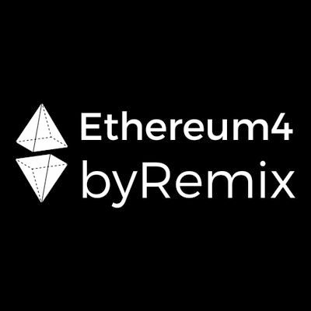

IS CODE LAW?
ASK A LAWYER!

Slide 2
outreach pilot program || EF’s Remix Team
4-6 hrs long online workshops || 2-3 days
classes of same professionals, colleagues
IF follow-up demand, THEN community project mentoring
Devshops4Impact

Slide 3






“from WEB1 to WEB3” || vertical
DAO/DFO demos
Remix IDE, Solidity, Dumb Contracts
Ecosystem’s blind spots || mass adoption
EthEducators || shared educational repo
Notes:
detect currently un-addressed spots (e.g. primary sale payout address on NFT marketplaces, secret voting in DAOs)
create an open archive of curricula and reports

Slide 4
Workshop Objectives
Providing a self-assessment strategy to get the best out of a legal team
Decision trees
Token Life-cycles
Legal Frameworks & Jurisdictions
Q&A

Slide 5
Code as Law⁽¹⁾
Both can influence users’ behaviors
“The answer to the machine is the machine”⁽²⁾
Legal and contractual provisions can be transposed as deterministic code-based rules
Code can reduce the uncertainty around the interpretation of rules and automate obligations
Laws and regulations are periodically amended to provide legal recognition to new technologies and encourage their use
P. De Filippi, A. Wright, Blockchain and the Law: The Rule of Code
Charles Clerk, The Answer to the Machine is the Machine, in The Future of Copyright in a Digital Environment: Proceedings of the Royal Academy Colloquium

Slide 6
Examples
ARIZONA
“Smart contracts” means an event-driven program, with state, that runs on a distributed, decentralized, shared and replicated ledger and that can take custody over and instruct transfer of assets on that ledger
A contract relating to a transaction may not be denied legal effect, validity or enforceability solely because that contract contains smart contract term
Source: House Bill 2417
MALTA
“Smart contract” means a form of innovative technology arrangement consisting of:
(a) a computer protocol; and, or
(b) an agreement concluded wholly or partly in an electronic form which is automatable and enforceable by execution of computer code, although some parts may require human input and control and which may be also enforceable by ordinary legal methods or by a mixture of both.
Source: Bill 45 MDIA Act

Slide 7
Smart Contracts as Legal Contracts
Smart contracts may be legal contracts themselves if they meet the requirements established by a given jurisdiction
Legal Contract + Smart Contract = Smart Legal Contract
The “Ricardian contract” model
UK Jurisdiction Taskforce, Consultation Paper May 2019: “A smart contract may or may not have legal ramifications as it is merely computer code, whereas a “smart legal contract” refers to a smart contract that either is, or is part of, a binding legal contract.”
Explore the LEXON Plugin on Remix IDE or at lexon.tech
Add legal provisions in code comments /** @legal (already in Natspec?)

Slide 8
INTENTION
BUILDING AND ROLES
CONSTRAINTS

Slide 9
INTENTION
What is my project about?
e.g. NFTs as collaterals
What action does my DApp enable?
e.g. P2P trading of digital ownership certificates
What behavior does it incentivize?
e.g. people issuing certificates over digital or physical items they don’t have ownership or copyright on.

Slide 10
ORGANIZATIONS AND ROLES
How do Smart Contracts re-shape my DApp’s range of action? Do I want to use standards?
What are the Roles and Limitations?
Contract Owner
Modifiers/Require functions
Promises and contract flexibility:
Where should I implement upgradability (Proxy contracts)?
What is the consensus mechanism of my upgradable contracts?

Slide 11
What does it represent? (utility, payment, security)
What is the token’s life cycle?
Custodian or non custodian?
KYC or anonymous?
AML compliance
Terrorism Financing
ID
TOKEN
DATA
OWN
What data goes public?
Immutability vs Right to Be Forgotten
On-chain vs Off-chain
Controllers/Processors
Who owns what?
Are smart contracts enough to cover all the rights and obligations involved?
IP Rights, Stakers, Referrals, Warranties, etc.
Notes:
DATA:

Slide 12

TOKEN FOCUS: Security or not Security?
USA
Federal laws and a federal regulator (SEC)
1933 Securities Act “Securities Act”
1934 Securities and Exchange Act “Exchange Act”
1940 Investment Advisers Act
1956 Uniform Securities Act “USA”
1998 Regulation ATS “Reg ATS”
States laws and regulators
Self-regulatory organizations
Howey Test, a transaction is an investment contract if:
it is an investment of money;
there is an expectation of profits from the investment;
the investment of money is in a common enterprise;
any profit comes from the efforts of a promoter or third party.
EU
EU laws
Directive 2014/65/EU (MIFID II)
Regulation (EU) 600/2014 (MIFIR)
Member states’ laws

Slide 13

Do I need a corporate structure or not ? (foundations, limited liability company, unincorporated organization)
What jurisdiction does my
model and my token analysis head towards?
(Malta, Lithuania, Estonia Switzerland, Gibraltar, Liechtenstein, Singapore, Taiwan, Delaware, Wyoming, Arizona etc.)
How can I access that blockchain friendly jurisdiction?
Notes:
DATA:

Slide 14
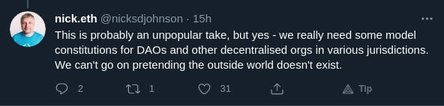
Decentralization:
An opportunity to innovate law, not to break it

Slide 15
Q&A

Slide 16




LUIGI CANTISANI
https://it.linkedin.com/in/luigicantisani
MATTEO TAMBUSSI
@matlepunk
@eth4byrmx
matlemad.medium.com

