Slide 1
BLOCKCHAIN IN HEALTHCARE
USE CASES FOR A NEW PATIENT-CENTRIC HEALTHCARE SYSTEM

Slide 2
CHECK-IN
Introduce yourself

Slide 3
Current problems in Healthcare administration
Vaccination tracking
Lack of Patient centrism
Insurance
Clinical Trials

Slide 4
COVID19-VACCINATION CAMPAIGN
Supply chain
Track of the chemical substances
Adverse Reactions tracking
Which active substance caused the most adverse reactions?
Which sub-population had adverse reactions?
Vaccine-Passport
Is it a true certificate or fake?
Is the Vaccine-Passport privacy-compliant? Who has access to the Data?
Who can modify its validity?
WHO HANDLES DATA?
Notes:
A covid vaccine passport’s ID could be verified (signed) by an official whose public key is on the passport. When it is signed a hash is created that is the result of the private key getting jammed together with the private key. With this signature, the public key of the official can be derived. If the public key that is derived is the same the official public key, then the passport is valid. At this level it doesn’t need to get saved to the blockchain.
Is the Vaccine passport privacy compliant - what is important is that the official signed the passport. So no other info is revealed.
Tracking individuals based on their reactions - how to do this anonymously - so tying individual with their reaction at a later date - having the data public but anonymous.
Individuals are addresses or some other identifier. Data associate with them is tied to them.
Data Storage
IPFS? the address is the content contained in their file
Centralized database - that is not publicly accessable

Slide 5
A PATIENT-CENTRIC HEALTHCARE SYSTEM INTEROPERABILITY
If not registered in a common ledger, a physician’s note, a prescription, or a lab result will be lost
Medical errors resulting from poorly coordinated care are the third leading cause of death in the US (2016, Johns Hopkins University)
incomplete view of medical histories
WannaCry ransomware infected most of the NHS devices → 6,912 appointments - including operations - were canceled
Who owns the data?
What about privacy?
Notes:
It would be nice if the data is stored publicly on decentralized servers - it could be a usecase in the future - (see the Swarm project) but in IPFS - the data is public.

Slide 6
A SYSTEM FOR MEDICAL INSURANCE THE USE OF SMART CONTRACTS
There are over one million claims made between medical insurance players every year, more than 5% of which are disputed, requiring lengthy manual resolution
Each player has its own version of insurance contracts creating confusion between customers
Notes:
Oracles - a doc signs the txn that say that the patient broke his leg and then this releases funds directly to the doctor’s or to the patients address. The doctor is the oracle. Probably it is a faster method of releasing the money than current insurance operations.

Slide 7
CLINICAL TRIALS THE HEALTHY USE OF DATA
Pharma companies store drug trial data in centralized databases. DATA ARE AT RISK! (Loss, manipulation, privacy and safety issues)
Data have to be shared in a safe way and with the right people DATA ARE WASTED!
Collaboration between organizations can’t occur without sharing sensitive information
Notes:
Blockchains are great at verifying data - making a hash and timestamping it.

Slide 8

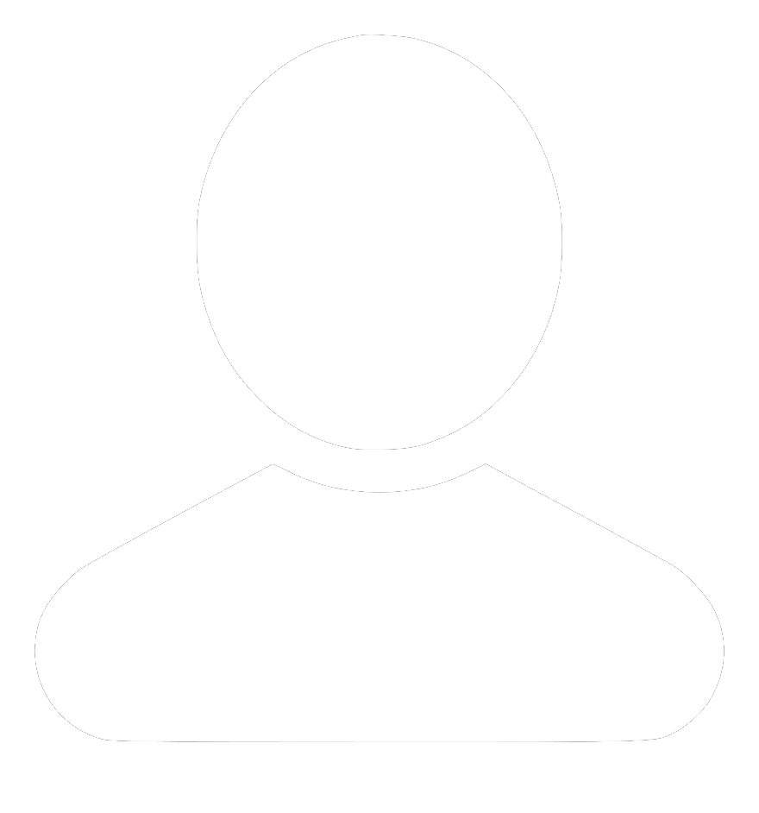


CENTRALIZATION
can be efficient but can have side effects...
APP / CENTRAL AUTHORITY
RESULT
FINANCE
DECISION MAKING
BROADCASTING
NETWORKING
DELINQUENCIES
MANIPULATION
CENSORSHIP
DATA TAMPERING
Notes:
ROB

Slide 9

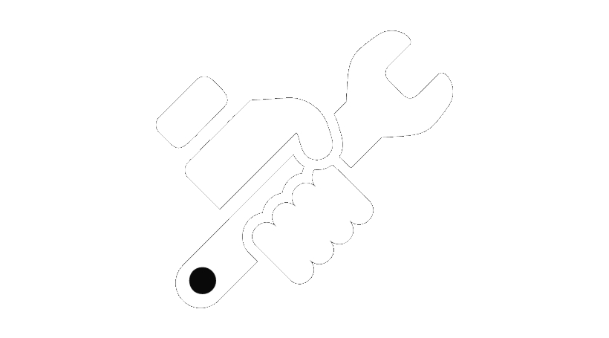
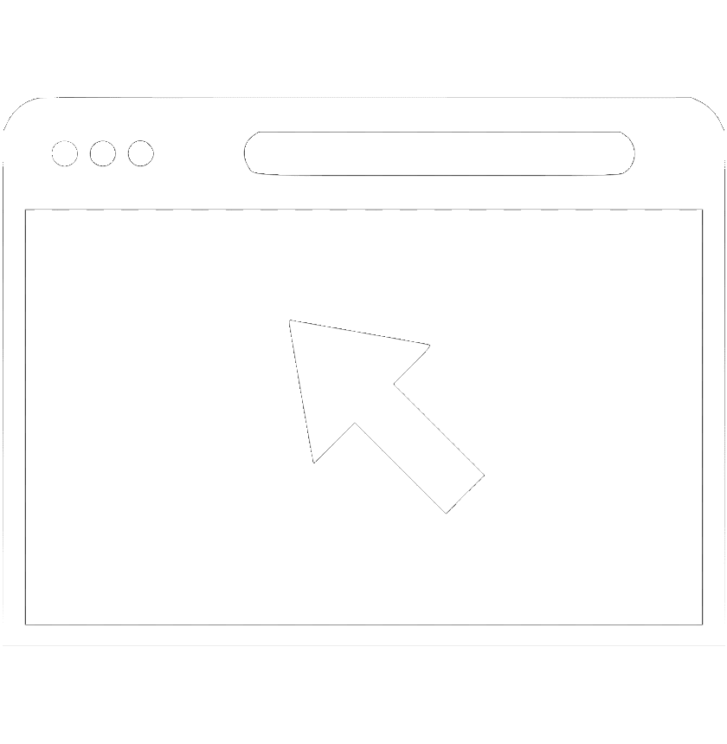
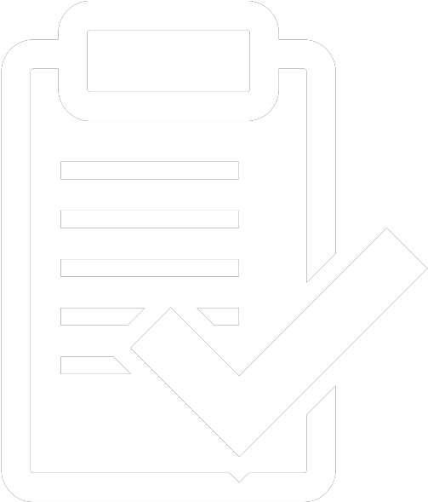
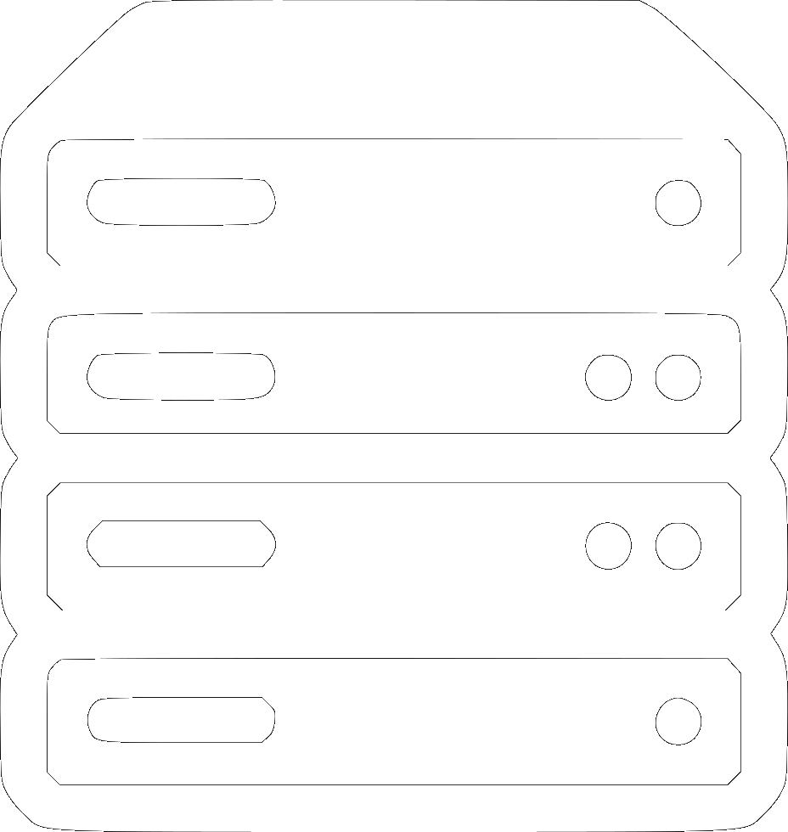

TRADITIONAL CONSENSUS
a visual representation of online voting
Notes:
ROB is this about centralized online voting?

Slide 10
ETHEREUM
Notes:
@ROB

Slide 11
ETHEREUM
A WORLD COMPUTER
DATABASE/Spreadsheet: Saving information and softwares (smart contracts)
DECENTRALIZED BANKING System: Saving info in a way that info can only be added not modified
Ran by Nodes in P2P
moves on by consensus is incentivized by ETH (cryptocurrency) you need 51% of the blockchain’s computing power in order to change history
Notes:
@ROB

Slide 12
Txn From To Value Data
0xa4...
Luigi
Frank
1
Thanks
Block N
0xa5...
Alice
Bob
0.5
Paid
0xa6...
Bob
Sam
2
0xa7...
Chiara
Contract
0
Vote for #1
Block N+1
0xa8...
Rob
Contract
0
Vote for #2
0xa9...
Carlo
Matteo
12.5
ricevuto!
0xa10...
Leo
Contract
0
vote
Block N+2
Notes:
ROB

Slide 13
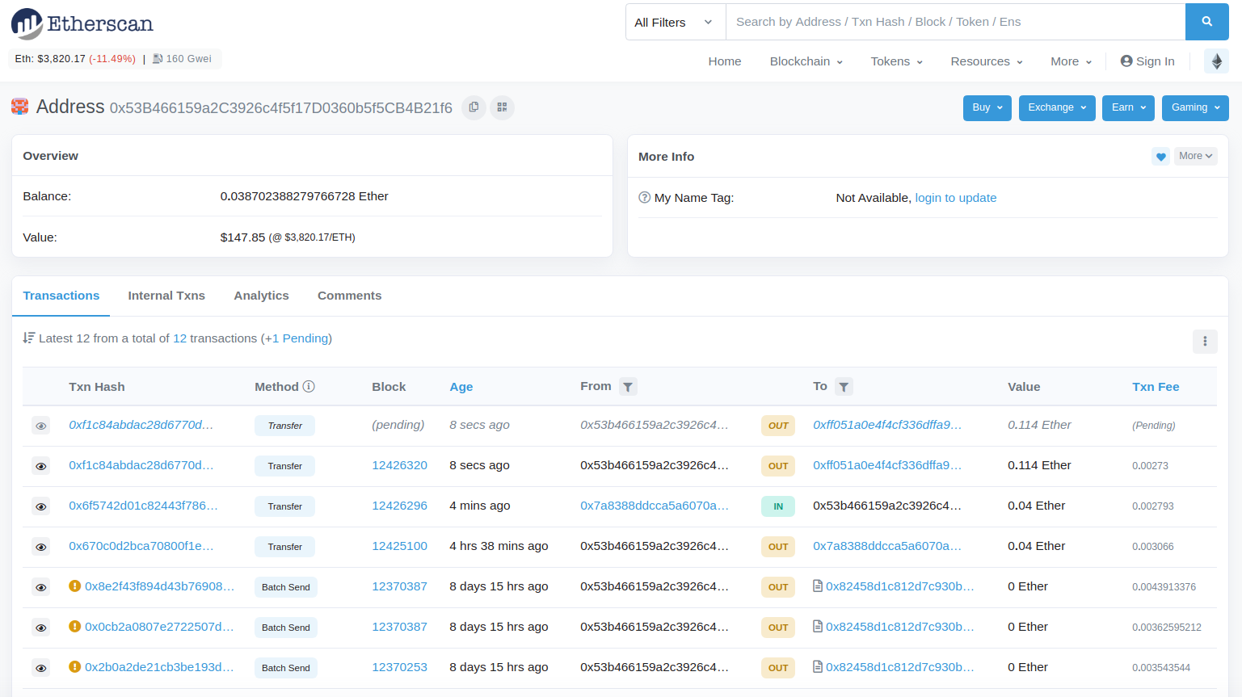
Notes:
ROB

Slide 14








WEB2 Apps
CENTRALIZED
CENSURABLE
DATA-TAMPERING
OPAQUE
“Terms of Service” TRUST
PUBLIC
INTERNET
Notes:
ROB Your personal data is monetized because it is under the control (and in the private databases) of the large players.

Slide 15

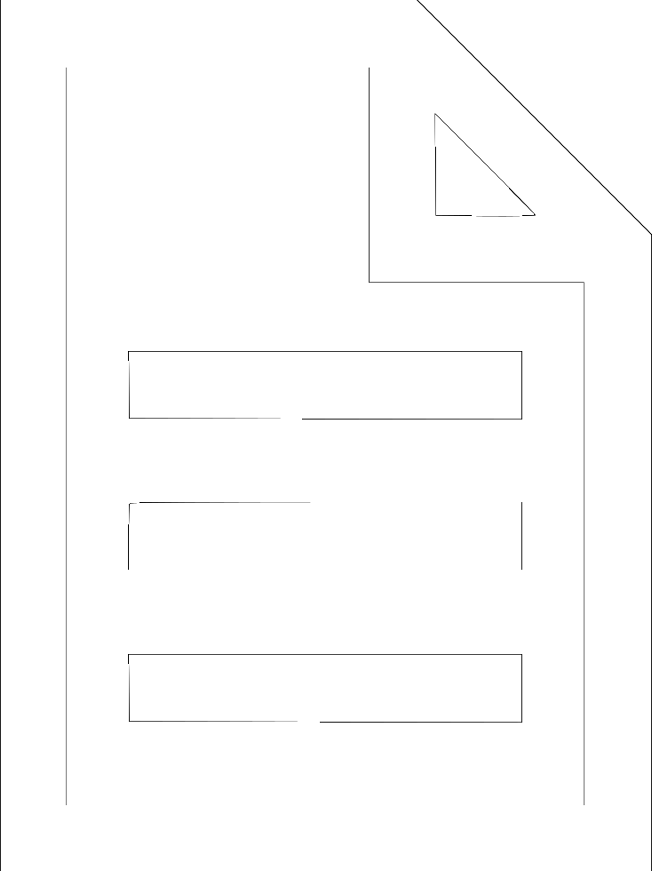
WEB3
Public Info storage and computation
IPFS
Nodes
DAPP
DECENTRALIZED
UNCENSORABLE
TRANSPARENT
TRUSTLESS
Smart Contracts
DAPP
DAPP
Info storage
DAPP
PUBLIC
BLOCKCHAIN
Notes:
ROB

Slide 16
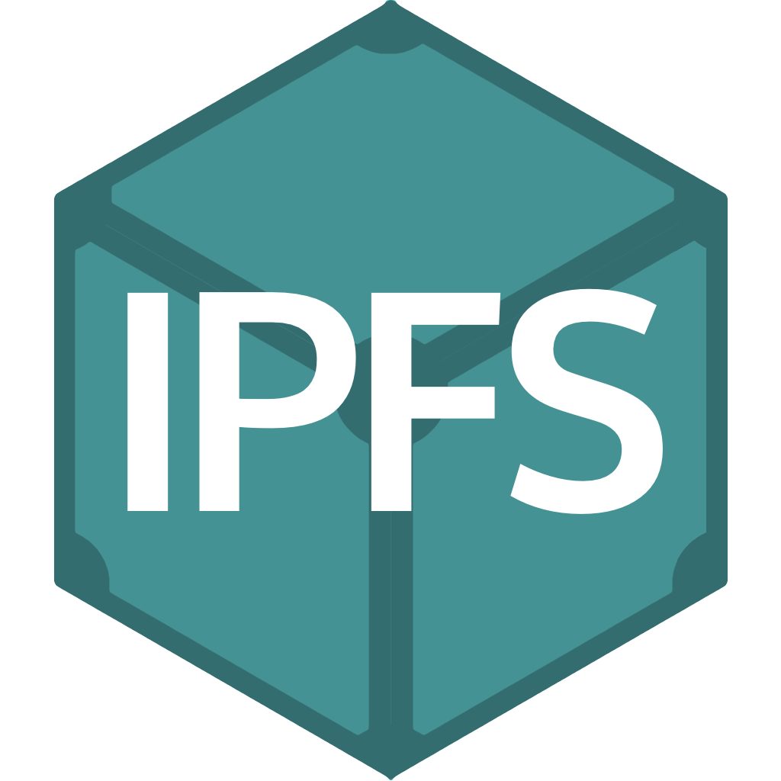
STORAGE
on the blockchain
VALUE
SMALL FILES
ADDRESSES
LARGE FILES
HASHES (of…)
SMART CONTRACTS
SPEEDY WRITES
Notes:
BLOCKCHAIN are good for storing small bits of info that need to be:
Small files (<50kb)
A hash of a song / art piece
Wallet Addresses (hashes)
A smart contract
Good for recording small pieces of info that should not be altered and that should be publicly accessible.

Slide 17

LOCATION vs CONTENT ADDRESSING
URL query
HASH query
Notes:
Availability : If the central server fails no-one is going to get any required resource in the case of location based addressing. Opposite to this if we are using content based addressing resource is stored decentralized and searched by resource id (CID) so if any node in decentralized network has the resource we can get it.
Security : We can't guarantee the resource we asked for and the resource we are getting are always the same i.e. if we asked for a rose we can't guarantee that we got is rose. In content based addressing the content that is rose itself is used for addressing and is hashed and the hash value used for comparing the resource is exactly what we asked.
Redundancy : Redundant data gets stored many times (e.g. when we download the same file twice it creates file, file(1)). Which does not happen in content based addressing as content is the same it will generate the same hash value so will get stored only once.

Slide 18
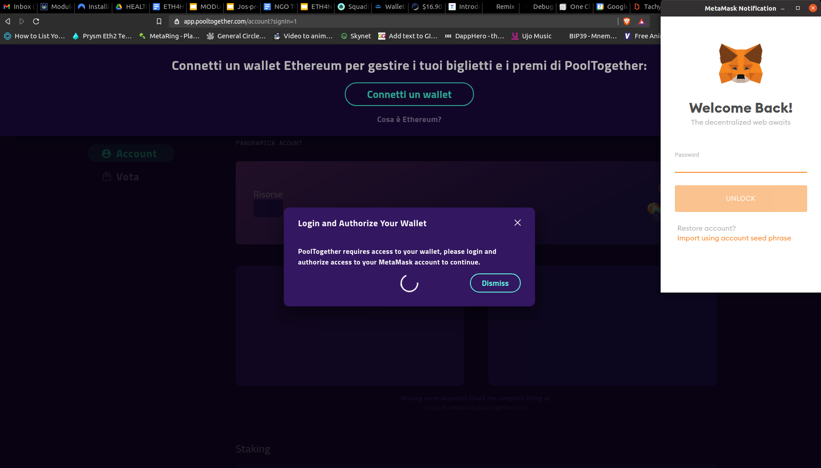
HOW TO ENTER THE BLOCKCHAIN
Wallets and DApps
A DApp interacts with a Wallet
A DApp will read and write to the blockchain
A DApps needs you to save data to the blockchain, you will need to pay fees - so you’ll need a balance of ETH in the wallet
A DApp in a browser will typically use the Metamask wallet (a browser extension)
Notes:
Update this slide

Slide 19
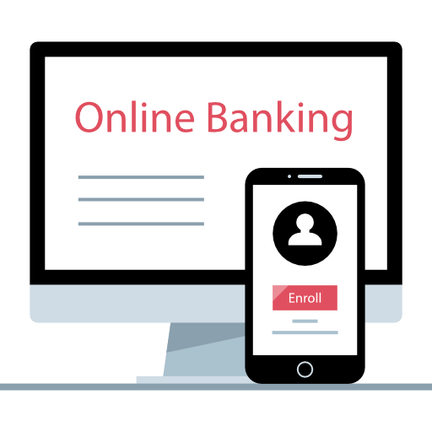
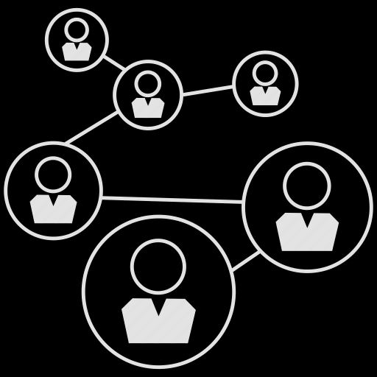

Social and Finance merge on the Internet
WEB 2
WEB 3
PROFILE
ACTIVITY
ACCOUNT
TRANSACTIONS
Rob’s Wallet
0x123abc...789a4b
PROFILE is BANK ACCOUNT
ACTIVITIES are TRANSACTIONS
Pseudo-Anonymity
Digital Signature
Password Responsibility
Notes:
Web3 def

Slide 20
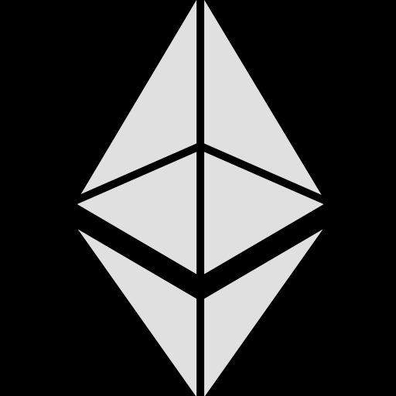
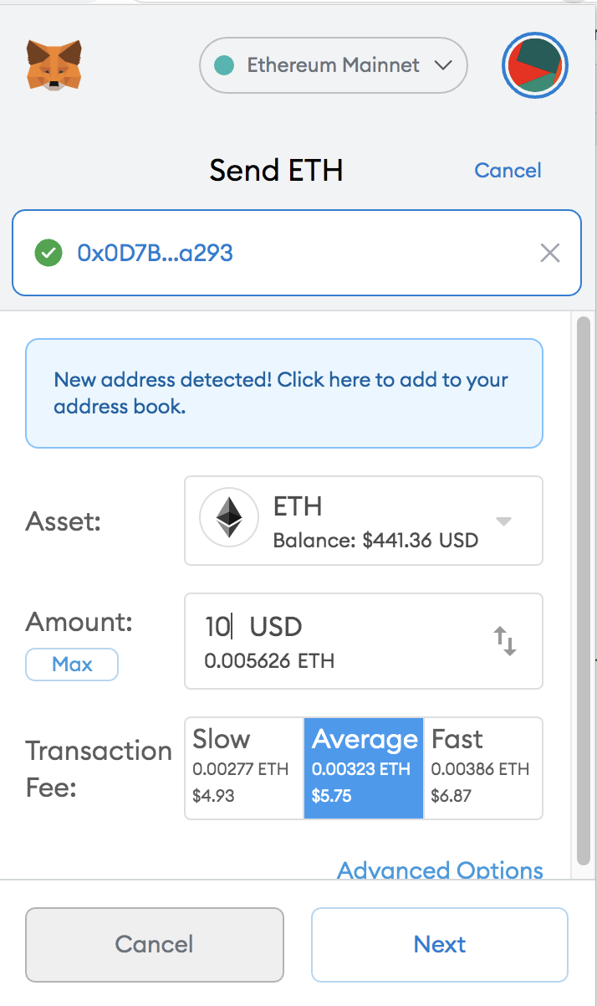
ETHER (ETH)
Is the native token of the Ethereum Blockchain
Miners get paid in Ether to glue (validate) the blocks together
In order to interact with the Ethereum Blockchain, you need a personal balance of ETH, because the Ethereum network charges you (in “Gas”) for:
saving information
computing

Slide 21
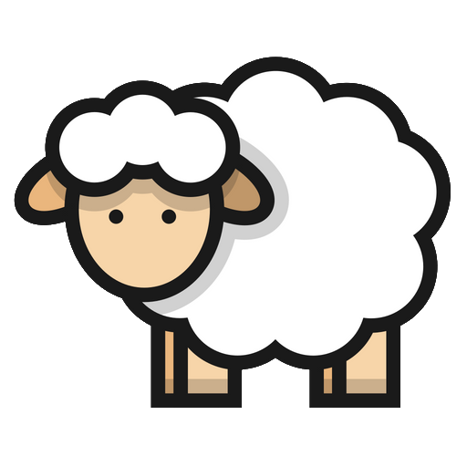
SMART CONTRACTS
CAN SAVE INFO (REGISTRY)
software that runs on the blockchain = public and decentralized. It contains a list of rules.
EXAMPLE
I am a shepherd. I want to save my sheep in a PUBLIC list that shows I own them.
If I registered the sheep with my city, I would have to trust the city’s record keeper & their servers.
Only the owner of a sheep can transfer its ownership to someone else. Everytime a sheep is sold, the new owner displays on the registry automatically (I don’t need a public functionary to update it)
ROB the SHEPHERD’s
SHEEP CONTRACT
0x05854cA140caB11e2f5AAb284c6AB5415f96E26B
Notes:
ROB

Slide 22
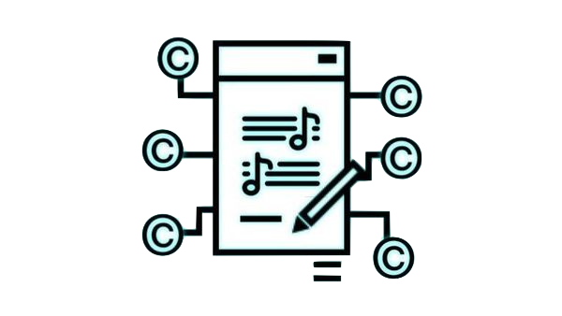
SMART CONTRACTS
CAN HOLD AND MANAGE MONEY FOR ORGANIZATIONS
Used in Escrow, DAOs and Multi-Signature Contracts
Contract can hold Ether or other tokens.
Payable functions / receive()
Rules can be set and voted on how that money is managed
Roles can be given to specific addresses (personal wallets or other smart contracts)
Notes:
ROB -

Slide 23



SMART CONTRACTS
ERC20 - FUNGIBLE TOKENs
Custom money
Token Standard Smart Contract
Contains the lists of Holders’ Addresses
They are “fungible” and “swappable” (e.g. 10 tokens of Project A can be exchanged for 2 tokens of Project B)
Many startups use these tokens to:
govern their Decentralized Apps (DApps)
raise funds
Notes:
ROB when I send a token to you - it looks like I just dropped it into your wallet - but actually I am going to the to token’s contract and telling it that I send the token to you. The token’s contract keeps track of the flow of that token.

Slide 24
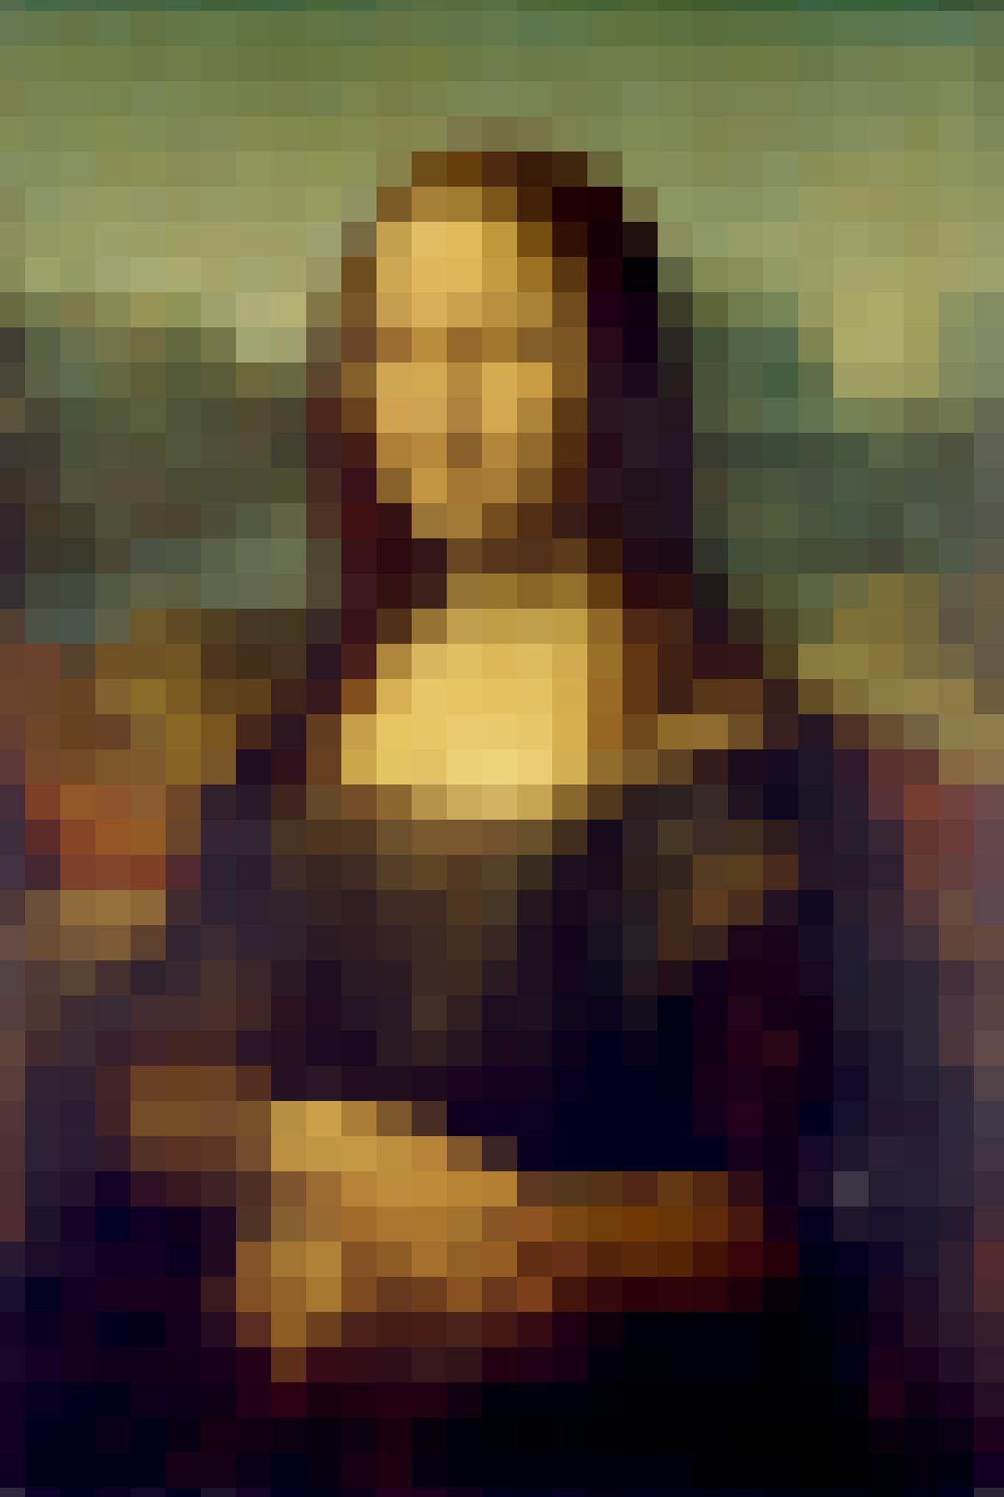
SMART CONTRACTS
ERC721 NON FUNGIBLE TOKENs (NFTs)
Each token is unique
The token can represent ownership of digital items, copyrights, licenses, tickets, etc. anything that the Author associated with the NFT
An example rule: The Author can receive royalties every time the NFT is sold on the secondary market
QUESTION: What does it mean to own a digital thing?
Who owns it
NFT
Address of artwork on IPFS
Proxy Contract e.g. auction like 10% of resales go to original creator
Notes:
ROB (end of this part)

Slide 25
BRAINSTORMING SESSION
Given the current issues in healthcare administration and this technology, what possible intersections can be developed?

Slide 26
BRAINSTORMING SESSION
Given the current issues in healthcare administration and this technology, what possible intersections can be developed?
Vaccination tracking
Transparent Clinical Trials
Patient-centric data coops
Insurance

Slide 27
COVID19-VACCINATION CAMPAIGN
A Vaccine-Passport should be:
Privacy-compliant → Individuals are addresses, data are public but (pseudo)-anonymous
→ A covid vaccine passport that can be verified (signed) only by an official (or a whitelist of officials) whose public key is on the passport
Timeframe
→ validity of the passport is determined by a smart contract (static or governable) and cannot be modified by unilateral decisions
Notes:
--
*blockchain is a peer-to-peer, decentralized database management system
*blockchain only supports create and read functions, DDBMSs support create, read, update, and delete it would be costly for DDBMSto achieve the high level of data redundancy blockchain does. block-chain is suitable when the preservation and continuous availability of records (eg, the electronic health records of patients) are important.
A covid vaccine passport’s ID could be verified (signed) by an official whose public key is on the passport. When it is signed a hash is created that is the result of the private key getting jammed together with the private key. With this signature, the public key of the official can be derived. If the public key that is derived is the same the official public key, then the passport is valid. At this level it doesn’t need to get saved to the blockchain.
Is the Vaccine passport privacy compliant - what is important is that the official signed the passport. So no other info is revealed.
Tracking individuals based on their reactions - how to do this anonymously - so tying individual with their reaction at a later date - having the data public but anonymous.
Individuals are addresses or some other identifier. Data associate with them is tied to them.
Data Storage
IPFS? the address is the content contained in their file
Centralized database - that is not publicly accessable

Slide 28
COVID19-VACCINATION CAMPAIGN
Control of the supply chain
Stop Counterfeit/Expired Drugs → An immutable record of hashes that verify the logistics of the trip from the factory to the pharmacy
Notes:
Blockchain for Supply chain management
---
In the existing solutions, there is still a central authority that can be compromised and documents that can be faked...If the current solutions could be modified with blockchain-enabled anti-tampering capabilities during manufacturing, the supply and dispensation system could make drug counterfeiting a non-issue.
*Using Blockchain, the origin of the medicine product and its components are detected, and any transfer of ownership in each case is made clear and available to everyone. Counterfeit items, poor quality or stolen goods can be tracked and identified.

Slide 29
COVID19-VACCINATION CAMPAIGN
The analysis of adverse reactions is:
Helping identify the more susceptible phenotypes for future subministrations
How: anonymous large DataLakes in public databases for open research (needs a Decentralized Healthcare storage with IPFS)
Notes:
*Utilization of an health blockchain has the potential to engage millions of individuals, health care providers, health care entities and medical researchers to share vast amounts of genetic, diet, lifestyle, environmental and health data with guaranteed security and privacy protection
*Because anonymous data are stored on a decentralized network, there is no single institution that can be robbed or hacked to obtain a large number of patient records and at the same time nobody can be blocked from accessing it
Normalizing the data from different projects will be a huge problem (not a blockchain problem)
The current reality:
Difficult to amalgamate disparate database and keep them anonymous
Difficult to keep patient records totally anon (can do pseudo anon - just the ethereum address) and pay them for the usage of the database.
may be some limitations about how large the dataset can be.

Slide 30
CLINICAL TRIALS THE HEALTHY USE OF DATA
Clinical Data can be shared and used as digital assets that can hold virtual and real-world value (Med-/Pharma-Token)
Web3 technology can lead a revolutionary process of drug discovery, development, and distribution process by creating incentives for open-source patents and royalty systems for peer-reviews
Notes:
*Use of blockchain technology has recently been shown to provide an immutable ledger of every step in a clinical research protocol, and this could easily be adapted to basic and experimental model science.
All participants in the peer-to-peer research network have access to all of the time stamped, continuously updated data. It is essentially tamper proof since any change, such as to the prespecified data analysis, would have to be made in every computer (typically thousands) within the distributed network.
*Blockchain is by design a decentralized (ie, a peer-to-peer, non-intermediated) architecture...Each institution can keep full control of their own computational resources while collaborating with other institutions for data sharing and analysis biomedical/health care data ledger: -> Blockchain Improve care data sharing and analysis without ceding control
Blockchains are great at verifying data - making a hash and timestamping it.

Slide 31
A PATIENT-CENTRIC HEALTHCARE SYSTEM INTEROPERABILITY
If not registered in a common ledger, a physician’s note, a prescription, or a lab result can be lost, Web3 would ensure continuous availability and access to real-time data
As trusted system, Web3 systems prevent prescription drug abuse: hand-written on prescription paper, which contains poor security features
Having one public database allows oracle-level scanning of this anonymous data that can help Decision Support and even predict the need for a test or to encourage a visit
Notes:
If the info associated with an address can be public - then the hash of a doctors note can load an IPFS url with the doctors note and in a DApp cant associate a hash with an address. eg: 0x234:note1, note2, note3 - but it would look more like: 0x234: 1qwuasldfjwqr484u5398592halwf, 2981495791238wqerqefwhehqw, 198r7923478924uihrquwrh
The blockchain then becomes the backbone for digital health,incorporating data from patient-based technologies and the EMR to provide a...pool from which authorized users, such as providers and patients, has access. All of the data is stored in a decentralized manner, with no single entity storing or having singular authority to access.
*Real-time data would also allow researchers and public health resources to rapidly detect, isolate and drive change for environmental conditions that impact public health. For example, epidemics could be detected earlier and contained.
Data is encrypted in the blockchain and can only be decrypted with the patient’s private key. Even if the network is infiltrated by a malicious party, there is no practical way to read patient data.
The data are stored in the private blockchain cloud. Blockchain may guarantee medical data cannot be changed by anybody including physicians and patients himself/herself internally and natively.
Blockchain is verified through a consensus system and stored across many nodes, making cyberattacks and tampering with records extremely difficult, providing privacy and transparency

Slide 32
A PATIENT-CENTRIC HEALTHCARE SYSTEM INTEROPERABILITY
Who owns the data? Patient as individuals or groups become the owners and the controllers of the access to their healthcare data
Decentralizing patient’s health history, enables patients to see every time their medical records are updated, to access from everywhere and to give explicit consent every time they are shared with healthcare providers or others
Medical Tokens can be minted and used to pay patients for data usage by researchers
Notes:
*Patient becomes the platform, owning and controlling access to their healthcare data.
Records are signed by source, allows legitimacy of records to be verified (and false records to be plausibly denied). Patients are able to add consent statements at any point in their care journey – confident that the blockchain will hold them securely.
For example this approach removes all obstacles to patients acquiring copies of their healthcare records or transferring them to another healthcare provider.
It would be great if the Patient can unlock their data. There could be a DApp where someone gives permission. But tying this to actual access is complicated and would mix centralized and decentralized solutions.

Slide 33
A SYSTEM FOR MEDICAL INSURANCE THE USE OF SMART CONTRACTS
What are the benefits of automatized solutions like Smart Contracts?
Automated smart contracts can reduce the time of transactions because the process no longer requires manual oversight, more efficiency and cost-effective solutions
Insurance providers can use more advanced analytics to optimize health outcomes
Blockchains are good for situations with multiple non-trusting parties: doctors, patients, insurance, researchers - audits facilitation and better fraud detection based on Blockchain immutability
Blockchains remove Middlemen & create trust through transparency
Digital contracts between manufacturers reduces disputes over payments
No one company or individual owns the blockchain, encouraging trustworthiness and longevity of the system
Notes:
*One of the main obstacle of the claim qualification process is the distributed nature of the many records that feed the decisions of patients, providers, and Medical administrators...The requirements for verification...are precisely the obstacles that a distributed blockchain solution...can address.
The ability to remove intermediaries from a process is the capability that sets Blockchain apart from other technologies. This capability will allow the solution to facilitate real-time claims adjudication by replacing the health plan intermediation with transparent Blockchain technologies.

Slide 34
HANDS ON DEMO “MEDICAL LEDGER” SMART CONTRACT
Install Metamask Wallet
Create an Ethereum Address
https://github.com/Matlemad/primitiveContracts/blob/main/MedicalLedger.sol

