Slide 1
Network Monitor tool
Ethan Olsen

Slide 2
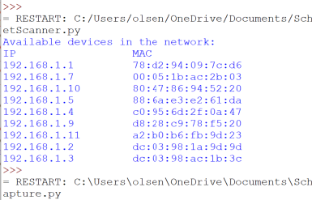
Net scanner using scapy

Slide 3
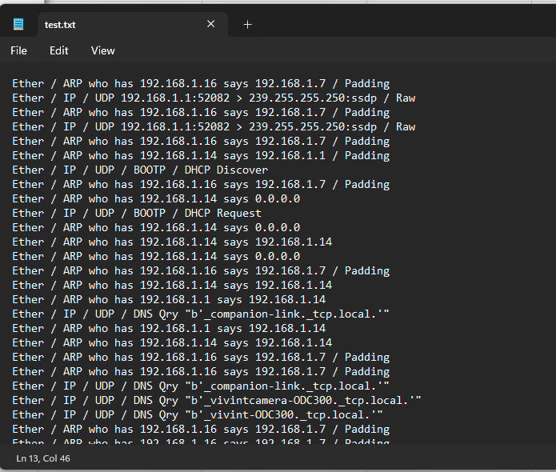
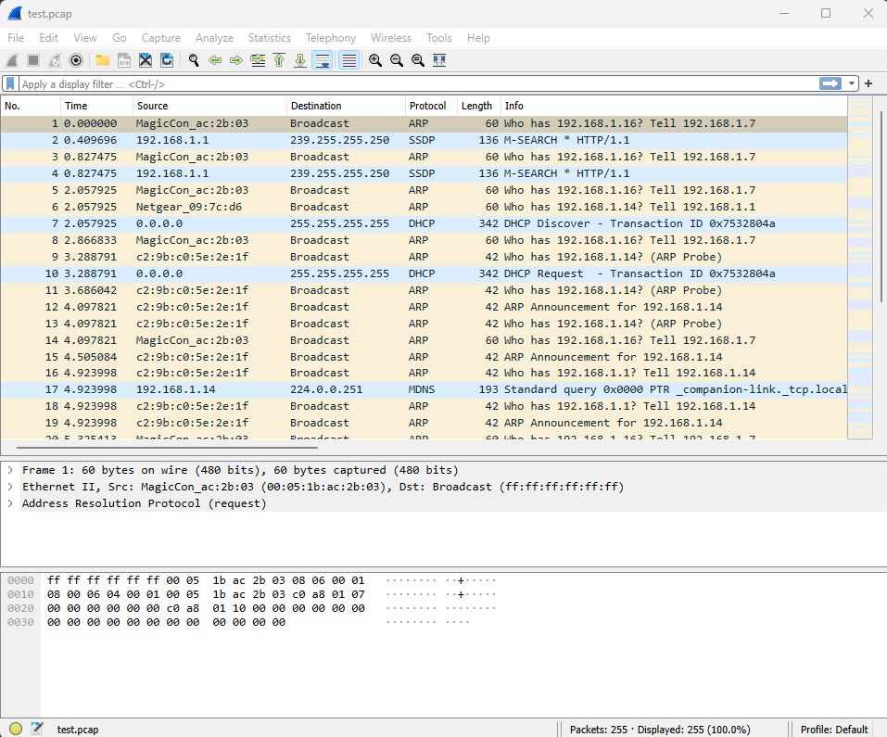
Packet capture using scapy

