Slide 1
MeChat
By Matthew Channing, Ethan Arrowood, and Jack Htay

Slide 2
Motivation
To be able to use the MeChat app, a network application (with peer-to-peer architecture) that utilizes a TCP connection, as well as:
sockets to communicate between users
Implementation of authentication, user-designated input for server selection, user account creation, log-in/log-out functionality, logging, communication between clients, sending and receiving past messages, listing channels and users, and the ability to disconnect from the server.

Slide 3
Design

Slide 4
System Design
Registry
ChatServer Lookup
Bind
RoomManager
ChatRoom List Lookup
Chat Server
Create/Delete ChatRooms
ChatRoom List lookup
Create/Delete
Chat Client
[TCP] Join/Leave
[TCP] Chat
Chat Room
Create/Destroy
Create/Destroy
[TCP] Socket Binding
Client Threads
Client Threads

Slide 5
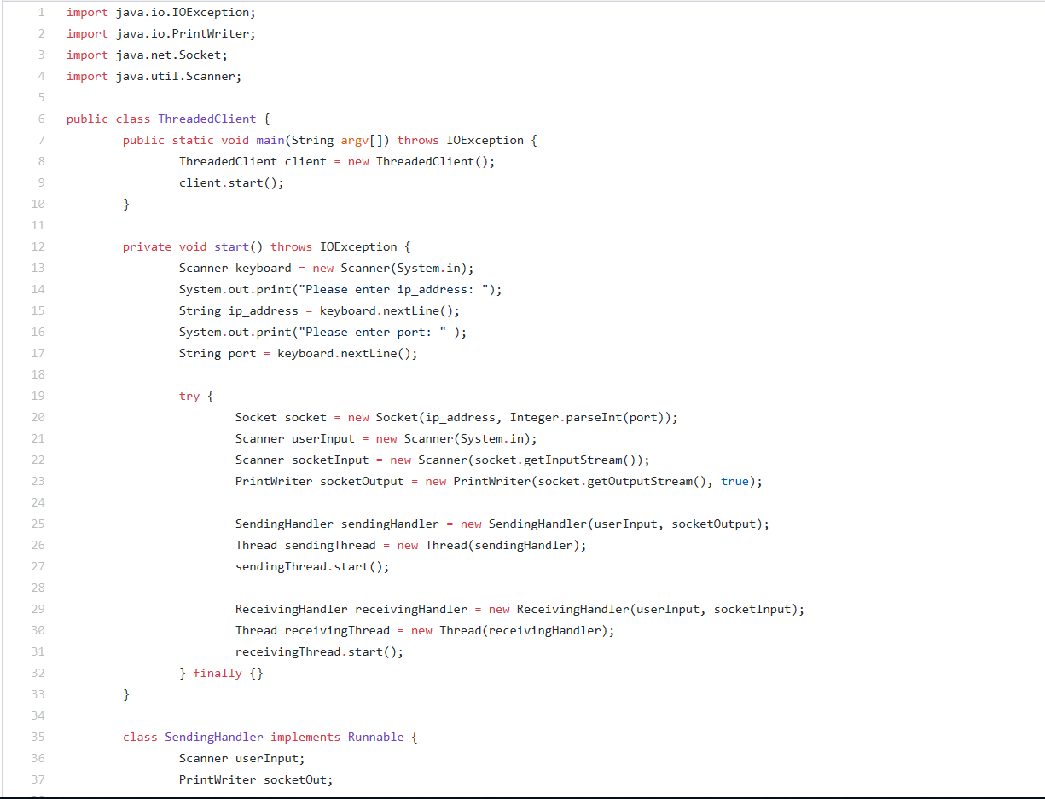
Client
Exhibit A: A portion of the code for the client.

Slide 6
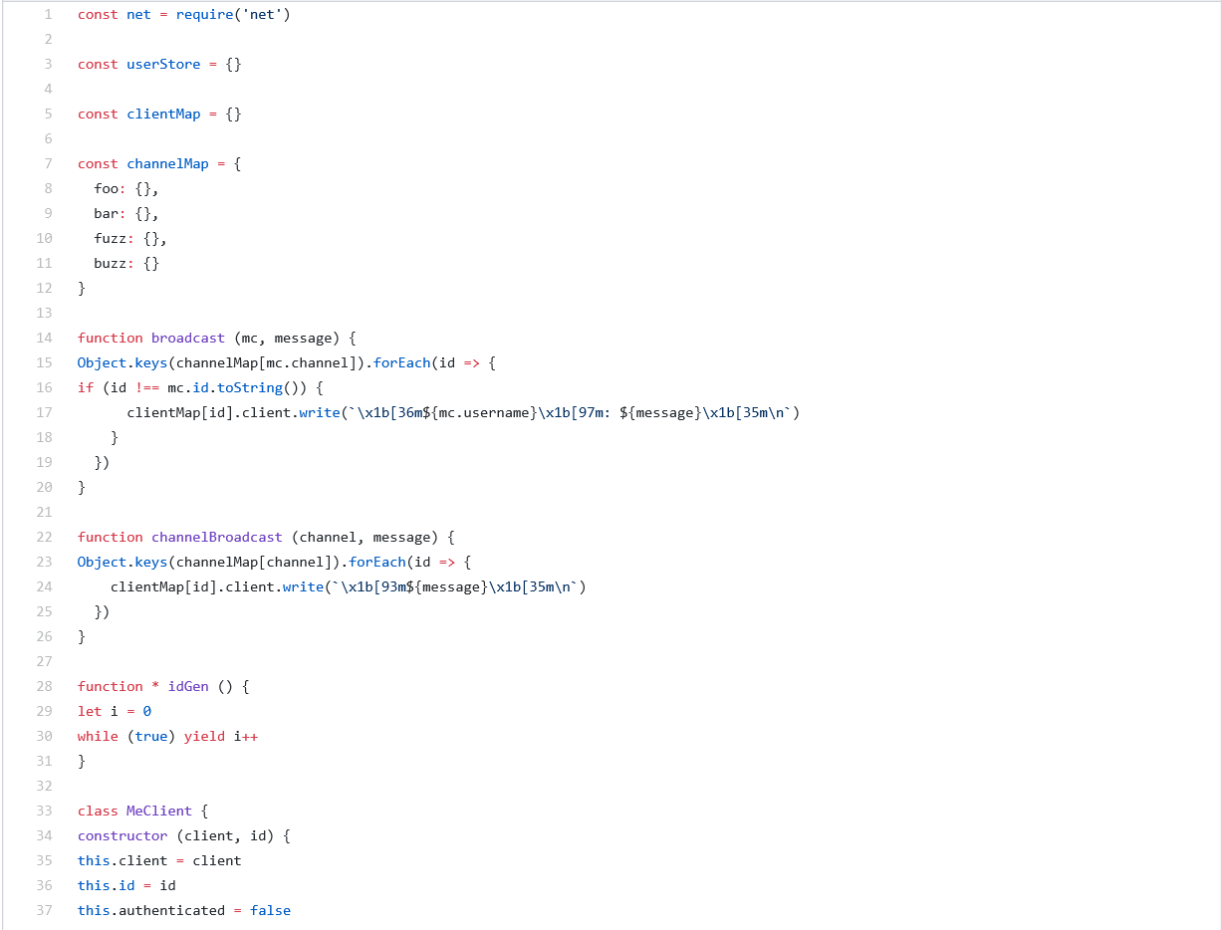
Server
Exhibit B: A portion of the code for the server.

Slide 7
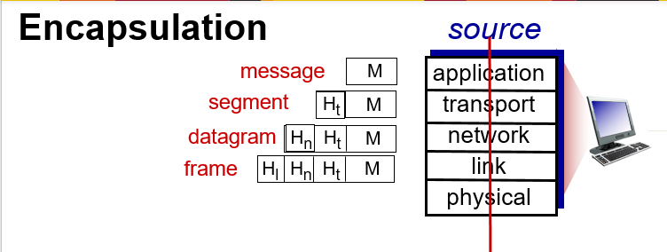
Layers of Networking

Slide 8
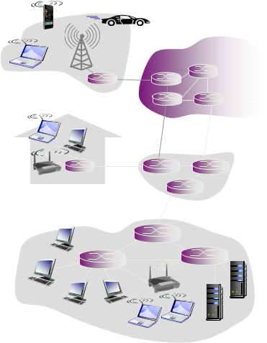
Peer-to-Peer Architecture
Our app utilizes a peer-to-peer (P2P) architecture.
There is no always-on server, arbitrary end systems
directly communicate, and peers request service from
other peers and provide service in return to other peers.
Applications with P2P architectures have client
processes (Client.java) & server processes (Server.js).

Slide 9
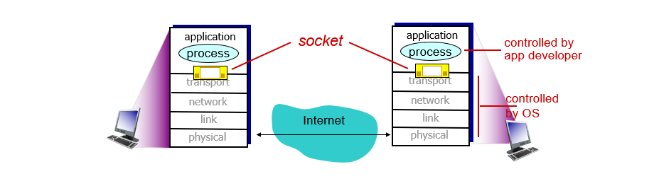
Sockets

Slide 10
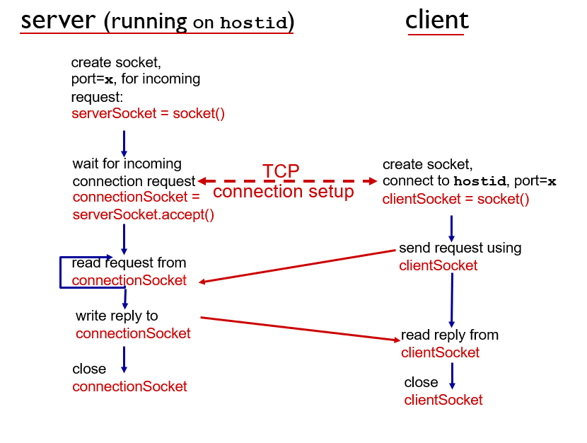
How Socket Programming Works

Slide 11
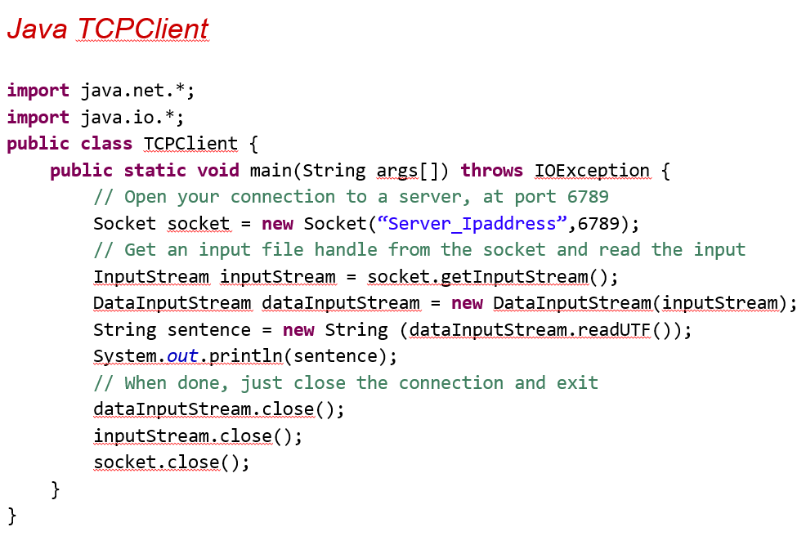
Example

Slide 12
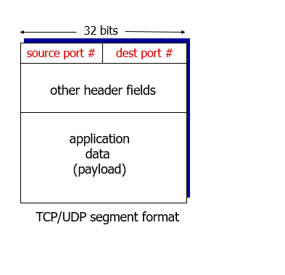
TCP Segment

Slide 13



Tools

Slide 14
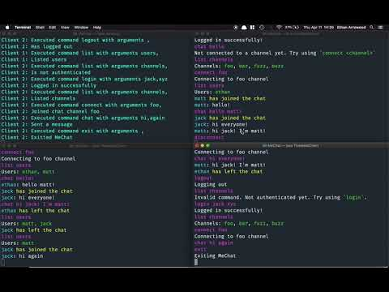
Demo

Slide 15
Questions?

Slide 16
Works Cited
https://www.youtube.com/watch?v=luUeSnIYjJo&t=166s
https://stackoverflow.com/questions/10924561/java-scanner-string-input-if-
statement-not-working
https://crunchify.com/how-to-get-server-ip-address-and-hostname-in-java/
https://stackoverflow.com/questions/43194442/how-do-i-take-user-input-and-
pass-it-into-a-constructor-in-java-it-says-that-ar

