Slide 1
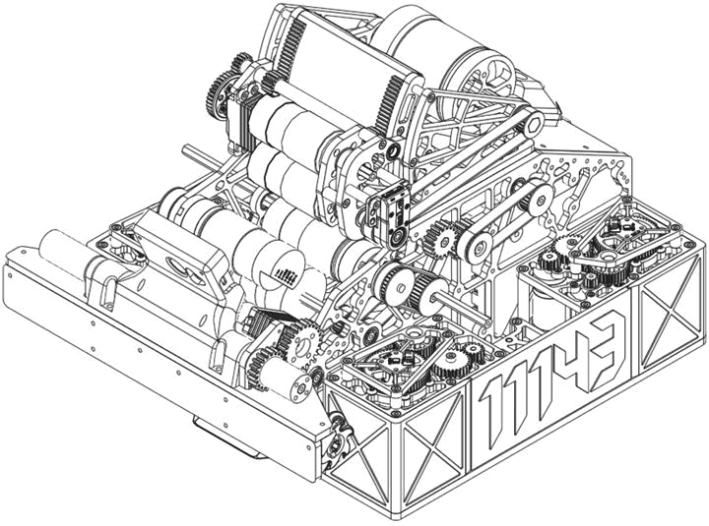

ENGINEERING
PORTFOLIO
FTC - FIRST TECH CHALLENGE
BARKER
YELLOWBACKS
11143
2026-2027
Sydney
Australia
Barker College
Supported by Barker Robotics

Slide 2
MEET THE TEAM
11143
12 MEMBERS
EB
Ethan B.
LEAD DESIGN
assembly
BL
Brandon L.
CAD
assembly
IH
Isaac H.
LEAD CODE
CAD, assembly
RT
Ryan T.
DRIVER
CAD
WQ
Will Q.
LEAD STRATEGY
drive coach
IW
Ivy W.
PROGRAMMING
HR
TX
Tina X.
PROGRAMMING
assembly, strategy
CW
Chelsey W.
ASSEMBLY
scouting
CL
Chloe L.
ELECTRICAL
assembly
CS
Chloe S.
STRATEGY
code, assembly
JC
Jemima C.
PROGRAMMING
scouting
LT
Lucas T.
CAD
assembly
HOW WE SPLIT THE WORK
HOW WE WORK
CAD: four of us worked on the CAD, mostly at the start of the season. Once the design was done we joined assembly so the build went faster
Code: five of us wrote the basic structure of the code and our simulator. We were ready to test as soon as the robot was finished, and we kept the work moving steadily
Strategy: three of us planned our strategy. We worked together on autonomous routes that suit our robot and the alliances we are likely to play with. Four of us scout
Assembly: eight of us assembled the manufactured parts with the design team once the CAD was done
We meet every week
Subteam meetings: each subteam shares updates from its areas. The programmers cover the shooter, the swerve and the ball transfer in turn
Whole-team meetings: we share the changes and progress that affect everyone. When the design team removed the turret, we had to tell the programmers
Whole-team meetings also keep us on schedule so deadlines do not slip
Each subteam decides its own area, then tells everyone else
11143 BARKER YELLOWBACKS
PAGE 01

Slide 3
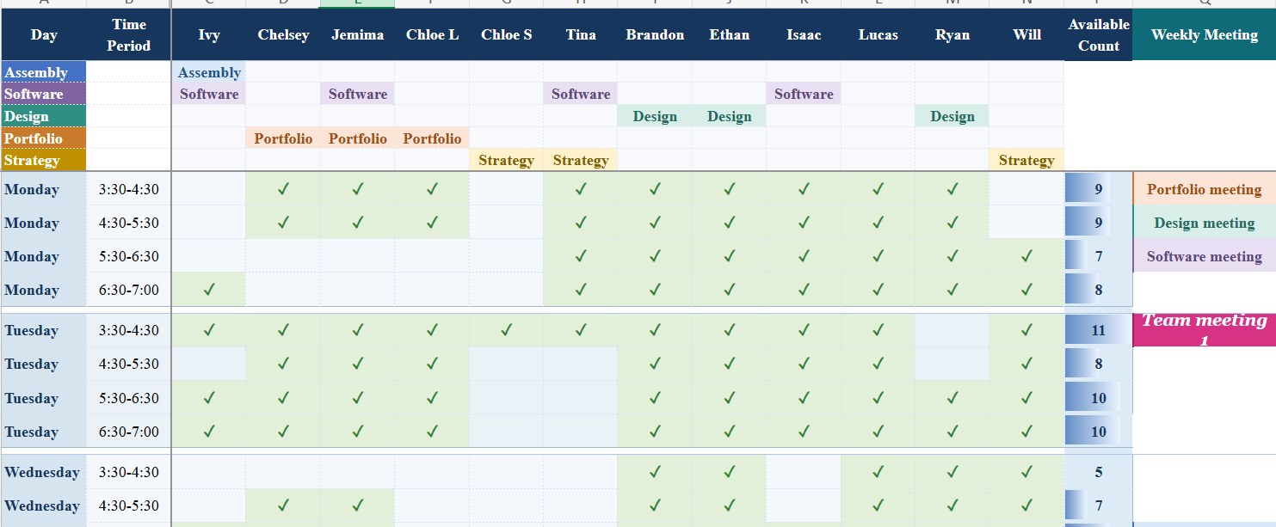
OUR SEASON
11143
2026-2027 SEASON TIMELINE
15 SEP
18 SEP
10 OCT
26 OCT-1 NOV
12 NOV
Schedule
everyone adds free times
First meeting
subteams chosen
Refocus
turret cut
Swerve built
goBILDA parts arrive
Wollongong
first event
28 NOV
4-5 DEC
28 APR-1 MAY
Dotted line: events after Wollongong that we are planning for.
Macquarie
second event
Macquarie
national competition
Worlds
FTC World Championship
PLANNED ON 10 OCTOBER VS WHAT HAPPENED
Our first team meeting was on 18 September. We chose our subteams and roles and began designing and programming. On 10 October we held a major meeting to refocus our timeline so the robot would be finished in time. We cut the turret (page 9) and planned each week:
WEEK
PLANNED
WHAT HAPPENED
12-18 Oct
finish the CAD; make the custom swerve parts
goBILDA parts ordered; shooter redesigned and simplified; intake and transfer design done; ball tracking for autos started; hood and shooter code started
19-25 Oct
goBILDA parts may arrive; make the shooter and transition; assembly
parts machined; assembly began
26 Oct-1 Nov
wiring, programming, fixing mechanical issues
goBILDA parts arrived; swerve assembled
2-8 Nov
programming and drive practice
<what happened>
HOW WE SCHEDULE
OUR SEASON GOALS
Win the national competition
Qualify for the FTC World Championship
<other season goals>
Our availability spreadsheet (part)
A shared spreadsheet shows who is free each week and what work they are given. It mostly worked, but an exam block and outreach made it hard to judge what each week could really fit.
11143 BARKER YELLOWBACKS
PAGE 02

Slide 4
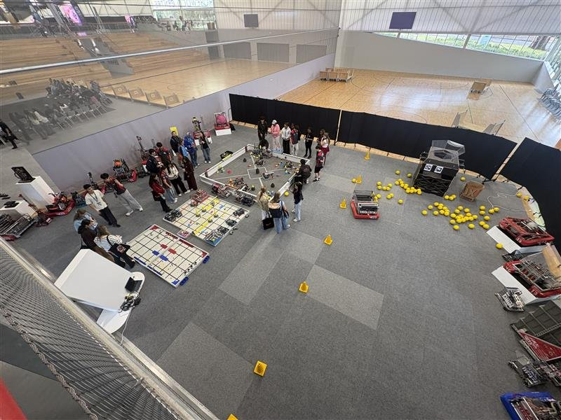
OUTREACH
11143
6
of us teach Darkinjung students
Fortnightly
since February 2026
1,500+
people at Round Square
32
countries at Round Square
TEACHING DARKINJUNG STUDENTS
WHAT
Six of us (Ethan B., Brandon L., Chloe S., Ivy W., Ryan T. and Will Q.) teach robotics to Darkinjung students once a fortnight, since February 2026.
WHAT THEY LEARN
They built robots for this year's VEX IQ game and learnt how to build, how to code, how to do interviews and how to write portfolios.
IMPACT
Some of the students were in competitive teams and won Skills, Teamwork Champion and Excellence awards.
ROUND SQUARE INTERNATIONAL CONFERENCE
WHAT
In the Term 2-3 holidays eight of us (Ivy W., Ethan B., Ryan T., Chelsey W., Chloe L., Isaac H., Tina X. and Will Q.) ran the robotics part of the conference at Barker.
DEMOS
At the opening fair we showed robots driving, shooting, intaking and scoring.
REACH
Over 1,500 people from 32 countries came. Many of them had not heard of FIRST before.
FOR US
It was a very rewarding experience, and it was great to see so many people there.
Our robotics showcase at Round Square
MENTORING A VEX TEAM
BARKER VEX COMPETITION
Three of us (Ethan B., Isaac H. and Brandon L.) mentor the Darkinjung VEX team <team name>. It is very rewarding to watch the students flourish in their games and competitions.
On 14 November 2026 Ethan B., Isaac H. and Brandon L. will referee, queue teams and help the competition run smoothly.
11143 BARKER YELLOWBACKS
PAGE 03

Slide 5



HOW WE DESIGN
11143
OUR DESIGN LOOP
1
2
3
4
5
Goals
what the game needs
Sketch + CAD
Onshape layouts
Simulate
same code, desktop sim
Build
parts and assembly
Test + change
back to step 2
OUR CAD PROCESS, SHOWN ON THE TRANSITION
rollers
gecko wheels
pollen
2. We design the plates and belts around the sketch
1. We sketch the layout first, with the pollen and roller sizes
3. We assemble the whole transition in CAD
CODING TOGETHER
IDEAS FROM VEX AND LAST SEASON
We each code one subsystem on its own branch, so we do not overwrite each other's work. Tina X. wrote the intake and Jemima C. wrote the shooter. On 25 October we merged everything into one robot, which showed us some problems:
Two branches each hid the other's subsystem
We were mixing units (RPM, ticks, degrees), so every value now has one unit
The other fixes are on page 12
Four of us (Ethan B., Will Q., Ryan T. and Tina X.) competed in VEX Push Back. The match loaders in that game worked well for getting pollen out of the flower, so we used the same idea (page 10).
Swerve and logging carried over from last season.
11143 BARKER YELLOWBACKS
PAGE 04

Slide 6
GAME AND STRATEGY
11143
WHAT SCORES POINTS (MANUAL, TABLE 10-2)
SCORING ACTION
POINTS
OUR ANSWER
HIVE TIP, by launching into the upward cell
20 in auto and 20 in teleop
shooter, hood and auto-aim
Pollen left in an upward cell at the end
2 each
the same launches
HOW WE PLAY
<our scoring plan: what we score first, where we shoot from, our role with the alliance partner>
ONE SCORING CYCLE
1
2
3
4
5
Collect
until we hold 4
Hold aim
robot turns to the goal
Spin up
flywheels and hood reach target
Settle
ready for 0.1 s
Feed
pollen goes to the shooter
REQUIREMENTS, AND HOW THE ROBOT MEETS EACH
WE NEED TO
WHY
OUR ANSWER
Launch from anywhere
fewer trips across the field
moving hood
Launch quickly and often
less waiting between shots
two flywheels
Launch without turning round
pollen collects along the wall
rear-facing shooter
Aim while driving
save time every cycle
swerve and auto-aim
Hold our spot
defence will push us
swerve X-lock
Avoid defence
defenders will chase us
very small frame perimeter
Stop opponents shooting
fewer points for them
blocker
Empty the flower
pollen sits inside it
flower mechanism
Find pollen and the goal
drive and aim without guessing
front and rear cameras
How well it worked
<a few sentences on how well each answer worked on the robot>
SCOUTING
Jemima C., Chelsey W., Chloe L. and Tina X. scout. <what we record and how it changes our plan>
11143 BARKER YELLOWBACKS
PAGE 05

Slide 7




ROBOT OVERVIEW
11143
OUR ROBOT
shooter
intake
swerve pod
transition
POLLEN PATH
DESIGN CHOICES
out
A very small frame perimeter, so defence is easier to avoid
Swerve drive: we move in any direction and can lock the wheels in an X
A rear-facing shooter, so we can launch straight after collecting along the wall
A light robot, so it moves more efficiently
in
up
In at the front, up the transition, out of the rear shooter
CHASSIS
Exploded view: pods, plates and side panels
Underneath: a pod in each corner
11143 BARKER YELLOWBACKS
PAGE 06

Slide 8



SWERVE DRIVETRAIN
11143
ONE SWERVE POD
WHY SWERVE
angle sensor
X-lock: we can place the wheels in an X. The friction makes us much harder to push, which helps against defence
We move more efficiently, which is a big advantage in a match
Full-grip wheels give more speed and pushing power than mecanum
We can drive in one direction while facing the goal
We built swerve last season, so we already knew it
Our pods
Each pod has a drive motor and a steering servo
We designed and machined custom parts for the pods
Every pod has an absolute angle sensor, so each wheel knows where it points from the start
steering gears
frame plates
drive motor
bevel gear
wheel
WHEEL DRIVE
MODULE ROTATION
gears
ring gear
steering gears
drive motor
bevel gears
wheel
wheel fork
wheel
Motor, gears, then a bevel gear turn the wheel
A servo and a ring gear turn the whole pod
TESTS
TEST
RESULT
STATUS
Top speed
not finished yet
NOT TESTED
Pushed by another robot in X-lock
not finished yet
NOT TESTED
11143 BARKER YELLOWBACKS
PAGE 07

Slide 9

INTAKE AND TRANSITION
11143
POLLEN PATH
HOW IT WORKS
Mecanum rollers at the front pull pollen in
Gecko wheels in the transition grip the pollen and carry it up
Smaller gecko wheels at the top reduce backspin going into the shooter
Polycarbonate ramps give the pollen a low-friction surface
Two motors drive the intake and the transition
4 beam sensors count the pollen we hold, up to the 4 that rule G407 allows. The intake stops when we are full
mecanum rollers
gecko wheels
pollen guide
Rollers pull pollen in and gecko wheels lift it to the shooter
ASSEMBLY
The intake and transition together
From the front
TESTS
TEST
RESULT
STATUS
Jams per 20 pickups
not finished yet
NOT TESTED
11143 BARKER YELLOWBACKS
PAGE 08

Slide 10



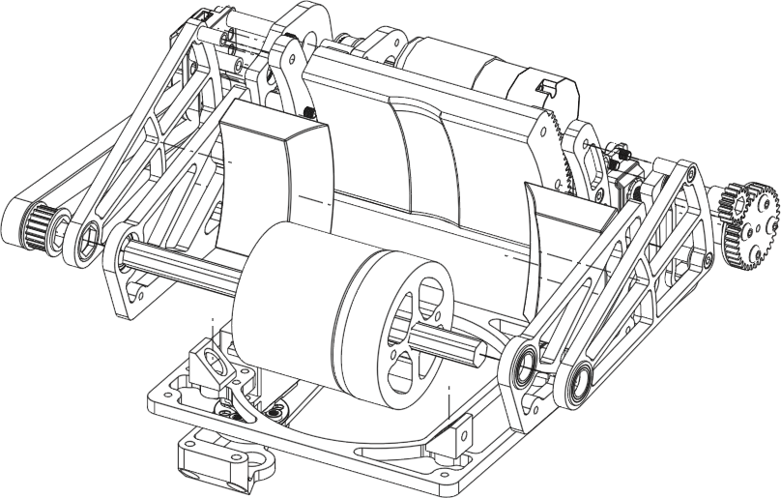
SHOOTER DESIGN
11143
WHAT WE TRIED
TURRET, LAST SEASON
TURRET, THIS SEASON
FIXED REAR SHOOTER
+ aims without turning the robot
− months of tuning (Apr-Jun 2026)
+ what we wanted first
− weight and space
− goBILDA parts delayed
− no time: regionals 4 weeks away
+ fewer parts
+ shoots out of the flowers without turning
− the whole robot must turn to aim
WHAT WE WANTED, AND WHY
HOOD DRIVE
Two flywheels, so there is less waiting between shots
A moving hood, so we can shoot from anywhere on the field. It moves from 33.6 to 67 degrees
A shooter that faces backwards. Pollen collects along the wall, so we can drive up to the wall and aim without turning round first
A lookup table that gives the flywheel speed and hood angle for where localisation says we are. We will measure its values once the robot is finished
Why we cut the turret
At our meeting on 10 October we decided to cut the turret. Regionals were four weeks away and our goBILDA parts were delayed, so we needed to save time. The turret was the least necessary part. We kept swerve and the blocker, which still speed up shooting, and spent the time making the intake, transfer, swerve, autos and code consistent. The swerve base now turns the robot to aim (page 13).
flywheel
hood rack
servo gear
A servo gear drives a rack to tilt the hood
EXPLODED VIEW
hood
motor
flywheel
TESTS
TEST
RESULT
STATUS
Shots in from 3 distances
not finished yet
NOT TESTED
Time between shots
not finished yet
NOT TESTED
11143 BARKER YELLOWBACKS
PAGE 09

Slide 11

FLOWER, BLOCKER, CAMERAS
11143
FLOWER MECHANISM
BLOCKER AND GATE
IDEA
BLOCKER
Four of us competed in VEX Push Back. The match loaders in that game worked well for getting pollen out of a container, so we used the same idea for the flower.
The blocker stops opponents from shooting (1 Axon Max servo).
GATE
PROBLEM
The gate stops pollen going into the shooter until the shot is ready (1 Axon servo).
Pollen sits inside the flower and we need to get it out.
RESULT
Not tested yet: the robot is not finished.
TWO CAMERAS
The front camera finds pollen so we can drive a path to it
The rear camera reads AprilTags so we know where the goal is
Status: not tested yet (robot not finished)
front camera
rear camera
HOW WE HOLD AND RELEASE POLLEN
Collect: the intake runs until the 4 beam sensors say we are full, then it stops
Hold: pollen waits while the robot aims
Release: pollen only feeds once aim, flywheel speed and hood have all been ready for 0.1 s (page 13)
11143 BARKER YELLOWBACKS
PAGE 10

Slide 12


CONTROL SYSTEM
11143
WHAT EACH PART DOES
PART
PROBLEM IT SOLVES
WHAT IT DOES
4 drive motors
moving in any direction
drive each swerve wheel
4 steering servos + 4 angle sensors
pointing every wheel the right way
turn each pod and read its angle
IMU
knowing which way we face
heading for driving and aiming
Front and rear cameras
finding pollen and the goal
pollen pathing; AprilTags
4 beam sensors
knowing how much pollen we hold
count the pollen along the transition
Gate servo
pollen reaching the shooter too early
holds pollen until the shot is ready
2 shooter motors
the same shot every time
flywheels held at target speed (PIDF)
Hood servo
shooting from different distances
sets the launch angle
Flower mechanism servo
pollen stuck inside the flower
gets it out
Blocker servo
opponents shooting at us
stops their shots
Voltage and current checks
brown-outs and stalled motors
logged every loop
8 motors and 8 servos
rule R503 limits us to 8 of each
we use all 16
ODOMETRY POD
SPEED CONTROL
mounting plate
CHALLENGE
Each shot takes energy from the flywheels, and a slower wheel shoots short.
SOLUTION
A PIDF controller holds the target speed. Its feedforward uses battery voltage, so a flat battery does not change the shot.
odometry wheels
LIMITS
The flywheels are limited to 3500 RPM. They count as ready within 50 RPM of the target and the hood within 2 degrees.
RESULT
Not tested yet: the robot is not finished.
Designed in CAD. The code uses wheels and the IMU for now
11143 BARKER YELLOWBACKS
PAGE 11

Slide 13
SOFTWARE AND SIMULATION
11143
SAME CODE ON THE ROBOT AND ON A LAPTOP
PART
WHAT IT HOLDS
WHY
RobotCode
behaviour: driving, aiming, shooting
written once, used on both
TeamCode
the real motors, servos and sensors
only place that touches hardware
RobotSim
simulated robot, field and pollen
test before the robot is finished
WHY WE SIMULATE
AUTOMATED TESTS
CHALLENGE
24 desktop tests pass (25 October 2026)
They cover heading wrap, 10 ms loops, a lost heading sensor, manual turn override and stop outputs
Every loop is logged, so we can replay a run
The robot is not finished yet, but the code needs testing now.
SOLUTION
The same TeleOp runs in our simulator on the official field CAD.
RESULT
In simulation we score 3 of 3 for both alliances, also while moving.
WHAT WE FOUND AND FIXED WHEN WE MERGED THE CODE
PROBLEM
FIX
Shooter could never reach its shooting state
a target speed now starts the wheel controller
Updates changed numbers but moved nothing
read feedback, write a limited motor power every loop
RPM, encoder ticks, degrees and servo positions mixed
one unit for each value; conversion only in hardware code
The flywheel's controller also drove the hood
the hood has its own mapping and rate limit
Lookup table divided by zero at its first point
handles exact points; never guesses past its ends
Simulated aiming stopped about 12 degrees short
wheel feedforward based on battery voltage
RISKS AND HOW WE REDUCE THEM
RISK
HOW WE REDUCE IT
Simulation is not the real robot
the code refuses to feed until the shooter is calibrated
Heading sensor lost mid-match
tested in simulation: stops driving and feeding
Flat battery changes the shot
feedforward scaled by battery voltage
A complex turret fails
no turret: the drivetrain aims
11143 BARKER YELLOWBACKS
PAGE 12

Slide 14
AUTO-AIM
11143
THE PROBLEM
CHALLENGE
We dropped the turret, so the shooter faces backwards and cannot turn on its own.
SOLUTION
Holding the aim button turns the whole robot until it is within 2.5 degrees of the goal.
WHAT THE ROBOT CHECKS BEFORE EVERY SHOT, IN ORDER
CHECK
IF NOT, THE ROBOT SAYS
WHY
Is there a possible shot?
NO TRAJECTORY
do not waste pollen
Is the shooter calibrated?
CALIBRATION REQUIRED
simulation is not the real robot
Is it aimed and not still turning?
AIMING
within 2.5 degrees
Flywheels and hood on target?
SPINNING UP
within 50 RPM and 2 degrees
Ready for 0.1 s?
SETTLING
it must stay on target, not pass through it
Is there pollen to shoot?
EMPTY
the beam sensors know
All yes
FEEDING
pollen goes to the shooter
MATHS: TURNING TO AIM
MATHS: SHOOTING WHILE MOVING
Turn speed = feedback on the heading error + damping + feedforward for a goal that moves as we drive + a small push past static friction.
Gains: kP 4.0, kD 0.35, kS 0.06.
In simulation, aiming first stopped 12 degrees short because small commands sat inside the static friction dead zone.
The pollen leaves with the shooter's speed plus the robot's:
v pollen = v shot + v robot + turn rate × r
(r is where the pollen leaves, measured from the robot's centre). We look 0.07 s ahead to where the robot will be at release, then a gravity solver finds the speed and hood angle.
TESTS
TEST
SIMULATION
ROBOT
Score while still
3 of 3
not finished yet
Score while moving
3 of 3
not finished yet
11143 BARKER YELLOWBACKS
PAGE 13

Slide 15
AUTONOMOUS
11143
OUR ROUTE
<auto route drawing: our hand-drawn route, redrawn cleanly>
EACH STEP
STATUS
STEP
WHAT
POINTS
On 12-18 October we started a ball-tracking setup so the robot can find, map and intake pollen by itself
The full autonomous is not finished: NOT TESTED
<date we plan to have it running>
1
<step>
<pts>
2
<step>
<pts>
3
<step>
<pts>
WHAT IT CAN USE
PART
WHAT IT GIVES THE AUTONOMOUS
Wheels + IMU
where we are as we drive
Rear camera
AprilTags, to know where we are on the field
Front camera
a path to the pollen
Beam sensors
how much pollen we hold
Auto-aim
the same shot checks as TeleOp (page 13)
11143 BARKER YELLOWBACKS
PAGE 14

Slide 16
TESTING AND LESSONS
11143
TEST RESULTS
TEST
RESULT
STATUS
24 automated code tests
all pass
PASS
Simulation: score 3 of 3, still and moving
3 of 3
PASS
Simulation: pick up 3, aim, score 3
3 of 3
PASS
Simulation: lost heading sensor
stops drive and feeding
PASS
Robot: shots in from 3 distances
not finished yet
NOT TESTED
Robot: time between shots
not finished yet
NOT TESTED
Robot: top speed
not finished yet
NOT TESTED
Robot: X-lock push
not finished yet
NOT TESTED
Robot: jams per 20 pickups
not finished yet
NOT TESTED
Autonomous
not written yet
NOT TESTED
LESSONS WE APPLIED
NEXT
A turret cost us months last season, so this season the drivetrain aims
We sketch the pollen path before the CAD, starting with sizes
Every value in the code has one unit (RPM, radians)
We merge subsystems early, because the bugs on page 12 only showed when they met
When time is short, we cut the least necessary part and make the rest consistent
We plan each week around exams and outreach
Finish the robot, then run every test on this page
Calibrate the shooter on the real robot
Measure the lookup table
Write and test the autonomous
<next design change>
RELIABILITY
No matches yet: the robot is not finished. For every match we will record whether it worked all match, and any fault and its fix.
Endnote: we drafted and laid out this portfolio with help from an AI assistant. All results, photos, CAD, code and decisions are our own, and we checked every page.
11143 BARKER YELLOWBACKS
PAGE 15

