Slide 1


ENGINEERING
PORTFOLIO
FTC - FIRST TECH CHALLENGE
BARKER YELLOWBACKS
11143
2026-2027
Sydney
Australia

Slide 2
FORMAT GUIDE
11143
COLOURS
TYPE
Page #171616
BANNER TITLE 19 PT BOLD CAPS
BOX HEADING 12 PT BOLD CAPS
Sub-heading 11.5 pt yellow
Body 10.5 pt Montserrat, with key words in yellow, pros in green and cons in red.
Bullets are small yellow squares
Captions, tables and footer 10 pt grey (the smallest size: FTC A201)
Handwritten labels 15 pt
Text #F2F2F2
Yellow #F5E660
Grey #C4C4C4
Pro / pass #6FD98B
Con / fail #FF7B72
CHALLENGE TO SOLUTION
OPTIONS COMPARED
CHALLENGE
DRIVETRAIN
SCORE /25
STATUS
In simulation the chassis stopped aiming about 12 degrees short: small wheel commands were inside the static friction dead zone.
Swerve
<score>
CHOSEN
Mecanum
<score>
NOT CHOSEN
Tank
<score>
NOT CHOSEN
SOLUTION
Added wheel feedforward based on battery voltage.
RESULT
ITERATIONS
Simulation aims on target. Real robot: <RESULT: aim error in degrees>.
V1
V2
V3
+ <pro>
− <con>
+ <pro>
− <con>
+ <pro>
+ <pro>
SEASON SO FAR (FROM OUR CODE HISTORY)
23 SEP
20 OCT
25 OCT
12 NOV
Shooter code
first shooter files
Intake code
intake and transfer
One robot
subsystems merged; 3 of 3 in sim
Wollongong
first event
11143 BARKER YELLOWBACKS
PAGE 01

Slide 3

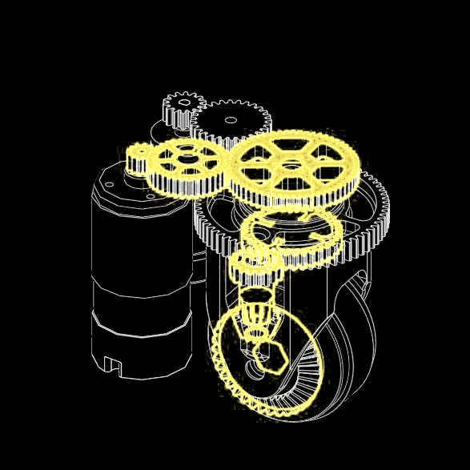

SWERVE DRIVETRAIN
11143
ONE SWERVE POD
KEY FEATURES
angle sensor
4 pods, each with a drive motor and a steering servo
An absolute angle sensor in every pod, so each wheel knows where it points from the start
Pod centres 239 x 239 mm apart; wheels 60.9 mm
Robot 407.7 x 327.0 mm, 290.9 mm tall (CAD)
Why swerve, again
X-lock: the wheels turn inwards, so defence cannot push us off our spot
Full-grip wheels: more speed and pushing power than mecanum
Aim while driving: drive one way, face the goal
We built swerve last season, so the risk was low
steering gears
frame plates
drive motor
bevel gear
wheel
WHEEL DRIVE
MODULE ROTATION
drive motor
gears
ring gear
steering gears
bevel gears
wheel
wheel fork
wheel
Motor, gears, then a bevel gear turn the wheel
Servo and ring gear turn the whole pod
TESTS
TEST
RESULT
STATUS
Top speed
<RESULT: m/s>
NOT TESTED
Steering angle error
<RESULT: degrees>
NOT TESTED
11143 BARKER YELLOWBACKS
PAGE 02

Slide 4

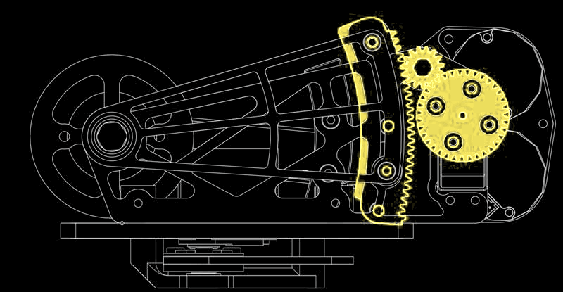
SHOOTER DESIGN
11143
WHAT WE TRIED
TURRET, LAST SEASON
TURRET, THIS SEASON
FIXED REAR SHOOTER
+ aims without turning the robot
− months of tuning (Apr-Jun 2026)
+ what we wanted first
− weight and space
− 1 more motor or servo
− no time to build it
+ fewer parts
+ shoots out of the flowers without turning
− the whole robot must turn to aim
WHAT WE WANTED, AND WHY
HOOD DRIVE
Two flywheels: more flywheel means less waiting between shots
Moving hood: shoot from anywhere on the field
Facing backwards: balls collect along the wall, so we drive up to the wall and aim, instead of collecting and then turning round
What we changed
We drew and coded a turret, but never built it. On 12 October we removed it: the swerve base turns the robot to aim instead (auto-aim, page 4).
flywheel
hood rack
servo gear
A servo gear drives a rack to tilt the hood
TESTS
TEST
RESULT
STATUS
Shots in from 3 distances
<RESULT: in / 10>
NOT TESTED
Time between shots
<RESULT: s>
NOT TESTED
11143 BARKER YELLOWBACKS
PAGE 03

Slide 5

CONTROL SYSTEM
11143
WHAT EACH PART DOES
PART
PROBLEM IT SOLVES
WHAT IT DOES
4 drive motors
moving in any direction
drive each swerve wheel
4 steering servos + 4 angle sensors
pointing every wheel the right way
turn each pod and read its angle
IMU
knowing which way we face
heading for driving and aiming
3 beam sensors
knowing how many balls we hold
sense balls at bottom, middle and top of the intake
Gate servo
balls reaching the shooter too early
holds balls until the shot is ready
2 shooter motors
the same shot every time
flywheel held at target speed (PIDF)
Hood servo
shooting from different distances
sets the launch angle from our shot table
Voltage and current checks
brown-outs and stalled motors
logged every loop
ODOMETRY POD
AUTO-AIM
CHALLENGE
We dropped the turret, so the shooter is fixed facing backwards.
SOLUTION
mounting plate
Holding aim turns the whole robot until it is within 2.5 degrees of the goal.
RESULT
Simulation: 3 of 3 scored, also while moving. Robot: <RESULT: shots in / 10>.
odometry wheels
In CAD; the code uses wheels + IMU for now
11143 BARKER YELLOWBACKS
PAGE 04

Slide 6
MEET THE TEAM
11143
OUR TEAM
EB
Ethan B.
LEAD DESIGN
assembly
BL
Brandon L.
CAD
assembly
IH
Isaac H.
LEAD CODE
CAD, assembly
RT
Ryan T.
DRIVER
CAD
WQ
Will Q.
LEAD STRATEGY
drive coach
IW
Ivy W.
PROGRAMMING
HR
TX
Tina X.
CODE
assembly
CW
Chelsea W.
CODE
assembly
CL
Chloe L.
ELECTRICAL
assembly
CS
Chloe S.
STRATEGY
code, assembly
CC
Cooper C.
SCOUTING
assembly
JC
Jemima C.
PROGRAMMING
scouting
LT
Lucas T.
CAD
assembly
OUTREACH
7 members teach robotics to Darkinjung students once a fortnight (<number> students since <month>)
Ethan B. and Isaac H. mentor <number> VEX teams
Ethan B., Isaac H. and Brandon L. volunteered at the Barker VEX competition (<date>)
We ran the robotics part of the Round Square International Conference at Barker (<date>, <number> people)
Endnote: text drafted and laid out with help from an AI assistant. All results, photos, CAD, code and decisions are the team's own; the team checked every page.
11143 BARKER YELLOWBACKS
PAGE 05

