Slide 1


ENGINEERING
PORTFOLIO
FTC - FIRST TECH CHALLENGE
BARKER YELLOWBACKS
11143
2026-2027
Sydney
Australia
Barker College
Supported by Barker Robotics

Slide 2
MEET THE TEAM
11143
13 MEMBERS
EB
Ethan B.
LEAD DESIGN
assembly
BL
Brandon L.
CAD
assembly
IH
Isaac H.
LEAD CODE
CAD, assembly
RT
Ryan T.
DRIVER
CAD
WQ
Will Q.
LEAD STRATEGY
drive coach
IW
Ivy W.
PROGRAMMING
HR
TX
Tina X.
CODE
assembly
CW
Chelsea W.
CODE
assembly
CL
Chloe L.
ELECTRICAL
assembly
CS
Chloe S.
STRATEGY
code, assembly
CC
Cooper C.
SCOUTING
assembly
JC
Jemima C.
PROGRAMMING
scouting
LT
Lucas T.
CAD
assembly
HOW WE SPLIT THE WORK
HOW WE WORK
CAD: 4 members in Onshape, with our lead designer
Code: 6 members write and test the code
Strategy: 2 strategists plus 2 scouts
Assembly: 9 of 13 members build
We meet every week or two
Each specialty decides its own area (mechanics decide mechanical changes), then tells the whole team
Each subsystem has its own code branch, merged into one robot
11143 BARKER YELLOWBACKS
PAGE 01

Slide 3
OUR SEASON
11143
2026 SO FAR (DATES FROM OUR CODE HISTORY)
23 SEP
12 OCT
20 OCT
25 OCT
12 NOV
Shooter
first shooter code
No turret
turret removed
Intake
intake and transfer code
One robot
all subsystems merged
Wollongong
first event
WHAT WE KEPT FROM LAST SEASON
THIS SEASON'S GOALS
Last season's robot (background only) taught us:
Swerve works for us: we kept it
A turret takes months to tune: April to June 2026, so this year we dropped it
Logging and replay carried over to this season's code
Shoot from anywhere on the field
Less waiting between shots
Collect along the wall and shoot without turning round
Hold our spot against defence
Keep the robot light, so it moves more efficiently
Where we are now
The robot is designed in CAD and its code runs in our simulator. It is not built yet, so nothing has been tested on a real robot.
11143 BARKER YELLOWBACKS
PAGE 02

Slide 4
OUTREACH
11143
TEACHING DARKINJUNG STUDENTS
WHAT
7 members of our team teach robotics to Darkinjung students once a fortnight, since about February 2026.
WHAT THEY LEARN
They built robots for this year's VEX IQ game and learnt how to build, how to code, how to do interviews and how to write portfolios.
IMPACT
Some of the students were in competitive teams and won Skills, Teamwork Champion and Excellence awards.
ROUND SQUARE INTERNATIONAL CONFERENCE
WHAT
On 28 September 2026 about 7 of us ran the robotics part of the conference at Barker.
REACH
We showed our robotics program to over 1,500 people from around 32 countries, and introduced them to FIRST.
MENTORING VEX TEAMS
BARKER VEX COMPETITION
Ethan B. and Isaac H. mentor VEX teams.
Ethan B., Isaac H. and Brandon L. volunteered at the Barker VEX competition.
11143 BARKER YELLOWBACKS
PAGE 03

Slide 5

HOW WE ENGINEER
11143
OUR DESIGN LOOP
1
2
3
4
5
Goals
what the game needs
Sketch + CAD
Onshape layouts
Simulate
same code, desktop sim
Build
print, cut, assemble
Test + change
back to step 2
EXAMPLE: FROM SKETCH TO PART
ONE ROBOT, MANY BRANCHES
Each subsystem was coded on its own branch: intake (Tina X.), shooter (Jemima C.), then merged into one robot on 25 October.
What merging taught us
Two branches each hid the other's subsystem: fixed
The shot table divided by zero at its first point: fixed and tested
Units were mixed (RPM, ticks, degrees): one unit per value now
belt spacing
pollen
Layout sketch first: pollen size, roller sizes and belt spacing (mm)
IDEAS WE BROUGHT IN
FROM VEX
Ethan B., Will Q., Ryan T. and Tina X. played VEX Push Back. The game was very similar, so our matchloader follows the same idea (page 10).
FROM LAST SEASON
Swerve and logging carried over; the turret did not (page 9).
11143 BARKER YELLOWBACKS
PAGE 04

Slide 6
STRATEGY AND REQUIREMENTS
11143
HOW WE PLAY
<our scoring plan: what we score first, where we shoot from, our role with the alliance partner>
Pollen collects along the wall, so we collect there and shoot from there.
REQUIREMENTS, AND HOW THE ROBOT MEETS EACH
WE NEED TO
WHY
OUR ANSWER
Shoot from anywhere
fewer trips across the field
moving hood + shot table
Shoot quickly, again and again
less waiting between shots
two flywheels
Shoot without turning round
pollen collects along the wall
rear-facing shooter
Aim while driving
save time every cycle
swerve + auto-aim
Hold our spot
defence will push us
swerve X-lock
Load the flower fast
<why>
matchloader
Find pollen and the goal
drive and aim without guessing
front + rear cameras
SCOUTING
Cooper C. and Jemima C. scout: <what we record and how it changes our plan>
11143 BARKER YELLOWBACKS
PAGE 05

Slide 7

ROBOT OVERVIEW
11143
OUR ROBOT
shooter
intake
swerve pod
transition
POLLEN PATH
NUMBERS
ITEM
VALUE
Length (CAD)
407.7 mm
Width (CAD)
327.0 mm
Height (CAD)
290.9 mm
Motors
8
Servos
8
Cameras
2
In at the front, up the transition, out of the rear shooter
11143 BARKER YELLOWBACKS
PAGE 06

Slide 8

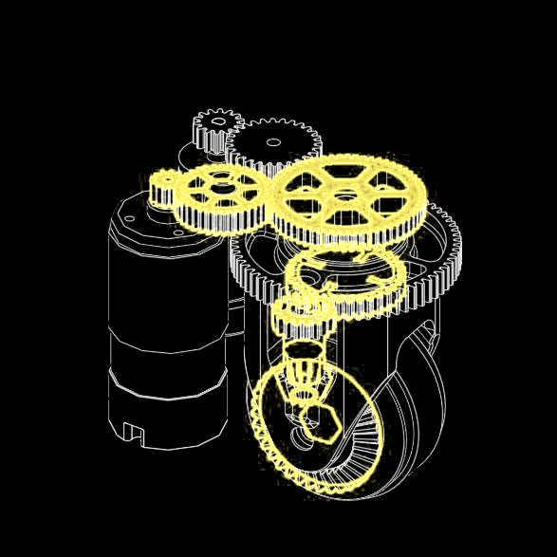
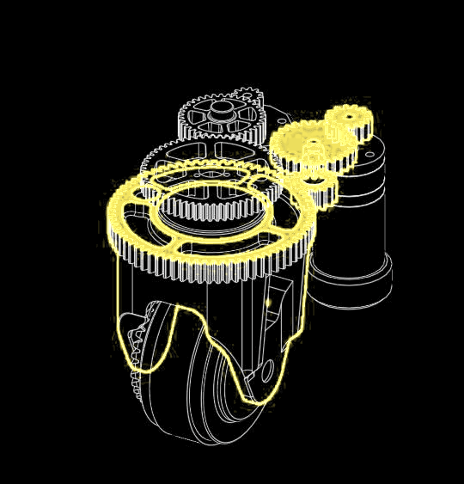
SWERVE DRIVETRAIN
11143
ONE SWERVE POD
WHY SWERVE, AGAIN
angle sensor
X-lock: the wheels sit in an X, and the friction makes us a lot harder to push or defend
Moves a lot more efficiently: a big advantage in matches
Full-grip wheels: more speed and pushing power than mecanum
Aim while driving: drive one way, face the goal
We built swerve last season, so the risk was low
Key features
4 pods, each with a drive motor and a steering servo
An absolute angle sensor in every pod, so each wheel knows where it points from the start
Pod centres 239 x 239 mm apart; wheels 60.9 mm
steering gears
frame plates
drive motor
bevel gear
wheel
WHEEL DRIVE
MODULE ROTATION
drive motor
gears
ring gear
steering gears
bevel gears
wheel
wheel fork
wheel
Motor, gears, then a bevel gear turn the wheel
Servo and ring gear turn the whole pod
TESTS
TEST
RESULT
STATUS
Top speed
not built yet
NOT TESTED
Pushed by another robot in X-lock
not built yet
NOT TESTED
11143 BARKER YELLOWBACKS
PAGE 07

Slide 9
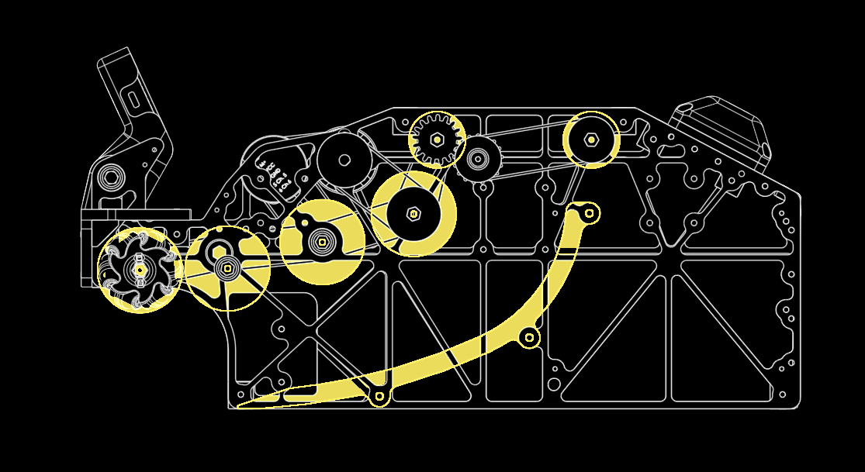
INTAKE AND TRANSITION
11143
WHAT WE TRIED
V1 PRINTED FUNNELS
V2 ROLLERS + TRANSITION
+ <what worked>
− gecko wheels at the front only
− <what went wrong>
+ mecanum rollers sweep pollen in
+ gecko wheels grip it and carry it up
− <downside, if any>
POLLEN PATH
KEY SIZES
Pollen 71.12 mm
Intake mecanum rollers 50 mm
Gecko wheels 48 mm
Small gecko wheels 32 mm at the top, so less backspin goes into the shooter
Belt spacing 45, 58.5, 54, 44 mm
2 motors drive the intake and transition
Polycarbonate ramps give the pollen a low-friction surface
mecanum rollers
gecko wheels
pollen guide
Rollers pull pollen in; gecko wheels lift it to the shooter
MATHS: WHERE THE POLLEN TOUCHES
SENSING
Our two rows of gecko wheels sit apart, so each row meets the pollen off its centre. The sketch plane cuts the pollen in a circle of 70.413 mm:
d = √(35.56² − 35.21²) = 5.0 mm
So the plane is 5.0 mm from the pollen's centre, and the sketch uses 70.413 mm there, not 71.12 mm.
3 beam sensors (bottom, middle, top) count the pollen we hold
A gate servo holds pollen until the shooter is ready
Jam rate: not tested yet (robot not built)
11143 BARKER YELLOWBACKS
PAGE 08

Slide 10
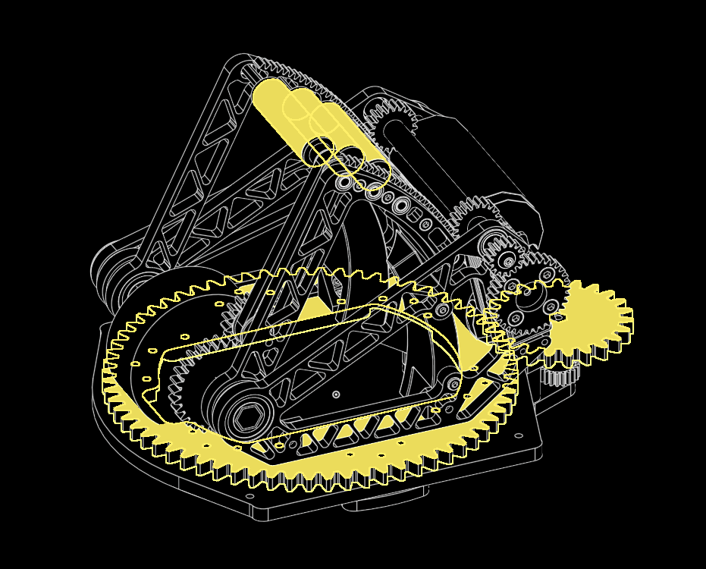


SHOOTER DESIGN
11143
WHAT WE TRIED
TURRET, LAST SEASON
TURRET, THIS SEASON
FIXED REAR SHOOTER
+ aims without turning the robot
− months of tuning (Apr-Jun 2026)
+ what we wanted first
− weight and space
− 1 more motor or servo
− no time to build it
+ fewer parts
+ shoots out of the flowers without turning
− the whole robot must turn to aim
WHAT WE WANTED, AND WHY
HOOD DRIVE
Two flywheels: more flywheel means less waiting between shots
Moving hood: shoot from anywhere on the field
Facing backwards: pollen collects along the wall, so we drive up to the wall and aim, instead of collecting and then turning round
Lookup table: the code picks flywheel speed and hood angle from where localisation says we are (values still to be measured)
What we changed
The turret got as far as CAD and code, never built. On 12 October we removed it: the swerve base turns the robot to aim instead (page 13).
flywheel
hood rack
servo gear
A servo gear drives a rack to tilt the hood
TESTS
TEST
RESULT
STATUS
Shots in from 3 distances
not built yet
NOT TESTED
Time between shots
not built yet
NOT TESTED
11143 BARKER YELLOWBACKS
PAGE 09

Slide 11

MATCHLOADER AND CAMERAS
11143
MATCHLOADER
BLOCKER AND GATE
IDEA
BLOCKER
Four of us played VEX Push Back, a very similar game. We used the same kind of matchloader for the flower.
<what the blocker stops> (1 Axon Max servo)
GATE
PROBLEM
Stops pollen going into the shooter until the shot is ready (1 Axon servo).
<what the matchloader fixes, with a number>
RESULT
Not tested yet: the robot is not built.
TWO CAMERAS
Front camera: finds pollen, so we can path to it
Rear camera: reads AprilTags, so we know where the goal is
Status: not tested yet (robot not built)
front camera
rear camera
11143 BARKER YELLOWBACKS
PAGE 10

Slide 12

CONTROL SYSTEM
11143
WHAT EACH PART DOES
PART
PROBLEM IT SOLVES
WHAT IT DOES
4 drive motors
moving in any direction
drive each swerve wheel
4 steering servos + 4 angle sensors
pointing every wheel the right way
turn each pod and read its angle
IMU
knowing which way we face
heading for driving and aiming
Front and rear cameras
finding pollen and the goal
pollen pathing; AprilTags
3 beam sensors
knowing how much pollen we hold
sense pollen at bottom, middle and top
Gate servo
pollen reaching the shooter too early
holds pollen until the shot is ready
2 shooter motors
the same shot every time
flywheels held at target speed (PIDF)
Hood servo
shooting from different distances
sets the launch angle from our shot table
Voltage and current checks
brown-outs and stalled motors
logged every loop
ODOMETRY POD
SPEED CONTROL
CHALLENGE
Each shot takes energy from the flywheels, and a slower wheel shoots short.
mounting plate
SOLUTION
A PIDF controller holds the target speed; feedforward uses battery voltage, so a flat battery does not change the shot.
RESULT
odometry wheels
Not tested yet: the robot is not built.
Designed in CAD; the code uses wheels + IMU for now
11143 BARKER YELLOWBACKS
PAGE 11

Slide 13
SOFTWARE AND SIMULATION
11143
SAME CODE ON THE ROBOT AND ON A LAPTOP
PART
WHAT IT HOLDS
WHY
RobotCode
behaviour: driving, aiming, shooting
written once, used everywhere
TeamCode
the real motors, servos and sensors
only place that touches hardware
RobotSim
simulated robot, field and pollen
test before the robot is built
WHY WE SIMULATE
AUTOMATED TESTS
CHALLENGE
24 desktop tests pass (25 October 2026)
They cover heading wrap, 10 ms loops, a lost heading sensor, manual turn override and stop outputs
Every loop is logged, so a run can be replayed
The robot is not built yet, but the code needs testing now.
SOLUTION
The same TeleOp runs in our simulator on the official field CAD.
RESULT
Simulation: scores 3 of 3 for both alliances, also while moving.
RISKS AND HOW WE REDUCE THEM
RISK
HOW WE REDUCE IT
Simulation is not the real robot
calibrate hood travel, release point and wheel speed once the robot is built, before shooting for real
Heading sensor lost mid-match
tested in simulation: the robot stops driving and stops feeding pollen
Flat battery changes the shot
feedforward scaled by battery voltage
A complex turret fails
no turret: the drivetrain aims
11143 BARKER YELLOWBACKS
PAGE 12

Slide 14
AUTO-AIM
11143
THE PROBLEM
CHALLENGE
We dropped the turret, so the shooter faces backwards and cannot turn on its own.
SOLUTION
Holding the aim button turns the whole robot until it is within 2.5 degrees of the goal; the driver can still drive.
MATHS: TURNING TO AIM
MATHS: SHOOTING WHILE MOVING
Turn speed = feedback on the heading error + damping + feedforward for a goal that moves as we drive + a small push past static friction.
Gains in our code: kP 4.0, kD 0.35, kS 0.06.
In simulation aiming first stopped 12 degrees short: small commands were inside the static friction dead zone. Adding voltage feedforward fixed it.
The pollen leaves with the shooter's speed plus the robot's:
v pollen = v shot + v robot + turn rate × r
(r = where the pollen leaves, from the robot's centre). The solver aims so the sum hits the goal, and the shot table picks flywheel speed and hood angle from the distance.
TESTS
TEST
SIMULATION
ROBOT
Score while still
3 of 3
not built yet
Score while moving
3 of 3
not built yet
11143 BARKER YELLOWBACKS
PAGE 13

Slide 15
AUTONOMOUS
11143
OUR ROUTE
<auto route drawing: the team's hand-drawn route, redrawn cleanly>
EACH STEP
STATUS
STEP
WHAT
POINTS
The autonomous for this robot is not written yet: NOT TESTED
It will use the rear camera's AprilTags to know where we are
<date we plan to have it running>
1
<step>
<pts>
2
<step>
<pts>
3
<step>
<pts>
11143 BARKER YELLOWBACKS
PAGE 14

Slide 16
TESTING AND LESSONS
11143
TEST RESULTS
TEST
RESULT
STATUS
24 automated code tests
all pass
PASS
Simulation: score 3 of 3, still and moving
3 of 3
PASS
Robot: shots in from 3 distances
not built yet
NOT TESTED
Robot: top speed
not built yet
NOT TESTED
Robot: jams per 20 pickups
not built yet
NOT TESTED
Autonomous
not written yet
NOT TESTED
LESSONS WE APPLIED
NEXT
A turret cost months last season, so we let the drivetrain aim
Sketch the pollen path before CAD: sizes and spacing first
One unit for each value in code (RPM, radians)
Calibrate the shooter on the real robot
Write and test the autonomous
Build the robot, then run every test on this page
<next design change>
RELIABILITY
No matches yet: the robot is not built. For every match we will record whether it worked all match, and any fault and its fix.
Endnote: text drafted and laid out with help from an AI assistant. All results, photos, CAD, code and decisions are the team's own; the team checked every page.
11143 BARKER YELLOWBACKS
PAGE 15

