Slide 1
ASSMU Club Information System
By: Ethan Chung, Shawn Mathews, Justin Le

Slide 2
Purpose
Develop a club information system for students
Current system provides little to no information about each club
Clubs on the website are very outdated and some clubs are not even provided at SMU
Easier to access compared to current system (which took months to get information updated)
Club leads will be able to instantly update any information and have it shown
Allow quick access to critical information
Club, Events, ASSMU officers, Calendar, Resources, and Contact
Allows students to meet new people that have a common interest with them
This will be separate from the SMU website (as per client request) and will be publicized by ASSMU and Campus Life

Slide 3
Team Roles
Ethan Chung: Back-end
Justin Le: Front-end
Shawn Mathews: Front-end
Shaina Agonoy-Pascua (ASSMU Executive Club Coordinator): Client

Slide 4
Project Constraints
Delay in communication with client
Awaiting information for clubs
Temporary placeholders where needed
Time
A timeline of 5 months is too short to incorporate everything we wanted to
Full time students and part time jobs

Slide 5
Schedule
Each week we completed at least two Github issues/tasks
Every other week did research to improve user interface
Weekly team meetings and client meetings (Agile Scrum Style)
Agile scrum methodology is a project management system that relies on incremental development with in our case 2 week sprints
Schedule got pushed back due to…
Learning how to get and use Cosmic.JS API data
Finding a way to get Google Calendar event data without requiring OAuth consent
Overall learning curve for using new framework ReactJS

Slide 6
Budgeting
Web Hosting Services
GoDaddy - $6 /mo
DreamHost - $2.95 /mo
AWS - Varies between $1 - $3 /mo
No web hosting costs if SMU can host the website
Database Cost
MySQL - Free if used locally, $2,000 to $10,000 if used commercially (does not include hosting fee)
Oracle - $21,000 for every two server cores
Cosmic - Free using 1 account, $99 /mo for up to 5 accounts

Slide 7
Tech Stack
Front End - React.JS, CSS, HTML, JavaScript
Backend - Node.JS, Google Calendar
Database - Cosmic.JS
Mobile Responsiveness - Bootstrap / CSS

Slide 8
Github
We used Github to make collaborating with each other very easily and locally
Made use of different branches so there will be no merge conflicts
Allows us to practice real world techniques with adding changes, pushing changes, and merging branches
This is the link to our project:
https://github.com/Ethan-Chung/ASSMU-Website-Final
https://github.com/Ethan-Chung/ASSMU-Website-Backend

Slide 9
Cosmic.JS
Headless CMS
A regular CMS makes it so that the project and the CMS are linked and cannot be changed and all the content is in “one big bucket.”
Using a headless CMS makes it very flexible and we are able to reuse anything we liked because it is separated from our code
All information is in the cloud, with continuous updates
Cosmic.JS allowed us to create, edit, and manage content across our website.
We use a Rest API to take data from cosmic send it through the front end
Notes:
-” This means that everything was mingled in with the code and is very hard to reuse things

Slide 10
Clubs Tab / ASSMU
Client requested a minimalistic design
Card styling allows for a focus on the club image and club name
Small search bar on the side for quick access for certain clubs
Grid layout styling
More control over layout
Scales dynamically
Uses API call to retrieve data from our backend for each club
Each club is a clickable link using Reacts <Link> objects
Redirects to the ClubDetails.js page

Slide 11
Search bar
Creating a search bar was a difficult task
We weren’t able to gather all of the data on the website because it was coming from multiple places
Our workaround was making 2 different search bars that searched based on which tab the user is currently on.
The search bar worked by taking the data that is already being grabbed by the api and filtering by what the user inputed. If nothing is inputed, it would display all data.
Notes:
-Creating a search bar was a difficult task because we had to find a way to gather all of the data and allow it to be searched by title

Slide 12
Resources / Contact
Resources utilize simple unordered list to display all the relevant forms needed for clubs
Contact page allows customers to interact with ASSMU team
Takes customers name, email, and their comments
Enforces required fields to ensure no missing data when submitting form
Utilizes EmailJS package
Client-side technology, no database required
Sends email directly to ASSMU team email
Does not require customers to log in with their own email

Slide 13
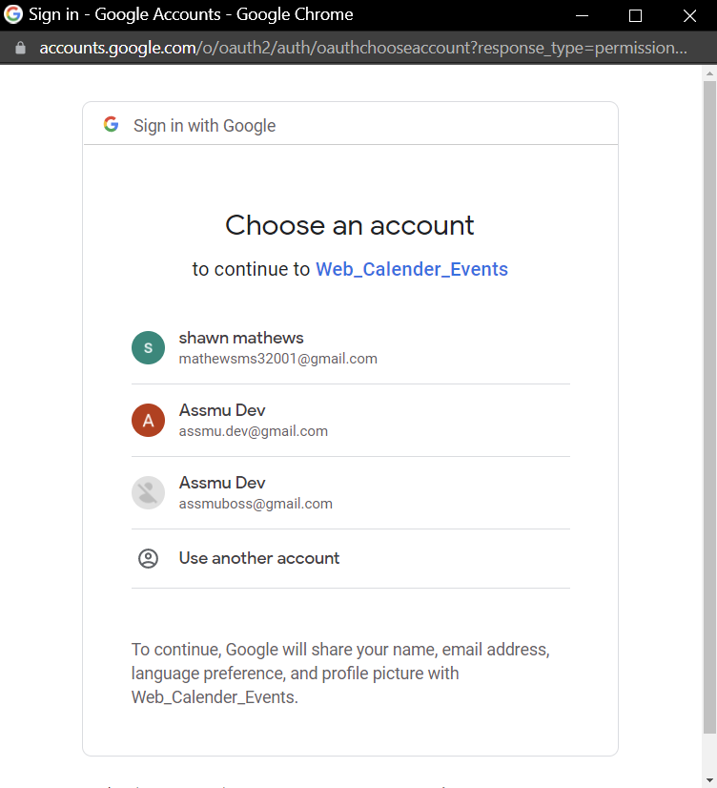
OAuth 2 Consent
Google stores calendars in the cloud and our app needs permissions to access cloud stored data
Requests to Google Calendar API must include an authorization token
The token also identifies your application to Google
Requires each user to log into email address with Google Calendar Events

Slide 14
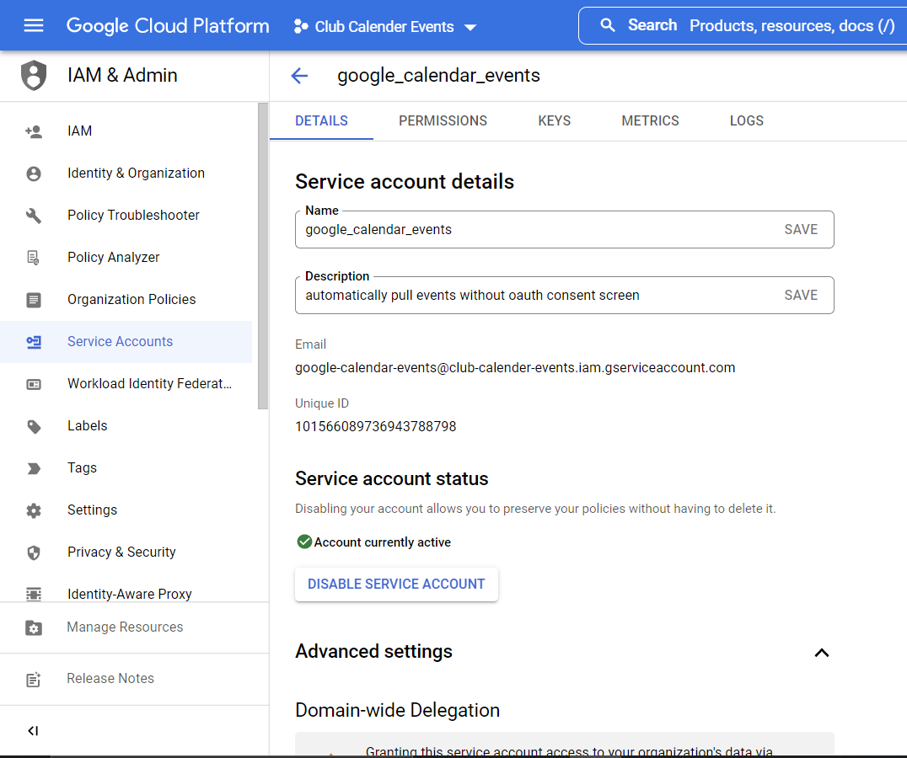
Service Account
Bypasses oauth consent requirements by “impersonating” a user account
Our service account will belong to the application instead of the user
The application will handle calling the calendar API without directly involving users
Notes:
Our application will handle the job of calling calendar API without involving the users directly.

Slide 15
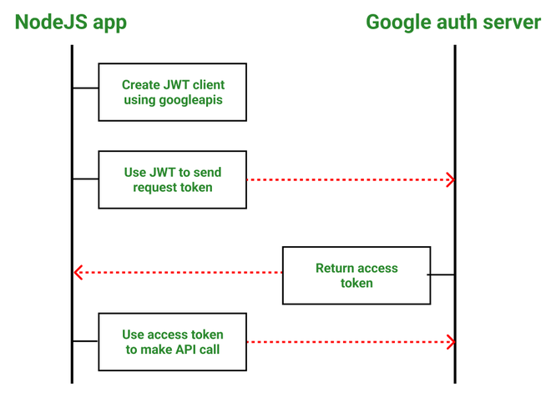
Service Account Tokens
Account credentials require creation of JSON key. The data in the JSON file will be used to authorize our app
Our service account credentials and method call are combined into a request and then sent to Google Authorization Server via HTTP/REST
We will finally send requests via HTTP by using a JSON Web Token (JWT)

Slide 16
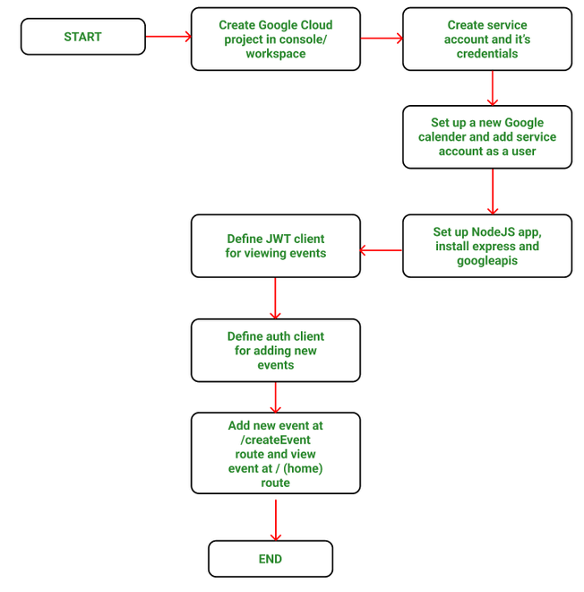
Service Account Flowchart

Slide 17
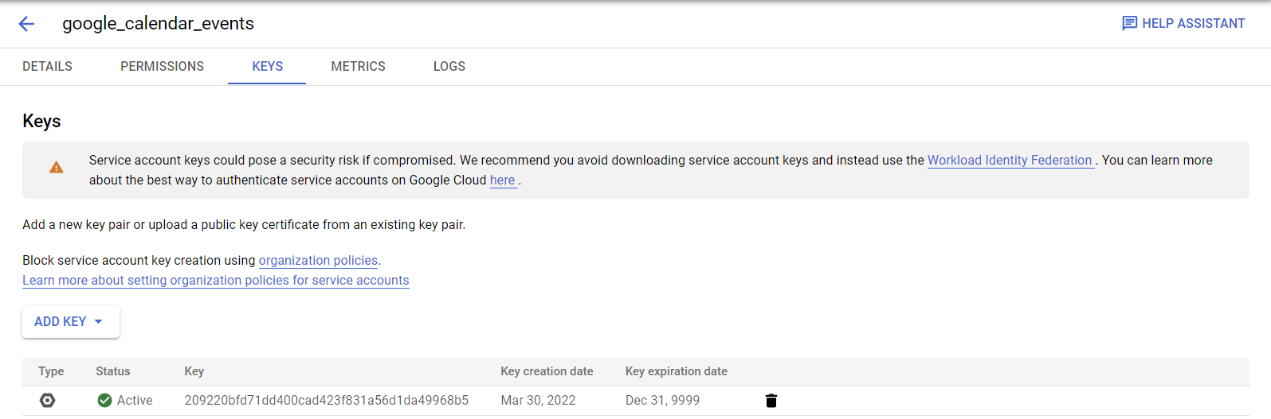
Risks
We eliminating risk of having credentials exposed for Google Account by creating a service account that “impersonates” our user account and belongs to our application instead of a user.
Service accounts should only be used if they are absolutely needed because they could pose a security risk.
We are using 1 account for cosmic.js

Slide 18
Website Demo
https://www.youtube.com/watch?v=9MExO4Td9b0

Slide 19
Next Steps
Advanced styling
Different layout for mobile devices
Animations
Search bar for whole site
Slideshow of images
More club images
More information
Clubs, resources, and events

Slide 20
Thank you!
Please feel free to contact us at AssmuDev@gmail.com for inquiries and feedback.

