Slide 1
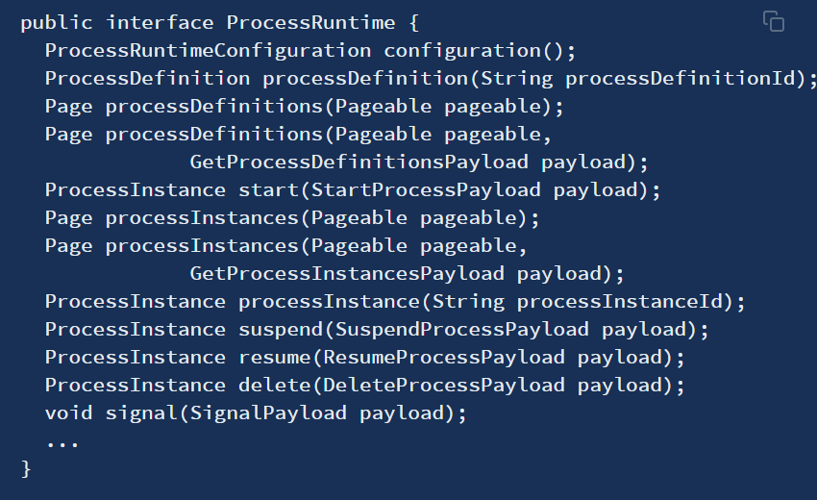
ProcessRuntime
in order to interact with the ProcessRuntime API the currently logged user is required to have the role “ACTIVITI_USER”.
为了与ProcessRuntime API交互，当前登录的用户必须具有“ACTIVITI_USER”角色。

