Slide 1
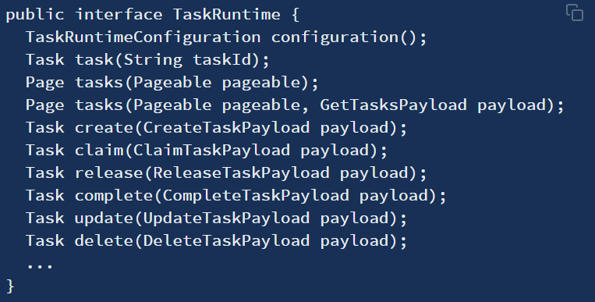
TaskRuntime
Something important to notice here, is that in order to interact with the TaskRuntime API as a user, you need to have the role: ACTIVITI_USER (Granted Authority: ROLE_ACTIVITI_USER) .
这里需要注意，为了以用户身份与TaskRuntime API交互，需要具有角色：ACTIVITI_USER。

