Slide 1
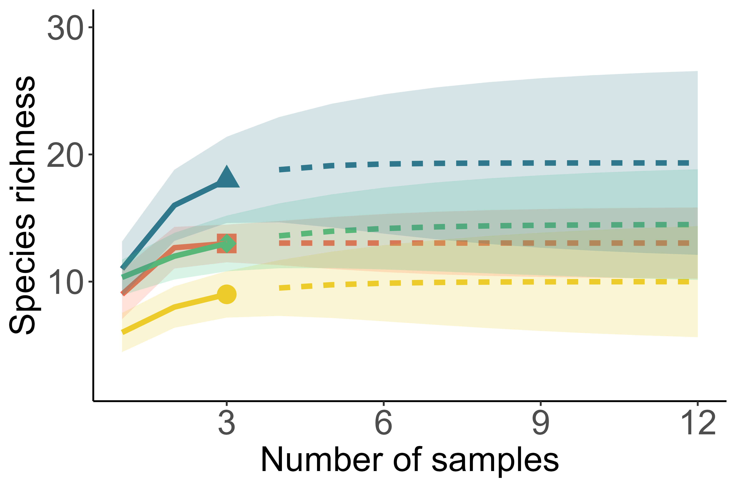
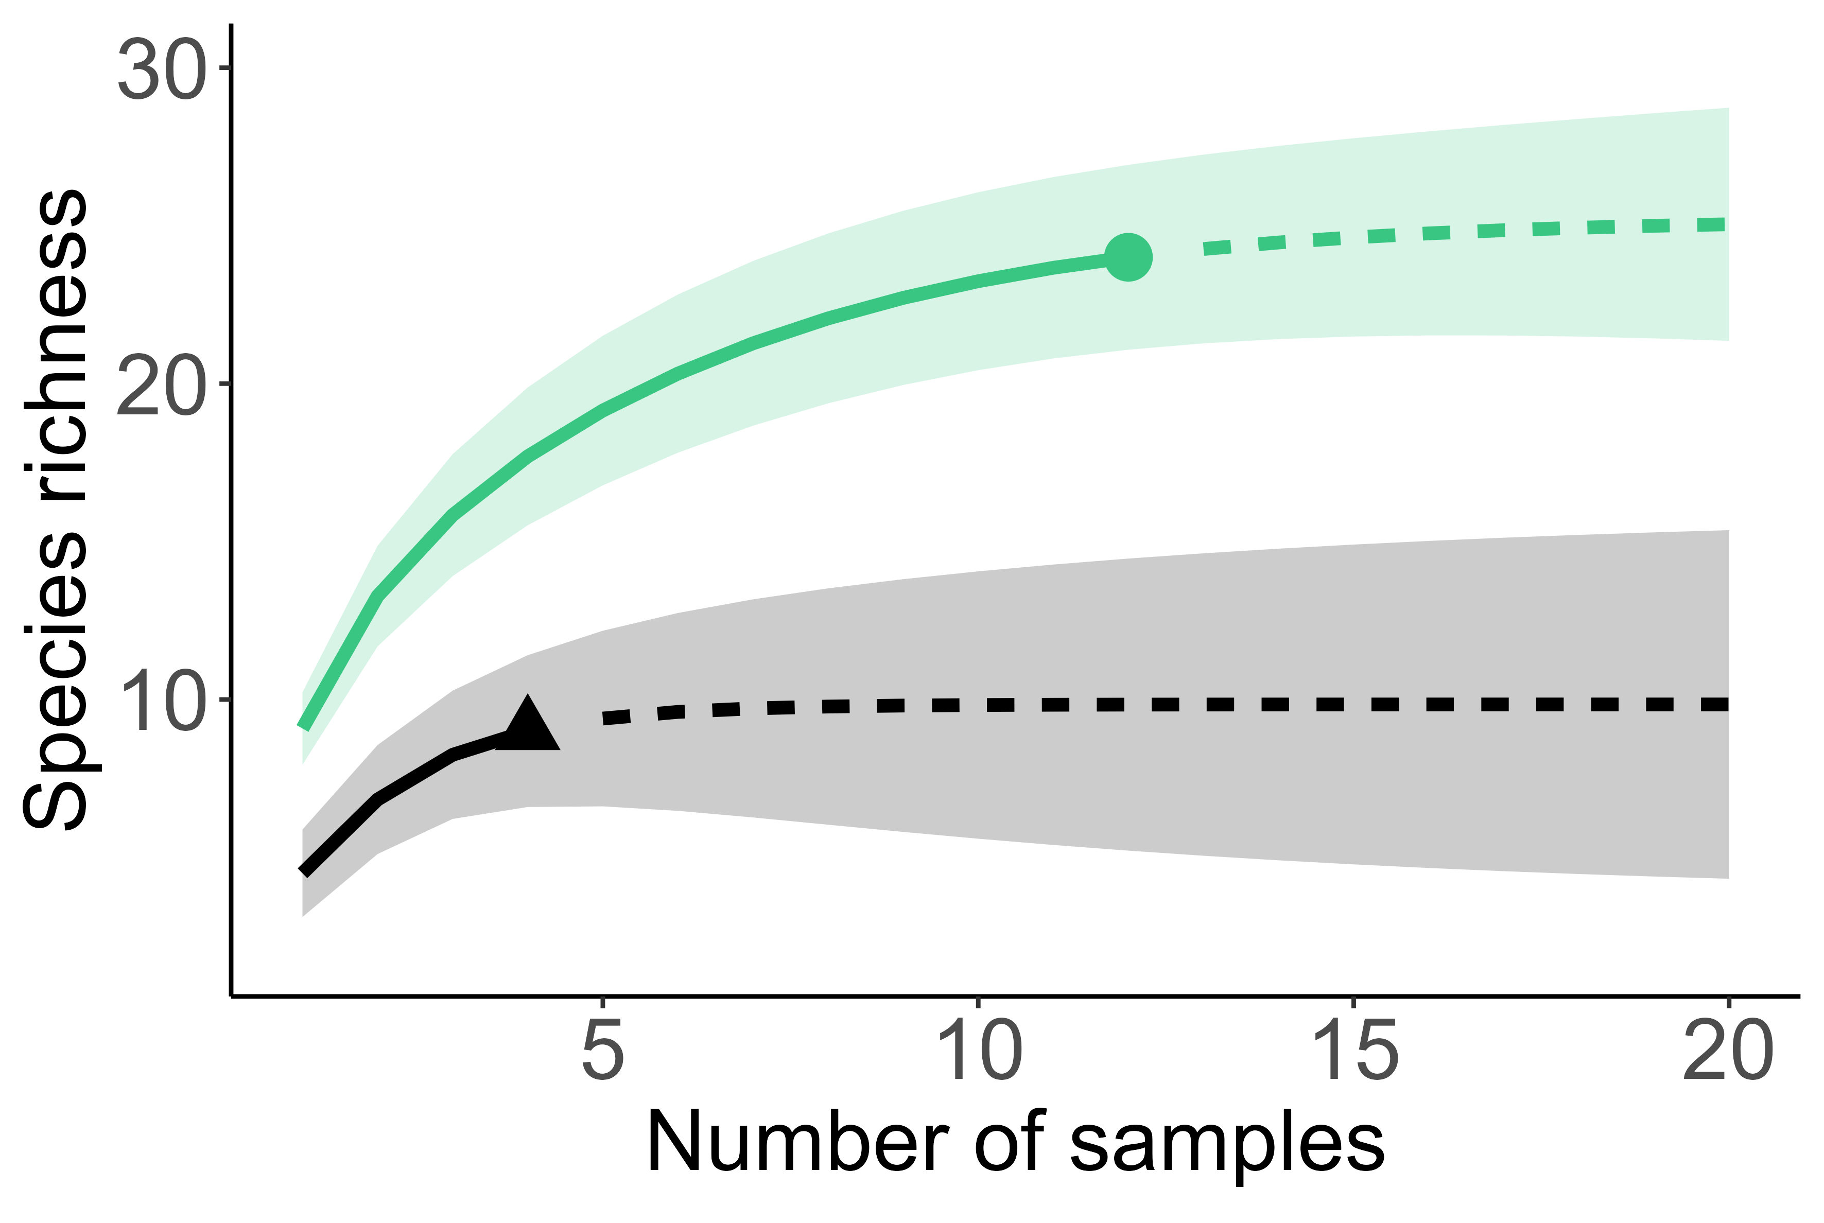
(a)
Deployment
1 (Day 1)
2 (Day 1)
3 (Day 2)
4 (Day 2)
(b)
Sample type
Metaprobe
BRUV
Rarefaction
Extrapolation

