Slide 1
Phân tích thiết kế hệ thống
Một số mẫu thiết kế (tiếp)

Slide 2
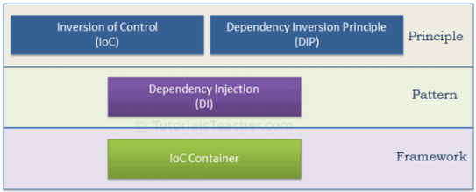
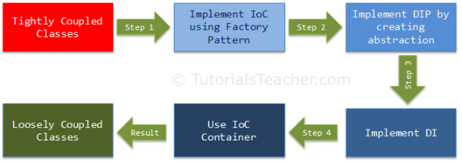
Nội dung
Inversion of Control Principle
Dependency Inversion Principle
Dependency Injection
IOC Container

Slide 3
Design Principle vs Design Pattern
Design principles provide high level guidelines to design better software applications. They do not provide implementation guidelines and are not bound to any programming language. The SOLID (SRP, OCP, LSP, ISP, DIP) principles are one of the most popular sets of design principles.
Design Pattern provides low-level solutions related to implementation, of commonly occurring object-oriented problems. In other words, design pattern suggests a specific implementation for the specific object-oriented programming problem.

Slide 4
Inversion of Control (IoC) Principle
IoC is a design principle which recommends the inversion of different kinds of controls in object-oriented design to achieve loose coupling between application classes.
In this case, control refers to any additional responsibilities a class has, other than its main responsibility, such as control over the flow of an application, or control over the dependent object creation and binding (Remember SRP - Single Responsibility Principle).
If we want to do TDD (Test Driven Development), then we must use the IoC principle, without which TDD is not possible.

Slide 5
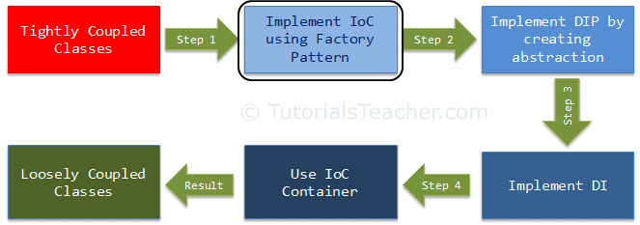
Inversion of Control
IOC is the first step towards achieving loose coupled design
IoC principle helps in designing loosely coupled classes which make them testable, maintainable and extensible.

Slide 6
Thí dụ
Suppose you drive a car to your work place.
This means you control the car. The IoC principle suggests to invert the control, meaning that instead of driving the car yourself, you hire a cab, where another person will drive the car.
Thus, this is called inversion of the control - from you to the cab driver.
You don't have to drive a car yourself and you can let the driver do the driving so that you can focus on your main work.

Slide 7
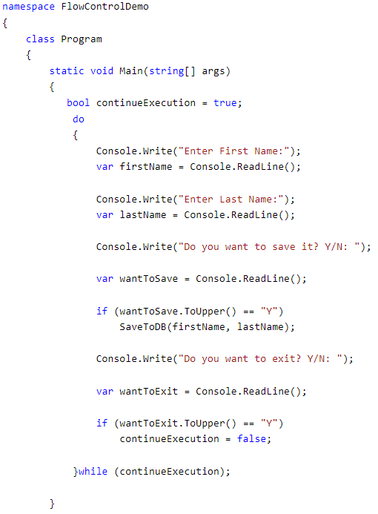
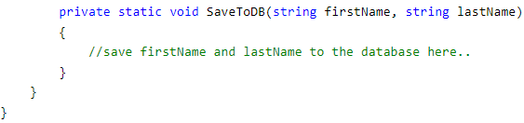
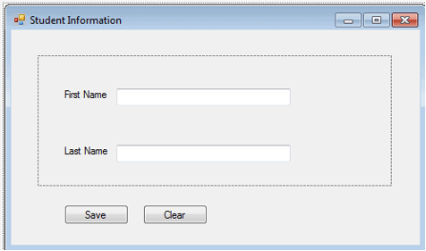
Control Over the Flow of a Program
The Main() function of the program class controls the flow of a program. It takes the user's input for the first name and last name. It saves the data, and continues or exits the console, depending upon the user's input. So here, the flow is controlled through the Main() function.
IoC can be applied to the above program by creating a GUI-based application such as the following windows-based application, wherein the framework will handle the flow of a program by using events.

Slide 8
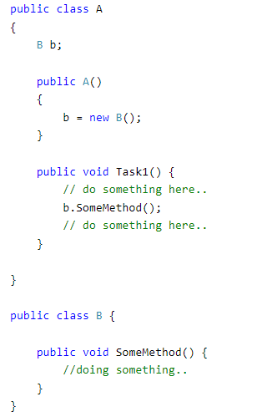
Control Over the Dependent Object Creation
Class A calls b.SomeMethod() to complete its task1.
Class A cannot complete its task without class B and so you can say that "Class A is dependent on class B" or "class B is a dependency of class A".
Class A creates and manages the life time of an object of class B.
Essentially, it controls the creation and life time of objects of the dependency class.

Slide 9
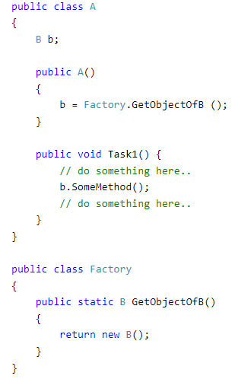
IOC using Factory

Slide 10
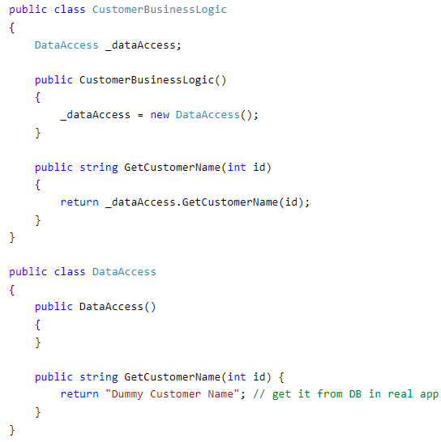
Example of BusinessLogic and DataAccess classes

Slide 11
Problems in tightly coupled classes
CustomerBusinessLogic and DataAccess classes are tightly coupled classes. So, changes in the DataAccess class will lead to changes in the CustomerBusinessLogic class
Suppose the customer data comes from different databases or web services and, in the future, we may need to create different classes, so this will lead to changes in the CustomerBusinessLogic class.
The CustomerBusinessLogic class creates an object of the DataAccess class using the new keyword. There may be multiple classes which use the DataAccess class and create its objects. So, if you change the name of the class, then you need to find all the places in your source code where you created objects of DataAccess and make the changes throughout the code. This is repetitive code for creating objects of the same class and maintaining their dependencies.
Because the CustomerBusinessLogic class creates an object of the concrete DataAccess class, it cannot be tested independently (TDD). The DataAccess class cannot be replaced with a mock class.

Slide 12
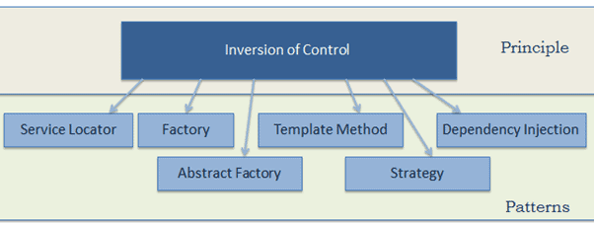
Patterns implement the IoC principle

Slide 13
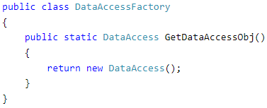
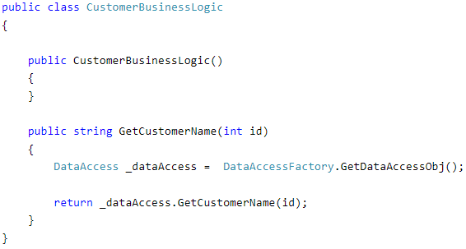
IOC using Factory

Slide 14
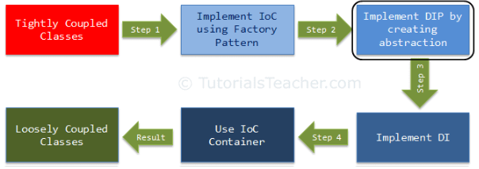
Dependency Inversion Principle
DIP Definition
High-level modules should not depend on low-level modules. Both should depend on the abstraction.
Abstractions should not depend on details. Details should depend on abstractions.

Slide 15
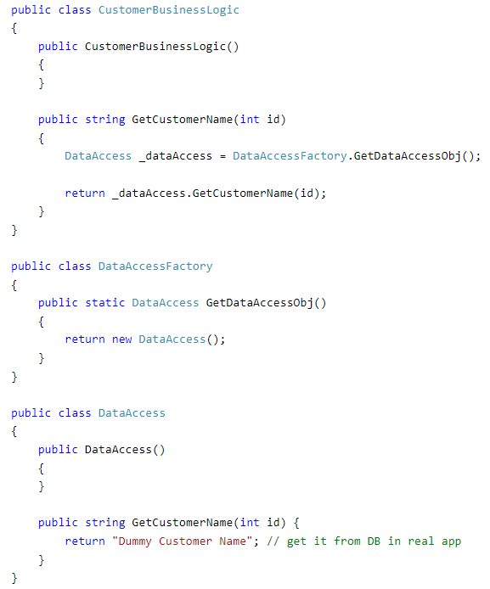

Slide 16
High and low level
CustomerBusinessLogic is a high-level module and DataAccess is a low-level module.
So, as per the first rule of DIP, CustomerBusinessLogic should not depend on the concrete DataAccess class, instead both classes should depend on abstraction.
The second rule in DIP is "Abstractions should not depend on details. Details should depend on abstractions".

Slide 17
What is an Abstraction?
Abstraction and encapsulation are important principles of object-oriented programming.
Abstraction means something which is non-concrete. In programming terms, the above CustomerBusinessLogic and DataAccess are concrete classes, meaning we can create objects of them. So, abstraction in programming means to create an interface or an abstract class which is non-concrete.
Both classes should depend on abstractions, meaning both classes should depend on an interface or an abstract class.

Slide 18
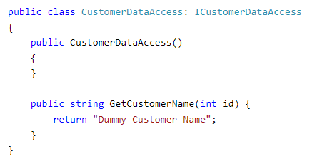

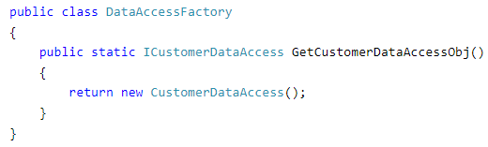
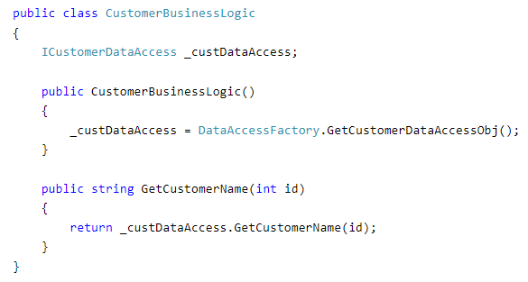

Slide 19
The advantages of implementing DIP in the above example is that the CustomerBusinessLogic and CustomerDataAccess classes are loosely coupled classes because CustomerBusinessLogic does not depend on the concrete DataAccess class, instead it includes a reference of the ICustomerDataAccess interface. So now, we can easily use another class which implements ICustomerDataAccess with a different implementation.

Slide 20
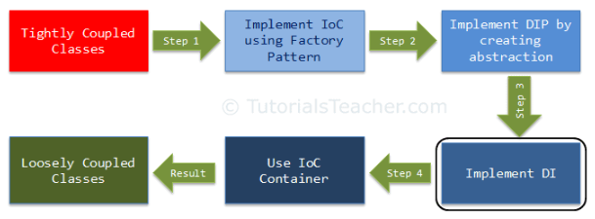
Dependency Injection
Dependency Injection (DI) is a design pattern used to implement IoC. It allows the creation of dependent objects outside of a class and provides those objects to a class through different ways. Using DI, we move the creation and binding of the dependent objects outside of the class that depends on them.

Slide 21
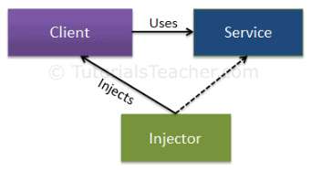
Dependency Injection
The Dependency Injection pattern involves 3 types of classes.
Client Class: The client class (dependent class) is a class which depends on the service class
Service Class: The service class (dependency) is a class that provides service to the client class.
Injector Class: The injector class injects the service class object into the client class.
The injector class creates an object of the service class, and injects that object to a client object. In this way, the DI pattern separates the responsibility of creating an object of the service class out of the client class.

Slide 22
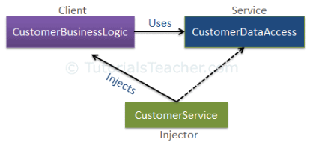
Types of Dependency Injection
Constructor Injection: In the constructor injection, the injector supplies the service (dependency) through the client class constructor.
Property Injection: In the property injection (aka the Setter Injection), the injector supplies the dependency through a public property of the client class.
Method Injection: In this type of injection, the client class implements an interface which declares the method(s) to supply the dependency and the injector uses this interface to supply the dependency to the client class.

Slide 23
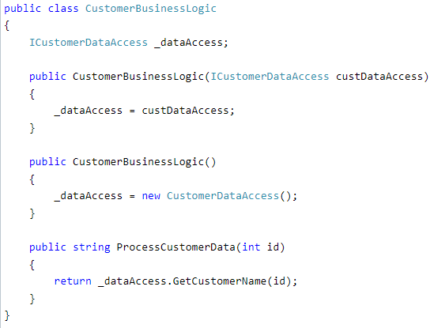
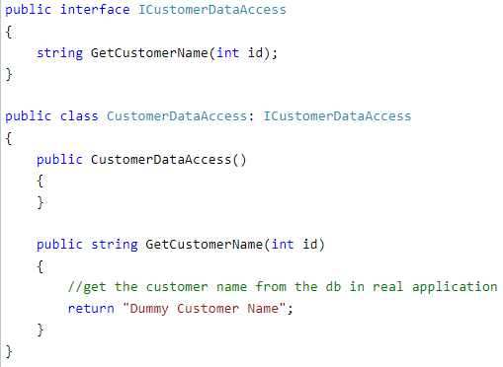
Constructor Injection

Slide 24
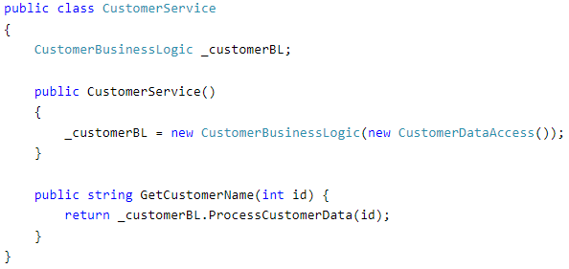

Slide 25
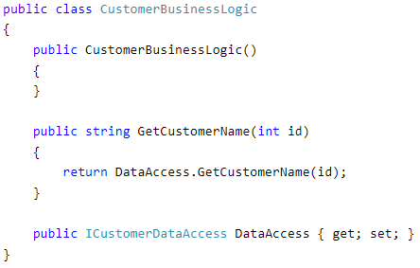
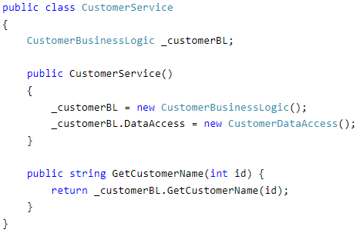
Property Injection

Slide 26
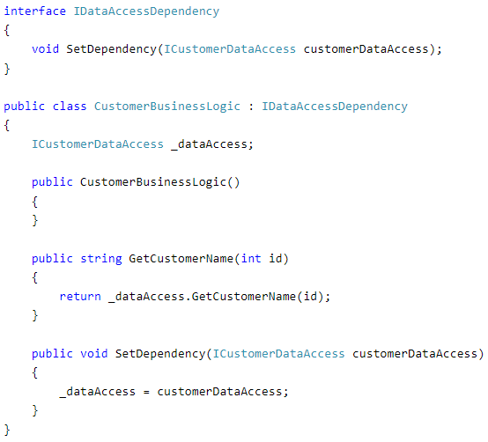
Method Injection

Slide 27
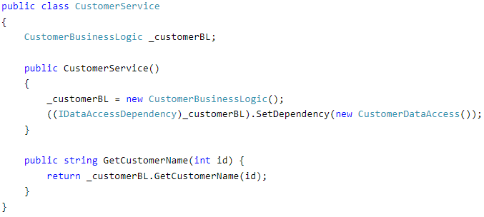

Slide 28
IoC Container
IoC Container (a.k.a. DI Container) is a framework for implementing automatic dependency injection. It manages object creation and it's life-time, and also injects dependencies to the class.
The IoC container creates an object of the specified class and also injects all the dependency objects through a constructor, a property or a method at run time and disposes it at the appropriate time.

Slide 29
IoC Container
All the containers must provide easy support for the following DI lifecycle.
Register: The container must know which dependency to instantiate when it encounters a particular type. This process is called registration. Basically, it must include some way to register type-mapping.
Resolve: When using the IoC container, we don't need to create objects manually. The container does it for us. This is called resolution. The container must include some methods to resolve the specified type; the container creates an object of the specified type, injects the required dependencies if any and returns the object.
Dispose: The container must manage the lifetime of the dependent objects. Most IoC containers include different lifetimemanagers to manage an object's lifecycle and dispose it.

