Slide 1

Vmobile
Marketing Campaign Impact Analysis
Presented by
- Ethan Roelf
Notes:
Good day everyone, my name is Ethan Roelf, I hope you are all well. I am certainly not, because this project gave me a couple more grey hairs, just joking. To give you a quick rundown of who I am and the role I played in this project, I am one of the data engineers at PBT. I have about 10 years expertise within the data engineering field. About 1 week ago, management approached me, saying that one of their clients really needed help in identifying the impact of a campaign they just recently launched.
I thought okay sure, lets go and have a sit down meeting with the client so that I could conduct an in depth requirements analysis to ensure that we produce an effective solution. Nope. This client invested a large sum of capital into this campaign, so every second that passed by without them having insight into the performance of their campaign, meant they were potentially losing. So time was of the essence. And to be exact, we had to work with a 7 day deadline. However, even with the tight deadline, to kick off this project, I still started off by spending the entirety of the first day just trying to understand the use case and what exactly it is that the client wants.

Slide 2

Business use case and the gap causing the issue:
Client: VMobile Marketing department
Context: “Free minutes” campaign to drive usage
The issue: Marketing lacks visibility into the “Free Minutes” campaign impact.
The Gap: No consolidated view of the total qualifying subscribers each week
Notes:
So, with that being said, I’d like to start off on that point.
What is the use case, what is the problem in the use case, where does the gap lie, and how do we ultimately fill this gap?
The client for this project was Vmobile, specifically their marketing department. For simplicity, throughout this presentation I’ll refer to the client as Marketing. Marketing recently launched a free minutes campaign to their subscribers. This campaign involved allocating free minutes every week, to those subscribers who qualified within the week. We assume that Marketing launched this campaign in order to drive subscriber usage and spending up.
However, there is one fundamental problem. Marketing has no insight to whether their campaign accomplishes this or not. This is because they cant see; week on week; whether there is an increase or a decrease of qualifying subscribers.
And this is ultimately where the gap lies. Marketing does not have a consolidated view of the total amount of qualifying subscribers each week.

Slide 3
Project Deliverables
Generate a weekly report on total qualifying subscribers per week
2. Create a visualization to interactively analyse the
trends in data, answering the following questions:
- What trends are there in qualifying subscribers over time?
- Which region contains the most qualifying subscribers each week?
Notes:
With that being said, I identified our first goal, which is to generate a report that contains the qualifying subscribers for each week.
However, marketing also asked for additional visualizations to aid them in identifying trends in the qualifying subscriber numbers over time. Furthermore, they requested that
the visualization also aids them in identifying the area which generates the most qualifying subscribers each week.
And this slide is probably thee most important slide in this entire presentation, because these points, determined the entire development process of the technical solution.

Slide 4
Project Scope
Write a script to create the MySQL database tables based on business requirements for the report.
Write a script which extracts subscriber information from the three different subscriber systems
Write a script which combines all this subscriber information and loads it into the necessary tables
Write a script which generates a weekly report from the necessary tables.
Create a visualization using Excel to analyse trends in data
Create a presentation and explain the solution to stakeholders
Notes:
Once I identified those 2 core deliverables for the project, I then started working backwards from each deliverable. I started listing all the in-scope items for this project, as well as how I was going to manage each item across the 7-day timespan.
As you can see on the slide, we have about 7 in-scope items. I am not going to delve too deep into the actual code of the solution as I want to keep this presentation as simple as possible for you all. However if you have any questions whatsoever, please don’t hesitate to ask me, I promise you, I don’t bite. To start it off, overall, I adopted a three-phase Extract-Transform-Load (ETL) process for this project

Slide 5
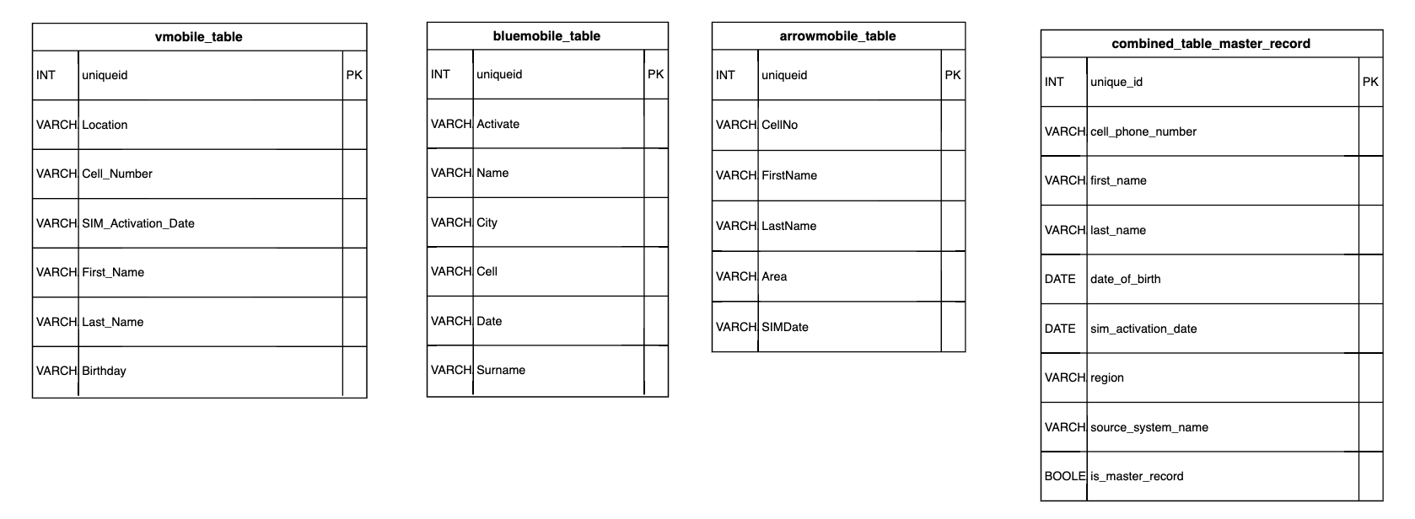
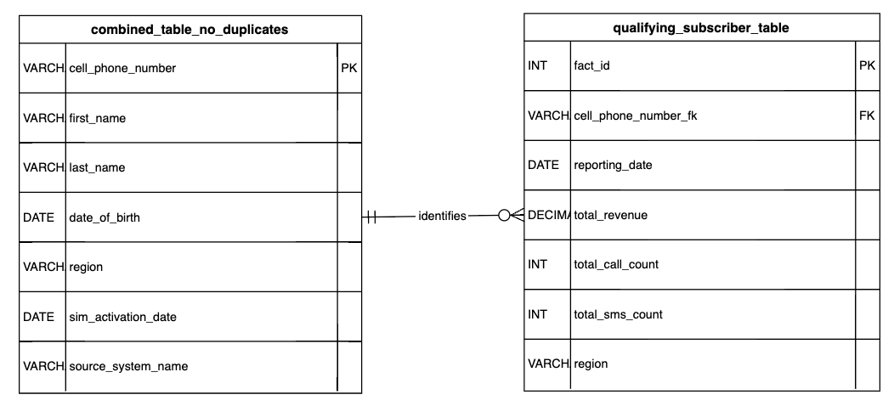
Database schema
Notes:
Starting off with the database schema. The database schema was designed based off the final report which the client requested for, but also from the specifications I received in the Use Case document. I used the database provider MySQL for this project.
All the code for the creation of the database schema can be reviewed in the “db_schema_creation.py” file. And once again, if you do have any questions, please feel free to ask them. To give you a quick overview of the database schema. We have 5 total MySQL tables. Vmobile, bluemobile and arrow mobile are the tables which contain the subscriber demographic information.
These tables are not completely normalized, as they purely act as staging tables for the data. Lastly we have the 3 remaining tables – combined master record(which contains duplicate records), combined table no duplicates, and the qualifying subscribers table.
Now that we identified the necessary tables for the database, we had to start looking at the raw data and how we were going to populate these database tables with the raw data. The assumption was made from the business document provided to me, that the data was infact clean. However, upon inspection of the raw csv files, it was determined that the data, was extremely messy. This was the first bottleneck I ran into.
However this was not a train smash. Pandas, a software library used in Python, really streamlined the processs of cleaning this data.
I started off with extracting and cleansing only the CSV files which contained the subscriber demographic information.

Slide 6
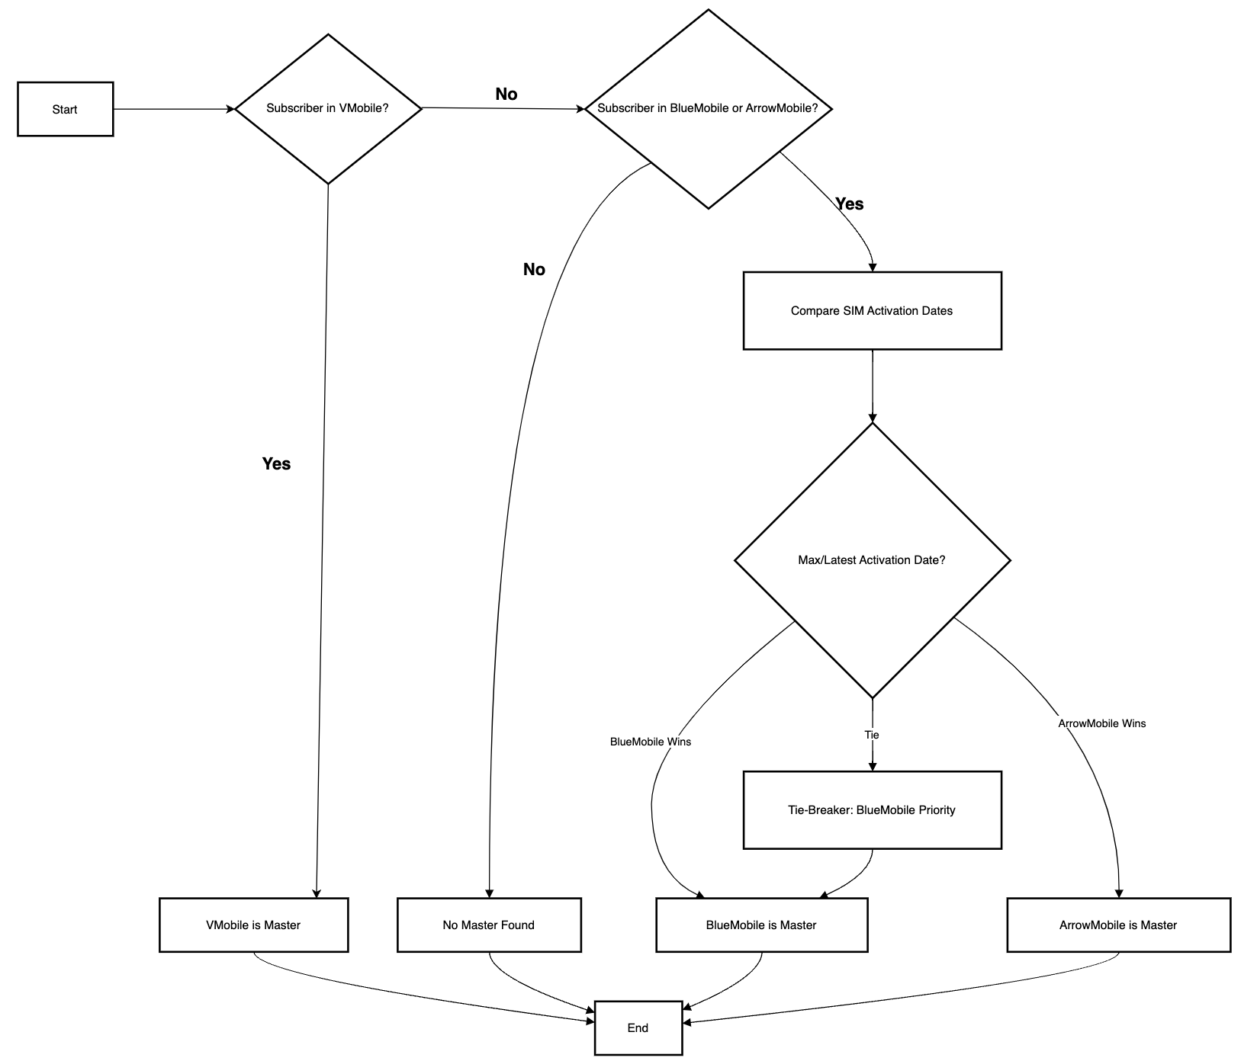
Master Record Logic
Notes:
Once I successfully extracted and loaded the subscriber information into their specific tables, I then had to determine the master record for each customer.
This was also done using python and pandas.
For better context, the diagram above illustrates the process for identifying the master record for each customer.
Once I identified the master record for each customer, I could then populate the combined table, with duplicates. And thereafter using pandas again, I could populate the combined table without duplicates. This produced a single, clean MySQL table, containing unique customers only.

Slide 7
Optimizing qualifying subscriber calculation
Revenue>=R30
Notes:
I then had to do the same for the CSV files which contained the usage records for each subscriber.
However, this meant creating extra database tables for the usage records. Initially i wanted to create the tables for these CSV files, because instinctively, you’d think that it would serve a great purpose for auditing purposes. However, the idea of doing this was immediately eliminated, purely because I wanted to stick to the table specifications provided to me.
To further support the reason as to why i did not create database tables for the transactional data, transactional data can be very unpredictable regarding their volume of data. It could range from thousands of rows, to millions of rows. Calculating and aggregating this data in python memory, is far more efficient than first loading all that data into a physical database table. This led me to once again, utilizing pandas to extract the data from the usage records and load them into memory. I then also read the subscriber data from the no duplicates sql tables into memory. This was crucial in calculating which subscribers qualified( according to the marketing department’s requirements) should get free minutes. As you can see from the illustration above, a customer could only qualify if they generated revenue of R30 or more for that specific week.
Once this logic was performed in memory, a final pandas dataframe was populated with qualifying subscriber information. This dataframe was then loaded into the final MySQL qualifying subscribers table, completing the extraction, transformation and load phase.
All the code for this phase of the project can be reviewed in the “master_record_load.py” file

Slide 8
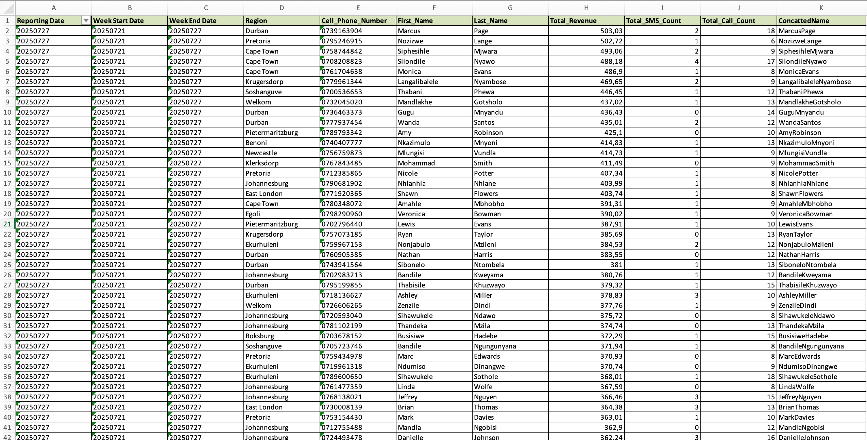
Weekly Report Generated
Notes:
Now that we had all the qualifying subscribers per week in a single database table, we had one last step - which was creating a report from this table for the marketing team, aswell as the visualizations which they requested.
For this we used python, specifically pandas, RAW SQL and Excel. In order to populate the report with the qualifying subscribers, we joined the qualifying subscribers table, with the no duplicates table. The reason we joined the no duplicates table, is because the no duplicates table contained the names of the customers, and not only their cellphone number as it was in the qualifying subscribers table. Once again, working backwards from the report the client requested, it was crucial to include the customer names in the report. Once we joined these 2 tables, in memory, we then loaded it into a dataframe and transformed it into an excel sheet, which you can see over here.
Now, the following report accomplishes exactly what Marketing requested.
However as we can see, it may still be a bit uneasy on the eye.

Slide 9
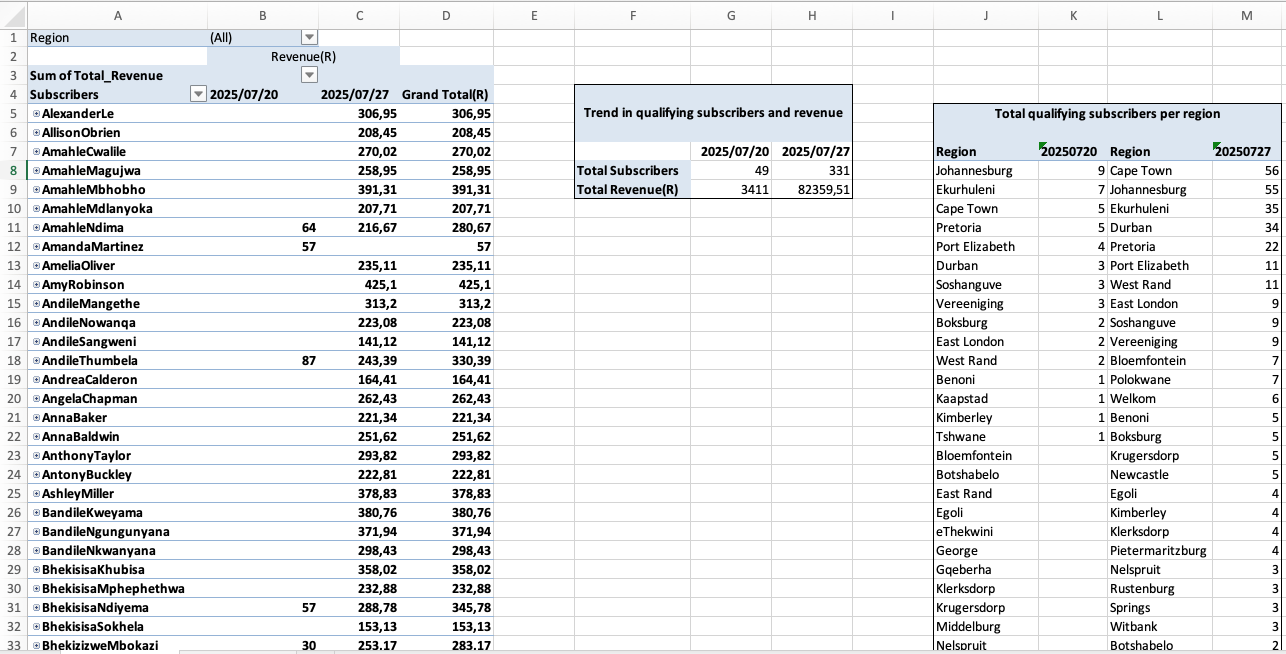
Visualizations generated
Notes:
In order to solve this, aswell as meet the second request from marketing, I created another sheet, which contained a much better visualization of the data. This sheet was created using pivot tables from the data in the report from the previous slide As we can see from the following visualizations, we are now also able to identify the exact amount of qualifying subscribers per week; aswell as the region which brings in the most qualifying subscribers each week.

Slide 10
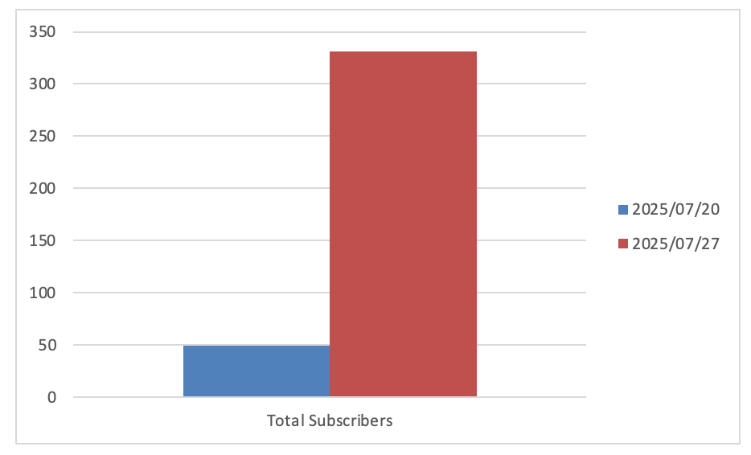
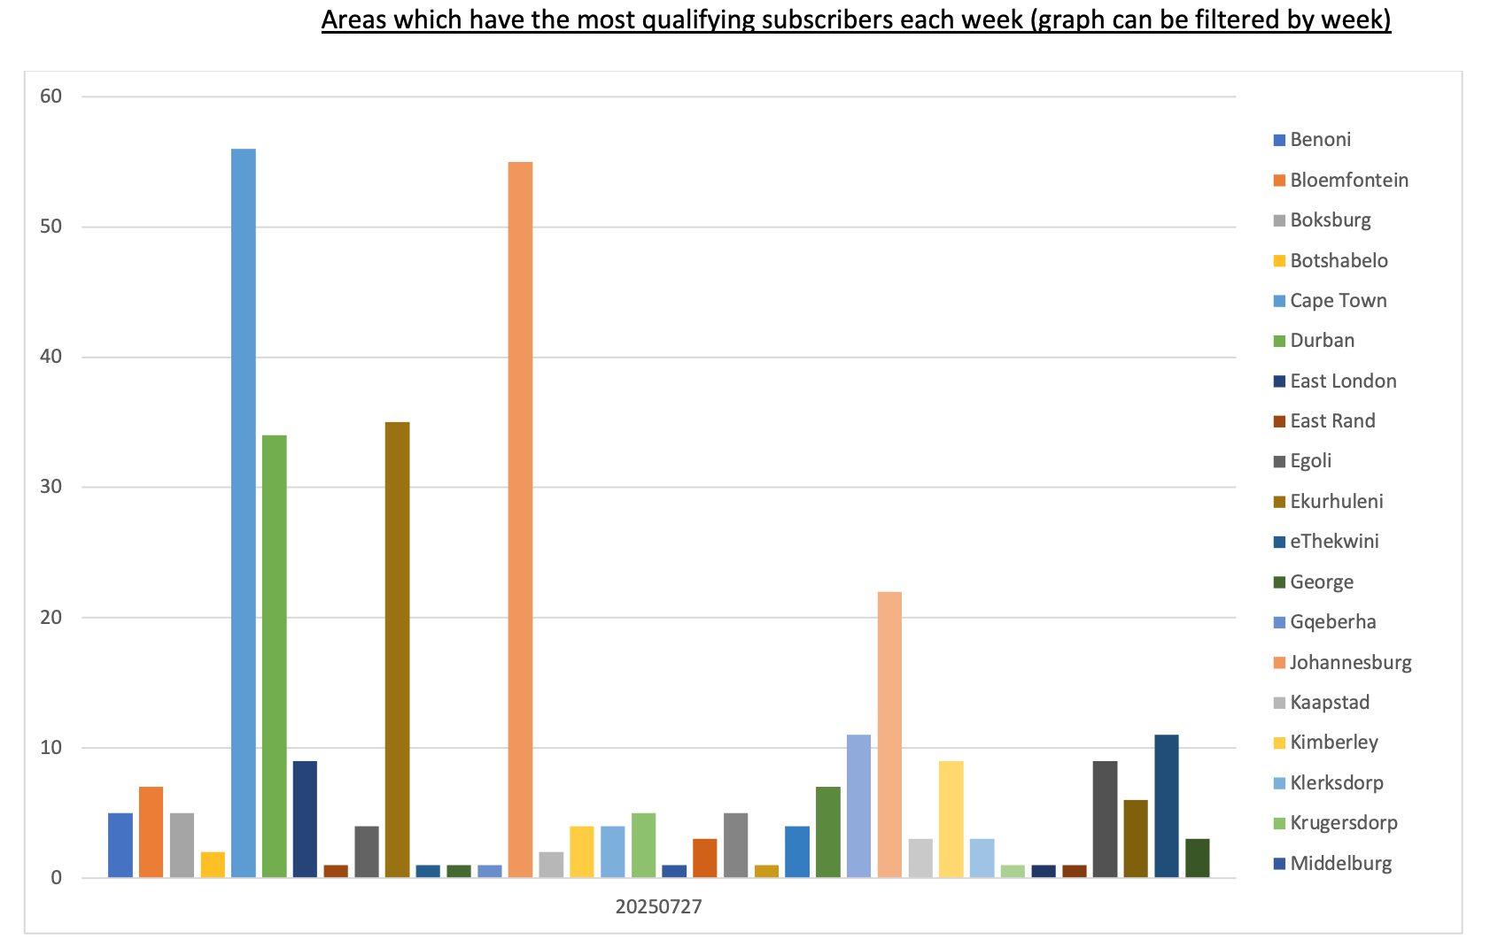
Visualizations generated
Notes:
However, to some people, reading tabular data may still be abit tedious. I am one of those people. And this is where the last visualizations come into play.
As you can see above, from the chart on the left, we are easily able to see that the second week of the campaign produced a far more qualifying subscribers than the first week. And on the right, you are also able to identify which area or region had the most qualifying subscribers each week.

Slide 11
Conclusion and Findings
Ability to monitor qualifying subscribers
Fully utilize their campaign budget
Maximise ROI on Campaign
Notes:
To conclude. We have successfully identified the challenge of Vmobiles Marketing department; and demonstrated how this 3 phase ETL solution not only solves the challenge, but also adds value by allowing Marketing to make strategic adjustments based on these reports and visualizations.
This, in turn, will allow them to fully maximise the ROI on their campaign.

Slide 12


THANK YOU Questions?
Ethan Roelf
Data Engineer
PBT Group
Notes:
And that concludes the presntation of the VMobile Marketing Campaign Analysis solution. Thank you all for your time, and I am now open to any questions.

Slide 13

“Without data you’re just another person with an opinion” - W. Edwards Deming

