Slide 1
THE PROBLEM
Packing Smarter: Can AI Learn to Outperform Traditional Methods for Managing Cloud Resources
deadline
94%
M1
of enterprises already use cloud services [1]
M2
$8,000 / min
M3
average cost of cloud downtime (AUD) [1]
$1.7 trillion
M4
time →
A job-machine schedule over time. Orange means finishes late
expected global cloud market by 2033 (AUD) [1]
Efficient allocation of cloud resources is a significant issue
Our question: can reinforcement learning schedule better than classical heuristic and dispatching rules, and under what conditions?
Ethan Ty Riekert | Curtin University | Supervisors: Elham Mardaneh, Tony Mathew
1 / 4
[1] DigitalDefynd, “30 Surprising Cloud Computing Facts & Statistics,” 2026.

Slide 2

THE METHOD
Modelling Decisions and Methods Compared
THE OBJECTIVE FUNCTION
WHAT WAS COMPARED
J_{λ} = λ₁Σ w_{j} T_{j}² + λ₂ Σ w_{j} T_{j}
49 dispatching heuristics
a priority rule plus a placement rule, e.g. EDF + First-Fit
CP-SAT exact solver
gives a proven bound on the best possible
+ λ₃ Σ w_{j} U_{j} + λ₄ E
Reinforcement learning (PPO and A2C) across 5 variations of action-space modelling
Σ w T²
Lateness squared, weighted by importance
Option 0 Direct pick
job + machine, one choice
$λ$ Σ w T
Lateness itself, weighted by importance
Option 1 Rule selection
picks a rule
Other placement rules were tested*
the rule does the rest
λ Σ w U
How many jobs finish late (deadlines missed)
λ E
Energy: how long machines are switched on
Option 2 Priority learning
job
machine: First-Fit*
T_{j} = how late job j finishes U_{j} = 1 if late w_{j} = importance λ = weight of each goal
Option 3 Priority + ATC feature
job (+ ATC hint)
machine: First-Fit*
MODELLED AS
Resource Constrained Scheduling Optimisation (RCSO) with Markov Decision Process (MDP) modelling for reinforcement learning
Option 4 Action branching
job
machine
chosen by the network
chosen by a fixed rule
We explore different metric and job arrival scenarios to see if RL can outperform
Watch it learn
Train a tiny scheduler yourself and see how it learns
Interactive demo →
Ethan Ty Riekert | Curtin University | Supervisors: Elham Mardaneh, Tony Mathew
2 / 4

Slide 3
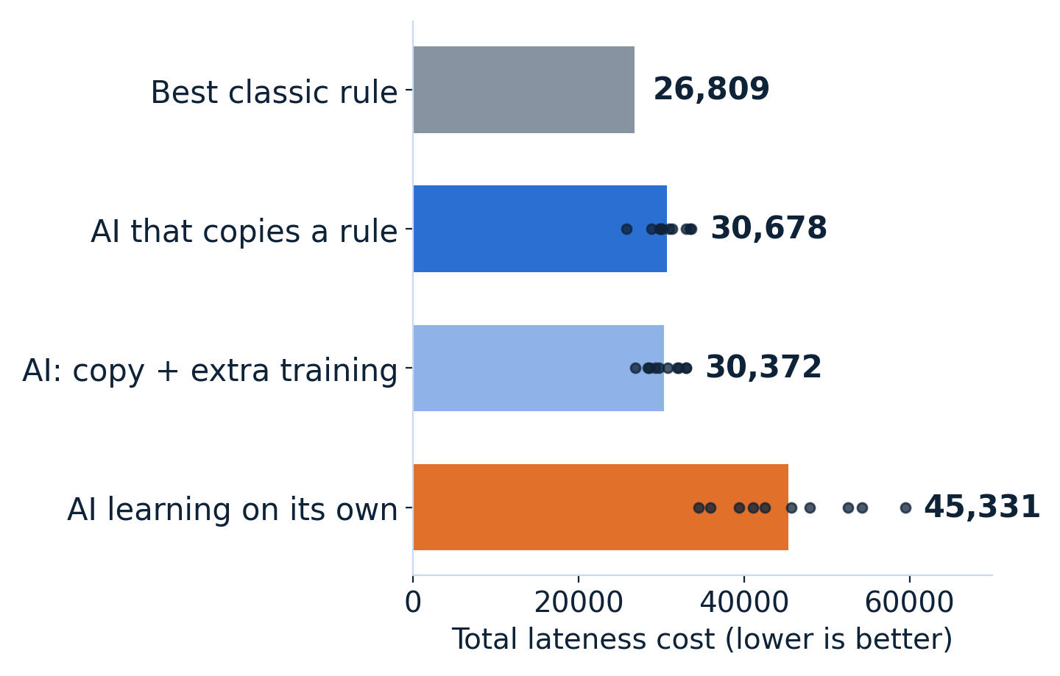
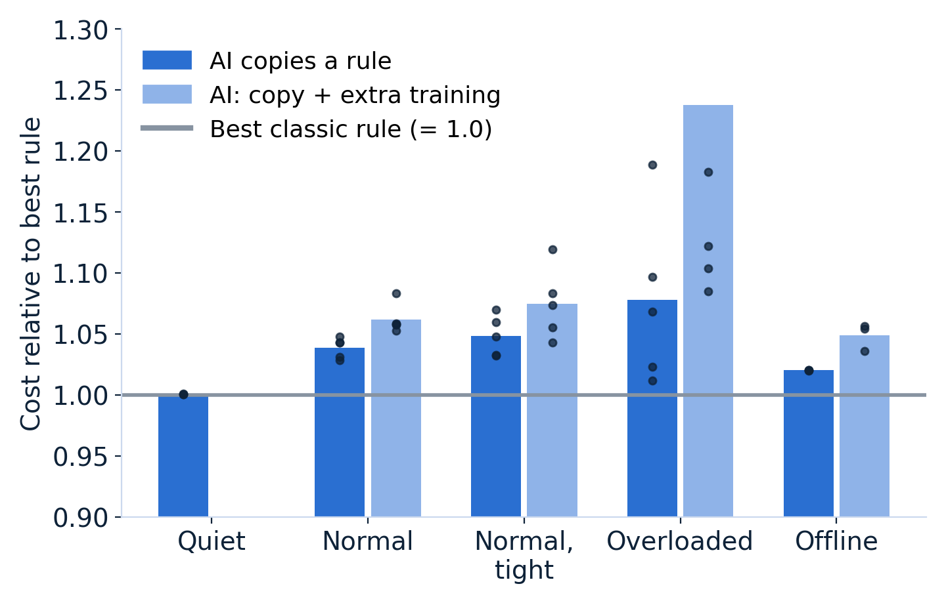
THE RESULTS
RL Almost Never Beat Classical Heuristics
Busy machines: cost on 50 fresh test cases
Five scenarios: cost relative to the best rule
No AI scheduler was significantly better than the best classic rule.
But there is still opportunity. When the objective mixes several goals and jobs differ in importance, RL did beat the best rule by up to 10%. Online it needed far more training and closed most of the gap but did not overtake it. Moreover, on incredibly small problems RL did outperform. So the gap looks like a training and design problem worth pursuing, but I’ve yet to explore this insight.
Interactive Model Race→
Ethan Ty Riekert | Curtin University | Supervisors: Elham Mardaneh, Tony Mathew
3 / 4

Slide 4
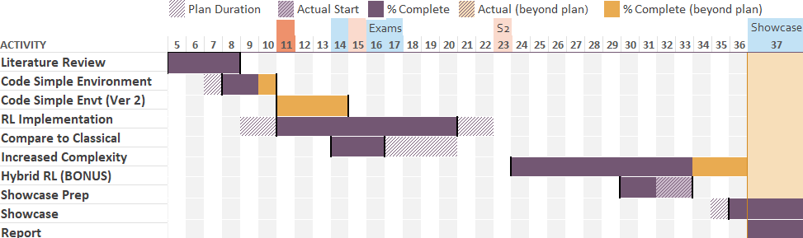
PROFESSIONAL DEVELOPMENT AND FUTURE WORK
Skills built
Personal Relation
Future Project Work
Optimisation and Modelling
Modelling a cloud issue as a type of resource allocation problem
Machine Learning
Implementing varying RL algorithms
Research and Communication
Ability to collate and communicate information
Communication
interactive tools for non-experts
My Direction
Machine learning, optimisation, computational physics
Skills to Develop
Critical-thinking, data analysis and visualisation, algorithmic design, advanced mathematics, programming
Training
RL training is incredibly costly, potentially use a cloud machine to train instead for longer periods – maybe RL can still outperform
Real Data
Use real traces from Google instead of synthetically created data
Future Projects
Other optimisation problems and approaches, agentic systems, quantum computing
4 / 4
Ethan Ty Riekert | Curtin University | Supervisors: Elham Mardaneh, Tony Mathew

Slide 5
