Slide 1
THE PROBLEM
Packing Smarter: Can AI Learn to Outperform Traditional Methods for Managing Cloud Resources
deadline
94%
M1
of enterprises already use cloud services [1]
M2
$8,000 / min
M3
average cost of cloud downtime (AUD) [1]
$1.7 trillion
M4
time →
A schedule: each block is a job on a machine. Orange jobs finish late.
expected global cloud market by 2033 (AUD) [1]
Efficient allocation of cloud resources is a significant issue
Our question: can reinforcement learning schedule better than classical heuristic and dispatching rules, and under what conditions?
Ethan Ty Riekert | Curtin University | Supervisors: Elham Mardaneh, Tony Mathew
1 / 4
[1] DigitalDefynd, “30 Surprising Cloud Computing Facts & Statistics,” 2026.
Notes:
Open with the picture. Each block is a job on a machine; the orange ones finish after their deadline and cost money. Then the three numbers: nearly every business already runs on the cloud, an hour of downtime is very expensive, and the market is still growing. The same decision (which job next, on which machine) appears in hospitals, factories and deliveries, which is why a better scheduler matters beyond computing. Finish on the question: can reinforcement learning, a computer teaching itself by reward, schedule better than the best hand-made rule? [1] DigitalDefynd, 2026.

Slide 2
THE METHOD
The scheduler is a neural network that learns from reward
WHAT IT TRIES TO MINIMISE
Agent
neural network
Environment
10 machines + jobs
J = Σ w × (lateness)²
action: start a job
Late jobs hurt more the later they are; important jobs count more. Optional terms: late jobs, energy.
THREE KINDS OF SCHEDULER
new state + reward
Classic rules, made by hand
AI that learns on its own
AI that first copies a rule
State
Action
Reward
waiting jobs, deadlines, machine loads
which job to start next (or wait)
minus the lateness cost
Watch it learn
Train a tiny scheduler yourself and see how it learns
Interactive demo →
Ethan Ty Riekert | Curtin University | Supervisors: Elham Mardaneh, Tony Mathew
2 / 4
Notes:
Explain the loop. The agent is a neural network. It sees the state (which jobs are waiting, how close their deadlines are, how full the machines are), chooses an action (which job to start next, or wait), and the environment returns a reward: minus the lateness cost. Repeat millions of times and it improves. We tried three things: classic rules, a network that learns on its own, and a network that first copies a rule. Then invite the audience to the interactive training demo (link to be added when the demo is built) and point to the cost formula on the right: weight times lateness squared, with optional late-job and energy terms.

Slide 3
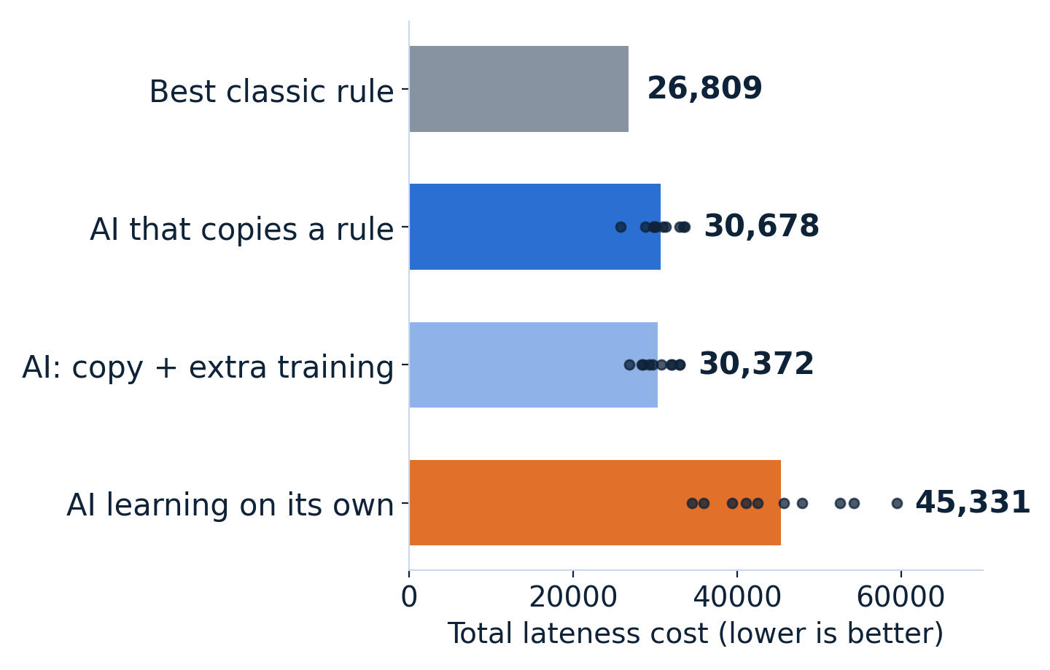
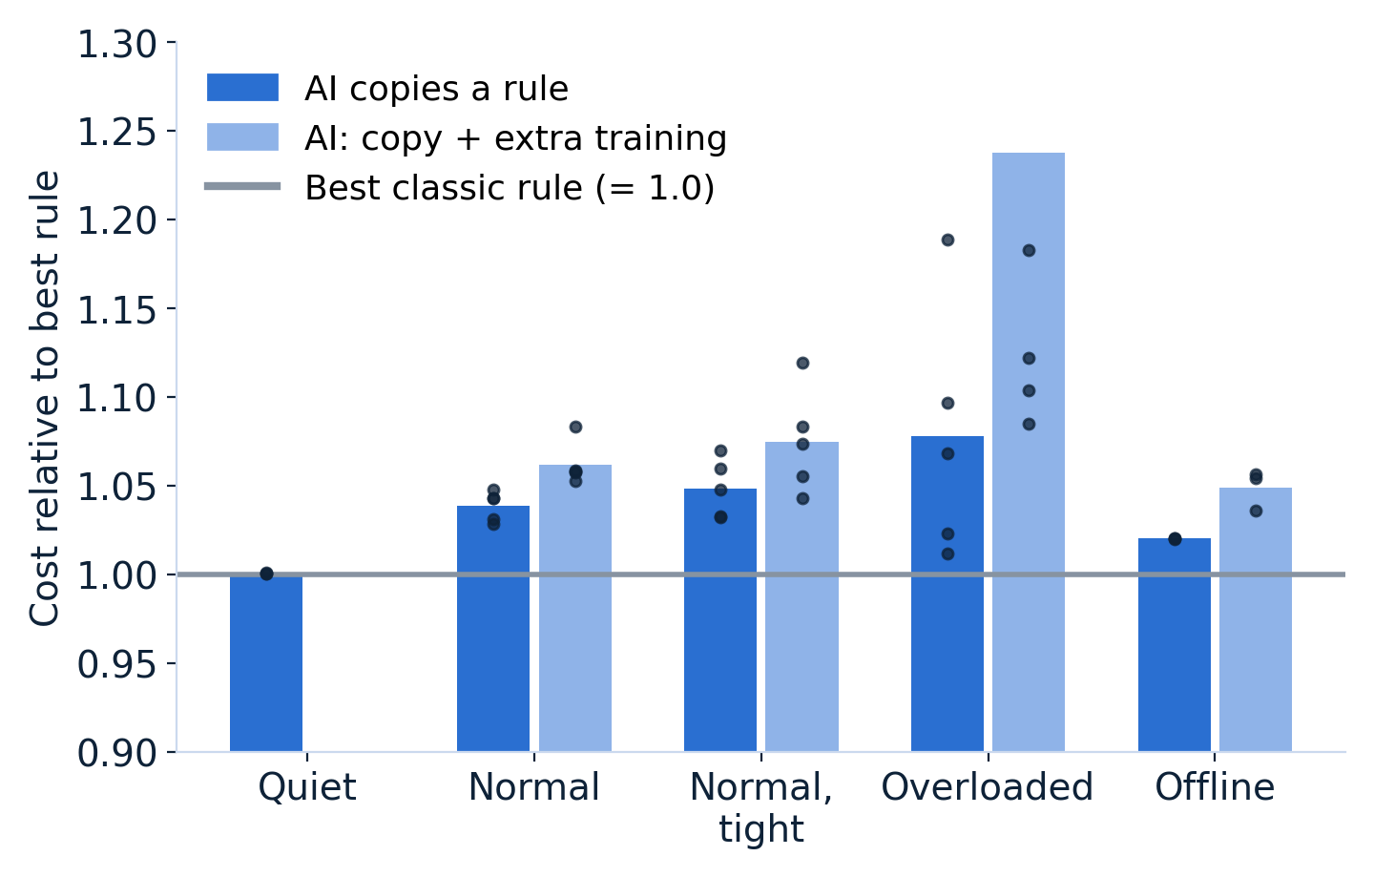
WHAT WE FOUND
The AI learned to match the best rules, but did not beat them
Busy machines: cost on 50 fresh test cases
Five scenarios: cost relative to the best rule
No AI scheduler was significantly better than the best classic rule.
Exploratory results: 50 fresh test cases per scenario, 3 to 10 training runs per bar (dots).
Interactive Model Race→
Ethan Ty Riekert | Curtin University | Supervisors: Elham Mardaneh, Tony Mathew
3 / 4
Notes:
Left graph: busy machines, 50 fresh test cases the models had never seen. Lower is better. The grey bar is the best classic rule. The AI that copies a rule lands close to it; extra training did not help; learning completely on its own was worse and varied a lot between runs (the dots are separate training runs). Right graph: the same story in five scenarios, cost relative to the best rule. Be honest about the limits: 3 to 10 training runs per bar, exploratory results, no AI scheduler was significantly better than the best rule. Then send the audience to the Scheduler Race page to choose their own priorities (late jobs, waiting, energy) and see who wins.

Slide 4
WHAT I BUILT AND WHERE IT LEADS
From following a plan to leading the next project
Skills built
Where it leads
What is next
Modelling
a cloud problem turned into mathematics
Machine learning
reinforcement and imitation learning
Research rigour
fresh test data, honest reporting
Communication
interactive tools for non-experts
My direction
machine learning and mathematical optimisation
The thread
computation that makes hidden dynamics visible
Audience
from experts to curious visitors
Trade-offs
train for late jobs versus energy
Forecasts
can predicting arrivals help?
Understanding
why learning on its own is unstable
Leading
[my next step: own a project]
Year 2
CO₂ and quantum vibrations
MATLAB visualisation
Year 3
Cloud scheduling with RL
Python, interactive demos
Next
Lead a project
machine learning + optimisation
Ethan Ty Riekert | Curtin University | Supervisors: Elham Mardaneh, Tony Mathew
4 / 4
Notes:
Skills: I turned a real cloud problem into mathematics, learned reinforcement and imitation learning, designed experiments with fresh test data, and reported a null result honestly. Link to the future: in second year I made quantum vibrations visible in MATLAB; this year I made scheduling decisions visible and interactive. The thread is the same, using computation to make hidden dynamics understandable to non-experts. Machine learning and mathematical optimisation are the direction I want to build a career in. Next: train for trade-offs between late jobs and energy, test forecasts of arriving jobs, explain why learning from scratch is unstable, and take a more active role in leading a project. [Replace the last bullet with your own next step.]

