Slide 1
Can reinforcement learning beat the best scheduling rule?
We trained neural networks to schedule cloud jobs. They learned to copy good rules of thumb, but on fresh test instances none was significantly better than the best rule.
Ty Riekert | Curtin University, Year 3 research project | Supervisors: Elham Mardaneh, Tony Mathew

Slide 2
WHY IT MATTERS
Deciding what to run first, and where, shows up everywhere
The problem
Same problem, other fields
Work arrives over time, each piece with a deadline and a cost if it is late
Something must decide which piece goes next and on which machine
Good choices mean fewer late jobs and less energy spent keeping machines on
Data centres
which task runs where, and when machines can be switched off
Hospitals
which operation or scan comes next, in which room
Factories and logistics
which order is built or delivered first
Cloud cost and energy
a business can trade lateness against running cost
Our test case: cloud computing jobs on a group of machines. The same structure appears in the fields on the right (by analogy; we tested only the cloud case).
2 / 6

Slide 3
WHAT WE DID
We compared classic rules with a neural network that learns to schedule
1
2
3
Classic rules
A learned scheduler
A fair test
Simple, fast recipes such as "do the most urgent job first". Used in practice today.
A neural network trained by trial and error (reinforcement learning), or first taught by copying a rule, then improved.
Both tried on 50 fresh test cases that no design decision had ever seen, scored on lateness, late jobs and energy.
The question: can the learned scheduler beat the best classic rule?
Rules named in the report: EDF (earliest deadline first), MDC, COVERT, WLST, ATC. PPO is the reinforcement learning method used.
3 / 6

Slide 4
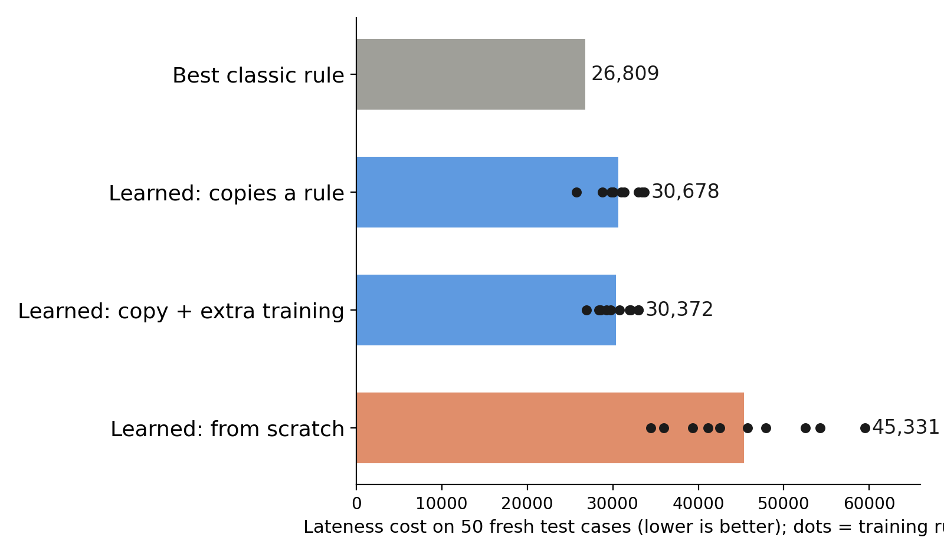
WHAT WE FOUND
No learned scheduler was significantly better than the best classic rule
0 of 3
learned setups significantly better than the best rule
Close
copies of a rule finish near it; extra training did not help
Wide
learning from scratch varied a lot between runs
Online, 10 machines, load 0.95; 50 fresh test cases; exploratory results; 10 training runs per learned setting.
4 / 6

Slide 5
TRY IT
Which scheduler is best for what you care about?
1
2
3
Choose the environment
Choose what matters
Press Start
How busy the machines are, how tight the deadlines are, online or offline
Energy, lateness, or your own weighted mix of metrics
The two best rules race the two best learned models; 100% = the best score of that scenario
Things to notice
The winner changes with the goal and with the load. Learned models are mostly copies of a rule, so they finish beside it. What would you weight?
5 / 6

Slide 6
WHAT I LEARNED
Skills built this year, honest limits, and what comes next
Skills developed
Honest limits
Next
Reinforcement learning and imitation (PPO, behaviour cloning)
Experiment design: fresh test sets, paired comparisons, pre-set wording rules
Research software: queued training runs, reproducible results archive
Communicating negative results honestly
Few training runs per setting (3-10)
Best rule was picked on the original test set
Extra training tried at one tuned setting only
Exploratory, not proof that RL cannot win
One objective that weights all metrics together
Explain why from-scratch learning is unstable
[Add your own career goal here]
Details and per-seed values: Future/research/2026-10-21-final-week-findings.md
6 / 6

