Slide 1
1 The Foundations: Logic and Proofs
1.1 Propositional Logic
1.2 Applications of Propositional Logic
1.3 Propositional Equivalences
1.4 Predicates and Quantifiers
1.5 Nested Quantifiers
1.6 Rules of Inference
1.7 Introduction to Proofs
1.8 Proof Methods and Strategy

Slide 2
Foundations of Logic: Overview
Propositional logic (§1.1-1.3) 命题逻辑
Basic definitions. (§1.1)
Applications (§1.2)
Equivalence rules (§1.3)
Predicate logic (§1.4-1.5) 谓词逻辑
Predicates.
Quantified predicate expressions.
Equivalences

Slide 3
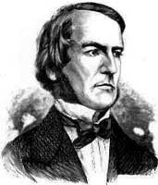
1.1 Propositional Logic (命题逻辑)
Topic #1 – Propositional Logic
Propositional Logic is the logic of compound statements built from simpler statements using so-called Boolean connectives.
Basic element: statement (or proposition)
Some applications in computer science:
Design of digital electronic circuits.
Expressing conditions in programs.
Queries to databases & search engines.
George Boole (1815-1864)
《The Laws of Thought》1854
Notes:
We normally attribute propositional logic to George Boole, who first formalized it. Actually the particular formal notation we will present is not precisely Boole’s; he originally spoke of logic in terms of sets, not propositions, and he also used Boolean algebra notation such as AB, A+B, rather than the A /\ B, A \/ B notation we will use. But, he was the first to mathematically formalize these kinds of concepts in preserved writings. Boole’s formalization of logic was developed further by the philosopher Frege.
However, even though logic was not formalized as such until the 1800’s, the basic ideas of it go all the way back to the ancient Greeks. Aristotle (ca. 384-322 B.C.) developed a detailed system of logic (though one that was not quite as convenient and powerful as the modern one), and Chrysippus of Soli (ca. 281-205 B.C.) introduced a logic centered around logic AND, inclusive and exclusive OR, NOT, and implication, similarly to Boole’s. Chrysippus’ logic apparently included all of the key rules that Boole’s logic had. However, his original works were unfortunately lost; we only have fragments quoted by other authors.

Slide 4
Propositions in natural language
Topic #1 – Propositional Logic
Definition: A proposition (命题) is simply:
a statement (i.e., a declarative sentence 陈述句)
with some definite meaning, (not vague or ambiguous)
having a truth value that’s either true (T) or false (F)
it is never both, neither, or somewhere “in between!”
However, you might not know the actual truth value

Slide 5
Propositions（命题）
A statement or proposition is a declarative sentence（陈述句） that is
“either true or false, but not both”.
true = T (or 1)
false = F (or 0) (binary logic)

Slide 6
Examples of Propositions
Topic #1 – Propositional Logic
“ Toronto is the capital of Canada. ”
“ 1 + 0 = 1”
“ 0 + 0 = 2”
“ Beijing is the capital of China, and 1 + 1 = 2”
But, the following are NOT propositions:
“Who’s there?” (interrogative 疑问句: no truth value)
“Sit down!” (imperative 祈使句: no truth value)
“x + 1 = 2” (no truth value)
“ x + y = z” (no truth value)

Slide 7
Propositional variables
We use letters to denote propositional variables (or statement variables)
p, q, r, . . . p_{i}, q_{i}, r_{i} , . . .
These variables represent propositions, just as using letters to denote numerical variables.
The proposition that is always true is denoted by T (or 1). Otherwise, denoted by F (or 0).
The area of logic that deals with propositions is called the propositional logic or propositional calculus .

Slide 8
1.1 Propositional Logic (命题逻辑)
Atoms (原子命题)
Propositions
Compound propositions
(复合命题)
原子命题：不能分解为更简单的陈述句。

Slide 9
Propositions in Propositional Logic
Atoms: p, q, r, … (Corresponds to simple English sentences, e.g. `I had salad for lunch’)
Compound propositions : built up from atoms using operators, e.g., p∧q (Corresponds to compound English sentences, e.g., “I had salad for lunch and I had steak for dinner.”)

Slide 10
Operators / Connectives（联结词）
Topic #1.0 – Propositional Logic: Operators
An operator or connective combines n operand expressions into a larger expression. (e.g., “+” in numeric exprs.)
Unary operators (单元运算符) take 1 operand (e.g., −3); binary operators (二元运算符) take 2 operands (eg 3 × 4).
Propositional or Boolean operators operate on propositions instead of on numbers.
Notes:
Later in the course, we will see that operators can themselves be defined in terms of functions. This slide doesn’t define them that way because we haven’t defined functions yet. But for your reference, when you come back to study this section after learning about functions, in general, an n-ary operator O on any set S (the domain of the operator) is a function O:S^n->S mapping n-tuples of members of S (the operands) to members of S. “S^n” here denotes S with n as a superscript, that is, the nth Cartesian power of S. All this will be defined later when we talk about set theory.
For Boolean operators, the set we are dealing with is B={True,False}.
A unary Boolean operator U is a function U:B->B, while a binary Boolean operator T is a function T:(B,B)->B.
Binary operators are conventionally written in between their operands, while unary operators are usually written in front of their operands. (One exception is the post-increment and post-decrement operators in C/C++/Java, which are written after their operands.)

Slide 11
Logical Operators (逻辑运算）
Unary
Negation（否定）
Binary
Conjunction（合取）
Disjunction （析取）
Exclusive OR （异或）
Implication （蕴涵）
Biconditional （等价）

Slide 12
Some Popular Boolean Operators
Formal Name | Nickname | Arity | Symbol
Negation operator | NOT | Unary | ¬
Conjunction operator | AND | Binary | ∧
Disjunction operator | OR | Binary | ∨
Exclusive-OR operator | XOR | Binary | ⊕
Implication operator | IMPLIES | Binary | →
Biconditional operator | IFF | Binary | ↔

Slide 13
Negation (否定联结词)
Topic #1.0 – Propositional Logic: Operators
The unary negation operator “¬” (NOT) transforms a prop. into its negation.
E.g. If p = “I have brown hair.”
then ¬p = “I do not have brown hair.”
The truth table (真值表) for NOT:
p | ¬p
T | F
F | T

Slide 14
Conjunction (合取联结词)
Topic #1.0 – Propositional Logic: Operators
The binary conjunction operator “∧” (AND) combines two propositions to form their logical conjunction.
E.g. If p=“I will have salad for lunch.” and q=“I will have steak for dinner.”, then p∧q=“I will have salad for lunch and I will have steak for dinner.”

Slide 15
Conjunction (合取联结词)
Topic #1.0 – Propositional Logic: Operators
Note that a conjunction p₁ ∧ p₂ ∧ … ∧ p_{n} of n propositions will have 2^{n} rows in its truth table.
Also: ¬ and ∧ operations together are suffi-cient to express any Boolean truth table!
p | q | p ∧ q
T | T | T
T | F | F
F | T | F
F | F | F
Notes:
Note that AND is commutative and associative, which means that we can write a long conjunction (like in the first bullet on the left) without parenthesizing it. It also doesn’t matter what order the n propositions are in.
The fact that an n-operand operator has 2^n rows in its truth table is an easy consequence of the product rule of combinatorics. Here is a proof. Note that for the table to be complete, we must have 1 row for every possible assignment of truth values to the n operands. Thus, there is 1 row for every function f:V->B, where V is the set of operand columns {p,q,…} and B={T,F}. Here, |V|=n and |B|=2. The number of functions from a set of size n to a set of size m is m^n. This is because of the product rule, as we will see in a moment. In this case, m=2 so we get 2^n such functions. In terms of the product rule: There are 2 possible values for p. For each of these, there are 2 possible values for q, since the choice of q is independent of the choice of p. And so on. So there are 2x2x…(n repetitions)…x2 possible rows, thus 2^n. Of course, we haven’t defined the product rule, set cardinality, or functions yet, so don’t worry if the above argument doesn’t quite make sense to you yet.
In the second bullet, we would say, {NOT,AND} is a universal set of Boolean operators, but we haven’t even defined sets yet. If you already know what a set is, a universal set of operators over a given domain is a set of operators such that nested expressions involving those operators are sufficient to express any possible operator over that domain. In this case, the domain is B={T,F}. The proof that {NOT,AND} is universal is as follows: OR can be defined by p OR q = NOT(NOT(p) AND NOT(q)) (easily verified; this is one of DeMorgan’s Laws, which we will get to later). Now, armed with OR, AND, and NOT, we can show how to express any Boolean truth table, with any number of columns, as follows. Look for the cases where the last (result) column is T. For each such row in the truth table, include a corresponding term in a disjunctive expression for the whole truth table. The term should be a conjunction of terms, one for each input operand in that row. Each of these terms should be p if the entry in that position is “T”, and NOT(p) if the entry in that position is “F”. So, the entire expression basically says, “the value of the operator is T if and only if the pattern of truth values of the input operands exactly matches one of the rows in the truth table that ends in a ‘T’ result.” Thus, the expression directly encodes the content of the truth table.

Slide 16
Disjunction (析取联结词)
Topic #1.0 – Propositional Logic: Operators
The binary disjunction operator “∨” (OR) combines two propositions to form their logical disjunction.
p=“My car has a bad engine.”
q=“My car has a bad door.”
p∨q=“Either my car has a bad engine, or my car has a bad door.”
Meaning is like “and/or” in English.
Notes:
OR is also commutative and associative.
The animated picture on the right is just a memory device to help you remember that the disjunction operator is symbolized with a downward-pointing wedge, like the blade of an axe, because it “splits” a proposition into two parts, such that you can take either part (or both), if you are trying to decide how to make the whole proposition true.
Note that the meaning of disjunction is like the phrase “and/or” which is sometimes used in informal English. “The car has a bad engine and/or a bad carburetor.”

Slide 17
Disjunction (析取联结词)
Topic #1.0 – Propositional Logic: Operators
Note that p∨q means that p is true, or q is true, or both are true!
So, this operation is also called inclusive or, because it includes the possibility that both p and q are true.
“¬” and “∨” together are also universal.
p | q | p ∨ q
T | T | T
T | F | T
F | T | T
F | F | F

Slide 18
The Exclusive Or Operator
Topic #1.0 – Propositional Logic: Operators
The binary exclusive-or operator “⊕” (XOR) combines two propositions to form their logical “exclusive or”.
p = “I will earn an A in this course,”
q = “I will drop this course,”
p ⊕ q = “I will either earn an A in this course, or I will drop it (but not both!)”

Slide 19
The Exclusive Or Operator
Topic #1.0 – Propositional Logic: Operators
Note that p⊕q means that p is true, or q is true, but not both!
This operation is called exclusive or, because it excludes the possibility that both p and q are true.
“¬” and “⊕” together are not universal.
p | q | p ⊕ q
T | T | F
T | F | T
F | T | T
F | F | F
Notes:
A good way to remember the symbol for XOR, a plus sign inside an O, is to think of XOR as adding the bit-values of its inputs (mod 2). E.g., 0+0=0, 1+0=0, 1+1=0 (mod 2). Thus XOR is basically an addition, and we put it inside an “O” to remind ourselves that it is a type of “Or”.
XOR together with unary operators do not form a universal set of operators over the Booleans. However, it turns out that they are a universal set for quantum logic! However we do not have time to cover quantum computing in this class, interesting though it is.

Slide 20
Implication (蕴含联结词)
Topic #1.0 – Propositional Logic: Operators
antecedent
consequent
The implication p → q states that p implies q.
i.e., If p is true, then q is true; but if p is not true, then q could be either true or false.
E.g., let p = “You study hard.” q = “You will get a good grade.”
p → q = “If you study hard, then you will get a good grade.”
Notes:
Note that the definition of “p implies q” says: “If p is true, then q is true, and if p is not true, then q is either true or false.” Well, saying that q is either true or false is not saying anything, since any proposition is, by the very definition of a proposition, either true or false. So, the last part of that sentence (covering the case where p is not true) is not really saying anything. So we may as well say the definition is, “If p is true, then q is true.”
Sometimes the antecedent is called the hypothesis and the consequent is called the conclusion.

Slide 21
Implication (蕴含联结词)
Topic #1.0 – Propositional Logic: Operators
p → q is false only when p is true but q is not true.
p → q does not say that p causes q!
p → q does not require that p or q are true!
e.g. “(1=0) → pigs can fly” is TRUE!
p | q | p → q
T | T | T
T | F | F
F | T | T
F | F | T
Notes:
Let’s consider the rows of the truth table, one at a time. In the first row, p is false and q is false. Now, let’s consider the definition of p->q. It says “If p is true, then q is true, but if p is false, then q is either true or false.” Well, in this case, p is false, and q is either true or false (namely false), so the second part of the statement is true. But, of course that part is true, since it is just a tautology that q is either true or false. In other words, and if is always true when its antecedent is false.
Similarly, the second row is True.
The third row is false, since p is true but q is false, so it is not the case that if p is true then q is true.
Finally, in the fourth row, since p is true and q is true, it is the case that if q is true then q is true.
Many students have trouble with the implication operator. When we say, “A implies B”, it is just a shorthand for “either not A, or B”. In other words, it is just the statement that it is NOT the case that A is true and B is false.
This often seems wrong to students, because when we say “A implies B” in everyday English, we mean that if somehow A were to become true in some way, somehow, the statement B would automatically be thereby made true, as a result. This does not seem to be the case in general when A and B are just two random false statements (such as the example in the last bullet). (However in this case, we might make a convoluted argument that the antecedent really DOES effectively imply the consequent: Note that if 1=0, then if a given pig flies 0 times in his life, then he also flies 1 time, thus he can fly.)
In any case, perhaps a more accurate and satisfying English rendering of the true meaning of the logical claim “A implies B”, might be just, “the possibility that A implies B is not contradicted directly by the truth values of A and B”. In other words, “it is not the case that A is true and B is false.” (Since that combination of truth values would directly contradict the hypothesis that A implies B.)

Slide 22
Different Ways of Expressing p →q
if p, then q p implies q
if p, q p only if q
q unless ¬p q when p
q if p q when p
q whenever p p is sufficient for q
q follows from p q is necessary for p
a necessary condition for p is q
a sufficient condition for q is p

Slide 23
Converse, Inverse and Contrapositive 逆命题 否命题 逆否命题
From p →q we can form new conditional statements .
q →p is the converse of p →q
¬ p → ¬ q is the inverse of p →q
¬q → ¬ p is the contrapositive of p →q
Example: Find the converse, inverse, and contrapositive of “If it is raining, then I stay at home.”
Solution:
converse: If I stay at home, then it is raining.
inverse: If it is not raining, then I will not stay at home.
contrapositive: If I do not stay at home, then it is not raining.

Slide 24
Biconditional (等价联结词)
Topic #1.0 – Propositional Logic: Operators
The biconditional p ↔ q states that p is true if and only if (IFF) q is true.
p = “Donald Trump won the 2016 presidential election.”
q = “Donald Trump was president for all of 2017.”
p ↔ q = “If, and only if, Donald Trump won the 2016 presidential election, Donald Trump was president for all of 2017.”

Slide 25
Biconditional Truth Table
Topic #1.0 – Propositional Logic: Operators
p ↔ q means that p and q have the same truth value.
Note this truth table is the exact opposite of ⊕’s!
Thus, p ↔ q means ¬(p ⊕ q)
p ↔ q does not imply that p and q are true, or that either of them causes the other.
p | q | p ↔ q
T | T | T
T | F | F
F | T | F
F | F | T
Notes:
Also, p IFF q is equivalent to (p -> q) /\ (q -> p). (“/\” being the AND wedge)

Slide 26
Boolean Operations Summary
Topic #1.0 – Propositional Logic: Operators
We have seen 1 unary operator (out of the 4 possible) and 5 binary operators:
Notes:
For fun, try writing down the truth tables for each of the 4 possible unary operators, and each of the 16 possible binary operators. For each one, try to come up with an English description of the operator that conveys its meaning. Also, figure out a way to define it in terms of other operators we already introduced.

Slide 27
Precedence (优先级) of Logical Operators
Operator | Precedence
¬ | 1
∧ | 2
∨ | 3
→ | 4
↔ | 5
p ∨ q → ¬r is equivalent to (p ∨ q) → ¬r
If the intended meaning is p ∨(q → ¬r)
then parentheses must be used.

Slide 28
Truth Tables For Compound Propositions
在命题公式中，对于分量指派真值的各种可能组合，就确定了这个命题公式的各种真值情况，把它汇列成表，就是命题公式的真值表。

Slide 29
Truth Tables For Compound Propositions
Construction of a truth table:
Rows
Need a row for every possible combination of values for the atomic propositions.
Columns
Need a column for the compound proposition (usually at far right)
Need a column for the truth value of each expression that occurs in the compound proposition as it is built up.
This includes the atomic propositions

Slide 30
Example Truth Table
Construct a truth table for p ∨ q → ¬r
p | q | r | ¬r | p ∨ q | p ∨ q → ¬r
T | T | T | F | T | F
T | T | F | T | T | T
T | F | T | F | T | F
T | F | F | T | T | T
F | T | T | F | T | F
F | T | F | T | T | T
F | F | T | F | F | T
F | F | F | T | F | T

Slide 31
Equivalent Propositions
Two propositions are equivalent (等价) if they always have the same truth value.
Example: Show using a truth table that the conditional is equivalent to the contrapositive.
Solution:
p | q | ¬p | ¬q | p → q | ¬q → ¬p
T | T | F | F | T | T
T | F | F | T | F | F
F | T | T | F | T | T
F | F | T | T | T | T

Slide 32
The language of propositional logic defined more properly
Atoms: p1, p2, p3, ..
Formulas (命题公式)
All atoms are formulas
If α is a formula then ¬ α is a formula
If α and β are formulas then the following are formulas: (α ∧ β), (α ∨ β), (α → β) (etc.)
Examples of formulas: (p1 ∨ ¬ p2), ¬ ¬ ¬(p9 → p8), (p1∧ (p2 ∨ p3))
etc.

Slide 33
Precedence of logical operators Nested Propositional Expressions
Use parentheses to group sub-expressions: “I just saw my old friend, and either he’s grown or I’ve shrunk.” = f ∧ (g ∨ s)
(f ∧ g) ∨ s would mean something different
f ∧ g ∨ s would be ambiguous
By convention, “¬” takes precedence over both “∧” and “∨”.
¬s ∧ f means (¬s) ∧ f , not ¬ (s ∧ f)
1 ¬ 2 ∧ ∨ 3→ ↔
Notes:
As an exercise, drop the truth tables for f /\ (g \/ s) and (f /\ g) \/ s to see that they’re different, and thus the parentheses are necessary.
Precedence conventions such as the one in the second bullet help to reduce the number of parentheses needed in expressions. Note that negation, with its tight binding (high precedence), and with its position to the left of its operand, behaves similarly to a negative sign in arithmetic.
There is also a precedence convention that you see sometimes (for example, in the C programming language) that AND takes precedence over OR. However, this convention is not quite universally accepted, not all systems adopt it. Therefore, to be safe, you should always include parentheses whenever you are mixing ANDs and ORs in a single sequence of binary operators.

Slide 34
§1.2 Applications of Propositional Logic

Slide 35
Applications of Propositional Logic: Summary
Translating English to Propositional Logic
System Specifications
Boolean Searching
Logic Puzzles
Logic Circuits

Slide 36

Translating English Sentences
Steps to convert an English sentence to a statement in propositional logic
Identify atomic propositions and represent using propositional variables.
Determine appropriate logical connectives
“You cannot ride the roller coaster if you are under 4 feet tall unless you are older than 16 years old.”
p: you are under 4 feet tall,
q: you are older than 16 years old.
r: You can ride the roller coaster.
If p and ¬q then not r.

Slide 37
System Specifications
System and Software engineers take requirements in English and express them in a precise specification language based on logic.
Example: Express in propositional logic:
“The automated reply cannot be sent when the file system is full”
Solution: One possible solution: Let p denote “The automated reply can be sent” and q denote “The file system is full.”
q→ ¬ p

Slide 38
Consistent System Specifications
Definition: A list of propositions is consistent if it is possible to assign truth values to the proposition variables so that each proposition is true.
Exercise: Are these specifications consistent?
“The diagnostic message is stored in the buffer or it is retransmitted.”
“The diagnostic message is not stored in the buffer.”
“If the diagnostic message is stored in the buffer, then it is retransmitted.”
Solution: Let p denote “The diagnostic message is stored in the buffer.” Let q denote “The diagnostic message is retransmitted” The specification can be written as: p ∨ q, ¬p, p→ q. When p is false and q is true all three statements are true. So the specification is consistent.
What if “The diagnostic message is not retransmitted” is added.
Solution: Now we are adding ¬q and there is no satisfying assignment. So the specification is not consistent.

Slide 39
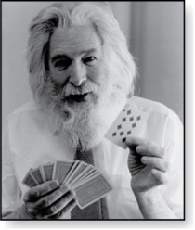
Logic Puzzles
Raymond Smullyan
(Born 1919)
An island has two kinds of inhabitants, knights, who always tell the truth, and knaves, who always lie.
You go to the island and meet A and B.
A says “B is a knight.”
B says “The two of us are of opposite types.”
Example: What are the types of A and B?
Solution: Let p and q be the statements that A is a knight and B is a knight, respectively. So, then ¬p represents the proposition that A is a knave and ¬q that B is a knave.
If A is a knight, then p is true. Since knights tell the truth, q must also be true. Then (p ∧ ¬ q)∨ (¬ p ∧ q) would have to be true, but it is not. So, A is not a knight and therefore ¬p must be true.
If A is a knave, then B must not be a knight since knaves always lie. So, then both ¬p and ¬q hold since both are knaves.

Slide 40
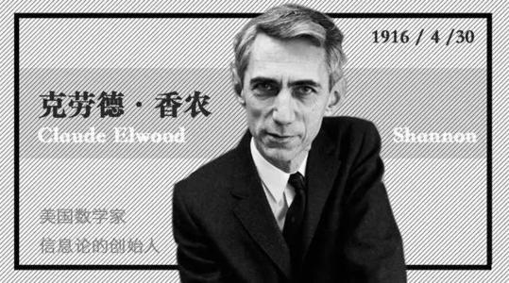
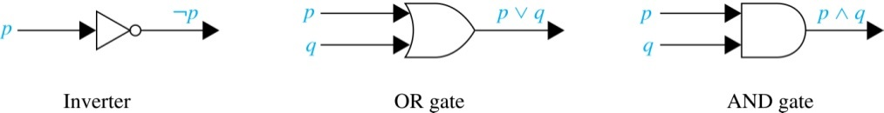
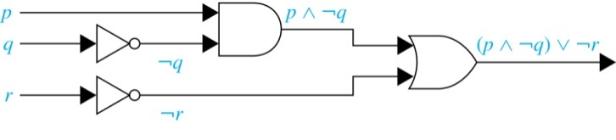
Logic Circuits
Electronic circuits; each input/output signal can be viewed as a 0 or 1.
0 represents False
1 represents True
Complicated circuits are constructed from three
basic circuits called gates.
The inverter (NOT gate)takes an input bit and produces the negation of that bit.
The OR gate takes two input bits and produces the value equivalent to the disjunction of the two bits.
The AND gate takes two input bits and produces the value equivalent to the conjunction of the two bits.
More complicated digital circuits can be constructed by combining these basic circuits to produce the desired output given the input signals by building a circuit for each piece of the output expression and then combining them. For example:
1937, master thesis
《A Symbolic Analysis of Relay
and Switching Circuits 》

Slide 41

1 The Foundations: Logic and Proofs
1.1 Propositional Logic
1.2 Applications of Propositional Logic 1.3 Propositional Equivalences 1.4 Predicates and Quantifiers 1.5 Nested Quantifiers 1.6 Rules of Inference 1.7 Introduction to Proofs 1.8 Proof Methods and Strategy

Slide 42
Tautologies 永真式
Topic #1.1 – Propositional Logic: Equivalences
A tautology is a compound proposition that is true no matter what the truth values of its atomic propositions are!
Ex. p ∨ ¬p [What is its truth table?]
p | ¬p | p∨¬p
T | F | T
F | T | T

Slide 43
Contradictions 永假式
Topic #1.1 – Propositional Logic: Equivalences
A contradiction is a compound proposition that is false no matter what the truth values of its atomic propositions are!
Ex. p ∧ ¬p [Truth table?]
p | ¬p | p∧¬p
T | F | F
F | T | F

Slide 44
What’s left besides Tautologies and Contradictions
Topic #1.1 – Propositional Logic: Equivalences
All other props. are contingencies (可满足式)
i.e., in the truth tables,
Some rows give T, others give F

Slide 45
Tautologies, Contradictions, and Contingencies
A tautology is a proposition which is always true.
Example: p ∨¬p
A contradiction is a proposition which is always false.
Example: p ∧¬p
A contingency is a proposition which is neither a tautology nor a contradiction, such as p
P | ¬p | p ∨¬p | p ∧¬p
T | F | T | F
F | T | T | F

Slide 46
Which of these are tautologies?
p→ (q → p) Tautologous
p→ (¬p → p) Tautologous
(q → p) → (p → q) Contingent
(q → p) ∨ (p → q) Tautologous
(p → (q → r)) → (q → (p → r)) Tautologous
Notes:
1,2,4,5 are known as “`paradoxes’ of the material implication”, because they contrast with implication in ordinary language

Slide 47
Logical Equivalence 等值式
Topic #1.1 – Propositional Logic: Equivalences
Compound proposition A is logically equivalent to compound proposition B, written A⇔B, IFF
A and B contain the same truth
values in all rows of their truth
tables

Slide 48
Propositional Equivalence
Topic #1.1 – Propositional Logic: Equivalences
Two syntactically (i.e., textually) different compound propositions may be semantically identical (i.e., have the same meaning). We call them logically equivalent. (逻辑等值)
Notation: … ⇔ …

Slide 49
Logical Equivalences 逻辑等值式
P ∧ T ⇔ P, P ∨ F ⇔ P Identity（同一律）
P ∨ T ⇔ T , P ∧ F ⇔ F
Domination（零律）
P ∨ P ⇔ P , P ∧ P ⇔ P
Idempotency（等幂律）

Slide 50
Logical Equivalences
¬(¬P)) ⇔ P Double negation（双重否定律）
P ∨Q ⇔ Q∨ P P ∧Q ⇔ Q∧ P Commutativity（交换律）
(P ∨Q)∨ R ⇔ P∨ (Q∨ R) (P ∧Q) ∧ R ⇔ P ∧ (Q∧ R) Associativity（结合律）

Slide 51
Logical Equivalences
P ∧(Q∨ R) ⇔(P ∧Q)∨ (P ∧ R) P ∨(Q∧ R) ⇔ (P ∨Q)∧ (P ∨ R) Distributivity（分配律）
¬(P ∧Q)⇔ ¬P ∨¬Q ¬(P ∨Q)⇔ ¬P ∧¬Q DeMorgan’s laws（德·摩根律）

Slide 52
Logical Equivalences
P → Q ⇔ ¬P ∨Q Implication（蕴涵等值式）
P ∨¬P ⇔ T Tautology（排中律）
P ∧¬P ⇔ F Contradiction（矛盾律）
(P → Q) ∧(Q → P) ⇔ (P ↔ Q) Equivalence （等价等值式）
(P → Q) ∧(P → ¬Q) ⇔ ¬P Absurdity ( 归谬论 )

Slide 53
Logical Equivalences
(P → Q) ⇔(¬Q → ¬P) Contrapositive（蕴涵逆反式）
P ∨(P ∧Q) ⇔ P P ∧(P ∨Q) ⇔ P Absorption（吸收律）
(P ∧Q) → R ⇔ P → (Q → R) Exportation（输出律）

Slide 54
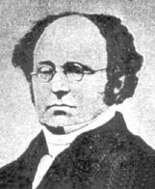
More Equivalence Laws
Topic #1.1 – Propositional Logic: Equivalences
De Morgan’s: ¬(p∧q) ⇔ ¬p ∨ ¬q ¬(p∨q) ⇔ ¬p ∧ ¬q
德·摩根律扩展：
¬(p∧q ∨r ∧ ¬ s) ⇔ ¬p ∨ ¬q ∧ ¬r ∨ s
Augustus De Morgan (1806-1871)

Slide 55
Defining Operators via Equivalences
Using equivalences, we can define operators in terms of other operators.
Exclusive or: p⊕q ⇔ (p∨q)∧¬(p∧q) p⊕q ⇔ (p∧¬q)∨(q∧¬p)

Slide 56
Tautologies revisited
We’ve introduced the notion of a tautology using the example p ∨ ¬p
Now, you know more operators, so can formulate many more tautologies, e.g., (p∨q) ↔ ¬(¬p ∧ ¬q) (p→q) ↔ (¬q → ¬ p), and so on

Slide 57
EXAMPLE 4
Show that the propositions p∨(q∧r) and (p∨q)∧(p∨r) are logically equivalent. This is the distributive law of disjunction over conjunction.

Slide 58
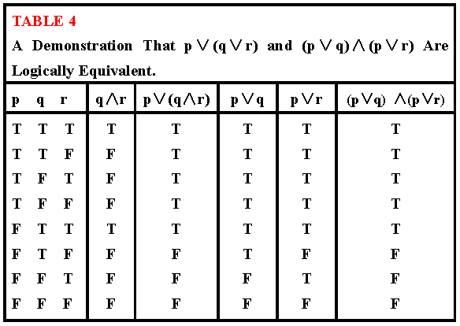
Table 4

Slide 59
置换规则
给定公式A，它的所有子公式为A₁, A₂,…,A_{n}, 设A_{i} ⇔ B_{i}, 用B_{i}置换A_{i，}所得公式为B，则 A⇔ B。
例：求证：
(P →( Q →R) ⇔ P →( ¬ Q ∨ R)为永真式
已 知 ( Q →R) ⇔ ( ¬ Q ∨ R)
用(¬Q ∨ R)置换原式中的(Q →R)

Slide 60


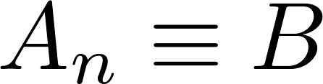
Constructing New Logical Equivalences
We can show that two expressions are logically equivalent by developing a series of logically equivalent statements.
To prove that we produce a series of equivalences beginning with A and ending with B.
Keep in mind that whenever a proposition (represented by a propositional variable) occurs in the equivalences listed earlier, it may be replaced by an arbitrarily complex compound proposition.

Slide 61
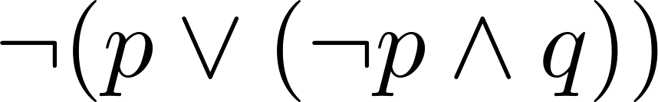
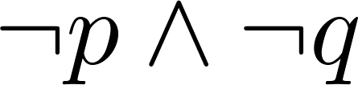
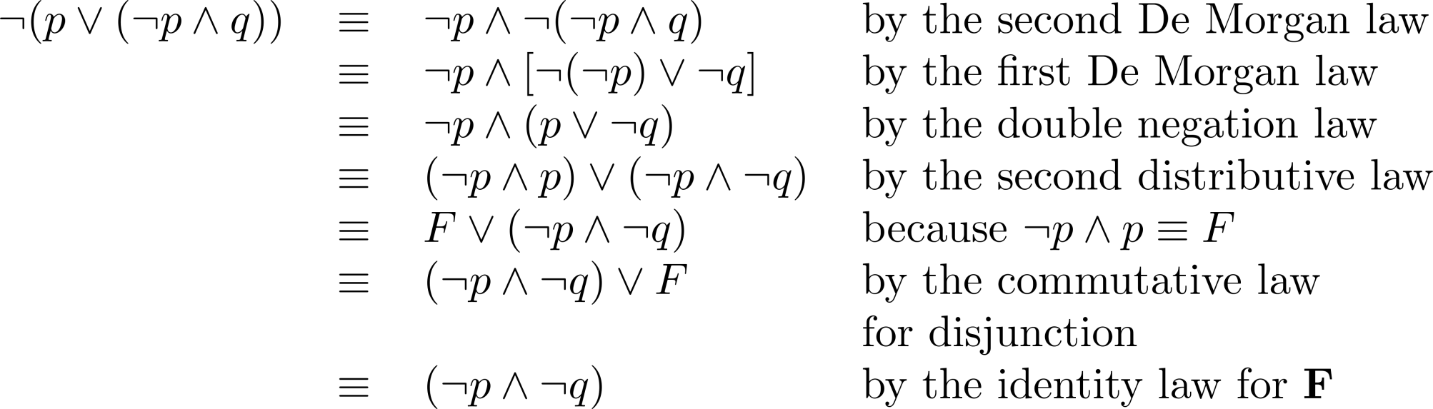
Equivalence Proofs
Example: Show that
is logically equivalent to
Solution:

Slide 62
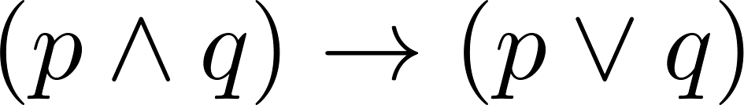
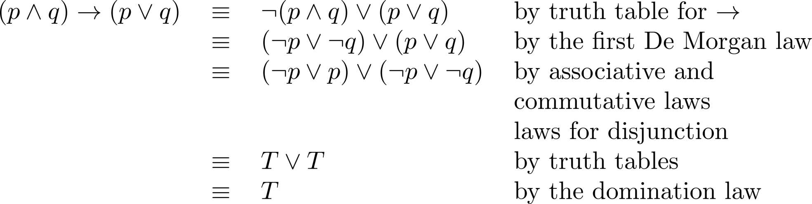
Equivalence Proofs
Example: Show that
is a tautology.
Solution:

Slide 63
Logically Equivalent
Two compound propositions p and q are logically equivalent if p↔q is a tautology.
We write this as p⇔q or as p≡q where p and q are compound propositions.
Two compound propositions p and q are equivalent if and only if the columns in a truth table giving their truth values agree.
This truth table show ¬p ∨ q is equivalent to p → q.
p | q | ¬p | ¬p ∨ q | p→ q
T | T | F | T | T
T | F | F | F | F
F | T | T | T | T
F | F | T | T | T

Slide 64
Application
Please simplify the following program
If A ∧ B then
If B ∨ C then
XXX
Else
YYY
End
Else
If A ∧ C then
YYY
Else
XXX
End
End
The condition for executing code segment XXX is:
((A∧B) ∧ (B ∨ C) ) ∨ (¬( A∧B) ∧ ¬(A∧C))
⇔ ¬(A ∧ ¬B ∧ C）
The condition for executing code segment YYY is:
((A∧B) ∧ ¬ (B ∨ C) )∨ (¬(A∧B) ∧ (A∧C))
⇔ A ∧ ¬B ∧ C
If A∧ ¬B∧C then
YYY
Else
XXX
End

Slide 65
Application
Please solve the following problem using the methods from Logical Equivalences.
A、B、C、D participate in the 100-meter race，four audience X、Y、Z predicate the result as follows before the competition.
X：C ranks the first place，B ranks the second place.
Y：C ranks the second place，D ranks the third place.
Z：A ranks the second place，D ranks the fourth place.
After the competition, we discover that each of the four audiences is right for half of their predication, so what is the real ranking？
Let p_{i} , q_{i} , r_{i} , s_{i} denote that A、B、C、D be the No. i in the final ranking, respectively
( r₁ ∧ ¬q₂) ∨ (¬r₁ ∧ q₂) ⇔1
( r₂ ∧ ¬s₃) ∨ (¬r₂ ∧ s₃) ⇔1
( p₂ ∧ ¬s₄) ∨ (¬p₂ ∧ s₄) ⇔1

Slide 66
By 1) and 2),
1 ⇔ (( r₁∧¬q₂) ∨ (¬r₁∧q₂) ) ∧ (( r₂∧¬s₃) ∨ (¬r₂∧s₃))
⇔ (r₁ ∧¬q₂ ∧ r₂ ∧ ¬s₃) ∨(r₁ ∧ ¬q₂ ∧ ¬r₂ ∧ s₃)
∨ (¬r₁ ∧ q₂ ∧ r₂ ∧ ¬s₃) ∨ (¬r₁ ∧ q₂ ∧ ¬r₂ ∧ s₃)
⇔ (r₁ ∧ ¬q₂ ∧ ¬r₂ ∧ s₃)∨ (¬r₁ ∧ q₂ ∧ ¬r₂ ∧ s₃) ⇔ 1
Combining the above argument with 3),
1 ⇔ ((r₁ ∧ ¬q₂ ∧ ¬r₂ ∧ s₃)∨ (¬r₁ ∧ q₂ ∧ ¬r₂ ∧ s₃))
∧(( p₂ ∧ ¬s₄) ∨ (¬p₂ ∧ s₄))
⇔ (r₁ ∧ ¬q₂ ∧ ¬r₂ ∧ s₃ ∧ p₂ ∧ ¬s₄)
∨ (r₁ ∧ ¬q₂ ∧ ¬r₂ ∧ s₃ ∧ ¬p₂ ∧ s₄)
∨ (¬r₁ ∧ q₂ ∧ ¬r₂ ∧ s₃ ∧ p₂ ∧ ¬s₄)
∨ (¬r₁ ∧ q₂ ∧ ¬r₂ ∧ s₃ ∧ ¬p₂ ∧ s₄)
⇔ (r₁ ∧¬q₂ ∧ ¬r₂ ∧ s₃ ∧ p₂ ∧ ¬s₄) ⇔ 1
Finally：
C: the first
A: the second
D: the third
B: the fourth

Slide 67
1 The Foundations: Logic and Proofs
1.1 Propositional Logic
1.2Applications of Propositional Logic 1.3 Propositional Equivalences 1.4 Predicates and Quantifiers 1.5 Nested Quantifiers 1.6 Rules of Inference 1.7 Introduction to Proofs 1.8 Proof Methods and Strategy

Slide 68
Section Summary
Predicates
Variables
Quantifiers
Universal Quantifier
Existential Quantifier
Negating Quantifiers
De Morgan’s Laws for Quantifiers
Translating English to Logic
Logic Programming (optional)

Slide 69
苏格拉底三段论
判断下面推理的正确性
凡人都是要死的。
苏格拉底是人。
所以苏格拉底是要死的。
采用p,q,r表示三个命题的话，则（p∧q）→r并不是重言式。
原因缺少命题内在的联系的反映,一阶逻辑是研究内在联系的逻辑关系,也称为谓词逻辑。

Slide 70
Introducing Predicate Logic
Predicate logic uses the following new features:
Variables（个体词）: x, y, z
Predicates: P(x), M(x) 谓词
Lu is a teacher.
y is a student.

Slide 71
个体词相关的基本概念
个体词：是可以独立存在的客体
个体常项: 用小写的英文字母a, b, c, d…写
个体变项: 用小写的英文字母x, y , z…写
个体域: 个体的取值范围
例如：{1,2,3}, {计算机,2}
全总个体域:指宇宙中的一切事物。

Slide 72
谓词相关的基本概念
谓词常项:表示具体性质或关系的谓词,用F,G,H表示。
谓词变项:表示抽象的性质或关系的谓词,也用F,G,H表示,但要根据个体变项x, y等来定。
x 具有属性F,则用F(x)表示。
x, y具有关系L,则用L(x,y)表示。
谓词中的个体数称为元数,含n 个个体词的谓词称为n元谓词。
例如 P(x₁, x₂, x₃, x₄ , … , x_{n})

Slide 73
Propositional Functions
The statement P(x) is said to be the value of the propositional function P at x.（一元谓词）
For example,
P(x) ： x > 0
P(-3) ： False.
P(3) ： True.
Often the domain is denoted by U. So in this example U is the integers.

Slide 74
Examples of Propositional Functions
Let “x + y = z” be denoted by R(x, y, z) and U (for all three variables) be the integers. Find these truth values:
R(2,-1,5) : F
R(3,4,7): T
R(x, 3, z): Not a Proposition
Now let “x - y = z” be denoted by Q(x, y, z), with U as the integers. Find these truth values:
Q(2,-1,3): T
Q(3,4,7): F
Q(x, 3, z): Not a Proposition
多元谓词

Slide 75
Section Summary
Predicates
Variables
Quantifiers
Universal Quantifier
Existential Quantifier
Negating Quantifiers
De Morgan’s Laws for Quantifiers
Translating English to Logic
Logic Programming (optional)

Slide 76
Quantifiers 量词
We need quantifiers to express the meaning of English words including all and some:
“All men are Mortal.”
“Some cats do not have fur.”
The two most important quantifiers are:
Universal Quantifier (全称量词), “For all,” ： ∀
Existential Quantifier (存在量词), “There exists,” ： ∃
We write as in ∀x P(x) and ∃x P(x).
∀x P(x) asserts P(x) is true for every x in the domain.
∃x P(x) asserts P(x) is true for some x in the domain.
The quantifiers are said to bind the variable x in these expressions.

Slide 77
Universal Quantifier 全称量词
∀x P(x) is read as “For all x, P(x)” or “For every x, P(x)”
Examples:
If P(x) denotes “x > 0” and U is the integers, then ∀x P(x) is false.
If P(x) denotes “x > 0” and U is the positive integers, then ∀x P(x) is true.
If P(x) denotes “x is even” and U is the integers, then ∀ x P(x) is false.

Slide 78
Existential Quantifier 存在量词
∃x P(x) is read as “For some x, P(x)”, or as “There is an x such that P(x),” or “For at least one x, P(x).”
Examples:
If P(x) denotes “x > 0” and U is the integers, then ∃x P(x) is true. It is also true if U is the positive integers.
If P(x) denotes “x < 0” and U is the positive integers, then ∃x P(x) is false.
If P(x) denotes “x is even” and U is the integers, then ∃x P(x) is true.

Slide 79
Thinking about Quantifiers
When the domain of discourse is finite, we can think of quantification as looping through the elements of the domain.
To evaluate ∀x P(x) loop through all x in the domain.
If at every step P(x) is true, then ∀x P(x) is true.
If at a step P(x) is false, then ∀x P(x) is false and the loop terminates.
To evaluate ∃x P(x) loop through all x in the domain.
If at some step, P(x) is true, then ∃x P(x) is true and the loop terminates.
If the loop ends without finding an x for which P(x) is true, then ∃x P(x) is false.
Even if the domains are infinite, we can still think of the quantifiers in this fashion, but the loops will not terminate in some cases.

Slide 80
Precedence of Quantifiers
The quantifiers ∀ and ∃ have higher precedence than all the logical operators.
For example, ∀x P(x) ∨ Q(x) means (∀x P(x))∨ Q(x)
∀x (P(x) ∨ Q(x)) means something different.
Unfortunately, often people write ∀x P(x) ∨ Q(x) when they mean ∀ x (P(x) ∨ Q(x)).

Slide 81
Returning to the Socrates Example
Introduce the propositional functions Man(x) denoting “x is a man” and Mortal(x) denoting “x is mortal.” Specify the domain as all people.
The two premises are:
∀x( Man(x) → Mortal(x) )
Man(Socrates)
The conclusion is:
Mortal(Socrates)
Later we will show how to prove that the conclusion follows from the premises.

Slide 82
Equivalences in Predicate Logic
Statements involving predicates and quantifiers are logically equivalent if and only if they have the same truth value
for every predicate substituted into these statements and
for every domain of discourse used for the variables in the expressions.
The notation S ≡T indicates that S and T are logically equivalent.
Example: ∀x ¬¬S(x) ≡ ∀x S(x)

Slide 83
Section Summary
Predicates
Variables
Quantifiers
Universal Quantifier
Existential Quantifier
Negating Quantifiers
De Morgan’s Laws for Quantifiers
Translating English to Logic
Logic Programming (optional)

Slide 84
Negating Quantified Expressions
Consider ∀x J(x)
“Every student in your class has taken a course in Java.”
Here J(x) is “x has taken a course in Java” and the domain is students in your class.
Negating the original statement gives “It is not the case that every student in your class has taken Java.” This implies that “There is a student in your class who has not taken calculus.”
Symbolically ¬∀x J(x) and ∃x ¬J(x) are equivalent

Slide 85
Negating Quantified Expressions (continued)
Now Consider ∃ x J(x)
“There is a student in this class who has taken a course in Java.”
Where J(x) is “x has taken a course in Java.”
Negating the original statement gives “It is not the case that there is a student in this class who has taken Java.” This implies that “Every student in this class has not taken Java”
Symbolically ¬∃ x J(x) and ∀ x ¬J(x) are equivalent

Slide 86
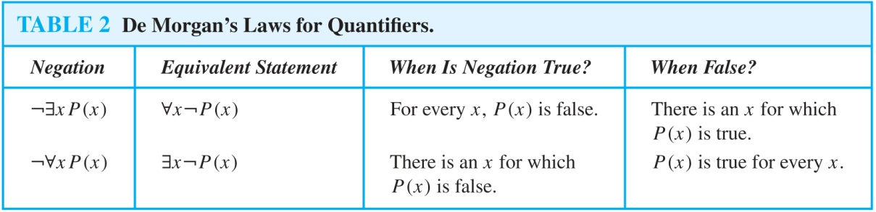
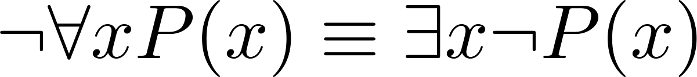
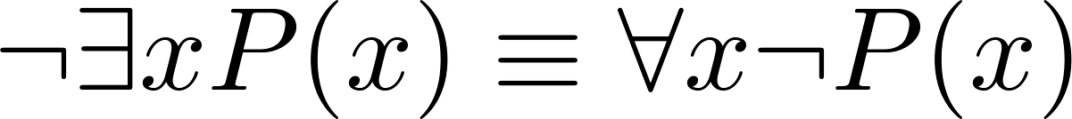
De Morgan’s Laws for Quantifiers
The rules for negating quantifiers are:
The reasoning in the table shows that:

Slide 87
Section Summary
Predicates
Variables
Quantifiers
Universal Quantifier
Existential Quantifier
Negating Quantifiers
De Morgan’s Laws for Quantifiers
Translating English to Logic
Logic Programming (optional)

Slide 88
Translation from English to Logic
“Some student in this class has visited Mexico.”
Solution: Let M(x) denote “x has visited Mexico” and S(x) denote “x is a student in this class,” and U be all people.
∃x (S(x) ∧ M(x))
“Every student in this class has visited Canada or Mexico.”
Solution: Add C(x) denoting “x has visited Canada.”
∀x (S(x)→ (M(x)∨C(x)))

Slide 89
采用一阶逻辑将下列命题符号化
没有不犯错误的人
M(x):x是人,F(x):x犯错误.
┐∃x(M(x) ∧ ┐F(x));
在北京工作的人未必都是北京人
F(x):x是北京工作的人,G(x):x是北京人.
┐ ∀x(F(x) →G(x)) ；
一切人都不一样高;
M(x):x是人,H(x,y):x和y是同一个人，L(x,y）:x和y一样高。
∀x∀y(M(x) ∧ M(y) ∧ ┐ H(x,y)→ ┐ L(x,y))；
每个自然数都有后继数
F(x):x是自然数； H(x,y)：y是x的后继数;
∀ x(F(x) →∃y(F(y) ∧ H(x,y)));
有的自然数无先驱数
F(x):x是自然数； L(x,y)：y是x的先驱数;
∃x(F(x) ∧ ∀y(F(y) → ┐ L(x,y)))

Slide 90
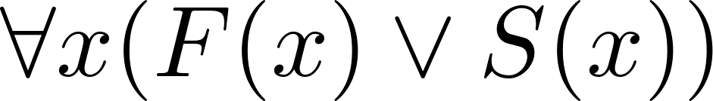
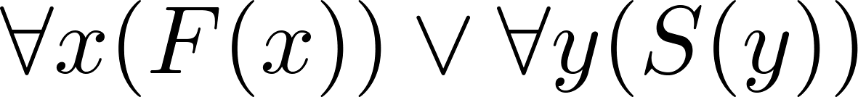
More Predicate Calculus Definitions (optional)
The scope （辖域） of a quantifier is the part of an assertion in which variables are bound by the quantifier.
Example: x has wide scope
Example: x has narrow scope

Slide 91
1 The Foundations: Logic and Proofs
1.1 Propositional Logic
1.2Applications of Propositional Logic 1.3 Propositional Equivalences 1.4 Predicates and Quantifiers 1.5 Nested Quantifiers 1.6 Rules of Inference 1.7 Introduction to Proofs 1.8 Proof Methods and Strategy

Slide 92
量词嵌套
Let Q(x, y, z) be the statement "x + y = z." What are the truth values of the statements
∀x∀y∃zQ(x, y, z) and ∃z∀x∀yQ(x, y, z) ?

Slide 93
Quantifier Equivalence Laws
Topic #3 – Predicate Logic
Expanding quantifiers: If u.d.=a,b,c,… ∀x P(x) ⇔ P(a)∧P(b)∧P(c)∧ … ∃x P(x) ⇔ P(a)∨P(b)∨P(c) ∨ …
From those, we can prove the laws: ∀x P(x) ⇔ ¬∃x ¬P(x) ∃x P(x) ⇔ ¬∀x ¬P(x)
Notes:
(Chalkboard.) Another way to see why the order of quantifiers matters is to expand out the definitions of FORALL and EXISTS in terms of AND and OR. For example, suppose the universe of discourse just consists of two objects a and b. Now, consider some predicate P(x,y).
Then,
FORALL x EXISTS y P(x,y) ⬄ (EXISTS y P(a,y)) /\ (EXISTS y P(b,y))
⬄ (P(a,a) \/ P(a,b)) /\ (P(b,a) \/ P(b,b)).
In contrast,
EXISTS y FORALL x P(x,y) ⬄ (FORALL x P(x,a)) \/ (FORALL x P(x,b))
⬄ (P(a,a) /\ P(b,a)) \/ (P(a,b) /\ P(b,b)).
To see that these two are inequivalent, suppose only P(a,a) and P(b,b) are true. Then, the first proposition (with the FORALL first) is true, but, the second proposition (with the EXISTS first) is true. Students can come up with this counterexample in-class as an exercise.

Slide 94
Negating nested quantifiers

Slide 95
More Equivalence Laws
Topic #3 – Predicate Logic
∀x ∀y P(x,y)⇔∀y ∀x P(x,y) ∃x ∃yP(x,y)⇔∃y ∃xP(x,y)
∀x (P(x)∧Q(x))⇔(∀xP(x))∧(∀xQ(x)) ∃x (P(x)∨Q(x)) ⇔ (∃x P(x))∨(∃x Q(x))
How about this one?
∃x (P(x)∧Q(x)) ？⇔(∃xP(x))∧(∃x Q(x))

Slide 96
More Equivalence Laws
Topic #3 – Predicate Logic
How about this one?
∃x (P(x)∧Q(x))？⇔(∃xP(x))∧(∃x Q(x)) ?
This equivalence statement is false. Counterexample: P(x): x’s birthday is on 30 April Q(x): x’s birthday is on 20 December

Slide 97
有限个体域上消去量词
设个体域为有限集D={a₁, a₂,…, a_{n}}, 则
∀xA(x)⇔A(a₁)∧A(a₂)∧…∧A(a_{n})
∃xA(x)⇔A(a₁)∨A(a₂)∨…∨A(a_{n})
例: 个体域D={a,b,c}, 则
∃x∀yF(x,y)
⇔∃x (F(x,a)∧F(x,b)∧F(x,c))
⇔ (F(a,a)∧F(a,b)∧F(a,c))∨
(F(b,a)∧F(b,b)∧F(b,c))∨
(F(c,a)∧F(c,b)∧F(c,c))

Slide 98
量词辖域收缩与扩张(∀)
n ∀x(A(x)∨B) ⇔ ∀xA(x)∨B
n ∀x(A(x)∧B) ⇔ ∀xA(x)∧B
n ∀x(A(x)→B) ⇔ ∃xA(x)→B
n ∀x(B→A(x)) ⇔ B→∀xA(x)
n 说明: B中不含x的出现
n 例1: ∀x(F(x)∨G(y)) ⇔ ∀xF(x)∨G(y)
n 例2: ∀x∀y(F(x)∧G(y)) ⇔∀x(F(x)∧∀yG(y))
⇔ ∀xF(x)∧∀yG(y)
Notes:
P56, 46-49题

Slide 99
量词辖域收缩与扩张
n ∀x(A(x)→B) ⇔ ∃xA(x)→B
证明: ∀x(A(x)→B)
⇔ ∀x(¬ A(x)∨B) ⇔∀x¬ A(x)∨B
⇔ ¬∃xA(x)∨B⇔∃xA(x)→B
n ∀x(B→A(x)) ⇔ B→∀xA(x)
证明: ∀x(B→A(x))
⇔ ∀x(¬ B∨A(x))
⇔ ¬ B∨∀xA(x) ⇔ B→∀xA(x)

Slide 100
量词辖域收缩与扩张(∃)
n ∃x(A(x)∨B) ⇔ ∃xA(x)∨B
n ∃x(A(x)∧B) ⇔ ∃xA(x)∧B
n ∃x(A(x)→B) ⇔ ∀xA(x)→B
n ∃x(B→A(x)) ⇔ B→∃xA(x)
n 说明: B中不含x的出现
n 例1: ∃x(F(x)∨G(y)) ⇔ ∃xF(x)∨G(y)
n 例2: ∀x∃y(F(x)∧G(y)) ⇔∀x(F(x)∧∃yG(y))
⇔ ∀xF(x)∧∃yG(y)

Slide 101
量词辖域收缩与扩张(∃、续)
n ∃x(A(x)→B) ⇔ ∀xA(x)→B
证明: ∃x(A(x)→B)
⇔ ∃x(¬ A(x)∨B) ⇔ ∃x ¬ A(x)∨B
⇔ ¬ ∀xA(x)∨B ⇔ ∀xA(x)→B
n ∃x(B→A(x)) ⇔ B→∃xA(x)
证明: ∃x(B→A(x))
⇔ ∃x(¬ B∨A(x)) ⇔ ¬ B∨∃xA(x)
⇔ ¬ B∨∃xA(x) ⇔ B→∃xA(x)

Slide 102
量词分配
n ∀x(A(x)∧B(x)) ⇔ ∀xA(x)∧∀xB(x)
n ∃x(A(x)∨B(x)) ⇔ ∃xA(x)∨∃xB(x)

Slide 103
量词分配(反例)
n ∀x(A(x)∨B(x)) ⇐ ∀xA(x)∨∀xB(x)
n ∀x(A(x)∨B(x)) ⇒ ∀xA(x)∨∀xB(x)
个体域为全体自然数; A(x): x是偶数
B(x): x是奇数; 左⇔T, 右⇔F
n ∃x(A(x)∧B(x)) ⇒ ∃xA(x)∧∃xB(x)
n ∃x(A(x)∧B(x)) ⇐ ∃xA(x)∧∃xB(x)
个体域为全体自然数; A(x): x是偶数
B(x): x是奇数; 左⇔F, 右⇔T

Slide 104
换名(rename)规则
n 把某个指导变项和其量词辖域中所有同名的约束出现, 都换成某个新的个体变项符号.
n 例如:
n ∀x(A(x)∧B(x)) ⇔ ∀y(A(y)∧B(y))
n ∀xA(x)∧∀xB(x) ⇔ ∀yA(y)∧∀zB(z)
n H(x,y)∨∃xF(x)∨∀y(G(y)→H(x,y))
⇔ H(x,y)∨∃zF(z)∨∀u(G(u)→H(x,u))

Slide 105
代替(substitute)规则
n 把某个自由变项的所有出现, 都换成某个新的个体变项符号.
n 例如:
n A(x)∧B(x) ⇔ A(y)∧B(y)
n ∀xA(x)∧B(x) ⇔ ∀xA(x)∧B(y)
n H(x,y)∨∃xF(x)∨∀y(G(y)→H(x,y))
⇔ H(s,t)∨∃xF(x)∨∀y(G(y)→H(s,y))

Slide 106
Dangerous situations
Commutativity of quantifiers
∀x∀yP(x, y) ⇔ ∀y∀xP( x, y)?
YES!
∀x∃yP(x, y) ⇔ ∃y∀xP(x, y)?
NO!
DIFFERENT MEANING!

Slide 107
谓词公式的范式
前束范式 prenex normal forms ：一个公式，如果量词均在全式的开头，它们的作用域，延伸到整个公式的末尾，则该公式称为前束范式。
如：
(∀ x)(∀ y)(∃ z)(Q(x,y) → R(z))
(∀ y)(∀ x)(¬ P(x,y) → Q(y))
方法：将¬后移，辖域扩张或收缩，换名和替换规则等值演算

Slide 108
求下列公式的前束范式
∀xF(x)∧¬∃xG(x) ⬄∀xF(x)∧∀x¬G(x)
⬄∀x(F(x)∧¬G(x))
2. ∀xF(x)∨¬∃xG(x) ⬄∀xF(x) ∨∀x¬G(x)
⬄∀xF(x) ∨∀y¬G(y)
⬄∀x∀y (F(x)∨¬G(y))

Slide 109
1 The Foundations: Logic and Proofs
1.1 Propositional Logic
1.2 Applications of Propositional Logic 1.3 Propositional Equivalences 1.4 Predicates and Quantifiers 1.5 Nested Quantifiers 1.6 Rules of Inference 1.7 Introduction to Proofs 1.8 Proof Methods and Strategy

Slide 110
Argument(论证)
A sequence of statements that end with a conclusion.
“If you have a current password, then you can log onto the network.”
“You have a current password.”
Therefore
“You can log onto the network.”

Slide 111
Definition 1
An argument (论证) in propositional logic is a sequence of propositions. All but the final proposition in the argument are called premises (前提) and the final proposition is called the conclusion (结论). An argument is valid if the truth of all its premises implies that the conclusion is true.

Slide 112
Argument form
An argument form in propositional logic is a sequence of compound propositions involving propositional variables. An argument form is valid if no matter which particular propositions are substituted for the propositional variables in its premises, the conclusion is true if the premises are all true.
Corresponding tautology:
((p₁) ∧ (p₂) ∧ … ∧ (p_{n}) ) → q

Slide 113
Argument form 论证的形式结构
premises： A₁,A₂ ,A₃ ,…,A_{k}
conclusion： B
An argument form is valid if and only if the following compound proposition is a tautology
(A₁∧A₂∧A₃∧…∧A_{k})→B

Slide 114
Argument form 论证的形式结构
premises：p∨q , ¬p conclusion：q
(p∨q )∧¬p →q is a tautology
p | q | p∨q | ¬p | (p∨q )∧¬p | (p∨q )∧¬p→q
0 0 1 1 | 0 1 0 1 | 0 1 1 1 | 1 1 0 0 | 0 1 0 0 | 1 1 1 1

Slide 115
Inference Rules 推理规则 General Form
An Inference Rule is
A pattern establishing that if we know that a set of antecedent statements of certain forms are all true, then we can validly deduce that a certain related consequent statement is true.
antecedent 1 antecedent 2 … ∴ consequent
“∴” means “therefore”

Slide 116
Inference Rules & Implications
Each valid logical inference rule corresponds to an implication that is a tautology.
antecedent 1 Inference rule antecedent 2 … ∴ consequent
Corresponding tautology:
((ante. 1) ∧ (ante. 2) ∧ …) → consequent

Slide 117
Modus Ponens & Tollens
p Rule of modus ponens 假言推理 p→q (a.k.a. law of detachment) ∴q
¬q p→q Rule of modus tollens 拒取式 ∴¬p
“the mode of affirming”
“the mode of denying”

Slide 118
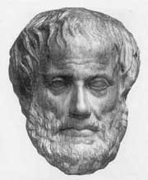
Syllogism Inference Rules
p→q Rule of hypothetical q→r syllogism 假言三段论 ∴p→r
p ∨ q Rule of disjunctive ¬p syllogism 析取三段论 ∴ q
Aristotle (ca. 384-322 B.C.)
Notes:
Many valid inference rules were first described by Aristotle. He called these patterns of argument “syllogisms.”

Slide 119
Some Inference Rules
p Rule of Addition 附加律 ∴ p∨q
p∧q Rule of Simplification 化简律 ∴ p
p Rule of Conjunction 合取律 q ∴ p∧q

Slide 120
Syllogism Inference Rules
p ∨ q Resolution ¬p ∨ r 消解原理 ∴ q ∨ r
Notes:
Many valid inference rules were first described by Aristotle. He called these patterns of argument “syllogisms.”

Slide 121
Formal Proofs
A formal proof of a conclusion C, given premises p₁, p₂,…,p_{n}, consists of a sequence of steps, each of which applies some inference rule to premises or previously-proven statements (antecedents) to yield a new true statement (the consequent).
A proof demonstrates that if the premises are true, then the conclusion is true.

Slide 122
Example
Show that the hypotheses “If you send me an e-mail message, then I will finish writing the program,” “If you do not send me an e-mail message, then I will go to sleep early,” and “If I go to sleep early, then I will wake up feeling refreshed” lead to the conclusion “If I do not finish writing the program, then I will wake up feeling refreshed.”

Slide 123
Proof Example
p: you send me an e-mail message.
q: I will finish writing the program.
r: I will go to sleep early.
s: I will wake up feeling refreshed.
p → q
¬ p →r
r→s
¬ q →s
Step Reason 1. p → q Premise #1. 2. ¬ q → ¬ p Contrapositive of 1. 3. ¬ p →r Premise #2. 4. ¬ q→r Hypothetical syllogism using 2,3. 5. r→s Premise #3. 6. ¬ q →s Hypothetical syllogism using 4,5.

Slide 124
Example
Show that the premises (p ∧ q) ∨ r and r → s imply the conclusion p ∨ s.
Proof:
We can rewrite the premises (p ∧ q) ∨ r as two clauses, (p ∨ r) ∧ (q ∨ r). We can also replace r → s by the equivalent clause ¬ r ∨ s. Using the two clauses p ∨ r and ¬ r ∨ s, we can use resolution to conclude p ∨ s.

Slide 125
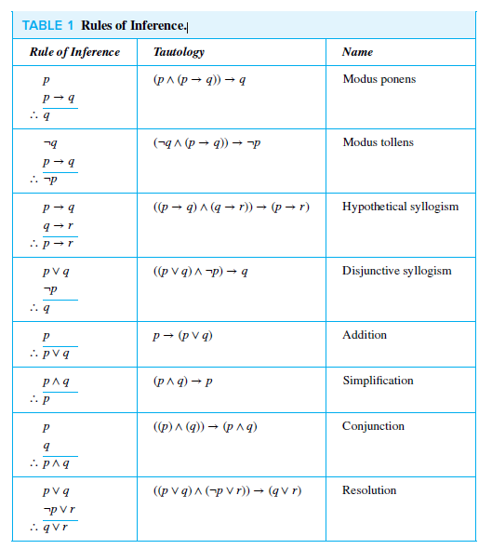
Rules of Inference.

Slide 126
推理规则
前提引入规则：在证明的任何步骤上都可以引入前提
结论引入规则：在证明的任何步骤上所得到的结论都可以做为后继证明的前提
置换规则：在证明的任何步骤上，命题公式中的子公式都可以用与之等值的公式置换，得到公式序列中又一个公式

Slide 127
证明
所谓证明，就是一些公式的序列，其中每一个公式或是已知的前提，或是由前面的公式运用推理规则得出的公式，最后一个公式是结论
前提： A₁,A₂ ,A₃ ,…,A_{k}
结论： B
证明： (1) A₁ 前提引入
(2) A₂ ××××(推理规则)
(3) A₃ ××××
  
(s) B ××××

Slide 128
推理证明(举例、续)
前提： (p∧q) →r， ¬s∨p，q
结论： s→r
证明： (1) ¬s∨p 前提引入
(2) s→p (1)置换
(3) (p∧q) →r 前提引入
(4) q →(p→r) (3)置换
(5) q 前提引入
(6) p→r (4)(5)假言推理
(7) s→r (2)(6)假言三段论

Slide 129
推理规则
附加前提推理规则(简称CP规则)
如果 ∑ ，A ⇒B，则∑ ⇒ A → B
注：∑代表一组前提
反证推理规则
如果 ∑ ， ¬ A ⇒F，则∑ ⇒ A

Slide 130
附加前提推理规则
欲证明（注：推理的结论为蕴含式）
前提：A₁, A₂, …, A_{k}
结论：B→C
等价地证明
前提：A₁, A₂, …, A_{k}, B
结论：C
原因： (A₁∧A₂∧…∧A_{k})→(B→C)
⇔ ¬( A₁∧A₂∧…∧A_{k})∨(¬B∨C)
⇔ ¬( A₁∧A₂∧…∧A_{k})∨(¬B)∨C
⇔ ¬( A₁∧A₂∧…∧A_{k}∧B)∨C
⇔ (A₁∧A₂∧…∧A_{k}∧Β)→C

Slide 131
附加前提推理规则
例: 前提：p∨q, p→r, r→¬s 结论：s→q
解 前提：p∨q, p→r, r→¬s, s 结论：q
① s 附加前提引入
② p→r 前提引入
③ r→¬s 前提引入
④ p→¬s ②③假言三段论
⑤ ¬p ①④拒取式
⑥ p∨q 前提引入
⑦ q ⑤⑥析取三段论

Slide 132
反证推理规则
欲证明 前提：A₁, A₂, … , A_{k} , 结论：A.
将¬A加入前提，若推出矛盾，则得证推理正确.
定理
(A₁ ∧ A₂ ∧ … ∧A_{k}) ⇒ A 推理正确，当且仅当 A₁ ∧ A₂ ∧ … ∧ A_{k} ∧ ¬A 为矛盾式.
原因:
A₁∧A₂∧…∧A_{k}→B
⇔ ¬(A₁∧A₂∧…∧A_{k})∨B
⇔ ¬(A₁∧A₂∧…∧A_{k}∧¬B)

Slide 133
反证推理规则
例： 构造下面推理的证明
前提：¬(p∧q)∨r, r→s, ¬s, p
结论：¬q
证明：用归缪法，证明 ¬(p∧q)∨r) ∧ (r→s) ∧ ¬s ∧ p ∧ q 为矛盾式
① q 结论否定引入
② r→s 前提引入
③ ¬s 前提引入
④ ¬r ②③拒取式
⑤ ¬(p∧q)∨r 前提引入
⑥ ¬(p∧q) ④⑤析取三段论
⑦ ¬p∨¬q ⑥置换
⑧ ¬p ①⑦析取三段论
⑨ p 前提引入
⑩¬p∧p ⑧⑨合取

Slide 134
Rules of Inference for Quantified Statements 一阶谓词的推理规则

Slide 135
一阶逻辑推理定律(定义)
推出： A⇒B
读作：A推出B
含义：A为真时, B也为真
A⇒B 当且仅当 A→B是永真式
例如： ∀xF(x) ⇒ ∃xF(x)
F

Slide 136
一阶逻辑的常用推理规则
前提引入、结论引入、置换规则
假言推理、附加、化简、拒取式、假言三段论、析取三段论、构造性两难、合取引入
UI、UG、EI、EG

Slide 137
Inference Rules for Quantifiers
∀x P(x) ∴P(o) (substitute any specific object o)
P(g) , for an arbitrary element g of u.d. ∴∀x P(x)
∃x P(x) ∴P(c) for some element c
P(o) for some element o ∴∃x P(x)
Universal instantiation
Universal generalization
Existential instantiation
Existential generalization

Slide 138
UI规则(universal instantiation) 全称量词实例化规则
表示为 ∀xA(x)
————
∴ A(c)
例如
(1) ∀x(F(x)→G(x)) 前提引入
(2) F(a)→G(a) (1)UI

Slide 139
UG规则(universal generalization) 全称量词引入规则
表示为 A(y), 任意y
————
∴ ∀xA(x)
例如 (1) F(y)→G(y) , 任意y 前提引入 (2) ∀x(F(x)→G(x)) (1)UG

Slide 140
EI规则(existential instantiation) 存在量词实例化规则
表示为 ∃xA(x)
————
∴ A(c), 对某个c
例如
(1) ∃x(F(x)∧G(x)) 前提引入
(2) F(a)∧G(a) (1)EI

Slide 141
EG规则(existential generalization) 存在量词引入规则
表示为 A(c), 对某个c
————
∴ ∃xA(x)
例如
(1) F(c)∧G(c) 前提引入
(2) ∃x(F(x)∧G(x)) (1)EG

Slide 142
构造推理的证明(举例)
前提: ∀x(F(x)→G(x))，F(a)
结论: G(a)
证明: (1) F(a) 前提引入
(2) ∀x(F(x)→G(x)) 前提引入
(3) F(a)→G(a) (2)UI
(4) G(a) (1)(3)假言推理

Slide 143
Returning to the Socrates Example
Introduce the propositional functions Man(x) denoting “x is a man” and Mortal(x) denoting “x is mortal.” Specify the domain as all people.
The two premises are:
∀x( Man(x) → Mortal(x) )
Man(Socrates)
The conclusion is:
Mortal(Socrates)

Slide 144
Returning to the Socrates Example
The two premises are:
∀x( Man(x) → Mortal(x) )
Man(Socrates)
The conclusion is:
Mortal(Socrates)
Proof
(1) ∀x( Man(x) → Mortal(x) ) 前提引入
(2) Man(Socrates) → Mortal(Socrates) (1)UI
(3) Man(Socrates) 前提引入
(4) Mortal(Socrates) (2)(3)假言推理

Slide 145
构造推理的证明(举例、续)
前提: ∀x(F(x)→G(x))，∃xF(x)
结论: ∃xG(x)
证明: (1) ∃xF(x) 前提引入
(2) F(c) (1) EI
(3) ∀x(F(x)→G(x)) 前提引入
(4) F(c)→G(c) (3) UI
(5) G(c) (2)(4)假言推理
(6) ∃xG(x) (5) EG

Slide 146
构造推理的证明(举例、续)
“先EI，后UI”
证明: (1) ∀x(F(x)→G(x)) 前提引入
(2) F(c)→G(c) (2) UI
(3) ∃xF(x) 前提引入
(4) F(c) (3) EI
  
说明：这个证明是错的. (3)(4)应当在(1)(2)前，(4)中的c是特定的， (2)中的c是任意的

Slide 147
Example
Show that the premises “A student in this class has not read the book,” and “ Everyone in this class passed the first exam” imply the conclusion “Someone who passed the first exam has not read the book.”

Slide 148
Example 13
C(x):x in this class B(x):x read the book
P(x):x pass the exam
Premises
∀x(C(x)→P(x)) Everyone in this class passed the exam
∃x(C(x)∧ ¬ B(x)) A student in this class has not read the book
Conclusion
∃x(P(x)∧ ¬ B(x)) Someone who passed the exam has not read the book.

Slide 149
Example 13
step Reason
1 ∃x(C(x)∧ ¬ B(x)) Premise
2 C(a)∧ ¬ B(a) EI
3 C(a) Simplification from (2)
4 ∀x(C(x)→P(x)) Premise
5 C(a)→P(a) UI
6 P(a) Modus ponens from(3)and(5)
7 ¬ B(a) Simplification from (2)
8 P(a)∧ ¬ B(a) Conjunction from(6) and (7)
9 ∃x(P(x)∧ ¬ B(x)) EG

Slide 150
1 The Foundations: Logic and Proofs
1.1 Propositional Logic
1.2 Applications of Propositional Logic 1.3 Propositional Equivalences 1.4 Predicates and Quantifiers 1.5 Nested Quantifiers 1.6 Rules of Inference 1.7 Introduction to Proofs 1.8 Proof Methods and Strategy

Slide 151
1.7 Introduction to Proofs 定理证明方法
1.7.1 Introduction
1.7.2 Some Terminology
1.7.3 Understanding How Theorems Are Stated
1.7.4 Methods of Proving Theorems
1.7.5 Direct Proofs
1.7.6 Proof by Contraposition
1.7.7 Proofs by Contradiction
1.7.8 Mistakes in Proofs

Slide 152
推理（deduction）
推理：从前提出发推出结论的思维过程
前提：已知命题公式的集合
结论：从前提出发应用推理规则推出的命题公式

Slide 153
1.7 Introduction to Proofs 定理证明方法
1、直接证明 / direct proof:
P → Q
2、间接证明 / indirect proof :
P → Q ⇔ ¬ Q → ¬ P
3、空证明 / vacuous proof:
P → Q 其中 P为 F
4、平凡证明 / trivial proof：
P → Q 其中 Q 为T
5、反证法 / proof of contradiction：
P
¬ P ⇒ S ∧ ¬ S

Slide 154
Proof Methods for Implications
For proving implications p → q, we have:
Direct proof: Assume p is true, and prove q.
Indirect proof: Assume ¬q, and prove ¬p.
(proof by contraposition :¬q →¬p )
Vacuous proof: Prove ¬p by itself.
Trivial proof: Prove q by itself.
Proof by Contradiction: Assume ¬p, and prove both q and ¬q for some proposition q.

Slide 155
Direct Proof Example
Definition: An integer n is called odd iff n=2k+1 for some integer k; n is even iff n=2k for some k.
Theorem: (For all numbers n) If n is an odd integer, then n² is an odd integer.
Proof: If n is odd, then n = 2k+1 for some integer k. Thus, n² = (2k+1)² = 4k² + 4k + 1 = 2(2k² + 2k) + 1. Therefore n² is of the form 2j + 1 (with j the integer 2k² + 2k), thus n² is odd. □
Notes:
The statement that every integer is either odd or even can actually be proven from simpler axioms, the Peano axioms of arithmetic. However, for

Slide 156
Indirect Proof Example Proof by Contraposition
Theorem: (For all integers n) If 3n+2 is odd, then n is odd.
Proof: Suppose that the conclusion is false, i.e., that n is even. Then n=2k for some integer k. Then 3n+2 = 3(2k)+2 = 6k+2 = 2(3k+1). Thus 3n+2 is even, because it equals 2j for integer j = 3k+1. So 3n+2 is not odd. We have shown that
¬(n is odd)→¬(3n+2 is odd),
thus its contrapositive (3n+2 is odd) → (n is odd)
is also true. □

Slide 157
Proof by Contradiction
A method for proving p.
Assume ¬p, and prove both q and ¬q for some proposition q. (Can be anything!)
Thus ¬p→ (q ∧ ¬q)
(q ∧ ¬q) is a trivial contradiction, equal to F
Thus ¬p→F, which is only true if ¬p=F
Thus p is true.

Slide 158
Proof by Contradiction Example
Theorem: is irrational.
Proof: Assume were rational. This means there are integers i,j with no common divisors such that = i/j.
Squaring both sides, 2 = i²/j², so 2j² = i². So i² is even; thus i is even.
Let i=2k. So 2j² = (2k)² = 4k². Dividing both sides by 2, j² = 2k². Thus j² is even, so j is even.
But then i and j have a common divisor, namely 2, so we have a contradiction. □

Slide 159
Common Fallacies
A fallacy is an inference rule or other proof method that is not logically valid.
A fallacy may yield a false conclusion!
Fallacy of affirming the conclusion:
“p→q is true, and q is true, so p must be true.” (No, because F→T is true.)
Fallacy of denying the hypothesis:
“p→q is true, and p is false, so q must be false.” (No, again because F→T is true.)
Notes:
It’s easy for each fallacy to give a counter-example showing why it is not valid.

Slide 160
Circular Reasoning
The fallacy of (explicitly or implicitly) assuming the very statement you are trying to prove in the course of its proof.
Example:
Prove if n² is even, then an integer n is even.
Attempted proof: “Assume n² is even. Then n²=2k for some integer k. Dividing both sides by n gives n = (2k)/n = 2(k/n). So there is an integer j (namely k/n) such that n=2j. Therefore n is even.”
Circular reasoning is used in this proof. Where?
Begs the question: How do you show that j=k/n=n/2 is an integer, without first assuming that n is even?
Notes:
The given statement is implicitly universal: FORALL integers n, n is even if n-squared is even.
Note that although the statement we are trying to prove is true, our proof of it is invalid. It does not give a clear, valid path to the conclusion.

Slide 161
1 The Foundations: Logic and Proofs
1.1 Propositional Logic
1.2 Applications of Propositional Logic 1.3 Propositional Equivalences 1.4 Predicates and Quantifiers 1.5 Nested Quantifiers 1.6 Rules of Inference 1.7 Introduction to Proofs 1.8 Proof Methods and Strategy

Slide 162
1.8 Proof Methods and Strategy
1.8.1 Introduction
1.8.2 Exhaustive Proof and Proof by Cases
1.8.3 Existence Proofs
1.8.4 Uniqueness Proofs
1.8.5 Proof Strategies
1.8.6 Looking for Counterexamples
1.8.7 Proof Strategy in Action
1.8.8 Tilings
1.8.9 The Role of Open Problems
1.8.10 Additional Proof Methods

Slide 163
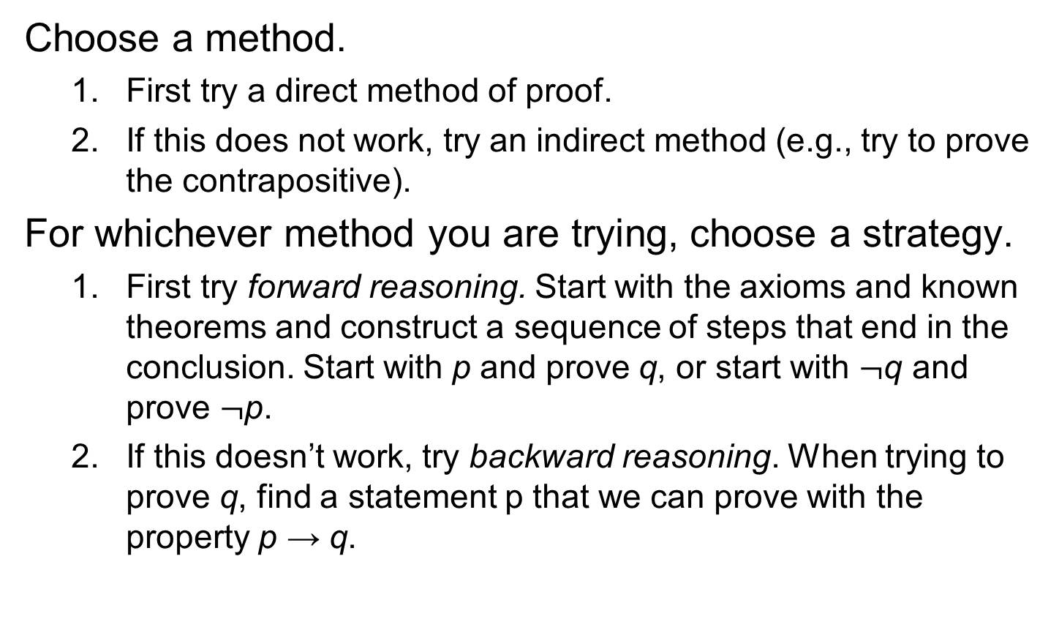
Proof Strategies for proving p → q

Slide 164
Forward Reasoning
Have premises p, and want to prove q.
Find a s₁ such that p→s₁
Then, find an s₂ such that s₁→s₂.
And hope to eventually get to an s_{n} such that s_{n}→q.
The problem with this method is…
It can be tough to see the path looking from p.

Slide 165
Backward Reasoning
It can often be easier to see the very same path if you just start looking from the conclusion q instead…
That is, first find an s₋₁ such that s₋₁→q.
Then, find an s₋₂ such that s₋₂→s₋₁, and so on…
Working back to an s_{−n} such that p→s_{−n.}
Note we still are using modus ponens to propagate truth forwards down the chain from p to s_{−n} to … to s₁ to q!
We are finding the chain backwards, but applying it forwards.
This is not quite the same thing as an indirect proof…
In that, we would use modus tollens and ¬q to prove ¬s₋₁, etc.
However, it is similar.

Slide 166
Backward Reasoning Example
Theorem: ∀a>0,b>0,a≠b: (a+b)/2 > (ab)^{1/2}.
Proof:
Notice it is not obvious how to go from the premises a>0, b>0, a≠b directly forward to the conclusion (a+b)/2 > (ab)^{1/2}.
So, let’s work backwards from the conclusion, (a+b)/2 > (ab)^{1/2} !

Slide 167
Steps of Example
(a+b)/2 > (ab)^{1/2} ⇔ (squaring both sides)
This preserves the “>” since both sides are positive.
(a+b)²/4 > ab ⇔ (multiplying through by 4)
(a+b)² > 4ab ⇔ (squaring a+b)
a²+2ab+b² > 4ab ⇔ (subtracting out 4ab)
a²−2ab+b² > 0 ⇔ (factoring left side)
(a−b)² > 0
Now, since a≠b, (a−b)≠0, thus (a−b)²>0, and we can work our way back along the chain of steps…

Slide 168
“Forwardized” version of Example
Theorem: ∀a>0,b>0,a≠b: (a+b)/2 > (ab)^{1/2}.
Proof. If Since a≠b, (a−b)≠0. Thus, (a−b)²>0, i.e., a²−2ab+b² > 0. Adding 4ab to both sides, a²+2ab+b² > 4ab. Factoring the left side, we have (a+b)² > 4ab, so (a+b)²/4 > ab. Since ab is positive, we can take the square root of both sides and get (a+b)/2 > (ab)^{1/2}. ■
This is just a simple proof proceeding directly from premises to conclusion, but if you don’t realize how it was obtained, it looks “magical.”
A common student reaction: “But how did you know to pick 4ab out of thin air, to add to both sides?”
Answer: By working backwards from the conclusion!

Slide 169
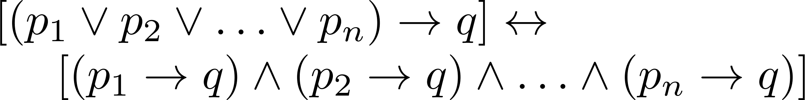

Proof by Cases
To prove a conditional statement of the form:
Use the tautology
Each of the implications is a case.

Slide 170
Proof by Cases
Example:
Let a @ b = max{a, b} = a
if a ≥ b, otherwise a @ b = max{a, b} = b.
Show that for all real numbers a, b, c
(a @b) @ c = a @ (b @ c)
(This means the operation @ is associative.)
Proof: Let a, b, and c be arbitrary real numbers.
Then one of the following 6 cases must hold.
a ≥ b ≥ c
a ≥ c ≥ b
b ≥ a ≥c
b ≥ c ≥a
c ≥ a ≥ b
c ≥ b ≥ a

Slide 171
Proof by Cases
Case 1: a ≥ b ≥ c
(a @ b) = a, a @ c = a, b @ c = b
Hence (a @ b) @ c = a = a @ (b @ c)
Therefore the equality holds for the first case.
A complete proof requires that the equality be shown to hold for all 6 cases. But the proofs of the remaining cases are similar. Try them.

Slide 172
Without Loss of Generality
Example: Show that if x and y are integers and both x∙y and x+y are even, then both x and y are even.
Proof: Use a proof by contraposition. Suppose x and y are not both even. Then, one or both are odd. Without loss of generality, assume that x is odd. Then x = 2m + 1 for some integer m.
Case 1: y is even. Then y = 2n for some integer n, so x + y = (2m + 1) + 2n = 2(m + n) + 1 is odd.
Case 2: y is odd. Then y = 2n + 1 for some integer n, so x ∙ y = (2m + 1) (2n + 1) = 2(2m ∙ n +m + n) + 1 is odd.
We only cover the case where x is odd because the case where y is odd is similar. The use phrase without loss of generality (WLOG) indicates this.

Slide 173
Proving Existentials
A proof of a statement of the form ∃x P(x) is called an existence proof.
If the proof demonstrates how to actually find or construct a specific element a such that P(a) is true, then it is a constructive proof.
Otherwise, it is nonconstructive.

Slide 174
Constructive Existence Proof
Theorem: There exists a positive integer n that is the sum of two perfect cubes in two different ways:
equal to j³ + k³ and l³ + m³ where j, k, l, m are positive integers, and {j,k} ≠ {l,m}
Proof: Consider n = 1729, j = 9, k = 10, l = 1, m = 12. Now just check that the equalities hold.

Slide 175
Another Constructive Existence Proof
Theorem: For any integer n>0, there exists a sequence of n consecutive composite integers.
Same statement in predicate logic: ∀n>0 ∃x ∀i (1≤i≤n)→(x+i is composite)
Proof follows on next slide…

Slide 176
The proof...
Given n>0, let x = (n + 1)! + 1.
Let i ≥ 1 and i ≤ n, and consider x+i.
Note x+i = (n + 1)! + (i + 1).
Note (i+1)|(n+1)!, since 2 ≤ i+1 ≤ n+1.
Also (i+1)|(i+1). So, (i+1)|(x+i).
∴ x+i is composite.
∴ ∀n ∃x ∀1≤i≤n : x+i is composite. Q.E.D.
Notes:
Need number theory for this example. At least, need the definitions of factorial “!”, and divides notation “|”.

Slide 177
Nonconstructive Existence Proof
Theorem: “There are infinitely many prime numbers.”
Any finite set of numbers must contain a maximal element, so we can prove the theorem if we can just show that there is no largest prime number.
i.e., show that for any prime number, there is a larger number that is also prime.
More generally: For any number, ∃ a larger prime.
Formally: Show ∀n ∃p>n : p is prime.

Slide 178
The proof, using proof by cases...
Given n>0, prove there is a prime p>n.
Consider x = n!+1. Since x>1, we know (x is prime)∨(x is composite).
Case 1: x is prime. Obviously x>n, so let p=x and we’re done.
Case 2: x has a prime factor p. But if p≤n, then x mod p = 1. So p>n, and we’re done.

