Slide 1
Trees 树
Chapter 11

Slide 2
Chapter Summary
Introduction to Trees
Tree Traversal
Spanning Trees

Slide 3
Introduction to Trees
Section 11.1

Slide 4
Section Summary 1
Introduction to Trees
Rooted Trees
Trees as Models
Properties of Trees

Slide 5
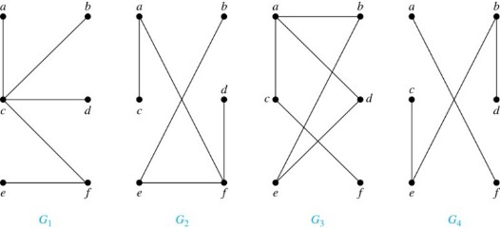
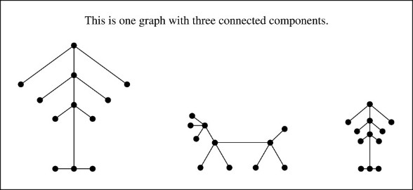
Trees 1
Definition: A tree is a connected undirected graph with no simple circuits【没有简单回路】.
Example: Which of these graphs are trees?
Solution:
1) G₁ and G₂ are trees . 2) G₃ is not a tree. 3) G₄ is not a tree because it is not connected.
Definition: A forest (森林) is a graph that has no simple circuit, but is not connected. Each of the connected components in a forest is a tree.

Slide 6
Trees
Theorem: An undirected graph is a tree if and only if there is a unique simple path between any two of its vertices [一个无向图是树，当且仅当任意两个节点之间有唯一的简单通路].
Proof:
1a）Assume that T is a tree. Then T is connected with no simple circuits. Hence, if x and y are distinct vertices of T, there is a simple path between them (by Theorem 1 of Section 10.4) 【树是连同的，存在简单通路】.
1b）This path must be unique - for if there were a second path, there would be a simple circuit in T (by Exercise 59 of Section 10.4). 【如果有两条简单通路，则会有回路】
1c）Hence, there is a unique simple path between any two vertices of a tree. 【所以树中任意两个节点，只存在唯一的简单通路】
2a）Now assume that there is a unique simple path between any two vertices of a graph T, then T is connected because there is a path between any two of its vertices. 【假设任意两个节点有唯一一条简单通路，则那么图是连通的】
2b) Furthermore, T can have no simple circuits since if there were a simple circuit, there would be two paths between some two vertices. 【由于任意节点间只有一条简单通路，所以没有回路】
2c) Hence, a graph with a unique simple path between any two vertices is a tree.

Slide 7
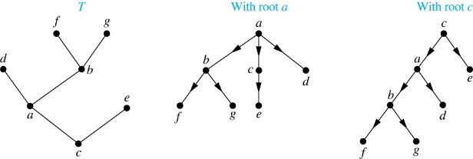
Rooted Trees 【根树】
Definition: A rooted tree is a tree in which one vertex has been designated as the root and every edge is directed away from the root.
An unrooted tree is converted into different rooted trees when different vertices are chosen as the root.

Slide 8
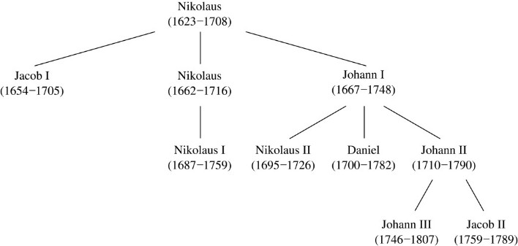
Rooted Tree Terminology
Terminology for rooted trees is amix from botany and genealogy (such as this family tree of the Bernoulli family of mathematicians).
If v is a vertex of a rooted tree other than the root, the parent [父节点] of v is the unique vertex u such that there is a directed edge from u to v. When u is a parent of v, v is called a child [孩子] of u. Vertices with the same parent are called siblings [兄弟].
The ancestors of a vertex are the vertices in the path from the root to this vertex, excluding the vertex itself and including the root. The descendants of a vertex v are those vertices that have v as an ancestor.
A vertex of a rooted tree with no children is called a leaf. Vertices that have children are called internal vertices.
If a is a vertex in a tree, the subtree with a as its root is the subgraph of the tree consisting of a and its descendants and all edges incident to these descendants.

Slide 9
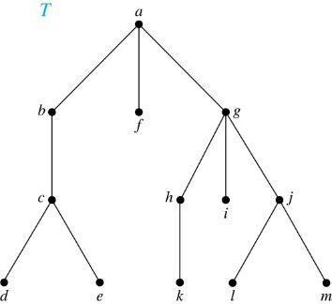
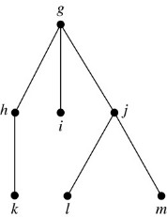
Terminology for Rooted Trees 【根树的术语】
Example: In the rooted tree T (with root a):
Find the parent of c, the children of g, the siblings【兄弟姐妹】 of h, the ancestors【祖先】 of e, and the descendants 【后代】 of b.
Find all internal vertices 【中间节点】and all leaves.【叶子】
What is the subtree 【子树】rooted at g?
Solution:
The parent of c is b. The children of g are h, i, and j. The siblings of h are i and j. The ancestors of e are c, b, and a. The descendants of b are c, d, and e.
The internal vertices are a, b, c, g, h, and j. The leaves are d, e, f, i, k, l, and m.
We display the subtree rooted at g.

Slide 10
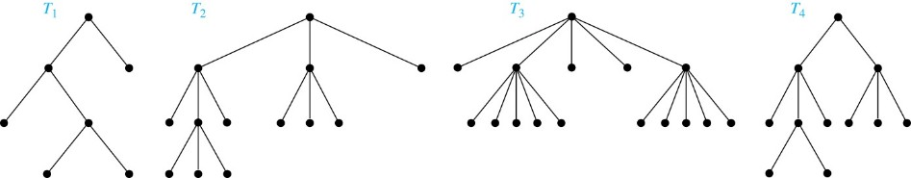
m-ary Rooted Trees 【m叉树】
Definition: A rooted tree is called an m-ary tree 【m叉树】 if every internal vertex has no more than m children. Definition: The tree is called a full m-ary tree 【满m叉树】 if every internal vertex has exactly m children. Definition: An m-ary tree with m = 2 is called a binary tree 【二叉树】.
Example: a) T1 is a full binary tree. b) T2 is a full 3-ary tree . c) T3 is a full 5-ary tree. d) T4 is not a full m-ary tree.

Slide 11
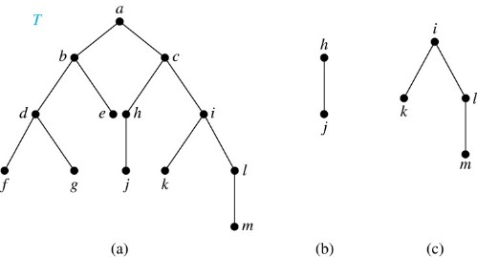
Ordered Rooted Trees 【有序根树】
Definition: An ordered rooted tree 【有序根树的定义】is a rooted tree where the children of each internal vertex are ordered.
Definition: A binary tree 【有序二叉树，简称二叉树】is an ordered rooted where each internal vertex has at most two children. If an internal vertex of a binary tree has two children, the first is called the left child 【左孩子】and the second the right child 【右孩子】. The tree rooted at the left child of a vertex is called the left subtree 【左子树】 of this vertex, and the tree rooted at the right child of a vertex is called the right subtree 【右子树】 of this vertex.
Example: Consider the binary tree T.
What are the left and right children of d?
What are the left and right subtrees of c?
Solution: The left child of d is f and the right child is g. The left and right subtrees of c are displayed in (b) and (c).

Slide 12
Properties of Trees 【树的性质】
Theorem : A tree with n vertices has n − 1 edges.
Proof : (by mathematical induction)
BASIS STEP: When n = 1, a tree with one vertex has no edges. Hence, the theorem holds when n = 1.
INDUCTIVE STEP: Assume that every tree with k vertices has k − 1 edges.
Suppose that a tree T has k + 1 vertices and that v is a leaf of T. Let w be the parent of v. Removing the vertex v and the edge connecting w to v produces a tree T′ with k vertices. By the inductive hypothesis, T′ has k − 1 edges. Because T has one more edge than T′, we see that T has k edges. This completes the inductive step.

Slide 13
Counting Vertices in Full m-Ary Trees【满叉树的节点计数】
Theorem: A full m-ary tree with i internal vertices has n = mi + 1 vertices.
Proof : Every vertex, except the root, is the child of an internal vertex. Because each of the i internal vertices has m children, there are mi vertices in the tree other than the root. Hence, the tree contains n = mi + 1 vertices.

Slide 14
Counting Vertices in Full m-Ary Trees 【满m叉树的节点计数】
Theorem : A full m-ary tree with n vertices has i = (n − 1)/m internal vertices and l = [(m − 1)n + 1]/m leaves. i internal vertices has n = mi + 1 vertices and l = (m − 1)i + 1 leaves. l leaves has n = (ml − 1)/(m − 1) vertices and i = (l − 1)/ (m − 1) internal vertices.
Proof (of part i): Solving for i in n = mi + 1 gives i = (n − 1)/m. Since each vertex is either a leaf or an internal vertex, n = l + i. By solving for l and using the formula for i, we see that

Slide 15
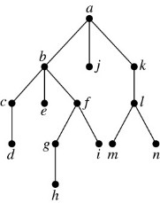
Level of vertices and height of trees
The level of a vertex v in a rooted tree is the length of the unique path from the root to this vertex. The height of a rooted tree is the maximum of the levels of the vertices.
Example: Find the level of each vertex in the tree to the right.
What is the height of the tree?
Solution:
The root a is at level 0. Vertices b, j, and k are at level 1.
Vertices c, e, f, and l are at level 2.
Vertices d, g, i, m, and n are at level 3.
Vertex h is at level 4. The height is 4, since 4 is the largest level of any vertex.

Slide 16
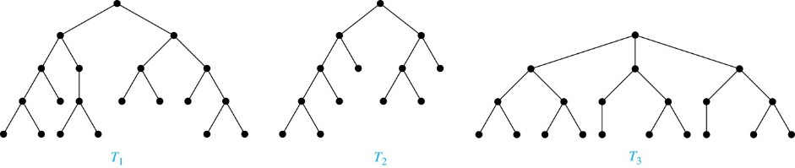
Balanced m-Ary Trees 【平衡m叉树】
Definition: A rooted m-ary tree of height h is balanced if all leaves are at levels h or h − 1.
Example: Which of the rooted trees shown below is balanced?
Solution: T₁ and T₃ are balanced, but T₂ is not because it has leaves at levels 2, 3, and 4.

Slide 17
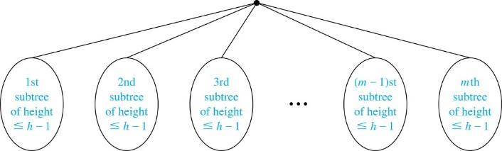
The Bound for the Number of Leaves in an m-Ary Tree 【叶子节点个数的上界】
Theorem：There are at most m^{h} leaves in an m-ary tree of height h.
Proof : (by mathematical induction on height）
BASIS STEP: Consider an m-ary trees of height 1. The tree consists of a root and no more than m children, all leaves. Hence, there are no more than m¹ = m leaves in an m-ary tree of height 1.
INDUCTIVE STEP: Assume the result is true for all m-ary trees of height < h. Let T be an m-ary tree of height h. The leaves of T are the leaves of the subtrees of T we get when we delete the edges from the root to each of the vertices of level 1.
Each of these subtrees has height ≤ h− 1. By the inductive hypothesis, each of these subtrees has at most m^{h− 1} leaves. Since there are at most m such subtrees, there are at most m⋅ m^{h− 1} = m^{h} leaves in the tree.
Corollary 1: If an m-ary tree of height h has l leaves, then h ≥ ⌈log_{m} l⌉. If the m-ary tree is full and balanced, then h = ⌈log_{m} l⌉.

Slide 18
Tree Traversal 【树的遍历】
Section 11.3

Slide 19
Section Summary 2
Traversal Algorithms
Infix, Prefix, and Postfix Notation

Slide 20
Tree Traversal
Procedures for systematically visiting every vertex of an ordered tree are called traversals【遍历】.
The three most commonly used traversals are preorder traversal, inorder traversal, and postorder traversal.

Slide 21
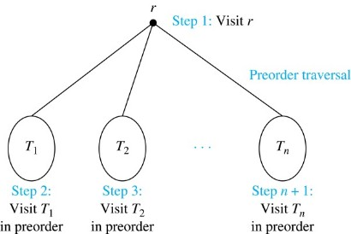
Preorder Traversal 【前序遍历】
Definition: Let T be an ordered rooted tree with root r. If T consists only of r, then r is the preorder traversal of T. Otherwise, suppose that T₁, T₂, …, T_{n} are the subtrees of r from left to right in T. The preorder traversal begins by visiting r, and continues by traversing T₁ in preorder, then T₂ in preorder, and so on, until T_{n} is traversed in preorder.

Slide 22
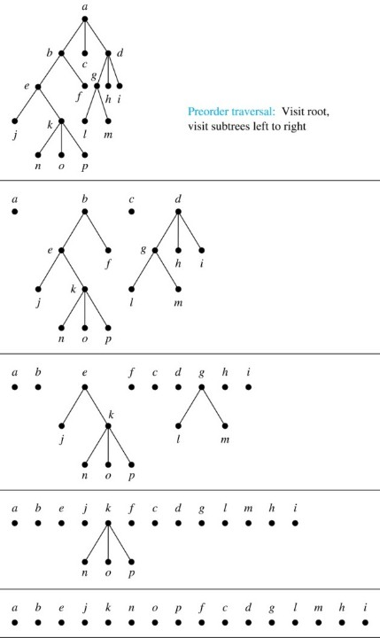
Preorder Traversal 【前序遍历】
procedure preorder (T: ordered rooted tree)
r := root of T
list r
for each child c of r from left to right{
T(c) := subtree with c as root
preorder(T(c))；【递归】
}
}

Slide 23
Preorder Traversal 【前序遍历】
Example: Give the node sequence of the following binary tree produced by preorder traversal.
A
B
C
D
E
F
Solution:
ABDCEF

Slide 24
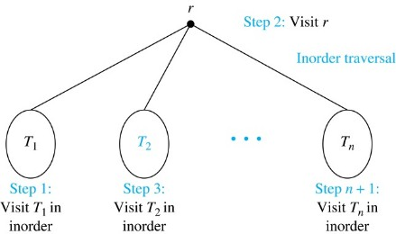
Inorder Traversal 【中序遍历】
Definition: Let T be an ordered rooted tree with root r. If T consists only of r, then r is the inorder traversal of T. Otherwise, suppose that T₁, T₂, …, T_{n} are the subtrees of r from left to right in T. The inorder traversal begins by traversing T₁ in inorder, then visiting r, and continues by traversing T₂ in inorder, and so on, until T_{n} is traversed in inorder.

Slide 25
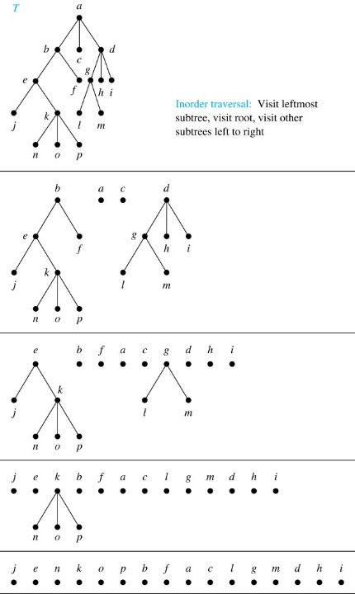
Inorder Traversal 【中序遍历】
procedure inorder (T: ordered rooted tree)
r := root of T
if r is a leaf then list r
else {
l := first child of r from left to right T(l) := subtree with l as its root
inorder(T(l))
list(r) // 【访问根节点】
for each other child c of r from left to right{
T(c) := subtree with c as root
inorder(T(c))
}
}
}

Slide 26
Inorder Traversal 【中序遍历】
Example: Give the node sequence of the following binary tree produced by inorder traversal.
A
B
C
D
E
F
Solution:
DBAECF

Slide 27
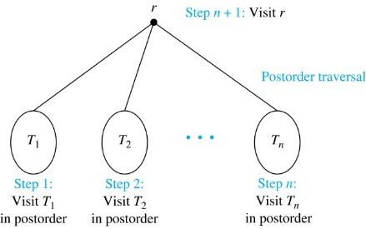
Postorder Traversal 【后序遍历】
Definition: Let T be an ordered rooted tree with root r. If T consists only of r, then r is the postorder traversal of T. Otherwise, suppose that T₁, T₂, …, T_{n} are the subtrees of r from left to right in T. The postorder traversal begins by traversing T₁ in postorder, then T₂ in postorder, and so on, after T_{n} is traversed in postorder, r is visited.

Slide 28
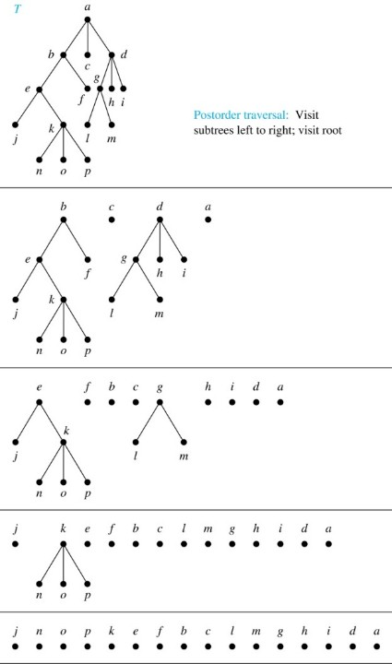
Postorder Traversal 【后序遍历】
procedure postorder (T: ordered rooted tree)
r := root of T
for each child c of r from left to right{
T(c) := subtree with c as root
postorder(T(c))
}
list r // 【访问根节点】

Slide 29
Postorder Traversal 【后序遍历】
Example: Give the node sequence of the following binary tree produced by postorder traversal.
A
B
C
D
E
F
Solution:
DBEFCA

Slide 30
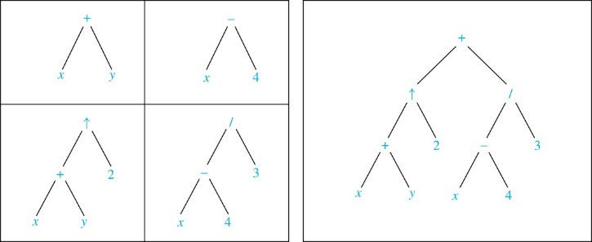
Expression Trees 【表达式树】
Complex expressions can be represented using ordered rooted trees.
Consider the expression
A binary tree for the expression can be built from the bottom up, as is illustrated here.

Slide 31
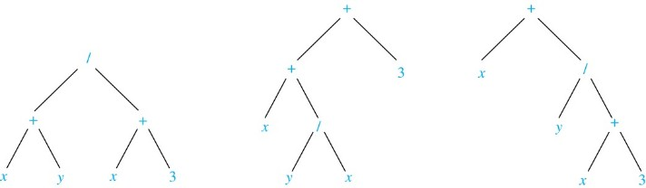
Infix Notation 【中缀记法】
An inorder traversal of the tree representing an expression produces the original expression when parentheses are included except for unary operations, which now immediately follow their operands.
We illustrate why parentheses are needed with an example that displays three trees all yield the same infix representation.

Slide 32
Prefix Notation 【前缀记法】
When we traverse the rooted tree representation of an expression in preorder, we obtain the prefix form of the expression. Expressions in prefix form are said to be in Polish notation【波兰记法】, named after the Polish logician Jan Łukasiewicz.
Operators precede their operands in the prefix form of an expression. Parentheses are not needed as the representation is unambiguous.
The prefix form of ((x + y) ↑ 2 ) + ((x − 4)/3) is
+ ↑ + x y 2 / − x 4 3.

Slide 33
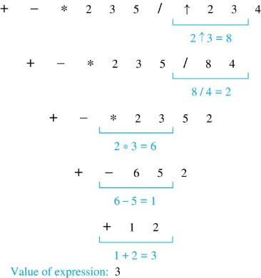
Prefix Notation 【前缀记法】
Example: We show the steps used to evaluate a particular prefix expression:

Slide 34
Postfix Notation 【后缀记法】
We obtain the postfix form of an expression by traversing its binary trees in postorder. Expressions written in postfix form are said to be in reverse Polish notation【逆波兰记法】.
Parentheses are not needed as the postfix form is unambiguous.
The postfix form of ((x + y) ↑ 2 ) + ((x − 4)/3) is
x y + 2 ↑ x 4 − 3 / +

Slide 35
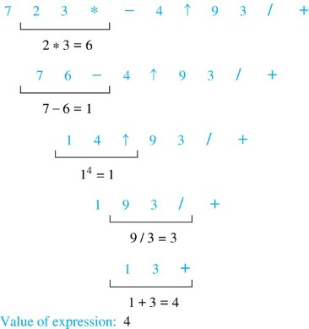
Postfix Notation 【后缀记法】
Example: We show the steps used to evaluate a particular postfix expression.

