Slide 1
2 Basic Structures: Sets, Functions, Sequences, Sums and Matrices
2.1 Sets
2.2 Set Operations
2.3 Functions
2.4 Sequences and Summations
2.5 Cardinality of Sets
2.6 Matrices

Slide 2
Introduction to Set Theory 集合论(§2.1)
A set is a new type of structure, representing an unordered collection (group, plurality) of zero or more distinct (different) objects.
Set theory deals with operations between, relations among, and statements about sets.
Sets are ubiquitous in computer software systems.
All of mathematics can be defined in terms of some form of set theory (using predicate logic).

Slide 3
Basic notations for sets
For sets, we’ll use variables S, T, U, …
Roster method: we can denote a set S in writing by listing all of its elements in curly braces:
{a, b, c} is the set of whatever 3 objects are denoted by a, b, c.
Set builder notation: For any proposition P(x) over any universe of discourse,
{x | P(x)} is the set of all x such that P(x).
Notes:
Read {a, b, c} as “the set whose elements are a, b, and c” or just “the set a, b, c”.

Slide 4
Basic properties of sets
Sets are inherently unordered:
No matter what objects a, b, and c denote, {a, b, c} = {a, c, b} = {b, a, c} = {b, c, a} = {c, a, b} = {c, b, a}.
All elements are distinct (unequal); multiple listings make no difference!
If a=b, then {a, b, c} = {a, c} = {b, c} = {a, a, b, a, b, c, c, c, c}.
This set contains (at most) 2 elements!

Slide 5
Definition of Set Equality 集合相等
Two sets are declared to be equal if and only if they contain exactly the same elements.
In particular, it does not matter how the set is defined or denoted.
For example:
The set {1, 2, 3, 4}
= {x | x is an integer where x>0 and x<5 }
= {x | x is a positive integer whose square is >0 and <25}

Slide 6
Infinite Sets 无限集
Conceptually, sets may be infinite (i.e., not finite, without end, unending).
Symbols for some special infinite sets: N = {0, 1, 2, …} The Natural numbers. Z = {…, -2, -1, 0, 1, 2, …} The Zntegers. R = The “Real” numbers, such as 374.1828471929498181917281943125…
“Blackboard Bold” or double-struck font (ℕ,ℤ,ℝ) is also often used for these special number sets.
Infinite sets come in different sizes!
Notes:
vowels

Slide 7
Basic Set Relations: Member of (成员)
x∈S (“x is in S”) is the proposition that object x is an ∈lement or member of set S.
e.g. 3∈N, “a”∈{x | x is a letter of the alphabet}
Can define set equality in terms of ∈ relation: ∀S,T: S=T ↔ (∀x: x∈S ↔ x∈T) “Two sets are equal iff they have all the same members.”
x∉S :≡ ¬(x∈S) “x is not in S”

Slide 8
The Empty Set 空集
∅ (“null”, “the empty set”) is the unique set that contains no elements whatsoever.
∅ = {} = {x | False}
No matter the domain of discourse, we have the axiom ¬∃x: x∈∅.

Slide 9
Subset 子集
S⊆T (“S is a subset of T”) means that every element of S is also an element of T.
S⊆T ⇔ ∀x (x∈S → x∈T)
∅⊆S, S⊆S.
Notes:
Note also that FORALL x P(x)->Q(x) can also be understood as meaning “{x|P(x)} is a subset of {x|Q{x}}”. This can help you understand the meaning of implication. For example, if I say, “if a student has a drivers license, then he is over 16,” this is the same as saying “the set of students with drivers licenses is a subset of the set of students who are over 16”, or “every student with a drivers license is over 16.” If no students in the universe of discourse have drivers licenses, then the antecedent is always false, or in other words the set of students with drivers licenses is just the empty set, which is of course a member of every set, and so the statement is vacuously true. Alternatively, if every student in the universe of discourse is over 16, then the consequent is always true, that is, the set of students who are over 16 is the entire universe of discourse, and so every set of students in the u.d. is necessarily a subset of the set of students who are over 16, and so the statement is trivially true. The statement is only false if there exists a student with a drivers license in the u.d. who is under 16 (perhaps the license is fake or from a foreign country), in which case, the set of students with drivers licenses is *not* a subset of the under-16 students.

Slide 10
Proper (Strict) Subsets 真子集
S⊂T (“S is a proper subset of T”) means that S⊆T but .
Example: {1,2} ⊂ {1,2,3}
S
T
Venn Diagram equivalent of S⊂T
Notes:
We may also say, “S is a strict subset of T”, or “S is strictly a subset of T” to mean the same thing.

Slide 11
Cardinality and Finiteness 基数
|S| (read “the cardinality of S”) is a measure of how many different elements S has.
e.g., |∅|=0, |{1,2,3}| = 3, |{a,b}| = 2, |{{1,2,3},{4,5}}| = ____
If there are exactly n distinct elements in S where n is a nonnegative integer, we say that S is a finite set. Otherwise, we say S is infinite set.
What are some infinite sets we’ve seen?
2
N
Z
R

Slide 12
The Power Set (幂集) Operation
The power set P(S) of a set S is the set of all subsets of S. P(S) :≡ {x | x⊆S}.
E.g. P({a,b}) = {∅, {a}, {b}, {a,b}}.
Sometimes P(S) is written 2^{S}. Note that for finite S, |P(S)| = 2^{|S|}.
It turns out ∀S:|P(S)|>|S|, e.g. |P(N)| > |N|.
Notes:
We’ll get to different sizes of infinite sets later, in the module on functions.

Slide 13
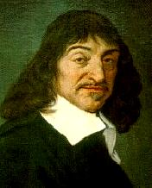
Cartesian Products of Sets 笛卡尔集
For sets A, B, their Cartesian product A×B :≡ {(a, b) | a∈A ∧ b∈B }.
E.g. {a,b}×{1,2} = {(a,1),(a,2),(b,1),(b,2)}
Note that for finite A, B, |A×B|=|A||B|.
Note that the Cartesian product is not commutative: i.e., ¬∀AB: A×B=B×A.
Extends to A₁ × A₂ × … × A_{n}...
René Descartes (1596-1650)
Notes:
Usually AxBxC is defined as {(a,b,c) | a is in A and b is in B and c is in C}.

Slide 14
Start §2.2: 集合运算The Union Operator 并集
For sets A, B, their∪nion A∪B is the set containing all elements that are either in A, or (“∨”) in B (or, of course, in both).
Formally, ∀A,B: A∪B = {x | x∈A ∨ x∈B}.
Note that A∪B is a superset of both A and B (in fact, it is the smallest such superset): ∀A, B: (A∪B ⊇ A) ∧ (A∪B ⊇ B)

Slide 15
The Intersection Operator 交集
For sets A, B, their intersection A∩B is the set containing all elements that are simultaneously in A and (“∧”) in B.
Formally, ∀A,B: A∩B={x | x∈A ∧ x∈B}.
Note that A∩B is a subset of both A and B (in fact it is the largest such subset): ∀A, B: (A∩B ⊆ A) ∧ (A∩B ⊆ B)

Slide 16
Set Difference 差集
For sets A, B, the difference of A and B, written A−B, is the set of all elements that are in A but not B. Formally: A − B :≡ {x | x∈A ∧ x∉B} = {x | ¬(x∈A → x∈B) }
Also called: The complement of B with respect to A.
Notes:
NOT (x in A -> x in B) = NOT (x not in A or x in B) (defn. of implies) = x in A AND x not in B (DeMorgan’s law).

Slide 17
Set Complements 补集
The universe of discourse can itself be considered a set, call it U.
When the context clearly defines U, we say that for any set A⊆U, the complement of A, written , is the complement of A w.r.t. U, i.e., it is U−A.
E.g., If U=N,

Slide 18
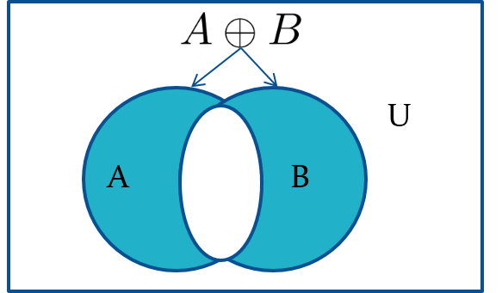
Symmetric Difference (optional)
Definition: The symmetric difference of A and B, denoted by
is the set
Example:
U = {0,1,2,3,4,5,6,7,8,9,10}
A = {1,2,3,4,5} B ={4,5,6,7,8}
What is
Solution: {1,2,3,6,7,8}
Venn Diagram

Slide 19
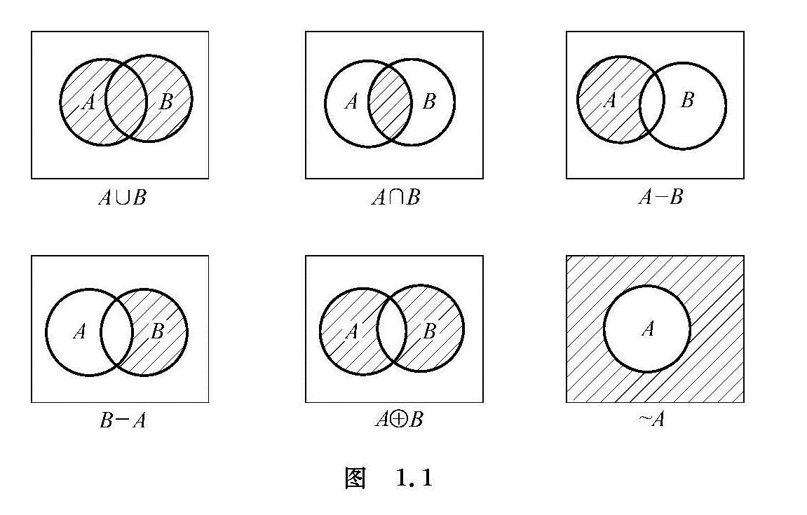
Venn Diagram

Slide 20
Set Identities
Identity laws
Domination laws
Idempotent laws
Complementation law

Slide 21
Set Identities 2
Commutative laws
Associative laws
Distributive laws

Slide 22
Set Identities 3
De Morgan’s laws
Absorption laws
Complement laws

Slide 23
DeMorgan’s Law for Sets
Exactly analogous to (and provable from) DeMorgan’s Law for propositions.

Slide 24
Proving Set Identities
Different ways to prove set identities:
Prove that each set (side of the identity) is a subset of the other.
Use set builder notation and propositional logic.
Membership Tables: Verify that elements in the same combination of sets always either belong or do not belong to the same side of the identity. Use 1 to indicate it is in the set and a 0 to indicate that it is not

Slide 25
Proof of Second De Morgan Law 1
Example: Prove that
Solution: We prove this identity by showing that:

Slide 26
Proof of Second De Morgan Law 2
These steps show that:

Slide 27
Proof of Second De Morgan Law 3
These steps show that:

Slide 28

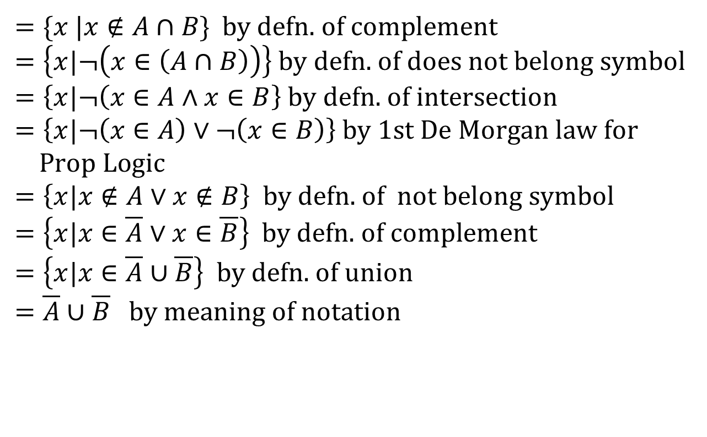
Set-Builder Notation: Second De Morgan Law
$$\overline{A∩B}$$
$$=\{x |x∉A∩B \} \text{by} \text{defn}\text{. }\text{of} \text{complement} \\ =\left\{x|¬\left(x∈\left(A∩B\right)\right)\right\} \text{by} \text{defn}\text{. }\text{of} \text{does} \text{not} \text{belong} \text{symbol} \\ =\left\{x|¬\left(x∈A∧x∈B\right.\right\} \text{by} \text{defn}\text{. }\text{of} \text{intersection} \\ =\left\{x|¬\left(x∈A\right)∨¬\left(x∈B\right)\right\} \text{by}\text{ 1}\text{st} \text{De} \text{Morgan} \text{law} \text{for} \\ \text{Prop} \text{Logic} \\ =\left\{x|x∉A∨x∉B\right\} \text{by} \text{defn}\text{. }\text{of} \text{not} \text{belong} \text{symbol} \\ =\left\{x|x∈\overline{A}∨x∈\overline{B}\right\} \text{by} \text{defn}\text{. }\text{of} \text{complement} \\ =\left\{x|x∈\overline{A}∪\overline{B}\right\} \text{by} \text{defn}\text{. }\text{of} \text{union} \\ =\overline{A}∪\overline{B} \text{by} \text{meaning} \text{of} \text{notation}$$

Slide 29
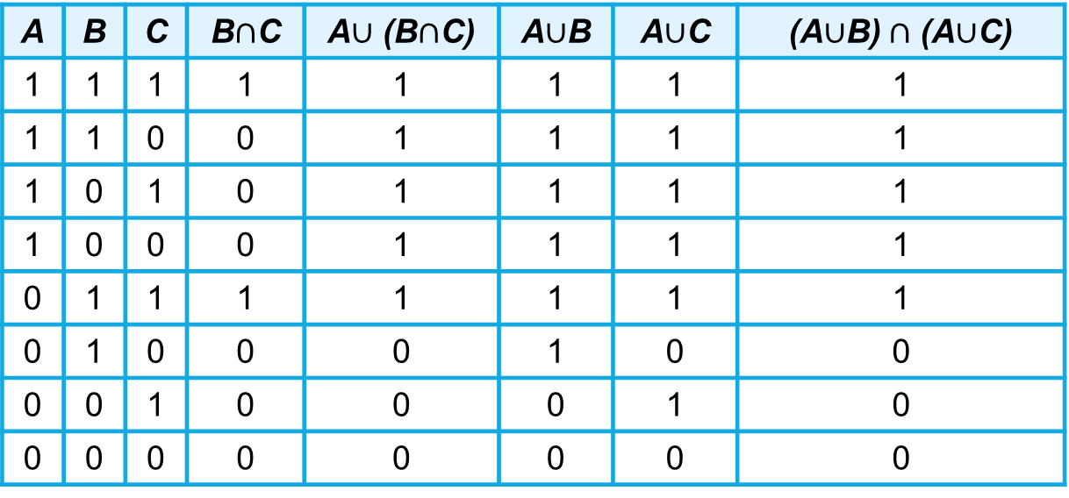
Membership Table
Example: Construct a membership table to show that the distributive law holds.
Solution:
A | B | C | B$∩$C | A$∪$ (B$∩$C) | A$∪$B | A$∪$C | (A$∪$B)$∩$ (A$∪$C)
1 | 1 | 1 | 1 | 1 | 1 | 1 | 1
1 | 1 | 0 | 0 | 1 | 1 | 1 | 1
1 | 0 | 1 | 0 | 1 | 1 | 1 | 1
1 | 0 | 0 | 0 | 1 | 1 | 1 | 1
0 | 1 | 1 | 1 | 1 | 1 | 1 | 1
0 | 1 | 0 | 0 | 0 | 1 | 0 | 0
0 | 0 | 1 | 0 | 0 | 0 | 1 | 0
0 | 0 | 0 | 0 | 0 | 0 | 0 | 0

Slide 30

Generalized Union
Binary union operator: A∪B
n-ary union: A∪A₂∪…∪A_{n} :≡ ((…((A₁∪ A₂) ∪…)∪ A_{n}) (grouping & order is irrelevant)
“Big U” notation:
$$\bigcup_{i=1}^{n}{A_{i}}$$

Slide 31

Generalized Intersection
Binary intersection operator: A∩B
n-ary intersection: A₁∩A₂∩…∩A_{n}≡((…((A₁∩A₂)∩…)∩A_{n}) (grouping & order is irrelevant)
“Big Arch” notation:
$$\bigcap_{i=1}^{n}{A_{i}}$$

Slide 32
Functions
Section 2.3

Slide 33
Section Summary
Definition of a Function.
Domain, Codomain
Image, Preimage
Injection, Surjection, Bijection
Inverse Function
Function Composition
Graphing Functions
Floor, Ceiling, Factorial
Partial Functions

Slide 34
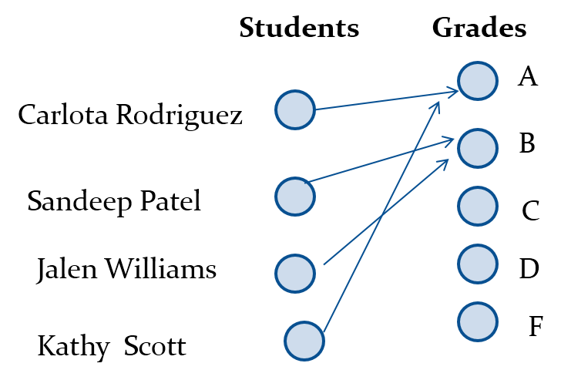
Functions 函数
Definition: Let A and B be nonempty sets. A function f from A to B, denoted f: A → B is an assignment of each element of A to exactly one element of B. We write f(a) = b if b is the unique element of B assigned by the function f to the element a of A.
Functions are sometimes called mappings or transformations.

Slide 35
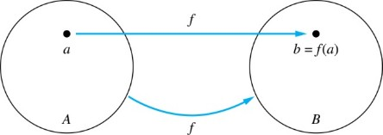
Functions 函数
Given a function f: A → B:
We say f maps A to B or f is a mapping from A to B.
A is called the domain (定义域) of f.
B is called the codomain (陪域) of f.
If f(a) = b,
then b is called the image (像) of a under f.
a is called the preimage (原像) of b.
The range of f is the set of all images of points in A under f. We denote it by f(A).
Two functions are equal when they have the same domain, the same codomain and map each element of the domain to the same element of the codomain.

Slide 36
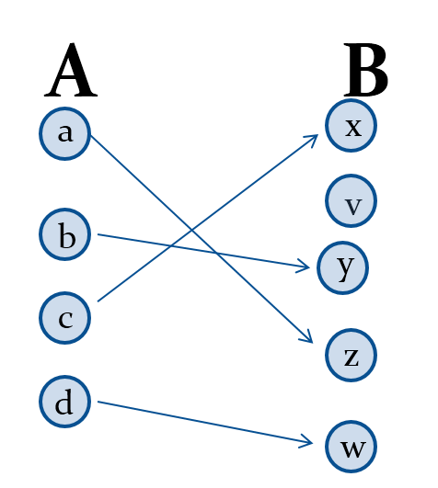

Injections 单射函数
Definition: A function f is said to be one-to-one , or injective, if and only if f(a) = f(b) implies that a = b for all a and b in the domain of f. A function is said to be an injection if it is one-to-one.

Slide 37
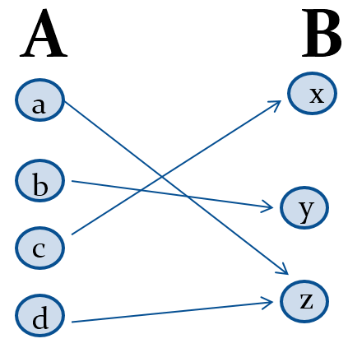
Surjections 满射函数
Definition: A function f from A to B is called onto or surjective, if and only if for every element
there is an element
with
A function f is called a surjection if it is onto.

Slide 38
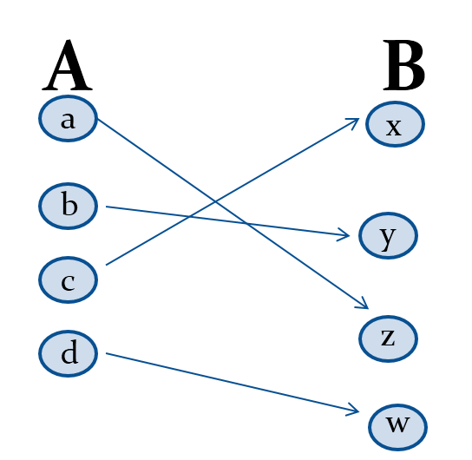
Bijections 双射函数
Definition: A function f is a one-to-one correspondence, or a bijection if it is both one-to-one and onto (surjective and injective).

Slide 39
Showing that f is one-to-one or onto 1
Suppose that f : A → B.
To show that f is injective Show that if f (x) = f (y) for arbitrary x, y ∈ A, then x = y.
To show that f is not injective Find particular elements x, y ∈ A such that x ≠ y and f (x) = f (y).
To show that f is surjective Consider an arbitrary element y ∈ B and find an element x ∈ A such that f (x) = y.
To show that f is not surjective Find a particular y ∈ B such that f (x) ≠ y for all x ∈ A.

Slide 40
Showing that f is one-to-one or onto 2
Example 1: Let f be the function from {a,b,c,d} to {1,2,3} defined by f(a) = 3, f(b) = 2, f(c) = 1, and f(d) = 3. Is f an onto function?
Solution: Yes, f is onto since all three elements of the codomain are images of elements in the domain. If the codomain were changed to {1,2,3,4}, f would not be onto.
Example 2: Is the function f(x) = x² from the set of integers to the set of integers onto?
Solution: No, f is not onto because there is no integer x with x² = −1, for example.

Slide 41
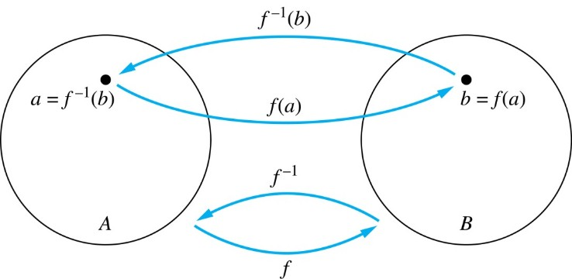
Inverse Functions 反函数
Definition: Let f be a bijection from A to B. Then the inverse of f, denoted
is the function from
B to A defined as
No inverse exists unless f is a bijection. Why?

Slide 42
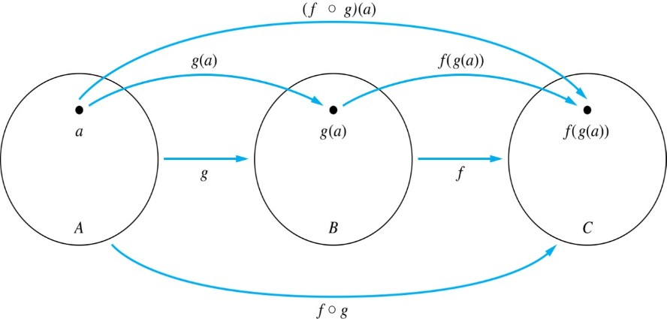
Composition 复合函数
Definition: Let f: B→C, g: A→B. The composition of f with g, denoted
is the function from A to C defined by

Slide 43
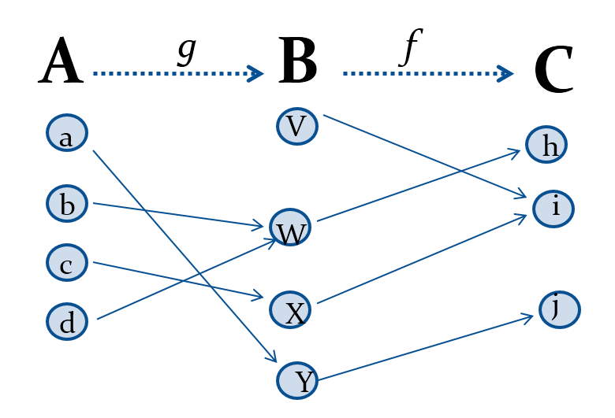
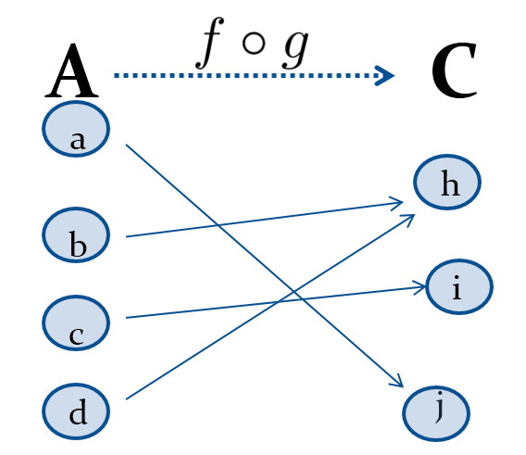
Composition 复合函数

Slide 44
Composition 复合函数
Example 1: If

Slide 45
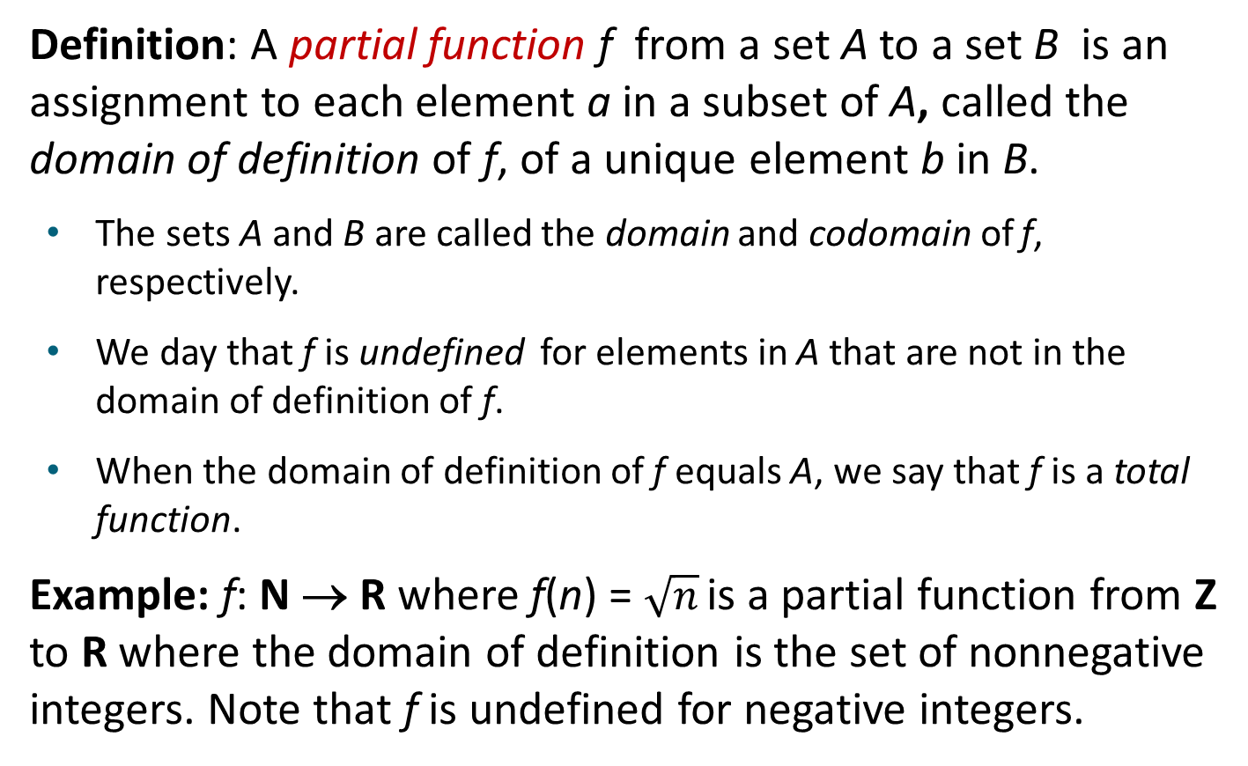
Partial Functions
Definition: A partial function f from a set A to a set B is an assignment to each element a in a subset of A, called the domain of definition of f, of a unique element b in B.
The sets A and B are called the domain and codomain of f, respectively.
We day that f is undefined for elements in A that are not in the domain of definition of f.
When the domain of definition of f equals A, we say that f is a total function.
Example: f: N → R where f(n) = $\sqrt{n}$ is a partial function from Z to R where the domain of definition is the set of nonnegative integers. Note that f is undefined for negative integers.

Slide 46
Sequences and Summations
Section 2.4

Slide 47
Section Summary
Sequences.
Examples: Geometric Progression, Arithmetic Progression
Recurrence Relations
Example: Fibonacci Sequence
Summations
Special Integer Sequences

Slide 48
Sequences 序列
Definition: A sequence is a function from a subset of the integers (usually either the set {0, 1, 2, 3, 4, …..} or {1, 2, 3, 4, ….}) to a set S.
The notation a_{n} is used to denote the image of the integer n. We can think of a_{n} as the equivalent of f(n) where f is a function from {0,1,2,…..} to S. We call a_{n} a term of the sequence.

Slide 49

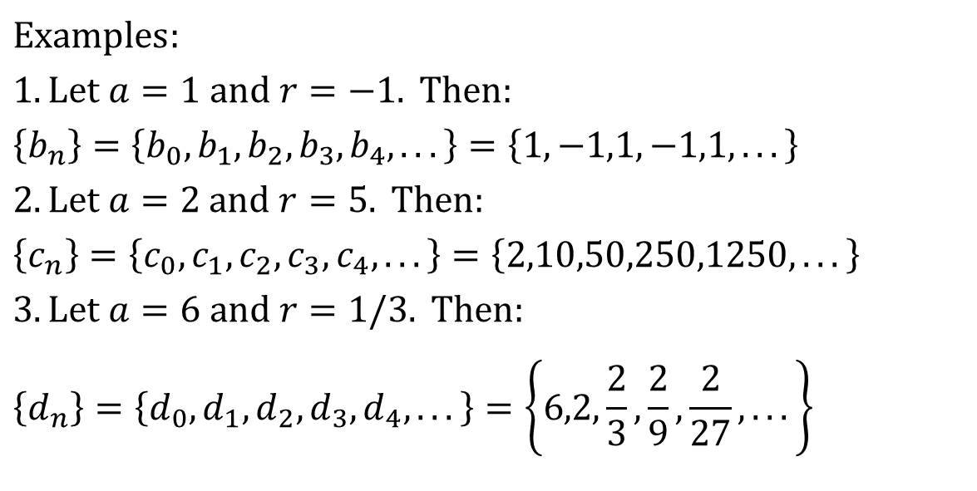
Geometric Progression 几何级数
Definition: A geometric progression is a sequence of the form:
$$a,ar^{1},ar^{2},…,ar^{n},…$$
where the initial term a and the common ratio r are real numbers.
$$Examples: \\ 1.\text{Let} a=1 \text{and} r=−1. \text{Then}: \\ \left\{b_{n}\right\}=\left\{b_{0},b_{1},b_{2},b_{3},b_{4},...\right\}=\left\{1,−1,1,−1,1,...\right\} \\ 2.\text{Let} a=2 \text{and} r=5. \text{Then}: \\ \left\{c_{n}\right\}=\left\{c_{0},c_{1},c_{2},c_{3},c_{4},...\right\}=\left\{2,10,50,250,1250,...\right\} \\ 3.\text{Let} a=6 \text{and} r=1/3. \text{Then}: \\ \left\{d_{n}\right\}=\left\{d_{0},d_{1},d_{2},d_{3},d_{4},...\right\}=\left\{6,2,\frac{2}{3},\frac{2}{9},\frac{2}{27},...\right\}$$

Slide 50
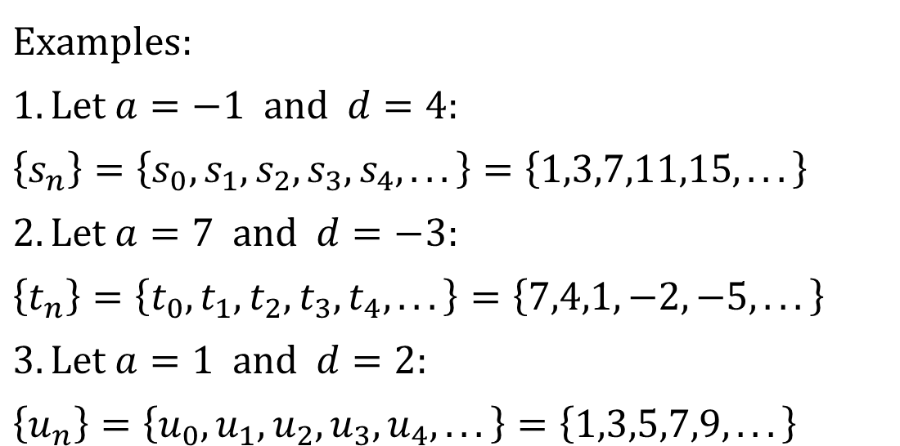
Arithmetic Progression 算数级数
Definition: A arithmetic progression is a sequence of the form:
where the initial term a and the common difference d are real numbers.
$$Examples: \\ 1.\text{Let} a=−1 \text{and} d=4: \\ \left\{s_{n}\right\}=\left\{s_{0},s_{1},s_{2},s_{3},s_{4},...\right\}=\left\{1,3,7,11,15,...\right\} \\ 2.\text{Let} a=7 \text{and} d=−3: \\ \left\{t_{n}\right\}=\left\{t_{0},t_{1},t_{2},t_{3},t_{4},...\right\}=\left\{7,4,1,−2,−5,...\right\} \\ 3.\text{Let} a=1 \text{and} d=2: \\ \left\{u_{n}\right\}=\left\{u_{0},u_{1},u_{2},u_{3},u_{4},...\right\}=\left\{1,3,5,7,9,...\right\}$$

Slide 51
Recurrence Relations 递推关系
Definition: A recurrence relation for the sequence {a_{n}} is an equation that expresses a_{n} in terms of one or more of the previous terms of the sequence, namely, a₀, a₁, …, a_{n−1}, for all integers n with n ≥ n₀, where n₀ is a nonnegative integer.
A sequence is called a solution of a recurrence relation if its terms satisfy the recurrence relation.
The initial conditions for a sequence specify the terms that precede the first term where the recurrence relation takes effect.

Slide 52
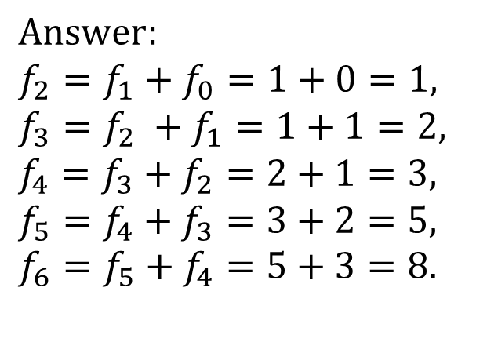
Fibonacci Sequence 斐波那契数列
Definition: Define the Fibonacci sequence, f₀ ,f₁ ,f₂,…, by:
Initial Conditions: f₀ = 0, f₁ = 1
Recurrence Relation: f_{n} = f_{n−1} + f_{n−2}
Example: Find f₂ ,f₃ ,f₄ , f₅ and f₆ .
$$Answer: \\ f_{2}=f_{1}+f_{0}=1+0=1, \\ f_{3}=f_{2} +f_{1}=1+1=2, \\ f_{4}=f_{3}+f_{2}=2+1=3, \\ f_{5}=f_{4}+f_{3}=3+2=5, \\ f_{6}=f_{5}+f_{4}=5+3=8.$$

Slide 53
Solving Recurrence Relations
Finding a formula for the nth term of the sequence generated by a recurrence relation is called solving the recurrence relation.
Such a formula is called a closed formula.
Various methods for solving recurrence relations will be covered in Chapter 8 where recurrence relations will be studied in greater depth.
Here we illustrate by example the method of iteration in which we need to guess the formula. The guess can be proved correct by the method of induction (Chapter 5).

Slide 54
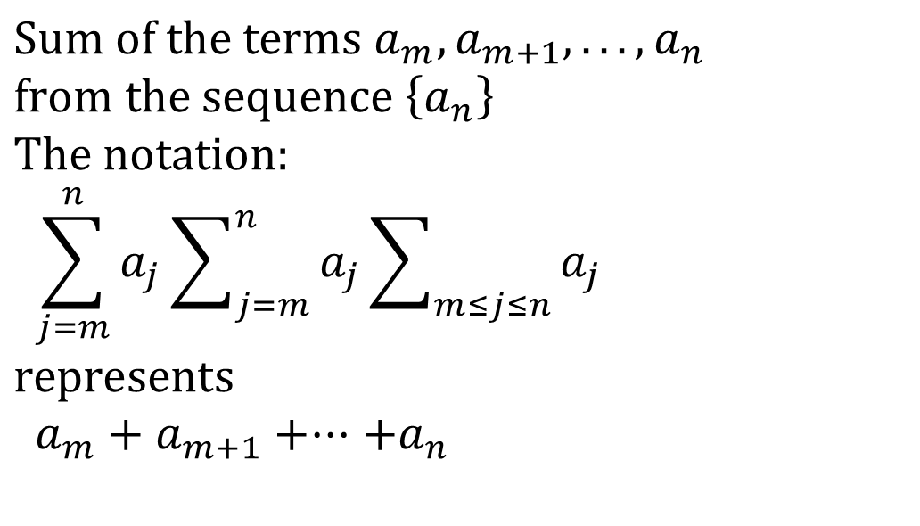
Summations
$$\text{Sum} \text{of} \text{the} \text{terms} a_{m},a_{m+1},...,a_{n} \\ \text{from} \text{the} \text{sequence} \left\{a_{n}\right\} \\ \text{The} \text{notation}\text{:} \\ \sum_{j=m}^{n}{a_{j}}\sum_{j=m}^{n}{a_{j}}\sum_{m≤j≤n}{a_{j}} \\ \text{represents} \\ a_{m}+a_{m+1}+⋅⋅⋅+a_{n}$$
The variable j is called the index of summation. It runs through all the integers starting with its lower limit m and ending with its upper limit n.

Slide 55
Summations

Slide 56
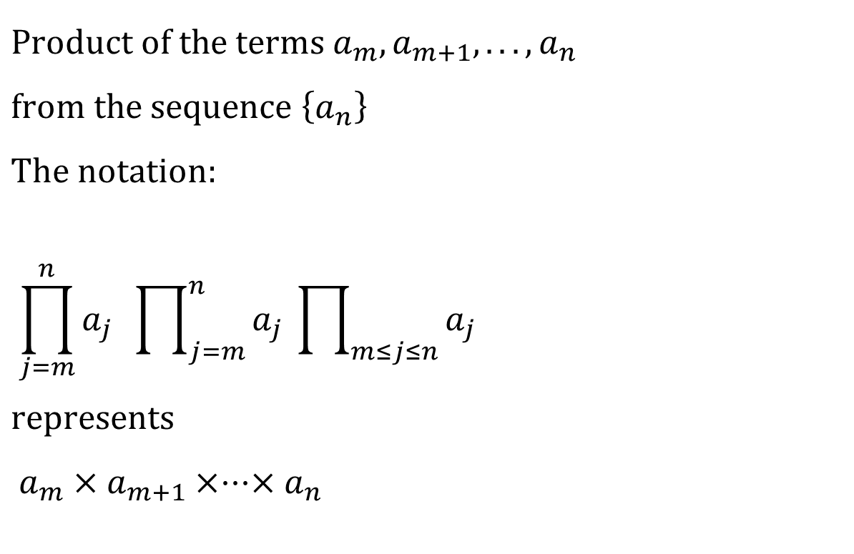
Product Notation
$$\text{Product} \text{of} \text{the} \text{terms} a_{m},a_{m+1},...,a_{n} \\ \text{from} \text{the} \text{sequence} \left\{a_{n}\right\} \\ \text{The} \text{notation}\text{:} \\ \prod_{j=m}^{n}{a_{j}} \prod_{j=m}^{n}{a_{j}} \prod_{m≤j≤n}{a_{j}} \\ \text{represents} \\ a_{m}×a_{m+1}×⋅⋅⋅×a_{n}$$

Slide 57
Geometric Series 1
Sums of terms of geometric progressions
Proof: Let
To compute S_{n} , first multiply both sides of the equality by r and then manipulate the resulting sum as follows:

Slide 58
Geometric Series
From previous slide.
Shifting the index of summation with k = j + 1.
Removing k = n + 1 term and adding k = 0 term.
Substituting S for summation formula
if r ≠1
if r = 1

Slide 59
Some Useful Summation Formulae
TABLE 2 Some Useful Summation Formulae.
Sum | Closed From
Geometric Series: We just proved this.
Later we will prove some of these by induction.
Proof in text (requires calculus)

Slide 60
Cardinality of Sets
Section 2.5

Slide 61
Section Summary
Cardinality
Countable Sets
Computability

Slide 62
Cardinality 基数
Definition: The cardinality of a set A is equal to the cardinality of a set B, denoted
|A| = |B|,
if and only if there is a one-to-one correspondence (i.e., a bijection) from A to B.
If there is a one-to-one function (i.e., an injection) from A to B, the cardinality of A is less than or the same as the cardinality of B and we write |A| ≤ |B|.
When |A| ≤ |B| and A and B have different cardinality, we say that the cardinality of A is less than the cardinality of B and write |A| < |B|.

Slide 63
Cardinality 基数
Definition: A set that is either finite or has the same cardinality as the set of positive integers (Z⁺) is called countable. A set that is not countable is uncountable.
The set of real numbers R is an uncountable set.
When an infinite set is countable (countably infinite) its cardinality is ℵ₀ (where ℵ is aleph, the 1st letter of the Hebrew alphabet). We write |S| = ℵ₀ and say that S has cardinality “aleph null.”

Slide 64
Showing that a Set is Countable
An infinite set is countable if and only if it is possible to list the elements of the set in a sequence (indexed by the positive integers).
The reason for this is that a one-to-one correspondence f from the set of positive integers to a set S can be expressed in terms of a sequence a₁,a₂,…, a_{n} ,… where a₁ = f(1), a₂ = f(2),…, a_{n} = f(n),…

Slide 65
Showing that a Set is Countable 1
Example 1: Show that the set of positive even integers E is countable set.
Solution: Let
Then f is a bijection from N to E since f is both one-to-one and onto. To show that it is one-to-one, suppose that f(n) = f(m). Then 2n = 2m, and so n = m. To see that it is onto, suppose that t is an even positive integer. Then t = 2k for some positive integer k and f(k) = t.

Slide 66
Showing that a Set is Countable 2
Example 2: Show that the set of integers Z is countable.
Solution: Can list in a sequence:
0, 1, − 1, 2, − 2, 3, − 3 ,………..
Or can define a bijection from N to Z:
When n is even: f(n) = n/2
When n is odd: f(n) = −(n−1)/2

Slide 67
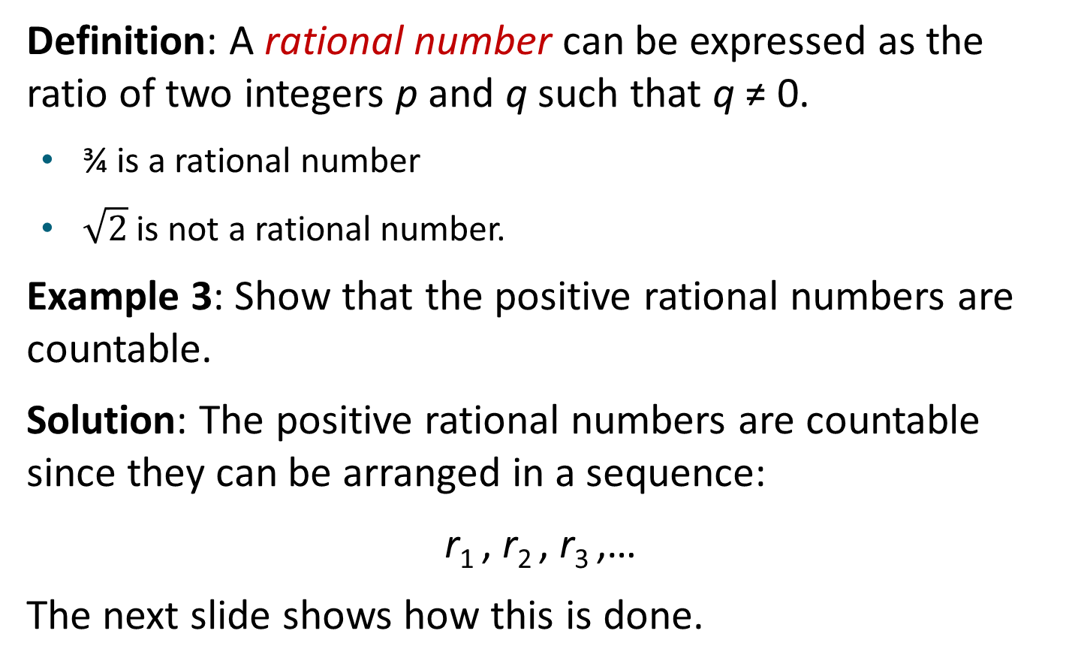
The Positive Rational Numbers are Countable 1
Definition: A rational number can be expressed as the ratio of two integers p and q such that q ≠ 0.
¾ is a rational number
$\sqrt{2}$ is not a rational number.
Example 3: Show that the positive rational numbers are countable.
Solution: The positive rational numbers are countable since they can be arranged in a sequence:
r₁ , r₂ , r₃ ,…
The next slide shows how this is done.
Notes:
根号2

Slide 68
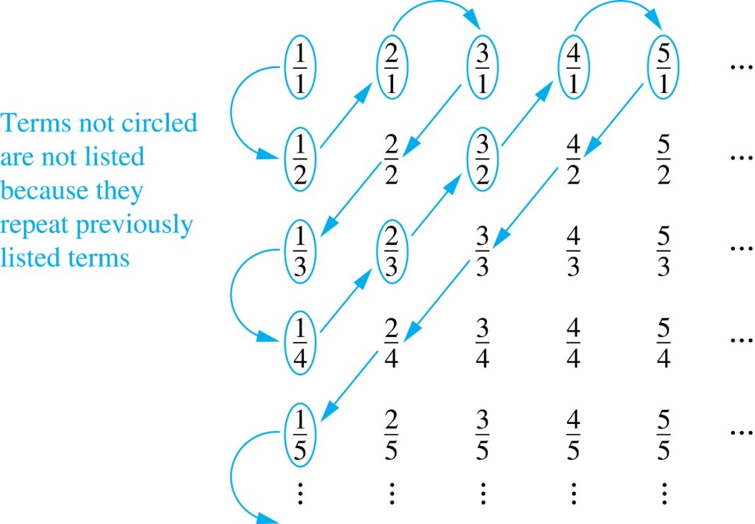
The Positive Rational Numbers are Countable 2
Constructing the List
First list p/q with p + q = 2.
Next list p/q with p + q = 3
And so on.
1, ½, 2, 3, 1/3,1/4, 2/3, ….
First row q = 1.
Second row q = 2.
etc.

Slide 69
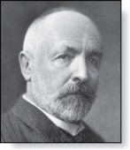

The Real Numbers are Uncountable
Georg Cantor
(1845-1918)
Example: Show that the set of real numbers is uncountable.
Solution: The method is called the Cantor diagnalization (康托对角线法) argument, and is a proof by contradiction.
Suppose R is countable. Then the real numbers between 0 and 1 are also countable (any subset of a countable set is countable - an exercise in the text).
The real numbers between 0 and 1 can be listed in order r₁ , r₂ , r₃ ,… .
Let the decimal representation of this listing be
r₁ = 0.d_{1,1} d_{1,2} d_{1,3} d_{1,4} d_{1,5} d_{1,6} d_{1,7} d_{1,8}… r₂ = 0.d_{2,1} d_{2,2} d_{2,3} d_{2,4} d_{2,5} d_{2,6} d_{2,7} d_{2,8}… r₃ = 0.d_{3,1} d_{3,2} d_{3,3} d_{3,4} d_{3,5} d_{3,6} d_{3,7} d_{3,8}… r₄ = 0.d_{4,1} d_{4,2} d_{4,3} d_{4,4} d_{4,5} d_{4,6} d_{4,7} d_{4,8}… $$. \\ .$$
Form a new real number with the decimal expansion

Slide 70
The Real Numbers are Uncountable
Georg Cantor
(1845-1918)
Example: Show that the set of real numbers is uncountable.
Solution: The method is called the Cantor diagnalization (康托对角线法) argument, and is a proof by contradiction.
r is not equal to any of the r₁ , r₂ , r₃ ,... Because it differs from r_{i} in its ith position after the decimal point. Therefore there is a real number between 0 and 1 that is not on the list since every real number has a unique decimal expansion. Hence, all the real numbers between 0 and 1 cannot be listed, so the set of real numbers between 0 and 1 is uncountable.
Since a set with an uncountable subset is uncountable (an exercise), the set of real numbers is uncountable.
E.g., a postulated enumeration of the reals: r₁ = 0.301948571… r₂ = 0.103918481… r₃ = 0.039194193… r₄ = 0.918237461…
Then, 0.4333… can’t be on the list anywhere!

Slide 71
Matrices
Section 2.6

Slide 72
Section Summary
Definition of a Matrix
Matrix Arithmetic
Transposes and Powers of Arithmetic
Zero-One matrices

Slide 73
Matrices
Matrices are useful discrete structures that can be used in many ways. For example, they are used to:
describe certain types of functions known as linear transformations.
Express which vertices of a graph are connected by edges (see Chapter 10).
In later chapters, we will see matrices used to build models of:
Transportation systems.
Communication networks.
Algorithms based on matrix models will be presented in later chapters.
Here we cover the aspect of matrix arithmetic that will be needed later.

Slide 74
Matrix
Definition: A matrix is a rectangular array of numbers. A matrix with m rows and n columns is called an m × n matrix.
The plural of matrix is matrices.
A matrix with the same number of rows as columns is called square.
Two matrices are equal if they have the same number of rows and the same number of columns and the corresponding entries in every position are equal.
3 × 2 matrix

Slide 75
Notation
Let m and n be positive integers and let
The ith row of A is the 1 × n matrix [a_{i1}, a_{i2},…,a_{in}]. The jth column of A is the m × 1 matrix:
The (i,j)th element or entry of A is the element a_{ij}. We can use A = [a_{ij} ] to denote the matrix with its (i,j)th element equal to a_{ij}.

Slide 76
Matrix Arithmetic: Addition
Definition: Let A = [a_{ij}] and B = [b_{ij}] be m × n matrices. The sum of A and B, denoted by A + B, is the m × n matrix that has a_{ij} + b_{ij} as its (i,j)th element. In other words, A + B = [a_{ij} + b_{ij}].
Example:
Note that matrices of different sizes can not be added.

Slide 77
Matrix Multiplication
Definition: Let A be an m × k matrix and B be a k × n matrix. The product of A and B, denoted by AB, is the m × n matrix that has its (i,j)th element equal to the sum of the products of the corresponding elements from the ith row of A and the jth column of B. In other words, if AB = [c_{ij}] then c_{ij} = a_{i1}b_{1j} + a_{i2}b_{2j} + … + a_{kj}b_{2j}.
Example:
The product of two matrices is undefined when the number of columns in the first matrix is not the same as the number of rows in the second.

Slide 78
Illustration of Matrix Multiplication
The Product of A = [a_{ij}] and B = [b_{ij}]

Slide 79
Matrix Multiplication is not Commutative
Example: Let
Does AB = BA?
Solution:
AB ≠ BA

Slide 80
Identity Matrix and Powers of Matrices
Definition: The identity matrix of order n is the m × n matrix I_{n} = [δ_{ij}], where δ_{ij} = 1 if i = j and δ_{ij} = 0 if i≠j.
AI_{n} = I_{m}A = A
when A is an m × n matrix
Powers of square matrices can be defined. When A is an n × n matrix, we have:

Slide 81
Transposes of Matrices 1
Definition: Let A = [a_{ij}] be an m × n matrix. The transpose (转置) of A, denoted by A^{t} ,is the n × m matrix obtained by interchanging the rows and columns of A.
If A^{t} = [b_{ij}], then b_{ij} = a_{ji} for i =1,2,…,n and j = 1,2, ...,m.

Slide 82
Transposes of Matrices 2
Definition: A square matrix A is called symmetric (对称) if A = A^{t}. Thus A = [a_{ij}] is symmetric if a_{ij} = a_{ji} for i and j with 1≤ i≤ n and 1≤ j≤ n.
Square matrices do not change when their rows and columns are interchanged.

Slide 83
Zero-One Matrices 1
Definition: A matrix all of whose entries are either 0 or 1 is called a zero-one matrix. (These will be used in Chapters 9 and 10.)
Algorithms operating on discrete structures represented by zero-one matrices are based on Boolean arithmetic defined by the following Boolean operations:

Slide 84
Zero-One Matrices 2
Definition: Let A = [a_{ij}] and B = [b_{ij}] be an m × n zero-one matrices.
The join (并)of A and B is the zero-one matrix with (i,j)th entry a_{ij} ∨ b_{ij}. The join of A and B is denoted by A ∨ B.
The meet (交) of A and B is the zero-one matrix with (i,j)th entry a_{ij} ∧ b_{ij}. The meet of A and B is denoted by A ∧ B.

Slide 85
Joins and Meets of Zero-One Matrices
Example: Find the join and meet of the zero-one matrices
Solution: The join of A and B is
The meet of A and B is

Slide 86
Boolean Product of Zero-One Matrices 1
Definition: Let A = [a_{ij}] be an m × k zero-one matrix and B = [b_{ij}] be a k × n zero-one matrix. The Boolean product (布尔积) of A and B, denoted by A ⊙ B, is the m × n zero-one matrix with(i,j)th entry
c_{ij} = (a_{i1} ∧ b_{1j})∨ (a_{i2} ∧ b_{2j}) ∨ … ∨ (a_{ik} ∧ b_{kj}).
Example: Find the Boolean product of A and B, where

Slide 87
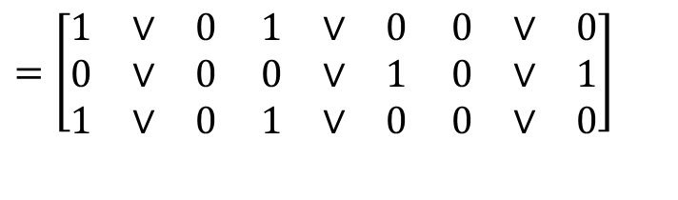
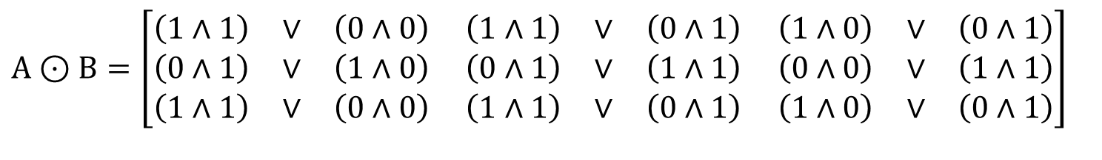
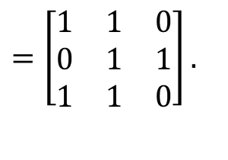
Boolean Product of Zero-One Matrices 2
Solution: The Boolean product A ⊙ B is given by
$$A⊙B=\left[\begin{matrix}\left(1∧1\right) & ∨ & \left(0∧0\right) \\ \left(0∧1\right) & ∨ & \left(1∧0\right) \\ \left(1∧1\right) & ∨ & \left(0∧0\right)\end{matrix} \begin{matrix}\left(1∧1\right) & ∨ & \left(0∧1\right) \\ \left(0∧1\right) & ∨ & \left(1∧1\right) \\ \left(1∧1\right) & ∨ & \left(0∧1\right)\end{matrix} \begin{matrix}\left(1∧0\right) & ∨ & \left(0∧1\right) \\ \left(0∧0\right) & ∨ & \left(1∧1\right) \\ \left(1∧0\right) & ∨ & \left(0∧1\right)\end{matrix}\right]$$
$$=\left[\begin{matrix}1 & ∨ & 0 \\ 0 & ∨ & 0 \\ 1 & ∨ & 0 \end{matrix}\begin{matrix} 1 & ∨ & 0 \\ 0 & ∨ & 1 \\ 1 & ∨ & 0 \end{matrix}\begin{matrix} 0 & ∨ & 0 \\ 0 & ∨ & 1 \\ 0 & ∨ & 0\end{matrix}\right]$$
$$=\left[\begin{matrix}1 & 1 & 0 \\ 0 & 1 & 1 \\ 1 & 1 & 0\end{matrix}\right].$$

Slide 88
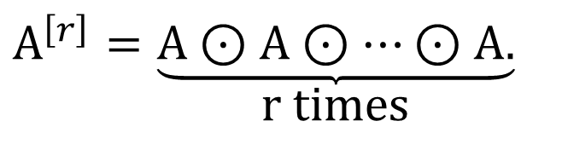
Boolean Powers of Zero-One Matrices 1
Definition: Let A be a square zero-one matrix and let r be a positive integer. The rth Boolean power (布尔幂) of A is the Boolean product of r factors of A, denoted by A^{[r]} . Hence,
$$A^{\left[r\right]}=\underset{\text{r} \text{times}}{\underbrace{A⊙A⊙…⊙A.}}$$
We define A^{[r]} to be I_{n}.
(The Boolean product is well defined because the Boolean product of matrices is associative.)

Slide 89
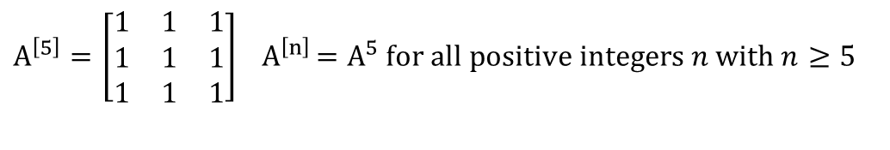
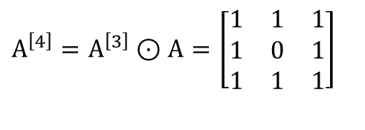
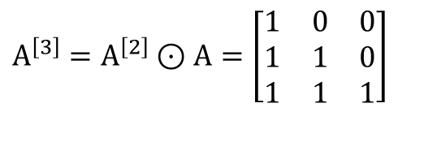
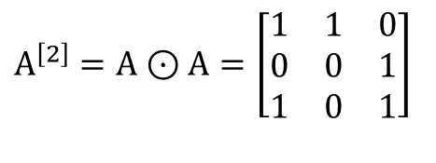
Boolean Powers of Zero-One Matrices 2
Example: Let
Find A^{n} for all positive integers n.
Solution:
$$A^{\left[2\right]}=A⊙A=\left[\begin{matrix}1 & 1 & 0 \\ 0 & 0 & 1 \\ 1 & 0 & 1\end{matrix}\right]$$
$$A^{\left[3\right]}=A^{\left[2\right]}⊙A=\left[\begin{matrix}1 & 0 & 0 \\ 1 & 1 & 0 \\ 1 & 1 & 1\end{matrix}\right]$$
$$A^{\left[4\right]}=A^{\left[3\right]}⊙A=\left[\begin{matrix}1 & 1 & 1 \\ 1 & 0 & 1 \\ 1 & 1 & 1\end{matrix}\right]$$
$$A^{\left[5\right]}=\left[\begin{matrix}1 & 1 & 1 \\ 1 & 1 & 1 \\ 1 & 1 & 1\end{matrix}\right] { A}^{\left[n\right]}=A^{5} \text{for} \text{all} \text{positive} \text{integers} n \text{with} n≥5$$

