Slide 1
Chapter 10 Graphs 图

Slide 2
Chapter Summary
Graphs and Graph Models
Graph Terminology and Special Types of Graphs
Representing Graphs and Graph Isomorphism
Connectivity
Euler and Hamiltonian Graphs
Graph Coloring

Slide 3
Graphs and Graph Models 图和图模型
Section 10.1

Slide 4
Section Summary 1
Introduction to Graphs
Graph Taxonomy
Graph Models

Slide 5
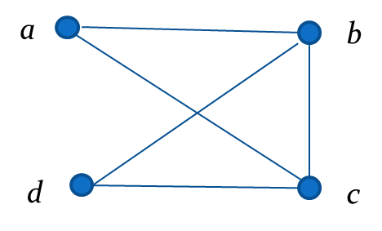
Graphs 图
Definition: A graph G = (V, E) consists of a nonempty set V of vertices (or nodes) (顶点或结点) and a set E of edges (边). Each edge has either one or two vertices associated with it, called its endpoints (端点). An edge is said to connect its endpoints.
Example: This is a graph with four vertices and five edges.
Remarks:
We have a lot of freedom when we draw a picture of a graph. All that matters is the connections made by the edges, not the particular geometry depicted. For example, the lengths of edges, whether edges cross, how vertices are depicted, and so on, do not matter.
A graph with an infinite vertex set is called an infinite graph. A graph with a finite vertex set is called a finite graph. We (following the text) restrict our attention to finite graphs.

Slide 6
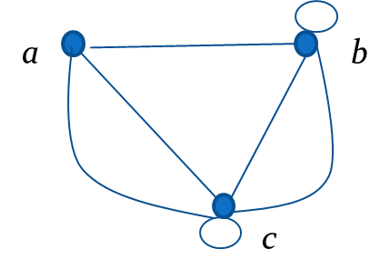
Some Terminology 一些术语
In a simple graph (简单图) each edge connects two different vertices and no two edges connect the same pair of vertices.
Multigraphs (多重图) may have multiple edges connecting the same two vertices. When m different edges connect the vertices u and v, we say that {u,v} is an edge of multiplicity m.
An edge that connects a vertex to itself is called a loop (环) .
A pseudograph (伪图) may include loops, as well as multiple edges connecting the same pair of vertices.
Example: This pseudograph has both multiple edges and a loop.
Remark: There is no standard terminology for graph theory. So, it is crucial that you understand the terminology being used whenever you read material about graphs.

Slide 7
Directed Graphs 有向图
Definition: An directed graph (有向图) (or digraph) G = (V, E) consists of a nonempty set V of vertices (or nodes) and a set E of directed edges (有向边) (or arcs 弧). Each edge is associated with an ordered pair of vertices. The directed edge associated with the ordered pair (u,v) is said to start at u and end at v.
Remark:
Graphs where the end points of an edge are not ordered are said to be undirected graphs (无向图) .

Slide 8
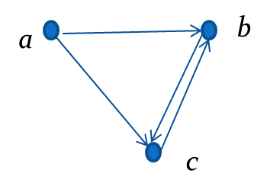
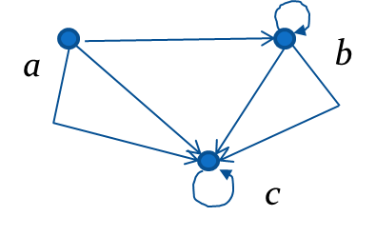
Some Terminology 一些术语
A simple directed graph (简单有向图) has no loops and no multiple edges.
Example: This is a directed graph with three vertices and four edges.
A directed multigraph (有向多重图) may have multiple directed edges. When there are m directed edges from the vertex u to the vertex v, we say that (u,v) is an edge of multiplicity m.
Example: In this directed multigraph the multiplicity of (a,b) is 1 and the multiplicity of (b,c) is 2.

Slide 9
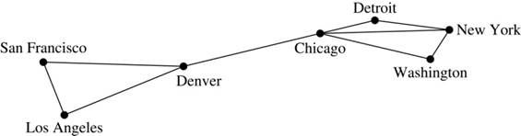
Graph Models: Computer Networks 1
When we build a graph model, we use the appropriate type of graph to capture the important features of the application.
We illustrate this process using graph models of different types of computer networks. In all these graph models, the vertices represent data centers and the edges represent communication links.
To model a computer network where we are only concerned whether two data centers are connected by a communications link, we use a simple graph. This is the appropriate type of graph when we only care whether two data centers are directly linked (and not how many links there may be) and all communications links work in both directions.

Slide 10
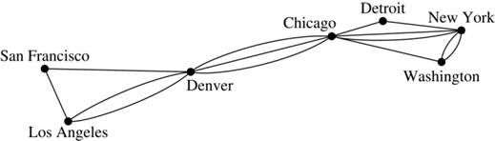
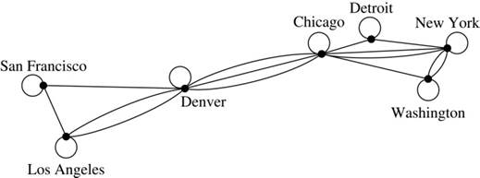
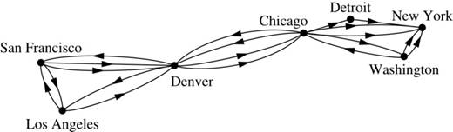
Graph Models: Computer Networks 2
To model a computer network where we care about the number of links between data centers, we use a multigraph.
To model a computer network with diagnostic links at data centers, we use a pseudograph, as loops are needed.
To model a network with multiple one-way links, we use a directed multigraph. Note that we could use a directed graph without multiple edges if we only care whether there is at least one link from a data center to another data center.

Slide 11
Graph Terminology: Summary
To understand the structure of a graph and to build a graph model, we ask these questions:
Are the edges of the graph undirected or directed (or both)?
If the edges are undirected, are multiple edges present that connect the same pair of vertices? If the edges are directed, are multiple directed edges present?
Are loops present?
TABLE 1 Graph Terminology.
Type | Edges | Multiple Edges Allowed? | Loops Allowed?
Simple graph Multigraph Pseudograph Simple directed graph Directed multigraph Mixed graph | Undirected Undirected Undirected Directed Directed Directed and undirected | No Yes Yes No Yes Yes | No No Yes No Yes Yes

Slide 12
Other Applications of Graphs
We will illustrate how graph theory can be used in models of:
Social networks
Communications networks
Information networks
Software design
Transportation networks
Biological networks
etc.

Slide 13
Graph Models: Social Networks 1
Graphs can be used to model social structures based on different kinds of relationships between people or groups.
In a social network (社交网络) , vertices represent individuals or organizations and edges represent relationships between them.
Useful graph models of social networks include:
friendship graphs - undirected graphs where two people are connected if they are friends (in the real world, on Facebook, or in a particular virtual world, and so on.)
collaboration graphs - undirected graphs where two people are connected if they collaborate in a specific way
influence graphs - directed graphs where there is an edge from one person to another if the first person can influence the second person

Slide 14
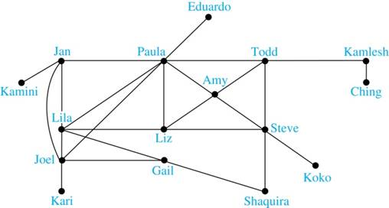
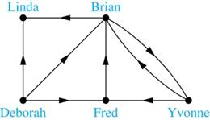
Graph Models: Social Networks 2
Example: A friendship graph where two people are connected if they are Facebook friends.
Example: An influence graph
Next Slide: Collaboration Graphs

Slide 15
Examples of Collaboration Graphs
The Hollywood graph models the collaboration of actors in films.
We represent actors by vertices and we connect two vertices if the actors they represent have appeared in the same movie.
We will study the Hollywood Graph in Section 10.4 when we discuss Kevin Bacon numbers.
An academic collaboration graph models the collaboration of researchers who have jointly written a paper in a particular subject.
We represent researchers in a particular academic discipline using vertices.
We connect the vertices representing two researchers in this discipline if they are coauthors of a paper.
We will study the academic collaboration graph for mathematicians when we discuss Erdős numbers in Section 10.4.

Slide 16
Applications to Information Networks
Graphs can be used to model different types of networks that link different types of information.
In a web graph, web pages are represented by vertices and links are represented by directed edges.
A web graph models the web at a particular time.
We will explain how the web graph is used by search engines in Section 11.4.
In a citation network:
Research papers in a particular discipline are represented by vertices.
When a paper cites a second paper as a reference, there is an edge from the vertex representing this paper to the vertex representing the second paper.

Slide 17
Transportation Graphs
Graph models are extensively used in the study of transportation networks (交通网络).
Airline networks can be modeled using directed multigraphs where
airports are represented by vertices
each flight is represented by a directed edge from the vertex representing the departure airport to the vertex representing the destination airport
Road networks can be modeled using graphs where
vertices represent intersections and edges represent roads.
undirected edges represent two-way roads and directed edges represent one-way roads.

Slide 18
Graph Terminology and Special Types of Graphs 图的术语和几种特殊的图
Section 10.2

Slide 19
Section Summary 2
Basic Terminology
Some Special Types of Graphs
Bipartite Graphs and Matchings
New Graphs from Old

Slide 20
Basic Terminology
Definition 1. Two vertices u, v in an undirected graph G are called adjacent (邻接) (or neighbors) in G if there is an edge e between u and v. Such an edge e is called incident (关联) with the vertices u and v and e is said to connect u and v.
Definition 2. The set of all neighbors of a vertex v of G = (V, E), denoted by N(v), is called the neighborhood (邻居) of v. If A is a subset of V, we denote by N(A) the set of all vertices in G that are adjacent to at least one vertex in A. So,
Definition 3. The degree (度) of a vertex in a undirected graph is the number of edges incident with it, except that a loop at a vertex contributes two to the degree of that vertex. The degree of the vertex v is denoted by deg(v).

Slide 21
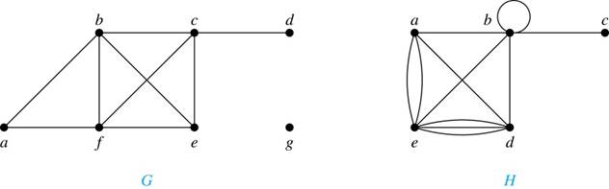
Degrees and Neighborhoods of Vertices
Example: What are the degrees and neighborhoods of the vertices in the graphs G and H?
Solution:
G: deg(a) = 2, deg(b) = deg(c) = deg(f ) = 4, deg(d ) = 1,
deg(e) = 3, deg(g) = 0.
N(a) = {b, f }, N(b) = {a, c, e, f }, N(c) = {b, d, e, f }, N(d) = {c},
N(e) = {b, c , f }, N(f) = {a, b, c, e}, N(g) = ∅ .
H: deg(a) = 4, deg(b) = deg(e) = 6, deg(c) = 1, deg(d) = 5.
N(a) = {b, d, e}, N(b) = {a, b, c, d, e}, N(c) = {b},
N(d) = {a, b, e}, N(e) = {a, b ,d}.

Slide 22
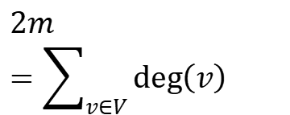
Degrees of Vertices
Theorem 1 (Handshaking Theorem 握手定理): If G = (V,E) is an undirected graph with m edges, then
$$2m=\sum_{v∈V}{\text{deg}\left(v\right)}$$
Proof:
Each edge contributes twice to the degree count of all vertices. Hence, both the left-hand and right-hand sides of this equation equal twice the number of edges.

Slide 23
Handshaking Theorem 握手定理
We now give two examples illustrating the usefulness of the handshaking theorem.
Example: How many edges are there in a graph with 10 vertices of degree six?
Solution: Because the sum of the degrees of the vertices is 6 ⋅ 10 = 60, the handshaking theorem tells us that 2m = 60. So the number of edges m = 30.
Example: If a graph has 5 vertices, can each vertex have degree 3?
Solution: This is not possible by the handshaking theorem, because the sum of the degrees of the vertices 3 ⋅ 5 = 15 is odd.

Slide 24
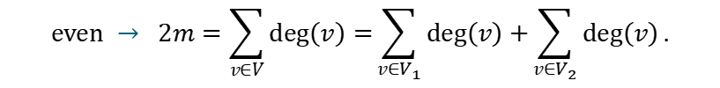
Degree of Vertices
Theorem 2: An undirected graph has an even number of vertices of odd degree.
Proof: Let V₁ be the vertices of even degree and V₂ be the vertices of odd degree in an undirected graph G = (V, E) with m edges. Then
$$\text{even} → 2m=\sum_{v∈V}{\text{deg}\left(v\right)=}\sum_{v∈V_{1}}{\text{deg}\left(v\right)+}\sum_{v∈V_{2}}{\text{deg}\left(v\right)}.$$
This sum must be even because 2m is even and the sum of the degrees of the vertices of even degrees is also even. Because this is the sum of the degrees of all vertices of odd degree in the graph, there must be an even number of such vertices.
must be even since deg(v) is even for each v ∈ V₁

Slide 25
Directed Graphs 有向图
Recall the definition of a directed graph.
Definition: A directed graph G = (V, E) consists of V, a nonempty set of vertices (or nodes), and E, a set of directed edges or arcs. Each edge is an ordered pair of vertices. The directed edge (u,v) is said to start at u and end at v.
Definition: Let (u,v) be an edge in G. Then u is the initial vertex (起点) of this edge and is adjacent to v and v is the terminal (or end) vertex (终点) of this edge and is adjacent from u. The initial and terminal vertices of a loop are the same.

Slide 26
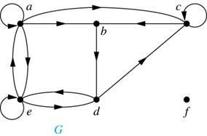
Directed Graphs 有向图
Definition: The in-degree (入度) of a vertex v, denoted deg⁻(v), is the number of edges which terminate at v. The out-degree (出度) of v, denoted deg⁺(v), is the number of edges with v as their initial vertex. Note that a loop at a vertex contributes 1 to both the in-degree and the out-degree of the vertex.
Example: In the graph G we have

Slide 27
Directed Graphs 有向图
Theorem 3: Let G = (V, E) be a graph with directed edges. Then:
Proof: The first sum counts the number of outgoing edges over all vertices and the second sum counts the number of incoming edges over all vertices. It follows that both sums equal the number of edges in the graph.

Slide 28
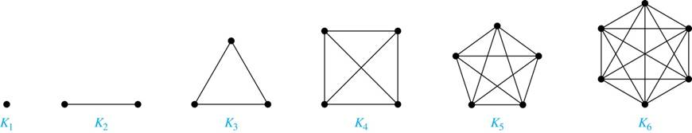
Special Types of Simple Graphs: Complete Graphs
A complete graph (完全图) on n vertices, denoted by K_{n}, is the simple graph that contains exactly one edge between each pair of distinct vertices.

Slide 29
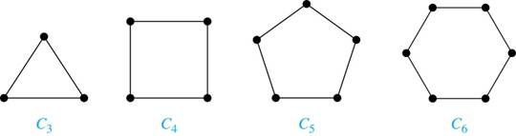
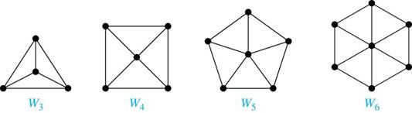
Special Types of Simple Graphs: Cycles and Wheels
A cycle (圈图) C_{n} for n ≥ 3 consists of n vertices v₁, v₂ ,⋯ , v_{n}, and edges {v₁, v₂}, {v₂, v₃} ,⋯ , {v_{n-1}, v_{n}}, {v_{n}, v₁}.
A wheel (轮图) W_{n} is obtained by adding an additional vertex to a cycle C_{n} for n ≥ 3 and connecting this new vertex to each of the n vertices in C_{n} by new edges.

Slide 30
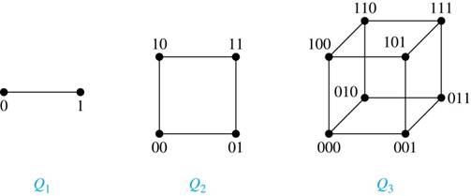
Special Types of Simple Graphs: n-Cubes (n立方体)
An n-dimensional hypercube, or n-cube, Q_{n}, is a graph with 2^{n} vertices representing all bit strings of length n, where there is an edge between two vertices that differ in exactly one bit position.

Slide 31
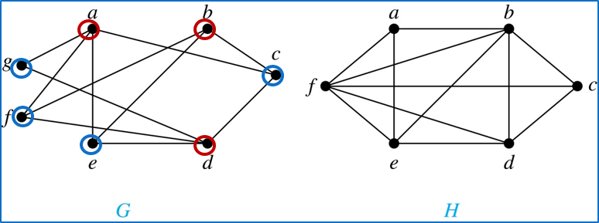
Bipartite Graphs 二分图
Definition: A simple graph G is bipartite if V can be partitioned into two disjoint subsets V₁ and V₂ such that every edge connects a vertex in V₁ and a vertex in V₂. In other words, there are no edges which connect two vertices in V₁ or in V₂.
It is not hard to show that an equivalent definition of a bipartite graph is a graph where it is possible to color the vertices red or blue so that no two adjacent vertices are the same color.
H is not bipartite since if we color a red, then the adjacent vertices f and b must both be blue.
G is bipartite

Slide 32
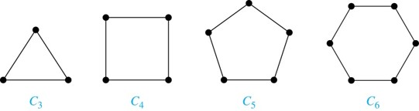
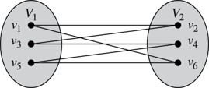
Bipartite Graphs 二分图
Example: Show that C₆ is bipartite.
Solution: We can partition the vertex set into V₁ = {v₁, v₃, v₅} and V₂ = {v₂, v₄, v₆} so that every edge of C₆ connects a vertex in V₁ and V₂ .
Example: Show that C₃ is not bipartite.
Solution: If we divide the vertex set of C₃ into two nonempty sets, one of the two must contain two vertices. But in C₃ every vertex is connected to every other vertex. Therefore, the two vertices in the same partition are connected. Hence, C₃ is not bipartite.

Slide 33
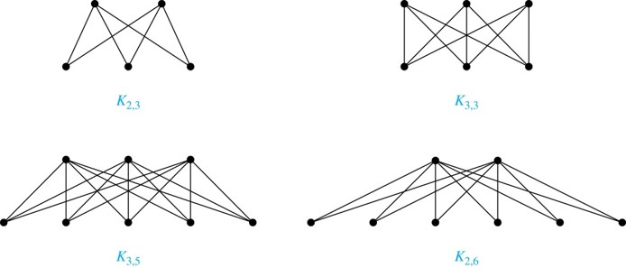
Complete Bipartite Graphs 完全二分图
Definition: A complete bipartite graph K_{m,n} is a graph that has its vertex set partitioned into two subsets V₁ of size m and V₂ of size n such that there is an edge from every vertex in V₁ to every vertex in V₂.
Example: We display four complete bipartite graphs here.

Slide 34
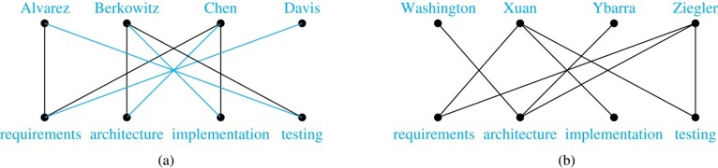
Bipartite Graphs and Matchings 二分图和匹配
Bipartite graphs are used to model applications that involve matching the elements of one set to elements in another, for example:
Job assignments - vertices represent the jobs and the employees, edges link employees with those jobs they have been trained to do. A common goal is to match jobs to employees so that the most jobs are done.

Slide 35
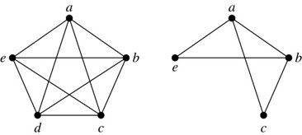
New Graphs from Old 1
Definition: A subgraph (子图) of a graph G = (V,E) is a graph (W,F), where W ⊂ V and F ⊂ E. A subgraph H of G is a proper subgraph of G if H ≠ G.
Example: Here we show K₅ and one of its subgraphs.
Definition: Let G = (V, E) be a simple graph. The subgraph induced (导出子图) by a subset W of the vertex set V is the graph (W,F), where the edge set F contains an edge in E if and only if both endpoints are in W.
Example: Here we show K₅ and the subgraph induced by W = {a,b,c,e}.

Slide 36
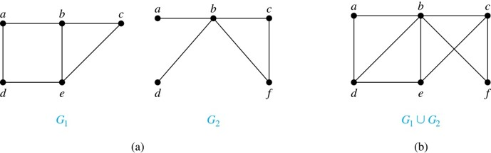
New Graphs from Old 2
Definition: The union (并图) of two simple graphs G₁ = (V₁, E₁) and G₂ = (V₂, E₂) is the simple graph with vertex set V₁ ⋃ V₂ and edge set E₁ ⋃ E₂. The union of G₁ and G₂ is denoted by G₁ ⋃ G₂.
Example:

Slide 37
Representing Graphs and Graph Isomorphism 图的表示与图的同构
Section 10.3

Slide 38
Section Summary 3
Adjacency Lists
Adjacency Matrices
Incidence Matrices
Isomorphism of Graphs

Slide 39
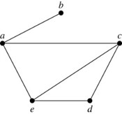
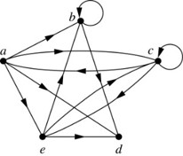
Representing Graphs: Adjacency Lists 图的表示: 邻接表
Definition: An adjacency list can be used to represent a graph with no multiple edges by specifying the vertices that are adjacent to each vertex of the graph.
Example:
TABLE 1 An Adjacency List for a Simple Graph.
Vertex | Adjacent Vertices
a | b, c, e
b | a
c | a, d, e
d | c, e
e | a, c, d
TABLE 2 An Adjacency List for a Directed Graph.
Initial Vertex | Terminal Vertices
a | b, c, d, e
b | b, d
c | a, c, e
d
e | b, c, d
Example:

Slide 40
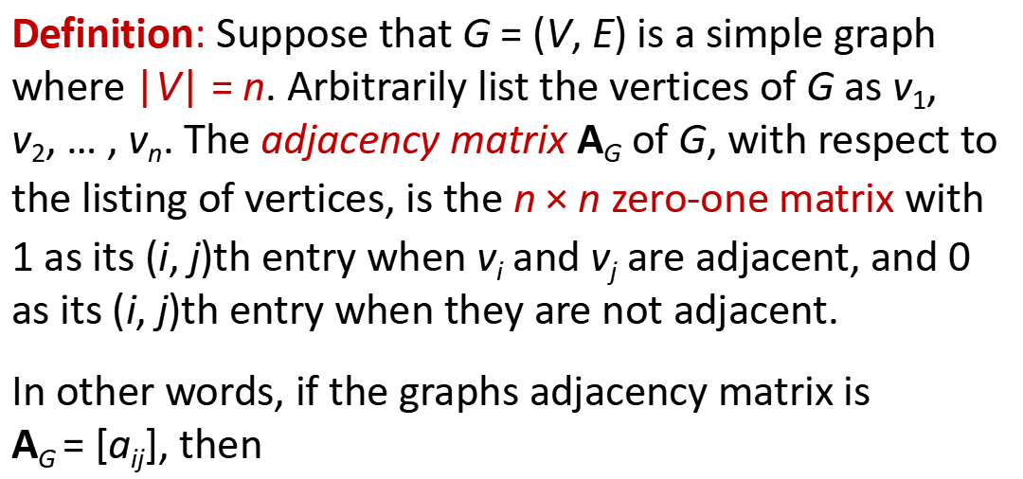
Representation of Graphs: Adjacency Matrices 邻接矩阵
Definition: Suppose that G = (V, E) is a simple graph where |V| = n. Arbitrarily list the vertices of G as v₁, v₂, … , v_{n}. The adjacency matrix A_{G} of G, with respect to the listing of vertices, is the n $×$ n zero-one matrix with 1 as its (i, j)th entry when v_{i} and v_{j} are adjacent, and 0 as its (i, j)th entry when they are not adjacent.
In other words, if the graphs adjacency matrix is A_{G} = [a_{ij}], then

Slide 41
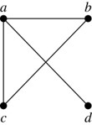
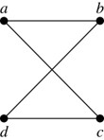
Representation of Graphs: Adjacency Matrices 邻接矩阵
Example:
When a graph is sparse, that is, it has few edges relatively to the total number of possible edges, it is much more efficient to represent the graph using an adjacency list than an adjacency matrix. But for a dense graph, which includes a high percentage of possible edges, an adjacency matrix is preferable.
The ordering of vertices is a, b, c, d.
The ordering of vertices is a, b, c, d.
Note: The adjacency matrix of a simple graph is symmetric, i.e., a_{ij} = a_{ji}
Also, since there are no loops, each diagonal entry a_{ii} for i = 1, 2, 3, …, n, is 0.

Slide 42
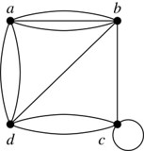
Representation of Graphs: Adjacency Matrices 邻接矩阵
Adjacency matrices can also be used to represent graphs with loops and multiple edges.
A loop at the vertex v_{i} is represented by a 1 at the (i, j)th position of the matrix.
When multiple edges connect the same pair of vertices v_{i} and v_{j}, (or if multiple loops are present at the same vertex), the (i, j)th entry equals the number of edges connecting the pair of vertices.
Example: We give the adjacency matrix of the pseudograph shown here using the ordering of vertices a, b, c, d.

Slide 43
Representation of Graphs: Adjacency Matrices 邻接矩阵
Adjacency matrices can also be used to represent directed graphs. The matrix for a directed graph G = (V, E) has a 1 in its (i, j)th position if there is an edge from v_{i} to v_{j}, where v₁, v₂, … v_{n} is a list of the vertices.
In other words, if the graphs adjacency matrix is A_{G} = [a_{ij}], then
The adjacency matrix for a directed graph does not have to be symmetric, because there may not be an edge from v_{i} to v_{j}, when there is an edge from v_{j} to v_{i} .
To represent directed multigraphs, the value of a_{ij} is the number of edges connecting v_{i} to v_{j}.

Slide 44
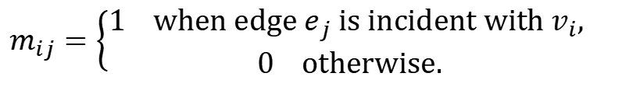
Representation of Graphs: Incidence Matrices 关联矩阵
Definition: Let G = (V, E) be an undirected graph with vertices where v₁, v₂, … v_{n} and edges e₁, e₂, … e_{m}. The incidence matrix with respect to the ordering of V and E is the n × m matrix M = [m_{ij}], where
$$m_{ij}=\left\{\begin{aligned}&\text{1} \text{when} \text{edge} e_{j} \text{is} \text{incident} \text{with} v_{i}\text{, } \\ &\text{0} \text{otherwise}\text{.}\end{aligned}\right.$$

Slide 45
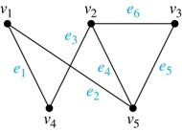
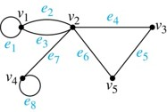
Representation of Graphs: Incidence Matrices 关联矩阵
Example: Simple Graph and Incidence Matrix
The rows going from top to bottom represent v₁ through v₅ and the columns going from left to right represent e₁ through e₆.
Example: Pseudograph and Incidence Matrix
The rows going from top to bottom represent v₁ through v₅ and the columns going from left to right represent e₁ through e₈.

Slide 46
Isomorphism of Graphs 图的同构
Definition: The simple graphs G₁ = (V₁, E₁) and G₂ = (V₂, E₂) are isomorphic (同构的) if there is a one-to-one and onto function f from V₁ to V₂ with the property that a and b are adjacent in G₁ if and only if f(a) and f(b) are adjacent in G₂ , for all a and b in V₁ . Such a function f is called an isomorphism. Two simple graphs that are not isomorphic are called nonisomorphic (非同构) .

Slide 47
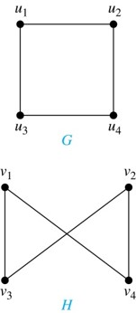
Isomorphism of Graphs 图的同构
Example: Show that the graphs G =(V, E) and H = (W, F) are isomorphic.
Solution: The function f with f(u₁) = v₁,
f(u₂) = v₄, f(u₃) = v₃, and f(u₄) = v₂ is a
one-to-one correspondence between V and W. Note that adjacent vertices in G are u₁ and u₂, u₁ and u₃, u₂ and u₄, and u₃ and u₄. Each of the pairs f(u₁) = v₁ and f(u₂) = v₄, f(u₁) = v₁ and f(u₃) = v₃ , f(u₂) = v₄ and f(u₄) = v₂ , and f(u₃) = v₃ and f(u₄) = v₂ consists of two adjacent vertices in H.

Slide 48
Isomorphism of Graphs 图的同构
It is difficult to determine whether two simple graphs are isomorphic using brute force because there are n! possible one-to-one correspondences between the vertex sets of two simple graphs with n vertices.
The best algorithms for determining weather two graphs are isomorphic have exponential worst case complexity in terms of the number of vertices of the graphs.
Sometimes it is not hard to show that two graphs are not isomorphic. We can do so by finding a property, preserved by isomorphism, that only one of the two graphs has. Such a property is called graph invariant (图不变量).
There are many different useful graph invariants that can be used to distinguish nonisomorphic graphs, such as the number of vertices, number of edges, and degree sequence [度数列] (list of the degrees of the vertices in nonincreasing order).

Slide 49
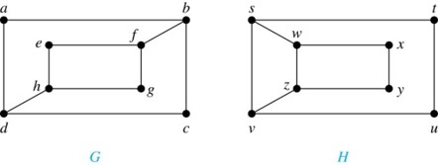
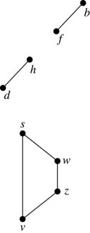
Isomorphism of Graphs 图的同构
Example: Determine whether these two graphs are isomorphic.
Solution: Both graphs have eight vertices and ten edges. They also both have four vertices of degree two and four of degree three.
However, G and H are not isomorphic. Note that since deg(a) = 2 in G, a must correspond to t, u, x, or y in H, because these are the vertices of degree 2. But each of these vertices is adjacent to another vertex of degree two in H, which is not true for a in G.
Alternatively, note that the subgraphs of G and H made up of vertices of degree three and the edges connecting them must be isomorphic. But the subgraphs, as shown at the right, are not isomorphic.

Slide 50
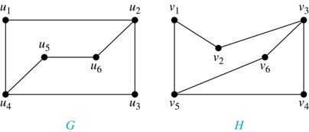
Isomorphism of Graphs 图的同构
Example: Determine whether these two graphs are isomorphic.
Solution:
Both graphs have six vertices and seven edges. (顶点和边的个数相同)
They also both have four vertices of degree two and two of degree three. (度数列相同)
The subgraphs of G and H consisting of all the vertices of degree two and the edges connecting them are isomorphic. So, it is reasonable to try to find an isomorphism f.
We define an injection f from the vertices of G to the vertices of H that preserves the degree of vertices. We will determine whether it is an isomorphism.
The function f with f(u₁) = v₆, f(u₂) = v₃, f(u₃) = v₄, and f(u₄) = v₅ , f(u₅) = v₁, and f(u₆) = v₂ is a one-to-one correspondence between G and H. Showing that this correspondence preserves edges is straightforward, so we will omit the details here. Because f is an isomorphism, it follows that G and H are isomorphic graphs

Slide 51
Algorithms for Graph Isomorphism
The best algorithms known for determining whether two graphs are isomorphic have exponential worst-case time complexity (in the number of vertices of the graphs).
However, there are algorithms with linear average-case time complexity. You can use a public domain program called NAUTY to determine in less than a second whether two graphs with as many as 100 vertices are isomorphic.
Graph isomorphism is a problem of special interest because it is one of a few NP problems not known to be either tractable or NP-complete (see Section 3.3).

Slide 52
Applications of Graph Isomorphism
The question whether graphs are isomorphic plays an important role in applications of graph theory. For example,
chemists use molecular graphs to model chemical compounds (化合物). Vertices represent atoms and edges represent chemical bonds (化学键). When a new compound is synthesized, a database of molecular graphs is checked to determine whether the graph representing the new compound is isomorphic to the graph of a compound that this already known.
Electronic circuits are modeled as graphs in which the vertices represent components and the edges represent connections between them. Graph isomorphism is the basis for
the verification that a particular layout of a circuit corresponds to the design’s original schematics.
determining whether a chip from one vendor includes the intellectual property of another vendor.

Slide 53
Connectivity 连通性
Section 10.4

Slide 54
Section Summary 4
Paths
Connectedness in Undirected Graphs
Connectedness in Directed Graphs
Counting Paths between Vertices

Slide 55
Paths 1
Informal Definition: A path (通路) is a sequence of edges that begins at a vertex of a graph and travels from vertex to vertex along edges of the graph. As the path travels along its edges, it visits the vertices along this path, that is, the endpoints of these.
Applications: Numerous problems can be modeled with paths formed by traveling along edges of graphs such as:
determining whether a message can be sent between two computers.
efficiently planning routes for mail delivery.

Slide 56
Paths 2
Definition: Let n be a nonnegative integer and G an undirected graph. A path of length n from u to v in G is a sequence of n edges e₁, … , e_{n} of G for which there exists a sequence x₀ = u, x₁, …, x_{n-1}, x_{n} = v of vertices such that e_{i} has, for i = 1, …, n, the endpoints x_{i-1} and x_{i}.
When the graph is simple, we denote this path by its vertex sequence x₀, x₁, … , x_{n}(since listing the vertices uniquely determines the path).
The path is a circuit (回路) if it begins and ends at the same vertex (u = v) and has length greater than zero.
The path or circuit is said to pass through the vertices x₁, x₂, … , x_{n-1} and traverse (遍历) the edges e₁, … , e_{n}.
A path or circuit is simple (简单的) if it does not contain the same edge more than once.
This terminology is readily extended to directed graphs. (see text)

Slide 57
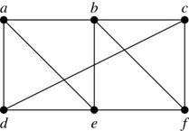
Paths 3
Example: In the simple graph here:
a, d, c, f, e is a simple path of length 4.
d, e, c, a is not a path because e is not connected to c.
b, c, f, e, b is a circuit of length 4.
a, b, e, d, a, b is a path of length 5, but it is not a simple path.

Slide 58
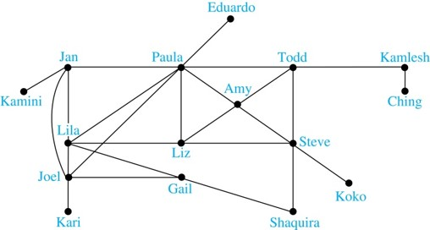
Degrees of Separation
Example: Paths in Acquaintanceship (相识关系) Graphs. In an acquaintanceship graph there is a path between two people if there is a chain of people linking these people, where two people adjacent in the chain know one another. In this graph there is a chain of six people linking Kamini and Ching.
Some have speculated that almost every pair of people in the world are linked by a small chain of no more than six, or maybe even, five people. The play Six Degrees of Separation (六度分割) by John Guare is based on this notion.

Slide 59
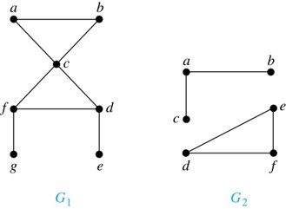
Connectedness in Undirected Graphs 无向图的连通性
Definition: An undirected graph is called connected (连通的) if there is a path between every pair of vertices. An undirected graph that is not connected is called disconnected (不连通的) . We say that we disconnect a graph when we remove vertices or edges, or both, to produce a disconnected subgraph.
Example: G₁ is connected because there is a path between any pair of its vertices, as can be easily seen. However G₂ is not connected because there is no path between vertices a and f, for example.

Slide 60
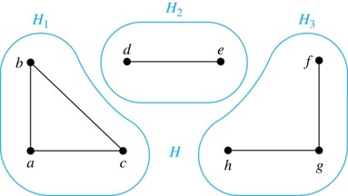
Connected Components 连通分支
Definition: A connected component of a graph G is a connected subgraph of G that is not a proper subgraph of another connected subgraph of G. A graph G that is not connected has two or more connected components that are disjoint and have G as their union.
Example: The graph H is the union of three disjoint subgraphs H₁, H₂, and H₃, none of which are proper subgraphs of a larger connected subgraph of G. These three subgraphs are the connected components of H.

Slide 61
Connectedness in Directed Graphs 1
Definition: A directed graph is strongly connected (强连通) if there is a path from a to b and a path from b to a whenever a and b are vertices in the graph.
Definition: A directed graph is weakly connected (弱连通) if there is a path between every two vertices in the underlying undirected graph, which is the undirected graph obtained by ignoring the directions of the edges of the directed graph.

Slide 62
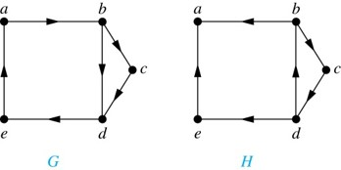
Connectedness in Directed Graphs 2
Example:
G is strongly connected.
G is also weakly connected.
H is not strongly connected.
H it is weakly connected.
Definition: The subgraphs of a directed graph G that are strongly connected but not contained in larger strongly connected subgraphs, i.e., the maximal strongly connected subgraphs, are called the strongly connected components (强连通分支) or strong components of G.
Example (continued): The graph H has three strongly connected components, consisting of the vertex a; the vertex e; and the subgraph consisting of the vertices b, c, d and edges (b,c), (c,d), and (d,b).

Slide 63
Counting Paths between Vertices 1
Theorem: Let G be a graph with adjacency matrix A with respect to the ordering v₁, … , v_{n} of vertices (with directed or undirected edges, multiple edges and loops allowed). The number of different paths of length r from v_{i} to v_{j}, where r >0 is a positive integer, equals the (i, j)th entry of A^{r}.
Proof by mathematical induction:
Basis Step: By definition of the adjacency matrix, the number of paths from v_{i} to v_{j} of length 1 is the (i,j)th entry of A.

Slide 64
Counting Paths between Vertices 1
Proof by mathematical induction:
Inductive Step: For the inductive hypothesis, we assume that that the (i, j)th entry of A^{r} is the number of different paths of length r from v_{i} to v_{j}.
Because A^{r+1} = A^{r} A, the (i, j)th entry of A^{r+1} equals b_{i1}a_{1j} + b_{i2}a_{2j} + ⋯ + b_{in}a_{nj}, where b_{ik} is the (i, k)th entry of A^{r}. By the inductive hypothesis, b_{ik} is the number of paths of length r from v_{i} to v_{k}.
A path of length r + 1 from v_{i} to v_{j} is made up of a path of length r from v_{i} to some v_{k} , and an edge from v_{k} to v_{j}. By the product rule for counting, the number of such paths is the product of the number of paths of length r from v_{i} to v_{k} (i.e., b_{ik} ) and the number of edges from v_{k} to v_{j} (i.e, a_{kj}). The sum over all possible intermediate vertices v_{k} is b_{i1}a_{1j} + b_{i2}a_{2j} + ⋯ + b_{in}a_{nj} .

Slide 65
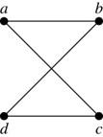
Counting Paths between Vertices 2
Example: How many paths of length four are there from a to d in the graph G.
G
adjacency matrix of G
Solution: The adjacency matrix of G (ordering the vertices as a, b, c, d) is given above. Hence the number of paths of length four from a to d is the (1, 4)th entry of A⁴ . The eight paths are as:

Slide 66
Euler and Hamiltonian Graphs
Section 10.5

Slide 67
Section Summary 5
Euler Paths and Circuits
Hamilton Paths and Circuits
Applications of Hamilton Circuits

Slide 68
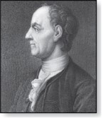
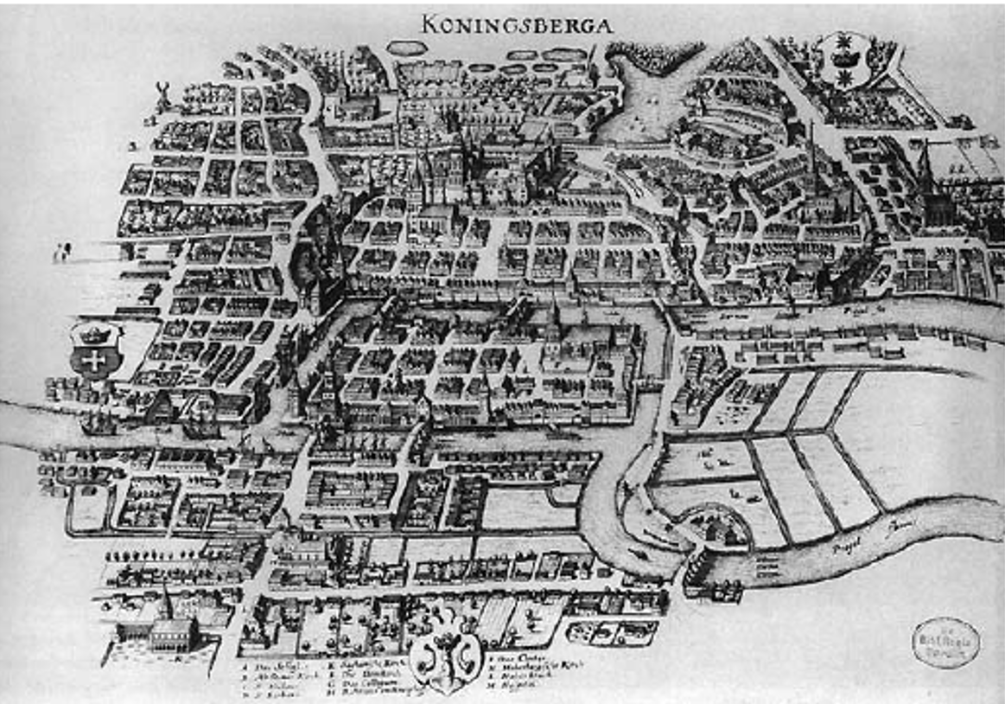
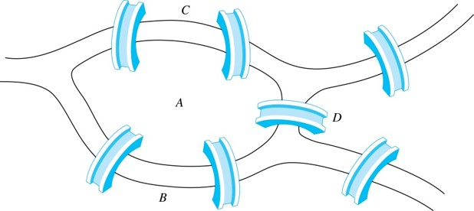
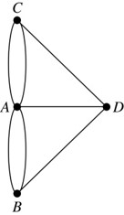
Euler Paths and Circuits 欧拉通路与回路
Leonard Euler (1707-1783)z
The town of Kӧnigsberg, Prussia (now Kalingrad, Russia) was divided into four sections by the branches of the Pregel river. In the 18th century seven bridges connected these regions.
People wondered whether whether it was possible to follow a path that crosses each bridge exactly once and returns to the starting point.
【哥尼斯堡七桥问题无解】The Swiss mathematician Leonard Euler proved that no such path exists. This result is often considered to be the first theorem ever proved in graph theory.
Multigraph Model of the Bridges of Kӧnigsberg
The 7 Bridges of Kӧnigsberg

Slide 69
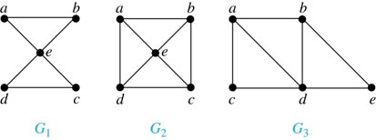
Euler Paths and Circuits 2
Definition: An Euler circuit (欧拉回路) in a graph G is a simple circuit containing every edge of G. An Euler path (欧拉通路) in G is a simple path containing every edge of G.
Example: Which of the undirected graphs G₁, G₂, and G₃ has a Euler circuit? Of those that do not, which has an Euler path?
Solution: The graph G₁ has an Euler circuit (e.g., a, e, c, d, e, b, a). But, as can easily be verified by inspection, neither G₂ nor G₃ has an Euler circuit. Note that G₃ has an Euler path (e.g., a, c, d, e, b, d, a, b), but there is no Euler path in G₂, which can be verified by inspection.

Slide 70
Necessary Conditions for Euler Circuits and Paths
An Euler circuit begins with a vertex a and continues with an edge incident with a, say {a, b}. The edge {a, b} contributes one to deg(a). Each time the circuit passes through a vertex it contributes two to the vertex’s degree. Finally, the circuit terminates where it started, contributing one to deg(a). Therefore deg(a) must be even.
We conclude that the degree of every other vertex must also be even.
By the same reasoning, we see that the initial vertex and the final vertex of an Euler path have odd degree, while every other vertex has even degree. So, a graph with an Euler path has exactly two vertices of odd degree.
In the next slide we will show that these necessary conditions are also sufficient conditions.

Slide 71
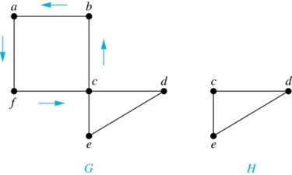
Sufficient Conditions for Euler Circuits and Paths
Suppose that G is a connected multigraph with ≥ 2 vertices, all of even degree. Let x₀ = a be a vertex of even degree. Choose an edge {x₀, x₁} incident with a and proceed to build a simple path {x₀, x₁}, {x₁, x₂}, …, {x_{n-1}, x_{n}} by adding edges one by one until another edge can not be added.
We illustrate this idea in the graph G here. We begin at a and choose the edges {a, f}, {f, c}, {c, b}, and {b, a} in succession.
This path begins at a with an edge of the form {a, x}; we show that it must terminate at a with an edge of the form {y, a}. Since each vertex has an even degree, there must be an even number of edges incident with this vertex. Hence, every time we enter a vertex other than a, we can leave it. Therefore, the path can only end at a.
If all of the edges have been used, an Euler circuit has been constructed. Otherwise, consider the subgraph H obtained from G by deleting the edges already used.
In the example H consists of the vertices c, d, e.

Slide 72
Sufficient Conditions for Euler Circuits and Paths
Because G is connected, H must have at least one vertex in common with the circuit that has been deleted.
In the example, the vertex is c.
Every vertex in H must have even degree because all the vertices in G have even degree and for each vertex, pairs of edges incident with this vertex have been deleted. Beginning with the shared vertex construct a path ending in the same vertex (as was done before). Then splice this new circuit into the original circuit.
In the example, we end up with the circuit a, f, c, d, e, c, b, a.
Continue this process until all edges have been used. This produces an Euler circuit. Since every edge is included and no edge is included more than once.
Similar reasoning can be used to show that a graph with exactly two vertices of odd degree must have an Euler path connecting these two vertices of odd degree

Slide 73
Algorithm for Constructing an Euler Circuits 1
In our proof we developed this algorithms for constructing a Euler circuit in a graph with no vertices of odd degree.
procedure Euler(G: connected multigraph with all vertices of even degree)
circuit := a circuit in G beginning at an arbitrarily chosen vertex with edges
successively added to form a path that returns to this vertex.
H := G with the edges of this circuit removed
while H has edges
subcircuit := a circuit in H beginning at a vertex in H that also is
an endpoint of an edge in circuit.
H := H with edges of subcircuit and all isolated vertices removed
circuit := circuit with subcircuit inserted at the appropriate vertex.
return circuit{circuit is an Euler circuit}

Slide 74
Algorithm for Constructing an Euler Circuits 2
Theorem: A connected multigraph with at least two vertices has an Euler circuit if and only if each of its vertices has an even degree (欧拉回路存在的充分必要条件是所有顶点的度为偶数) and it has an Euler path if and only if it has exactly two vertices of odd degree (欧拉通路存在的充分必要条件是恰好有两个顶点的度为奇数).
Example: Four of the vertices in the multigraph model of the Kӧnigsberg bridge problem have odd degree. Hence, there is no Euler circuit in this multigraph and it is impossible to start at a given point, cross each bridge exactly once, and return to the starting point.

Slide 75

Euler Circuits and Paths
Example:
G₁ contains exactly two vertices of odd degree (b and d). Hence it has an Euler path, e.g., d, a, b, c, d, b.
G₂ has exactly two vertices of odd degree (b and d). Hence it has an Euler path, e.g., b, a, g, f, e, d, c, g, b, c, f, d.
G₃ has six vertices of odd degree. Hence, it does not have an Euler path.

Slide 76
Applications of Euler Paths and Circuits
Euler paths and circuits can be used to solve many practical problems such as finding a path or circuit that traverses each
street in a neighborhood,
road in a transportation network,
connection in a utility grid,
link in a communications network.
Other applications are found in the
layout of circuits,
network multicasting,
molecular biology, where Euler paths are used in the sequencing of DNA.

Slide 77
Applications of Euler Paths and Circuits
例：设旋转磁鼓分成 8 个扇区, 每个扇区标记一个 0 或 1, 有 3 个探测器能够读出连续的 3 个扇区的标记. 如何赋给扇区标记, 使得能够根据探测器的读数确定磁鼓的位置.
为了能够根据读数确定磁鼓的位置, 必须构造一个由 8 个 0 和 1 组成的圆环, 使得圆环上连续 3 个数字的序列都不相同
0
1
1
1
0
0
1
1

Slide 78
Applications of Euler Paths and Circuits
解：
构造一个4阶有向图, 8条边的标记是不同的, 图中存在一条欧拉回路: 000, 001, 011, 111, 110, 101, 010, 100. 在这条回路上连续3条边的标记的第一位恰好与第一条边的标记相同. 顺着这条回路取每一条边标记的第一位得到00011101, 按照这个顺序标记磁鼓的扇区.
000
100
00
001
010
10
01
101
110
011
11
111

Slide 79



Hamilton Paths and Circuits 哈密顿通路和哈密顿回路
William Rowan Hamilton (1805- 1865)
Euler paths and circuits contained every edge only once. Now we look at paths and circuits that contain every vertex exactly once.
William Hamilton invented the Icosian puzzle in 1857. It consisted of a wooden dodecahedron [十二面体] (with 12 regular pentagons [五边形] as faces), illustrated in (a), with a peg at each vertex, labeled with the names of different cities. String was used to used to plot a circuit visiting 20 cities exactly once
The graph form of the puzzle is given in (b).
The solution (a Hamilton circuit) is given here.

Slide 80
Hamilton Paths and Circuits 哈密顿通路和哈密顿回路
Definition: A simple path in a graph G that passes through every vertex exactly once is called a Hamilton path, and a simple circuit in a graph G that passes through every vertex exactly once is called a Hamilton circuit.
That is, a simple path x₀, x₁, …, x_{n-1}, x_{n} in the graph G = (V, E) is called a Hamilton path if V = {x₀, x₁, … , x_{n-1,} x_{n} } and x_{i} ≠ x_{j} for 0≤ i < j ≤ n, and the simple circuit x₀, x₁, …, x_{n-1}, x_{n}, x₀ (with n > 0) is a Hamilton circuit if x₀, x₁, … , x_{n-1}, x_{n} is a Hamilton path.

Slide 81

Hamilton Paths and Circuits 哈密顿通路和哈密顿回路
Example: Which of these simple graphs has a Hamilton circuit or, if not, a Hamilton path?
Solution:
G₁ has a Hamilton circuit: a, b, c, d, e, a.
G₂ does not have a Hamilton circuit (Why?), but does have a Hamilton path : a, b, c, d.
G₃ does not have a Hamilton circuit, or a Hamilton path. Why?

Slide 82


Necessary Conditions for Hamilton Circuits
Gabriel Andrew Dirac
(1925-1984)
Unlike for an Euler circuit, no simple necessary and sufficient conditions are known for the existence of a Hamilton circuit.
However, there are some useful sufficient conditions. We describe two of these now.
Dirac’s Theorem (狄拉克定理): If G is a simple graph with n ≥ 3 vertices such that the degree of every vertex in G is ≥ n/2, then G has a Hamilton circuit.
Ore’s Theorem (欧尔定理): If G is a simple graph with n ≥ 3 vertices such that deg(u) + deg(v) ≥ n for every pair of nonadjacent vertices, then G has a Hamilton circuit.
Øysten Ore
(1899-1968)

Slide 83
Applications of Hamilton Paths and Circuits
Applications that ask for a path or a circuit that visits each intersection of a city, each place pipelines intersect in a utility grid, or each node in a communications network exactly once, can be solved by finding a Hamilton path in the appropriate graph.
The famous traveling salesperson problem (TSP) asks for the shortest route a traveling salesperson should take to visit a set of cities. This problem reduces to finding a Hamilton circuit such that the total sum of the weights of its edges is as small as possible.
A family of binary codes, known as Gray codes, which minimize the effect of transmission errors, correspond to Hamilton circuits in the n-cube Q_{n}. (See the text for details.)

Slide 84


Gray Codes
A Gray code is a labeling of the arcs of the circle such that adjacent arcs are labeled with bit Links strings that differ in exactly one bit. The assignment in (b) is a Gray code.
A Hamilton circuit for Q₃.

Slide 85

Applications of Hamilton Paths and Circuits
例：有7个人, A会讲英语, B会讲英语和汉语, C会讲英语、意大利语和俄语, D会讲日语和汉语, E会讲德语和意大利语, F会讲法语、日语和俄语, G会讲法语和德语. 问能否将他们沿圆桌安排就坐成一圈, 使得每个人都能与两旁的人交谈?
解：
作无向图, 每人是一个顶点,
2人之间有边⇔他们有共同的语言.
G
A
F
B
ACEGFDBA是一条哈密顿回路,
按此顺序就坐即可.
E
C
D

Slide 86
Graph Coloring 图的着色
Section 10.8

Slide 87


Graph Coloring 图的着色
Definition: A coloring (着色) of a simple graph is the assignment of a color to each vertex of the graph so that no two adjacent vertices are assigned the same color.
Example: When a map is colored, two regions with a common
border are customarily assigned different colors.
A map
Dual graph of the map

Slide 88




Graph Coloring 图的着色
For most graphs a coloring can be found that uses fewer colors than the number of vertices. What is the least number of colors necessary?
Definition: The chromatic number of a graph is the least number of colors needed for a coloring of this graph. The chromatic number of a graph G is denoted by 𝜒(G). (Here 𝜒 is the Greek letter chi.)
Example:

Slide 89


Graph Coloring 图的着色
Example: A coloring of K₅.
Example: A coloring of K_{3,4}.

Slide 90


Applications of Graph Colorings
Example: Scheduling Final Exams How can the final exams at a university be scheduled so that no student has two exams at the same time?
For instance, suppose there are seven finals to be scheduled. Suppose the courses are numbered 1 through 7. Suppose that the following pairs of courses have common students: 1 and 2, 1 and 3, 1 and 4, 1 and 7, 2 and 3, 2 and 4, 2 and 5, 2 and 7, 3 and 4, 3 and 6, 3 and 7, 4 and 5, 4 and 6, 5 and 6, 5 and 7, and 6 and 7.
The graph representing the scheduling of final exams.
Using a coloring to schedule final exams.

Slide 91
Homework
§10.2 2, 7, 28
§10.3 3, 11, 40, 47, §10.4 14 a), 27 c) e)
§10.5 2, 4, 18, 19, 30, 32
§10.8 6, 8, 19
Due date : 2023.5.28

