Slide 1
Modeling Computation 计算模型
Chapter 13

Slide 2
Chapter Summary
Languages and Grammars
Finite-State Machines with Output
Finite-State Machines with No Output
Language Recognition
Turing Machines

Slide 3
Languages and Grammars 语言和文法
Section 13.1

Slide 4
Section Summary 1
Phrase-Structure Grammars
Types of Phrase-Structure Grammars
Derivation Trees
Backus-Naur Form

Slide 5
Introduction 1
Syntax (语法, form of a sentence) vs. semantics (语义, meaning of a sentence)
The sentence the frog writes neatly is a valid sentence according to the rules of English grammar. That is, it is syntactically correct, even though it’s nonsensical (unless we are talking about a fantasy world).
The sequence of words swims quickly mathematics is not a valid sentence according to the rules of English grammar.

Slide 6
Grammars 文法
The rules that specify the syntactically correct sentences of a natural language such as English are complex.
Instead of studying natural languages, we can define formal languages (形式语言) that have well-defined rules of syntax.
These rules of syntax are important both in linguistics (the study of natural languages) and in the study of programming languages.

Slide 7
An Example of Grammar
a sentence is made up of a noun phrase followed by a verb phrase;
a noun phrase is made up of an article followed by an adjective followed by a noun, or
a noun phrase is made up of an article followed by a noun;
a verb phrase is made up of a verb followed by an adverb, or
a verb phrase is made up of a verb;
an article is a, or
an article is the;
an adjective is large, or
an adjective is hungry;
a noun is rabbit, or
a noun is mathematician;
a verb is eats, or
a verb is hops;
an adverb is quickly, or
an adverb is wildly.
We use these rules to form valid sentences by making a series of replacements until no more rules can be used.
An example sequence of replacements:
noun phrase verb phrase
article adjective noun verb phrase
article adjective noun verb adverb
the adjective noun verb adverb
the large noun verb adverb
the large rabbit verb adverb
the large rabbit hops adverb
the large rabbit hops quickly
Some additional valid sentences are:
a hungry mathematician eats wildly,
a large mathematician hops,
the rabbit eats quickly, etc.
But note that the following is not valid:
the quickly eats mathematician

Slide 8
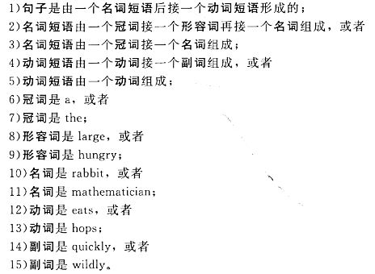
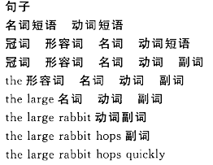
An Example of Grammar
We use these rules to form valid sentences by making a series of replacements until no more rules can be used.
An example sequence of replacements:
Some additional valid sentences are:
a hungry mathematician eats wildly,
a large mathematician hops,
the rabbit eats quickly, etc.
But note that the following is not valid:
the quickly eats mathematician

Slide 9
Phrase-Structure Grammars 短语结构文法
A vocabulary 词汇表 (or alphabet 字母表) V is a finite, nonempty set of elements called symbols.
A word 词 (or sentence 句子) over V is a string of finite length of elements of V. The empty string or null string, denoted by λ, is the string containing no symbols.
The set of all words over V is denoted by V*. A language (语言) over V is a subset of V*.
The elements of V that can not be replaced by other symbols are called terminals (终结符), e.g., a, the, and rabbit in the example grammar.
Those that can be replaced by other symbols are called nonterminals (非终结符), e.g., sentence, noun phrase, etc.
The rules that specify when we can replace a string V* with another string are called productions (产生式) of the grammar. We denote by z₀ → z₁ the production that specifies that z₀ can be replaced by z₁ within a string.

Slide 10
Phrase-Structure Grammars 短语结构文法
A phrase-structure grammar G =(V, T, S, P) consists of a vocabulary V, a subset T of V consisting of terminal symbols, a start symbol S from V, and a finite set of productions (产生式) P.
The set N = V − T is the set of nonterminal symbols.
Every production in P must contain at least one nonterminal on its left side.
Example (Grammar 1): Let G =(V, T, S, P), where V = {a, b, A, B, S}, T = {a,b}, S is the start symbol, and P = {S →Aba, A →BB, B →ab, AB →b}.

Slide 11
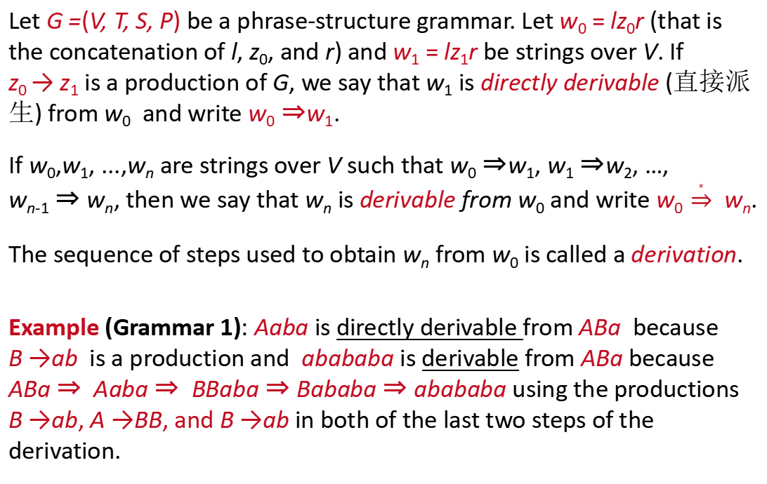
Derivations 派生
Let G =(V, T, S, P) be a phrase-structure grammar. Let w₀ = lz₀r (that is the concatenation of l, z₀, and r) and w₁ = lz₁r be strings over V. If z₀ → z₁ is a production of G, we say that w₁ is directly derivable (直接派生) from w₀ and write w₀ ⇒w₁.
If w₀,w₁, ...,w_{n} are strings over V such that w₀ ⇒w₁, w₁ ⇒w₂, …, w_{n-1} ⇒ w_{n}, then we say that w_{n} is derivable from w₀ and write w₀ $\underset{⇒}{∗}$ w_{n}.
The sequence of steps used to obtain w_{n} from w₀ is called a derivation.
Example (Grammar 1): Aaba is directly derivable from ABa because B →ab is a production and abababa is derivable from ABa because ABa ⇒ Aaba ⇒ BBaba ⇒ Bababa ⇒ abababa using the productions B →ab, A →BB, and B →ab in both of the last two steps of the derivation.

Slide 12

Language Generation
Let G =(V, T, S, P) be a phrase-structure grammar. The language generated by G, denoted by L(G), is the set of all strings of terminals that are derivable from the starting symbol S.
Example: Let G be the grammar with the vocabulary V = {S, A, a, b}, a set of terminals T = {a, b}, starting symbol S, and productions
$$P=\left\{S→aA, S→b, A→aa\right\}.$$
Then, L(G) = {b, aaa}, because we can begin a derivation with S → aA or with S → b, and from aA we can derive aaa using A → aa. There are no other possible derivations.

Slide 13
Language Generation
Example: Let G be the grammar with vocabulary V = {S, 0, 1}, set of terminals T = {0, 1}, starting symbol S, and productions P = {S → 11S, S → 0}. What is L(G), the language of this grammar?
Solution:
From S we can derive 0 using S → 0, or 11S using S → 11S. From 11S we can derive either 110 or 1111S. From 1111S we can derive 11110 and 111111S.
At any stage of a derivation we can either add two 1s at the end of the string or terminate the derivation by adding a 0 at the end of the string. We surmise that
L(G) = {0, 110, 11110, 1111110,…},
the set of all strings that begin with an even number of 1s and end with a 0.

Slide 14
Language Generation
Example: Find a phrase-structure grammar to generate the set {0^{n}1^{n} ∣ n = 0, 1, 2,…}.
Solution:
The grammar G =(V, T, S, P) with
V = {0, 1, S},
T = {0, 1}, S is the starting symbol,
P: S → 0S1, S → 𝜆.

Slide 15
Language Generation
Example: Find a phrase-structure grammar to generate the set {0^{m}1^{n} ∣ m and n are nonnegative integers}.
Solution:
The grammar G₁ =(V, T, S, P) with
V = {S, 0, 1},
T = {0, 1}, S is the starting symbol,
P: S → 0S, S → S1, and S → 𝜆.
The grammar G₂ =(V, T, S, P) with
V = {S, A, 0, 1},
T = {0, 1}, S is the starting symbol,
P: S → 0S, S → 1A, S → 1, A → 1A, A → 1, and S → 𝜆.

Slide 16
Language Generation
Example: Find a phrase-structure grammar to generate the set {0^{n}1^{n}2^{n} ∣ n = 0, 1, 2, 3,…}
Solution:
The grammar G =(V, T, S, P) with
V = {0, 1, 2, S, A, B, C},
T = {0, 1, 2}, S is the starting symbol,
P: S → 0SAB, S → 𝜆, BA → AB, 0A → 01, 1A → 11,
1B → 12, and 2B → 22.
S ⇒ 0SAB ⇒ 00SABAB ⇒ 00ABAB ⇒ 00 AABB
⇒ 001ABB ⇒ 0011BB ⇒ 00112B ⇒ 001122

Slide 17
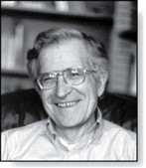
Types of Phrase Structure Grammars 短语结构文法的类型
Phrase-structure grammars are classified by the types of allowable productions.
Avram Noam Chomsky (Born 1928)
TABLE 1 Types of Grammars.
Type | Restrictions on Productions w₁ → w₂
0 | No restrictions
1 | w₁ = lAr and w₂ = lwr, where A ∊ N, l, r, w ∊ (N ∪ T)∗ and w ≠ 𝜆; or w₁ = S and w₂ = 𝜆 as long as S is not on the right-hand side of another production
2 | w₁ = A, where A is a nonterminal symbol
3 | w₁ = A and w₂ = aB or w₂ = a, where A ∊ N, B ∊ N, and a ∊ T; or w₁ = S and w₂ = 𝜆
Type 1 grammars are called context-sensitive grammars (上下文有关文法). A language generated by a context-sensitive grammar is called a context-sensitive language (上下文有关语言).
Type 2 grammars are called context-free grammars (上下文无关文法). A language generated by a context-free grammar is called a context-free language (上下文无关语言).
Type 3 grammars are called regular grammars (正则文法). A language generated by a regular grammar is called a regular language (正则语言).

Slide 18
Examples for Different Types of Phrase Structure Grammars
A context-sensitive language generated by type 1 grammars
{0^{n}1^{n}2^{n} ∣ n = 0, 1, 2, 3,…}
G = (V, T, S, P) with V = {0, 1, 2, S, A, B, C}; T = {0, 1, 2}; starting state S;
P: S → 0SAB, S → 𝜆, BA → AB, 0A → 01, 1A → 11, 1B → 12, and 2B → 22.
A context-free language generated by type 2 grammars
{0^{n}1^{n} ∣ n = 0, 1, 2,…}.
G = (V, T, S, P) with V = {0, 1, S}, T = {0, 1}, S is the starting symbol, and
P: S → 0S1, S → 𝜆.
A regular language generated by type 3 grammars (regular grammars )
{0^{m}1^{n} ∣ m and n are nonnegative integers}.
V = {S, A, 0, 1}; terminals T = {0, 1}; and
P: S → 0S, S → 1A, S → 1, A → 1A, A → 1, and S → 𝜆.
Avram Noam Chomsky (Born 1928)

Slide 19
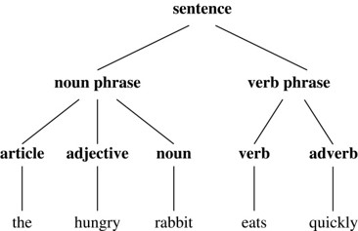
Derivation Trees 派生树
We can represent a derivation in the language generated by a context-free grammar by an ordered rooted tree, called a derivation, or parse tree.
The root of the tree represents the start symbol.
The internal vertices represent the nonterminal symbols that arise in the derivation.
The leaves represent the terminal symbols that arise.
If the production A →w, where w is a word, arises in the derivation, the vertex that represents A has as children vertices that represent each symbol in w, in order from left to right.
A derivation tree for the derivation of the hungry rabbit eats quickly, given the grammar described earlier.

Slide 20
Derivation Trees 派生树
The problem of determining whether a string is in the language generated by a context-free grammar arises in many applications, such as in the construction of compilers.
When given a string, the naive approach for determining whether it is in the language generated by a grammar is to look for a sequence of productions that can be applied, beginning at the start state, that lead to the given string. When following such an approach, it is useful to think a few moves ahead. This approach is known as top-down parsing.
A second approach, known as bottom-up parsing, is to work backward from the given string with the goal of undoing productions one-by-one to reach the start symbol.

Slide 21
Derivation Trees 派生树
Example: Determine whether the word cbab belongs to the language generated by the grammar G = (V, T, S, P), where V = {a, b, c, A, B, C, S}, T = {a, b, c}, S is the starting symbol, and the productions are
S → AB, A → Ca, B → Ba, B → Cb, B → b, C → cb, C → b.
Solution: A top-down approach to this problem is to begin with S and attempt to derive cbab using a series of productions. Because there is only one production with S on its left-hand side, we must start with S⇒AB. Next we use the only production that has A on its left-hand side, namely, A → Ca, to obtain S⇒AB⇒CaB. Because cbab begins with the symbols cb, we use the production C → cb. This gives us S⇒AB⇒CaB⇒cbaB. We finish by using the production B → b, to obtain S⇒AB⇒CaB⇒cbaB⇒cbab.

Slide 22
Derivation Trees 派生树
Example: Determine whether the word cbab belongs to the language generated by the grammar G = (V, T, S, P), where V = {a, b, c, A, B, C, S}, T = {a, b, c}, S is the starting symbol, and the productions are
S → AB, A → Ca, B → Ba, B → Cb, B → b, C → cb, C → b.
Solution: We will solve the same problem using bottom-up parsing. Because cbab is the string to be derived, we can use the production C → cb, so that Cab⇒cbab. Then, we can use the production A → Ca, so that Ab⇒Cab⇒cbab. Using the production B → b gives AB⇒Ab⇒Cab⇒cbab. Finally, using S → AB shows that a complete derivation for cbab is S⇒AB⇒Ab⇒ Cab⇒cbab.

Slide 23
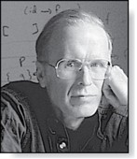
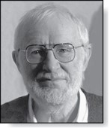

Backus-Naur Form 巴克斯-诺尔范式
John Backus (1924-2007)
Peter Naur (Born 1928)
Backus-Naur form (BNF) is sometimes used to specify a type 2 grammar. It is often used to specify the syntactic rules of computer languages.
The productions of a type 2 grammar have a single nonterminal symbol on their left-hand side.
All the productions with the same nonterminal symbol on the left-hand side are combined into one statement using the symbol ::= instead of →.
All nonterminal symbols are enclosed in brackets (〈〉), and the right-hand side of productions are separated by bars.
For example, the productions A →Aa, A →a, and A →AB are written as
$$\left.\left\langle A\right\rangle ::=\left\langle A\right\rangle a\right|\left.a\right|\left\langle A\right\rangle \left\langle B\right\rangle .$$

Slide 24
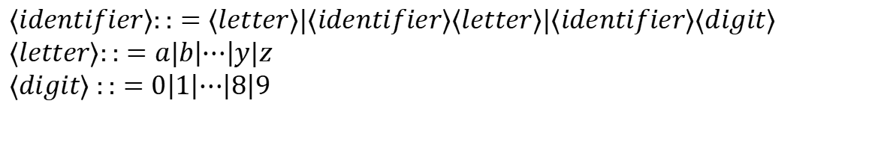
BNF and ALGOL 60
In the programming language ALGOL 60 an identifier (标识符) consists of a string of alphanumeric characters and must begin with a letter.
The BNF description of allowable identifiers is:
$$⟨identifier⟩::=⟨letter⟩|⟨identifier⟩⟨letter⟩|⟨identifier⟩⟨digit⟩ \\ ⟨letter⟩::=a|b\left|⋯\right|y|z \\ ⟨digit⟩ ::=0\left|1\right|⋯\left|8\right|9$$
x99a is a valid identifier since 1) the first rule can be used to replace 〈identifier〉 by 〈identifier〉〈letter〉, 2) the second rule to obtain 〈identifier〉 a, 3) the first rule twice to obtain 〈identifier〉〈digit〉〈digit〉 a, 4) the third rule twice to obtain 〈identifier〉99a, 5) the first rule to obtain 〈letter〉99a, and 6) finally the second rule to obtain x99a.

Slide 25
Backus-Naur Form 巴克斯-诺尔范式
Example: Give the Backus–Naur formfor the production of signed integers in decimal notation. (A signed integer is a nonnegative integer preceded by a plus sign or a minus sign.)
Solution: The Backus–Naur form for a grammar that produces signed integers is
⟨signed integer⟩ ::= ⟨sign⟩⟨integer⟩
⟨sign⟩ ::= + ∣ −
⟨integer⟩ ::= ⟨digit⟩ ∣ ⟨digit⟩⟨integer⟩
⟨digit⟩ ::= 0 ∣ 1 ∣ 2 ∣ 3 ∣ 4 ∣ 5 ∣ 6 ∣ 7 ∣ 8 ∣ 9

Slide 26
Finite-State Machines with Output 带输出的有限状态机
Section 13.2

Slide 27
Introduction 2
Many kinds of machines, including computers, can be modeled using a structure called a finite-state machine (or finite automaton).
A finite-state machine (有限状态机) consists of a finite set of states, a designated start state, an input alphabet, and a transition function that assigns a next state to every (state, input) pair.
As we will see in Sections 13.2 − 13.4, some types of finite-state machines produce output, while for other types of finite-state machines that do not produce output some states are designated as accepting states.
Finite-state machines are used in many diverse applications, including spell-checking programs, grammar checking, indexing, searching large bodies of text, speech recognition, XML, HTML, and network protocols .

Slide 28
An Example of a Finite-State Machine with Output 1
Problem: A vending machine (自动售货机) accepts nickels (5 cents) , dimes (10 cents) , and quarters (25 cents). When 30 cents or more has been deposited, the machine returns the amount over 30 cents. The customer can then press an orange button to receive a container of orange juice or a red button to receive a container of apple juice.

Slide 29
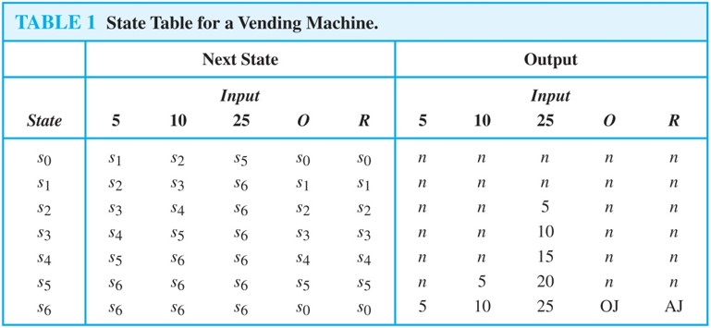
An Example of a Finite-State Machine with Output 1
The machine can be in any of the states s_{i}, i = 0, …, 6, where s_{i} is the state where the machine has received 5i cents.
The machine starts in state s₀, with 0 cents received.
The possible inputs are 5 cents, 10 cents, 25 cents, the orange button (O), and the red button (R).
The possible outputs are nothing (n), 5 cents, 10 cents, 15 cents, 20 cents, 25 cents, an orange juice, and an apple juice.

Slide 30
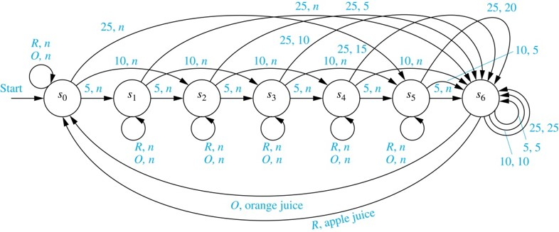
An Example of a Finite-State Machine with Output 1
We represent this vending machine using a directed graph with labeled edges, where each state is represented by a circle, edges represent transitions, and edges are labeled with the input and output for that transition.

Slide 31
An Example of a Finite-State Machine with Output 3
We will trace the transitions and outputs of the vending machine when a student puts in a dime (10 cents) followed by a quarter (25 cents) , receives 5 cents back, and then pushes the orange button and receives an orange juice.
The machine starts in state s₀.
The first input is 10 cents, which changes the state to s₂ and gives no output.
After the second input of 25 cents, the state changes to s₆ and gives 5 cents as output.
The last input is the orange button, which changes the state back to s₀ and gives an orange juice as output.

Slide 32
FSMs with Outputs
A finite-state machine M =(S, I, O, f, g, s₀) consists of a finite set S of states, a finite input alphabet I, a finite output alphabet O, a transition function f that assigns to each state and input pair a new state, an output function g that assigns to each state and input pair an output, and an initial state s₀ .
A state table (状态表) is used to represent the values of the transition function f and the output function g for all (state, input).
Alternatively, a finite-state machine can be represented by a state diagram (状态图) , which is a directed graph with labeled edges. Each state is represented by a circle, and arrows labeled with the input and output pair represent the transitions.

Slide 33
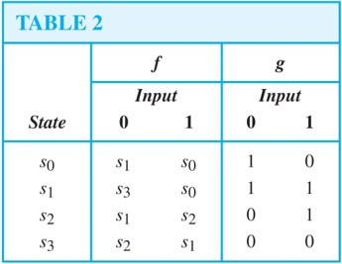
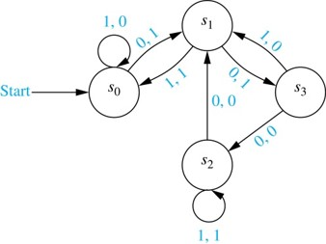
FSMs with Outputs
Example: The state table and state diagram both represent the finite state machine with S = {s₀ ,s₁ ,s₂ ,s₃}, I = {0, 1}, and O = {0, 1}.

Slide 34
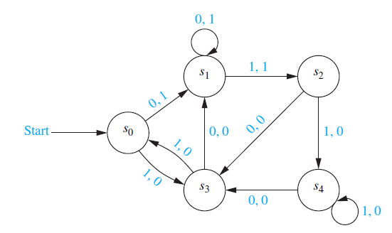
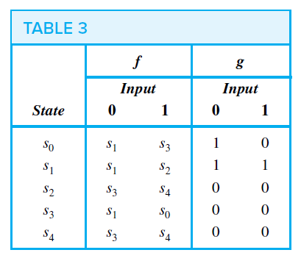
FSMs with Outputs
Example: Construct the state table for the finite-state machine with the state diagram shown as follows.

Slide 35
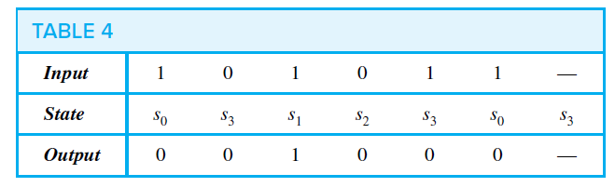
FSMs with Outputs
We read the input string symbol by symbol (from left to right), each input symbol takes the machine from one state to another. Because each transition produces an output, an input string also produces an output string.
Example: Find the output string generated by the finite-state machine if the input string is 101011.
Solution: The output obtained is 001000. The successive states and outputs are as follows.

Slide 36
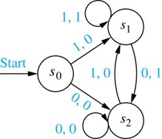
Unit-delay Machine 单位延迟机
An important element in many electronic devices is a unit-delay machine, which produces as output the input string delayed by a specified amount of time, i.e., padded with an initial string of 0s.
How can a finite-state machine be constructed that delays an input string by one unit of time, that is, produces as output the bit string 0x₁x₂…x_{k-1} given the input bit string x₁x₂…x_{k-1}?
A delay machine can be constructed that has 0 or 1 as possible inputs. The machine has the start state s₀.
The transition from s₀ produces an output of 0.
The machine is in state s₁ if the previous input was
a ‘1’ and it produces 1 as output for its next transition.
The machine is in state s₂ if the previous input was ‘0’
and it produces an output of 0 for its next transition.

Slide 37
Addition Machine
We will construct a finite-state machine that adds two positive integers using their binary expansions.
Recall the conventional procedure to add (x_{n}…x₁x₀)₂ and (y_{n}…y₁y₀)₂ .
First, the bits x₀ and y₀ are added, producing a sum bit z₀ and a carry bit c₀. Next the bits x₁ and y₁ are added together with the carry bit c₀. This gives a sum bit z₁ and a carry bit c₁.
The procedure continues until the nth stage, where x_{n}, y_{n} and the previous carry c_{n-1} are added to produce the sum bit z_{n} and the carry bit c_{n}, which is equal to the sum bit z_{n+1}.

Slide 38
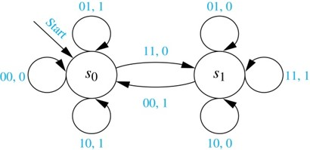
Addition Machine
We can construct a finite state machine that uses just two states.
The start state s₀ is used to remember that the previous carry is 0.
The other state s₁ is used to remember that the previous carry is 1. (For simplicity, we assume that both x_{n} and y_{n} are 0.)
The inputs are pairs of bits. The transitions and the outputs are constructed from the sum of the two bits in the input and the carry represented by the state.
For example, when the machine is in state s₁ and receives 01 as input, the next state is s₁ and the output is 0, because the sum 0 + 1 + 1 =(10)₂.

Slide 39
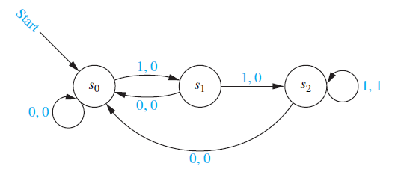
FSMs with Outputs
Example: In a certain coding scheme, when three consecutive 1s appear in a message, the receiver of the message knows that there has been a transmission error. Construct a finite-state machine that gives a 1 as its current output bit if and only if the last three bits received are all 1s.

Slide 40
FSMs with Outputs
The final output bit of the finite-state machine we constructed in the previous example is 1 if and only if the input string ends with 111. Because of this, we say that this finite-state machine recognizes the set of bit strings that end with 111.
Definition: Let M = (S, I, O, f, g, s₀) be a finite-state machine and L ⊆ I∗. We say that M recognizes (or accepts) L if an input string x belongs to L if and only if the last output bit produced by M when given x as input is a 1.
Note that another type of finite-state machine, giving no output, is usually used for language recognition. Finite-state machines with no output, also known as finite-state automata, have a set of final states and recognize a string if and only if it takes the start state to a final state.

Slide 41
Finite-State Machines with No Output 不带输出的有限状态机
Section 13.3

Slide 42
Finite-State Machines with No Output
One of the most important applications of finite-state machines is in language recognition. This plays a fundamental role in the design and construction of compilers for programming languages.
In Section 13.2 we showed that a finite-state machine with output can be used to recognize a language, by giving an output of 1 when a string from the language has been read and a 0 otherwise.
However, there are other types of finite-state machines that are specially designed for recognizing languages. Instead of producing output, these machines have final states. A string is recognized if and only if it takes the starting state to one of these final states.

Slide 43
Section Summary 3
Set of Strings
Finite-State Automata
Language Recognition by Finite-State Machines
Designing Finite-State Automata
Nondeterministic Finite-State Automata

Slide 44
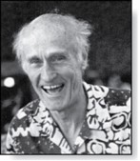
Set of Strings
Stephen Cole Kleene (1909-1994)
FSMs with no output, but with some states designated as accepting states, are specifically designed for recognizing languages.
Definition: The concatenation (串接) of A and B, where A and B are subsets of V*, denoted by AB, is the set of all strings of the form xy, where x is a string in A and y is a string in B.
Example: Let A = {0, 11} and B = {1, 10, 110}. Then
AB = {01, 010, 0110, 111, 110, 11110} and
BA = {10, 111, 100, 1011, 1100, 11011}
We can define A^{n}, for n = 0, 1, 2,…. This is done recursively by specifying that
A⁰ = {𝜆 },
A^{n+1} = A^{n}A for n = 0, 1, 2,….
Example: Let A = {1,00}. We have A⁰ = {𝜆 } and A¹ = A⁰A = {𝜆 }A = {1, 00}. This gives A² = AA = {11, 100, 001, 0000}. A³ = A² A= {111, 1100, 1001, 10000, 0011, 00100, 00001, 000000}.

Slide 45


Set of Strings
Stephen Cole Kleene (1909-1994)
Definition: If A is a subset of V*, the Kleene closure (克莱因闭包) of A, denoted by A*, is the set consisting of arbitrarily long strings of elements of A.
$$A^{∗}=\bigcup_{k=0}^{∞}{A^{k}}.$$
Example: The Kleene closures of the sets A = {0}, B = {0,1} and C = {11} are
$$A^{∗}=\left\{0^{n}|n=0,1,2,⋯\right\},$$
$$B^{∗}=V^{∗},$$
$C^{∗}=\left\{1^{2n}|n=0,1,2,⋯\right\}$.

Slide 46
Finite-State Automata (FSA)
Definition: A finite-state automaton M = (S, I, f, s₀, F) consists of a finite set S of states, a finite input alphabet I, a transition function f that assigns a next state to every pair of state and input (so that f: S × I → S), an initial or start state s₀, and a subset F of S consisting of final (or accepting) states.
FSAs can be represented using either state tables or state diagrams, in which final states are indicated with a double circle.

Slide 47
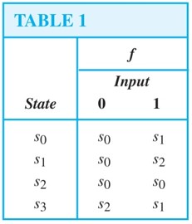
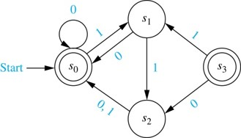
Finite-State Automata (FSA)
Example: The state diagram for the FSA M = (S, I, f, s₀, F), where S = {s₀, s₁, s₂,s₃}, I = {0, 1}, F = {s₀,s₃}, and the state table is shown as follows.

Slide 48
Language Recognition by FSAs 1
Definition: A string x is said to be recognized (or accepted) by the machine M = (S, I, f, s₀, F) if it takes the initial state s₀ to a final state, that is, f(s₀, x). The language recognized (or accepted) by M, denoted by L(M), is the set of all strings that are recognized by M. Two finite-state automata are called equivalent if they recognize the same language.

Slide 49
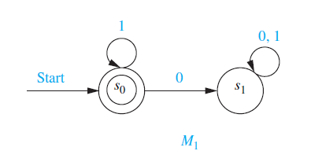
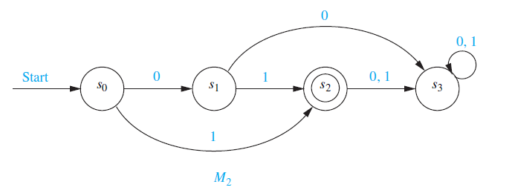
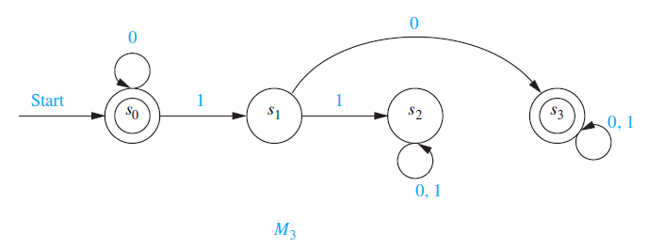
Language Recognition by FSAs 1
Example:
1. The only final state of M₁ is s₀. The strings that take s₀ to itself consist of zero or more consecutive 1s. Hence, L(M₁) = {1^{n} | n = 0, 1, 2, ….}.
2. The only final state of M₂ is s₂. The strings that take s₀ to s₂ are 1 and 01. Hence , L(M₂) = {1, 01}.
3. The final state of M₃ are s₀ and s₃. The strings that take s₀ to itself are λ, 0, 00, 000,… . The strings that take s₀ to s₃ are a string of zero or more consecutive 0s, followed by 10, followed by any string. Hence, L(M₃) = {0^{n},0^{n}10x | n = 0, 1, 2, …., and x is any string}.

Slide 50
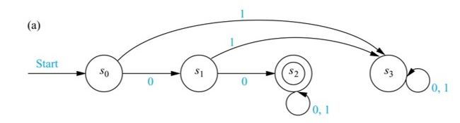
Language Recognition by FSAs 2
Example: Construct a FSA that recognizes the set of bit strings that begin with two 0s.
Solution:
Besides the start state s₀, we include a nonfinal state s₁; we move to s₁ from s₀ if the first bit is a 0.
Next, we add a final state s₂, which we move to from s₁, if the second bit is a 0. We stay in this state no matter what the succeeding bits (if any) are.
We need a nonfinal state s₃, so that we can move to it from s₀ if the first bit is a 1 and from s₁ if the second bit is a 1.

Slide 51
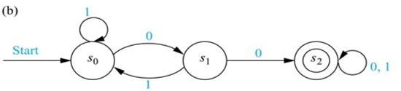
Language Recognition by FSAs 3
Example: Construct a FSA that recognizes the set of bit strings that contain two consecutive 0s.
Solution:
Besides the start state s₀, we include a nonfinal state s₁, which tells us that the last input bit seen is a 0, but either the bit before was a 1, or this is the initial bit.
Next, we add a final state s₂, if the next bit after a 0 is also 0, we move to s₂ from s₁. We stay in this state no matter what the succeeding bits (if any) are.
We return to s₀, if a 1 follows a 0 in the string, before we come to two consecutive 0s.

Slide 52
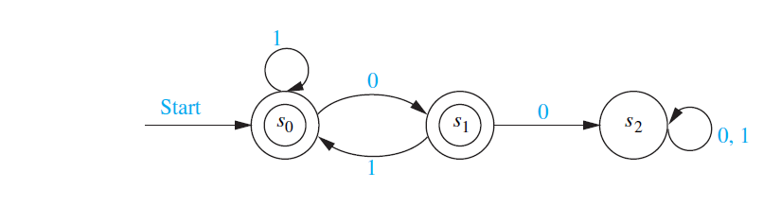
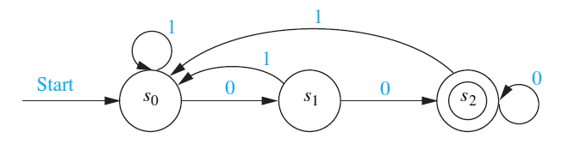
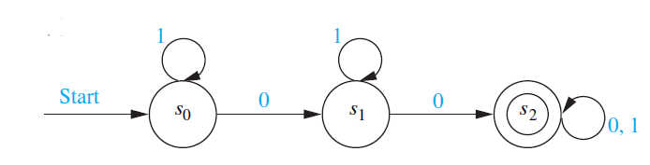
Language Recognition by FSAs 3
Example: Construct a FSA that recognizes each of these languages.
the set of bit strings that do not contain two consecutive 0s;
the set of bit strings that end with two 0s;
the set of bit strings that contain at least two 0s.
Solution:

Slide 53
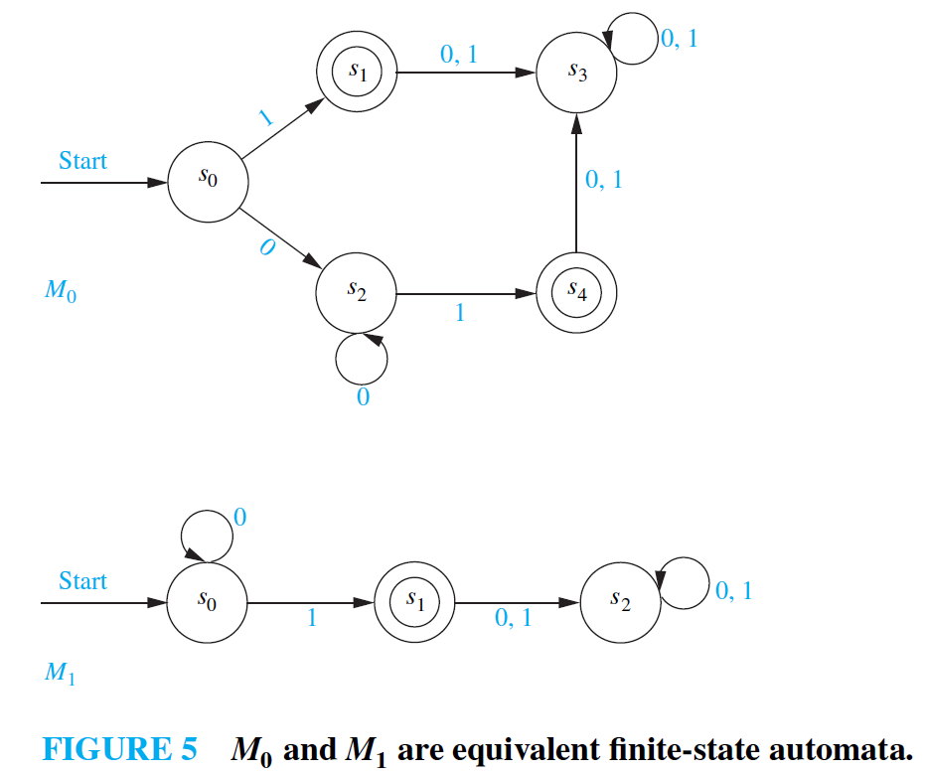
Equivalent Finite-state Automata
Definition: Two finite-state automata are called equivalent if they recognize the same language.
Example:
Both L(M0) and L(M1) is the set of strings of zero or more 0 bits followed by a final 1.

Slide 54
Nondeterministic Finite-state Automaton 非确定性的有限状态自动机
Definition: A nondeterministic finite-state automaton M = (S, I, f, s₀, F) consists of a finite set S of states, a finite input alphabet I, a transition function f that assigns a set of states to every pair of state and input (so that f: S × I → P(S)), an initial or start state s₀, and a subset F of S consisting of final (or accepting) states.
We can represent a nondeterministic finite-state automaton using a state table where we give a list of possible next states for each pair of a state and an input value.
We construct a state diagram for a nondeterministic automaton by including an edge from each state to all possible next states, labeling edges with the input or inputs that lead to this transition.
We use the abbreviation NFSA for a nondeterministic finite-state automaton and DFSA for a deterministic finite-state automata when we needed to distinguish between NDFSA and DFSA.

Slide 55
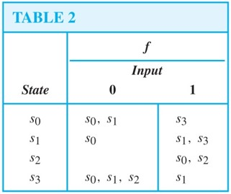
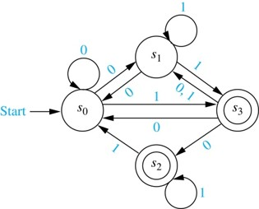
Nondeterministic Finite-state Automaton 非确定性的有限状态自动机
Example: Find the state diagram for the NDFSA with the state table shown as follows. The final states are s₂ and s₃.
Solution:

Slide 56
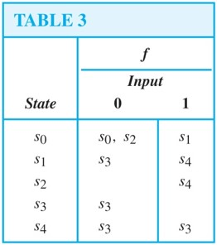
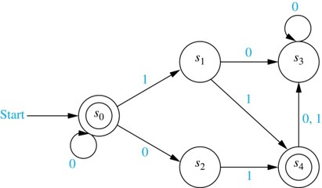
Nondeterministic Finite-state Automaton 非确定性的有限状态自动机
Example: Find the language recognized by the following nondeterministic finite-state automaton.
Solution: the language recognized by the machine is {0^{n}, 0^{n}01, 0^{n}11 ∣ n ≥ 0}.

Slide 57
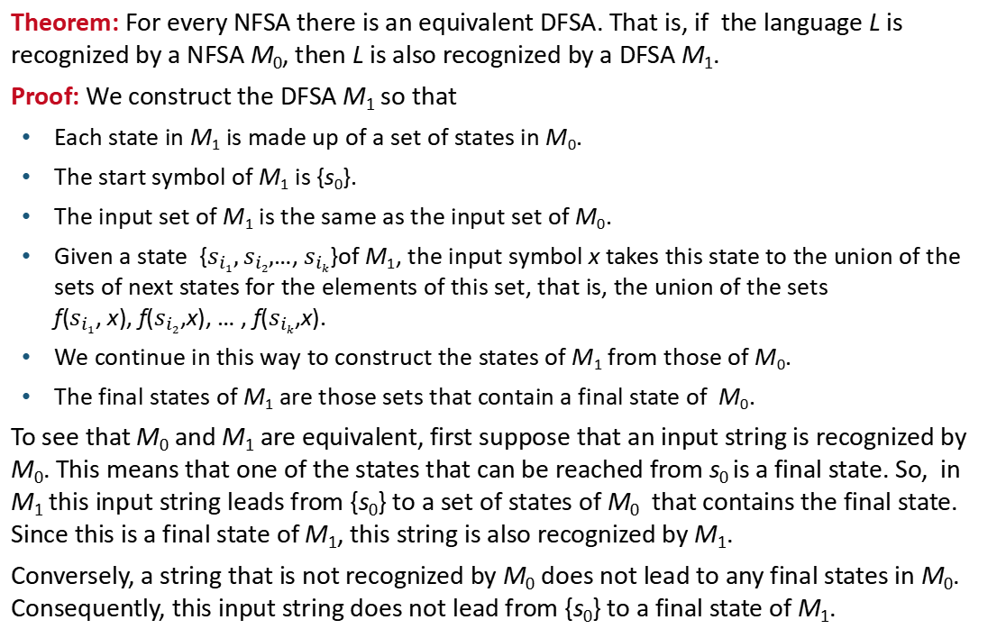
Finding a DFSA Equivalent to a NFSA 1
Theorem: For every NFSA there is an equivalent DFSA. That is, if the language L is recognized by a NFSA M₀, then L is also recognized by a DFSA M₁.
Proof: We construct the DFSA M₁ so that
Each state in M₁ is made up of a set of states in M₀.
The start symbol of M₁ is {s₀}.
The input set of M₁ is the same as the input set of M₀.
Given a state {$s_{i1},s_{i2},$…, $s_{ik}$}of M₁, the input symbol x takes this state to the union of the sets of next states for the elements of this set, that is, the union of the sets f($s_{i1}$, x), f($s_{i2}$,x), … , f($s_{ik}$,x).
We continue in this way to construct the states of M₁ from those of M₀.
The final states of M₁ are those sets that contain a final state of M₀.
To see that M₀ and M₁ are equivalent, first suppose that an input string is recognized by M₀. This means that one of the states that can be reached from s₀ is a final state. So, in M₁ this input string leads from {s₀} to a set of states of M₀ that contains the final state. Since this is a final state of M₁, this string is also recognized by M₁.
Conversely, a string that is not recognized by M₀ does not lead to any final states in M₀. Consequently, this input string does not lead from {s₀} to a final state of M₁.

Slide 58
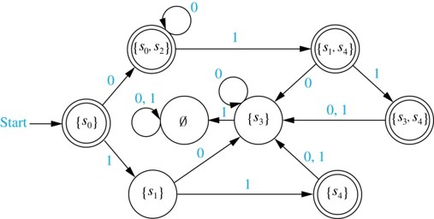
Finding a DFSA Equivalent to a NFSA 2
Example: Find a DFSA that recognizes the same language as the NFSA:
Solution: Following the steps of the procedure described on the previous slide, we obtain the DFSA shown here.

Slide 59
Language Recognition 语言的识别
Section 13.4

Slide 60
Section Summary
Regular Expressions
Kleene’s Theorem
Regular Sets and Regular Grammars
More Powerful Types of Machines

Slide 61
Regular Sets 正则集合
We have seen that finite-state automata can be used as language recognizers. What sets can be recognized by these machines? Although this seems like an extremely difficult problem, there is a simple characterization of the sets that can be recognized by finite state automata.
This problem was first solved in 1956 by the American mathematician Stephen Kleene. He showed that there is a finite-state automaton that recognizes a set if and only if this set can be built up from the null set, the empty string, and singleton strings by taking concatenations, unions, and Kleene closures, in arbitrary order. Sets that can be built up in this way are called regular sets.

Slide 62
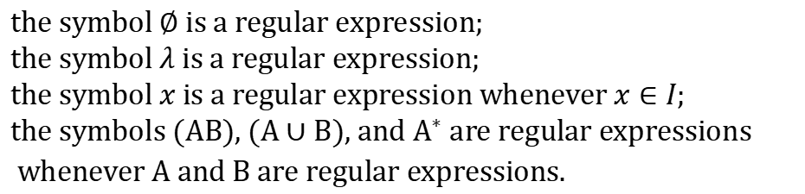
Regular Sets 正则集合
The regular expressions over a set$I$ are defined recursively by:
$$\text{the} \text{symbol} ∅ \text{is} \text{a} \text{regular} \text{expression}\text{;} \\ \text{the} \text{symbol} λ \text{is} \text{a} \text{regular} \text{expression}\text{;} \\ \text{the} \text{symbol} x \text{is} \text{a} \text{regular} \text{expression} \text{whenever} x∈I; \\ \text{the} \text{symbols} (AB)\text{, }(A∪B)\text{, }\text{and} A^{∗} \text{are} \text{regular} \text{expressions} \\ \text{whenever} A \text{and} B \text{are} \text{regular} \text{expressions}\text{.}$$
Each regular expression represents a set specified by these rules:
Sets represented by regular expressions are called regular sets (正则集).

Slide 63
Regular Sets 正则集合
Example: What are the strings in the regular sets specified by the regular expressions 10*, (10)*, 0 ∪ 01, 0(0 ∪ 1)*, and (0*1)*?
Solution:
TABLE 1
Expression | Strings
10∗ | a 1 followed by any number of 0s (including no zeros)
(10)∗ | any number of copies of 10 (including the null string)
0 ∪ 01 | the string 0 or the string 01
0(0 ∪ 1)∗ | any string beginning with 0
(0∗1)∗ | any string not ending with 0

Slide 64
Finite-State Automata, Regular Sets, and Regular Grammars
In 1956 Kleene established the connection between regular sets and sets recognized by a FSA.
Kleene’s Theorem: (克莱因定理) A set is regular if and only if it is recognized by a FSA.
(See the text for the lengthy proof of this theorem.)

Slide 65
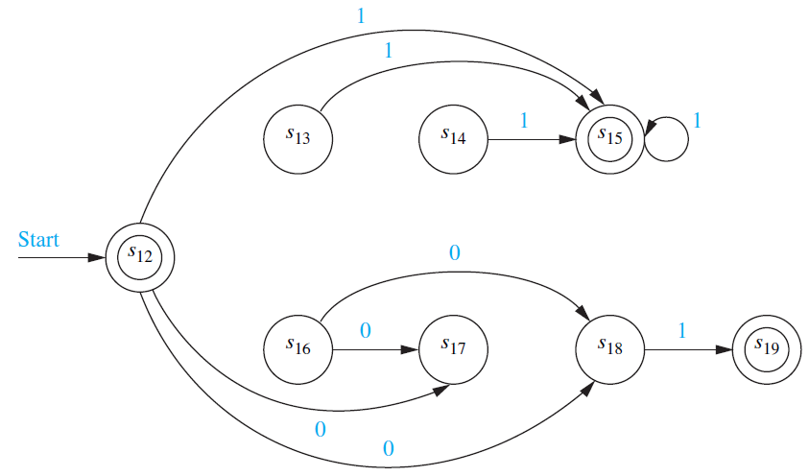
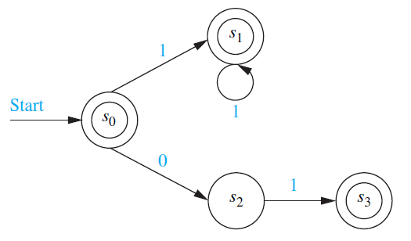
Finite-State Automata, Regular Sets, and Regular Grammars
Example: What Construct a nondeterministic finite-state automaton that recognizes the regular set 1* ∪ 01.
Solution:

Slide 66
Finite-State Automata, Regular Sets, and Regular Grammars
There is a close connection between regular grammars and regular sets.
Theorem: A set is generated by a regular grammar if and only if it is a regular set.
(See the text for a proof.)
We will give an example of a set that is not regular later in this section by finding a set that is not recognized by an FSA.

Slide 67
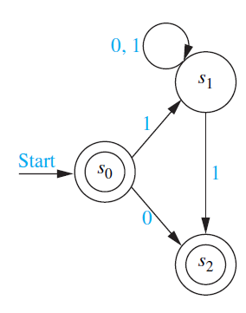
Finite-State Automata, Regular Sets, and Regular Grammars
Example: Construct a nondeterministic finite-state automaton that recognizes the language generated by the regular grammar G = (V, T, S, P), where V = {0, 1, A, S}, T = {0, 1}, and the productions in P are
S → 1A, S → 0, S → 𝜆, A → 0A, A → 1A, and A → 1.
Solution:

Slide 68
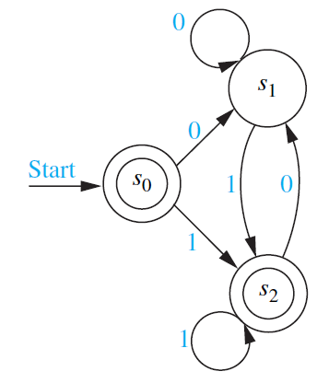
Finite-State Automata, Regular Sets, and Regular Grammars
Example: Find a regular grammar that generates the regular set recognized by the finite-state automaton in the figure.
Solution: The grammar G = (V, T, S, P) generates the set recognized by this automaton where V = {S, A, B, 0, 1}, the symbols S, A, and B correspond to the states s₀, s₁, and s₂, respectively, T = {0, 1}, S is the start symbol; and the productions are
S → 0A, S → 1B, S → 1, S → 𝜆, A → 0A,
A → 1B, A → 1, B → 0A, B → 1B, and B → 1.

Slide 69

A Set Not Recognized by a FSA 1
Example: The set
$$\left\{0^{n}1^{n}|n=0,1,2,…\right\}$$
of all strings consisting of a block of
0s followed by a block of an equal number of 1s is not regular.
Solution: To show that this set is not regular, suppose that this set was regular. Then there would be a FSA
recognizing it.
Let N be the number of states in this machine, that is,
M must recognize 0^{N}1^{N} since it is made up of a block of 0s followed by a block of an equal number of 1s.
Let s₀, s₁, s₂,…,s_{2N} be the sequence of states obtained starting at s₀ and using the symbols of 0^{N}1^{N} as input. So,
and s_{2N} is a final state.
Because there are only N states, by the pigeonhole principle at least two of the first N + 1 states s₀, s₁, s₂,…,s_{N} must be the same.
Suppose that s_{i} and s_{j} are identical states with
This means that
Hence, there is a loop leading from s_{i} back to
itself, using 0 a total of t times.

Slide 70
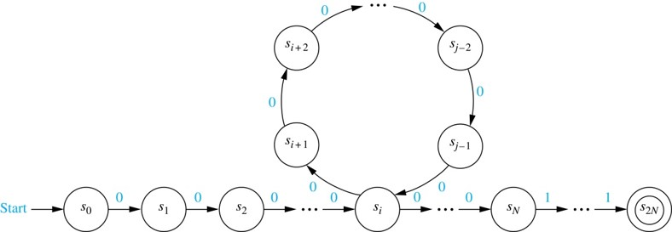
A Set Not Recognized by a FSA 2
Now consider the input string
The string is not of the
correct form and so, it is not recognized by M.
Consequently,
can not be a final state.
However, when we use the string
as input, we end up in the
same state as before, namely, s_{2N}. The reason is that we go through the loop one more time.
This contradiction shows that
is not regular.

Slide 71
More Powerful Types of Machines
The main limitation of finite-state automata is their finite amount of memory. This has led to the development of more powerful types of machines.
Pushdown Automaton (PDA): includes a stack, which provides unlimited memory. We can use a PDA to recognize
but no PDA recognizes the set
Linear Bounded Automaton (LBA): More powerful than pushdown automata. We can use a LBA to recognize
but there are languages generated by phrase-structure grammars that cannot be recognized by a LBA.
Turing Machine (TM): Yet more powerful machines (to be studied in the next section) which can recognize all languages generated by phrase-structure grammars.

Slide 72
Turing Machines 图灵机
Section 13.5

Slide 73
Section Summary 5
Definition of Turing Machines
Using Turing Machines to Recognize Sets
Computing Functions with Turing Machines
The Church-Turing Thesis

Slide 74
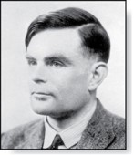
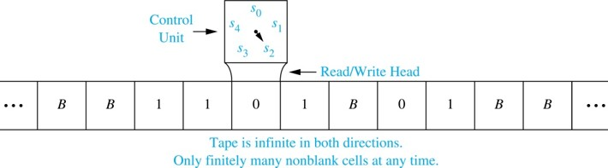
Introduction
Alan Mathison Turing (1912-1954)
Informally, a Turing machine consists of
a control unit, which at any step is in one of finitely many different states, (包含有限个状态的控制器)
together with a tape, infinite in both directions, which is divided into cells. (两端无限分成很多方格的纸带)
Turing machines have read and write capabilities on the tape as the control unit moves back and forth along this tape, changing states depending on the tape symbol read.
Turing machines are more powerful than finite-state machines because they include additional memory capability.
Turing machines are the most general models of computation; essentially they can do whatever a computer can do.

Slide 75
Definition of Turing Machines (TM)
Definition: A Turing machine T = (S, I, f, s₀) consists of
a finite set S of states,
an alphabet I containing the blank symbol B,
a partial function f from S × I to S × I ×{R,L}, and
a starting state s₀.
For some (state, symbol) pairs the partial function f may be undefined, but for a pair for which it is defined, there is a unique (state, symbol, direction) triple associated to this pair.
The five-tuples corresponding to the partial function in the definition of a TM are called the transition rules (转移规则) of the machine.

Slide 76
Definition of Turing Machines (TM)
At each step, the control unit reads the current tape symbol x. If the control unit is in state s and if the partial function f is defined for the pair (s, x) with f(s, x) = (s′, x′, d), the control unit:
enters the state s′,
writes the symbol x′ in the current cell, erasing x, and
moves right one cell if d = R or moves left one cell if d = L.
This step is written as the five-tuple (s, x, s′, x′, d). Turing machines are defined by specifying a set of such five-tuples. If the partial function f is undefined for the pair (s, x) then T will halt.
At the beginning of its operation a TM is assumed to be in the initial state s₀ and to be positioned over the leftmost nonblank symbol on the tape. This is the initial position of the machine.

Slide 77
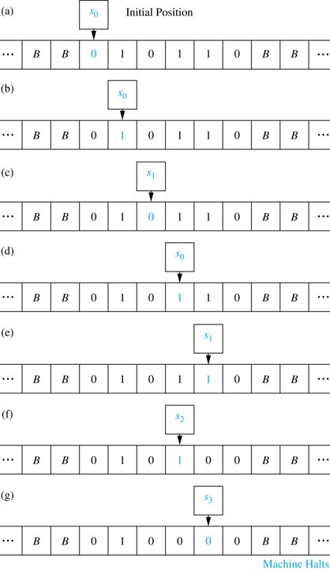
A TM in Operation
Example: What is the final tape when the TM T defined by the seven five-tuples (s₀, 0, s₀, 0, R), (s₀, 1, s₁, 1, R), (s₀, B, s₃, B, R), (s₁, 0, s₀, 0, R), (s₁, 1, s₂, 0, L), (s₁, B, s₃, B, R), and (s₂, 1, s₃, 0, R) is run on the tape shown here in (a)?
Solution: The transitions of this TM are shown to the right. The final tape is shown in (g).

Slide 78
Using TM to Recognize Sets 1
Let V be a subset of an alphabet I. A TM T = (S, I, f, s₀) recognizes a string x in V* if and only if T, starting in the initial position when x is written on the tape, halts in a final state.
T is said to recognize a subset A of V* if x is recognized by T if and only if x belongs to A.
Note that to recognize a subset A of V* we can use symbols not in V. This means that the input alphabet I may include symbols not in V. We will see that these extra symbols are used as markers.
A TM operating on a tape containing the symbols of a string x in consecutive cells, does not recognize x if it does not halt or halts in a state that is not final.

Slide 79
Using TMs to Recognize Sets 2
Example: Find a Turing machine that recognizes the set of bit strings that have a 1 as their second bit, that is, the regular set (0 ∪ 1)1(0 ∪ 1)∗.
Solution: To construct such a machine, we include the five-tuples (s₀, 0, s₁, 0, R) and (s₀, 1, s₁, 1, R) to read in the first symbol and put the Turing machine in state s₁.
Next, we include the five-tuples (s₁, 0, s₂, 0, R) and (s₁, 1, s₃, 1, R) to read in the second symbol and either move to state s₂ if this symbol is a 0, or to state s₃ if this symbol is a 1.
We do not want to recognize strings that have a 0 as their second bit, so s₂ should not be a final state. We want s₃ to be a final state. So, we can include the five-tuple (s₂, 0, s₂, 0, R).
Because we do not want to recognize the empty string or a string with one bit, we also include the five-tuples (s₀, B, s₂, 0, R) and (s₁, B, s₂, 0, R).

Slide 80
Using TMs to Recognize Sets 2
In Section 13.4 we showed that there is no FSA that recognizes the set
We will now construct a TM that recognizes this set.
We use an auxiliary tape symbol M as a marker, and specify that V = {0, 1} and I = {0, 1, M}.
Our TM has one final state, s₆ . The TM successively replaces a 0 at the leftmost position of the string with an M and a 1 at the rightmost position of the string with an M, sweeping back and forth, terminating in a final state if and only if the string consists of a block of 0s followed by a block of the same number of 1s.
The five-tuples are (s₀, 0, s₁, M, R), (s₁, 0, s₁, 0, R), (s₁, 1, s₁, 1, R), (s₁, M, s₂, M, L), (s₁, B, s₂, B, L), (s₂, 1, s₃, M, L), (s₃, 1, s₃, 1, L), (s₃, 0, s₄, 0, L), (s₃, M, s₅, M, R), (s₄, 0, s₄, 0, L), (s₄, M, s₀, M, R), and (s₅, M, s₆, M, R).
For example, the string 000111 would successively become M00111, M0011M, MM011M, MM01MM, MMM1MM, MMMMMM as the machine operates until it halts.

Slide 81
Computing Functions with TMs 1
A Turing machine can be used to compute the values of a partial function.
Suppose that the TM T, when given the string x as input, halts with the string y on its tape. We can then define T(x) = y.
To consider a TM as a computer of functions from the set of k-tuples of nonnegative integers to the set of nonnegative integers, we use the unary representation of integers.
A nonnegative integer n is represented by a string of n + 1 1s. So, 0 is represented by 1, 5 by 111111, etc.
To represent an input that is a k-tuple of integers, we represent each integer in the k-tuple separately and separate these representations using asterisks. For example, (2,0,1,3) is represented by 111*1*11*1111.
Constructing a Turing machine that computes a particular function can be extremely complicated. Fortunately, the ability of Turing machines to compute functions is of theoretical, rather than practical, interest.

Slide 82
Computing Functions with TMs 2
To construct a TM T that computes the function
we first represent the pair (n₁,n₂) by a string of n₁ + 1 1s followed by an asterisk, followed by n₂ + 1 1s.
The machine starts at the leftmost 1 of the input string, and proceeds to erase this 1.
If the next character is an asterisk, n₁ = 0. In this case, it replaces the asterisk with a blank and halts.
Otherwise, it erases the next 1, and then passes over the remaining 1s, until it comes to the asterisk.
The asterisk is then replaced by a 1.
The five-tuples defining this Turing machine are: (s₀, 1, s₁, B, R), (s₁, ∗, s₃, B, R), (s₁, 1, s₂, B, R), (s₂, 1, s₂, 1, R), (s₂, ∗, s₃, 1, R).

Slide 83
The Church-Turing Thesis 丘奇-图灵论题
The Church-Turing Thesis says that given any problem that can be solved with an effective algorithm, there is a TM that can solve this problem.
It is called a thesis rather than a theorem because the concept of solvability by an effective algorithm is informal and imprecise, as opposed to the concept of solvability by a TM, which is formal and precise.

Slide 84
Homework
§13.1 4, 16, 28
§13.2 2 a), 19 §13.3 16, 25
§13.4 6, 16
§13.5 2
Due date : 2024.6.18

