Slide 1
Cardinality of Sets
Section 2.5

Slide 2
Section Summary
Cardinality
Countable Sets
Computability

Slide 3
Cardinality 基数
Definition: The cardinality of a set A is equal to the cardinality of a set B, denoted
|A| = |B|,
if and only if there is a one-to-one correspondence (i.e., a bijection) from A to B.
If there is a one-to-one function (i.e., an injection) from A to B, the cardinality of A is less than or the same as the cardinality of B and we write |A| ≤ |B|.
When |A| ≤ |B| and A and B have different cardinality, we say that the cardinality of A is less than the cardinality of B and write |A| < |B|.

Slide 4
Cardinality 基数
Definition: A set that is either finite or has the same cardinality as the set of positive integers (Z⁺) is called countable. A set that is not countable is uncountable.
The set of real numbers R is an uncountable set.
When an infinite set is countable (countably infinite) its cardinality is ℵ₀ (where ℵ is aleph, the 1st letter of the Hebrew alphabet). We write |S| = ℵ₀ and say that S has cardinality “aleph null.”

Slide 5
Showing that a Set is Countable
An infinite set is countable if and only if it is possible to list the elements of the set in a sequence (indexed by the positive integers).
The reason for this is that a one-to-one correspondence f from the set of positive integers to a set S can be expressed in terms of a sequence a₁,a₂,…, a_{n} ,… where a₁ = f(1), a₂ = f(2),…, a_{n} = f(n),…

Slide 6
Showing that a Set is Countable 1
Example 1: Show that the set of positive even integers E is countable set.
Solution: Let
Then f is a bijection from N to E since f is both one-to-one and onto. To show that it is one-to-one, suppose that f(n) = f(m). Then 2n = 2m, and so n = m. To see that it is onto, suppose that t is an even positive integer. Then t = 2k for some positive integer k and f(k) = t.

Slide 7
Showing that a Set is Countable 2
Example 2: Show that the set of integers Z is countable.
Solution: Can list in a sequence:
0, 1, − 1, 2, − 2, 3, − 3 ,………..
Or can define a bijection from N to Z:
When n is even: f(n) = n/2
When n is odd: f(n) = −(n−1)/2

Slide 8
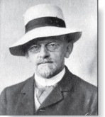
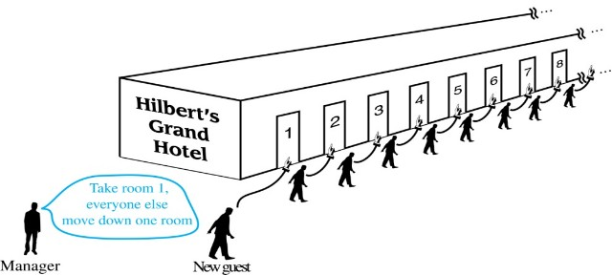
Hilbert’s Grand Hotel
The Grand Hotel (example due to David Hilbert) has countably infinite number of rooms, each occupied by a guest. We can always accommodate a new guest at this hotel. How is this possible?
Explanation: Because the rooms of Grand Hotel are countable, we can list them as Room 1, Room 2, Room 3, and so on. When a new guest arrives, we move the guest in Room 1 to Room 2, the guest in Room 2 to Room 3, and in general the guest in Room n to Room n + 1, for all positive integers n. This frees up Room 1, which we assign to the new guest, and all the current guests still have rooms.
David Hilbert
The hotel can also accommodate a countable number of new guests, all the guests on a countable number of buses where each bus contains a countable number of guests (see exercises).

Slide 9
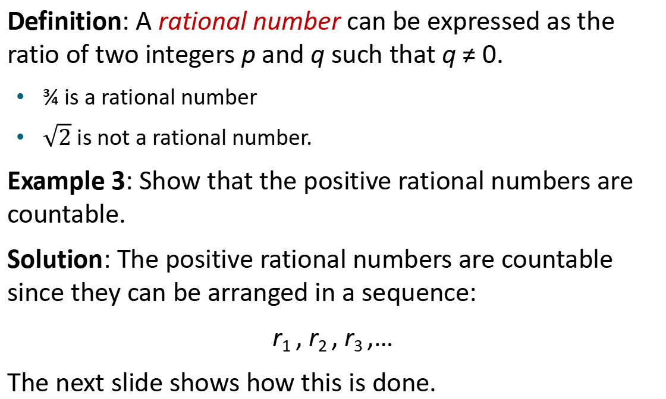
The Positive Rational Numbers are Countable 1
Definition: A rational number can be expressed as the ratio of two integers p and q such that q ≠ 0.
¾ is a rational number
$\sqrt{2}$ is not a rational number.
Example 3: Show that the positive rational numbers are countable.
Solution: The positive rational numbers are countable since they can be arranged in a sequence:
r₁ , r₂ , r₃ ,…
The next slide shows how this is done.
Notes:
根号2

Slide 10
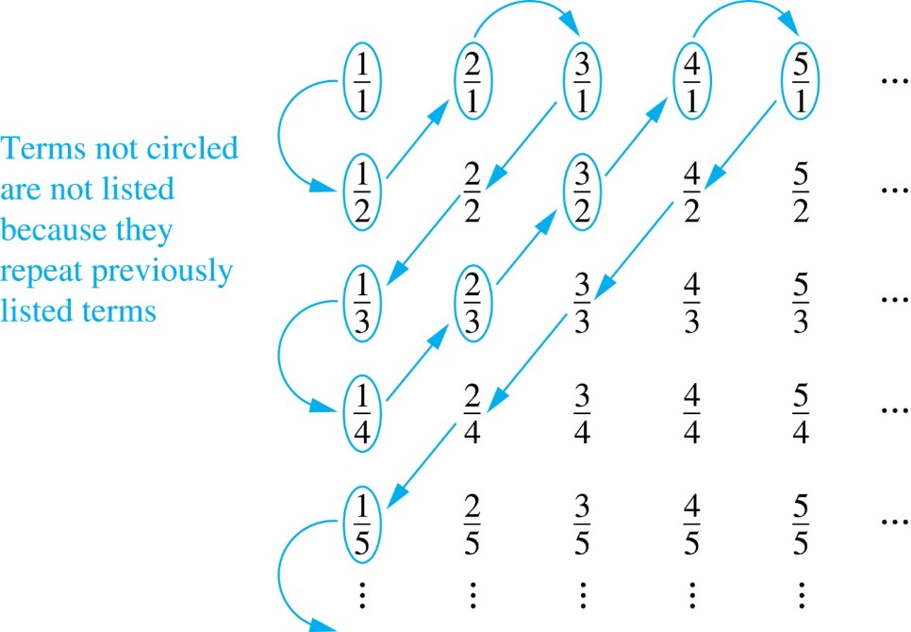
The Positive Rational Numbers are Countable 2
Constructing the List
First list p/q with p + q = 2.
Next list p/q with p + q = 3
And so on.
1, ½, 2, 3, 1/3,1/4, 2/3, ….
First row q = 1.
Second row q = 2.
etc.

Slide 11
Strings
Example 4: Show that the set of finite strings S over a finite alphabet A is countably infinite.
Assume an alphabetical ordering of symbols in A
Solution: Show that the strings can be listed in a sequence. First list
All the strings of length 0 in alphabetical order.
Then all the strings of length 1 in lexicographic (as in a dictionary) order.
Then all the strings of length 2 in lexicographic order.
And so on.
This implies a bijection from N to S and hence it is a countably infinite set.

Slide 12
The set of all Java programs is countable.
Example 5: Show that the set of all Java programs is countable.
Solution: Let S be the set of strings constructed from the characters which can appear in a Java program. Use the ordering from the previous example. Take each string in turn:
Feed the string into a Java compiler. (A Java compiler will determine if the input program is a syntactically correct Java program.)
If the compiler says YES, this is a syntactically correct Java program, we add the program to the list.
We move on to the next string.
In this way we construct an implied bijection from N to the set of Java programs. Hence, the set of Java programs is countable.

Slide 13
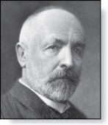

The Real Numbers are Uncountable
Georg Cantor
(1845-1918)
Example: Show that the set of real numbers is uncountable.
Solution: The method is called the Cantor diagnalization (康托对角线法) argument, and is a proof by contradiction.
Suppose R is countable. Then the real numbers between 0 and 1 are also countable (any subset of a countable set is countable - an exercise in the text).
The real numbers between 0 and 1 can be listed in order r₁ , r₂ , r₃ ,… .
Let the decimal representation of this listing be
r₁ = 0.d_{1,1} d_{1,2} d_{1,3} d_{1,4} d_{1,5} d_{1,6} d_{1,7} d_{1,8}… r₂ = 0.d_{2,1} d_{2,2} d_{2,3} d_{2,4} d_{2,5} d_{2,6} d_{2,7} d_{2,8}… r₃ = 0.d_{3,1} d_{3,2} d_{3,3} d_{3,4} d_{3,5} d_{3,6} d_{3,7} d_{3,8}… r₄ = 0.d_{4,1} d_{4,2} d_{4,3} d_{4,4} d_{4,5} d_{4,6} d_{4,7} d_{4,8}… $$. \\ .$$
Form a new real number with the decimal expansion

Slide 14
The Real Numbers are Uncountable
Georg Cantor
(1845-1918)
Example: Show that the set of real numbers is uncountable.
Solution: The method is called the Cantor diagnalization (康托对角线法) argument, and is a proof by contradiction.
r is not equal to any of the r₁ , r₂ , r₃ ,... Because it differs from r_{i} in its ith position after the decimal point. Therefore there is a real number between 0 and 1 that is not on the list since every real number has a unique decimal expansion. Hence, all the real numbers between 0 and 1 cannot be listed, so the set of real numbers between 0 and 1 is uncountable.
Since a set with an uncountable subset is uncountable (an exercise), the set of real numbers is uncountable.
E.g., a postulated enumeration of the reals: r₁ = 0.301948571… r₂ = 0.103918481… r₃ = 0.039194193… r₄ = 0.918237461…
Then, 0.4333… can’t be on the list anywhere!

Slide 15
Computability
Definition: We say that a function is computable if there is a computer program in some programming language that finds the values of this function. If a function is not computable we say it is uncomputable.
There are uncomputable functions. We have shown that the set of Java programs is countable. Exercise 38 in the text shows that there are uncountably many different functions from a particular countably infinite set (i.e., the positive integers) to itself. Therefore (Exercise 39) there must be uncomputable functions.

Slide 16
Matrices
Section 2.6

Slide 17
Section Summary
Definition of a Matrix
Matrix Arithmetic
Transposes and Powers of Arithmetic
Zero-One matrices

Slide 18
Matrices
Matrices are useful discrete structures that can be used in many ways. For example, they are used to:
describe certain types of functions known as linear transformations.
Express which vertices of a graph are connected by edges (see Chapter 10).
In later chapters, we will see matrices used to build models of:
Transportation systems.
Communication networks.
Algorithms based on matrix models will be presented in later chapters.
Here we cover the aspect of matrix arithmetic that will be needed later.

Slide 19
Matrix
Definition: A matrix is a rectangular array of numbers. A matrix with m rows and n columns is called an m × n matrix.
The plural of matrix is matrices.
A matrix with the same number of rows as columns is called square.
Two matrices are equal if they have the same number of rows and the same number of columns and the corresponding entries in every position are equal.
3 × 2 matrix

Slide 20
Notation
Let m and n be positive integers and let
The ith row of A is the 1 × n matrix [a_{i1}, a_{i2},…,a_{in}]. The jth column of A is the m × 1 matrix:
The (i,j)th element or entry of A is the element a_{ij}. We can use A = [a_{ij} ] to denote the matrix with its (i,j)th element equal to a_{ij}.

Slide 21
Matrix Arithmetic: Addition
Definition: Let A = [a_{ij}] and B = [b_{ij}] be m × n matrices. The sum of A and B, denoted by A + B, is the m × n matrix that has a_{ij} + b_{ij} as its (i,j)th element. In other words, A + B = [a_{ij} + b_{ij}].
Example:
Note that matrices of different sizes can not be added.

Slide 22
Matrix Multiplication
Definition: Let A be an m × k matrix and B be a k × n matrix. The product of A and B, denoted by AB, is the m × n matrix that has its (i,j)th element equal to the sum of the products of the corresponding elements from the ith row of A and the jth column of B. In other words, if AB = [c_{ij}] then c_{ij} = a_{i1}b_{1j} + a_{i2}b_{2j} + … + a_{kj}b_{2j}.
Example:
The product of two matrices is undefined when the number of columns in the first matrix is not the same as the number of rows in the second.

Slide 23
Illustration of Matrix Multiplication
The Product of A = [a_{ij}] and B = [b_{ij}]

Slide 24
Matrix Multiplication is not Commutative
Example: Let
Does AB = BA?
Solution:
AB ≠ BA

Slide 25
Identity Matrix and Powers of Matrices
Definition: The identity matrix of order n is the m × n matrix I_{n} = [δ_{ij}], where δ_{ij} = 1 if i = j and δ_{ij} = 0 if i≠j.
AI_{n} = I_{m}A = A
when A is an m × n matrix
Powers of square matrices can be defined. When A is an n × n matrix, we have:

Slide 26
Transposes of Matrices 1
Definition: Let A = [a_{ij}] be an m × n matrix. The transpose (转置) of A, denoted by A^{t} ,is the n × m matrix obtained by interchanging the rows and columns of A.
If A^{t} = [b_{ij}], then b_{ij} = a_{ji} for i =1,2,…,n and j = 1,2, ...,m.

Slide 27
Transposes of Matrices 2
Definition: A square matrix A is called symmetric (对称) if A = A^{t}. Thus A = [a_{ij}] is symmetric if a_{ij} = a_{ji} for i and j with 1≤ i≤ n and 1≤ j≤ n.
Square matrices do not change when their rows and columns are interchanged.

Slide 28
Zero-One Matrices 1
Definition: A matrix all of whose entries are either 0 or 1 is called a zero-one matrix. (These will be used in Chapters 9 and 10.)
Algorithms operating on discrete structures represented by zero-one matrices are based on Boolean arithmetic defined by the following Boolean operations:

Slide 29
Zero-One Matrices 2
Definition: Let A = [a_{ij}] and B = [b_{ij}] be an m × n zero-one matrices.
The join (并)of A and B is the zero-one matrix with (i,j)th entry a_{ij} ∨ b_{ij}. The join of A and B is denoted by A ∨ B.
The meet (交) of A and B is the zero-one matrix with (i,j)th entry a_{ij} ∧ b_{ij}. The meet of A and B is denoted by A ∧ B.

Slide 30
Joins and Meets of Zero-One Matrices
Example: Find the join and meet of the zero-one matrices
Solution: The join of A and B is
The meet of A and B is

Slide 31
Boolean Product of Zero-One Matrices 1
Definition: Let A = [a_{ij}] be an m × k zero-one matrix and B = [b_{ij}] be a k × n zero-one matrix. The Boolean product (布尔积) of A and B, denoted by A ⊙ B, is the m × n zero-one matrix with(i,j)th entry
c_{ij} = (a_{i1} ∧ b_{1j})∨ (a_{i2} ∧ b_{2j}) ∨ … ∨ (a_{ik} ∧ b_{kj}).
Example: Find the Boolean product of A and B, where

Slide 32
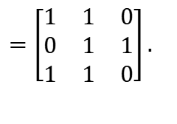
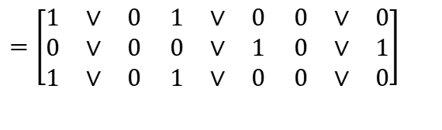
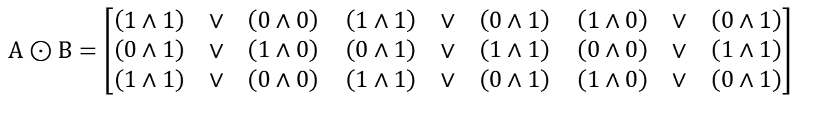
Boolean Product of Zero-One Matrices 2
Solution: The Boolean product A ⊙ B is given by
$$A⊙B=\left[\begin{matrix}\left(1∧1\right) & ∨ & \left(0∧0\right) \\ \left(0∧1\right) & ∨ & \left(1∧0\right) \\ \left(1∧1\right) & ∨ & \left(0∧0\right)\end{matrix} \begin{matrix}\left(1∧1\right) & ∨ & \left(0∧1\right) \\ \left(0∧1\right) & ∨ & \left(1∧1\right) \\ \left(1∧1\right) & ∨ & \left(0∧1\right)\end{matrix} \begin{matrix}\left(1∧0\right) & ∨ & \left(0∧1\right) \\ \left(0∧0\right) & ∨ & \left(1∧1\right) \\ \left(1∧0\right) & ∨ & \left(0∧1\right)\end{matrix}\right]$$
$$=\left[\begin{matrix}1 & ∨ & 0 \\ 0 & ∨ & 0 \\ 1 & ∨ & 0 \end{matrix}\begin{matrix} 1 & ∨ & 0 \\ 0 & ∨ & 1 \\ 1 & ∨ & 0 \end{matrix}\begin{matrix} 0 & ∨ & 0 \\ 0 & ∨ & 1 \\ 0 & ∨ & 0\end{matrix}\right]$$
$$=\left[\begin{matrix}1 & 1 & 0 \\ 0 & 1 & 1 \\ 1 & 1 & 0\end{matrix}\right].$$

Slide 33
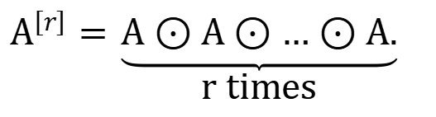
Boolean Powers of Zero-One Matrices 1
Definition: Let A be a square zero-one matrix and let r be a positive integer. The rth Boolean power (布尔幂) of A is the Boolean product of r factors of A, denoted by A^{[r]} . Hence,
$$A^{\left[r\right]}=\underset{\text{r} \text{times}}{\underbrace{A⊙A⊙…⊙A.}}$$
We define A^{[r]} to be I_{n}.
(The Boolean product is well defined because the Boolean product of matrices is associative.)

Slide 34
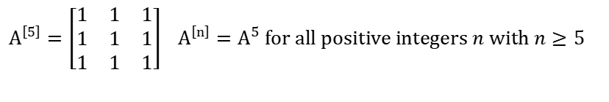
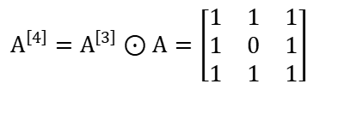
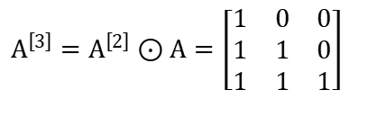
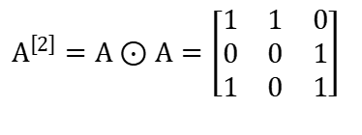
Boolean Powers of Zero-One Matrices 2
Example: Let
Find A^{n} for all positive integers n.
Solution:
$$A^{\left[2\right]}=A⊙A=\left[\begin{matrix}1 & 1 & 0 \\ 0 & 0 & 1 \\ 1 & 0 & 1\end{matrix}\right]$$
$$A^{\left[3\right]}=A^{\left[2\right]}⊙A=\left[\begin{matrix}1 & 0 & 0 \\ 1 & 1 & 0 \\ 1 & 1 & 1\end{matrix}\right]$$
$$A^{\left[4\right]}=A^{\left[3\right]}⊙A=\left[\begin{matrix}1 & 1 & 1 \\ 1 & 0 & 1 \\ 1 & 1 & 1\end{matrix}\right]$$
$$A^{\left[5\right]}=\left[\begin{matrix}1 & 1 & 1 \\ 1 & 1 & 1 \\ 1 & 1 & 1\end{matrix}\right] { A}^{\left[n\right]}=A^{5} \text{for} \text{all} \text{positive} \text{integers} n \text{with} n≥5$$

Slide 35
Homework
§2.5 2, 19
§2.6 4, 6, 27, 32
Due date : 2024.03.26

