Slide 1
Chapter 4: Number Theory and Cryptography
1

Slide 2
Chapter Motivation
Number theory【数论】： is the part of mathematics devoted to the study of the integers and their properties.
Divisibility and the primality of integers【整除性与整数的素性】：Key ideas in number theory include divisibility and the primality of integers.
Representations of integers 【整数的表示】：Representations of integers, including binary and hexadecimal representations, are part of number theory.
Proof methods 【证明方法】：We’ll use many ideas developed in Chapter 1 about proof methods and proof strategy in our exploration of number theory.

Slide 3
Chapter Summary
Divisibility and Modular Arithmetic
Integer Representations and Algorithms
Primes and Greatest Common Divisors
Solving Congruences
Applications of Congruences
Cryptography

Slide 4
Section Summary
Division
Division Algorithm
Modular Arithmetic

Slide 5
Division 除
Definition: If a and b are integers with a ≠ 0, then a divides b if there exists an integer c such that b = ac.
When a divides b we say that a is a factor or divisor of b and that b is a multiple of a.
The notation a | b denotes that a divides b.
If a | b, then b/a is an integer.
If a does not divide b, we write a ∤ b.
Example: Determine whether 3 | 7 and whether 3 | 12.

Slide 6
Properties of Divisibility 整除的性质
Theorem 1: Let a, b, and c be integers, where a ≠0.
If a | b and a | c, then a | (b + c);
If a | b, then a | bc for all integers c;
If a | b and b | c, then a | c.
Proof: (i) Suppose a | b and a | c, then it follows that there are integers s and t with b = as and c = at. Hence,
b + c = as + at = a(s + t).
Hence, a | (b + c).
Corollary : If a, b, and c be integers, where a ≠0, such that a | b and a | c, then a | (mb + nc) whenever m and n are integers.

Slide 7
Section Summary
Division
Division Algorithm
Modular Arithmetic

Slide 8
Division Algorithm
Division Algorithm: If a is an integer and d a positive integer, then there are unique integers q and r, with 0 ≤ r < d, such that a = dq + r (proved in Section 5.2).
d is called the divisor.【除数】
a is called the dividend.【被除数】
q is called the quotient. 【商】
r is called the remainder.【余数】
Examples:
What are the quotient and remainder when 101 is divided by 11?
Solution: The quotient when 101 is divided by 11 is 9 = 101 div 11, and the remainder is 2 = 101 mod 11.
What are the quotient and remainder when −11 is divided by 3?
Solution: The quotient when −11 is divided by 3 is −4 = −11 div 3, and the remainder is 1 = −11 mod 3.
Definitions of Functions div and mod
q = a div d
r = a mod d

Slide 9
Section Summary
Division
Division Algorithm
Modular Arithmetic

Slide 10
Congruence Relation 同余关系
Definition: If a and b are integers and m is a positive integer, then a is congruent to b modulo m if m divides a − b.
The notation a ≡ b (mod m) says that a is congruent to b modulo m.
We say that a ≡ b (mod m) is a congruence and that m is its modulus.
Two integers are congruent mod m if and only if they have the same remainder when divided by m.
If a is not congruent to b modulo m, we write a ≢ b (mod m)
Example: Determine whether 17 is congruent to 5 modulo 6 and whether 24 and 14 are congruent modulo 6.
Solution:
17 ≡ 5 (mod 6) because 6 divides 17 − 5 = 12.
24 ≢ 14 (mod 6) since 24 − 14 = 10 is not divisible by 6.

Slide 11
同余关系【二元关系】
A = {1, 2, ... , 8 }, R = {<x, y> | x, y∈A ∧ x≡y(mod 3) }, 其中 x≡y (mod 3) 为 x-y 被3整除.
1
2
3
5
8
6
4
7

Slide 12
More on Congruence
Theorem 4: Let m be a positive integer. The integers a and b are congruent modulo m if and only if there is an integer k such that a = b + km.
Proof:
If a ≡ b (mod m), then (by the definition of congruence) m | a − b. Hence, there is an integer k such that a − b = km and equivalently a = b + km.
Conversely, if there is an integer k such that a = b + km, then km = a − b. Hence, m | a − b and a ≡ b (mod m).

Slide 13
The Relationship between (mod m) and mod m Notations
different ：The use of “mod” in a ≡ b (mod m) and a mod m = b are different.
a ≡ b (mod m) is a relation on the set of integers.
In a mod m = b, the notation mod denotes a function.
The relationship between these notations is made clear in this theorem.
Theorem 3: Let a and b be integers, and let m be a positive integer. Then a ≡ b (mod m) if and only if a mod m = b mod m.

Slide 14
Congruence of Sums and Products
Theorem 5: Let m be a positive integer. If a ≡ b (mod m) and c ≡ d (mod m), then a + c ≡ b + d (mod m) and ac ≡ bd (mod m)
Proof:
Because a ≡ b (mod m) and c ≡ d (mod m), by Theorem 4 there are integers s and t with b = a + sm and d = c + tm.
Therefore,
b + d = (a + sm) + (c + tm) = (a + c) + m(s + t) and
b d = (a + sm) (c + tm) = ac + m(at + cs + stm).
Hence, a + c ≡ b + d (mod m) and ac ≡ bd (mod m).
Example: Because 7 ≡ 2 (mod 5) and 11 ≡ 1 (mod 5) , it follows from Theorem 5 that
18 = 7 + 11 ≡ 2 + 1 = 3 (mod 5)
77 = 7 ∙ 11 ≡ 2 ∙ 1 = 2 (mod 5)

Slide 15
Computing the mod m Function of Products and Sums
Corollary: Let m be a positive integer and let a and b be integers. Then
(a + b) (mod m) = ((a mod m) + (b mod m)) mod m
and ab mod m = ((a mod m) (b mod m)) mod m.

Slide 16
Algebraic Manipulation of Congruences
Multiplying both sides of a valid congruence by an integer preserves validity. 【同乘】
If a ≡ b (mod m) holds then c∙a ≡ c∙b (mod m), where c is any integer, holds by Theorem 5 with d = c.
Adding an integer to both sides of a valid congruence preserves validity. 【同加】
If a ≡ b (mod m) holds then c + a ≡ c + b (mod m), where c is any integer, holds by Theorem 5 with d = c.
Dividing a congruence by an integer does not always produce a valid congruence.
【同除？】
Counterexample: The congruence 14≡ 8 (mod 6) holds. But dividing both sides by 2 does not produce a valid congruence since 14/2 = 7 and 8/2 = 4, but 7≢4 (mod 6).

Slide 17
Chapter Summary
Divisibility and Modular Arithmetic
Integer Representations and Algorithms
Primes and Greatest Common Divisors
Solving Congruences
Applications of Congruences
Cryptography

Slide 18
Section Summary
Integer Representations
Base b Expansions
Binary Expansions
Octal Expansions
Hexadecimal Expansions
Base Conversion Algorithm
Algorithms for Integer Operations

Slide 19
Representations of Integers 【整数的表示】
decimal ：In the modern world, we use decimal, or base 10, notation to represent integers. For example when we write 965, we mean 9∙10² + 6∙10¹ + 5∙10⁰ .
base b ：We can represent numbers using any base b, where b is a positive integer greater than 1. The bases b = 2 (binary), b = 8 (octal) , and b = 16 (hexadecimal) are important for computing and communications
ancient base: The ancient Mayans used base 20 and the ancient Babylonians used base 60.

Slide 20
Base b Representations
Theorem 1: Let b be a positive integer greater than 1. Then if n is a positive integer, it can be expressed uniquely in the form:
n = a_{k}b^{k} + a_{k-1}b^{k-1} + …. + a₁b + a₀
where k is a nonnegative integer, a₀,a₁,…. a_{k} are nonnegative integers less than b, and a_{k}≠ 0. The a_{j}, j = 0,…,k are called the base-b digits of the representation. The representation of n given in Theorem 1 is called the base b expansion of n and is denoted by (a_{k}a_{k-1}….a₁a₀)_{b}.
We usually omit the subscript 10 for base 10 expansions.

Slide 21
Binary Expansions
Example: What is the decimal expansion of the integer that has (1 0101 1111)₂ as its binary expansion?
Solution:
(1 0101 1111)₂ = 1∙2⁸ + 0∙2⁷ + 1∙2⁶ + 0∙2⁵ + 1∙2⁴ + 1∙2³ + 1∙2² + 1∙2¹ + 1∙2⁰ =351.
Example: What is the decimal expansion of the integer that has (11011)₂ as its binary expansion?
Solution: (11011)₂ = 1 ∙2⁴ + 1∙2³ + 0∙2² + 1∙2¹ + 1∙2⁰ =27.

Slide 22
Octal Expansions
Example: What is the decimal expansion of the number with octal expansion (7016)₈ ?
Solution: 7∙8³ + 0∙8² + 1∙8¹ + 6∙8⁰ =3598
Example: What is the decimal expansion of the number with octal expansion (111)₈ ?
Solution: 1∙8² + 1∙8¹ + 1∙8⁰ = 64 + 8 + 1 = 73

Slide 23
Hexadecimal Expansions
The hexadecimal expansion needs 16 digits, but our decimal system provides only 10. So letters are used for the additional symbols. The hexadecimal system uses the digits {0,1,2,3,4,5,6,7,8,9,A,B,C,D,E,F}. The letters A through F represent the decimal numbers 10 through 15.
Example: What is the decimal expansion of the number with hexadecimal expansion (2AE0B)₁₆ ?
Solution:
2∙16⁴ + 10∙16³ + 14∙16² + 0∙16¹ + 11∙16⁰ =175627
Example: What is the decimal expansion of the number with hexadecimal expansion (E5)₁₆ ?
Solution: 14∙16¹ + 5∙16⁰ = 224 + 5 = 229

Slide 24
Section Summary
Integer Representations
Base b Expansions
Binary Expansions
Octal Expansions
Hexadecimal Expansions
Base Conversion Algorithm
Algorithms for Integer Operations

Slide 25
Base Conversion 1
To construct the base b expansion of an integer n:
Divide n by b to obtain a quotient and remainder. n = bq₀ + a₀ 0 ≤ a₀ ≤ b
The remainder, a₀ , is the rightmost digit in the base b expansion of n. Next, divide q₀ by b. q₀ = bq₁ + a₁ 0 ≤ a₁ ≤ b
The remainder, a₁, is the second digit from the right in the base b expansion of n.
Continue by successively dividing the quotients by b, obtaining the additional base b digits as the remainder. The process terminates when the quotient is 0.

Slide 26
Base Conversion2
Example: Find the octal expansion of (12345)₁₀
Solution: Successively dividing by 8 gives:
12345 = 8 ∙ 1543 + 1
1543 = 8 ∙ 192 + 7
192 = 8 ∙ 24 + 0
24 = 8 ∙ 3 + 0
3 = 8 ∙ 0 + 3
The remainders are the digits from right to left yielding (30071)₈.

Slide 27
Comparison of Hexadecimal, Octal, and Binary Representations
TABLE 1 Hexadecimal, Octal, and Binary Representation of the Integers 0 through 15.
Decimal | 0 | 1 | 2 | 3 | 4 | 5 | 6 | 7 | 8 | 9 | 10 | 11 | 12 | 13 | 14 | 15
Hexadecimal | 0 | 1 | 2 | 3 | 4 | 5 | 6 | 7 | 8 | 9 | A | B | C | D | E | F
Octal | 0 | 1 | 2 | 3 | 4 | 5 | 6 | 7 | 10 | 11 | 12 | 13 | 14 | 15 | 16 | 17
Binary | 0 | 1 | 10 | 11 | 100 | 101 | 110 | 111 | 1000 | 1001 | 1010 | 1011 | 1100 | 1101 | 1110 | 1111
Initial 0s are not shown
Each octal digit corresponds to a block of 3 binary digits.
Each hexadecimal digit corresponds to a block of 4 binary digits.
So, conversion between binary, octal, and hexadecimal is easy.

Slide 28
Conversion Between Binary, Octal, and Hexadecimal Expansions
Example: Find the octal and hexadecimal expansions of (11 1110 1011 1100)₂.
Solution:
To convert to octal, we group the digits into blocks of three (011 111 010 111 100)₂, adding initial 0s as needed. The blocks from left to right correspond to the digits 3,7,2,7, and 4. Hence, the solution is (37274)₈.
To convert to hexadecimal, we group the digits into blocks of four (0011 1110 1011 1100)₂, adding initial 0s as needed. The blocks from left to right correspond to the digits 3,E,B, and C. Hence, the solution is (3EBC)₁₆.

Slide 29
Section Summary
Integer Representations
Base b Expansions
Binary Expansions
Octal Expansions
Hexadecimal Expansions
Base Conversion Algorithm
Algorithms for Integer Operations

Slide 30
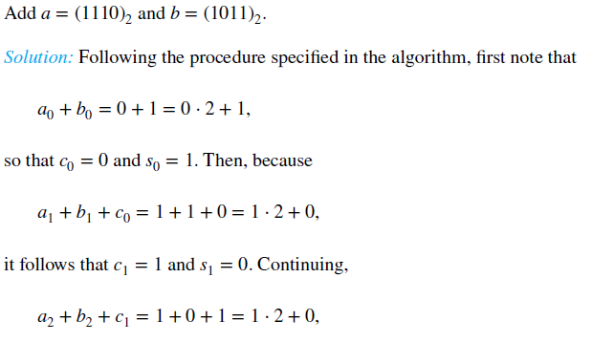

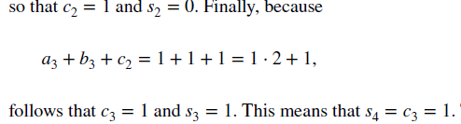
Binary Addition of Integers
Algorithms for performing operations with integers using their binary expansions are important as computer chips work with binary numbers. Each digit is called a bit.

Slide 31
Binary Addition of Integers
Algorithms for performing operations with integers using their binary expansions are important as computer chips work with binary numbers. Each digit is called a bit.
procedure add (a, b: positive integers)
{the binary expansions of a and b are (a_{n-1},a_{n-2},…,a₀)₂ and (b_{n-1},b_{n-2},…,b₀)₂, respectively}
c := 0
for j := 0 to n − 1 {
d := ⌊(a_{j} + b_{j} + c)/2⌋ \\ 计算进位
s_{j} := a_{j} + b_{j} + c − 2d \\ 计算和，并去除进位
c := d
}
s_{n} := c
return(s₀,s₁,…, s_{n}){the binary expansion of the sum is (s_{n},s_{n-1},…,s₀)₂}
The number of additions of bits used by the algorithm to add two n-bit integers is O(n).

Slide 32
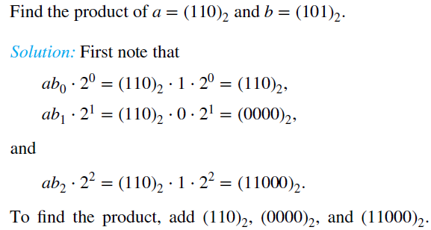
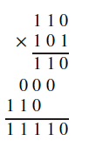
Binary Multiplication of Integers
Computing the product of two n-bit integers.

Slide 33
Binary Multiplication of Integers
Algorithm for computing the product of two n-bit integers.
procedure multiply (a, b: positive integers)
{binary expansions of a and b : (a_{n-1},a_{n-2},…,a₀)₂ and (b_{n−1},b_{n-2},…,b₀)₂}
for j := 0 to n − 1
if b_{j} = 1 then c_{j} = a shifted j places \\ 整个 a 移位 j 个位置
else c_{j} := 0
{c_{o},c₁,…, c_{n-1} are the partial products}
p := 0 \\ 【然后做加法】
for j := 0 to n − 1
p := p + c_{j}
return p { p is the value of ab}
The number of additions of bits used by the algorithm to multiply two n-bit integers is O(n²).

Slide 34
Binary Modular Exponentiation
In cryptography, it is important to be able to find b^{n} mod m efficiently, where b, n, and m are large integers. Use the binary expansion of n, n = (a_{k-1}a_{k-2}…a₁a₀)₂ , to compute b^{n} . 【密码学中大数模幂运算】
to compute b^{n}, we need only compute the values of b, b², (b²)² = b⁴, (b⁴)² = b⁸, …, and the multiply the terms in this list, where a_{j} = 1.
Example: Compute 3¹¹ using this method.
Solution: Note that 11 = (1011)₂ so that
3¹¹ = 3⁸ 3² 3¹ = ((3²)² )² 3² 3¹ = (9² )² ∙ 9 ∙3
= (81)² ∙ 9 ∙3 =6561 ∙ 9 ∙3 =117,147.

Slide 35
Binary Modular Exponentiation
Algorithm for computing the product of two n bit integers.
procedure modular exponentiation(b: integer, n = (a_{k-1}a_{k-2}…a₁a₀)₂ , m: positive integers)
x := 1 \\ 为了累计乘
power := b mod m
for i := 0 to k − 1 {
if a_{i}= 1 then { x := (x∙ power ) mod m}
power := (power∙ power ) mod m 【 b², b⁴ , b⁸ , … 】
}
return x {x equals b^{n} mod m }
O((log m )² log n) bit operations are used to find b^{n} mod m.

Slide 36
Chapter Summary
Divisibility and Modular Arithmetic
Integer Representations and Algorithms
Primes and Greatest Common Divisors
Solving Congruences
Applications of Congruences
Cryptography

Slide 37
Section Summary
Prime Numbers and their Properties
Conjectures and Open Problems About Primes
Greatest Common Divisors and Least Common Multiples
The Euclidian Algorithm
gcds as Linear Combinations

Slide 38
Primes 素数
Definition: A positive integer p greater than 1 is called prime if the only positive factors of p are 1 and p. A positive integer that is greater than 1 and is not prime is called composite (合数).
Example: The integer 7 is prime because its only positive factors are 1 and 7, but 9 is composite because it is divisible by 3.

Slide 39
The Fundamental Theorem of Arithmetic
Theorem: Every positive integer greater than 1 can be written uniquely as a prime or as the product of two or more primes where the prime factors are written in order of nondecreasing size. (大于1的整数是素数或者是素数的乘积)
Examples:
100 = 2 ∙ 2 ∙ 5 ∙ 5 = 2² ∙ 5²
641 = 641
999 = 3 ∙ 3 ∙ 3 ∙ 37 = 3³ ∙ 37
1024 = 2 ∙ 2 ∙ 2 ∙ 2 ∙ 2 ∙ 2 ∙ 2 ∙ 2 ∙ 2 ∙ 2 = 2¹⁰

Slide 40

Trial Division 试除法
If an integer n is a composite integer, then it has a prime divisor less than or equal to $\sqrt{n}$. To see this, note that if n = ab, then a ≤ $\sqrt{n}$ or b ≤$\sqrt{n}$.
Trial division, a very inefficient method of determining if a number n is prime, is to try every integer i ≤ $\sqrt{n}$and see if n is divisible by i.

Slide 41
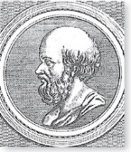
The Sieve of Erastosthenes 埃拉托斯特尼筛
The Sieve of Erastosthenes can be used to find all primes not exceeding a specified positive integer.
Example, begin with the list of integers between 1 and 100. (求1-100以内的素数)
Delete all the integers, other than 2, divisible by 2.
Delete all the integers, other than 3, divisible by 3.
Next, delete all the integers, other than 5, divisible by 5.
Next, delete all the integers, other than 7, divisible by 7.
Since all the remaining integers are not divisible by any of the previous integers, other than 1, the primes are:
{2,3,5,7,11,15,17,19,23,29,31,37,41,43,47,53,59,61,67,71,73,79,83,89, 97}
Erastothenes
(276-194 B.C.)

Slide 42
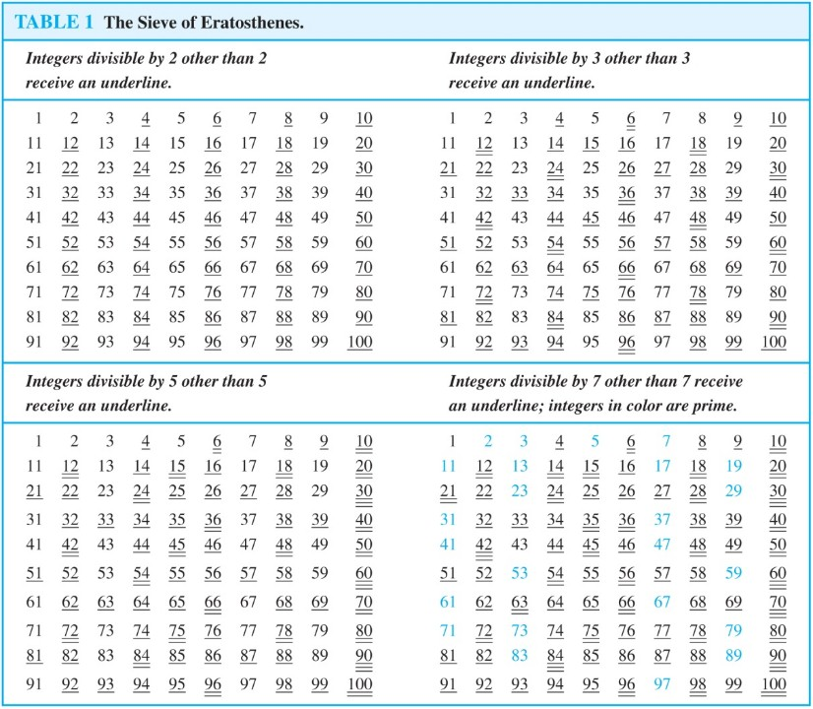
The Sieve of Erastosthenes 埃拉托斯特尼筛

Slide 43
Infinitude of Primes 素数的无限性
Theorem: There are infinitely many primes. (Euclid，欧几里得)
Proof: Assume finitely many primes: p₁, p₂, ….., p_{n}
Let q = p₁p₂∙∙∙ p_{n} + 1
Either q is prime or by the fundamental theorem of arithmetic it is a product of primes.
But none of the primes p_{j} divides q since if p_{j} | q, then p_{j} divides q − p₁p₂∙∙∙ p_{n} = 1 .【 p_{j}整除1是不可能的，矛盾】
Hence, there is a prime not on the list p₁, p₂, ….., p_{n}. It is either q, or if q is composite, it is a prime factor of q.
Consequently, there are infinitely many primes.

Slide 44
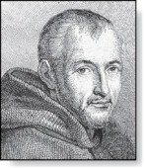
Mersenne Primes
Definition: Prime numbers of the form 2^{p} − 1 , where
p is prime, are called Mersenne primes (梅森素数).
2² − 1 = 3, 2³ − 1 = 7, 2⁵ − 1 = 37 , and 2⁷ − 1 = 127 are Mersenne primes.
2¹¹ − 1 = 2047 is not a Mersenne prime since 2047 = 23∙89.
There is an efficient test for determining if 2^{p} − 1 is prime.
The largest known prime numbers are Mersenne primes.
As of early 2018, 50 Mersenne primes were known, the largest is 2^{77,232,917} − 1, which has 23,249,425 decimal digits. (Dec. 2017)
The Great Internet Mersenne Prime Search (GIMPS) is a distributed computing project to search for new Mersenne Primes.
http://www.mersenne.org/
Marin Mersenne
(1588-1648)

Slide 45
Distribution of Primes 素数的分布
Mathematicians have been interested in the distribution of prime numbers among the positive integers. In the nineteenth century, the prime number theorem (素数定理) was proved which gives an asymptotic estimate for the number of primes not exceeding x.
Prime Number Theorem: The ratio of the number of primes not exceeding x and x/ln x approaches 1 as x grows without bound. (ln x is the natural logarithm of x)
The theorem tells us that the number of primes not exceeding x, can be approximated by x/ln x.
The odds that a randomly selected positive integer less than n is prime are approximately (n/ln n)/n = 1/ln n.

Slide 46
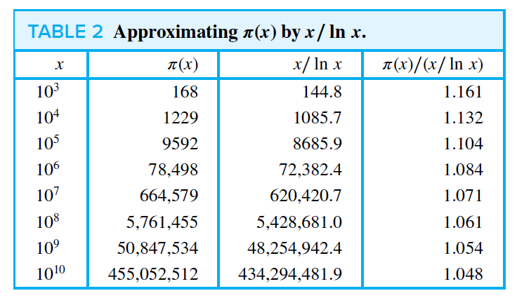
Distribution of Primes 素数的分布
Prime Number Theorem: The ratio of the number of primes not exceeding x and x/ln x approaches 1 as x grows without bound. (ln x is the natural logarithm of x)

Slide 47
Section Summary
Prime Numbers and their Properties
Conjectures and Open Problems About Primes
Greatest Common Divisors and Least Common Multiples
The Euclidian Algorithm
gcds as Linear Combinations

Slide 48

Conjectures about Primes
Goldbach’s Conjecture（哥德巴赫猜想）: Every even integer n, n > 2, is the sum of two primes. It has been verified by computer for all positive even integers up to 1.6 ∙10¹⁸. The conjecture is believed to be true by most mathematicians.
The Twin Prime Conjecture（孪生素数猜想）: The twin prime conjecture is that there are infinitely many pairs of twin primes. Twin primes are pairs of primes that differ by 2. Examples are 3 and 5, 5 and 7, 11 and 13, etc. The current world’s record for twin primes (as of mid 2011) consists of numbers 65,516,468,355∙23^{33,333} ±1, which have 100,355
decimal digits.
张益唐

Slide 49
Section Summary
Prime Numbers and their Properties
Conjectures and Open Problems About Primes
Greatest Common Divisors and Least Common Multiples
The Euclidian Algorithm
gcds as Linear Combinations

Slide 50
Greatest Common Divisor 最大公约数
Definition: Let a and b be integers, not both zero. The largest integer d such that d | a and also d | b is called the greatest common divisor of a and b. The greatest common divisor of a and b is denoted by gcd(a,b).
Example: What is the greatest common divisor of 24 and 36?
Solution: gcd(24, 36) = 12
Example: What is the greatest common divisor of 17 and 22?
Solution: gcd(17,22) = 1

Slide 51
Greatest Common Divisor 2
Definition: The integers a and b are relatively prime (互素) if their greatest common divisor is 1.
Example: 17 and 22
Definition: The integers a₁, a₂, …, a_{n} are pairwise relatively prime if gcd(a_{i}, a_{j}) = 1 whenever 1 ≤ i<j ≤n.
Example: Determine whether the integers 10, 17 and 21 are pairwise relatively prime.
Solution: Because gcd(10,17) = 1, gcd(10,21) = 1, and gcd(17,21) = 1, we know 10, 17, and 21 are pairwise relatively prime.
Example: Determine whether the integers 10, 19, and 24 are pairwise relatively prime.
Solution: Because gcd(10,24) = 2, we conclude 10, 19, and 24 are not pairwise relatively prime.

Slide 52
Finding the Greatest Common Divisor Using Prime Factorizations 质因子分解
Suppose the prime factorizations of a and b are:
where each exponent is a nonnegative integer, and where all primes occurring in either prime factorization are included in both. Then:
Example: 120 = 2³ ∙3 ∙5 500 = 2² ∙5³
gcd(120,500) = 2^{min(3,2)} ∙3^{min(1,0)} ∙5^{min(1,3)} = 2² ∙3⁰ ∙5¹ = 20

Slide 53
Least Common Multiple 最小公倍数
Definition: The least common multiple of the positive integers a and b is the smallest positive integer that is divisible by both a and b. It is denoted by lcm(a,b).
The least common multiple can also be computed from the prime factorizations.
Example: lcm(2³3⁵7², 2⁴3³) = 2^{max(3,4)} 3^{max(5,3)} 7^{max(2,0)} = 2⁴ 3⁵ 7²
The greatest common divisor and the least common multiple of two integers are related by:
Theorem 5: Let a and b be positive integers. Then
ab = gcd(a,b) ∙lcm(a,b)

Slide 54
Section Summary
Prime Numbers and their Properties
Conjectures and Open Problems About Primes
Greatest Common Divisors and Least Common Multiples
The Euclidian Algorithm
gcds as Linear Combinations

Slide 55
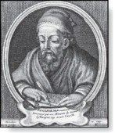
The Euclidian Algorithm 欧几里德算法
The Euclidian algorithm is an efficient method for computing the greatest common divisor of two integers. It is based on the idea that gcd(a,b) is equal to gcd(b,c) when a > b and c is the remainder when a is divided by b.
Example: Find gcd(91, 287):
287 = 91 ∙ 3 + 14
91 = 14 ∙ 6 + 7
14 = 7 ∙ 2 + 0
Euclid
(325 B.C.E. – 265 B.C.E.)
Divide 287 by 91
Divide 91 by 14
Divide 14 by 7
Stopping condition
gcd(287, 91) = gcd(91, 14) = gcd(14, 7) = 7

Slide 56
The Euclidian Algorithm 欧几里德算法
The Euclidean algorithm expressed in pseudocode is:
procedure gcd(a, b: positive integers)
x := a
y := b
while y ≠ 0
r := x mod y
x := y
y := r
return x {gcd(a,b) is x}
In Section 5.3, we’ll see that the time complexity of the algorithm is O (log b), where a > b.

Slide 57
Correctness of Euclidean Algorithm 正确性证明
Lemma 1: Let a = bq + r, where a, b, q, and r are integers. Then gcd(a,b) = gcd(b,r).
Proof:
Suppose that d divides both a and b. Then d also divides a − bq = r (by Theorem 1 of Section 4.1). Hence, any common divisor of a and b must also be any common divisor of b and r. 【如果整除a,b，则一定整除b,r】
Suppose that d divides both b and r. Then d also divides bq + r = a. Hence, any common divisor of b and r must also be a common divisor of a and b. 【如果整除b,r，一定整除a,b 】
Therefore, gcd(a,b) = gcd(b,r).

Slide 58

The Euclidian Algorithm 欧几里德算法
$$\begin{matrix}r_{0}=r_{1}q_{1}+r_{2} 0≤r_{2}<r_{1}, \\ r_{1}=r_{2}q_{2}+r_{3} 0≤r_{3}<r_{2}, \\ . \\ . \\ . \\ r_{n−2}=r_{n−1}q_{n−1}+r_{2} 0≤r_{n}<r_{n−1}, \\ r_{n−1}=r_{n}q_{n}.\end{matrix}$$
Suppose that a and b are positive
integers with a ≥ b.
Let r₀ = a and r₁ = b.
Successive applications of the
division algorithm yields:
Eventually, a remainder of zero occurs in the sequence of terms: a = r₀ > r₁ > r₂ > ∙ ∙ ∙ ≥ 0. The sequence can’t contain more than a terms.
By Lemma 1,
gcd(a,b) = gcd(r₀,r₁) = ∙ ∙ ∙ = gcd(r_{n-1},r_{n}) = gcd(r_{n} , 0) = r_{n}.
Hence the greatest common divisor is the last nonzero remainder in the sequence of divisions.

Slide 59
Section Summary
Prime Numbers and their Properties
Conjectures and Open Problems About Primes
Greatest Common Divisors and Least Common Multiples
The Euclidian Algorithm
gcds as Linear Combinations

Slide 60
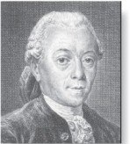
gcds as Linear Combinations
Bézout’s Theorem (贝祖定理 ): If a and b are
positive integers, then there exist integers s and t
such that gcd(a,b) = sa + tb.
Definition: If a and b are positive integers, then integers s and t such that gcd(a,b) = sa + tb are called Bézout coefficients of a and b. The equation gcd(a,b) = sa + tb is called Bézout’s identity.
By Bézout’s Theorem, the gcd of integers a and b can be expressed in the form sa + tb where s and t are integers. This is a linear combination with integer coefficients of a and b.
gcd(6,14) = (−2)∙6 + 1∙14
Étienne Bézout
(1730-1783)

Slide 61
gcds as Linear Combinations
Example: Express gcd(252,198) = 18 as a linear combination of 252 and 198.
Solution: First use the Euclidean algorithm to show gcd(252,198) = 18
252 = 1∙198 + 54
198 = 3 ∙54 + 36
54 = 1 ∙36 + 18
36 = 2 ∙18
Now working backwards, from iii and ii above
18 = 54 − 1 ∙36
36 = 198 − 3 ∙54
Substituting the 2nd equation into the 1st yields:
18 = 54 − 1 ∙(198 − 3 ∙54 )= 4 ∙54 − 1 ∙198
Substituting 54 = 252 − 1 ∙198 (from i)) yields:
18 = 4 ∙(252 − 1 ∙198) − 1 ∙198 = 4 ∙252 − 5 ∙198

Slide 62
Consequences of Bézout’s Theorem
Lemma: If a, b, and c are positive integers such that gcd(a, b) = 1 and a | bc, then a | c.
Proof: Assume gcd(a, b) = 1 and a | bc
Since gcd(a, b) = 1, by Bézout’s Theorem there are integers s and t such that
sa + tb = 1.
Multiplying both sides of the equation by c, yields sac + tbc = c.
From Theorem 1 of Section 4.1: a | tbc (part ii) and a divides sac + tbc since a | sac and a|tbc (part i)
We conclude a | c, since sac + tbc = c.
Lemma: If p is prime and p | a₁a₂∙∙∙a_{n}, then p | a_{i} for some i.
Lemma 3 is crucial in the proof of the uniqueness of prime factorizations.

Slide 63

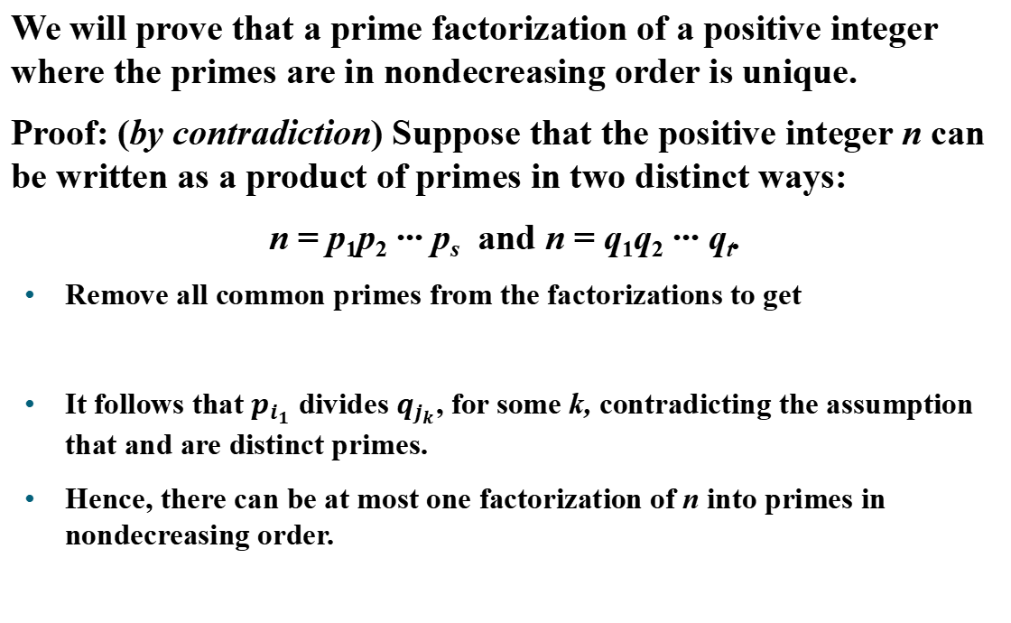
Uniqueness of Prime Factorization
We will prove that a prime factorization of a positive integer where the primes are in nondecreasing order is unique.
Proof: (by contradiction) Suppose that the positive integer n can be written as a product of primes in two distinct ways:
n = p₁p₂ ∙∙∙ p_{s} and n = q₁q₂ ∙∙∙ q_{t}.
Remove all common primes from the factorizations to get
It follows that $p_{i_{1}}$ divides $q_{j_{k}}$, for some k, contradicting the assumption that and are distinct primes.
Hence, there can be at most one factorization of n into primes in nondecreasing order.

Slide 64
Chapter Summary
Divisibility and Modular Arithmetic
Integer Representations and Algorithms
Primes and Greatest Common Divisors
Solving Congruences
Applications of Congruences
Cryptography

Slide 65
Section Summary 4
Linear Congruence
The Chinese Remainder Theorem

Slide 66
Linear Congruences 线性同余方程
Definition: A congruence of the form
ax ≡ b( mod m),
where m is a positive integer, a and b are integers, and x is a variable, is called a linear congruence.
The solutions to a linear congruence ax ≡ b( mod m) are all integers x that satisfy the congruence.
Definition: An integer ā such that āa ≡ 1( mod m) is said to be an inverse of a modulo m.【a模m的逆】
Example: 5 is an inverse of 3 modulo 7 since 5∙3 = 15 ≡ 1(mod 7)
One method of solving linear congruences makes use of an inverse ā, if it exists. Although we can not divide both sides of the congruence by a, we can multiply by ā to solve for x.

Slide 67
Inverse of a modulo m
The following theorem guarantees that an inverse of a modulo m exists whenever a and m are relatively prime.
Theorem 1: If a and m are relatively prime integers and m > 1, then an inverse of a modulo m exists. Furthermore, this inverse is unique modulo m. (This means that there is a unique positive integer ā less than m that is an inverse of a modulo m and every other inverse of a modulo m is congruent to ā modulo m.)
Proof of existence: Since gcd(a,m) = 1, by Theorem 6 of Section 4.3, there are integers s and t such that gcd(a,m )=sa + tm = 1.
Hence, sa + tm ≡ 1 ( mod m).
Since tm ≡ 0 ( mod m), it follows that sa ≡ 1 ( mod m)
Consequently, s is an inverse of a modulo m.【贝祖系数s】

Slide 68
Finding Inverses 1
Example: Find an inverse of 3 modulo 7.
Solution: Because gcd(3,7) = 1, by Theorem 1, an inverse of 3 modulo 7 exists.
Using the Euclidian algorithm: 7 = 2∙3 + 1.
From this equation, we get −2∙3 + 1∙7 = 1, and see that −2 and 1 are Bézout coefficients of 3 and 7.
Hence, −2 is an inverse of 3 modulo 7.
Also every integer congruent to −2 modulo 7 is an inverse of 3 modulo 7, i.e., 5, −9, 12, etc.

Slide 69
Finding Inverses 2
Example: Find an inverse of 101 modulo 4620.
Solution: First use the Euclidian algorithm to show that gcd(101,4620) = 1.
4620 = 45∙101 + 75
101 = 1∙75 + 26
75 = 2∙26 + 23
26 = 1∙23 + 3
23 = 7∙3 + 2
3 = 1∙2 + 1
2 = 2∙1
Working Backwards:
1 = 3 − 1∙2
1 = 3 − 1∙(23 − 7∙3) = − 1 ∙23 + 8∙3
1 = −1∙23 + 8∙(26 − 1∙23) = 8∙26 − 9 ∙23
1 = 8∙26 − 9 ∙(75 − 2∙26 )= 26∙26 − 9 ∙75
1 = 26∙(101 − 1∙75) − 9 ∙75
= 26∙101 − 35 ∙75
1 = 26∙101 − 35 ∙(4620 − 45∙101)
= − 35 ∙4620 + 1601∙101
Since the last nonzero remainder is 1, gcd(101,4260) = 1
Bézout coefficients : − 35 and 1601
1601 is an inverse of 101 modulo 4620

Slide 70
Using Inverses to Solve Congruence
Example: What are the solutions of the congruence 3x≡ 4( mod 7).
Solution: We found that −2 is an inverse of 3 modulo 7 (two slides back). We multiply both sides of the congruence by −2 giving
−2 ∙ 3x ≡ −2 ∙ 4(mod 7).
Because −6 ≡ 1 (mod 7) and −8 ≡ 6 (mod 7), it follows that if x is a solution, then x ≡ −8 ≡ 6 (mod 7)
The solutions are the integers x such that x ≡ 6 (mod 7), namely, 6,13,20 … and −1, − 8, − 15,…

Slide 71
Section Summary 4
Linear Congruence
The Chinese Remainder Theorem

Slide 72
The Chinese Remainder Theorem 中国剩余定理
Question: There are certain things whose number is unknown. When divided by 3, the remainder is 2; when divided by 5, the remainder is 3; when divided by 7, the remainder is 2. What will be the number of things?【有物不知其数，三分之余二，五分之余三，七分之余二，此物几何？】
This puzzle can be translated into the solution of the system of congruences: 【同余方程组】
x ≡ 2 ( mod 3)
x ≡ 3 ( mod 5)
x ≡ 2 ( mod 7)
We’ll see how the theorem that is known as the Chinese Remainder Theorem

Slide 73
The Chinese Remainder Theorem 中国剩余定理
Theorem 2: (The Chinese Remainder Theorem) Let m₁,m₂,…,m_{n} be pairwise relatively prime positive integers greater than one and a₁,a₂,…,a_{n} arbitrary integers. Then the system
x ≡ a₁ ( mod m₁)
x ≡ a₂ ( mod m₂)
∙
∙
∙
x ≡ a_{n} ( mod m_{n})
has a unique solution modulo m = m₁m₂ ∙ ∙ ∙ m_{n}.

Slide 74
The Chinese Remainder Theorem 中国剩余定理
Proof: To construct a solution first let M_{k}=m/m_{k} for k = 1,2,…,n and m = m₁m₂ ∙ ∙ ∙ m_{n}. Since gcd(m_{k} ,M_{k} ) = 1, by Theorem 1, there is an integer y_{k} , an inverse of M_{k} modulo m_{k}, such that
M_{k} y_{k} ≡ 1 ( mod m_{k} ).
Form the sum
x = a₁ M₁ y₁ + a₂ M₂ y₂ + ∙ ∙ ∙ + a_{n} M_{n} y_{n} .
Note that because M_{j} ≡ 0 ( mod m_{k}) whenever j ≠k , all terms except the kth term in this sum are congruent to 0 modulo m_{k} .
Because M_{k} y_{k} ≡ 1 ( mod m_{k} ), we see that x ≡ a_{k} M_{k} y_{k} ≡ a_{k}( mod m_{k}), for k = 1,2,…,n.
Hence, x is a simultaneous solution to the n congruences.
x ≡ a₁ ( mod m₁)
x ≡ a₂ ( mod m₂)
∙
∙
∙
x ≡ a_{n} ( mod m_{n})

Slide 75
The Chinese Remainder Theorem 中国剩余定理
Solution: Consider the 3 congruences from :
x ≡ 2 ( mod 3), x ≡ 3 ( mod 5), x ≡ 2 ( mod 7).
Let m = 3∙ 5 ∙ 7 = 105, M₁ = m/3 = 35, M₂ = m/5 = 21, M₃ = m/7 = 15.
We see that
2 is an inverse of M₁ = 35 modulo 3 since 35 ∙ 2 ≡ 2 ∙ 2 ≡ 1 (mod 3)
1 is an inverse of M₂ = 21 modulo 5 since 21 ≡ 1 (mod 5)
1 is an inverse of M₃ = 15 modulo 7 since 15 ≡ 1 (mod 7)
Hence, x = a₁ M₁ y₁ + a₂ M₂ y₂ + a₃ M₃ y₃ = 2 ∙ 35 ∙ 2 + 3 ∙ 21 ∙ 1 + 2 ∙ 15 ∙ 1 = 233 ≡ 23 (mod 105)
We have shown that 23 is the smallest positive integer that is a simultaneous solution. Check it!

Slide 76
Homework
§4.1 40, 44
§4.2 21, 25
§4.3 28, 33 e), 42, 54
§4.4 7, 26
Due date: 2024. 04.16

