Slide 1
Chapter 5: Induction and Recursion

Slide 2
Chapter Summary
Mathematical Induction
Strong Induction and Well-Ordering
Recursive Definitions and Structural Induction
Recursive Algorithms

Slide 3
Mathematical Induction 【数学归纳法】
Section 5.1

Slide 4
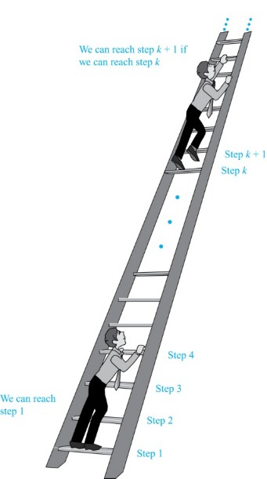
Climbing an Infinite Ladder
【攀登一个无限高的梯子】
Suppose we have an infinite ladder:
We can reach the first rung of the ladder.
If we can reach a particular rung of the ladder, then we can reach the next rung.
From (1), we can reach the first rung. Then by applying (2), we can reach the second rung. Applying (2) again, the third rung. And so on. We can apply (2) any number of times to reach any particular rung, no matter how high up.
This example motivates proof by mathematical induction.

Slide 5
Principle of Mathematical Induction
Principle of Mathematical Induction: To prove that P(n) is true for all positive integers n, we complete these steps:
【基础步骤】Basis Step: Show that P(1) is true.
【归纳步骤】Inductive Step: Show that P(k) → P(k + 1) is true for all positive integers k.
To complete the inductive step, assuming the inductive hypothesis 【归纳假设】that P(k) holds for an arbitrary integer k, show that P(k + 1) must be true.
Example ：Climbing an Infinite Ladder Example:
BASIS STEP: By (1), we can reach rung 1.
INDUCTIVE STEP: Assume the inductive hypothesis that we can reach rung k. Then by (2), we can reach rung k + 1.
Hence, P(k) → P(k + 1) is true for all positive integers k. We can reach every rung on the ladder.

Slide 6
Validity of Mathematical Induction 【数学归纳法有效性证明】
Mathematical induction can be expressed as the rule of inference【数学归纳可用推理规则表示如下】
$$\left(P\left(1\right)∧∀k\left(P\left(k\right)→P\left(k+1\right)\right)\right)→∀n P\left(n\right)$$

Slide 7
Validity of Mathematical Induction 【数学归纳法有效性证明】
Mathematical induction is valid because of the well ordering property (良序性), which states that every nonempty subset of the set of positive integers has a least element (see Section 5.2 and Appendix 1). Here is the proof （反证法）:
Suppose that P(1) holds and P(k) → P(k + 1) is true for all positive integers k.
Assume there is at least one positive integer n for which P(n) is false. Then the set S of positive integers for which P(n) is false is nonempty. 【假设S集合中的整数使得P(n) 为false】
By the well-ordering property, S has a least element, say m. 【m 是S中最小的】
We know that m can not be 1 since P(1) holds. Since m is positive and greater than 1, m − 1 must be a positive integer. Since m − 1 < m, it is not in S, so P(m − 1) must be true.【m-1不是S中元素，得出P(m − 1) 为真】
But then, since the conditional P(k) → P(k + 1) for every positive integer k holds, P(m) must also be true. This contradicts P(m) being false.
Hence, P(n) must be true for every positive integer n.

Slide 8
Proving a Summation Formula by Mathematical Induction
Example: Show that:
Note: Once we have this conjecture, mathematical induction can be used to prove it correct.
Solution:
BASIS STEP: P(1) is true since 1(1 + 1)/2 = 1.
INDUCTIVE STEP: Assume true for P(k).
The inductive hypothesis is
Under this assumption,

Slide 9
Conjecturing and Proving a Summation Formula
Example: Conjecture and prove correct a formula for the sum of the first n positive odd integers. Then prove your conjecture.
Solution: We have:
We can conjecture that the sum of the first n positive odd integers is n²,
We prove the conjecture with mathematical induction.
BASIS STEP: P(1) is true since 1² = 1.
INDUCTIVE STEP: P(k) → P(k + 1) for every positive integer k.
Assume the inductive hypothesis P(k) holds and then show that P(k + 1) holds has well.
Inductive Hypothesis:
P(k + 1) is :
Hence, P(k + 1) follows from P(k). Therefore the sum of the first n positive odd integers is n².

Slide 10
Proving Inequalities
Example: Use mathematical induction to prove that 2^{n} < n!, for every integer n ≥ 4.
Solution: Let P(n) be the proposition that 2^{n} < n!.
BASIS STEP: P(4) is true since 2⁴ = 16 < 4! = 24.
INDUCTIVE STEP: Assume P(k) holds, i.e., 2^{k} < k! for an arbitrary integer k ≥ 4. To show that P(k + 1) holds:
Therefore, 2^{n} < n! holds, for every integer n ≥ 4.
Note that here the basis step is P(4), since P(0), P(1), P(2), and P(3) are all false.

Slide 11
Guidelines: Mathematical Induction Proofs
Template for Proofs by Mathematical Induction
Express the statement that is to be proved in the form “for all n ≥ b, P(n)” for a fixed integer b.
Write out the words “Basis Step.” Then show that P(b) is true, taking care that the correct value of b is used. This completes the first part of the proof.
Write out the words “Inductive Step”.
State, and clearly identify, the inductive hypothesis, in the form “assume that P(k) is true for an arbitrary fixed integer k ≥ b.”
State what needs to be proved under the assumption that the inductive hypothesis is true. That is, write out what P(k + 1) says.
Prove the statement P(k + 1) making use the assumption P(k). Be sure that your proof is valid for all integers k with k ≥ b, taking care that the proof works for small values of k, including k = b.
Clearly identify the conclusion of the inductive step, such as by saying “this completes the inductive step.”
After completing the basis step and the inductive step, state the conclusion, namely, by mathematical induction, P(n) is true for all integers n with n ≥ b.

Slide 12
Strong Induction and Well-Ordering 【强归纳法与良序性】
Section 5.2

Slide 13
Section Summary 2
Strong Induction
Example Proofs using Strong Induction
Well-Ordering Property

Slide 14
Strong Induction 强归纳法
Strong Induction: To prove that P(n) is true for all positive integers n, where P(n) is a propositional function, complete two steps:
Basis Step: Verify that the proposition P(1) is true.
Inductive Step: Show the conditional statement
holds for all positive integers k.
Strong Induction is sometimes called the second principle of mathematical induction (数学归纳法第二原理) or complete induction (完全归纳法).

Slide 15
Strong Induction and the Infinite Ladder 【强归纳法和无限梯子的相似性比喻】
Strong induction tells us that we can reach all rungs if:
We can reach the first rung of the ladder.
For every integer k, if we can reach the first k rungs, then we can reach the (k + 1)-st rung.
To conclude that we can reach every rung by strong induction:
BASIS STEP: P(1) holds
INDUCTIVE STEP: Assume P(1) ∧ P(2) ∧∙∙∙ ∧ P(k) holds for an arbitrary integer k, and show that P(k + 1) must also hold.
We will have then shown by strong induction that for every positive integer n, P(n) holds, i.e., we can reach the nth rung of the ladder.

Slide 16
Section Summary 2
Strong Induction
Example Proofs using Strong Induction
Well-Ordering Property

Slide 17
Completion of the proof of the Fundamental Theorem of Arithmetic
Example: Show that if n is an integer greater than 1, then n can be written as the product of primes.
Solution: Let P(n) be the proposition that n can be written as a product of primes.
BASIS STEP: P(2) is true since 2 itself is prime.
INDUCTIVE STEP: The inductive hypothesis is P(j) is true for all integers j with 2 ≤ j ≤ k. To show that P(k + 1) must be true under this assumption, two cases need to be considered:
If k + 1 is prime, then P(k + 1) is true.
Otherwise, k + 1 is composite and can be written as the product of two positive integers a and b with 2 ≤ a ≤ b < k + 1. By the inductive hypothesis a and b can be written as the product of primes and therefore k + 1 can also be written as the product of those primes.
Hence, it has been shown that every integer greater than 1 can be written as the product of primes.
(uniqueness proved in Section 4.3)

Slide 18
Section Summary 2
Strong Induction
Example Proofs using Strong Induction
Well-Ordering Property

Slide 19
Well-Ordering Property 良序性
Well-ordering property (良序性公理) : Every nonempty set of nonnegative integers has a least element.【每个非空的非负整数集合都有最小元素】
The well-ordering property can be generalized.
Definition: A set is well ordered if every subset has a least element. 【如果一个集合的所有子集是良序的，那么该集合是良序的】
N is well ordered under ≤.【自然数是良序的】
The set of finite strings over an alphabet using lexicographic ordering is well ordered.【字符串也是良序的】
We will see a generalization of induction to sets other than the integers in the next section.

Slide 20
Well-Ordering Property 良序性
Example: Use the well-ordering property to prove the division algorithm, which states that if a is an integer and d is a positive integer, then there are unique integers q and r with 0 ≤ r < d, such that a = dq + r.
Solution: Let S be the set of nonnegative integers of the form a − dq, where q is an integer. The set is nonempty since −dq can be made as large as needed. 【定义了一个集合S={r | r = a − dq > 0}】
By the well-ordering property, S has a least element r = a − dq₀. The integer r is nonnegative. It also must be the case that r < d. If it were not, then there would be a smaller nonnegative element in S, namely,
【这与 r 是S中最小的元素矛盾】
Therefore, there are integers q and r with 0 ≤ r < d.
(uniqueness of q and r is Exercise 37)

Slide 21
Recursive Definitions and Structural Induction 【递归定义与结构归纳法】
Section 5.3

Slide 22
Section Summary 3
Recursively Defined Functions
Recursively Defined Sets and Structures
Structural Induction
Generalized Induction

Slide 23
Recursively Defined Functions 【递归定义函数】
Definition: A recursive or inductive definition of a function consists of two steps.
BASIS STEP【基础步骤】: Specify the value of the function at zero.
RECURSIVE STEP 【递归步骤】: Give a rule for finding its value at an integer from its values at smaller integers.

Slide 24
Recursively Defined Functions
Example: Suppose f is defined by:
Find f(1), f(2), f(3), f(4)
Solution:
Example: Give a recursive definition of the factorial function n!:
Solution:

Slide 25
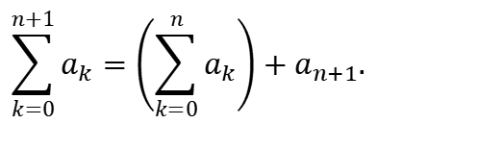
Recursively Defined Functions3
Example: Give a recursive definition of:
Solution: The first part of the definition is
The second part is
$$\sum_{k=0}^{n+1}{a_{k}}=\left(\sum_{k=0}^{n}{a_{k}}\right)+a_{n+1}.$$

Slide 26
Fibonacci Numbers 【斐波那契数】
Example : The Fibonacci numbers are defined as follows:
Find f₂, f₃ , f₄ , f₅ .

Slide 27
Fibonacci Numbers
Example: Show that whenever
where
Solution: Let P(n) be the statement
Use strong induction to show that P(n) is true whenever n ≥ 3.
BASIS STEP: P(3) holds since
P(4) holds since
INDUCTIVE STEP: Assume that P(j) holds, i.e., f_{j} > α^{j−2} for all integers j with
3 ≤ j ≤ k, where k ≥ 4. Show that P(k + 1) holds, i.e.,
Since α² = α + 1 (because α is a solution of x² − x − 1 = 0),
By the inductive hypothesis, because k ≥ 4 we have
Therefore, it follows that
Hence, P(k + 1) is true.

Slide 28
Section Summary 3
Recursively Defined Functions
Recursively Defined Sets and Structures
Structural Induction
Generalized Induction

Slide 29
Recursively Defined Sets 【递归定义集合】
Example : Subset of Integers S:【整数的子集】
BASIS STEP: 3 ∊ S.
RECURSIVE STEP: If x ∊ S and y ∊ S, then x + y is in S.
Initially 3 is in S, then 3 + 3 = 6, then 3 + 6 = 9, etc.
Example: The natural numbers N.【自然数集合】
BASIS STEP: 0 ∊ N.
RECURSIVE STEP: If n is in N, then n + 1 is in N.
Initially 0 is in S, then 0 + 1 = 1, then 1 + 1 = 2, etc.

Slide 30
Strings
Definition: The set Σ* of strings over the alphabet Σ:
BASIS STEP: λ ∊ Σ* (λ is the empty string)
RECURSIVE STEP: If w is in Σ* and x is in Σ, then wx ∈ Σ*.
Example: If Σ = {0,1}, the strings in in Σ* are the set of all bit strings, λ,0,1, 00,01,10, 11, etc.
Example: If Σ = {a,b}, show that aab is in Σ*.
Since λ ∊ Σ* and a ∊ Σ, a ∊ Σ*.
Since a ∊ Σ* and a ∊ Σ, aa ∊ Σ*.
Since aa ∊ Σ* and b ∊ Σ, aab ∊ Σ*.

Slide 31
Well-Formed Formulae in Propositional Logic
Definition: The set of well-formed formulae in propositional logic involving T, F, propositional variables, and operators from the set {¬,∧,∨,→,↔}.
BASIS STEP: T,F, and s, where s is a propositional variable, are well-formed formulae.
RECURSIVE STEP: If E and F are well formed formulae, then (¬ E), (E ∧ F), (E ∨ F), (E → F), (E ↔ F), are well-formed formulae.
Examples: ((p ∨q) → (q ∧ F)) is a well-formed formula.
pq ∧ is not a well formed formula.

Slide 32
Rooted Trees
Definition: The set of rooted trees, where a rooted tree consists of a set of vertices containing a distinguished vertex called the root, and edges connecting these vertices, can be defined recursively by these steps:
BASIS STEP: A single vertex r is a rooted tree.
RECURSIVE STEP: Suppose that T₁, T₂, …,T_{n} are disjoint rooted trees with roots r₁, r₂,…,r_{n}, respectively. Then the graph formed by starting with a root r, which is not in any of the rooted trees T₁, T₂, …,T_{n}, and adding an edge from r to each of the vertices r₁, r₂,…,r_{n}, is also a rooted tree.

Slide 33
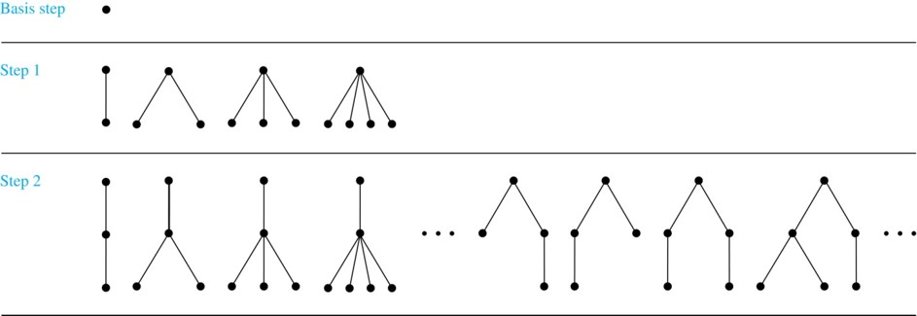
Building Up Rooted Trees
Trees are studied extensively in Chapter 11.

Slide 34
Full Binary Trees 1
Definition: The set of full binary trees can be defined recursively by these steps.
BASIS STEP: There is a full binary tree consisting of only a single vertex r.
RECURSIVE STEP: If T₁ and T₂ are disjoint full binary trees, there is a full binary tree, denoted by T₁∙T₂, consisting of a root r together with edges connecting the root to each of the roots of the left subtree T₁ and the right subtree T₂.

Slide 35
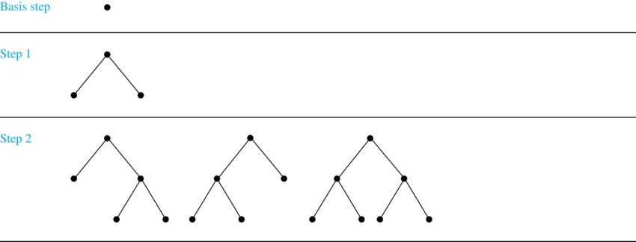
Building Up Full Binary Trees
Jump to long description

Slide 36
Section Summary 3
Recursively Defined Functions
Recursively Defined Sets and Structures
Structural Induction
Generalized Induction

Slide 37
Induction and Recursively Defined Sets
Example: Show that the set S defined by specifying that 3 ∊ S and that if x ∊ S and y ∊ S, then x + y is in S, is the set of all positive integers that are multiples of 3.
Solution: Let A be the set of all positive integers divisible by 3. To prove that A = S, show that A is a subset of S and S is a subset of A.
A⊂ S: Let P(n) be the statement that 3n belongs to S.
BASIS STEP: 3∙1 = 3 ∊ S, by the first part of recursive definition.
INDUCTIVE STEP: Assume P(k) is true. By the second part of the recursive definition, if 3k ∊ S, then since 3 ∊ S, 3k + 3 = 3(k + 1) ∊ S. Hence, P(k + 1) is true.
S ⊂ A:
BASIS STEP: 3 ∊ S by the first part of recursive definition, and 3 = 3∙1.
INDUCTIVE STEP: The second part of the recursive definition adds x +y to S, if both x and y are in S. If x and y are both in A, then both x and y are divisible by 3. By part (i) of Theorem 1 of Section 4.1, it follows that x + y is divisible by 3.

Slide 38
Definition of Structural Induction 【结构归纳法定义】
Definition: To prove a property of the elements of a recursively defined set, we use structural induction.
BASIS STEP: Show that the result holds for all elements specified in the basis step of the recursive definition.
RECURSIVE STEP: Show that if the statement is true for each of the elements used to construct new elements in the recursive step of the definition, the result holds for these new elements.

Slide 39
Full Binary Trees 2
Definition: The height h(T) of a full binary tree T is defined recursively as follows:
BASIS STEP: The height of a full binary tree T consisting of only a root r is h(T) = 0.
RECURSIVE STEP: If T₁ and T₂ are full binary trees, then the full binary tree T = T₁∙T₂ has height
The number of vertices n(T) of a full binary tree T satisfies the following recursive formula:
BASIS STEP: The number of vertices of a full binary tree T consisting of only a root r is n(T) = 1.
RECURSIVE STEP: If T₁ and T₂ are full binary trees, then the full binary tree T = T₁∙T₂ has the number of vertices

Slide 40
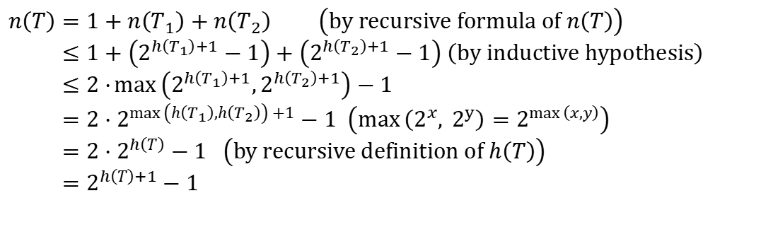
Structural Induction and Binary Trees
Theorem: If T is a full binary tree, then
Proof: Use structural induction.
BASIS STEP: The result holds for a full binary tree consisting only of a root,
Hence,
RECURSIVE STEP: Assume
and also
whenever T₁ and T₂ are full binary trees.
$$n\left(T\right)=1+n\left(T_{1}\right)+n\left(T_{2}\right) \left(by recursive formula of n\left(T\right)\right) \\ ≤1+\left(2^{h\left(T_{1}\right)+1}−1\right)+\left(2^{h\left(T_{2}\right)+1}−1\right) \left(by inductive hypothesis\right) \\ ≤2⋅\max\left(2^{h\left(T_{1}\right)+1},2^{h\left(T_{2}\right)+1}\right)−1 \\ =2⋅2^{\max\left(h\left(T_{1}\right),h\left(T_{2}\right)\right)+1}−1 \left(\max\left(2^{x}, {\text{2}}^{y}\right)=2^{\max\left(x,y\right)}\right) \\ =2⋅2^{h\left(T\right)}−1 \left(by recursive definition of h\left(T\right)\right) \\ =2^{h\left(T\right)+1}−1$$

Slide 41
Section Summary 3
Recursively Defined Functions
Recursively Defined Sets and Structures
Structural Induction
Generalized Induction

Slide 42
Generalized Induction 【广义归纳法】
Generalized induction is used to prove results about sets other than the integers that have the well-ordering property. 【证明整数集合以外的其他具有良序性的集合的结果】
For example, consider an ordering on N ⨉ N, ordered pairs of nonnegative integers. Specify that (x₁, y₁) is less than or equal to (x₂, y₂) if either x₁ < x₂, or x₁ = x₂ and y₁ <y₂ . This is called the lexicographic ordering.【字典序】
Strings are also commonly ordered by a lexicographic ordering.

Slide 43

Generalized Induction
Example: Suppose that a_{m,n} is defined for
by a_{0,0} = 0 and
Show that
is defined for all
Solution: Use generalized induction.
BASIS STEP:
$$a_{0,0}=0+\frac{\left(0×1\right)}{2}$$
INDUCTIVE STEP: Assume that
whenever(̍mʹ,nʹ) is less than (m,n) in the lexicographic ordering of N × N .
If n = 0, by the inductive hypothesis we can conclude
$$a_{m,n}=a_{m−1,n}+1=m−1+\frac{n\left(n+1\right)}{2}+1=m+\frac{n\left(n+1\right)}{2}.$$
If n > 0, by the inductive hypothesis we can conclude
$$a_{m,n}=a_{m,n−1}+n=m+\frac{n\left(n−1\right)}{2}+n=m+\frac{n\left(n+1\right)}{2}.$$

Slide 44
Recursive Algorithms 【递归算法】
Section 5.4

Slide 45
Section Summary 4
Recursive Algorithms
Proving Recursive Algorithms Correct

Slide 46
Recursive Algorithms
Recursive algorithm: An algorithm is called recursive if it solves a problem by reducing it to an instance of the same problem with smaller input.

Slide 47
Recursive Factorial Algorithm 【递归阶乘算法】
Example: Give a recursive algorithm for computing n!, where n is a nonnegative integer.
Solution: Use the recursive definition of the factorial function.
procedure factorial(n: nonnegative integer)
if n = 0
then return 1
else
return n∙factorial (n − 1)
{output is n!}

Slide 48
Recursive Exponentiation Algorithm 【递归指数运算】
Example: Give a recursive algorithm for computing a^{n}, where a is a nonzero real number and n is a nonnegative integer.
Solution: Use the recursive definition of a^{n}.
procedure power(a: nonzero real number, n: nonnegative integer)
if n = 0
then return 1
else
return a∙ power (a, n − 1)
{output is a^{n}}

Slide 49
Section Summary 4
Recursive Algorithms
Proving Recursive Algorithms Correct

Slide 50
Proving Recursive Algorithms Correct 【递归算法的正确性证明】
Example: Prove that the algorithm for computing the powers of real numbers is correct.
伪代码
procedure power(a: nonzero real number, n: nonnegative integer)
if n = 0 then return 1
else return a∙ power (a, n − 1)
{output is a^{n}}
数学归纳法证明其正确性
Solution: Use mathematical induction on the exponent n.
BASIS STEP: a⁰ =1 for every nonzero real number a, and power(a,0) = 1.
INDUCTIVE STEP: The inductive hypothesis is that power(a,k) = a^{k}, for all a ≠0. Assuming the inductive hypothesis, the algorithm correctly computes a^{k+1}, since

Slide 51
Homework
§5.1 7, 10, 15 §5.2 12 §5.3 8, 26
§5.4 12, 15, 32
Due date : 2024.04.16

