Slide 1
Chapter 6 Counting

Slide 2
Chapter Summary
6.1 The Basics of Counting
6.2 The Pigeonhole Principle
6.3 Permutations and Combinations
6.4 Binomial Coefficients and Identities
6.5 Generalized Permutations and Combinations

Slide 3
The Basics of Counting 计数的基础
Section 6.1

Slide 4
Section Summary 1
The Product Rule
The Sum Rule
The Subtraction Rule
The Division Rule
Examples, Examples, and Examples Tree Diagrams

Slide 5
Basic Counting Principles: The Product Rule 乘积原则
The Product Rule: A procedure can be broken down into a sequence of two tasks. There are n₁ ways to do the first task and n₂ ways to do the second task. Then there are n₁∙n₂ ways to do the procedure.
Example: How many bit strings of length seven are there?
Solution: Since each of the seven bits is either a 0 or a 1, the answer is 2⁷ = 128.

Slide 6
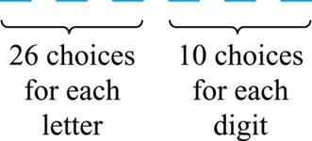
The Product Rule 乘积原则
Example: How many different license plates can be made if each plate contains a sequence of three uppercase English letters followed by three digits?
Solution: By the product rule,
there are 26 ∙ 26 ∙ 26 ∙ 10 ∙ 10 ∙ 10 = 17,576,000 different possible license plates.

Slide 7
Basic Counting Principles: The Sum Rule 求和原则
The Sum Rule: If a task can be done either in one of n₁ ways or in one of n₂, where none of the set of n₁ ways is the same as any of the n₂ ways, then there are n₁ + n₂ ways to do the task. Example: The mathematics department must choose either a student or a faculty member as a representative for a university committee. How many choices are there for this representative if there are 37 members of the mathematics faculty and 83 mathematics majors and no one is both a faculty member and a student. Solution: By the sum rule it follows that there are 37 + 83 = 120 possible ways to pick a representative.

Slide 8
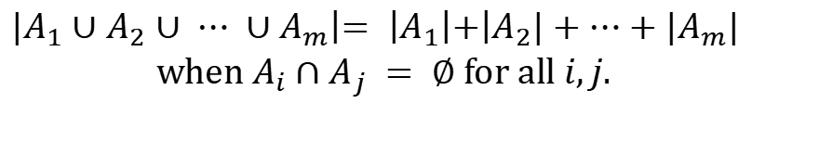
The Sum Rule in terms of sets.
The sum rule can be phrased in terms of sets.
|A ∪ B|= |A| + |B| as long as A and B are disjoint sets. Or more generally,
$$\begin{matrix}|A_{1}∪A_{2}∪ ⋯ ∪A_{m}\left|= \right|A_{1}\left|+\right|A_{2}|+⋯+|A_{m}| \\ \text{when} A_{i}∩A_{j} = ∅ \text{for} \text{all} i,j.\end{matrix}$$
The case where the sets have elements in common will be discussed when we consider the subtraction rule and taken up fully in Chapter 8.

Slide 9
Combining the Sum and Product Rule
Example: Suppose statement labels in a programming language can be either a single letter or a letter followed by a digit. Find the number of possible labels.
Solution: Use the product rule. 26 + 26 ∙ 10 = 286

Slide 10
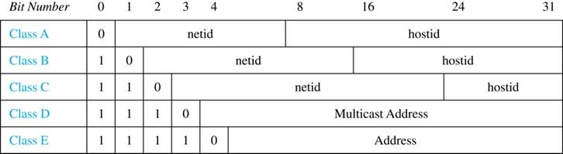
Internet Addresses
Version 4 of the Internet Protocol (IPv4) uses 32 bits.
Class A Addresses: used for the largest networks, a 0,followed by a 7-bit netid and a 24-bit hostid. Class B Addresses: used for the medium-sized networks, a 10,followed by a 14-bit netid and a 16-bit hostid. Class C Addresses: used for the smallest networks, a 110,followed by a 21-bit netid and a 8-bit hostid.
Neither Class D nor Class E addresses are assigned as the address of a computer on the internet. Only Classes A, B, and C are available.
1111111 is not available as the netid of a Class A network.
Hostids consisting of all 0s and all 1s are not available in any network.

Slide 11
Counting Internet Addresses
Example: How many different IPv4 addresses are available for computers on the internet? Solution: Use both the sum and the product rule. Let x be the number of available addresses, and let x_{A}, x_{B}, and x_{C} denote the number of addresses for the respective classes.
To find, x_{A}: 2⁷ − 1 = 127 netids. 2²⁴ − 2 = 16,777,214 hostids. x_{A} = 127∙ 16,777,214 = 2,130,706,178.
To find, x_{B}: 2¹⁴ = 16,384 netids. 2¹⁶ − 2 = 65,534 hostids. x_{B} = 16,384 ∙ 16, 534 = 1,073,709,056.
To find, x_{C}: 2²¹ = 2,097,152 netids. 2⁸ − 2 = 254 hostids. x_{C} = 2,097,152 ∙ 254 = 532,676,608.
Hence, the total number of available IPv4 addresses is x = x_{A} + x_{B} + xc = 2,130,706,178 + 1,073,709,056 + 532,676,608 = 3, 737,091,842.
Not Enough Today !! The newer IPv6 protocol solves the problem of too few addresses.

Slide 12
Basic Counting Principles: Subtraction Rule 减法原则
Subtraction Rule: If a task can be done either in one of n₁ ways or in one of n₂ ways, then the total number of ways to do the task is n₁ + n₂ minus the number of ways to do the task that are common to the two different ways.
Also known as, the principle of inclusion-exclusion:

Slide 13
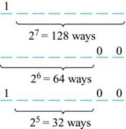
Counting Bit Strings
Example: How many bit strings of length eight either start with a 1 bit or end with the two bits 00?
Solution: Use the subtraction rule.
Number of bit strings of length eight that start with a 1 bit: 2⁷ = 128
Number of bit strings of length eight that end with bits 00: 2⁶ = 64
Number of bit strings of length eight that start with a 1 bit and end with bits 00 : 2⁵ = 32
Hence, the number is 128 + 64 − 32 = 160.

Slide 14
Basic Counting Principles Division Rule 除法原则
Division Rule: There are n/d ways to do a task if it can be done using a procedure that can be carried out in n ways, and for every way w, exactly d of the n ways correspond to way w. Restated in terms of sets: If the finite set A is the union of n pairwise disjoint subsets each with d elements, then n = |A|/d. In terms of functions: If f is a function from A to B, where both are finite sets, and for every value y ∈ B there are exactly d values x ∈ A such that f(x) = y, then |B| = |A|/d.
Example: How many ways are there to seat four people around a circular table, where two seatings are considered the same when each person has the same left and right neighbor?
Solution: Number the seats around the table from 1 to 4 proceeding clockwise. There are four ways to select the person for seat 1, 3 for seat 2, 2, for seat 3, and one way for seat 4. Thus there are 4! = 24 ways to order the four people. But since two seatings are the same when each person has the same left and right neighbor, for every choice for seat 1, we get the same seating. Therefore, by the division rule, there are 24/4 = 6 different seating arrangements.

Slide 15
The Pigeonhole Principle
Section 6.2

Slide 16
Section Summary 2
The Pigeonhole Principle
The Generalized Pigeonhole Principle

Slide 17
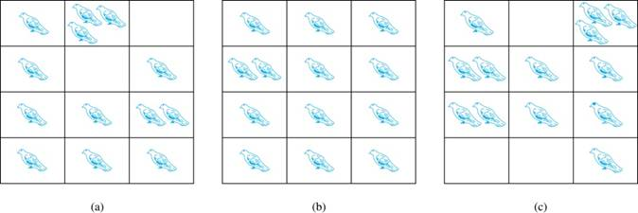
The Pigeonhole Principle 鸽巢原理
If a flock of 20 pigeons roosts in a set of 19 pigeonholes, one of the pigeonholes must have more than 1 pigeon.
Pigeonhole Principle: If k is a positive integer and k + 1 objects are placed into k boxes, then at least one box contains two or more objects. Proof: We use a proof by contraposition. Suppose none of the k boxes has more than one object. Then the total number of objects would be at most k. This contradicts the statement that we have k + 1 objects.

Slide 18
The Pigeonhole Principle 鸽巢原理
Example: Among any group of 367 people, there must be at least two with the same birthday, because there are only 366 possible birthdays.

Slide 19
The Generalized Pigeonhole Principle 1
The Generalized Pigeonhole Principle (广义鸽巢原理) : If N objects are placed into k boxes, then there is at least one box containing at least ⌈N/k⌉ objects. Proof: We use a proof by contraposition. Suppose that none of the boxes contains more than ⌈N/k⌉ − 1 objects. Then the total number of objects is at most
where the inequality ⌈N/k⌉ < ⌈N/k⌉ + 1 has been used. This is a contradiction because there are a total of N objects.
Example: Among 100 people there are at least ⌈100/12⌉ = 9 who were born in the same month.

Slide 20
The Generalized Pigeonhole Principle 2
Example: How many cards must be selected from a standard deck of 52 cards to guarantee that at least three cards of the same suit (花色) are chosen? Solution: We assume four boxes; one for each suit. Using the generalized pigeonhole principle, at least one box contains at least ⌈N/4⌉ cards. At least three cards of one suit are selected if ⌈N/4⌉ ≥3. The smallest integer N such that ⌈N/4⌉ ≥3 is
N = 2 ∙ 4 + 1 = 9.

Slide 21
Permutations and Combinations
Section 6.3

Slide 22
Section Summary 3
Permutations
Combinations
Combinatorial Proofs

Slide 23
Permutations 排列
Definition: A permutation of a set of distinct objects is an ordered arrangement of these objects. An ordered arrangement of r elements of a set is called an r-permutation.
Example: Let S = {1,2,3}.
The ordered arrangement 3,1,2 is a permutation of S.
The ordered arrangement 3,2 is a 2-permutation of S.
The number of r-permutations of a set with n elements is denoted by P(n,r).
The 2-permutations of S = {1,2,3} are 1,2; 1,3; 2,1; 2,3; 3,1; and 3,2. Hence, P(3,2) = 6.

Slide 24
A Formula for the Number of Permutations
Theorem 1: If n is a positive integer and r is an integer with 1 ≤ r ≤ n, then there are
P(n, r) = n(n − 1)(n − 2) ∙∙∙ (n − r + 1)
r-permutations of a set with n distinct elements. Proof: Use the product rule. The first element can be chosen in n ways. The second in n − 1 ways, and so on until there are (n − ( r − 1)) ways to choose the last element. Note that P(n,0) = 1, since there is only one way to order zero elements. Corollary 1: If n and r are integers with 1 ≤ r ≤ n, then

Slide 25
Solving Counting Problems by Counting Permutations
Example: How many ways are there to select a first-prize winner, a second prize winner, and a third-prize winner from 100 different people who have entered a contest?
Solution:
P(100,3) = 100 ∙ 99 ∙ 98 = 970,200

Slide 26
Solving Counting Problems by Counting Permutations
Example: How many permutations of the letters ABCDEFGH contain the string ABC ?
Solution: We solve this problem by counting the permutations of six objects, ABC, D, E, F, G, and H.
6! = 6 ∙ 5 ∙ 4 ∙ 3 ∙ 2 ∙ 1 = 720

Slide 27
Combinations 组合
Definition: An r-combination of elements of a set is an unordered selection of r elements from the set. Thus, an r-combination is simply a subset of the set with r elements. The number of r-combinations of a set with n distinct elements is denoted by C(n, r). The notation is also used
and is called a binomial coefficient (二项式系数).
Example: Let S be the set {a, b, c, d}. Then {a, c, d} is a 3-combination from S. It is the same as {d, c, a} since the order listed does not matter. C(4,2) = 6 because the 2-combinations of {a, b, c, d} are the six subsets {a, b}, {a, c}, {a, d}, {b, c}, {b, d}, and {c, d}.

Slide 28
Combinations 组合
Theorem 2: The number of r-combinations of a set with n elements, where n ≥ r ≥ 0, equals
Proof: By the product rule P(n, r) = C(n,r) ∙ P(r,r). Therefore

Slide 29
Combinations 组合
Corollary 2: Let n and r be nonnegative integers with r ≤ n. Then C(n, r) = C(n, n − r). Proof: From Theorem 2, it follows that
Hence, C(n, r) = C(n, n − r).

Slide 30
Combinations 组合
Example: How many ways are there to select 47 cards from a deck of 52 cards?
Solution: Since the order in which the cards are dealt does not matter, the different ways to select 47 cards from 52 is

Slide 31
Combinations 组合
Example: How many ways are there to select five players from a 10-member tennis team to make a trip to a match at another school.
Solution: By Theorem 2, the number of combinations is
Example: A group of 30 people have been trained as astronauts to go on the first mission to Mars. How many ways are there to select a crew of six people to go on this mission?
Solution: By Theorem 2, the number of possible crews is

Slide 32
Binomial Coefficients and Identities
Section 6.4

Slide 33
Section Summary 4
The Binomial Theorem
Pascal’s Identity and Triangle

Slide 34
Powers of Binomial Expressions 二项式的幂
Definition: A binomial expression is the sum of two terms, such as x + y. (More generally, these terms can be products of constants and variables.)
We can use counting principles to find the coefficients in the expansion of (x + y)^{n}.
To illustrate this idea, we first look at the process of expanding (x + y)³.
(x + y) (x + y) (x + y) expands into a sum of terms that are the product of a term from each of the three sums.
Terms of the form x³, x²y, x y², y³ arise. The coefficients are as follows.
To obtain x³ , an x must be chosen from each of the sums. There is only one way to do this. So, the coefficient of x³ is 1.
To obtain x²y, an x must be chosen from two of the sums and a y from the other. There are
ways to do this and so the coefficient of x²y is 3.
To obtain xy², an x must be chosen from of the sums and a y from the other two . There
are ways to do this and so the coefficient of xy² is 3.
To obtain y³ , a y must be chosen from each of the sums. There is only one way to do this. So, the coefficient of y³ is 1.
We have used a counting argument to show that (x + y)³ = x³ + 3x²y + 3x y² + y³ .
Next we present the binomial theorem gives the coefficients of the terms in the expansion of (x + y)^{n} .

Slide 35
Binomial Theorem 二项式定理
Binomial Theorem (二项式定理): Let x and y be variables, and n a nonnegative integer. Then:
Proof: We use combinatorial reasoning . The terms in the expansion of (x + y)^{n} are of the form x^{n−j}y^{j} for j = 0,1,2,…,n. To form the term x^{n−j}y^{j}, it is necessary to choose n−j x’s from the n sums. Therefore, the coefficient of x^{n−j}y^{j} is
which equals

Slide 36
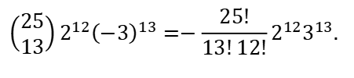
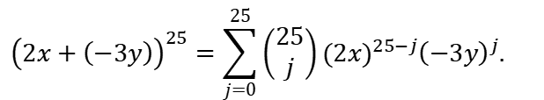
Using the Binomial Theorem
Example: What is the coefficient of x¹²y¹³ in the expansion of (2x − 3y)²⁵?
Solution: We view the expression as (2x +(−3y))²⁵. By the binomial theorem
$${\left(2x+\left(−3y\right)\right)}^{25}=\sum_{j=0}^{25}{\left(\begin{matrix}25 \\ j\end{matrix}\right)}(2{x)}^{25−j}{\left(−3y\right)}^{j}.$$
Consequently, the coefficient of x¹²y¹³ in the expansion is obtained when j = 13.
$$\left(\begin{matrix}25 \\ 13\end{matrix}\right)2^{12}{\left(−3\right)}^{13}=−\frac{25!}{13!12!}2^{12}3^{13}.$$

Slide 37
A Useful Identity
Corollary 1: With n ≥0,
Proof (using binomial theorem): With x = 1 and y = 1, from the binomial theorem we see that:
Proof (combinatorial): Consider the subsets of a set with n elements. There are
subsets with zero elements,
with one element,
with two elements, …, and
with n elements. Therefore the total is
Since, we know that a set with n elements has 2^{n} subsets, we conclude:

Slide 38
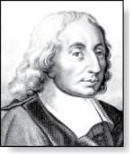
Pascal’s Identity 帕斯卡恒等式
Pascal’s Identity: If n and k are integers with n ≥ k ≥ 0, then
Blaise Pascal
(1623-1662)
Proof (combinatorial): Let T be a set where |T|= n + 1, a ∊T, and S = T − {a}. There are
subsets of T containing k elements.
Each of these subsets either:
contains a with k − 1 other elements, or
contains k elements of S and not a.
There are
subsets of k elements that contain a, since there are
subsets of k − 1 elements of S,
subsets of k elements of T that do not contain a, because there are
subsets of k elements of S.
See Exercise 19 for an algebraic proof.
Hence,

Slide 39
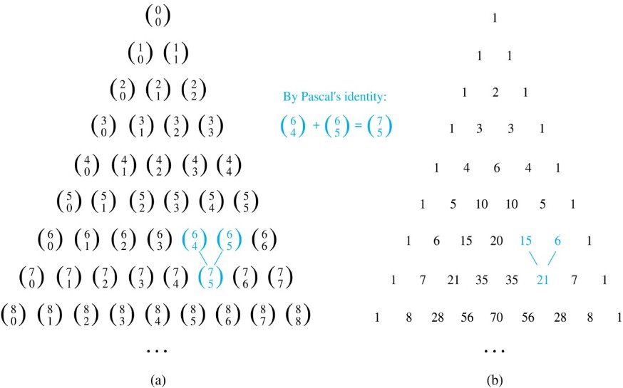
Pascal’s Triangle 帕斯卡三角形
The nth row in the triangle consists of the binomial coefficients
k = 0,1,….,n.
By Pascal’s identity, adding two adjacent binomial coefficients results is the binomial coefficient in the next row between these two coefficients.

Slide 40
Generalized Permutations and Combinations
Section 6.5

Slide 41
Section Summary 5
Permutations with Repetition
Combinations with Repetition
Permutations with Indistinguishable Objects
Distributing Objects into Boxes

Slide 42
Permutations with Repetition 有重复的排列
Theorem 1: The number of r-permutations of a set of n objects with repetition allowed is n^{r}.
Proof: There are n ways to select an element of the set for each of the r positions in the r-permutation when repetition is allowed. Hence, by the product rule there are n^{r} r-permutations with repetition.
Example: How many strings of length r can be formed from the uppercase letters of the English alphabet?
Solution: The number of such strings is 26^{r}, which is the number of r-permutations of a set with 26 elements.

Slide 43
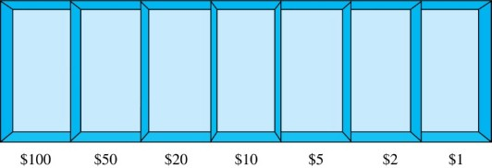
Combinations with Repetition 有重复的组合
Example: How many ways are there to select five bills (纸币) from a box containing at least five of each of the following denominations (面额): $1, $2, $5, $10, $20, $50, and $100?
Solution: Place the selected bills in the appropriate position of a cash box illustrated below:

Slide 44
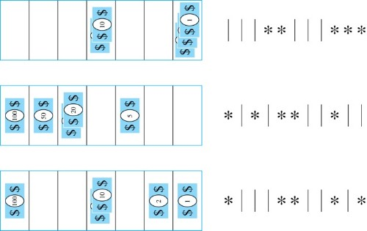
Combinations with Repetition 有重复的组合
Some possible ways of placing the five bills:
The number of ways to select five bills corresponds to the number of ways to arrange six bars (隔板) and five stars in a row.
This is the number of unordered selections of 5 objects from a set of 11. Hence, there are
ways to choose five bills with seven types of bills.

Slide 45

Combinations with Repetition 有重复的组合
Theorem 2: The number of r-combinations from a set with n elements when repetition of elements is allowed is
$$C\left(n+r–1,r\right)=C\left(n+r–1, n–1\right).$$
Proof: Each r-combination of a set with n elements with repetition allowed can be represented by a list of n –1 bars and r stars. The bars mark the n cells containing a star for each time the ith element of the set occurs in the combination.
The number of such lists is C(n + r – 1, r), because each list is a choice of the r positions to place the stars, from the total of n + r – 1 positions to place the stars and the bars. This is also equal to C(n + r – 1, n –1), which is the number of ways to place the n –1 bars.

Slide 46

Combinations with Repetition 有重复的组合
Example: Suppose that a cookie (饼干) shop has four different kinds of cookies. How many different ways can six cookies be chosen?
Solution: The number of ways to choose six cookies is the number of 6-combinations of a set with four elements. By Theorem 2
is the number of ways to choose six cookies from the four kinds.

Slide 47
Summarizing the Formulas for Counting Permutations and Combinations with and without Repetition
TABLE 1 Combinations and Permutations With and Without Repetition.
Type | Repetition Allowed? | Formula
r-permutations r-combinations r-permutations r-combinations | No No Yes Yes

Slide 48

Permutations with Indistinguishable Objects 具有不可区别对象的排列
Example: How many different strings can be made by reordering the letters of the word SUCCESS.
Solution: There are seven possible positions for the three Ss, two Cs, one U, and one E.
The three Ss can be placed in C(7,3) different ways, leaving four positions free.
The two Cs can be placed in C(4,2) different ways, leaving two positions free.
The U can be placed in C(2,1) different ways, leaving one position free.
The E can be placed in C(1,1) way.
By the product rule, the number of different strings is:
$$C\left(7,3\right)C\left(4,2\right)C\left(2,1\right)C\left(1,1\right)=\frac{7!}{3!4!}⋅\frac{4!}{2!2!}⋅\frac{2!}{1!1!}⋅\frac{1!}{1!0!}=420.$$

Slide 49
Permutations with Indistinguishable Objects 具有不可区别对象的排列
Theorem 3: The number of different permutations of n objects, where there are n₁ indistinguishable objects of type 1, n₂ indistinguishable objects of type 2, …., and n_{k} indistinguishable objects of type k, is:
Proof: By the product rule the total number of permutations is:
C(n, n₁ ) C(n − n₁, n₂ ) ∙∙∙ C(n − n₁ − n₂ − ∙∙∙ − n_{k-1}, n_{k}) since:
The n₁ objects of type one can be placed in the n positions in C(n, n₁ ) ways, leaving n − n₁ positions.
Then the n₂ objects of type two can be placed in the n − n₁ positions in C(n − n₁, n₂ ) ways, leaving n − n₁ − n₂ positions.
Continue in this fashion, until n_{k} objects of type k are placed in C(n − n₁ − n₂ − ∙∙∙ − n_{k-1}, n_{k}) ways.
The product can be manipulated into the desired result as follows:

Slide 50
Distributing Objects into Boxes 1
Many counting problems can be solved by counting the ways objects can be placed in boxes.
The objects may be either different from each other (distinguishable 可区分的) or identical (indistinguishable 不可区分的).
The boxes may be labeled (distinguishable) or unlabeled (indistinguishable).

Slide 51
Distributing Objects into Boxes 2
Distinguishable objects and distinguishable boxes.
There are n!/(n₁!n₂! ∙∙∙n_{k}!) ways to distribute n distinguishable objects into k distinguishable boxes.
(See Exercises 47 and 48 for two different proofs.)
Example: There are 52!/(5!5!5!5!32!) ways to distribute hands of 5 cards each to four players.

Slide 52
Distributing Objects into Boxes 2
Indistinguishable objects and distinguishable boxes.
There are C(n + r − 1, n − 1) ways to place r indistinguishable objects into n distinguishable boxes.
Proof based on one-to-one correspondence between r-combinations from a set with n-elements when repetition is allowed and the ways to place r indistinguishable objects into n distinguishable boxes.
Example: There are C(8 + 10 − 1, 10) = C(17,10) = 19,448 ways to place 10 indistinguishable objects into 8 distinguishable boxes.

Slide 53
Distributing Objects into Boxes 3
Distinguishable objects and indistinguishable boxes.
Example: There are 14 ways to put four employees into three indistinguishable offices (see Example 10).
There is no simple closed formula for the number of ways to distribute n distinguishable objects into j indistinguishable boxes.
See the text for a formula involving Stirling numbers of the second kind.

Slide 54
Distributing Objects into Boxes 3
Indistinguishable objects and indistinguishable boxes.
Example: There are 9 ways to pack six copies of the same book into four identical boxes (see Example 11).
The number of ways of distributing n indistinguishable objects into k indistinguishable boxes equals p_{k}(n), the number of ways to write n as the sum of at most k positive integers in increasing order.
No simple closed formula exists for this number.

Slide 55
Homework
§6.1 26, 50 §6.2 18, 25, 48 §6.3 12, 22
§6.4 24, 28, 29
Due date : 2024.4.23

